Slide 1
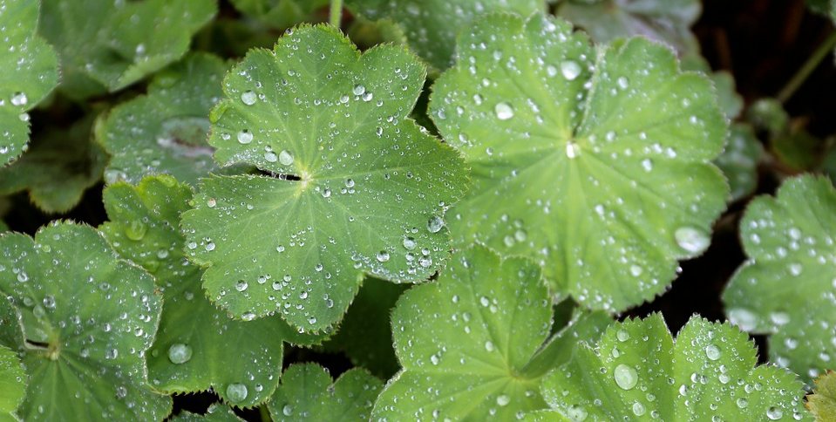




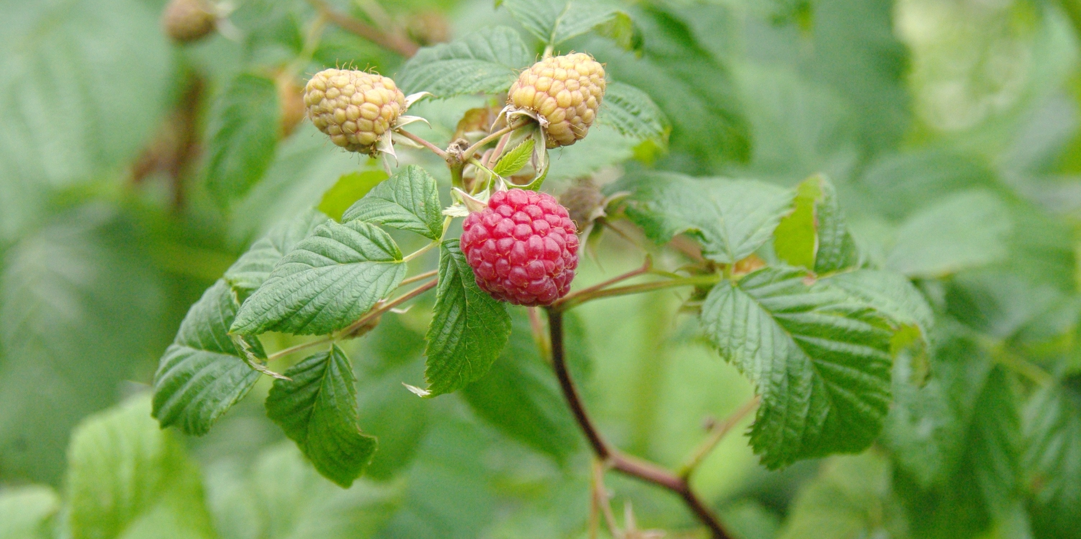

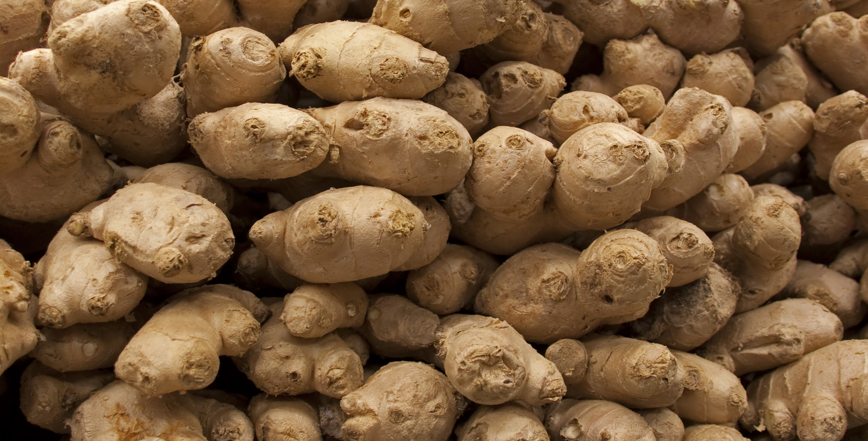

Treatments depend on various plant compounds and mechanisms of action.
143 surveys and 13 interviews (n=156)
Literature research
Important motivations:
Availability
Familiarity
Experienced benefits
At least 87 plant taxa used and advised to treat dysmenorrhea.
Insight in women’s medical choices = high quality healthcare.

