Slide 1
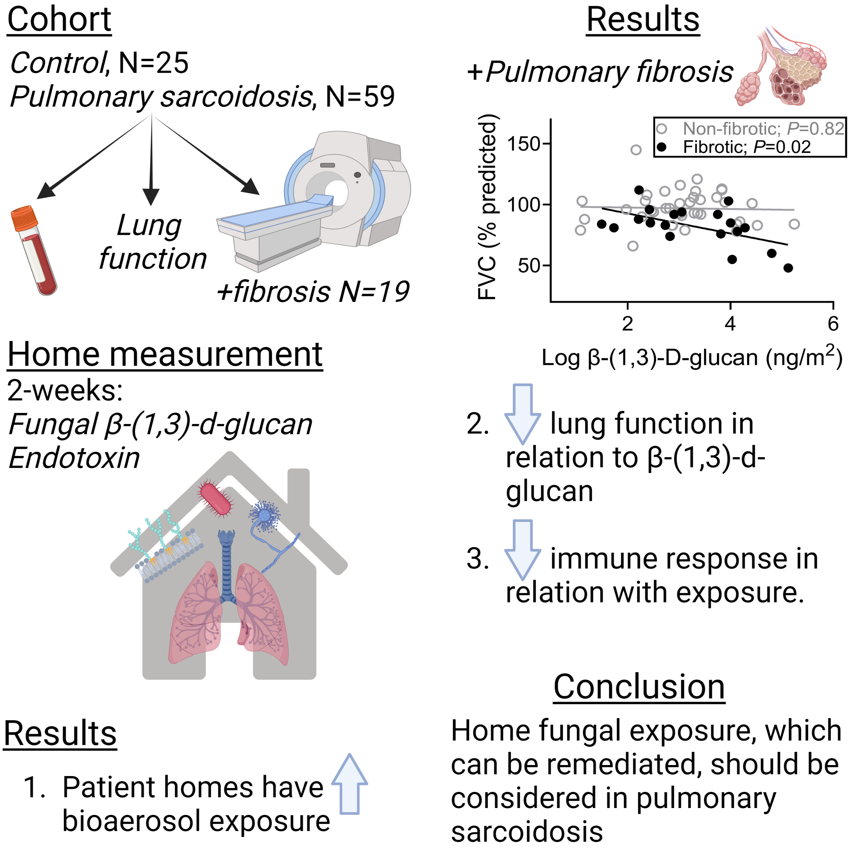
Is residential exposure to bioaerosol related to pulmonary sarcoidosis outcomes?

