Slide 1
Supplemental Figure S1
A
B
TITIN/Hoechst
DESMIN/MYOG/Hoechst
OCT4
GSDIII^{Patient2}
NANOG
DESMIN
MYOD
Gene expression
relative to hiPSCs
MYOG
DP427M
GSDIII^{Patient2}
OCT4
GSDIII^{Patient3}
NANOG
DESMIN
MYOD
Gene expression
relative to hiPSCs
MYOG
DP427M
GSDIII^{Patient3}
OCT4
GSDIII^{Patient4}
NANOG
DESMIN
MYOD
Gene expression
relative to hiPSCs
MYOG
DP427M
GSDIII^{Patient4}
50 µm
Supplemental Figure S1. Skeletal myogenic differentiation of GSDIII^{Patient2}, GSDIII^{Patient3} and GSDIII^{Patient4} skMt. (A) mRNA levels of pluripotency markers (OCT4, NANOG) and myogenic markers (DESMIN, MYOD, MYOG, DP427M) measured by qPCR in triplicate at day 0 (hiPSCs), day 10 (myogenic precursor), day 17 (skMb) and day 25 (skMt) of differentiation of GSDIII^{Patient2}, GSDIII^{Patient3} and GSDIII^{Patient4} cell lines. mRNA levels are normalised to hiPSCs at day 0. Immortalised myotubes are used as a control of the gene expression profile of terminated differentiation. (B) TITIN (green), DESMIN (green) and MYOG (red) staining by immunofluorescence in GSDIII^{Patient2}, GSDIII^{Patient3} and GSDIII^{Patient4} skMt. Nuclei are labelled by Hoechst staining (blue). Scale bar = 50 µm.
Notes:
Control 1 :PCI
Control 2: iCas9
Control 3: i90
GSDP1:576
GSDP2:3390
GSDP3:0303
GSDP4:2523

Slide 2
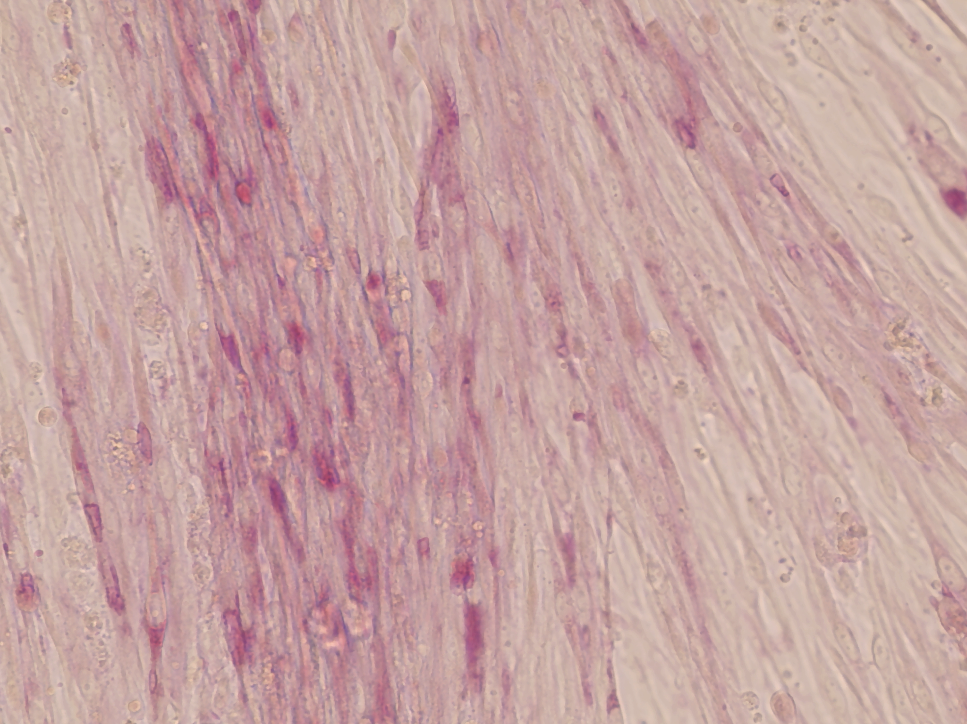
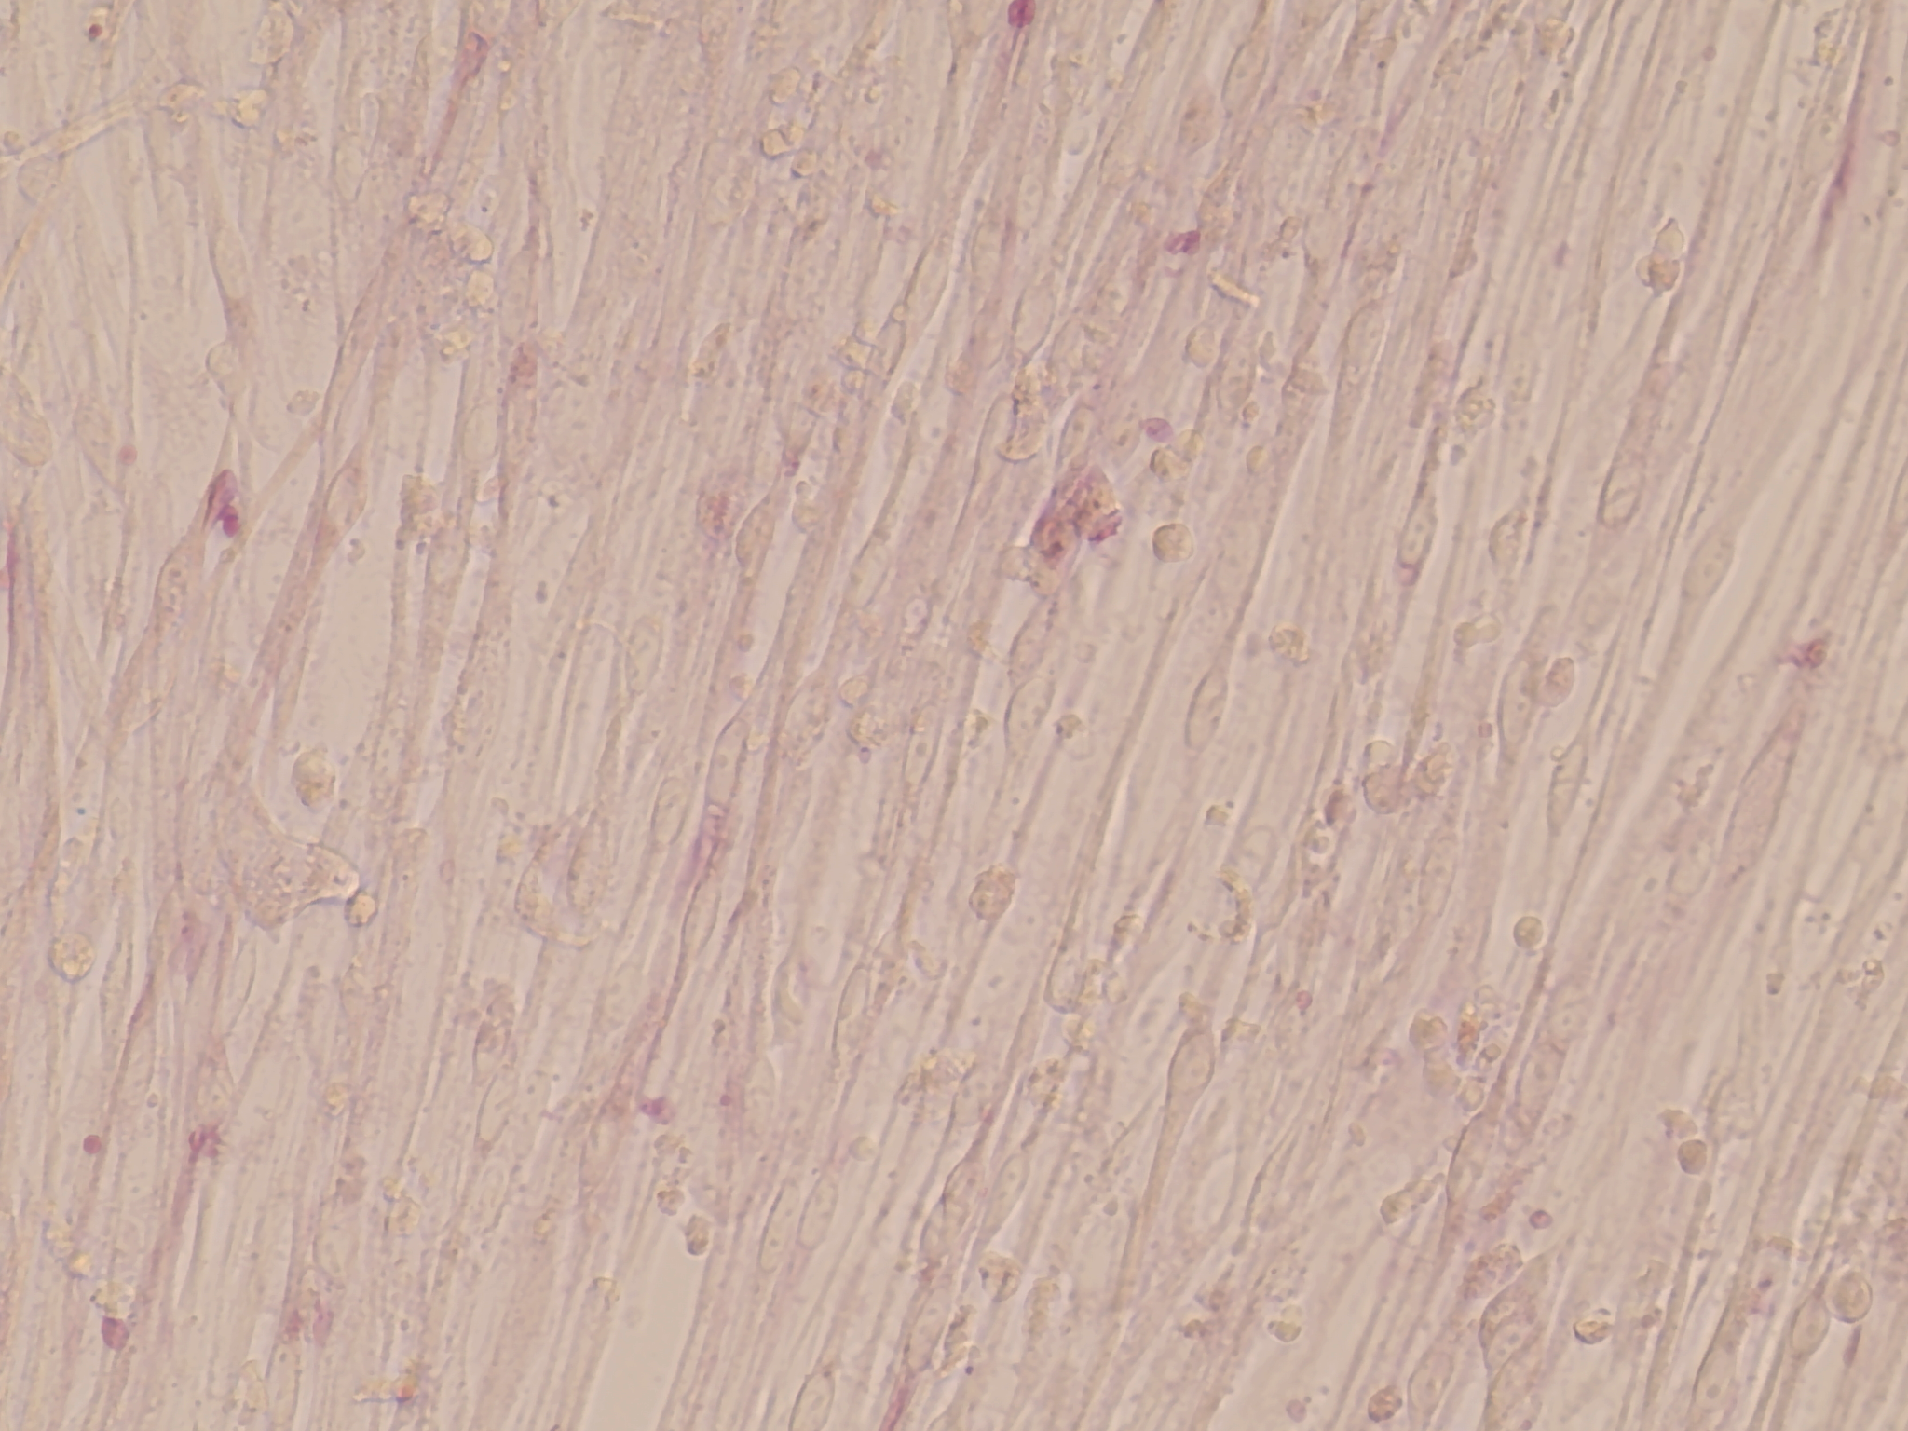
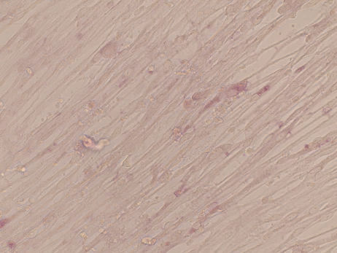
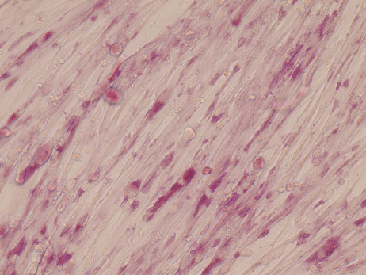
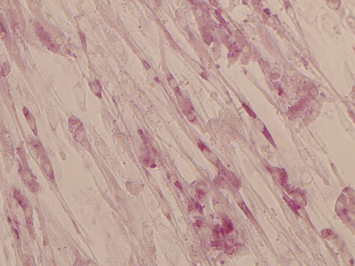
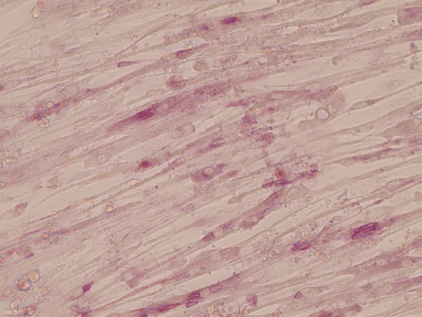
Supplemental Figure S2
D0
D2,5
D5
CTRL1
GSDIII^{Patient1}
100 μm
Supplemental Figure S2. Glycogen consumption along starvation time in GSDIII^{Patient1} and CRTL1 skMt. Periodic acid Sciff staining performed at day 0 (D0), day 2,5 (D2,5) and day 5 (D5) of starvation time in GSDIII^{Patient1} and CRTL1 skMt. Scale bar = 100 µm.
Notes:
Control 1 :PCI
Control 2: iCas9
Control 3: i90
GSDP1:576
GSDP2:3390
GSDP3:0303
GSDP4:2523

Slide 3
Supplemental Figure S3
A
CTRLs
GSDIII^{Patients}
B
CTRLs
GSDIII^{Patients}
Gene expression relative to the mean of CTRLs
Gene expression relative to the mean of CTRLs
Supplemental Figure S3. Validation of the most dysregulated genes in bulk RNAseq analysis of GSDIII^{Patient} vs CTRL starved skMt. (A) Gene expression of the 4 most up-regulated genes by qPCR. (B) Gene expression of the 4 most down-regulated genes by qPCR. (A,B) Data are normalised to the mean of CTRLs and are represented as mean ± standard deviation. Statistical analyses were performed using multiple unpaired t-test. p < 0,0001 : ****, p < 0,001 : ***, p < 0,01 : **, p < 0,05 : *. n=3 in CTRLs (3 distinct cell lines) and n=4 in GSDIII^{Patients} (4 distinct cell lines).
Notes:
Control 1 :PCI
Control 2: iCas9
Control 3: i90
GSDP1:576
GSDP2:3390
GSDP3:0303
GSDP4:2523

Slide 4
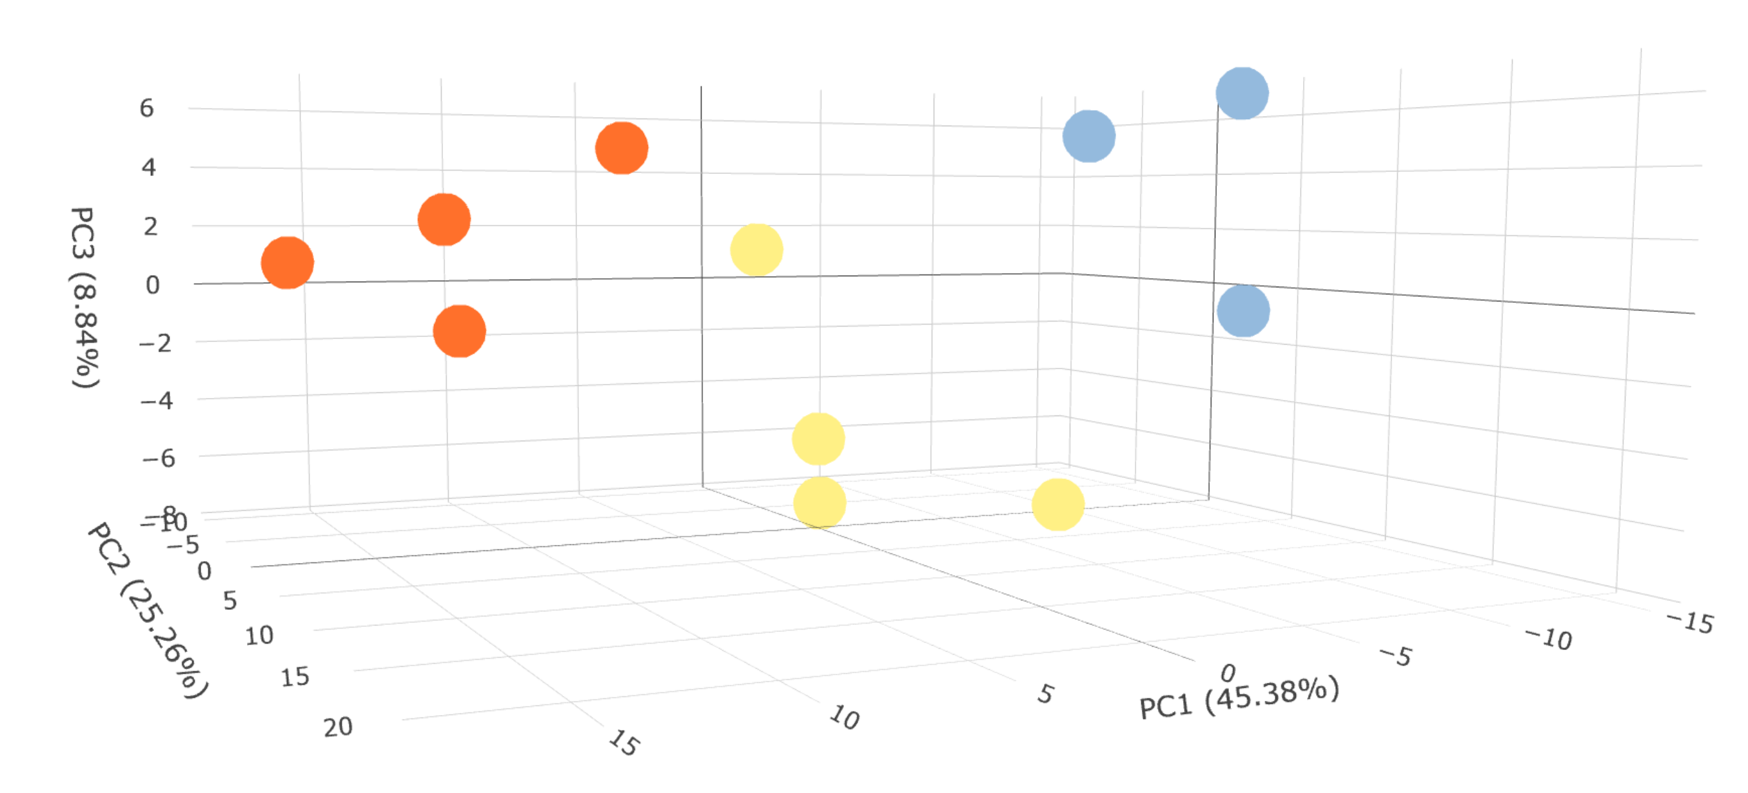
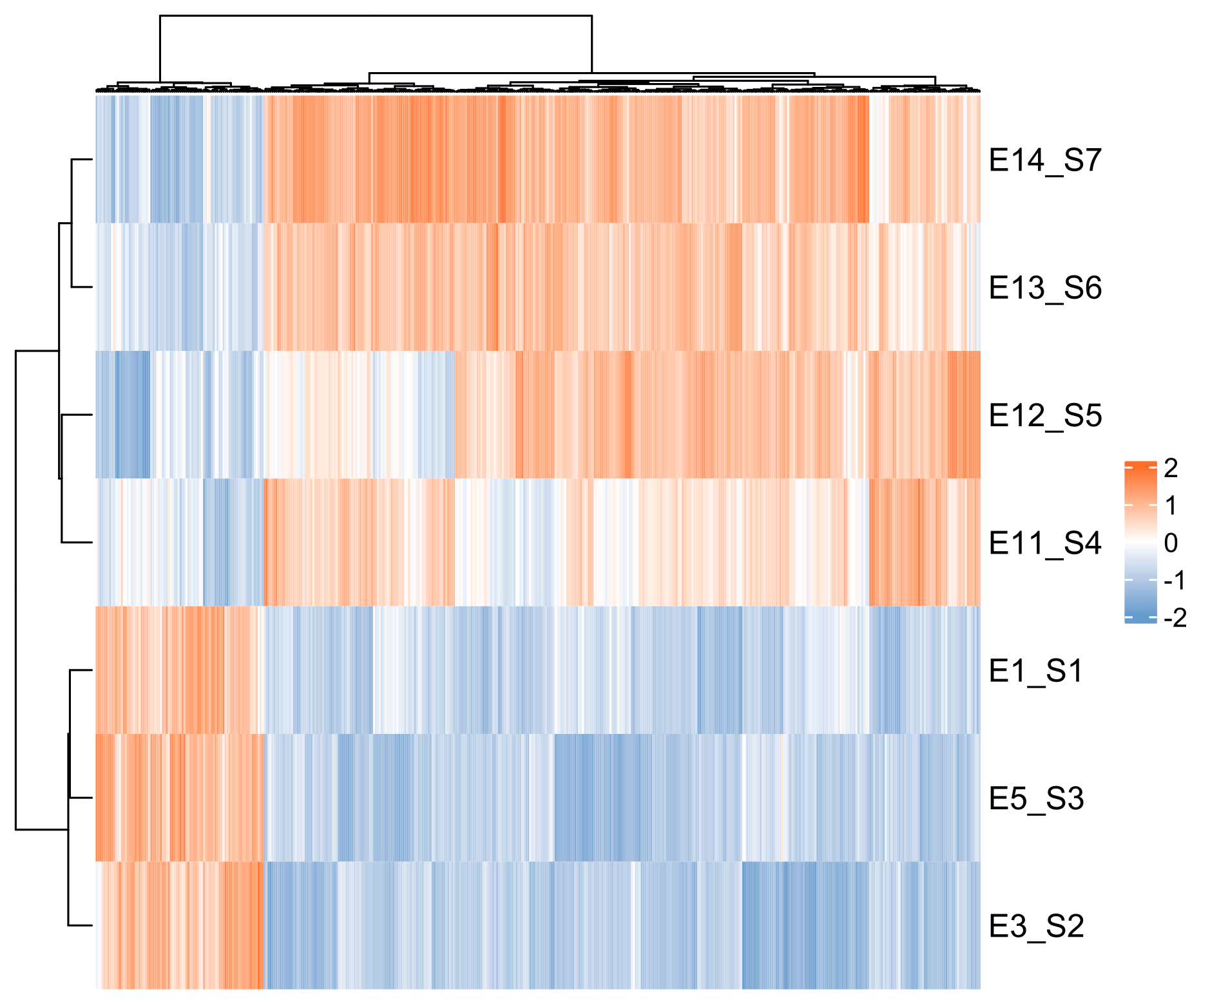
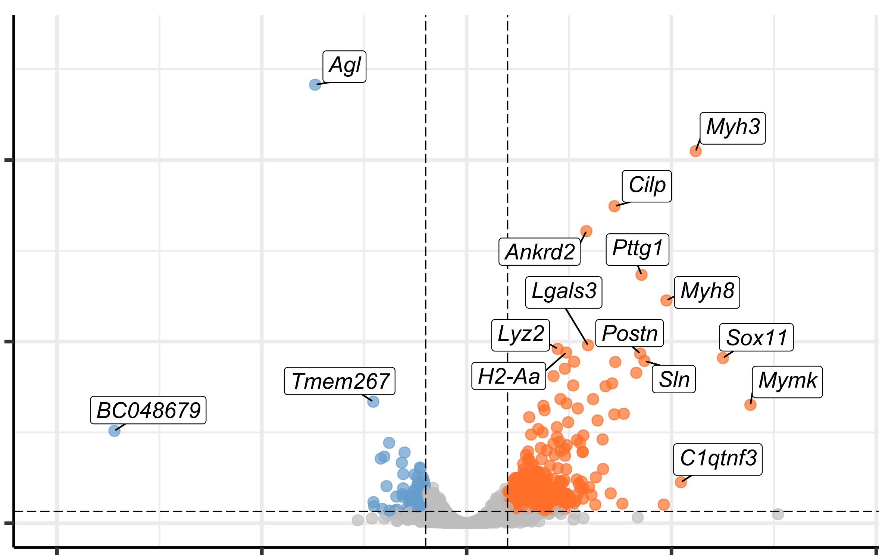
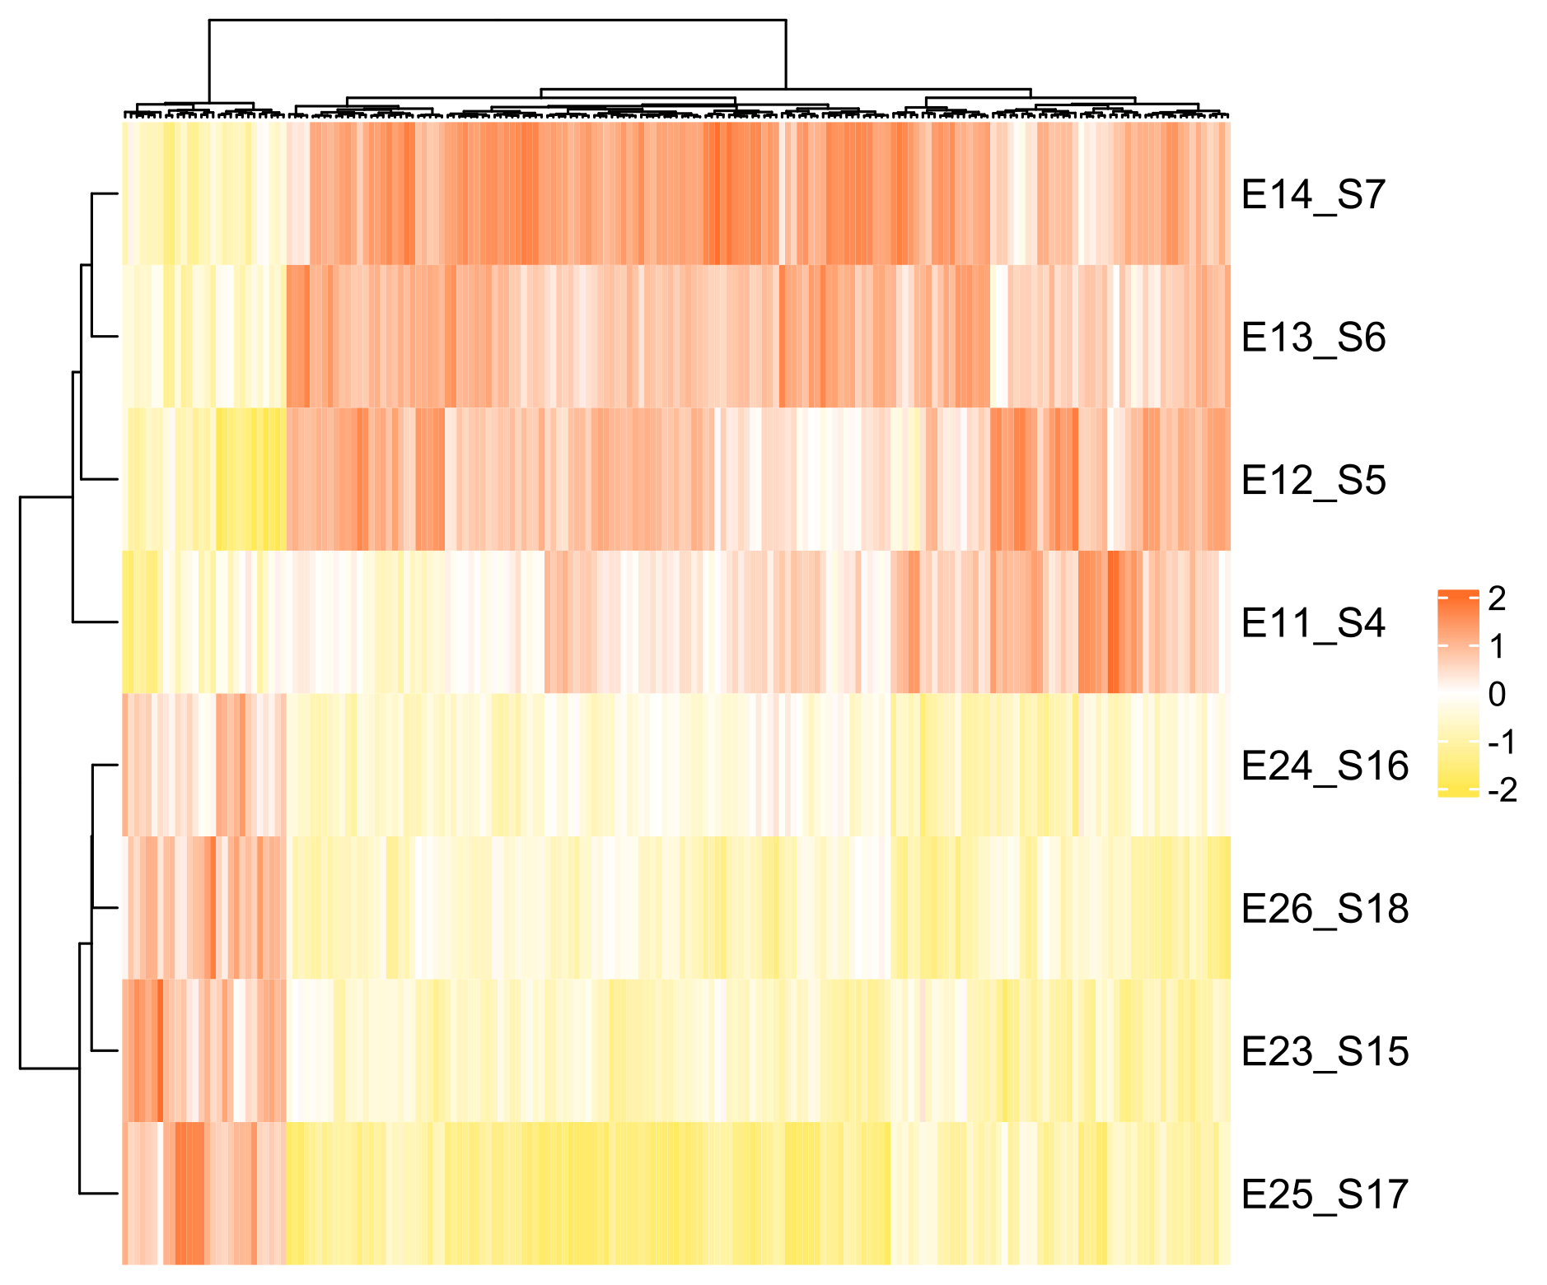
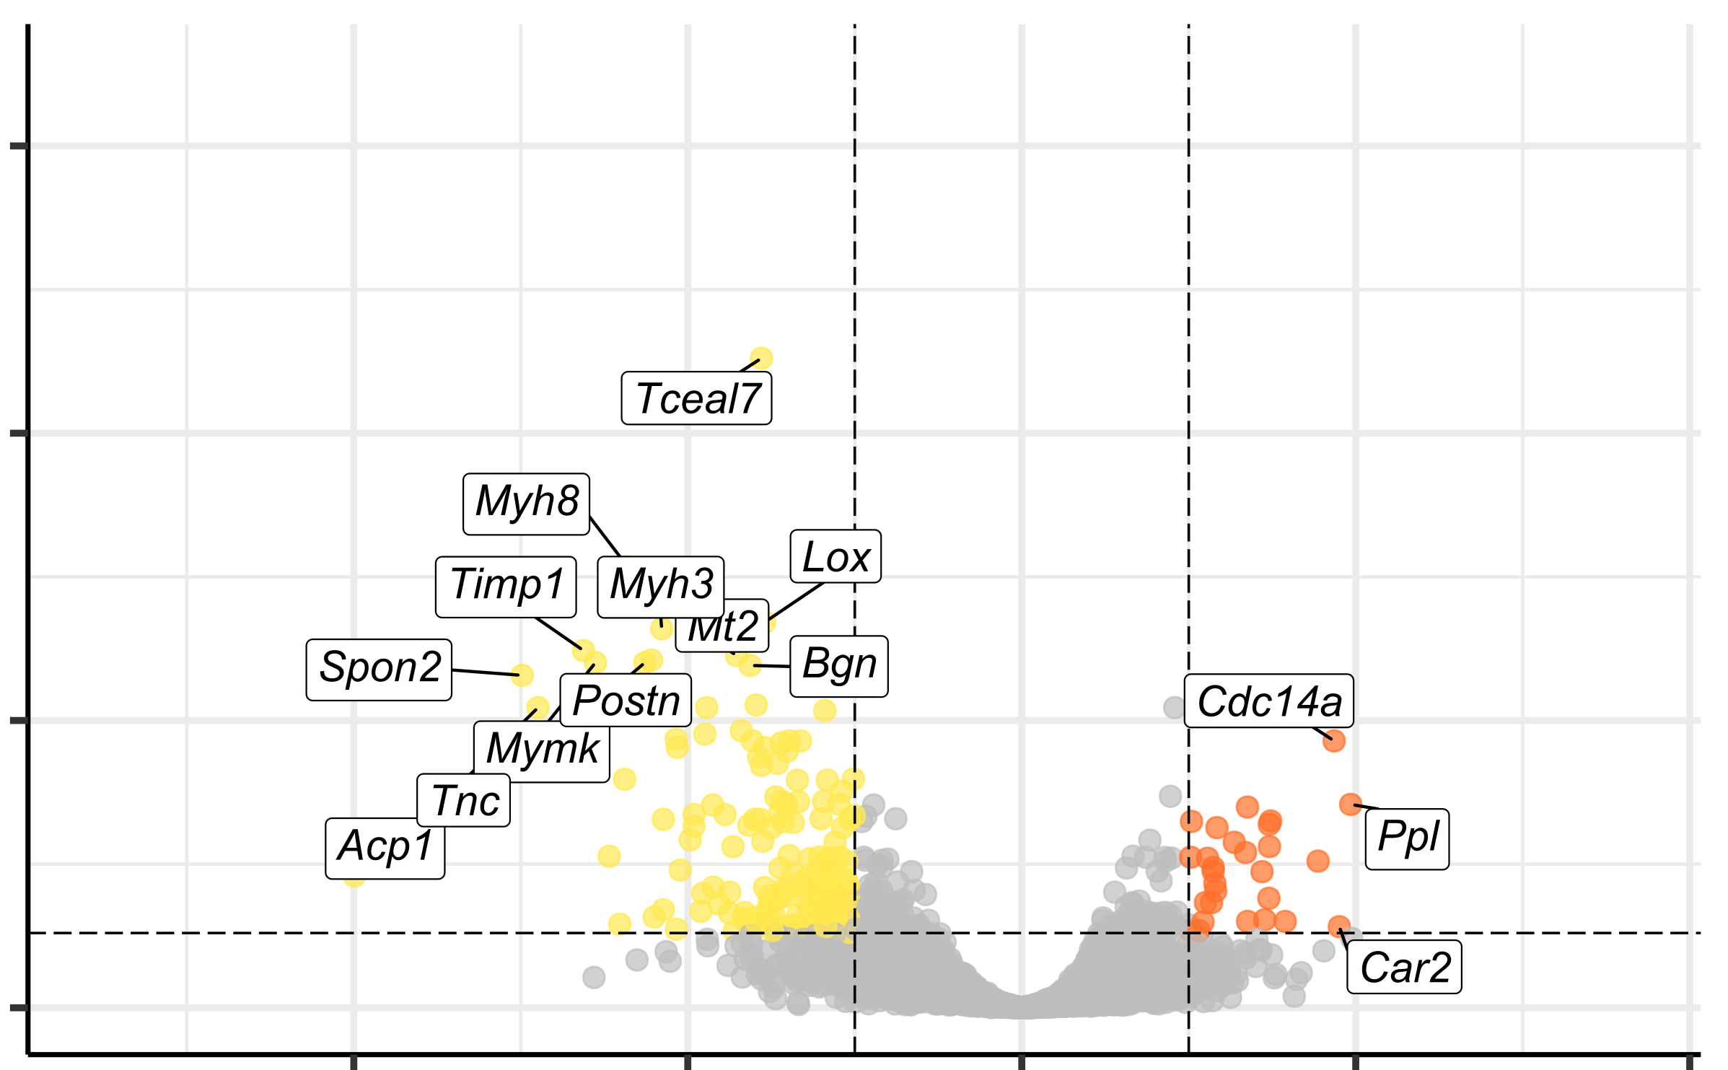
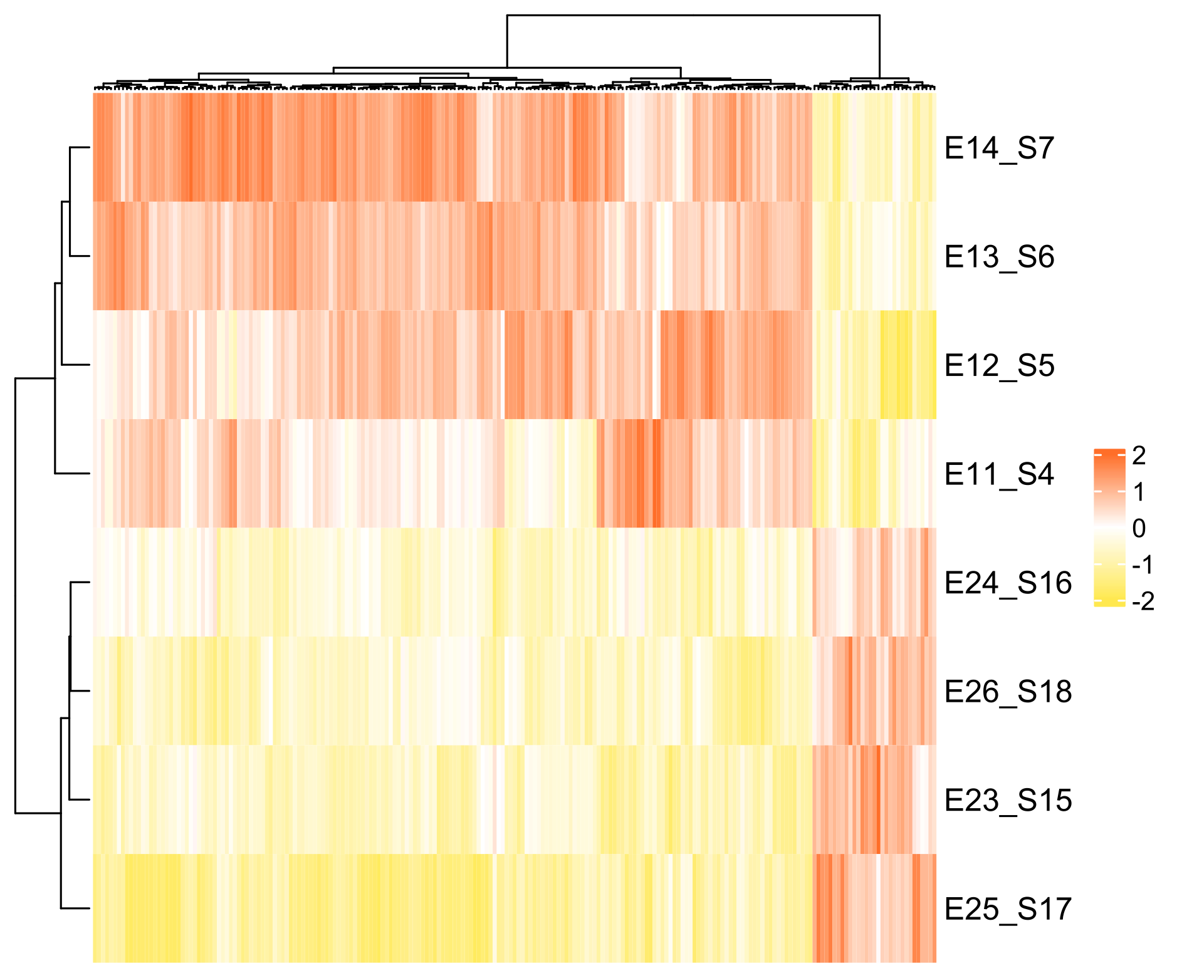
Supplemental Figure S4
A
6
4
Agl^{+/+}
2
PC3 (8,84%)
0
Agl^{-/-}
-2
-4
-6
Agl^{-/-} treated
-10
-5
0
5
-10
-15
10
PC2 (25,26%)
0
-5
15
10
5
B
20
15
PC1 (45,38%)
D
Down-regulated
Non significant
Up-regulated
Mouse:
87 genes
367 genes
Human:
372 genes
94 genes
Agl^{-/-}
40
-Log₁₀P
Agl^{+/+}
20
Agl^{-/-} treated vs Agl^{-/-}
0
-10
-5
0
5
10
Z score:
-2
-1
0
1
2
Log₂ fold change
C
E
Down-regulated
Non significant
Up-regulated
Mouse:
161 genes
28 genes
Human:
161 genes
29 genes
20
Agl^{-/-}
15
-Log₁₀P
Agl^{-/-}
treated
5
0
4
2
0
2
4
Z score:
-2
-1
0
1
2
Log₂ fold change
Supplemental Figure S4. Bulk RNAseq analysis of Agl^{-/-} vs Agl^{+/+} and Agl^{-/-} treated vs Agl^{-/-} mouse triceps biopsies. (A) Principal Component Analysis (PCA) representing the variability of the 3 conditions. n=3 Agl^{+/+} mice, n=4 Agl^{-/-} mice, n=4 Agl^{-/-} treated mice. (B,C) Heatmap representation of HCA showing clustering of detailed conditions based on DEGs of Agl^{-/-} vs Agl^{+/+} and Agl^{-/-} treated vs Agl^{-/-} respectively. (D,E) Volcano plot representation of down (blue, yellow) and up (orange) DEGs of Agl^{-/-} vs Agl^{+/+} and Agl^{-/-} treated vs Agl^{-/-} respectively. The number of DEGs corresponding to mouse gene list or human corresponding gene list are mentioned for both comparisons. Corrected p-value < 0,05. |fold change| > 2.

Slide 5
Supplemental Figure S5
A
HUMAN skMt
CTRL1
CTRL2
CTRL3
GSDIII
^{Patient1}
GSDIII
^{Patient2}
GSDIII
^{Patient3}
GSDIII
^{Patient4}
HSP60
GAL3
B
Agl^{+/+}
MOUSE TRICEPS
Agl^{-/-}
Agl^{-/-} treated
VINCULIN
GAL3
C
Healthy
HUMAN MUSCLE
GSDIII
HSP60
GAL3

Slide 6
Supplemental Figure S5. LGALS3 up regulation confirmed at the protein level (GAL3) in human skMt, mouse triceps biopsies and human patient muscle biopsies. (A,B,C) Uncropped Western Blot analysis of GAL3 protein level in respectively CTRLs and GSDIII^{Patients} skMt (A) , Agl^{+/+}, Agl^{-/-}, Agl^{-/-} treated mouse triceps biopsies (n=4 independant mice for each condition) (B) and healthy and GSDIII patient muscle biopsies (n=3 independant individuals for each condition) (C).

Slide 7
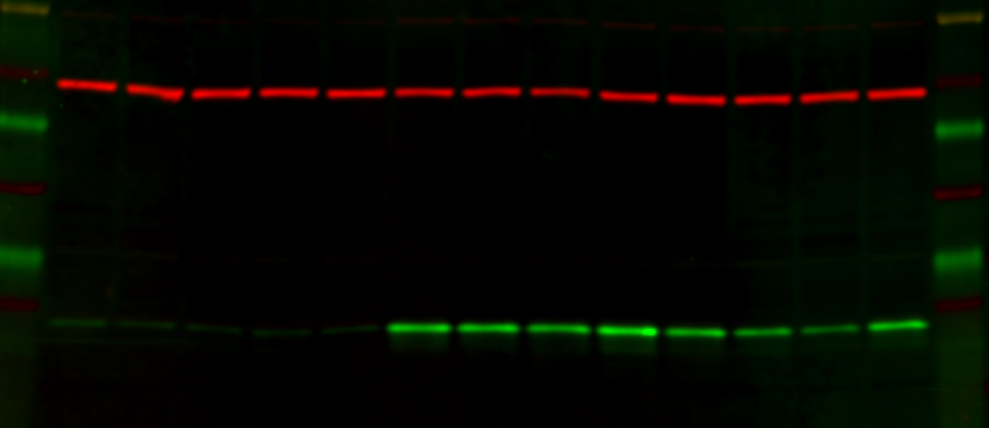
Supplemental Figure S6
A
MOUSE QUADRICEPS
Agl^{+/+}
Agl^{-/-}
Agl^{-/-} treated
VINCULIN
GAL3
GAL3/VINCULIN :
1,22
0,83
0,60
1,11
1,24
17,62
15,14
16,42
22,14
10,38
7,03
3,89
10,75
Supplemental Figure S6. LGALS3 up-regulation confirmed at the protein level (GAL3) in mouse quadriceps biopsies. Uncropped Western Blot analysis of GAL3 protein level in Agl^{+/+}, Agl^{-/-}, Agl^{-/-} treated mouse triceps biopsies. (n=4 or 5 independent mice for each condition). Quantification of the Western Blot analysis of GAL3 over VINCULIN are normalised to the mean of Agl^{+/+} values.

Slide 8
Supplemental Table S1
Human biopsies details
Age at biopsy | Sexe | Sampled Muscles | Condition
43 | M | Quadriceps | CTRL
23 | M | Deltoide | CTRL
38 | M | Deltoide | CTRL
53 | M | Quadriceps | GSDIII
24 | M | Deltoide | GSDIII
40 | M | Deltoide | GSDIII
Supplemental Table S1. Details of human patient biopsies.

Slide 9
Supplemental Table S2
Gene | Forward (5’→3’) | Reverse (5’→3’)
Human
18S | TCTTCAGTCCGCTCCAGGTCT | GAGGATGAGGTGGAACGTGT
OCT4 | CCTCACTTCACTGCACTGTA | CAGGTTTTCTTTCCCTAGCT
NANOG | CAAAGGCAAACAACCCACTT | TCTGCTGGAGGCTGAGGTAT
DESMIN | ATTGGAGGACCGATTTGCC | TCACCGTCTTCTTGGTATGGA
MYOD | GGGGCTAGGTTCAGCTTTCT | CTACATTTGGGACCGGAGTG
MYOG | TAAGGTGTGTAAGAGGAAGTCG | CCACAGACACATCTTCCACTGT
DP427m | GTGGGAAGAAGTAGAGGACTGT | TCCTGTAGGTCACTGAAGAGGT
MGATAC4 | GGGGAAACCACCTTCAACAGGAG | CGTTTTCCCCAACATCTAGGGCT
MOXD1 | GCACTTTGGAGTGCCTGGAAGA | AATGACGCAGCCTGATGCCTCT
ZIC1 | GATGTGCGACAAGTCCTACACG | TGGAGGATTCGTAGCCAGAGCT
ST6GALNAC3 | TACGTGACCACAGAGAAGCGCA | CGTGAATGCCATAACAGGCGTC
S100A6 | AAGCTGCAGGATGCTGAAAT | CCCTTGAGGGCTTCATTGTA
EMP1 | ATGCCAGTGAAGATGCCCTC | TGTAGATGGACACCCCCACA
VCAM1 | GATTCTGTGCCCACAGTAAGGC | TGGTCACAGAGCCACCTTCTTG
AiF1L | CCTTCCAGAAAAGCTCACAGCC | CTTCATCTCCAGGTGGGTCTTG
Col5a3 | TGACCGGGCATTCAGAATTGG | CGGGCACCCCTTTCATCAT
GPNMB | GTGCTCAATGGAACCTTCAGCC | AGGAATCCTACTCAGCTCCAGG
LGALS3 | GTGCCTCGCATGCTGATAAC | TGTTTGCATTGGGCTTCACC
RRAD | CGAGAGCGTTTACAAGGTGCTG | ATGGAGCGATCATAGGTGTGCC
SSC5D | TGTGACTGCCAGTGTTCTGGAG | GGAGTGTTTCGTGGTTGGCATC
THY1 | GAAGGTCCTCTACTTATCCGCC | TGATGCCCTCACACTTGACCAG
Mouse
P0 | CTCCAAGCAGATGCAGCACA | ATAGCCTTGCGCATCATGGT
Aif1l | ATGTCTTACCCGAGTGGGGA | GAAATGGGGGCAGAGATGCT
Col5a3 | GGCAAAGATGGTATTCCAGGACC | TGCTTCCTTTGTGACCAGGCATC
Gpnmb | AGGATCCATTGCTCCAGGAC | CTGCACAGCTCACATACATGC
Lgals3 | AACACGAAGCAGGACAATAACTGG | GCAGTAGGTGAGCATCGTTGAC
Rrad | TCTCGTGAGGTCTCTGTGGATG | CCTCGAATAGTGCCTGGACATTG
Ssc5d | AGGCTTCACTGTCAGAATGCCC | GCTCCAACTGAAAGGGTCTGAG
Thy1 | CCTTACCCTAGCCAACTTCACC | TTATGCCGCCACACTTGACCAG
Supplemental Table S2. List of primer sequences used for quantitative PCR.
Notes:
Control 1 :PCI
Control 2: iCas9
Control 3: i90
GSDP1:576
GSDP2:3390
GSDP3:0303
GSDP4:2523

Slide 10
Supplemental Table S3
Antibody | Supplier | Reference | dilution
Western Blot
GDE | Agrisera | AS09 454 | 1:1000
HSP60 | Santa Cruz | Sc-59567 | 1:200
GAL3 | R&D Systems | AF1197-SP | 1:1000
VINCULIN | Abcam | 129002 | 1:1000
IRDye® 680RD Donkey anti-Goat IgG | Li-Cor | 926-68074 | 1:5000
IRDye® 800CW Donkey anti-Rabbit | Li-Cor | 926-32213 | 1:10000
IRDye® 800CW Donkey anti-Mouse | Li-Cor | 926-32212 | 1:10000
Immunofluorescence
DESMIN | R&D Systems | AF3844 | 1:200
MYOG | DSHB | F5D-c | 1:50
TITIN | US Biological | T5650 | 1:50
Donkey anti-mouse AF488 | Invitrogen | A-21202 | 1:1000
Donkey anti-goat AF488 | Invitrogen | A-11055 | 1:1000
Donkey anti-mouse AF555 | Invitrogen | A-31570 | 1:1000
Supplemental Table S3. List of antibody references and dilutions used in Western Blot and immunofluorescence techniques.
Notes:
Control 1 :PCI
Control 2: iCas9
Control 3: i90
GSDP1:576
GSDP2:3390
GSDP3:0303
GSDP4:2523

