Slide 1
miR-9-1 is a new circulating biomarker for higher-grade meningioma regulated via the EGFR-FOS network
SUPPLEMENTARY FIGURES
Daniele Baiz, Caterina Negroni, Sara Ferluga, Emanuela Ercolano, Claire L Adams, Agbolahan Sofela, David A Hilton,
Kathreena M Kurian and Oliver C Hanemann.

Slide 2
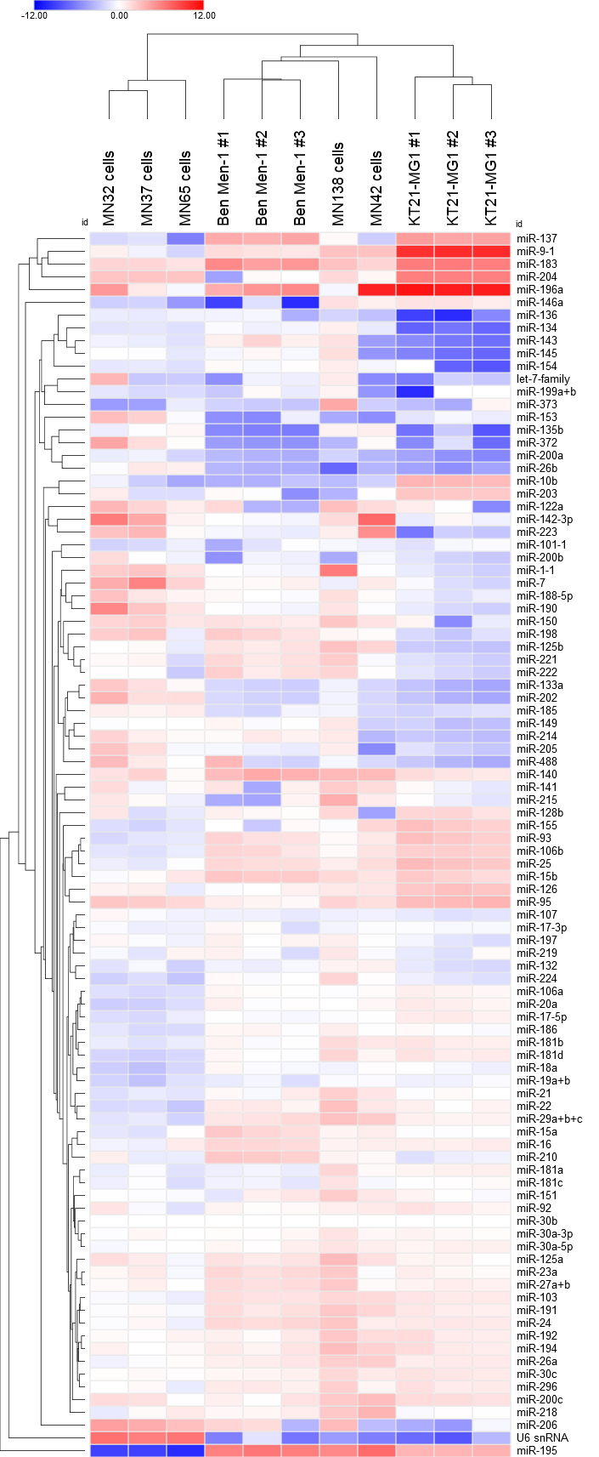
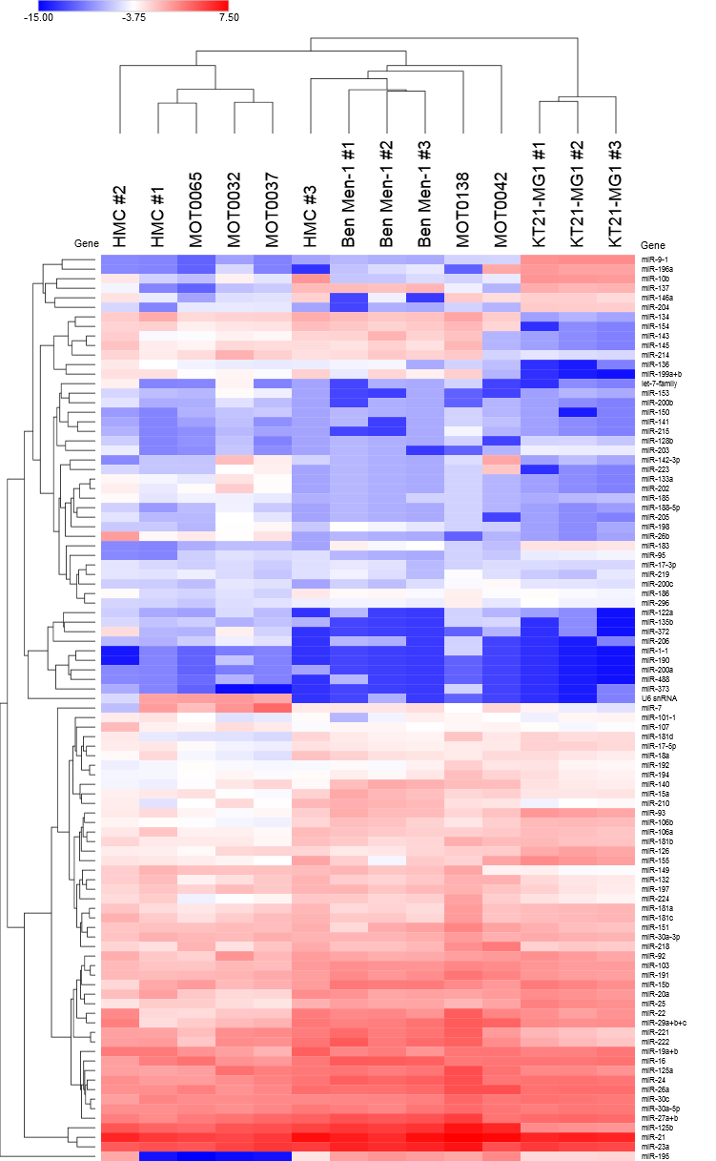
Figure S1
Supplemental Data
Colour Key (Log₂ 2^{-ΔΔCt})
KT21-MG1 #1
-12.00
0.00
12.00
KT21-MG1 #2
Ben-Men-1 #2
KT21-MG1 #3
Ben-Men-1 #1
MN036
Ben-Men-1 #3
MN038
MN033
MN082
MN048
Figure S1. Unsupervised hierarchical clustering and heat map showing the different expression pattern of the 96 miRNA genes. The dendrogram was obtained using the Euclidean distance metric with Ward grouping, led by the software Morpheus® (https://software.broadinstitute.org/morpheus/). Each row represents an individual miRNA gene, while columns represent individual cell samples. The color in each box reflects the expression level of the corresponding gene in the corresponding sample (red–high; blue-low and white-intermediate expression), relative to the average of 3 Human Meningeal Cells (HMC) at different passage, calculated using the comparative 2^{-ΔΔCt} method (MN=Tumor-derived WHO I cells). Data are expressed as Log2 (2^{-ΔΔCt}).

Slide 3
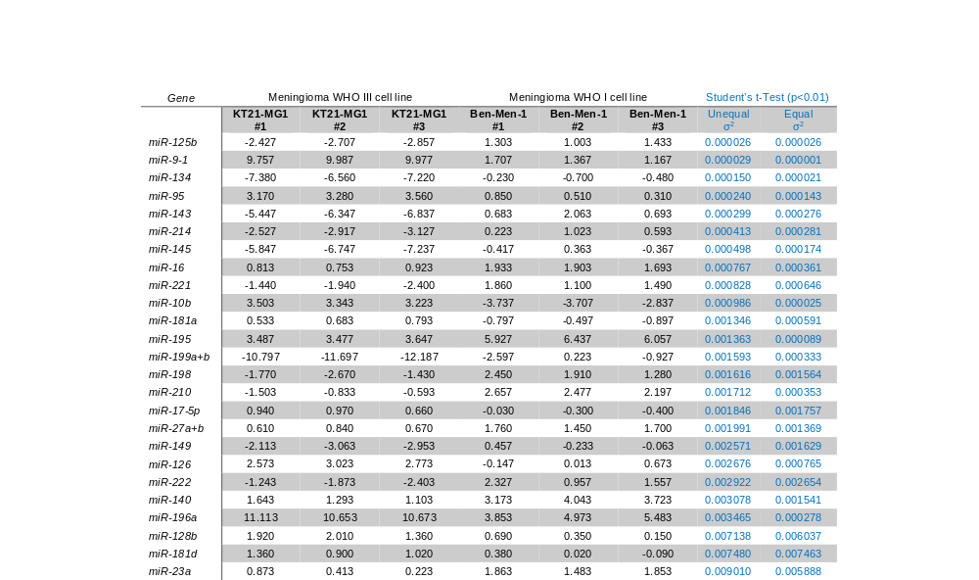
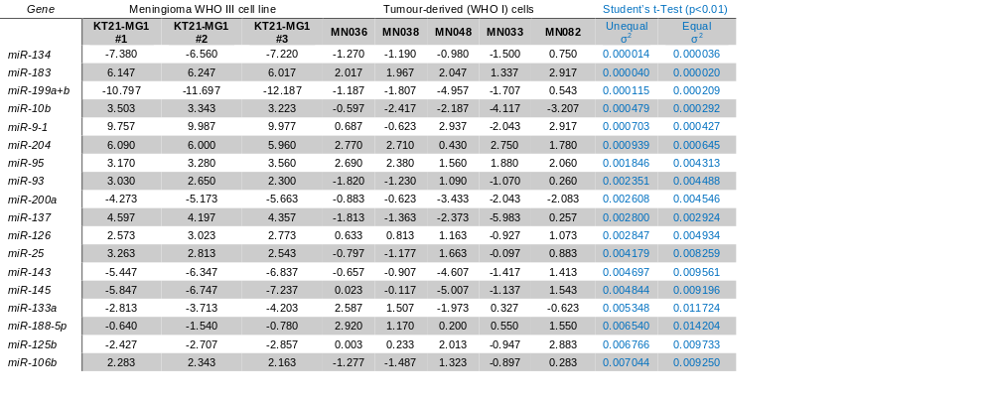
Figure S2
Supplemental Data
Figure S2. Selected statistically significant miRNA genes between KT21-MG1 (n=3) versus Ben-Men-1 (n=3) cells (top), and KT21-MG1 versus tumor-derived WHO I (n=5) cells (bottom), by computing the Student’s t-Test (unequal and equal σ², p<0.01). Data are expressed as Log₂ (2^{-ΔΔCt}).

Slide 4
Figure S3
Supplemental Data
a)
Best gene | miR-30b
Stability value | 0.244
Best combination of two genes | miR-197 and miR-30b
Stability value for best combination of two genes | 0.219
b)
c)
15.0
NS
15
KT21-MG1
14
12.5
13
IOMM-Lee
12
10.0
***
***
11
*
miR-9-1 expression
10
7.5
9
NS
Ben-Men-1
8
**
5.0
miR-9-1 levels
KT21-MG1
7
2.5
6
5
0.0
4
ANOVA
p<0.0001
3
RNU6B
miR-30b
RNU6B
miR-30b
2
1
0
FBS
HBS
FBS
HBS
Endogenous controls
Figure S3. a) NormFinder ranked miR-30b (RNU6B, Stability value = 2.617) as top candidate reference gene in the cancer miRNa array, based on its lower stability parameter (https://moma.dk/normfinder-software), which was used to analyse the array data. b) We compared miR-9-1 expression levels in Ben-Men-1 and KT21-MG1 cells using both RNU6B and miR-30b as endogenous controls using specific TaqMan® probes. Results suggested that there are no significant differences in miR-9-1 expression inside each cohort. Fold increase of miR-9-1 using RNU6B: 2.87 (Ben-Men-1), 12.07 (KT21-MG1). Fold increase of miR-9-1 using miR-30b: 2.20 (Ben-Men-1), 12.09 (KT21-MG1). As recommended by the manufacturer (Cambridge Biosciences), we chose the RNU6B as endogenous control for subsequent experiments. Both KT21-MG1 and Ben-Men-1 cells were tested at three different passages, and each sample was assayed in triplicate. Data are expressed as mean Log₂ (2^{-ΔΔCt}) ± SEM, ANOVA one-way (***p<0.0005, ****p*0.0003), when compared to HMC. c) MiR-9-1 expression levels assessed in malignant meningioma KT21-MG1 and IOMM-Lee cells using cell culture medium supplemented with fetal bovine serum (FBS, 7.89 and 4.31 folds, respectively) and human-derived serum (HBS, 7.49 and 5.32 folds, respectively). As reported, no major differences were detected between FBS and HBS conditions, while miR-9-1 levels were consistently higher when compared to Ben-Men-1 (=0). Data are expressed as mean Log₂ (2^{-ΔΔCt}) ± SEM, ANOVA one-way (*p<0.05, **p<0.001), when compared to HMC.

Slide 5
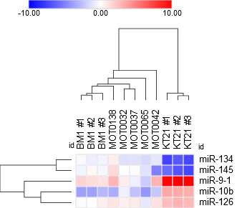
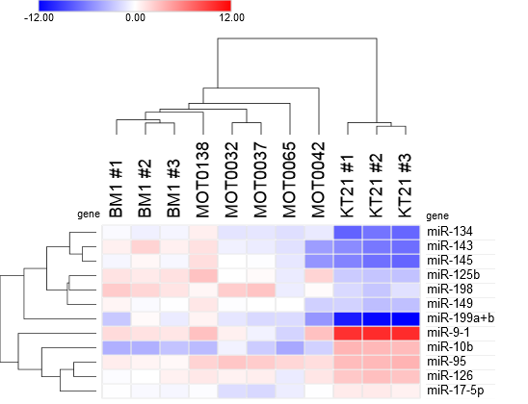
a)
Figure S4
Supplemental Data
KT21-MG1
vs
Ben-Men-1
KT21-MG1
vs
Tumour-derived (WHO I) cells
miR-95
miR-125b
miR-140
miR-149
miR-195
miR-196a
miR-198
miR-210
miR-214
miR-221
miR-222
11
(50%)
5
(22.7%)
6
(27.3%)
miR-25
miR-106b
miR-137
miR-183
miR-200a
miR-204
miR-9-1
miR-10b
miR-126
miR-134
miR-145
b)
12.0
Ben-Men-1
9.0
***
Tumour-derived cells (WHO I)
6.0
KT21-MG1
 | Ben-Men-1 | WHO I cells | KT21-MG1
miR-9-1 | 1.41 | 0.77 | 9.91
miR-10b | -3.43 | -2.50 | 3.36
miR-126 | 0.18 | 0.55 | 2.79
miR-134 | -0.47 | -0.84 | -7.05
miR-145 | -0.14 | -0.94 | -6.61
Fold values compared to HMC
3.0
***
***
miR-134
miR-145
miRNA expression levels
0.0
-3.0
-6.0
miR-9-1
miR-10b
miR-126
-9.0
***
***
-12.0
c)
Colour Key (Log₂ 2^{-ΔΔCt})
0.00
Ben-Men-1 #2
-10.00
10.00
KT21-MG1 #1
KT21-MG1 #2
Ben-Men-1 #1
KT21-MG1 #3
Ben-Men-1 #3
MN036
MN033
MN048
MN038
MN082
miR-134
miR-145
miR-9-1
miR-10b
miR-126

Slide 6
d)
10
10
1
miR-134 levels
**
NS
1
miR-145 levels
0.1
0.01
0.1
0.001
Ben-Men-1
WHO I cells
n=12
KT21-MG1
Ben-Men-1
WHO I cells
n=12
KT21-MG1
e)
100
1000
****
****
10
100
1
miR-126 levels
10
miR-10b levels
0.1
0.01
****
1
0.001
0.1
Ben-Men-1
WHO I cells
n=12
KT21-MG1
IOMM-Lee
Ben-Men-1
WHO I cells
n=12
KT21-MG1
IOMM-Lee
Figure S4. a) Venn diagram showing the 5 miRNAs commonly deregulated between KT21-MG1, Ben-Men-1, and primary WHO I meningioma cells. b) Expression levels of miR-10b, -126,-134 and -145 compared to miR-9-1. Data are expressed as mean Log₂ (^{2-ΔΔCt}) ± SEM, ANOVA one-way (***p<0.0001) when compared to HMC. c) Unsupervised hierarchical clustering and heat map showing the different expression pattern of miR-9-1, -10b, -126,-134, and -145. The dendrogram was obtained using the Euclidean distance metric with Ward grouping, led by the software Morpheus® (https://software.broadinstitute.org/morpheus/). The colour in each box reflects the expression level of the corresponding gene in the corresponding sample (red–high; blue-low and white-intermediate expression), relative to the average of 3 Human Meningeal Cells (HMC) at different passage, calculated using the comparative 2^{-ΔΔCt} method (MN=Tumour-derived WHO I cells). d) Validation of miR-134 and miR-145 (see Fig. 1a) by RT-qPCR, using specific TaqMan® probes, in KT21-MG1 (0.64 and 0.028, respectively; n=3), Ben-Men-1 (n=3) and tumor-derived WHO I (2.32 and 2.19 folds, respectively; n=12) cells. e) Validation of miR-126 and miR-10b (see Fig. 1A) by RT-qPCR, using specific TaqMan® probes, in KT21-MG1 (10.47 and 73.95, respectively; n=3), Ben-Men-1 (n=3), tumor-derived WHO I (1.08 and 0.97 folds, respectively; n=12), and IOMM-Lee (0.002 and 1.01, respectively; n=3) cells. Both KT21-MG1 and Ben-Men-1 cells were tested at three different passages, and each sample was assayed in triplicate. All data are expressed as mean Log₂ (2^{-ΔΔCt}) ± SEM, ANOVA one-way (*p<0.05, **p<0.005, ****p<0.0001 when compared to Ben-Men-1.

Slide 7


Figure S5
Supplemental Data
a)
b)
1.25
KT21-MG1
1.25
IOMM-Lee
1.00
*
Viability assay
1.00
*
Viability assay
0.75
*
ATP assay
0.75
ATP assay
Proliferation index
*
Proliferation index
****
****
0.50
**
**
0.50
0.25
0.25
****
****
IC50 ~ 5 µM
****
IC50 ~ 7.5 µM
****
0.00
0
5
10
15
20
0.00
0
5
10
15
20
Afatinib (µM)
Afatinib (µM)
c)
KT21-MG1
IOMM-Lee
AF (µM)
AF (µM)
kDa
V
10
20
kDa
V
10
20
75
p-AKT
S473
75
p-AKT
S473
50
50
AKT
75
AKT
50
50
37
GAPDH
37
GAPDH
Figure S5. a) Afatinib (AF) significantly reduced KT21-MG1 cell viability (10 µM AF: 0.32 folds; 20 µM AF: 0.03 folds) and proliferation (ATP assay; 10 µM AF: 0.73 folds; 20 µM AF: 0.26 folds), when compared to vehicle DMSO, at 24 hours. b) Afatinib (AF) significantly reduced IOMM-Lee cell viability (10 µM AF: 0.36 folds; 20 µM AF: 0.14 folds) and proliferation (ATP assay; 10 µM AF: 0.54 folds; 20 µM AF: 0.18 folds), when compared to vehicle DMSO, at 24 hours. c) Representative Western blot panel conducted in KT21-MG1 and IOMM-Lee cells that further confirmed a decrease of proliferation by assessing the levels of p-AKTS473/AKT, marker of cell proliferation. All data are expressed as means ± SEM, ANOVA one-way (*p<0.05, **p<0.005, ****p<0.0001), when compared to vehicle.

Slide 8

Figure S6
Supplemental Data
a)
6
Up-regulated
5
Down-regulated
4
BACE1
Unchanged
3
MYOCD
CRIM1
KT21-MG1 vs Ben-Men-1
Gene | Log₂(Fold Change) ≤-2 | -Log₁₀(t-Test) ≥1 | p-value
CDH1 | -17.801 | 2.244 | 0.0057
MYOCD | -8.805 | 2.624 | 0.0004
BACE1 | -4.156 | 3.689 | 0.0002
SNX25 | -3.560 | 2.685 | 0.0021
LAMP1 | -2.387 | 2.624 | 0.0024
CRIM1 | -2.347 | 2.663 | 0.0022
- Log₁₀(p-value)
SNX25
2
CDH1
LAMP1
1
0
-24
-20
-16
-12
-8
-4
0
4
8
12
16
20
24
Log₂(Fold change: KT21-MG1/Ben-Men-1)
CDH1 (ENST00000261769)
5’...CCUAAAGUGCUGCAG--CCAAAGAC...3’ 1327-1333
||| ||||||
3’ AGUAUGUCGAUCUAUUGGUUUCU hsa-miR-9-1
b)
c)
d)
10
1000
1
*
100
Ben-Men-1
KT21-MG1
10
IOMM-Lee
kDa
CDH1 levels
CDH1 levels
0.1
1
150
E-cadherin
0.1
***
***
100
1 0.25 0.32
0.01
0.01
37
GAPDH
0.001
0.001
Ben-Men-1
n=3
WHO I cells
n=24
KT21-MG1
n=3
IOMM-Lee
n=3
WHO I
n=32
WHO II
n=18
WHO III
n=9
e)
KT21-MG1
2.00
n=2
*
1.75
shFOS
1.50
kDa
Sc
1.25
150
E-cadherin
CDH1 levels
1.00
100
1 1.42
0.75
150
N-cadherin
0.50
1 0.49
0.25
37
GAPDH
0.00
Sc
shFOS
Figure S6. a) MiR-9 targets array. The volcano plot shows that CDH1 is the top mRNA candidate downregulated in KT21-MG1 compared to Ben-Men-1 cells (0.002 folds, p=0.0057, threshold p<0.01). Table reports values of the 6 significantly downregulated miR-9-1 targets (MYOCD, BACE1, SNX25, LAMP1 CRIM1). b) Gene expression analysis of CDH1 by RT-qPCR confirmed that CDH1 is significantly downregulated in the malignant meningioma cell lines KT21-MG1 (0.009 Log₁₀ folds) and IOMM-Lee (0.01 Log₁₀ folds), compared to Ben-Men-1. We profiled 24 tumor-derived WHO I cells, confirming that CDH1 levels are significantly higher in benign meningioma cells (52.44 Log₁₀ folds). KT21-MG1, IOMM-Lee, and Ben-Men-1 cells were tested at three different passages, and each sample was assayed in triplicate. Data are expressed as mean ± SEM (***p<0.001 compared to Ben-Men-1). c) Protein analysis by Western blotting in Ben-Men-1, KT21-MG1, and IOMM-Lee cells confirmed that E-cadherin is downregulated in malignant meningioma cells. d) Gene expression analysis of CDH1 by RT-qPCR in meningioma tissues. CDH1 is significantly downregulated in malignant (WHO III, 0.50 Log₁₀ folds) tissues, compared to those of benign origin. CDH1 was unchanged in atypical tissues (WHO II, 0.99 Log₁₀ folds). Data are expressed as mean ± SEM, unpaired Student’s t-Test (*p<0.05 compared to WHO I). e) Following viral-mediated RNA interference of FOS in KT21-MG1 cells, we observed a significant increase of CDH1 levels both at the transcriptional and protein levels (1.62 folds and 1.42 folds, respectively). Notably, we observed a considerable decrease of N-cadherin (0.49 folds). Data are expressed as mean ± SEM, ANOVA one-way (*p<0.05 when compared to scramble). The lentiviral-mediated gene silencing was conducted in duplicate biological repeats, ensuring consistency.

Slide 9





Figure S7
Supplemental Data
a)
Exosomes
Day 1
Day 2
Day 3
kDa
Cells
Day 4
55
CD63
40
25
CD9
15
GM130
100
Calnexin
70
40
GAPDH
35
b)
Serum exosomes
Healthy
controls
WHO I
WHO II
WHO III
MN244
MN251
MN177
MN182
MN180
MN270
kDa
#1
#2
HeLa
50
CD63
37
25
CD63
20
25
CD9
20
150
GM130
100
150
Calnexin
100
75
50
GAPDH
37
Figure S7. a) Tumor-derived (WHO I) meningioma cells (MN14) were plated as reported in Material and Methods. Cell culture exosomes were harvested at the indicated time points, and exosome enrichment monitored by Western blotting following the protein levels of exosomes biomarkers CD63 and CD9. Further incubation after three days did not improve the exosome preparations. b) Human serum exosome preparations. Western blot panel reported positive staining for exosome markers CD63 and CD9, while negative for GM130 and Calnexin (Golgi and ER vesicles markers, respectively), when compared to controls. Notably, serum exosomes showed two main bands for CD63 (as reported in the datasheet), while we were able to detect only one band from cell culture exosome preparations (Fig. 4a).

