Slide 1
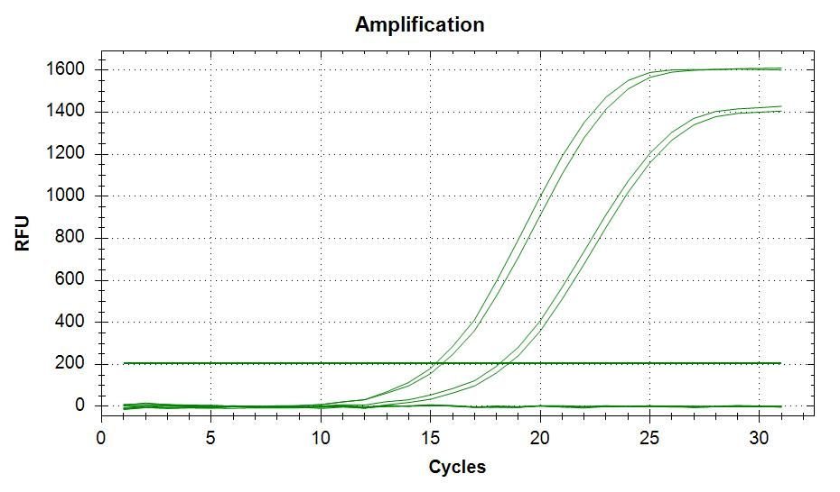
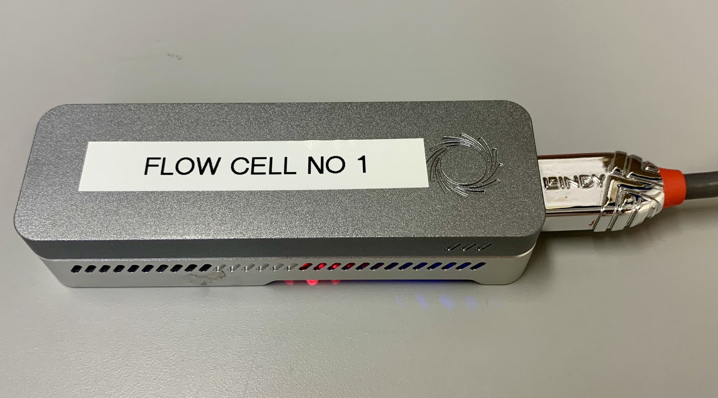
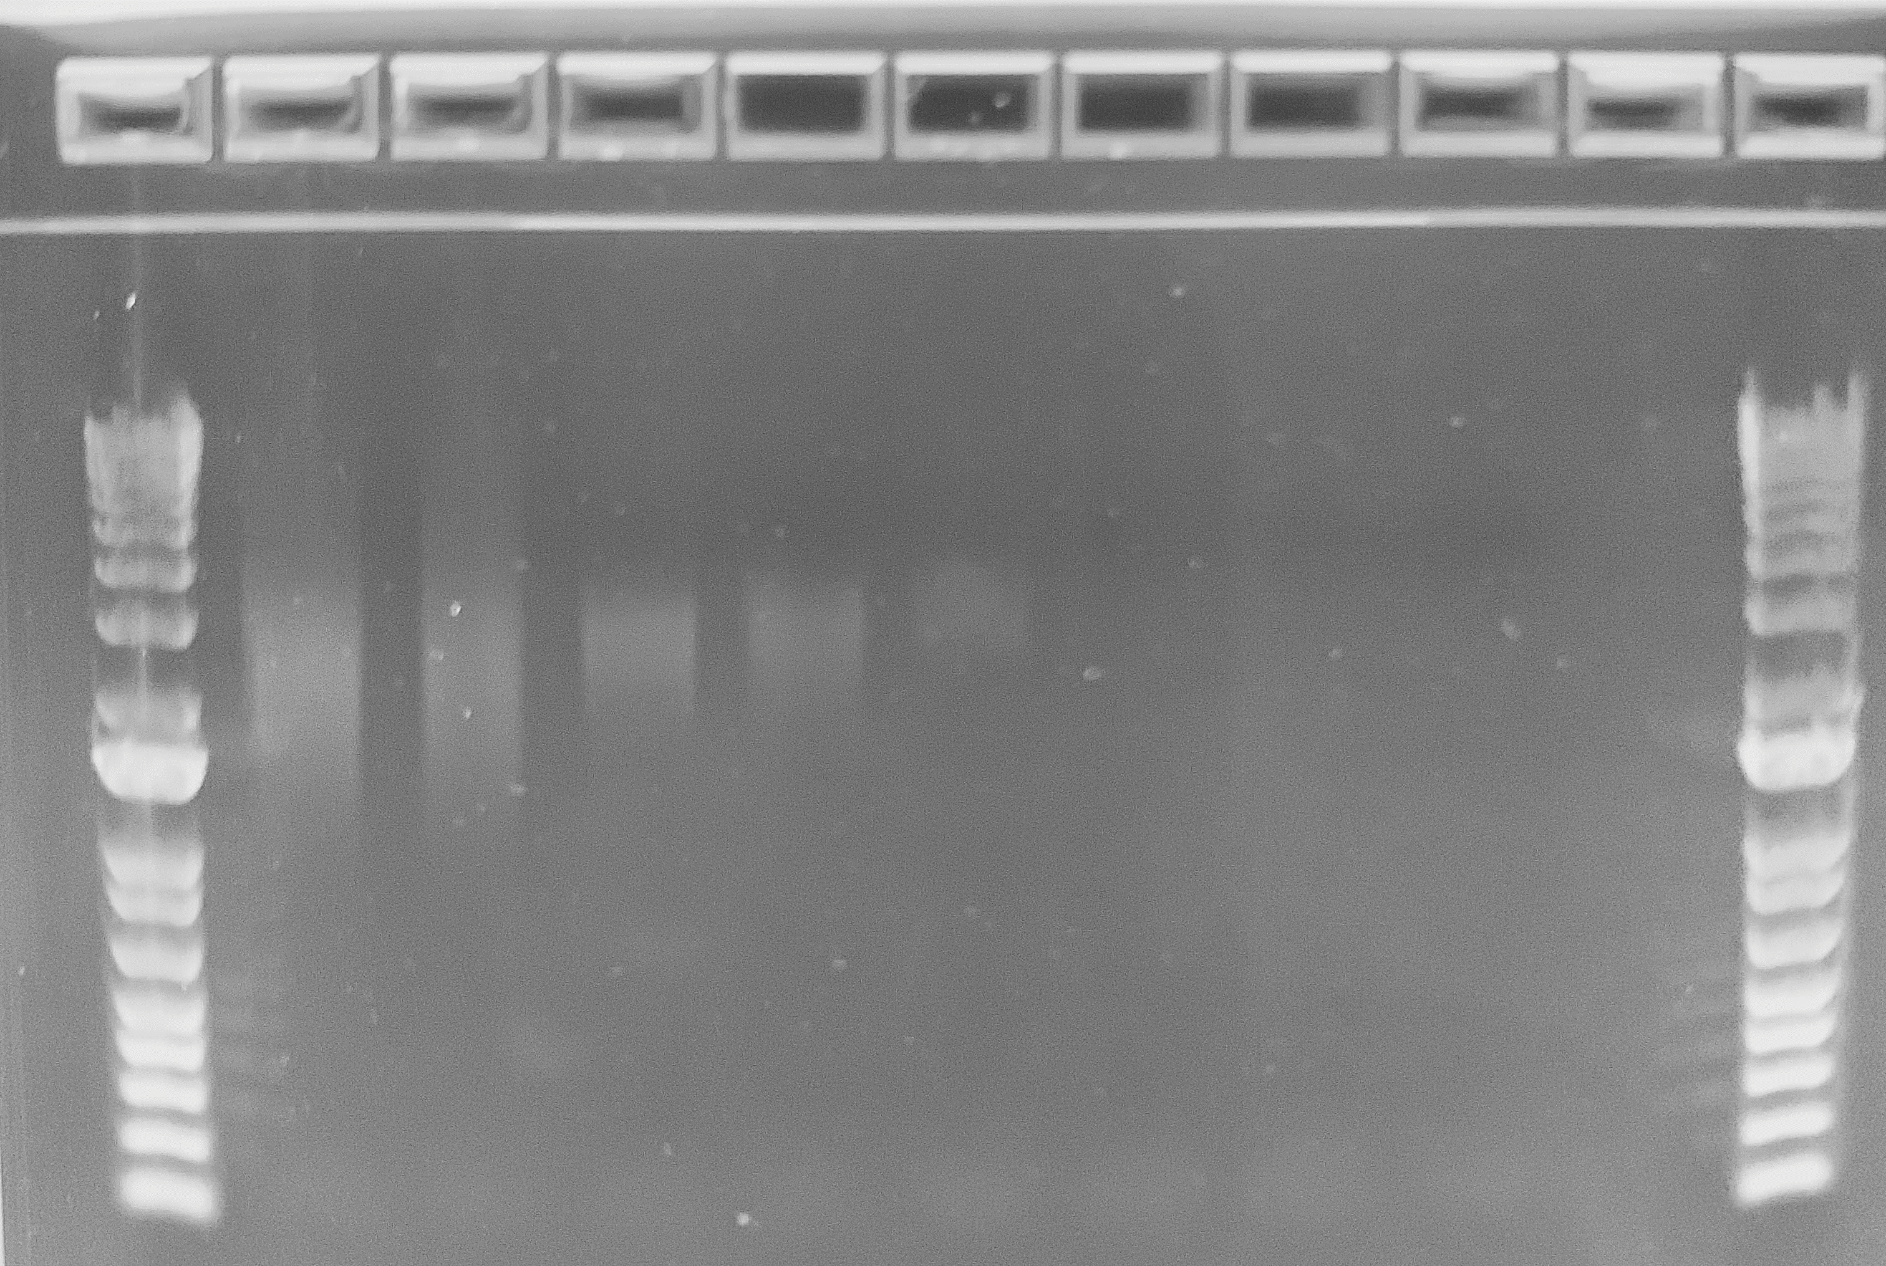
gDNA
5ʹ
3ʹ
N9 :
RLB :
Random Priming
using RLB-N9 primer
A
Linear amplicons
(RLB at one end only)
(95 °C/5 min
Snap cooling)
5ʹ
3ʹ
DNA synthesis
/strand displacement
(Vent DNA polymerase)
B
G
Looped amplicons with RLB ends
(70 °C/ 2 min)
Denaturation
C
10 cycles
D
H
PCR using RPB114.24 V14
barcoding primers
Random priming
Reaction Cleanup
Ia
Selective PCR amplification
of looped amplicons
I
Fresh round of synthesis
E
J
F
Ib
Fig. 1
Load library on
Flongle flowcell

Slide 2
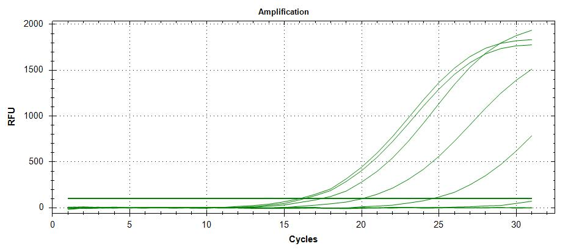
A
50ng
3
1
5ng
4
2
PCR Water
control
Water MALBAC
Template
(5)
(6)
B
50ng
1
2.5ng
3
5ng
2
0.25ng
0.025 ng
5
4
0.0025 ng
7
8
6
Fig. 2

Slide 3
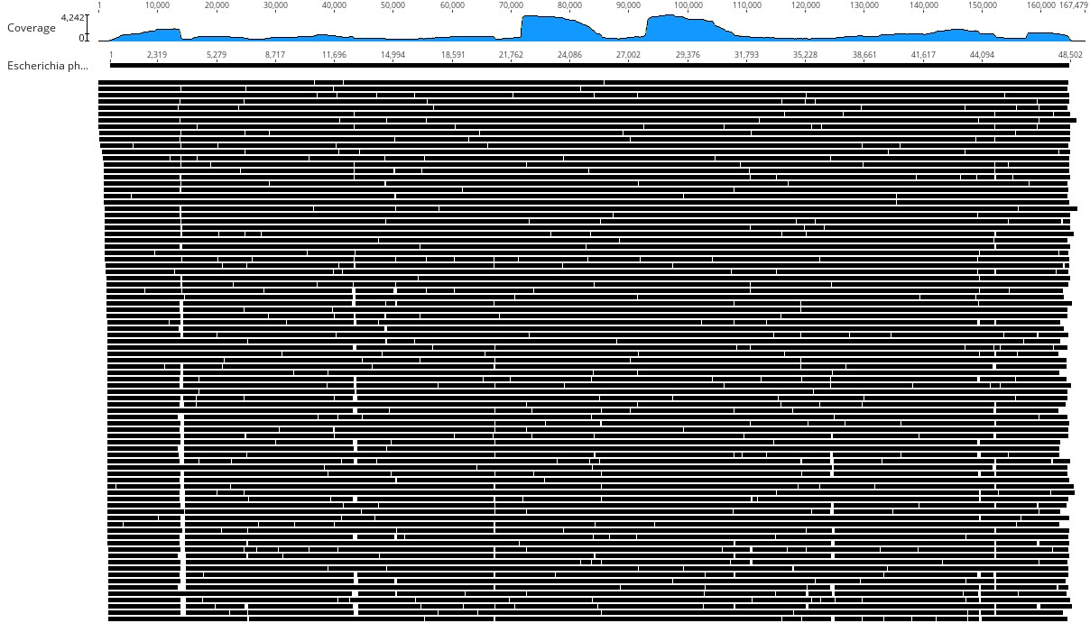
Fig. 3

Slide 4
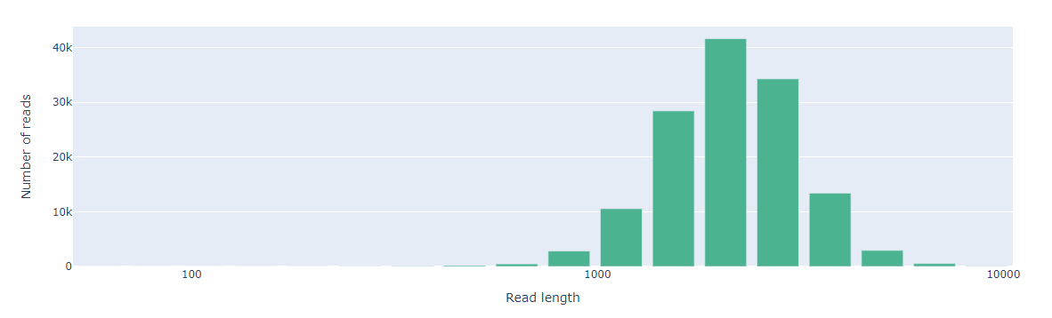
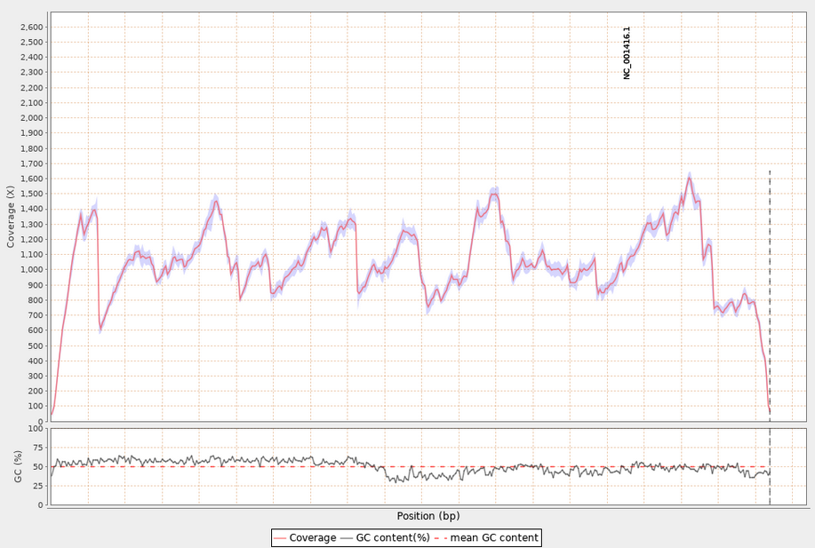
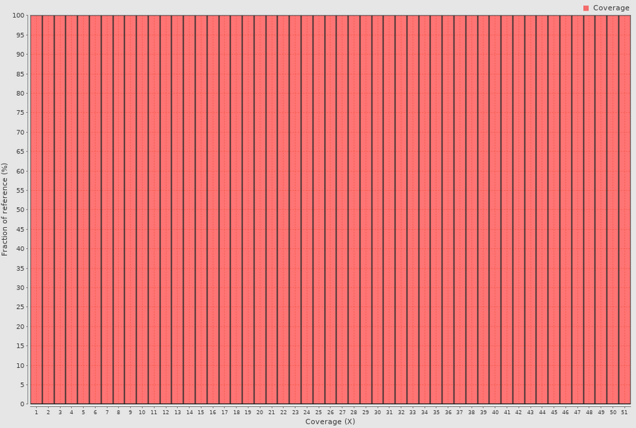
A
B
C
Fig. 4

Slide 5
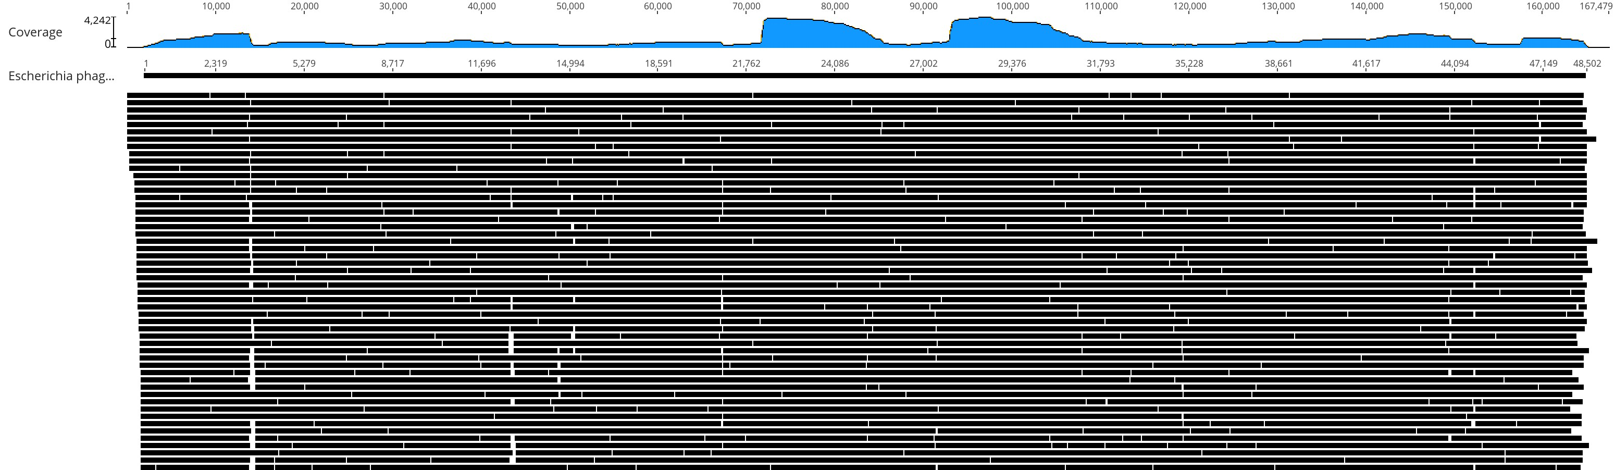
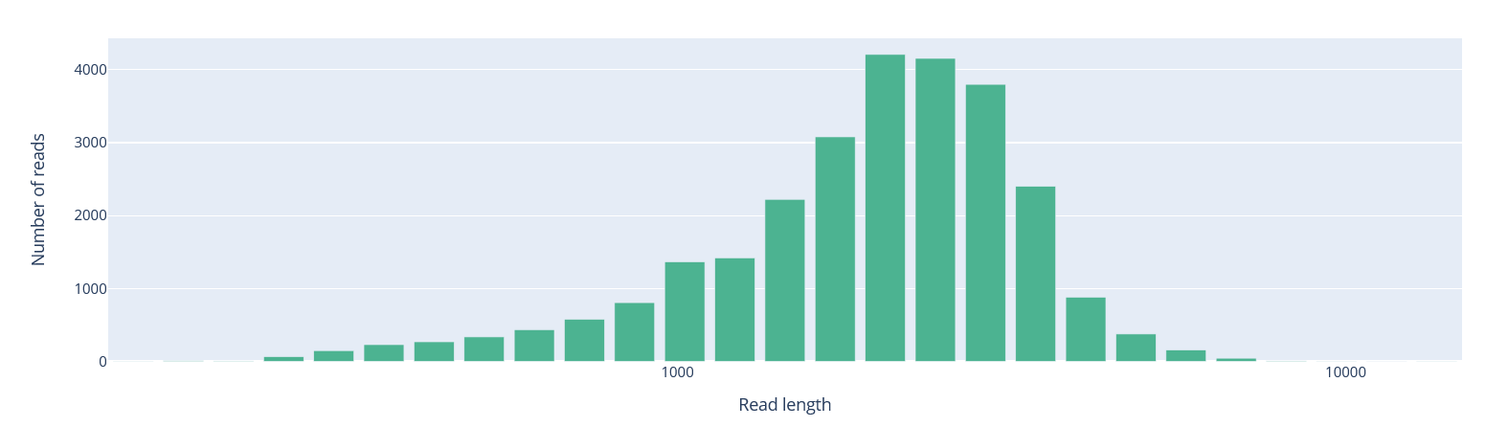
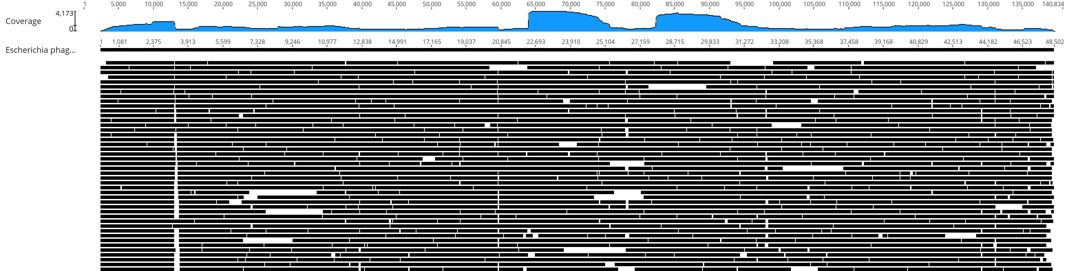
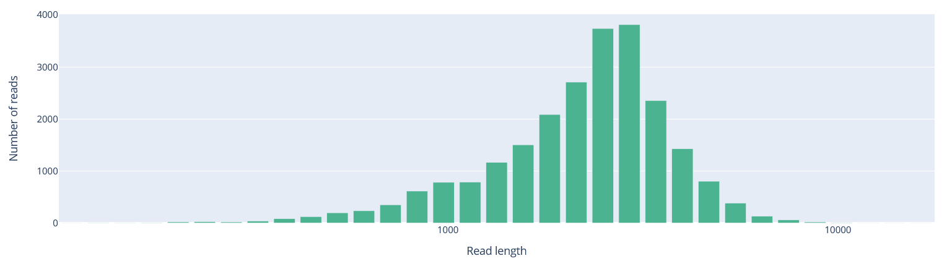
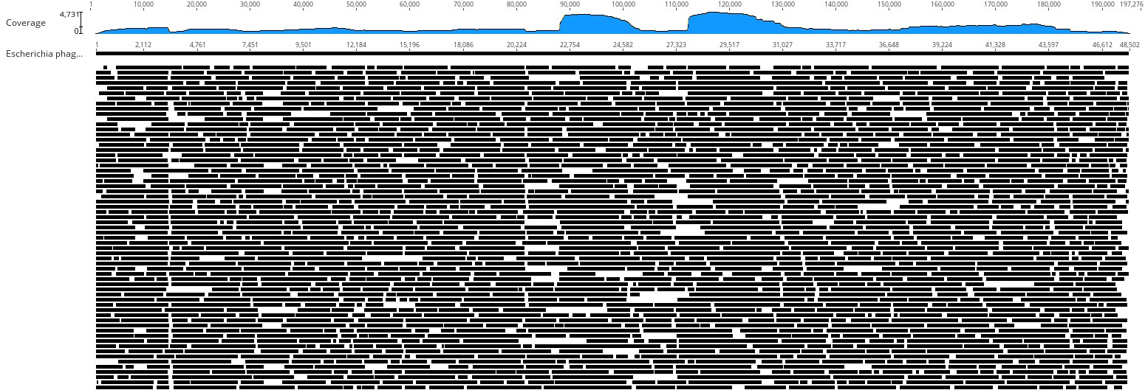
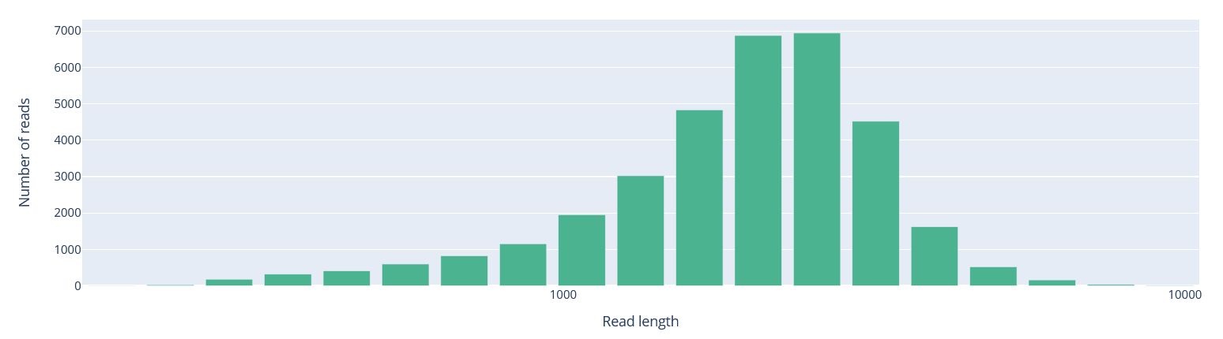
A2
A1
B2
B1
C2
C1
Fig. 5

Slide 6
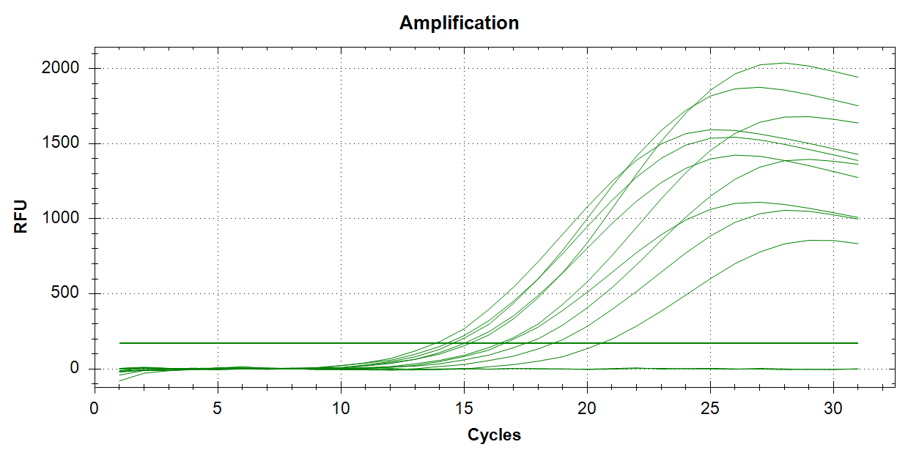
1
2
4
3
5
6
7
8
9
10
11
12
Fig. 6

Slide 7
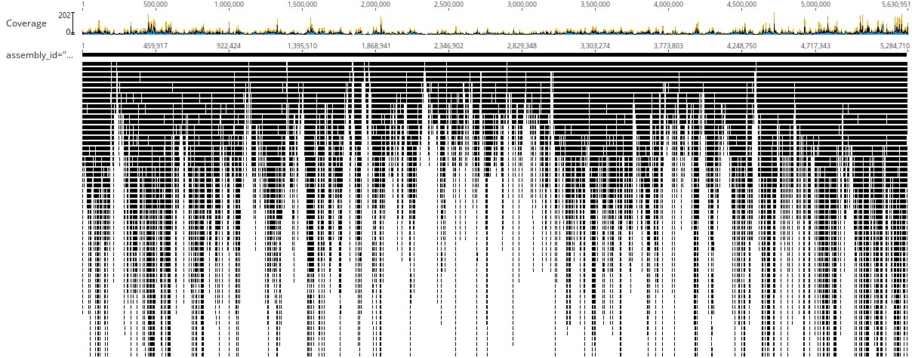
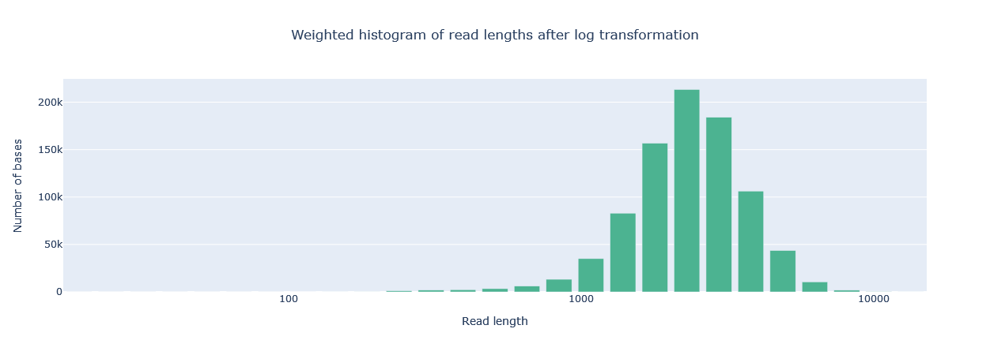
A
B
Fig. 7

Slide 8
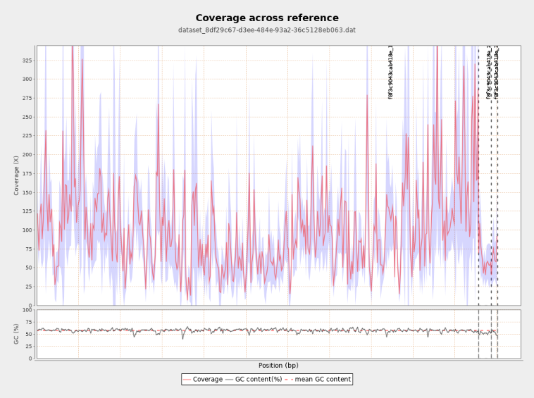
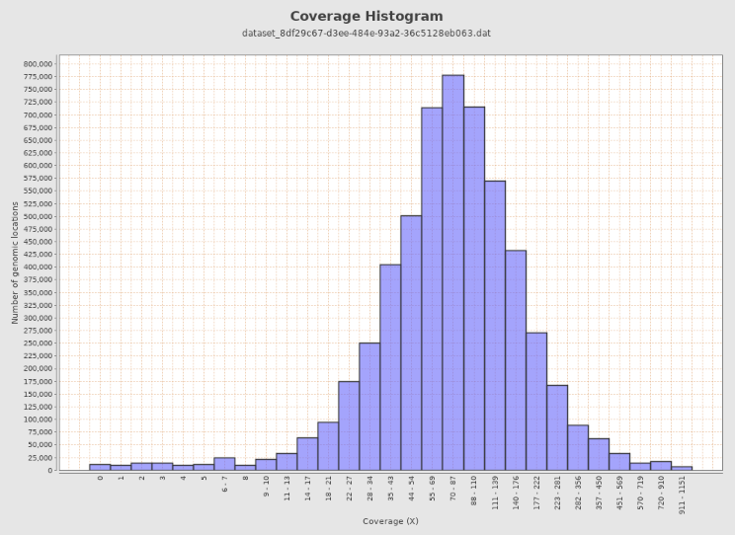
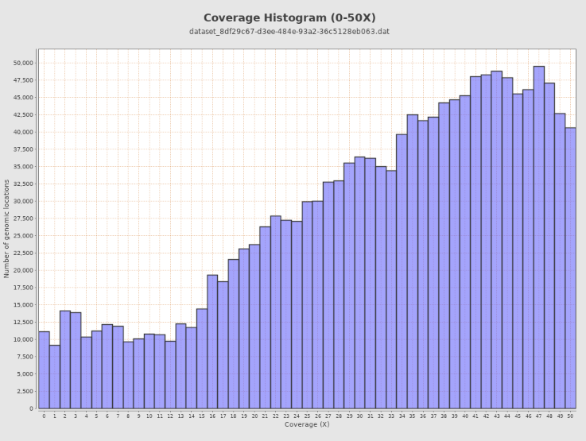
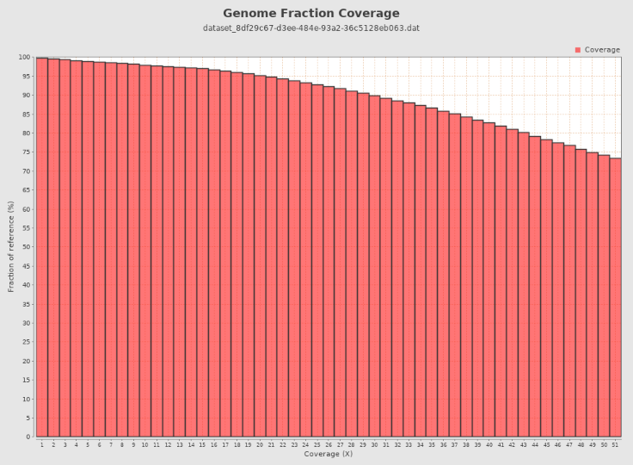
A
B
C
D
Fig. 8

Slide 9
M
1 2 3 4 5 6 7 8
M
1500 bp
50 ng 5ng 2.5ng 0.25ng 25pg 2.5pg 0.0ng water (PCR)
Suppl_Fig. 1
2% agarose gel of real-time PCR-amplified RLB-tagged lambda DNA, prepared using RLB-MALBAC procedure. The PCR amplicons were amplified using RLB control primer and its amplification
monitored using real-time PCR.
Lane 1: Lambda DNA (50 ng); Lane 2: Lambda DNA (5ng); Lane 3: Lambda DNA (2.5 ng); Lane 4: Lambda DNA (0.25ng); Lane 5: Lambda DNA (25 pg); Lane 6: lambda DNA (2.5pg); Lane 7: Lambda DNA (0 ng)
Lane 8: Water PCR control; M: 1kbPlus DNA ladder (ThermoFisher).

Slide 10
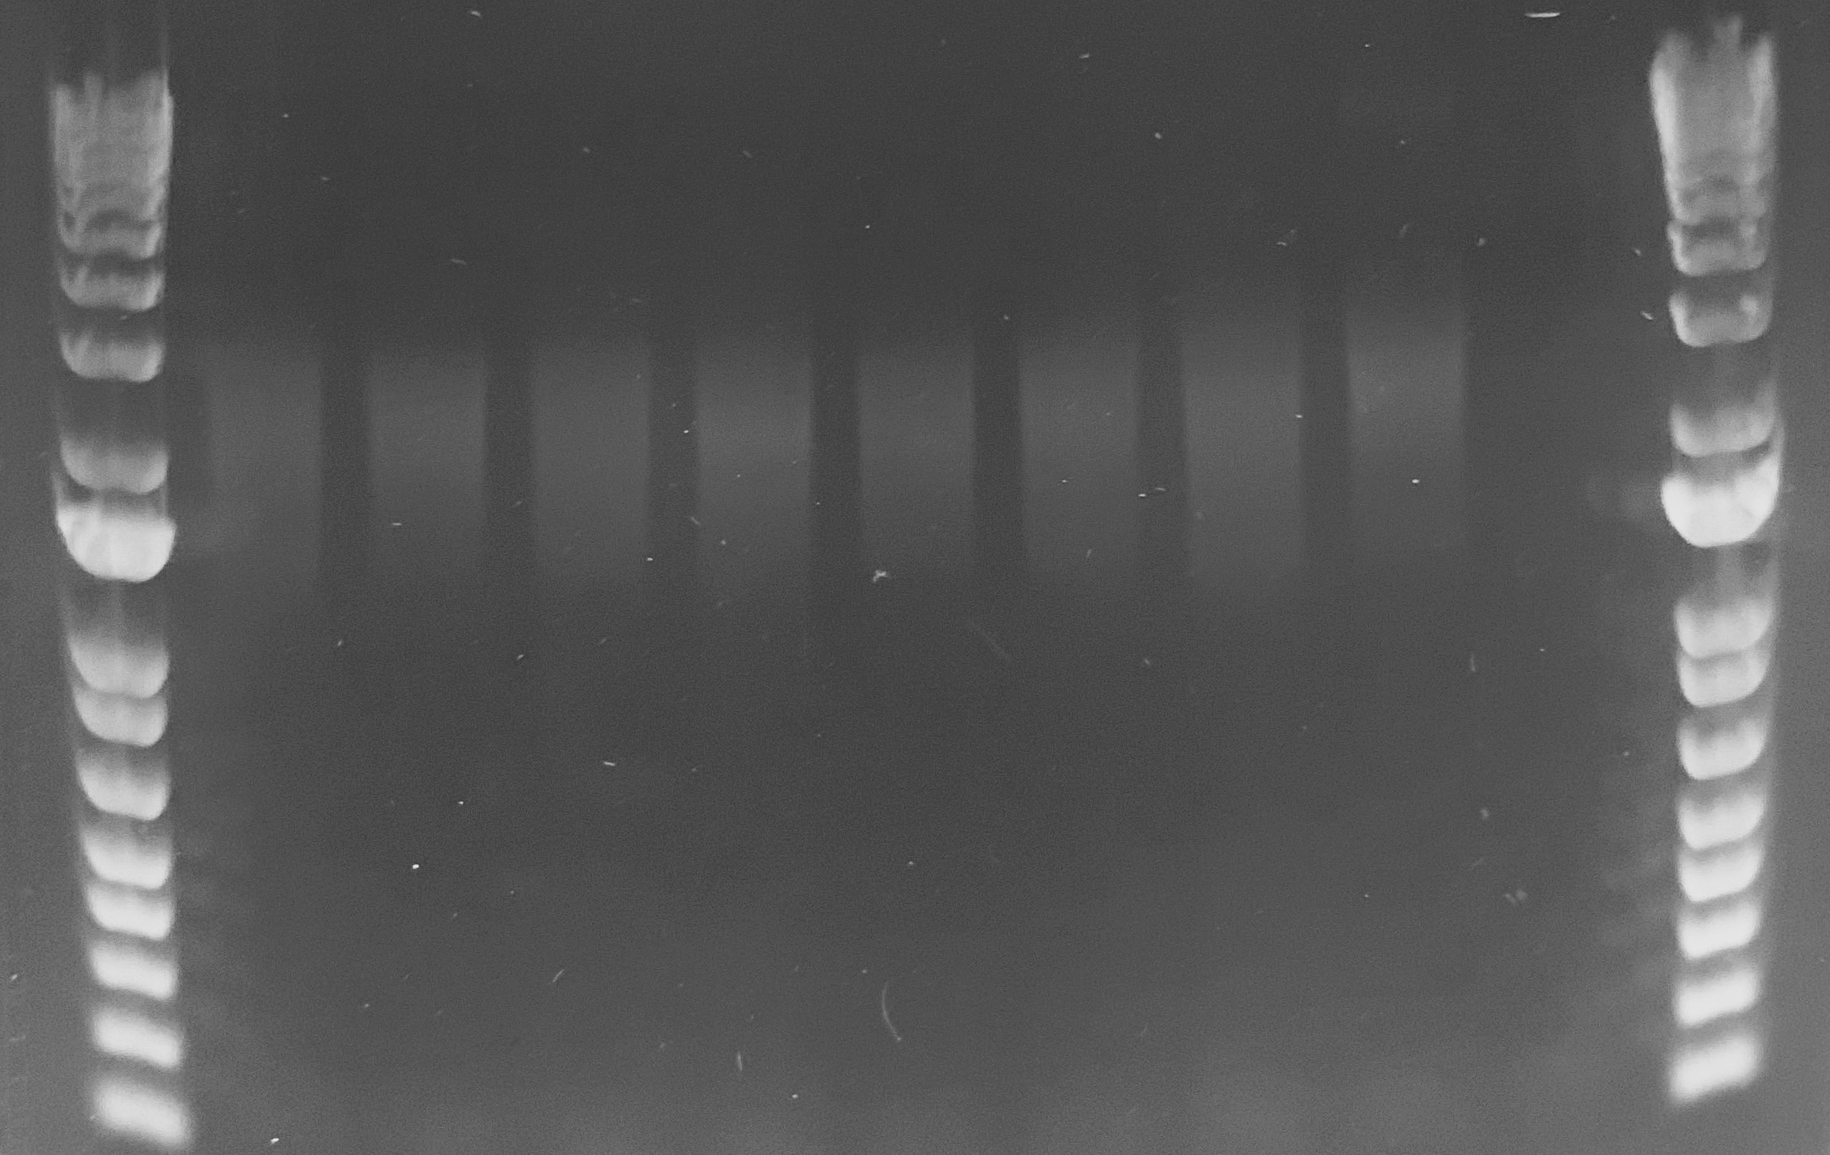
M
M
1 2 3 4 5 6 7 8 9
4000 bp
1500 bp
Suppl_Fig. 2
2% agarose gel of PCR-amplified RLB-tagged bacterial DNA, prepared using RLB-MALBAC procedure. The PCR amplicons were amplified using RLB control primer and its amplification monitored using real-time PCR.
Lane 1: Klebsiella pneumoniae (CARBA1), Lane 2: E. coli (ENT1), Lane 3: P. aeruginosa (CARBA14), Lane 4: K. pneumoniae (AMR01), Lane 5: C. freundii (AMR03), Lane 6: K. pneumoniae (AMR06)
Lane 7: E. coli (AMR02), Lane 8: E. coli (AMR05), Lane9: Water DNA template, Lane M: 1kbPlus DNA ladder (ThermoFisher).

Slide 11
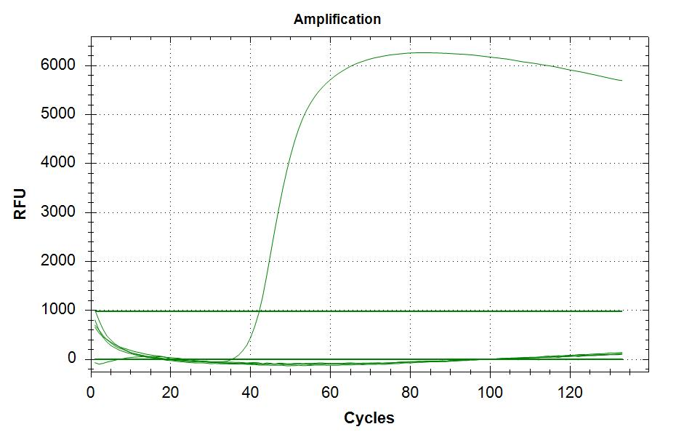
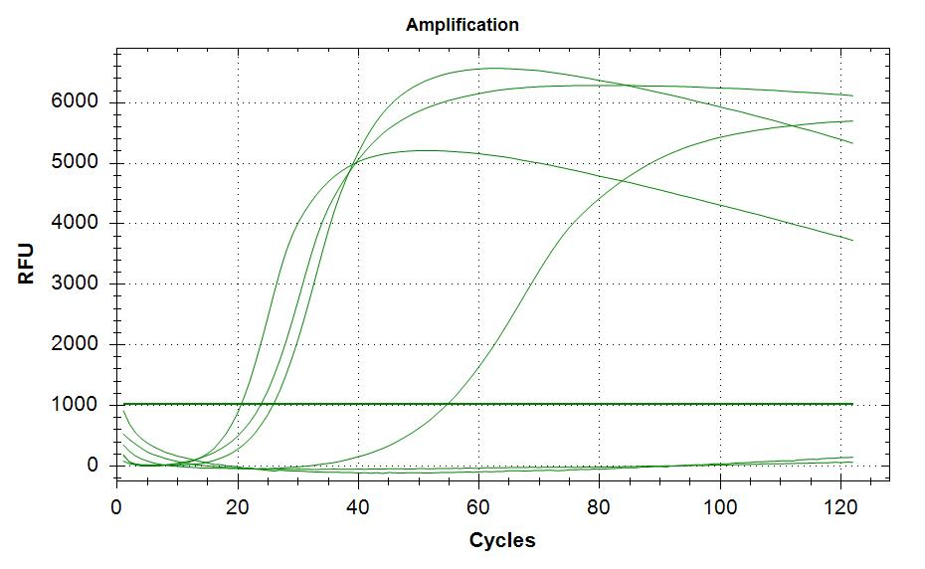
A
4
5
1
6
3
2
3
4
2
1
B
Suppl_Fig. 3
Real-time detection of MDA reaction using lambda genomic DNA.
1: N9 primer (Lambda); 2. RLB-N9 primer (Lambda), 3. RLB-N9 primer (water), 4. N9 primer (water).
(B): RLB-N9 primer (20µM) + N9 (10µM) + Lambda DNA 2. RLB-N9 primer (2.0µM) + N9 (10µM) + Lambda DNA 3. RLB-N9 primer (0.2µM) + N9 (10µM) + Lambda DNA
4. RLB-N9 primer (0.02µM) + N9 (10µM) + Lambda DNA 5. RLB-N9 primer (0.002µM) + N9 (10µM) + Lambda DNA 6. RLB-N9 primer (0.00µM) + N9 (10 µM) + Lambda DNA.

Slide 12
E. coli ENT1/ENT2
 |  | Epicenter RLB-MALBAC Predicted Clinical testing phenotype
Amikacin | aminoglycoside | No resistance | No resistance
Amoxicillin-Clavulanate | beta-lactam | No resistance | No resistance
Amplicillin | beta-lactam | No resistance | No resistance
Aztreonam | beta-lactam | No resistance | No resistance
Cefazolin | beta-lactam | No resistance | No resistance
Cefepime | beta-lactam | No resistance | No resistance
Cefotaxime | beta-lactam | No resistance | No resistance
Cefoxitin | beta-lactam | No resistance | No resistance
Ceftaroline | beta-lactam | No resistance | No resistance
Ceftazidime | beta-lactam | No resistance | No resistance
Ceftazidime-Avibactam | beta-lactam | No resistance | No resistance
Ceftolozane-Tazobactam | beta-lactam | No resistance | No resistance
Ceftriaxone | beta-lactam | No resistance | No resistance
Cefuroxime | beta-lactam | No resistance | No resistance
Cephalexin | beta-lactam | No resistance | No resistance
Cephalothin | beta-lactam | No resistance | No resistance
Ciprofloxacin | quinolone | No resistance | No resistance
Colistin | polymyxin | No resistance | No resistance
Ertapenem | beta-lactam | No resistance | No resistance
Fosfomycin | fosfomycin | No resistance | No resistance
Gentamicin | aminoglycoside | No resistance | No resistance
Imepenem | beta-lactam | No resistance | No resistance
Levofloxacin | quinolone | No resistance | No resistance
Meropenem | beta-lactam | No resistance | No resistance
Nitrofurantoin |  | No resistance | No resistance
Piperacillin-Tazobactam | beta-lactam | No resistance | No resistance
Tetracyline | tetracycline | No resistance | No resistance
Tigecyclin | tetracycline | No resistance | No resistance
Tobramycin | aminoglycoside | No resistance | No resistance
Trimethoprim-Sulfamethoxazole | folate pathway antagonist | No resistance | No resistance
Suppl_Table. 1
ResFinder prediction of the contigs assemblies generated using RLB-MALBAC protocol for β-lactam susceptible E. coli ENT1 & ENT2.

