Slide 1
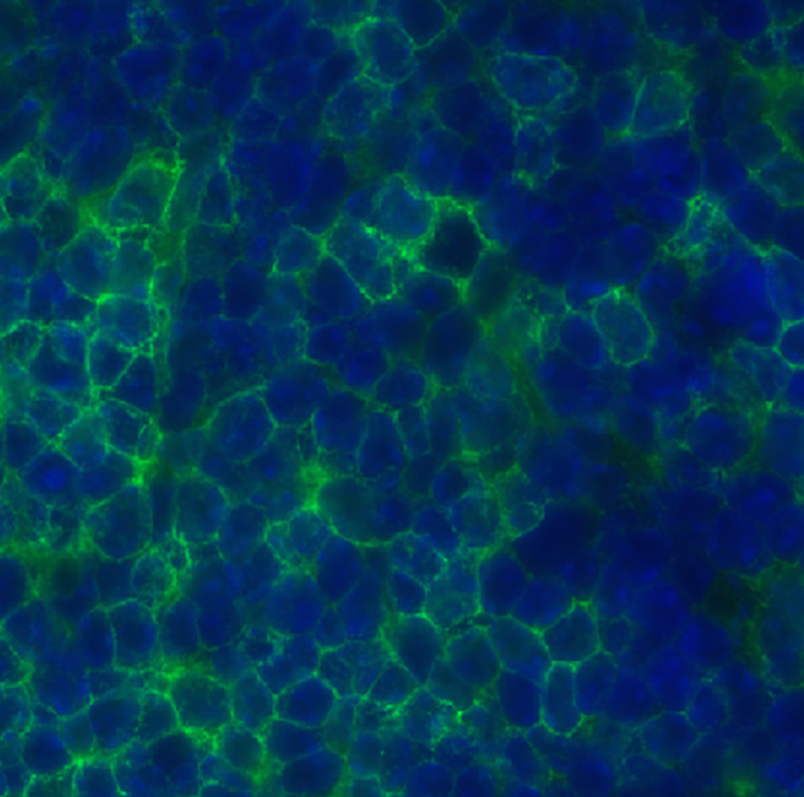

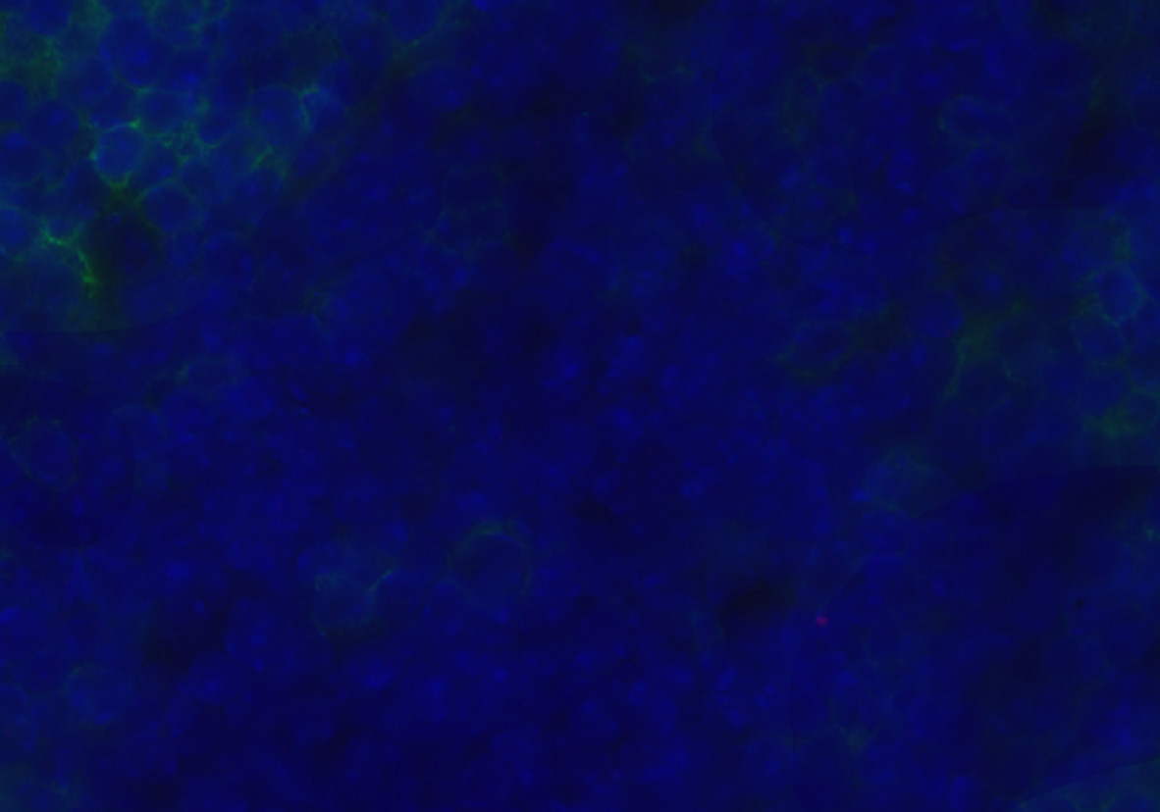
Supplementary Figure 1
C57BL/6
Rag1^{-/-}
Anti-CD8 + secondary Ab
Secondary Ab
Anti-CD8 + secondary Ab

Slide 2
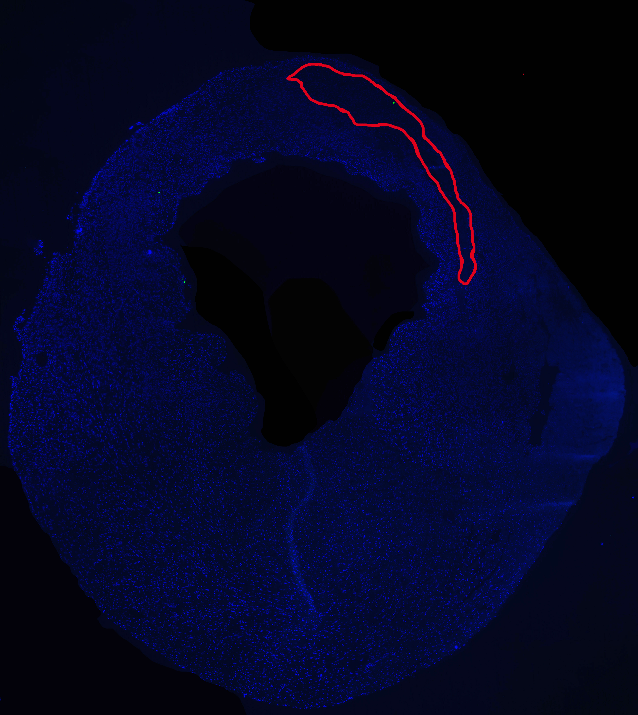
Supplementary Figure 2
CTR
CD8 Depleted

Slide 3
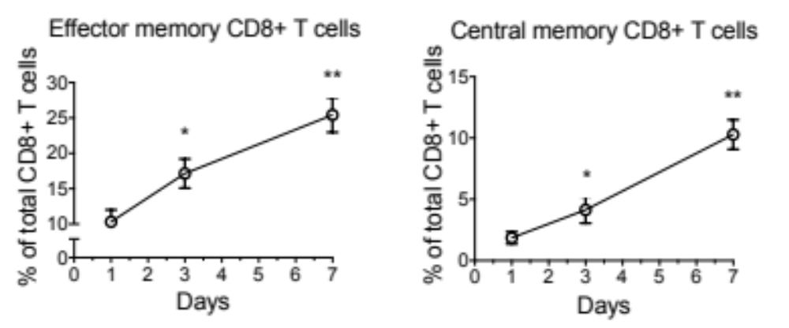
Supplementary Figure 3

Slide 4
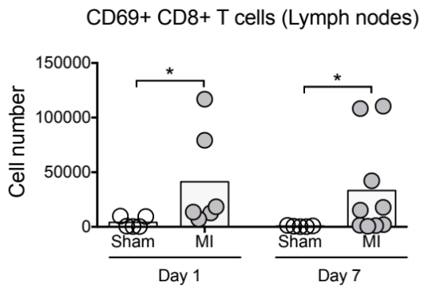
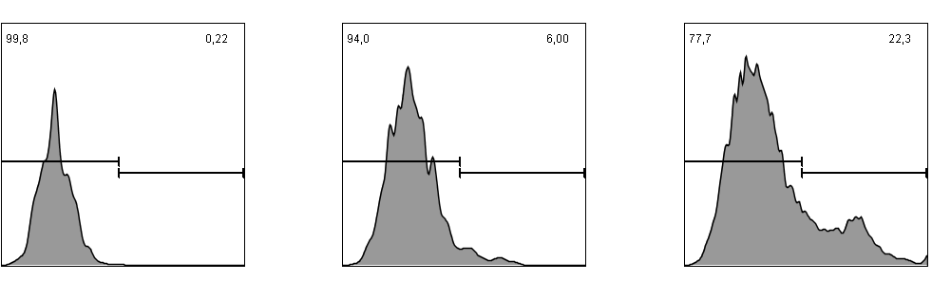
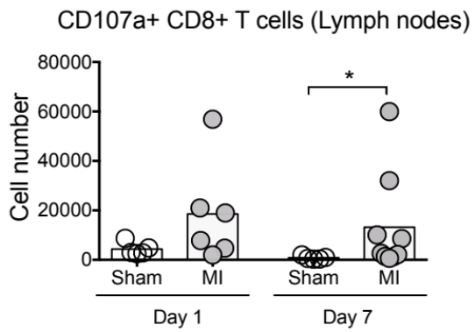
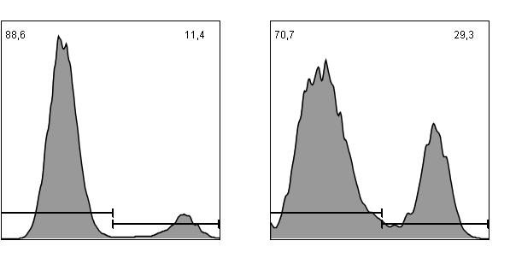
Supplementary Figure 4
Sham
MI
Count
CD69
Sham
MI
Count
CD107a

Slide 5
Supplementary Figure 5
cardiomyocyte
Granzyme B release
CD8+ T cell
cardiomyocyte

Slide 6
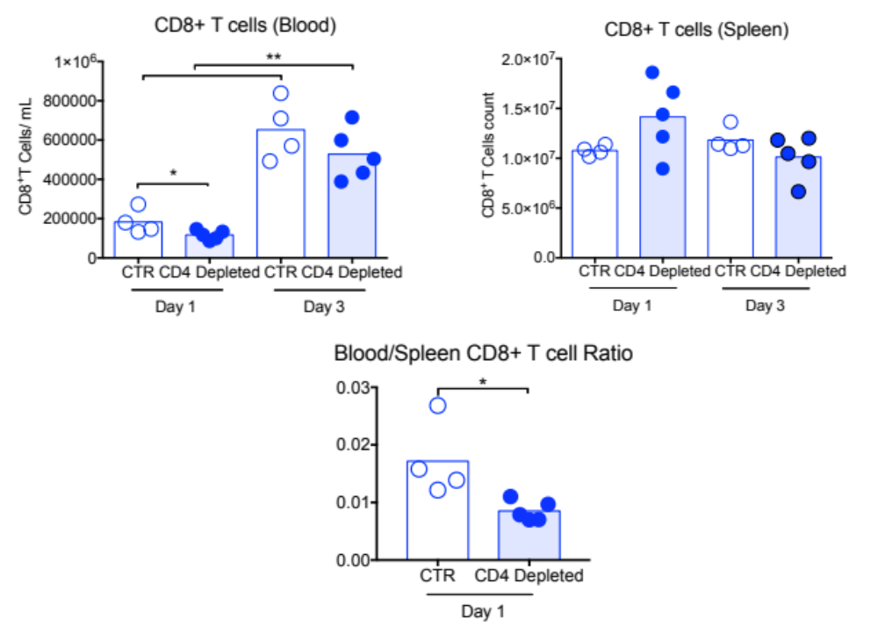
Supplementary Figure 6
A
B
C

Slide 7
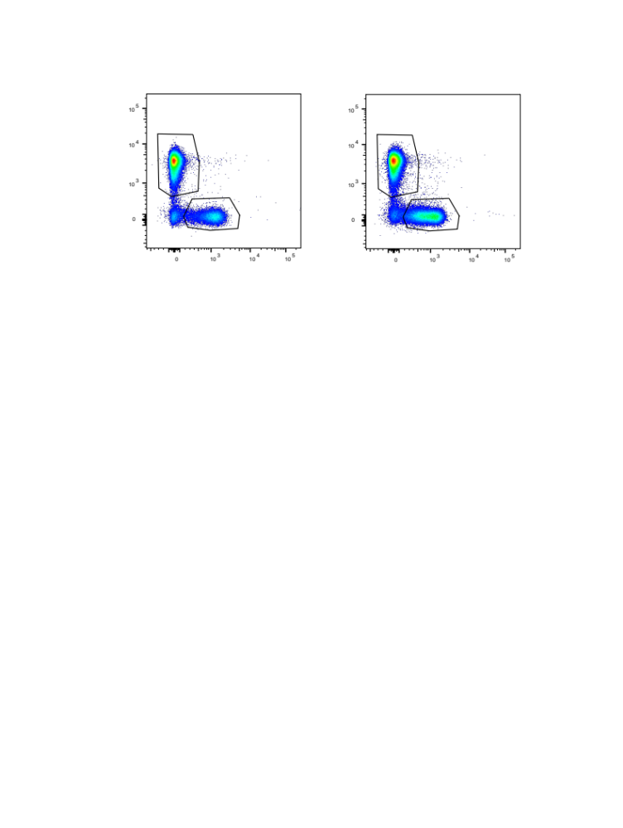
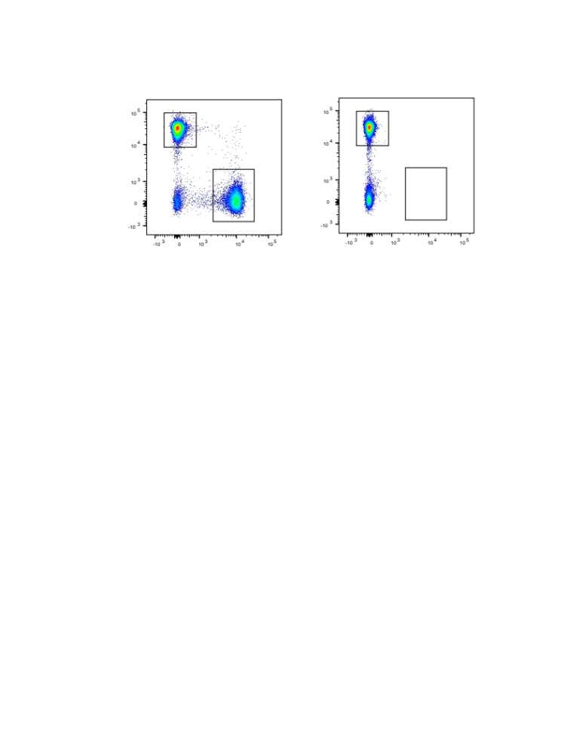
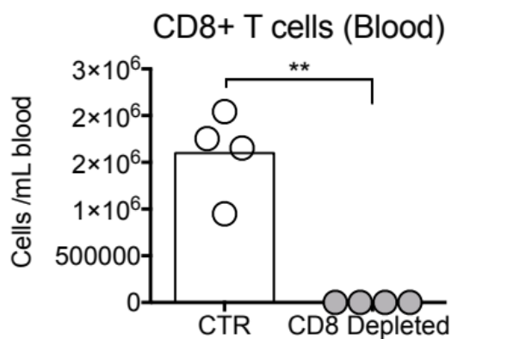
Supplementary Figure 7
6 hours after antibody injection (Blood)
CD19
CD4
CD3
CD8

Slide 8
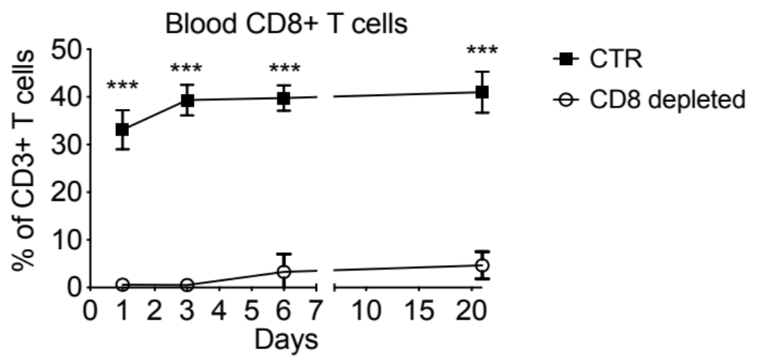
Supplementary Figure 8

Slide 9
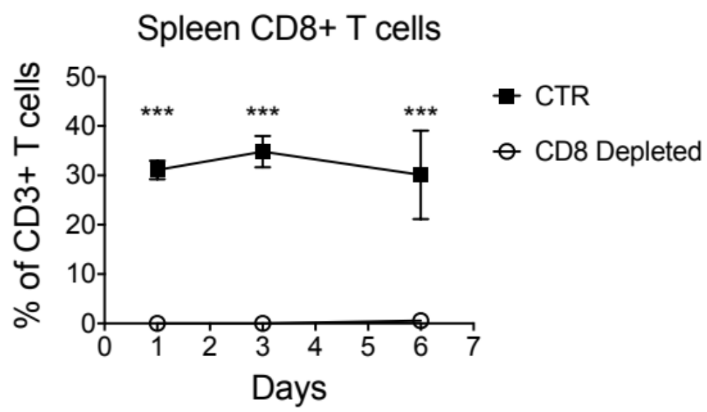
Supplementary Figure 9

Slide 10
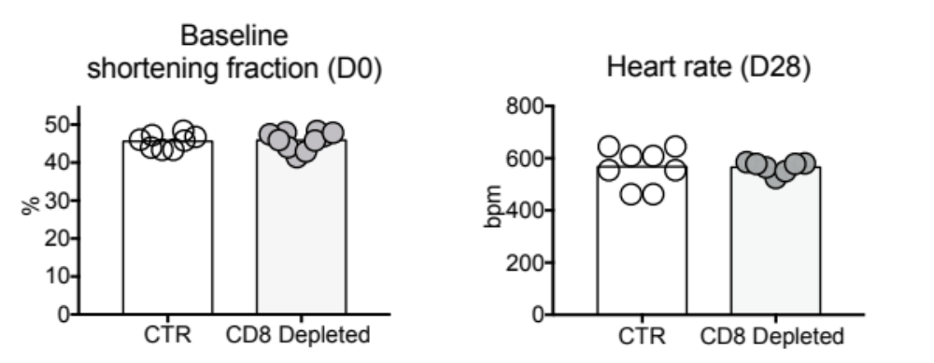
Supplementary Figure 10
A
B

Slide 11
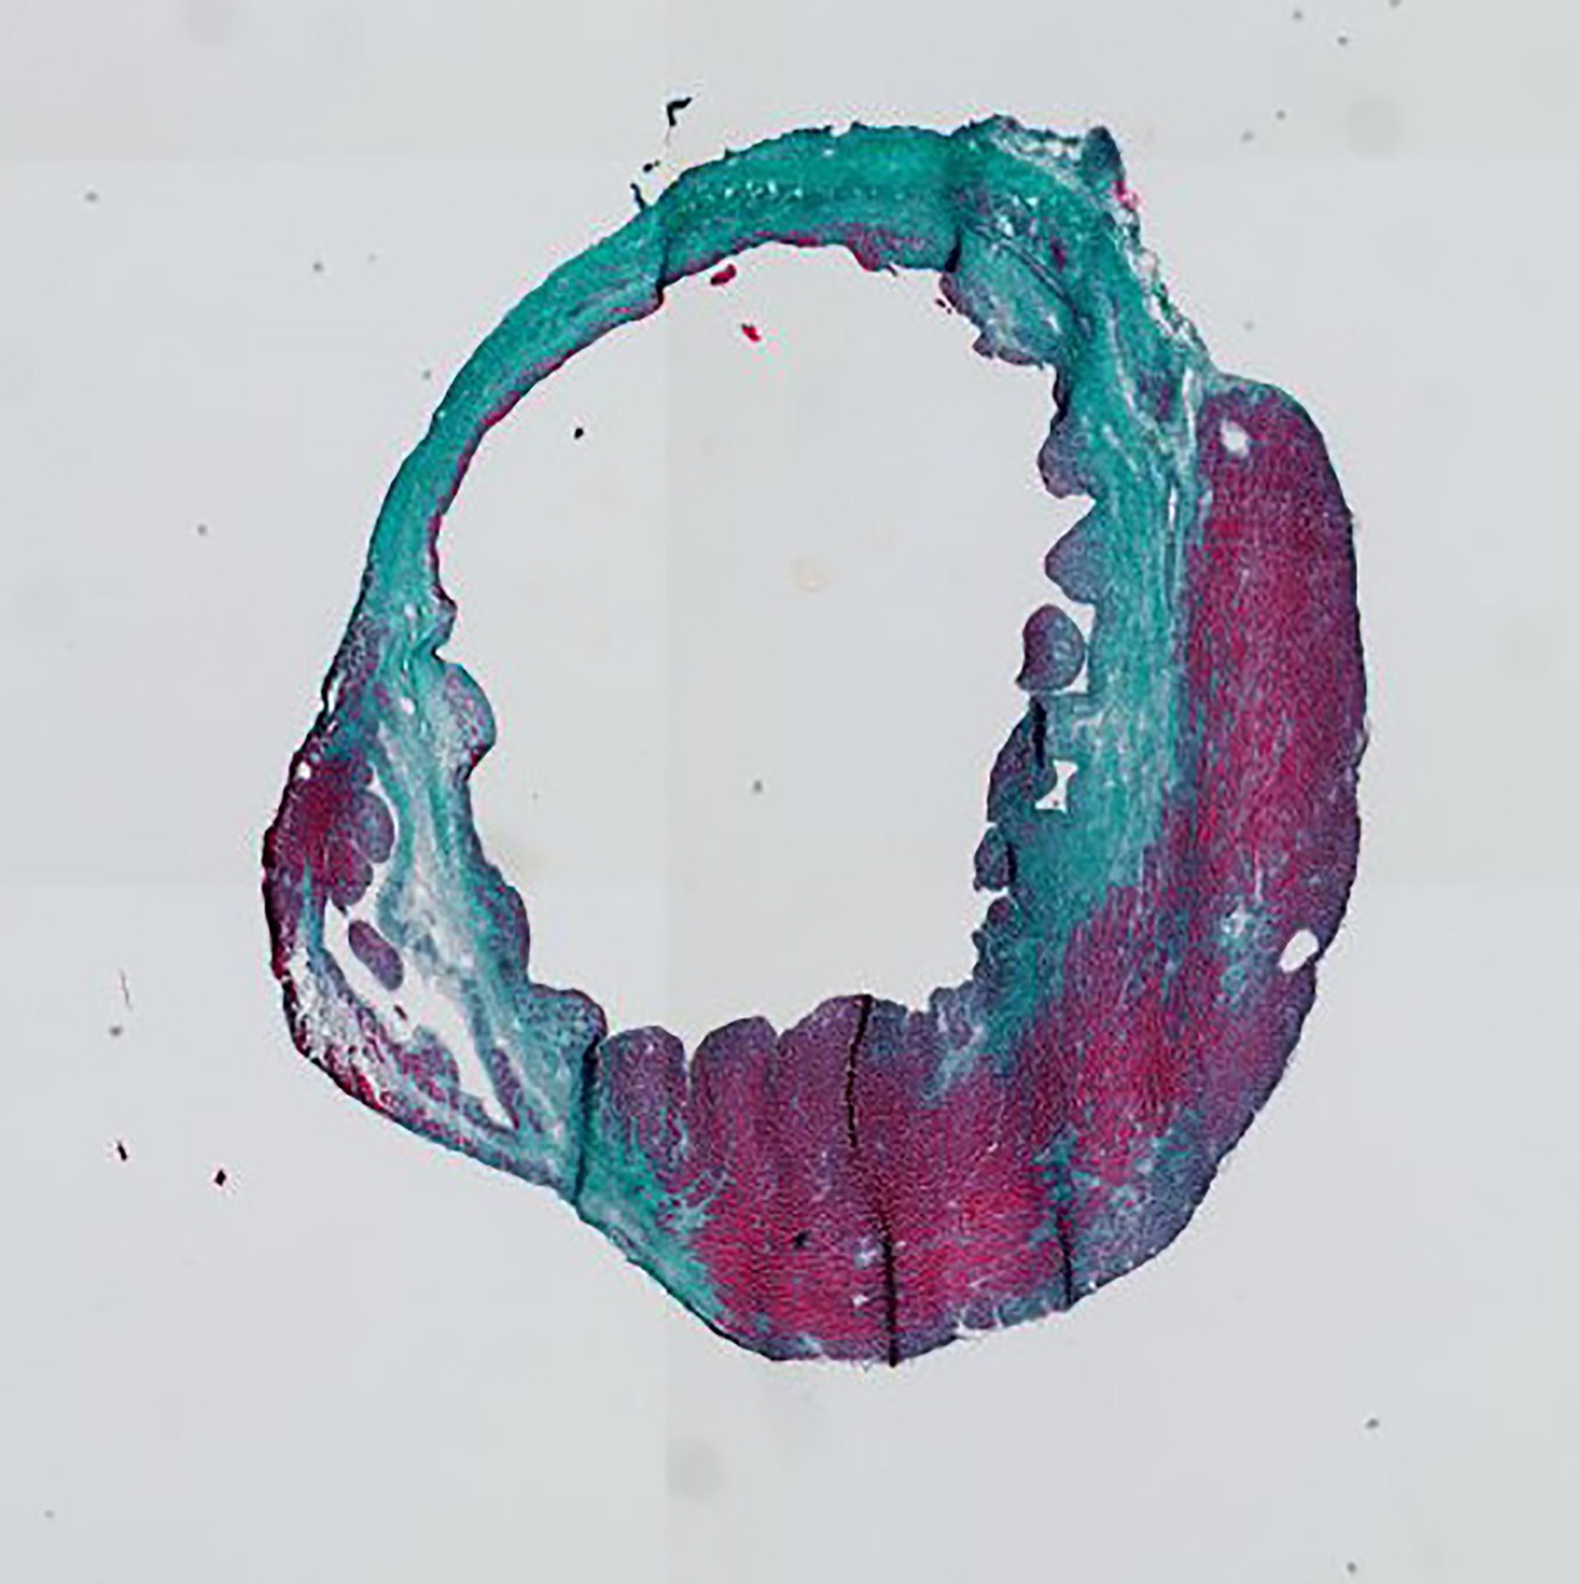
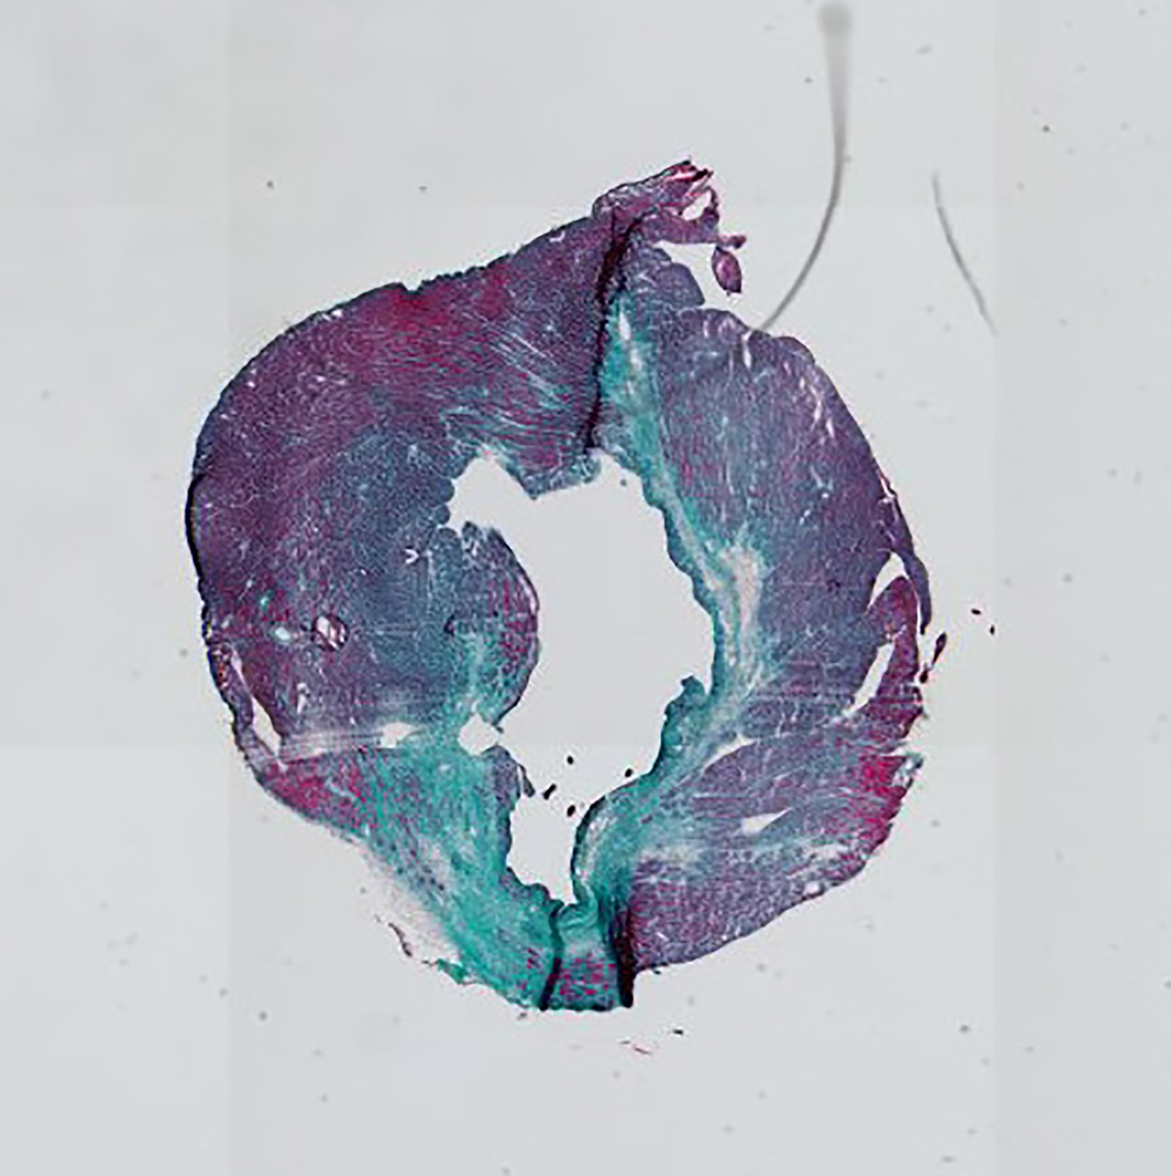
Supplementary Figure 11
CTR
CD8 Depleted

Slide 12
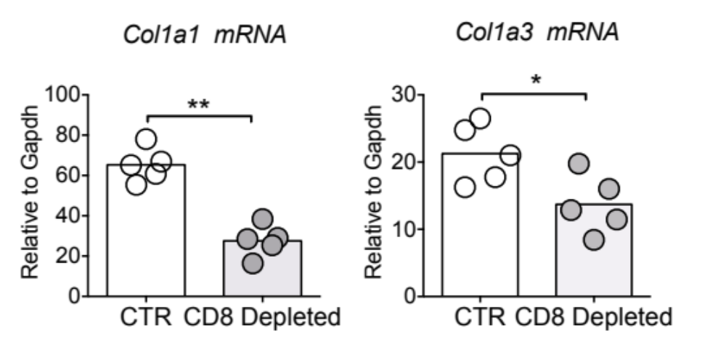
Supplementary Figure 12

Slide 13
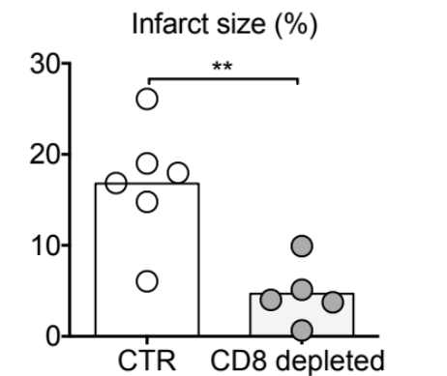
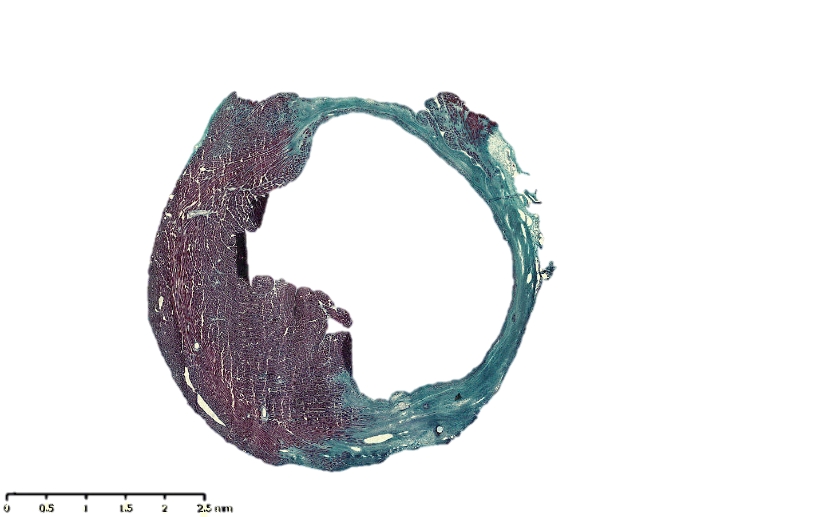
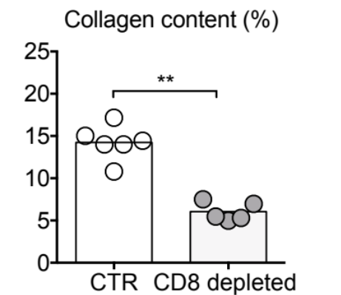
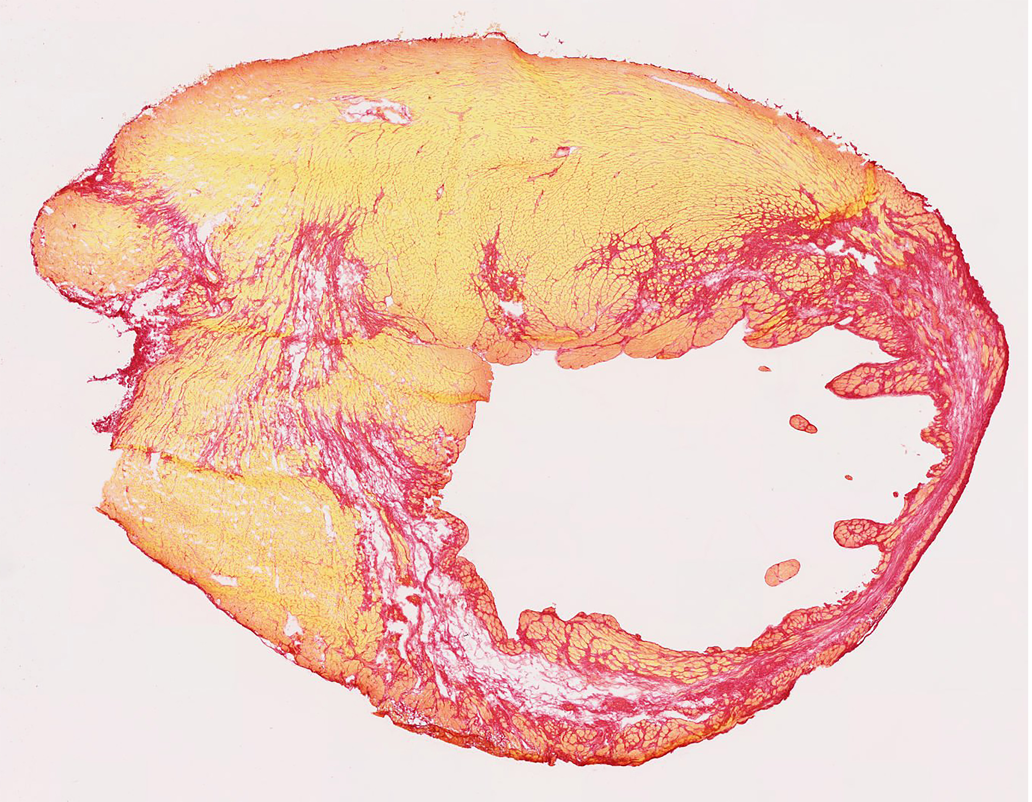
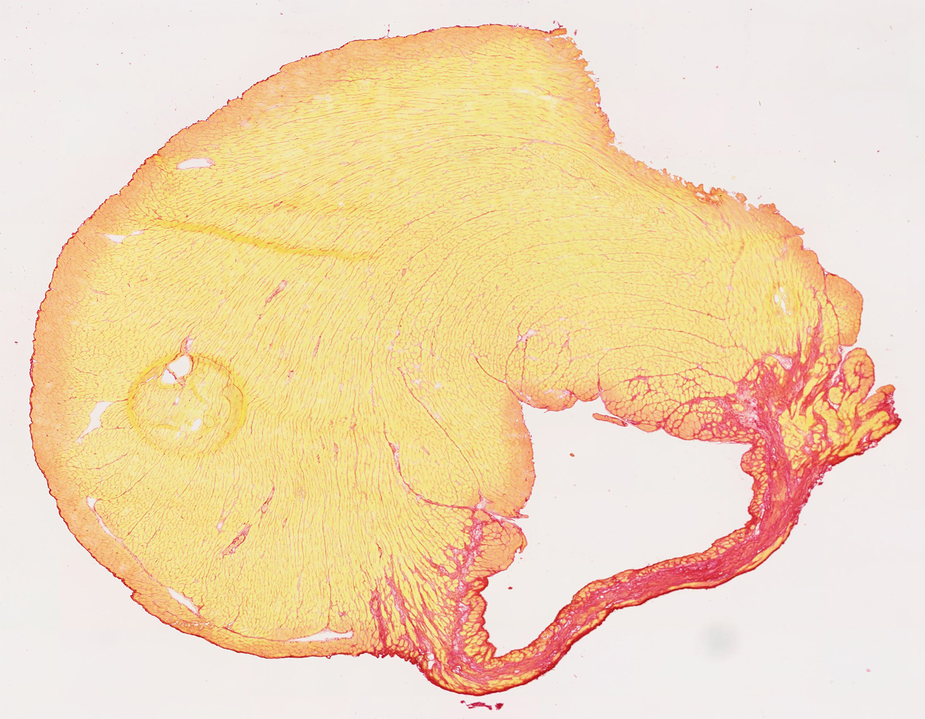
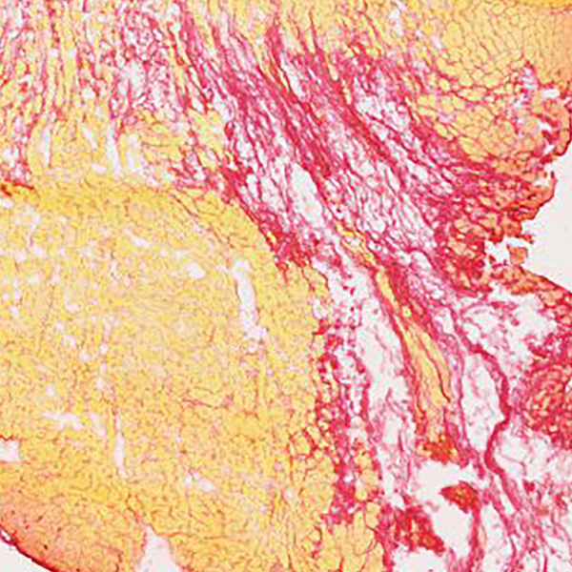
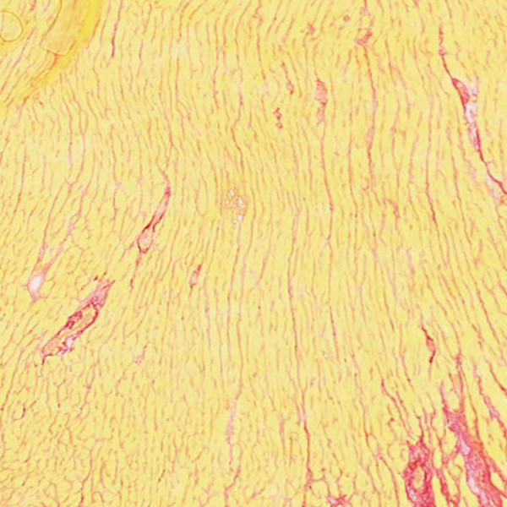
Supplementary Figure 13
CTR
CD8 depleted
A
B
CTR
CD8 depleted

Slide 14
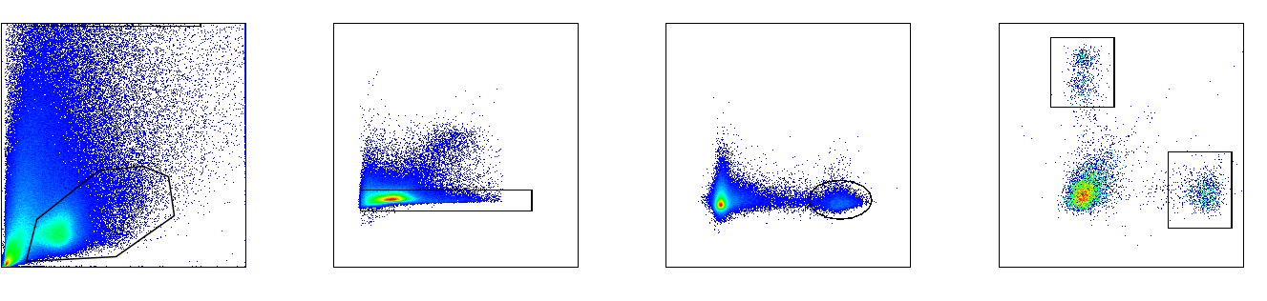
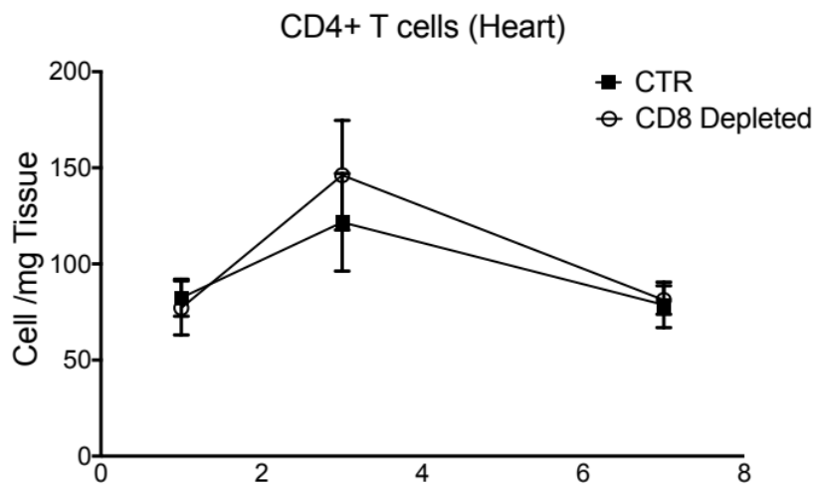
Supplementary Figure 14
SSC
FSC
SSC
CD8
FSC
FSC
CD45
CD4

Slide 15
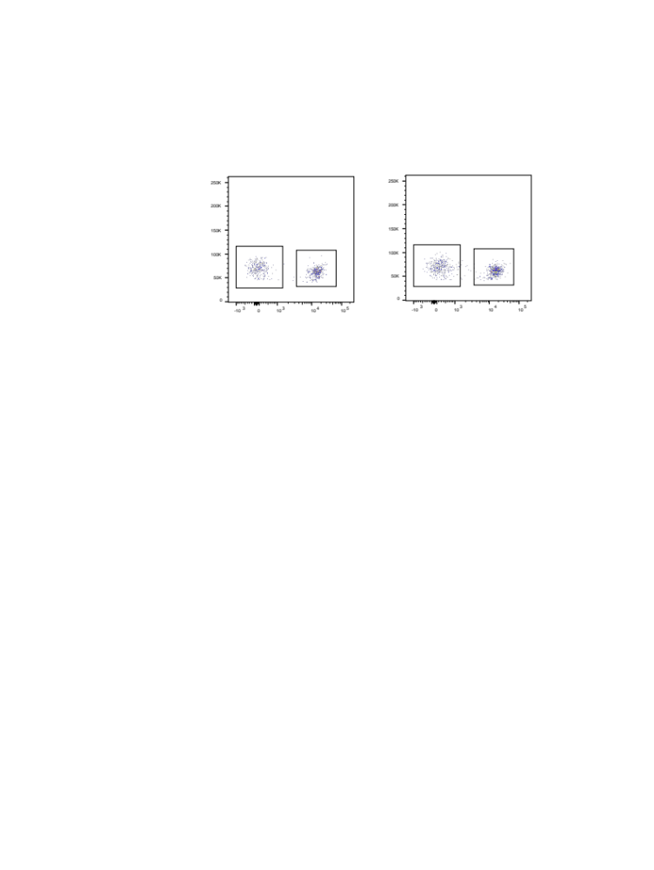
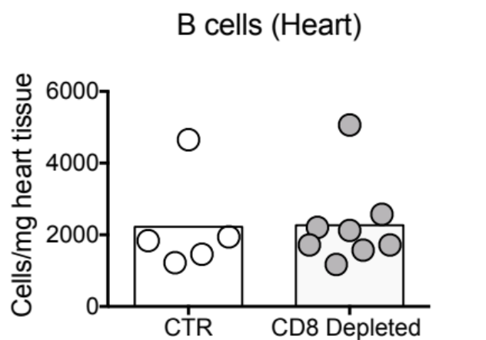
Supplementary Figure 15
Gated on CD45+ NK1.1-
CTR
CD8 depleted
FSC
CD19

Slide 16
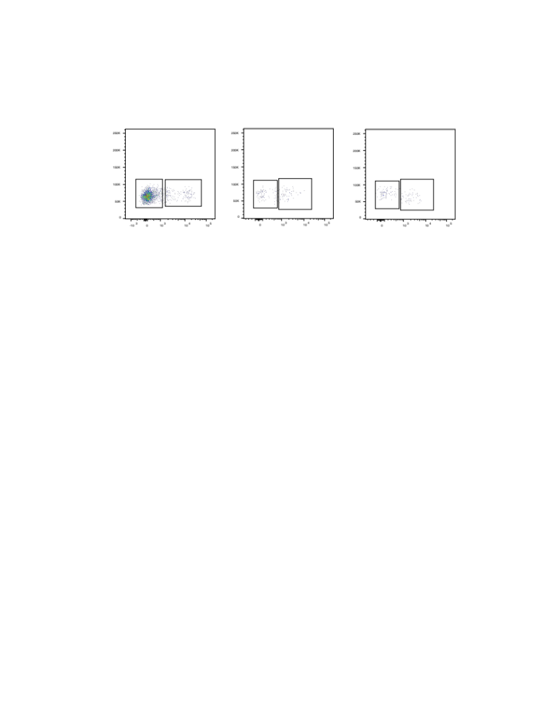
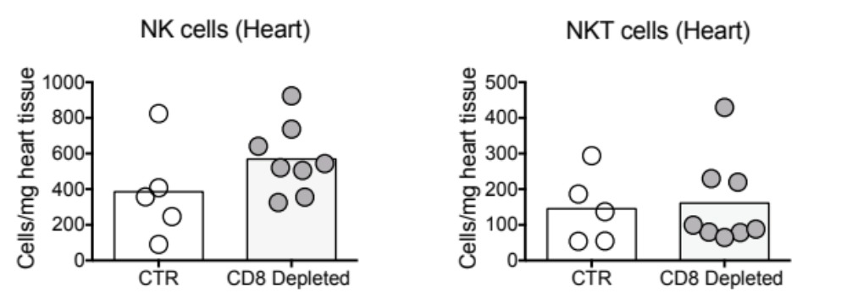
Supplementary Figure 16
Gated on CD45+
CTR
CD8 Depleted
FSC
FSC
CD3
NK1.1

Slide 17
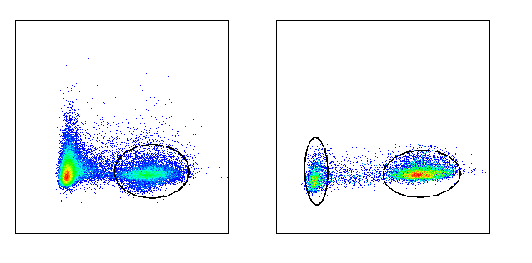
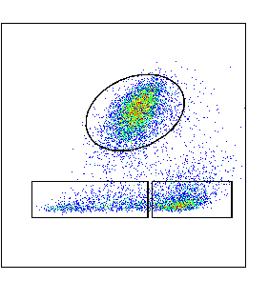
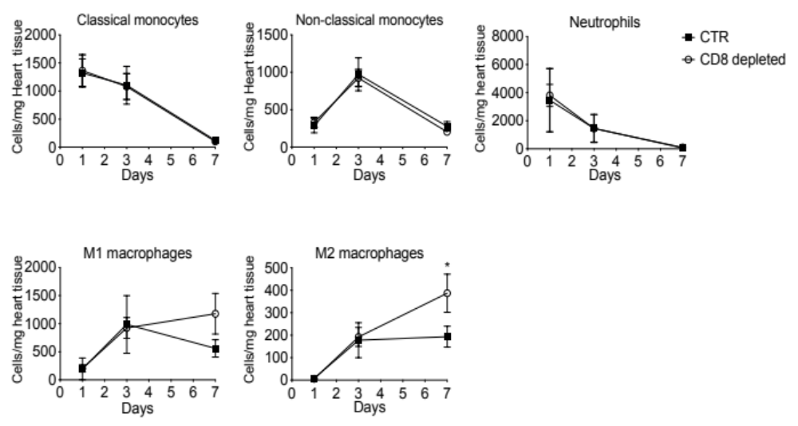
Supplementary Figure 17
SSC
SSC
Ly6G
low
high
CD45
CD11b
Ly6C

Slide 18
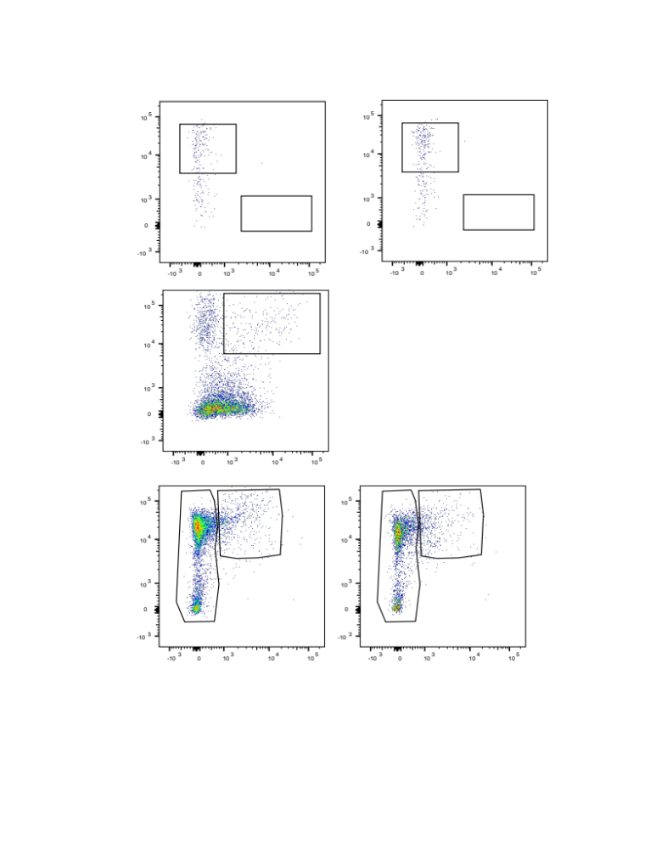
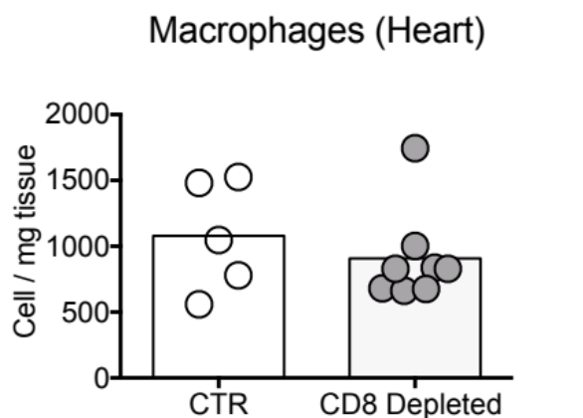
Supplementary Figure 18
Gated on CD45+ cells
CTR
CD8 Depleted
CD11b
F4/80

Slide 19
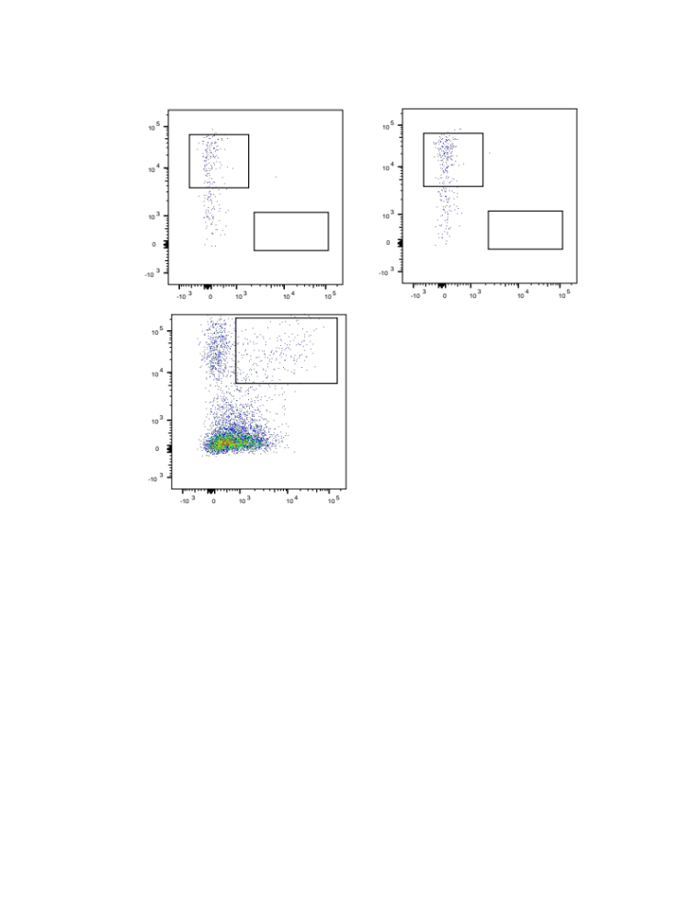
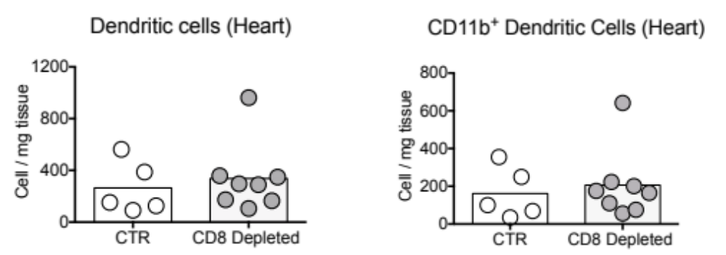
Supplementary Figure 19
Gated on CD45+ F4/80-
CTR
CD8 Depleted
CD11c
CD11b
MHCII
CD8

Slide 20
Supplementary Figure 20
TUNEL/DAPI/Granzyme B

Slide 21
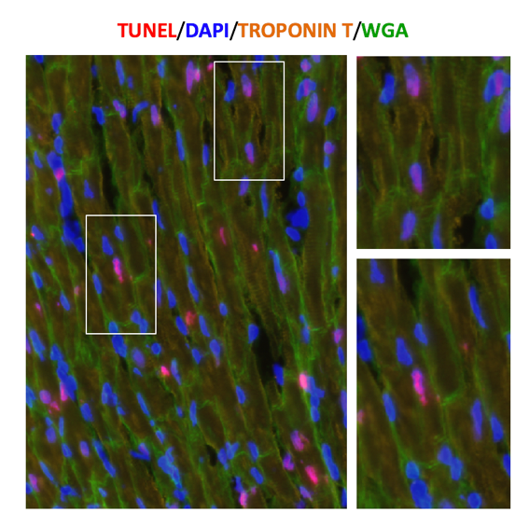
Supplementary Figure 21

Slide 22
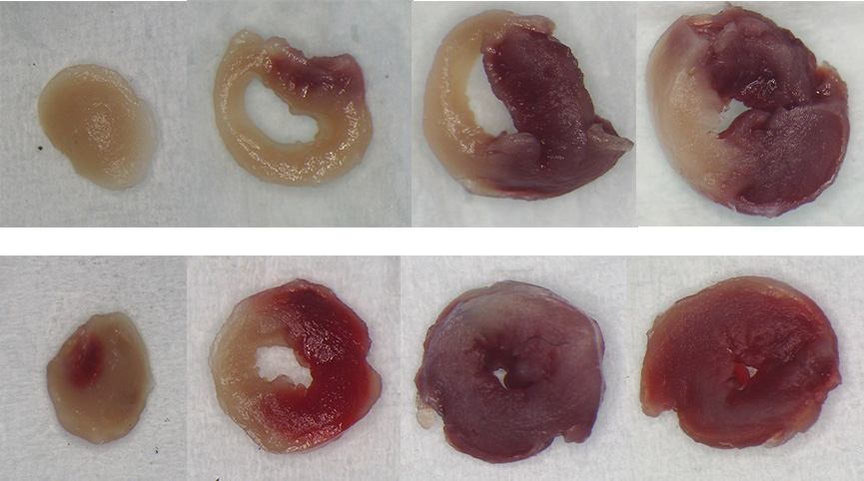
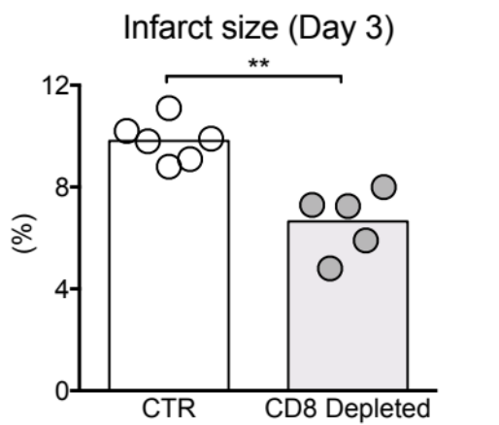
Supplementary Figure 22
CTR
CD8 Depleted

Slide 23
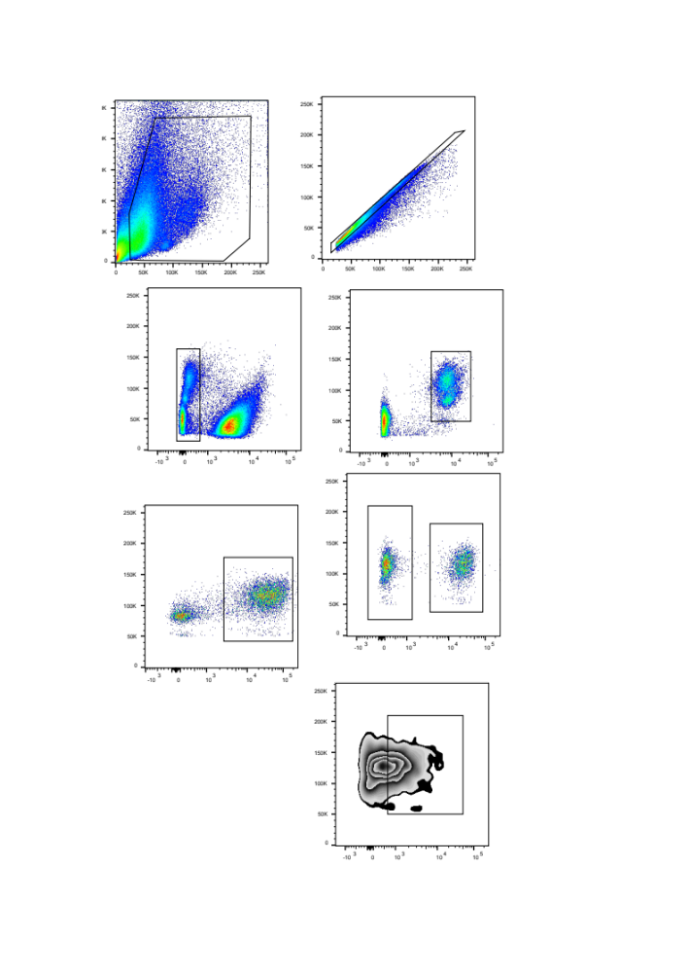

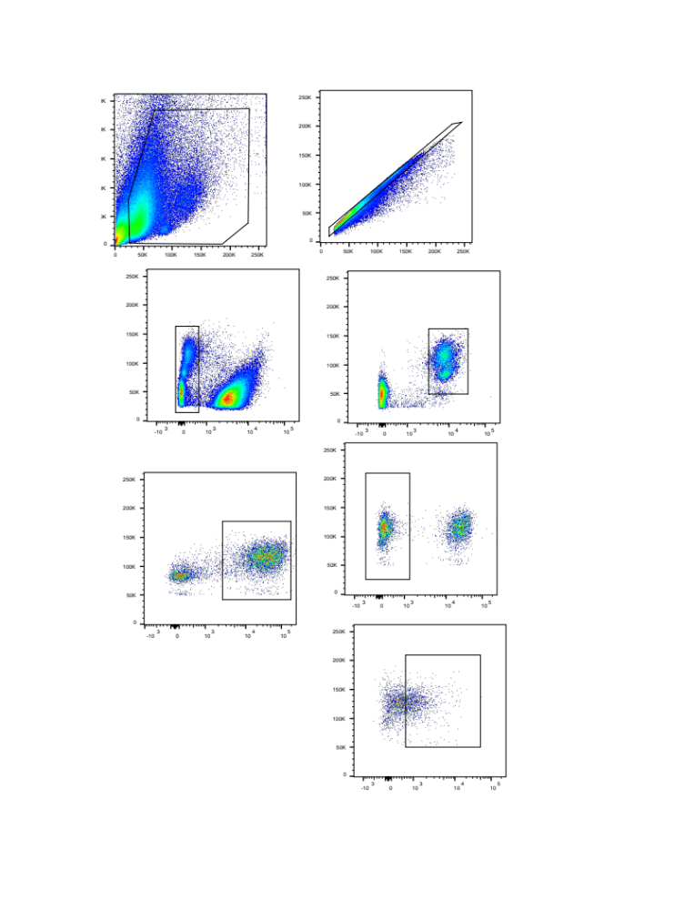

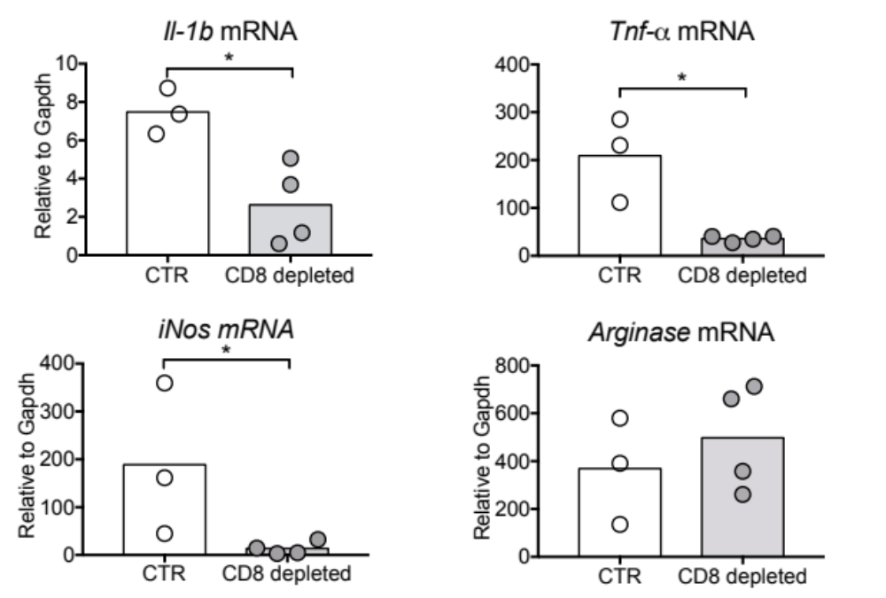
Supplementary Figure 23
A
FSC
FSC
FSC
FSC
FSC
Live/Dead
CD45
CD11b
LY6G
F4/80
B

Slide 24
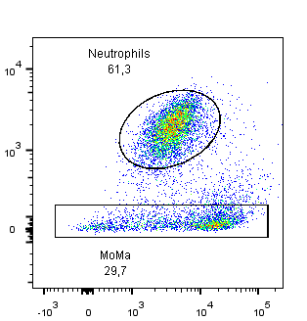
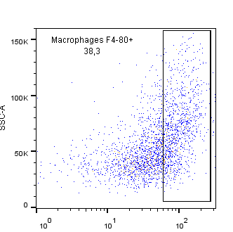
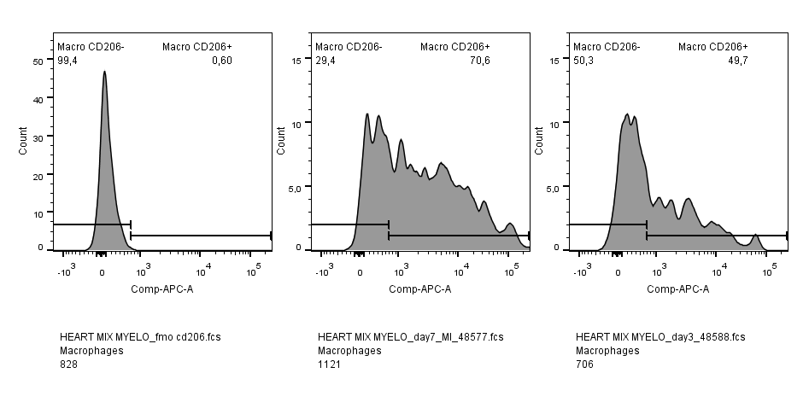
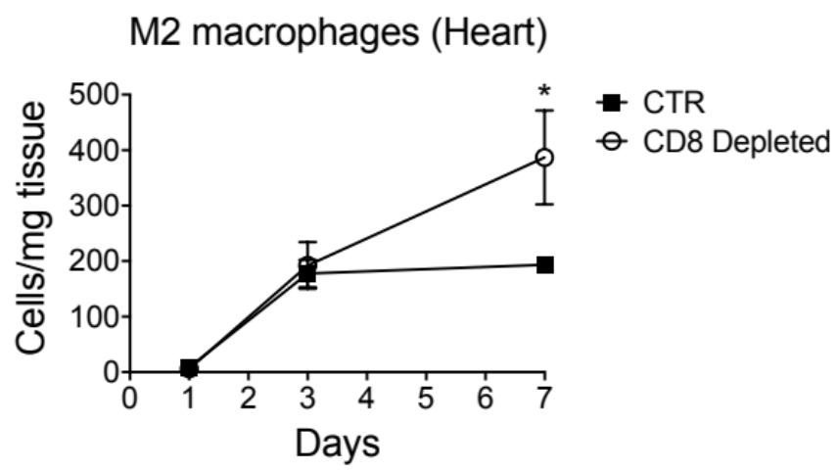
Supplementary Figure 24
FMO
Day 3
Day 7
Ly6G
SSC-A
Ly6C
F4/80
CD206

Slide 25
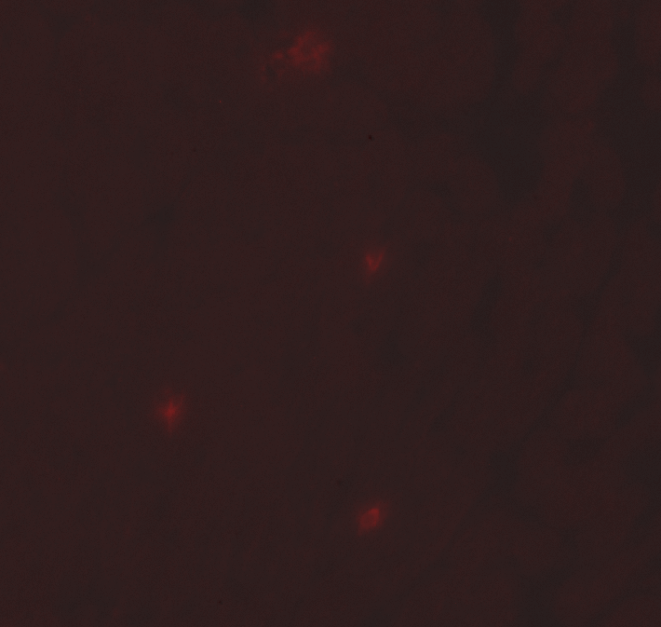

Supplementary Figure 25
WT
GzmB^{-/-}
Heart
WT
GzmB^{-/-}
Spleen

Slide 26
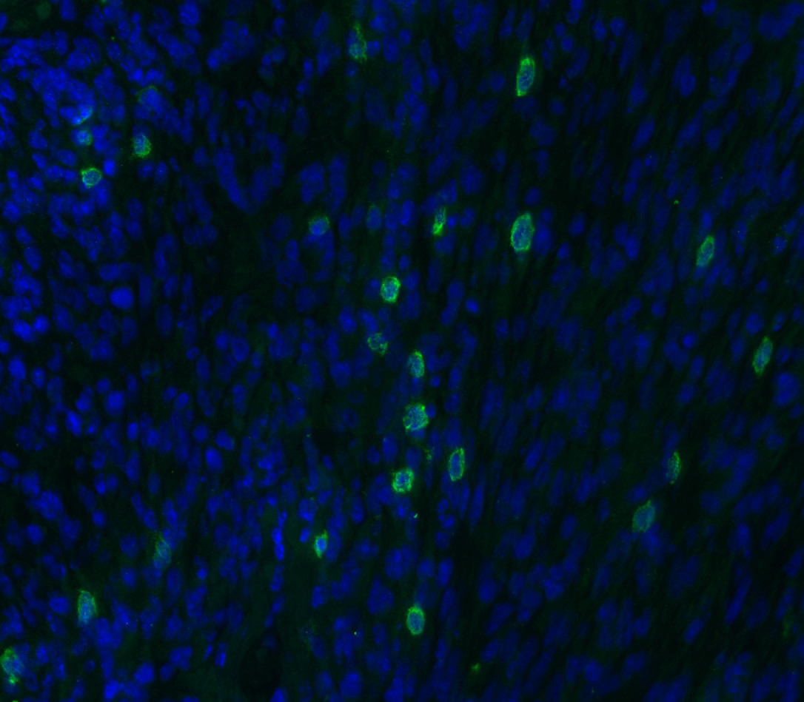
Supplementary Figure 26
DAPI/CD8
WT
GzmB ^{-/-}
Inf
Inf

Slide 27

Supplementary Figure 27

Slide 28

Supplementary Figure 28

Slide 29
Supplementary Figure 29
Before activation
After activation
CD4
CD4
CD8
CD8
FSC
FSC
FSC
FSC
CD69
CD107
CD69
CD107

Slide 30

Supplementary Figure 30
Exclusion of dead cells
67,1%
Before isolation
26,6%
9,4%
44%
0 %
After isolation
98%
SSC
87,4%
FSC
99,9%
CD4
FSC
CD3
CD8

Slide 31



Supplementary Figure 31
A
B
C
No
WT
3
weeks
3 days
5-week old
male Rag1^{-/-}
GzmB ^{-/-}
CD8 T cell transfer
Myocardial Infarction

Slide 32

Supplementary Figure 32
mAb CD8 injection
Baseline
Day 1
Day 3
CD4
CD8

Slide 33
Supplementary Figure 33
Blood sampling
Day 0
Day +1
Day +3
Coronary artery
Occlusion
40 mn
4-month old female pig
Catheter
Implantation
Day-15
mAb CD8 injection
Group HIGH depletion
Day-3
mAb CD8 injection
Group LOW depletion
Day 0 H+1
Echocardiography
and histology
Day+14

Slide 34



Supplementary Figure 34
Control
Low CD8 depletion
High CD8 depletion

Slide 35


Supplementary Figure 35

