Slide 1
Supplementary data: Table and figure Legends
Table S1: Distribution of the study population by age and gender.
Figure S1a: Sample collection sites. (1) Abomey Calavi in the Atlantic Region (a=Central Clinic of Abomey Calavi) and (2) Cotonou in the Central Region (b=Anastasis Hospital, c= Polyclinic St Vincent de Paul and d= Mênontin Hospital).
Figure S1b: Distribution of genotypes by age in Cotonou.
Figure S1c: Distribution of genotypes from 90 stool samples in Abomey-Calavi
Figure S1d: Distribution of genotypes according to age in Abomey-Calavi.

Slide 2
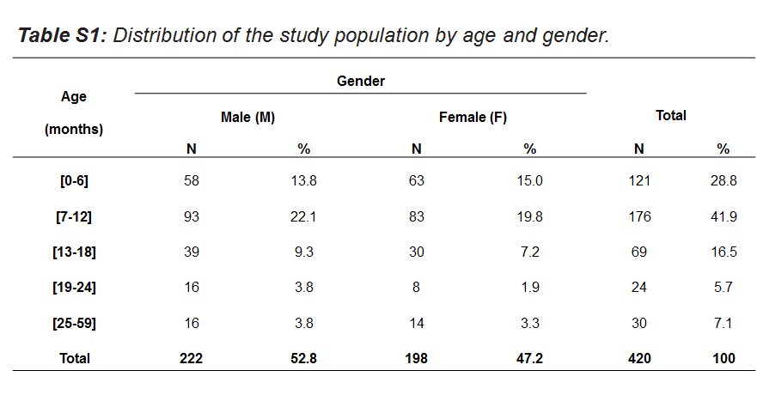
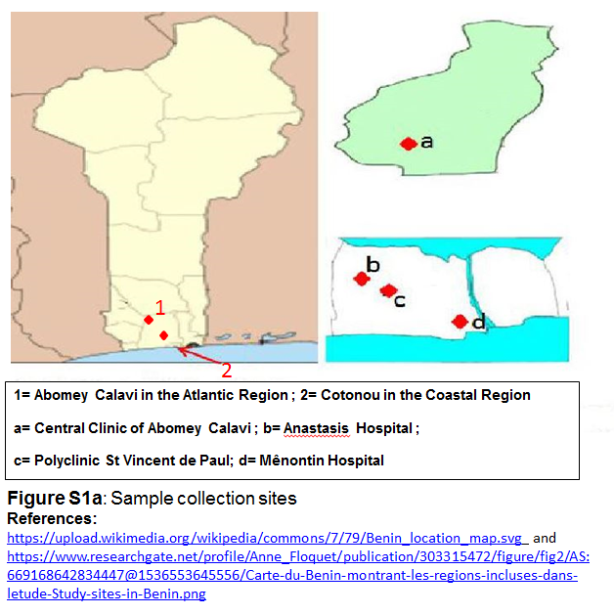
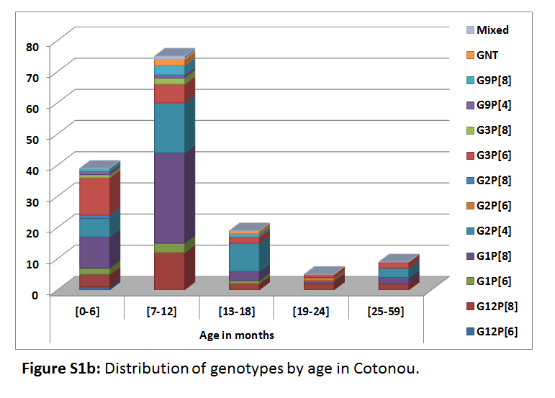

Slide 3
