Slide 1
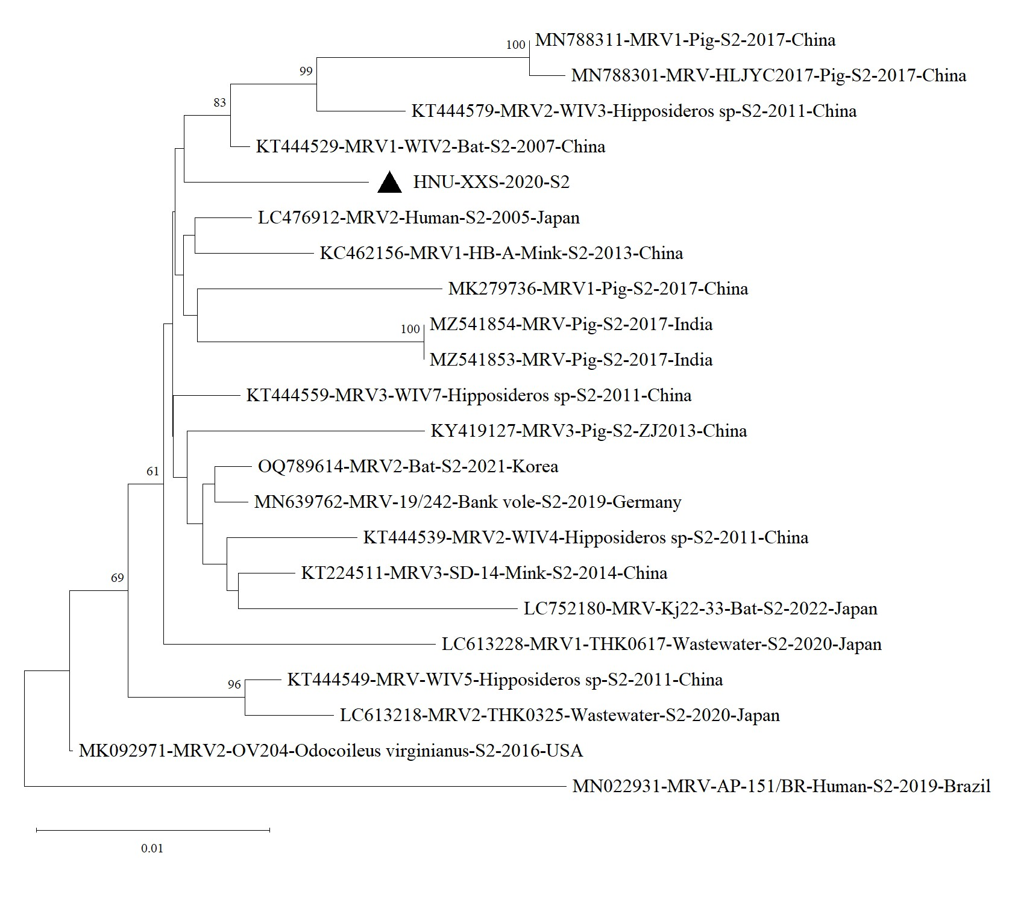
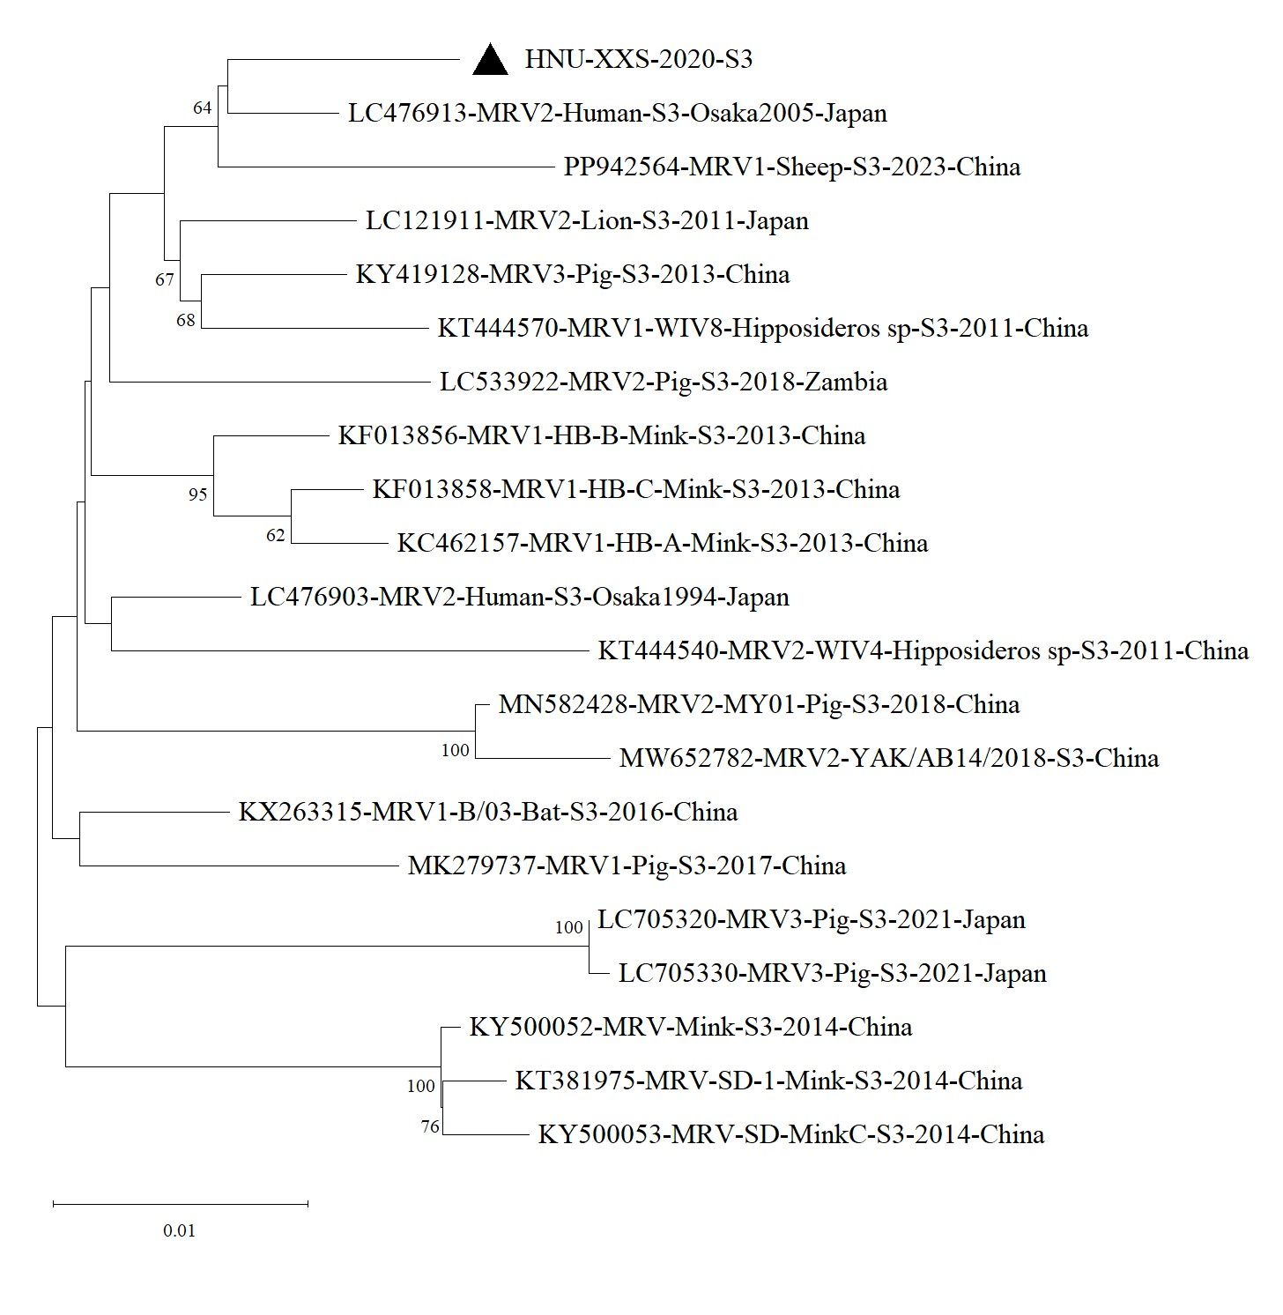
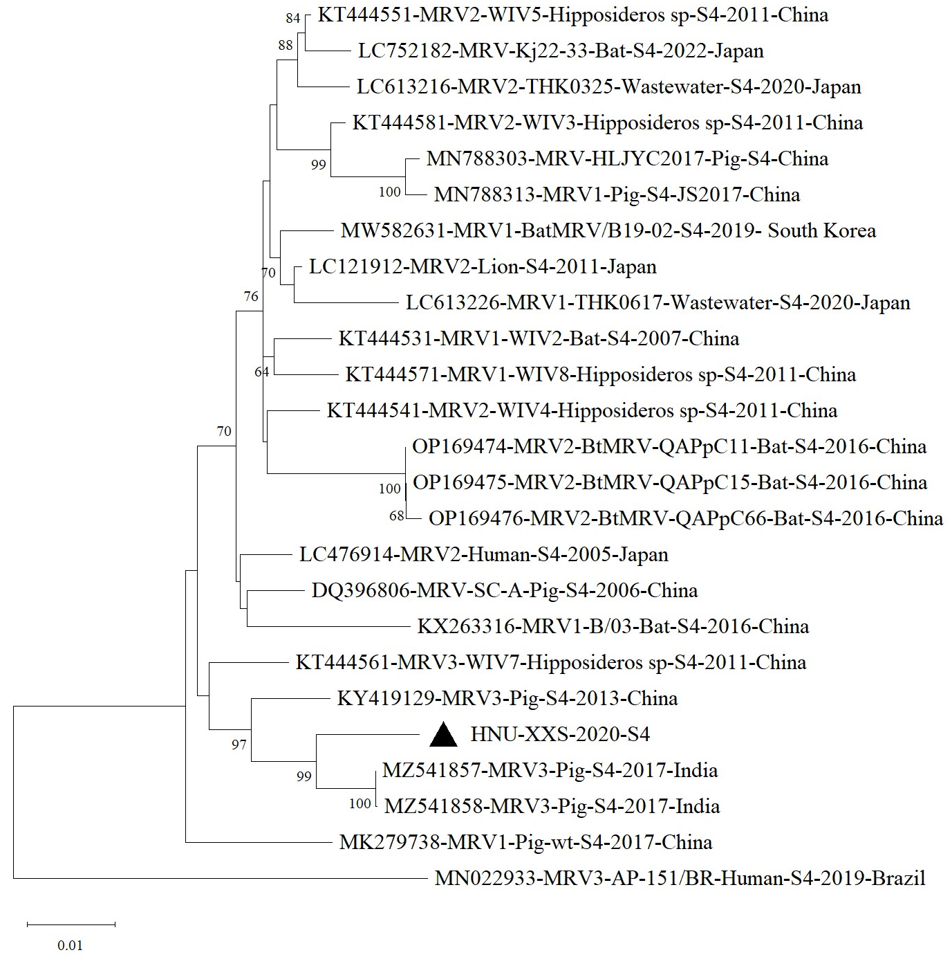
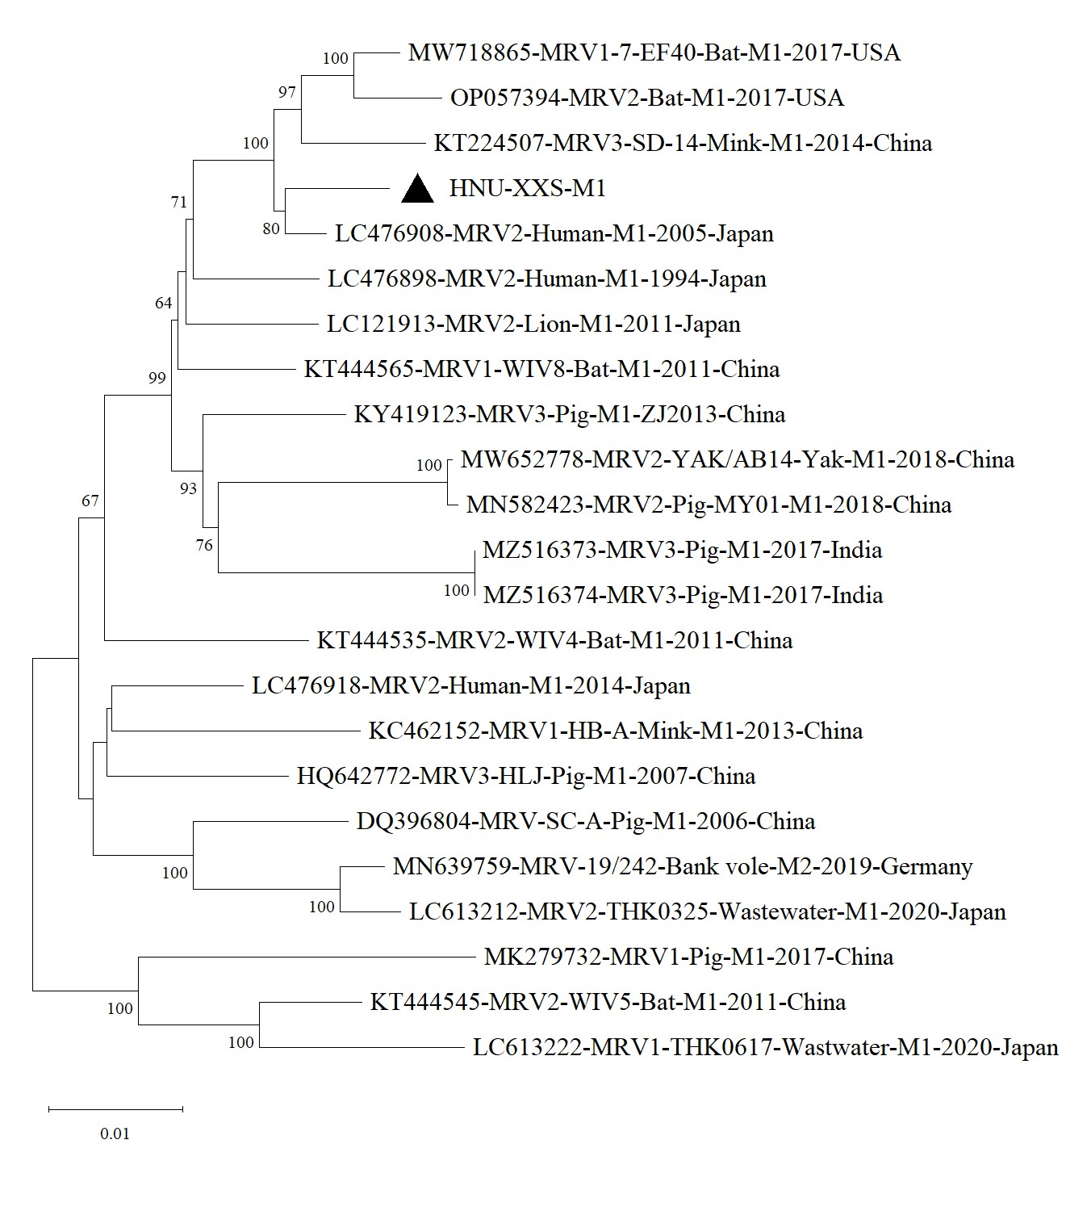
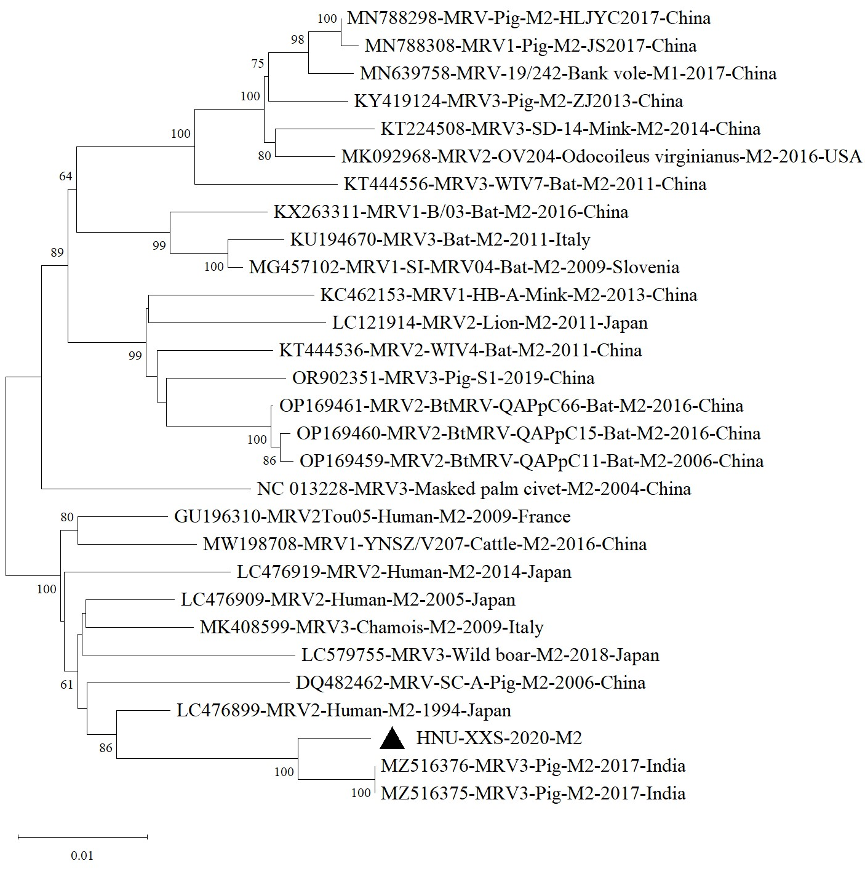
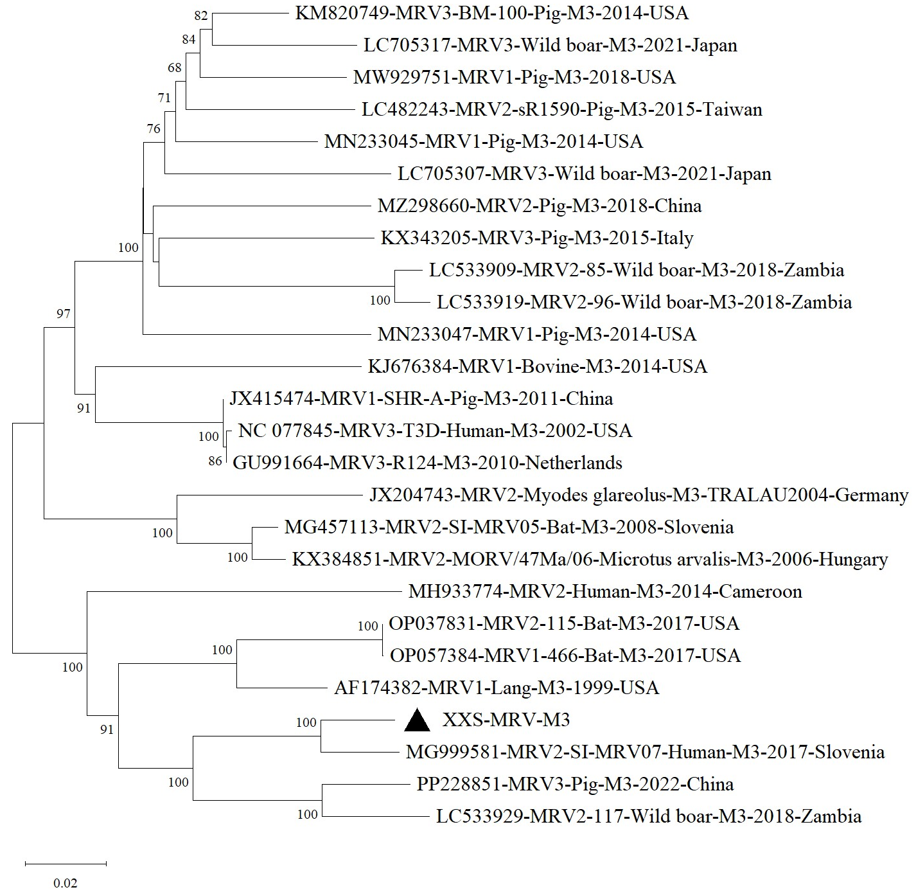
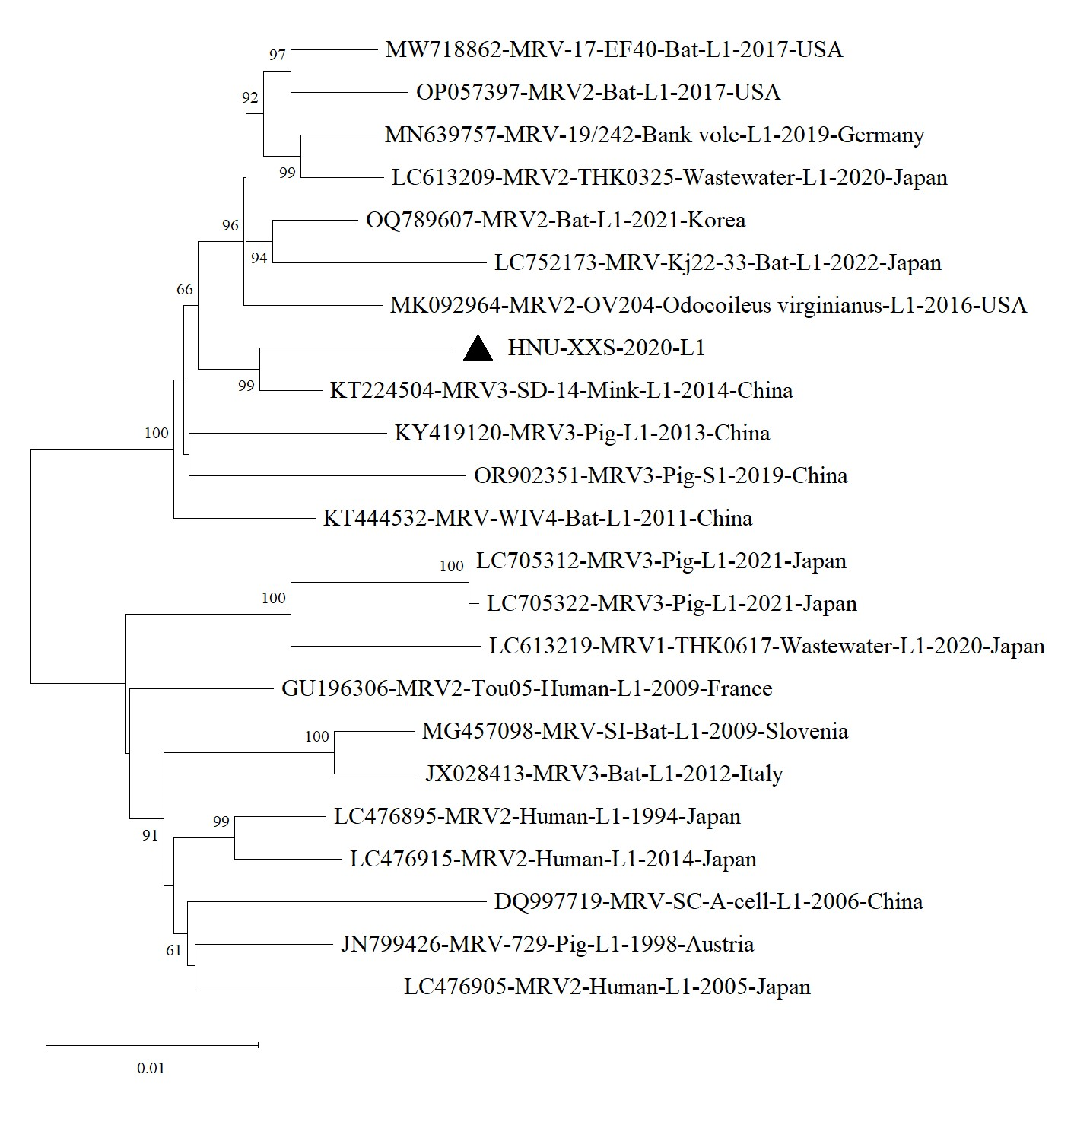
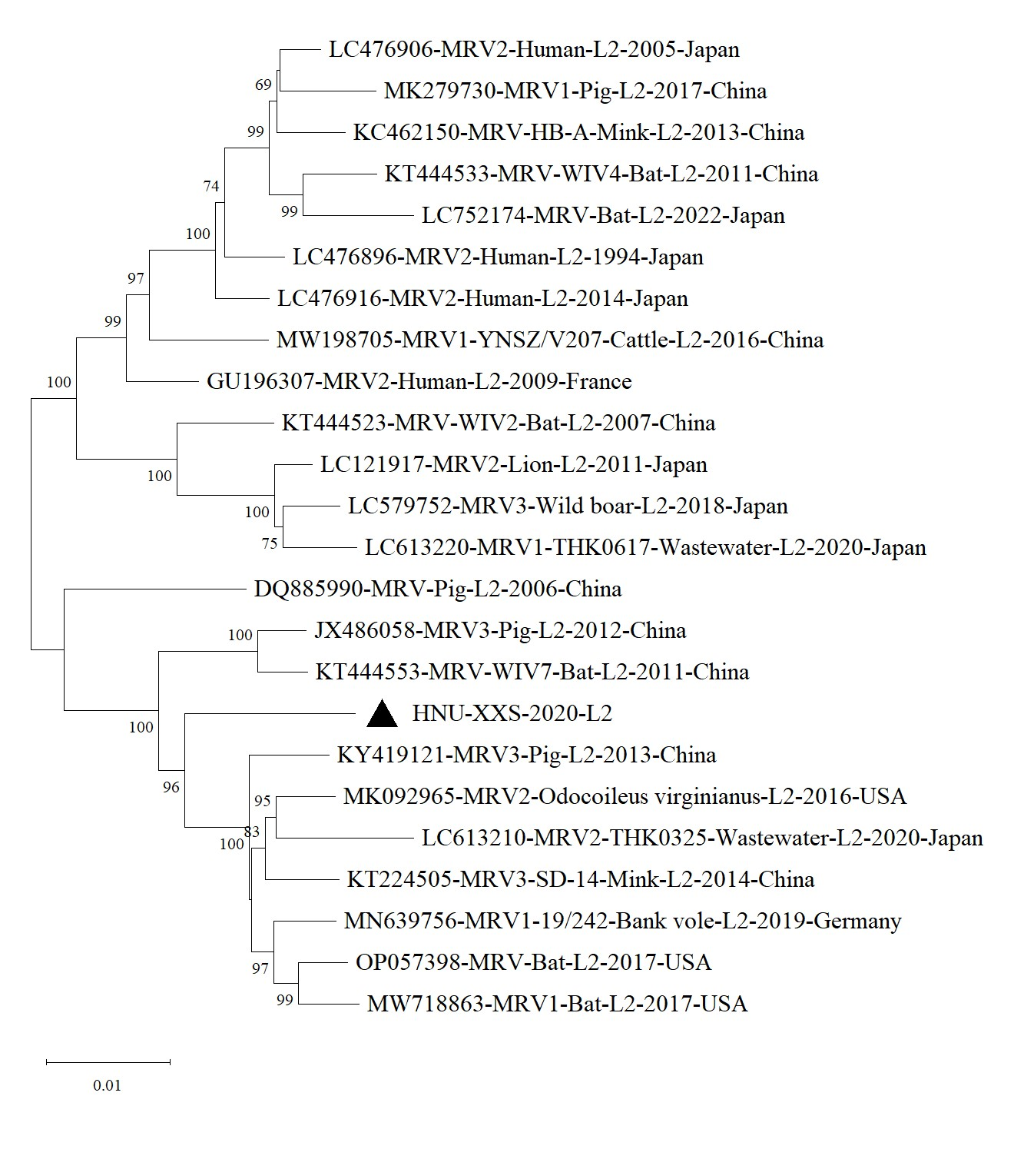
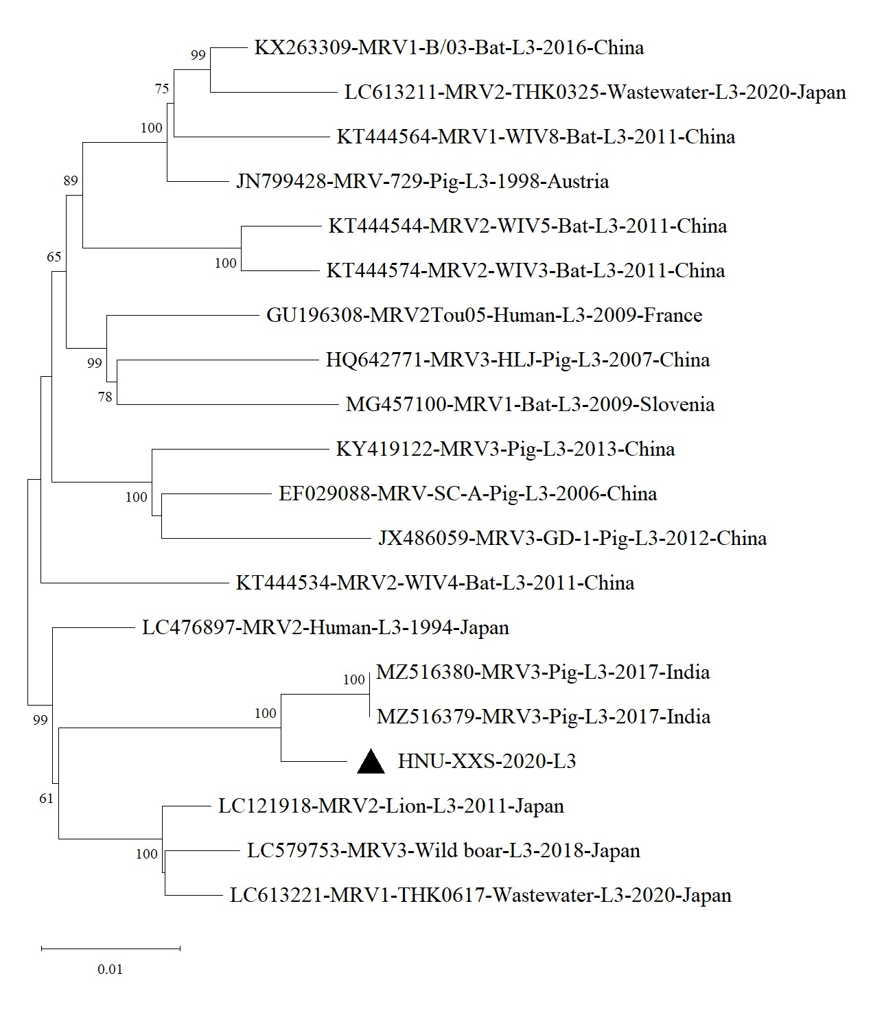
S2
S3
S4
M1
M2
M3
L1
L2
L3
Supplementary Fig. S1 Phylogenetic tree based on the S2, S3, S4, M1, M2, M3, L1, L2, L3 segments of HNU-XXS-2020 with the most related MRV sequences from GenBank. The evolutionary history was inferred using the Neighbor-Joining method. The percentage of replicate trees in which the associated taxa clustered together in the bootstrap test (1000 replicates) are shown next to the branches (only >60% are shown). The evolutionary distances were computed using the Maximum Composite Likelihood method and are in the units of the number of base substitutions per site. The strain HNU-XXS-MRV characterized in the present study is in bold and marked with “▲”. Evolutionary analyses were conducted in MEGA 11.

