Slide 1
Supplementary Fig. S2 Phylogenetic tree based on the S2, S3, S4, M1, M2, M3, L1, L2, L3 segments of HNU-XXS-2020 with all related MRV sequences from GenBank. The evolutionary history was inferred using the Neighbor-Joining method. The percentage of replicate trees in which the associated taxa clustered together in the bootstrap test (1000 replicates) are shown next to the branches (only >60% are shown). The evolutionary distances were computed using the Maximum Composite Likelihood method and are in the units of the number of base substitutions per site. The strain HNU-XXS-MRV characterized in the present study is in bold and marked with “▲”. Evolutionary analyses were conducted in MEGA 11.

Slide 2
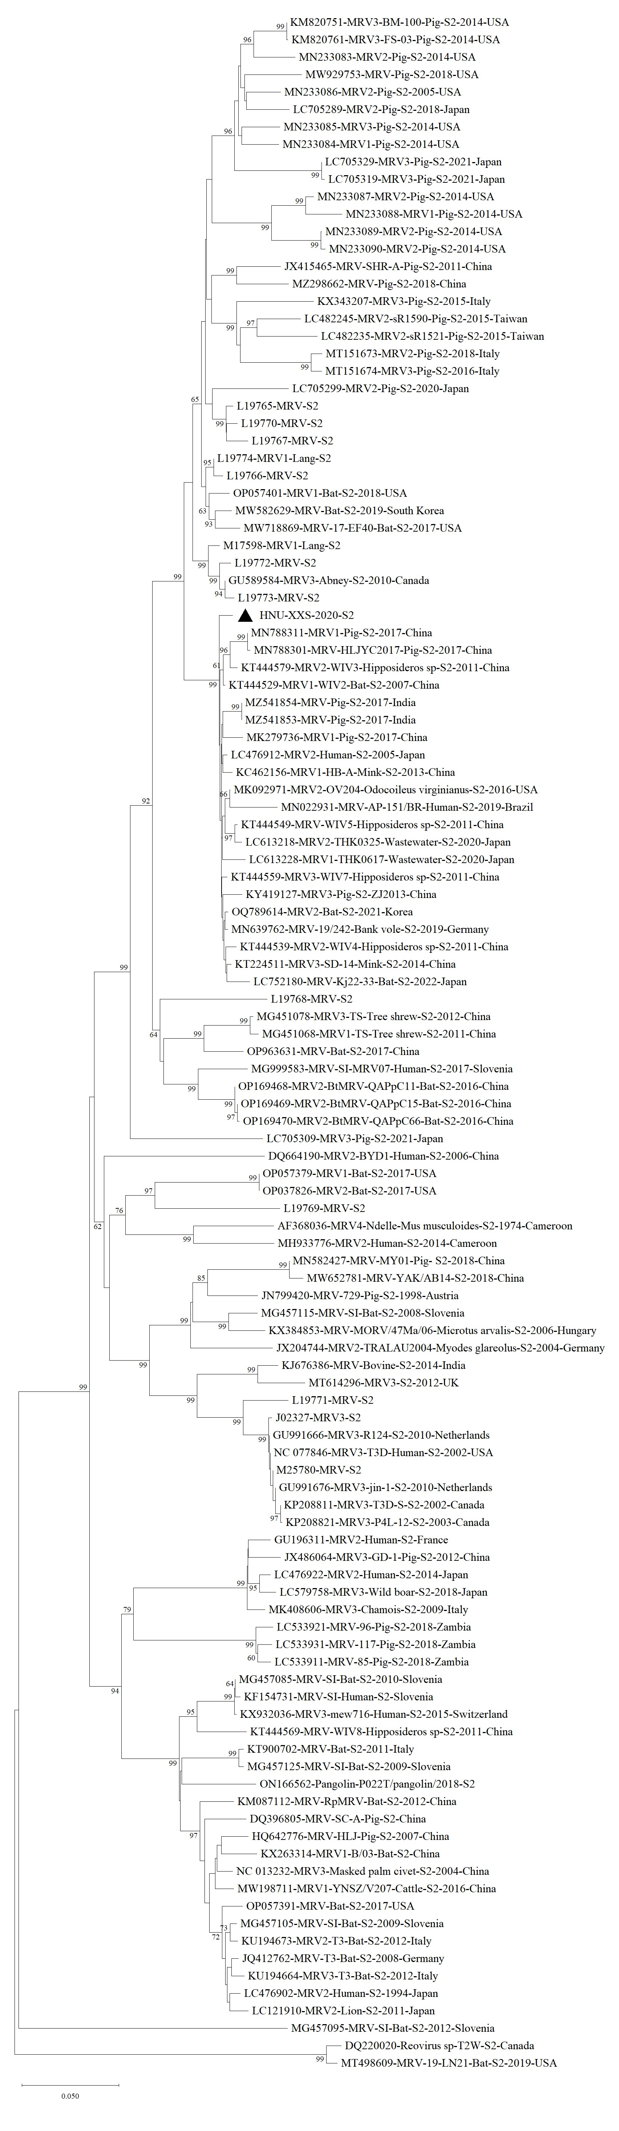
S2

Slide 3
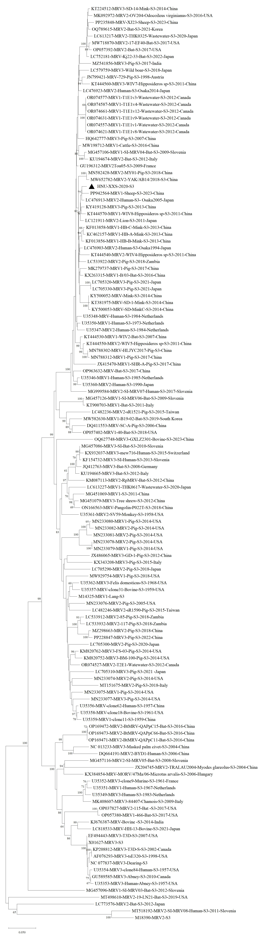
S3

Slide 4
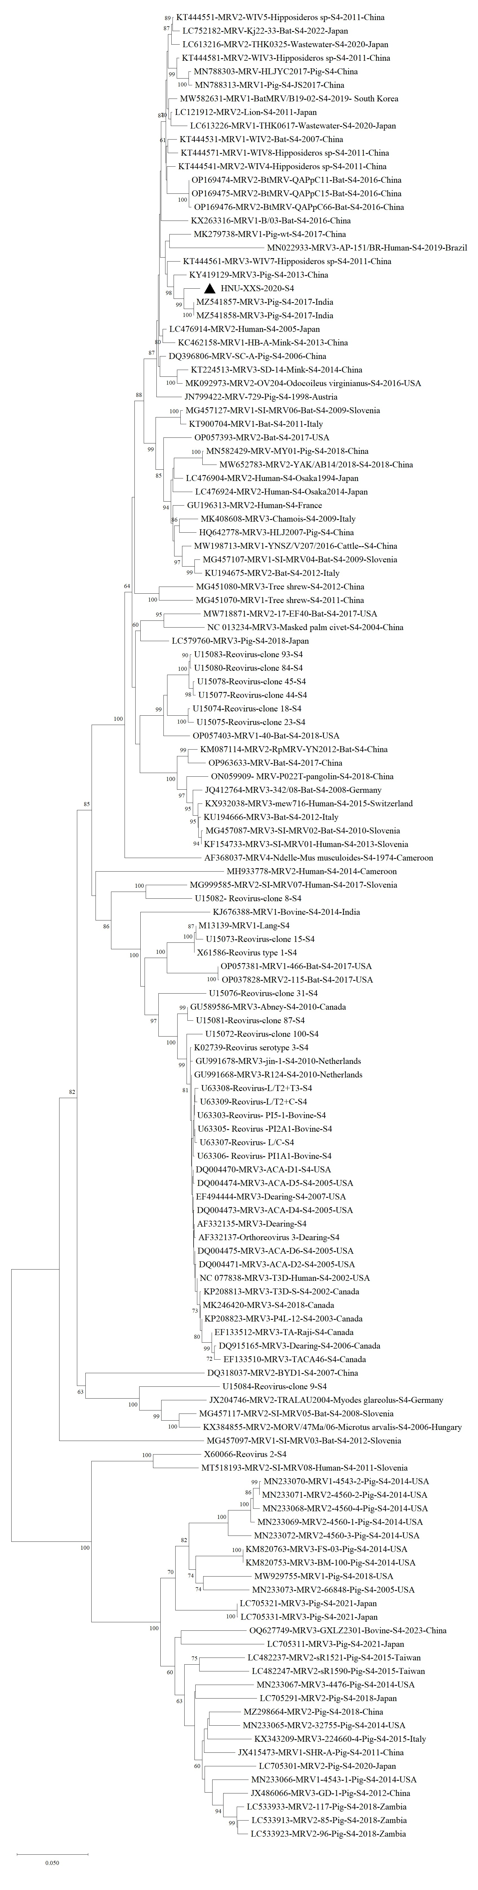
S4

Slide 5
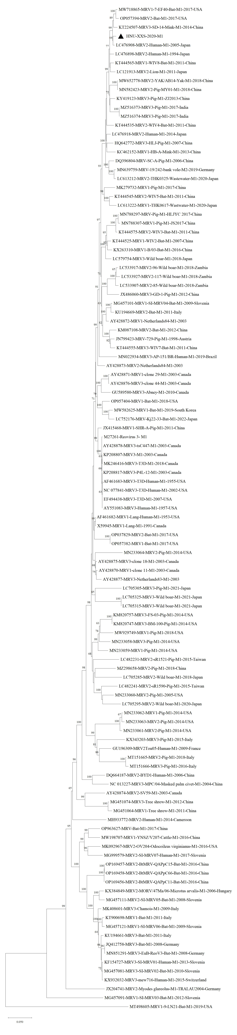
M1

Slide 6
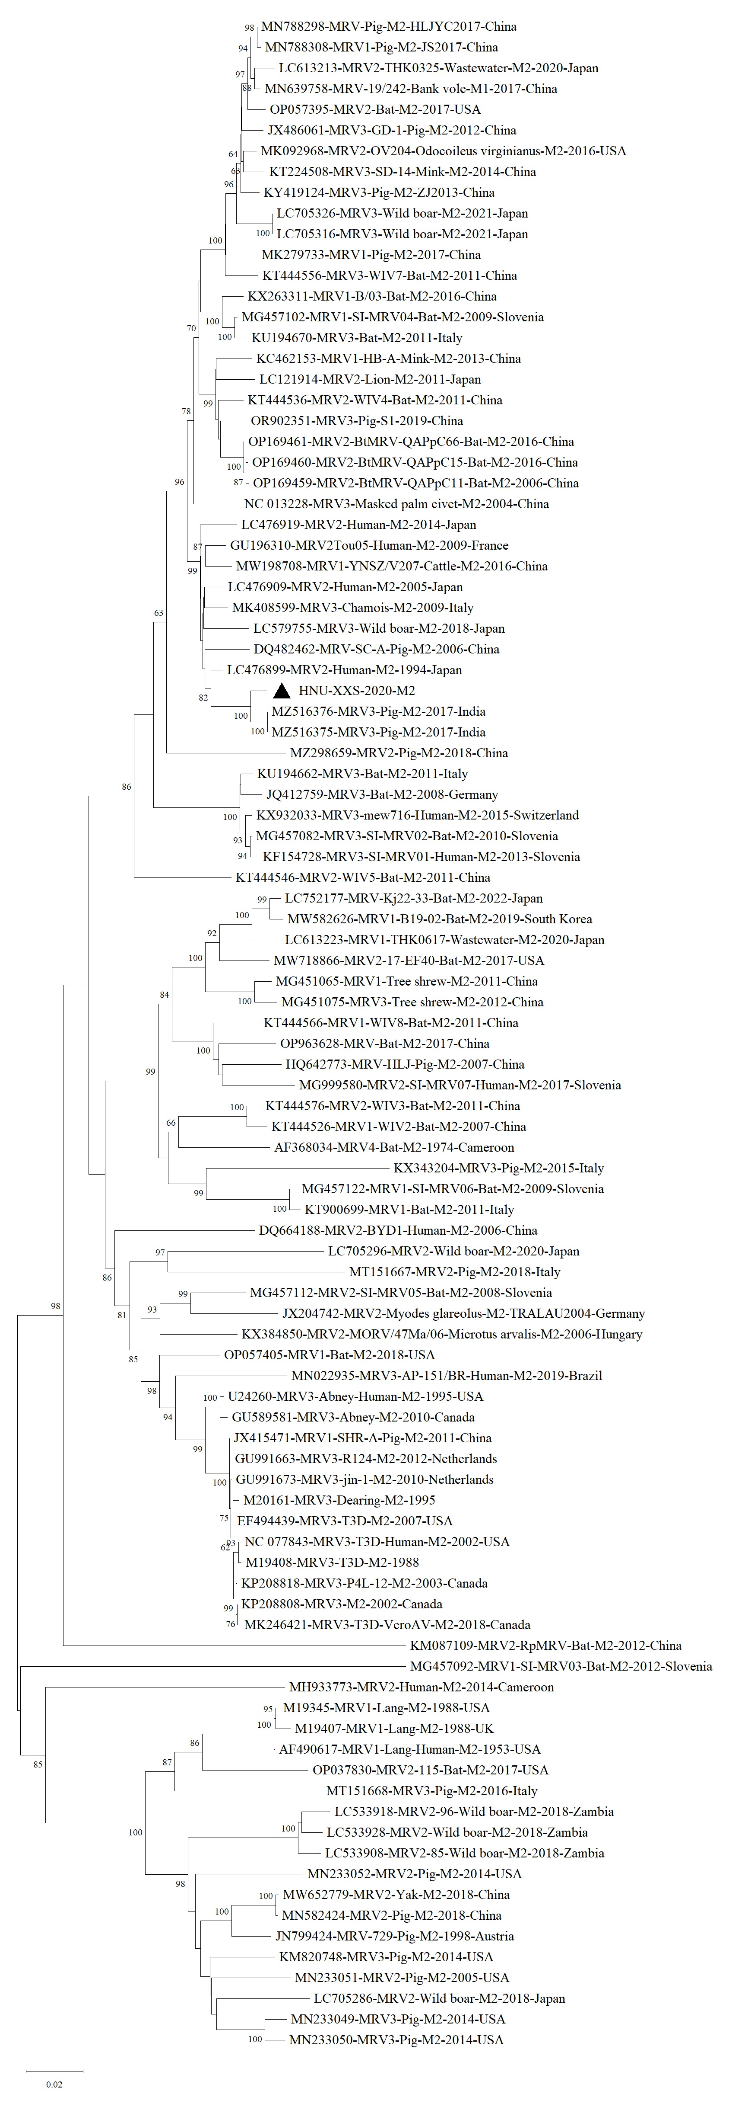
M2

Slide 7
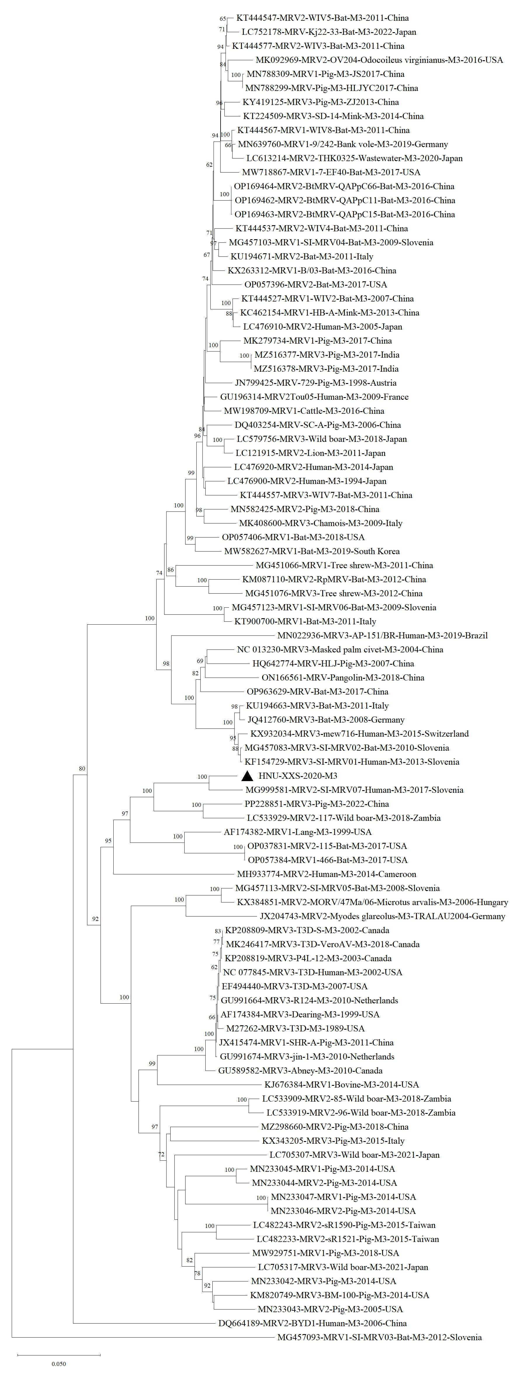
M3

Slide 8
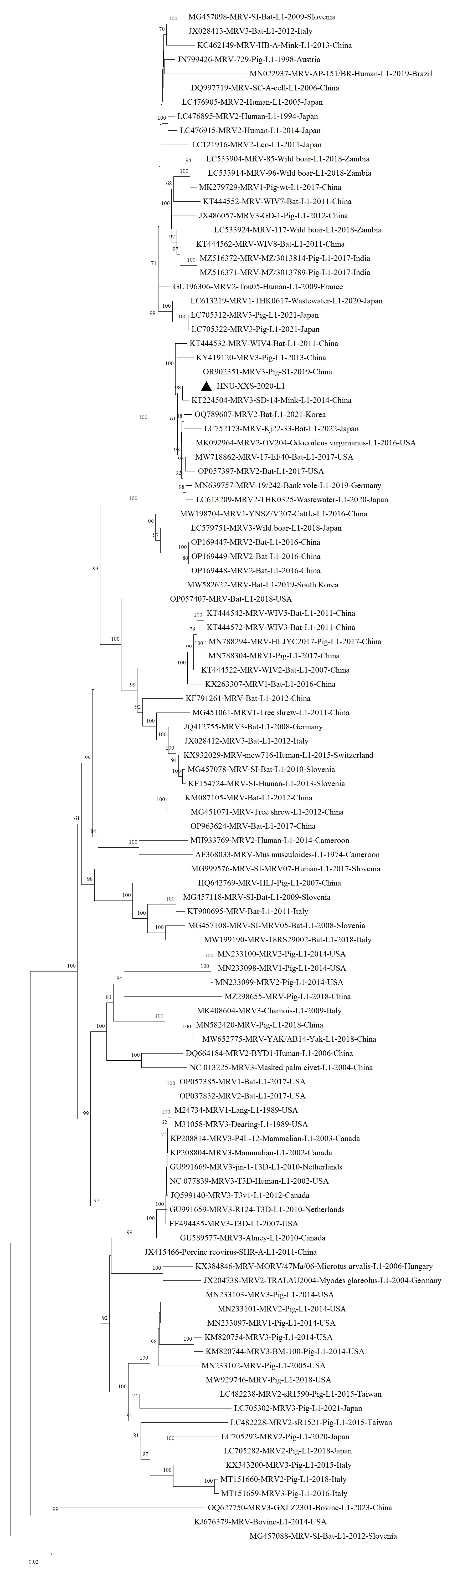
L1

Slide 9
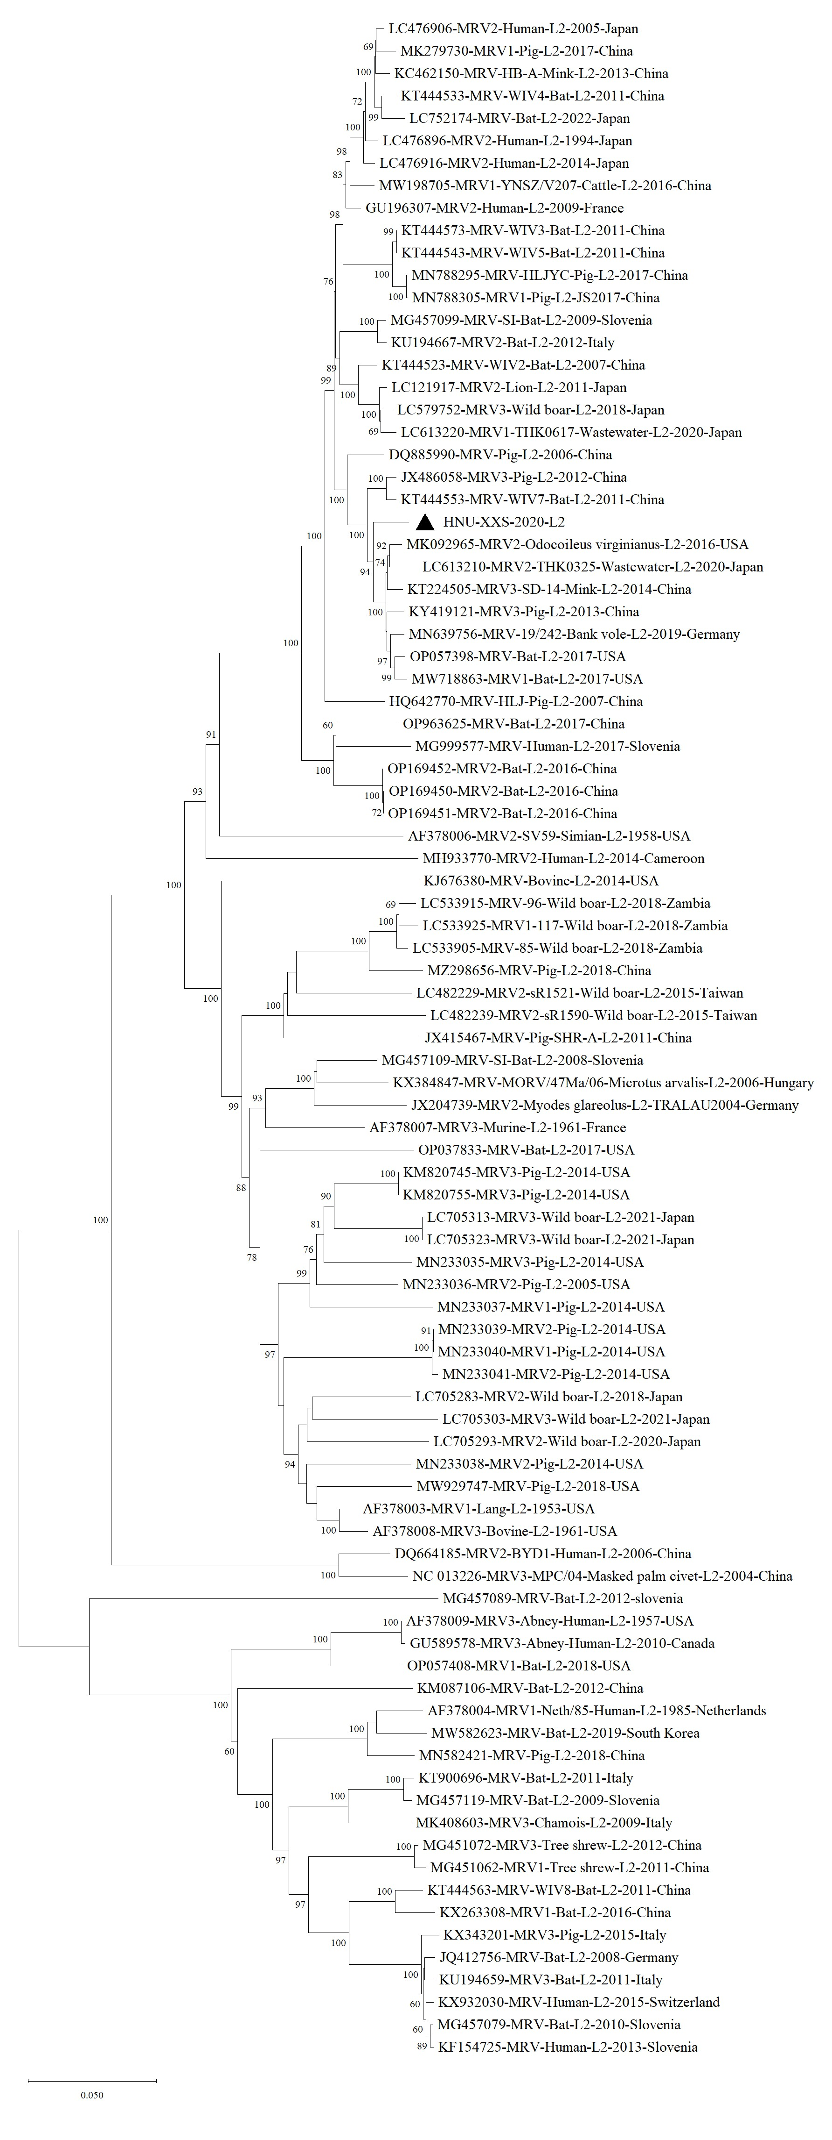
L2

Slide 10
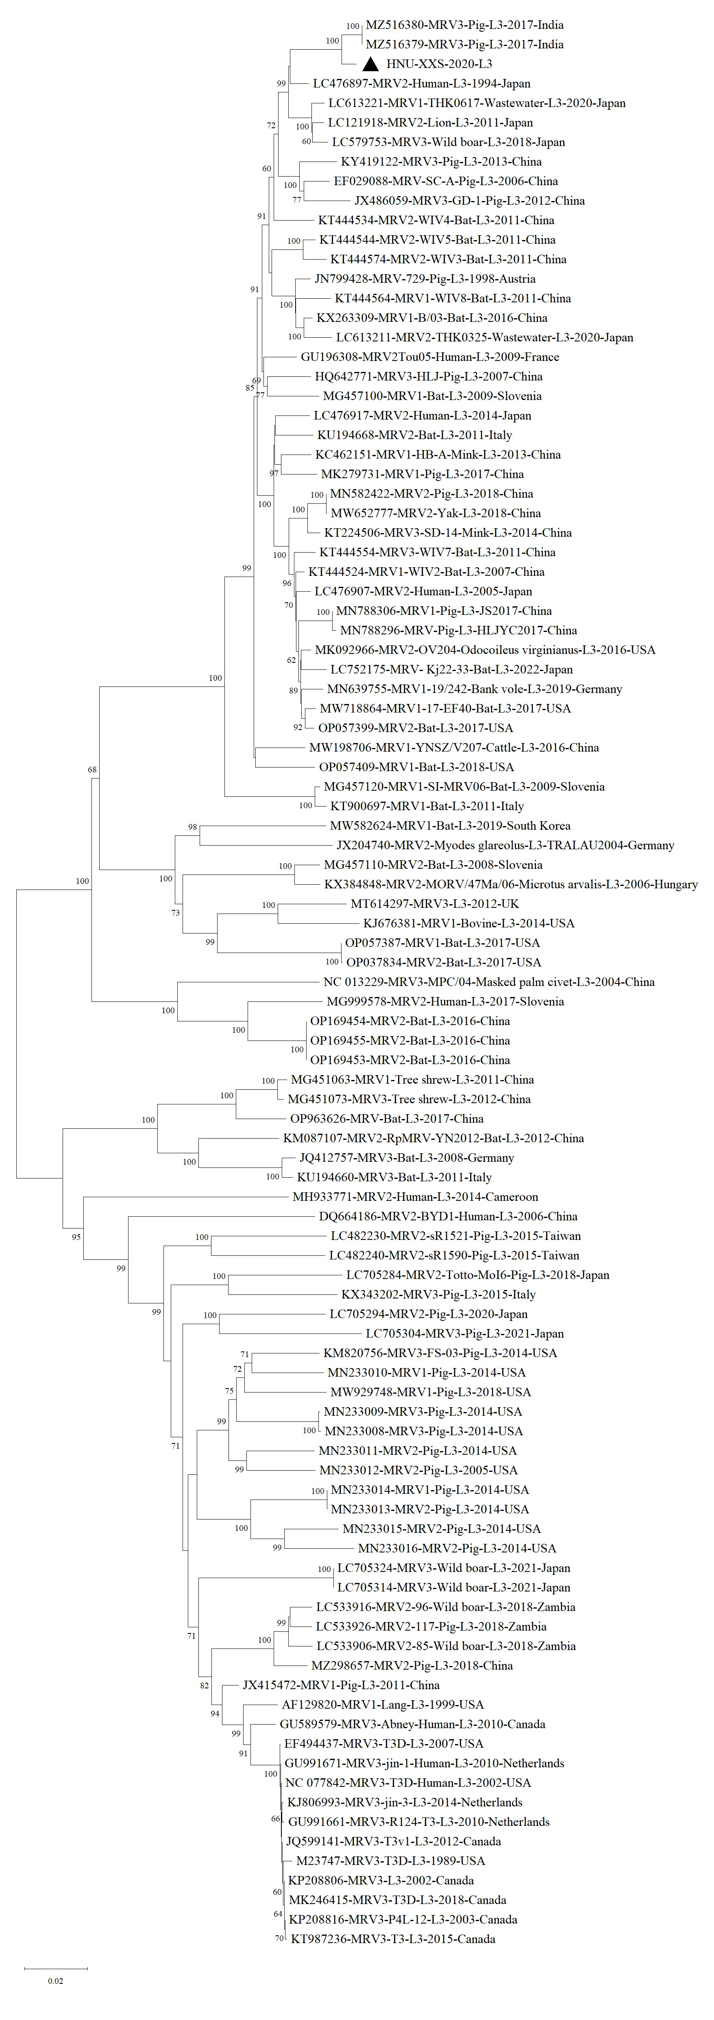
L3

