Slide 1
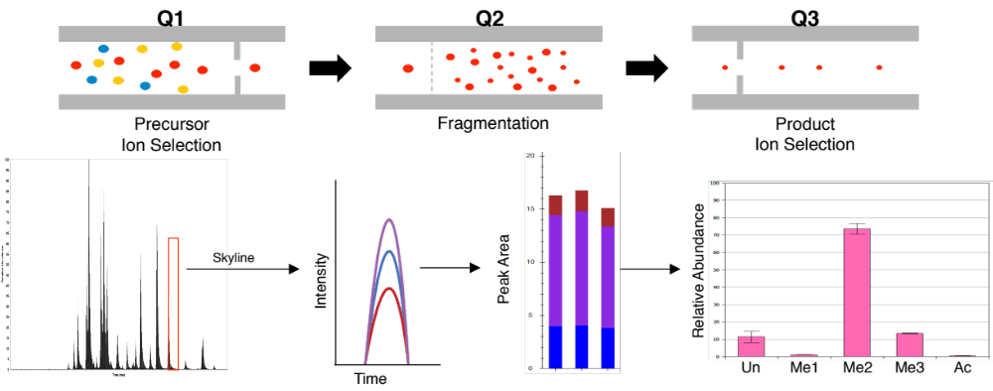
Supplementary Material 2
Surgical Specimen
Post Mortem Tumor Tissue
Immortalized Tumor Cell Lines
Histone extraction and tryptic digestion
Targeted mass spectrometry via multiple reaction monitoring (MRM)
Relative quantification of modification states
Compare differences between H3.3K27M and H3.3K27 wild-type specimens (t-test)
Find predominant modification states (multivariable analysis, One-way ANOVA with Turkey’s post test)
Determine correlations between mutation status and modification states (Pearson Correlation)

