Slide 1

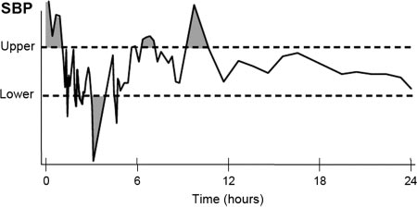
Intraoperative blood pressure variability is associated with postoperative acute kidney injury in pediatric cardiac surgery
AIM: To explore the relationship between intraoperative blood pressure variability and acute kidney injury in pediatric cardiac surgery
DESIGN & OUTCOMES:
Cardiac surgery-associated acute kidney injury (CSA-AKI)
36.1%
In pediatrics
(0 to 7 years)
coefficients of variation (CVs)
BPV | OR(95% CI) | P value
±10% AUC-MAP | 1.000(0.999 - 1.000) | 0.366
±20% AUC-MAP | 1.000(0.999 - 1.001) | 0.660
±30% AUC-MAP | 1.001(0.999 - 1.002) | 0.014
CVs-MAP | 0.133(0.004 - 4.656) | 0.266
A retrospective observational study
blood pressure variability (BPV)
570 patients
undergoing cardiac surgery
area under the curve (AUC)
CONCLUSION: Greater blood pressure variability, specifically MAP variations exceeding 30%AUC during CPB, may be a potential risk factor for CSA-AKI in pediatric.
Rong xiao et al. 2024

