Slide 1
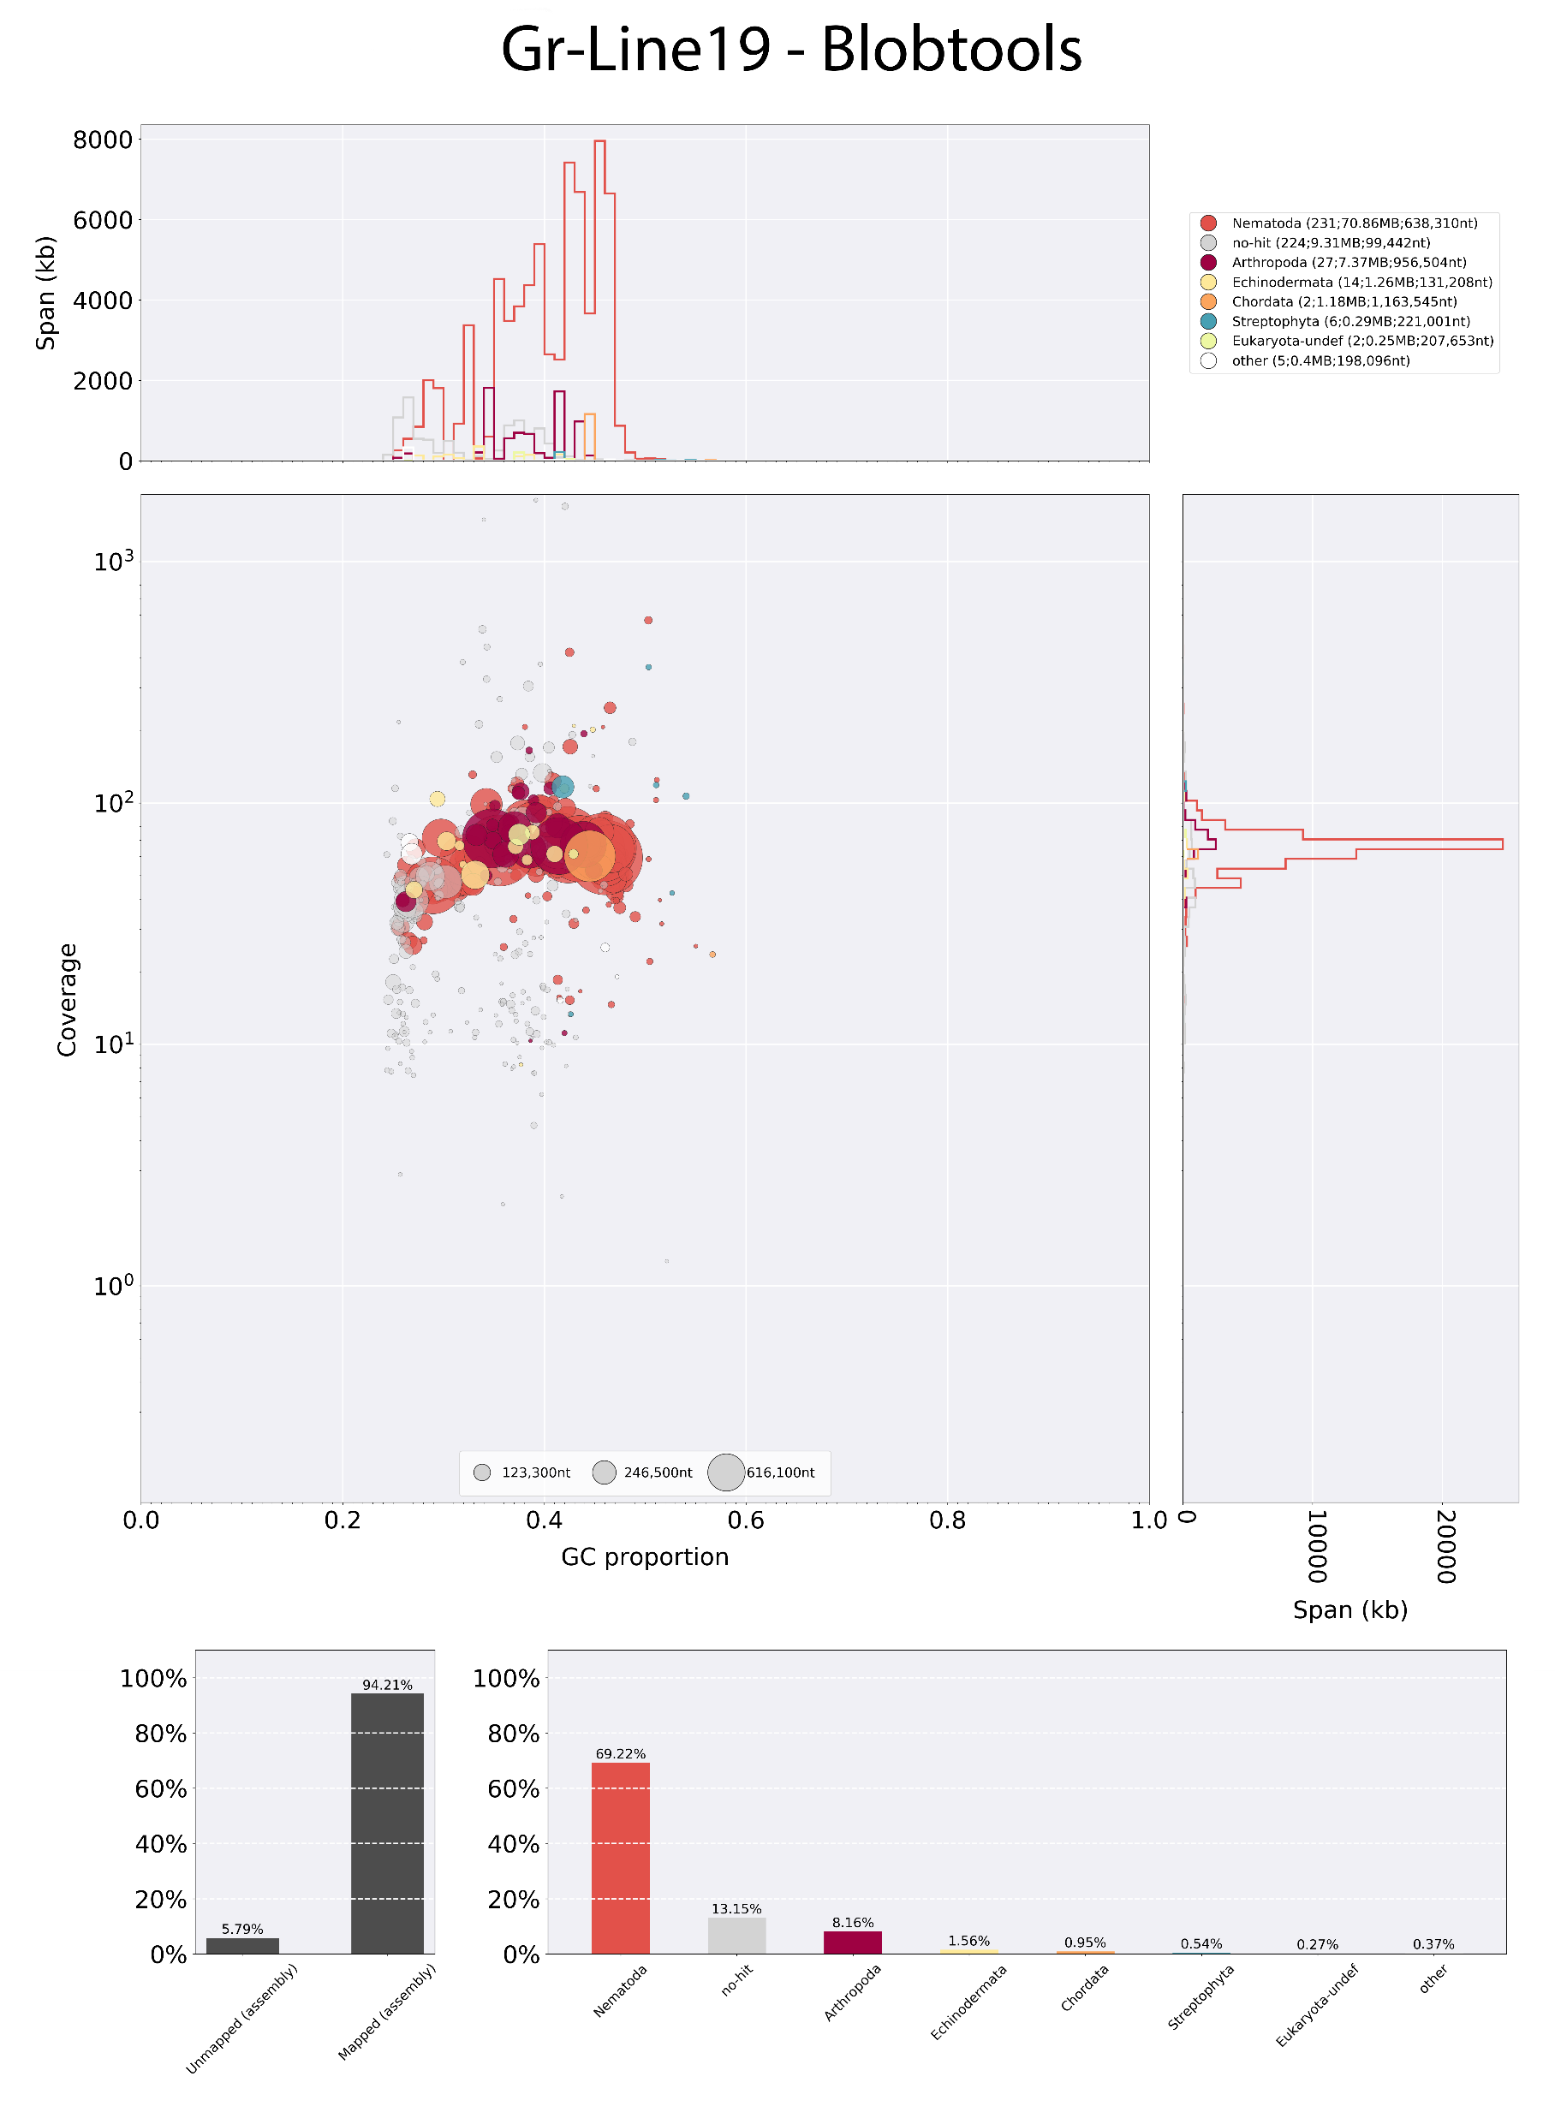
Supplemental figure 1
A
B

Slide 2
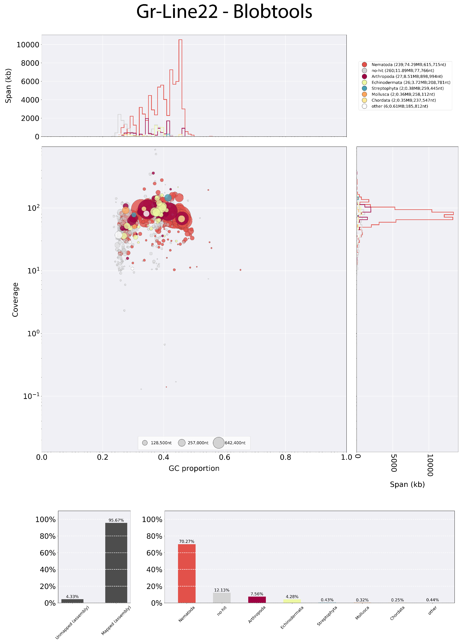
Supplemental figure 2
A
B

Slide 3
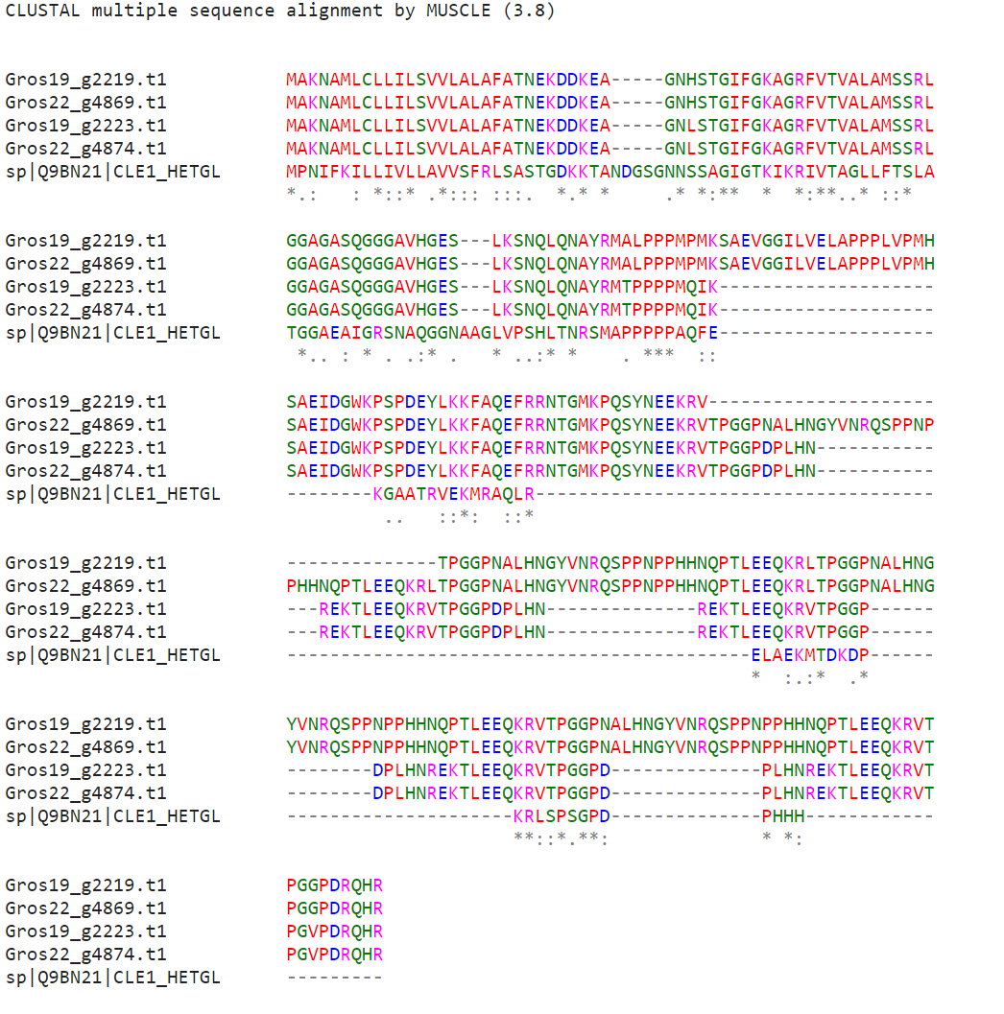
Supplemental figure 3

