Slide 1
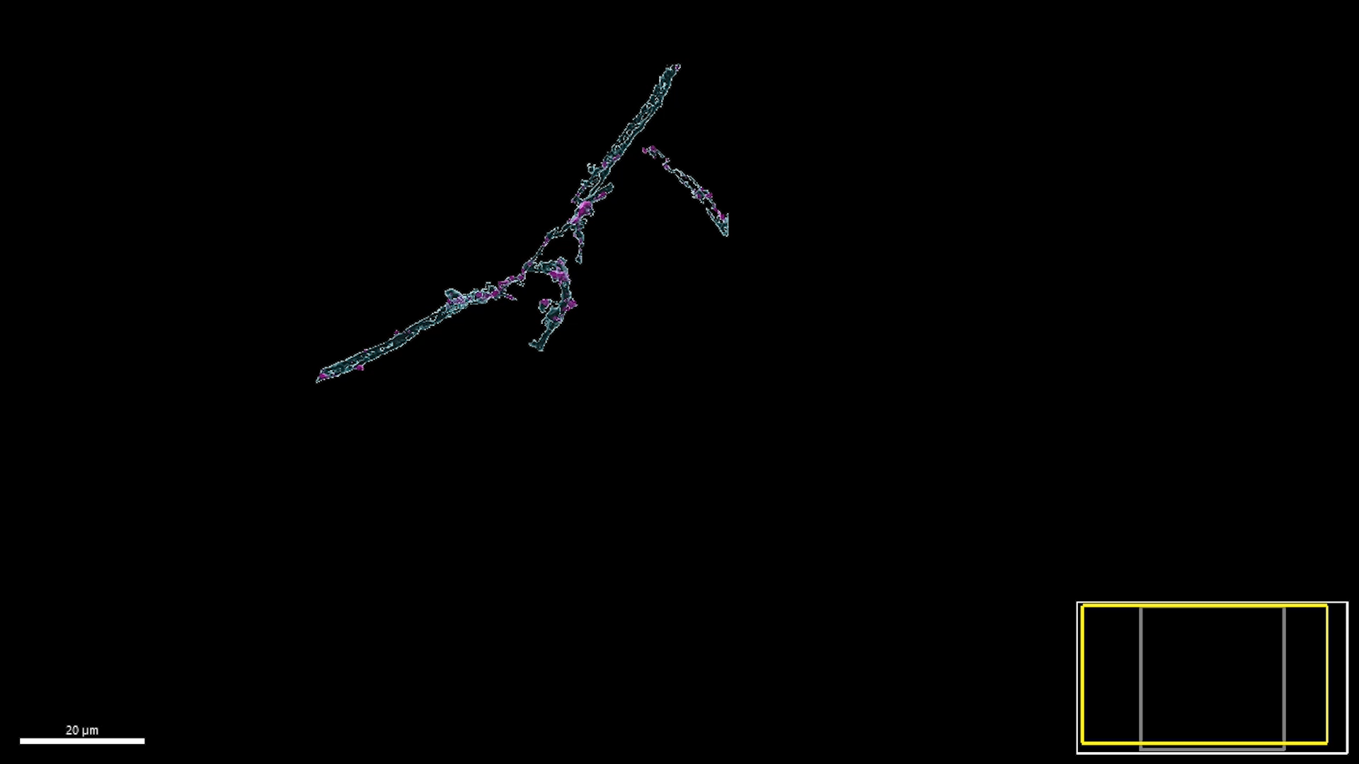
Supplementary Video 1
Mbp mRNA in nascent sheaths

Slide 2

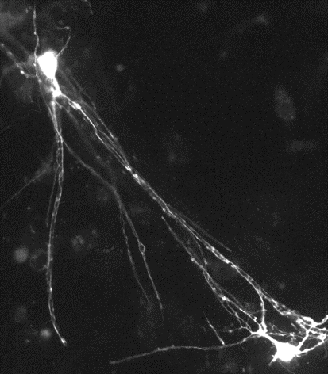
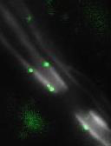
Supplementary Videos 2 and 3
Oligodendroglial peroxisomes in myelin sheaths
Td-tomato
Pex1-EOS2

Slide 3
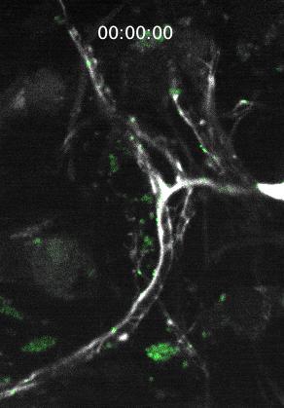

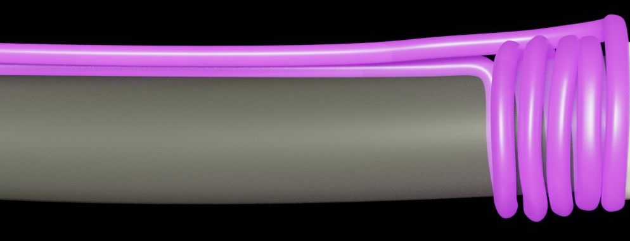
Supplementary Videos 4 and 5
Paranodal
loops
‘Neck’
Cell body
Td-tomato
EOS2

Slide 4
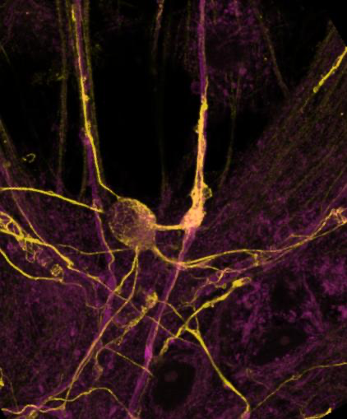
Supplementary video 6.
Anti-β-tubulin IV staining in cell processes and myelin in a tdTomato-labelled oligodendrocyte in vitro. The protocol for extracting free tubulins increases the background signal in the far-red channel.
.

Slide 5
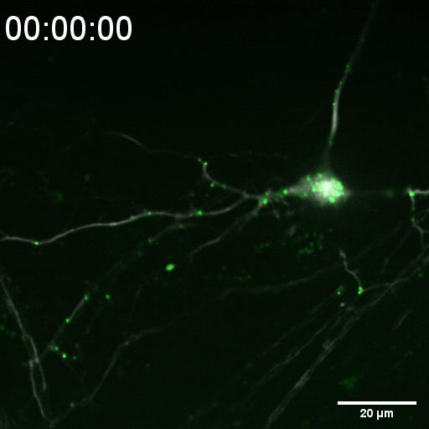
Supplementary video 7.
The oligodendrocyte cell body is a reservoir for peroxisomes, which travel between the soma and the myelin sheaths via processes extending from the cell body.
Process
Cell body
Process
Myelin sheaths

