Slide 1
Supplemental Figure 1.
Assessment of differences in age, CD4+ T cell count, pre-ART HIV viral load, and LFA (lateral flow immunoassay) between groups. Wilcoxon rank sum paired test and one way ANOVA (analyses of variances) test for nonparametric data were used for the comparison between the groups (JMP14.0pro SAS Institute Inc.). The cut-off significance level for all P values was 0.05. Blue line, Mean and Standard deviations
(Wilcoxon). Green, Mean and Standard deviation by ANOVA. See tables.
The pre-ART serum cryptococcal antigen titers, as measured by LFA assay, were significantly higher in C-IRIS survivors group, as compared to patients who died in earlier study arm with or without C-IRIS.

Slide 2
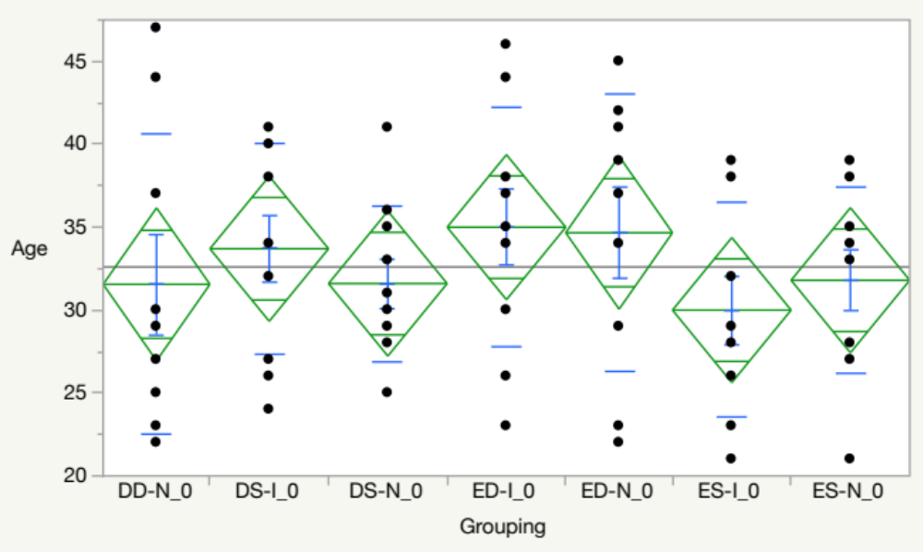
Oneway Analysis of Age By Grouping
Blue line, Mean and
Standard deviations
(Wilcoxon). See tables
below.
Green, Mean
and Standard deviation
by ANOVA. See tables.
Fit Group

Slide 3
Nonparametric Comparisons For Each Pair Using Wilcoxon Method
q* | Alpha
1.95996 | 0.05
Fit Group > Oneway Analysis of Age By Grouping

Slide 4
Nonparametric Comparisons For Each Pair Using Wilcoxon Method
Level | - Level | Score Mean Difference | Std Err Dif | Z | p-Value | Hodges-Lehmann | Lower CL | Upper CL | Difference Plot
ED-I_0 | DS-N_0 | 3.30000 | 2.641770 | 1.24916 | 0.2116 | 4.00000 | -3.0000 | 9.00000
ED-N_0 | DS-N_0 | 2.63889 | 2.582168 | 1.02197 | 0.3068 | 4.00000 | -6.0000 | 11.00000
ED-I_0 | DD-N_0 | 2.53333 | 2.577622 | 0.98282 | 0.3257 | 5.00000 | -6.0000 | 13.00000
DS-I_0 | DD-N_0 | 1.90000 | 2.582168 | 0.73582 | 0.4618 | 3.50000 | -6.0000 | 11.00000
ES-N_0 | ES-I_0 | 1.70000 | 2.633789 | 0.64546 | 0.5186 | 2.00000 | -4.0000 | 9.00000
ED-N_0 | DD-N_0 | 1.55556 | 2.511412 | 0.61939 | 0.5357 | 4.00000 | -7.0000 | 14.00000
DS-N_0 | DD-N_0 | 1.26667 | 2.581032 | 0.49076 | 0.6236 | 2.00000 | -9.0000 | 8.00000
ED-N_0 | DS-I_0 | 0.95000 | 2.576484 | 0.36872 | 0.7123 | 1.00000 | -7.0000 | 10.00000
ES-N_0 | DD-N_0 | 0.84444 | 2.582168 | 0.32703 | 0.7436 | 2.00000 | -9.0000 | 9.00000
ED-I_0 | DS-I_0 | 0.70000 | 2.637782 | 0.26537 | 0.7907 | 1.50000 | -6.0000 | 10.00000
ES-N_0 | DS-N_0 | 0.20000 | 2.630789 | 0.07602 | 0.9394 | 0.00000 | -6.0000 | 6.00000
ED-N_0 | ED-I_0 | 0.00000 | 2.578759 | 0.00000 | 1.0000 | 0.00000 | -9.0000 | 8.00000
ES-I_0 | DD-N_0 | -0.31667 | 2.581032 | -0.12269 | 0.9024 | -1.00000 | -9.0000 | 8.00000
ES-N_0 | DS-I_0 | -1.30000 | 2.636784 | -0.49302 | 0.6220 | -2.00000 | -7.0000 | 4.00000
DS-N_0 | DS-I_0 | -1.70000 | 2.639777 | -0.64399 | 0.5196 | -3.00000 | -9.0000 | 4.00000
ES-I_0 | DS-N_0 | -1.80000 | 2.638780 | -0.68213 | 0.4952 | -2.00000 | -7.0000 | 4.00000
ES-N_0 | ED-I_0 | -2.50000 | 2.637782 | -0.94777 | 0.3432 | -3.00000 | -10.0000 | 4.00000
ES-N_0 | ED-N_0 | -2.85000 | 2.581032 | -1.10421 | 0.2695 | -3.50000 | -11.0000 | 5.00000
ES-I_0 | ED-I_0 | -3.20000 | 2.635786 | -1.21406 | 0.2247 | -6.00000 | -12.0000 | 2.00000
ES-I_0 | ED-N_0 | -3.37778 | 2.579896 | -1.30927 | 0.1904 | -5.00000 | -13.0000 | 4.00000
ES-I_0 | DS-I_0 | -3.40000 | 2.634788 | -1.29043 | 0.1969 | -3.00000 | -12.0000 | 4.00000
Fit Group > Oneway Analysis of Age By Grouping

Slide 5
Summary of Fit
Rsquare | 0.064766
Adj Rsquare | -0.02722
Root Mean Square Error | 6.914374
Mean of Response | 32.60294
Observations (or Sum Wgts) | 68
Fit Group > Oneway Analysis of Age By Grouping > Oneway Anova

Slide 6
Analysis of Variance
Source | DF | Sum of Squares | Mean Square | F Ratio | Prob > F
Grouping | 6 | 201.9572 | 33.6595 | 0.7040 | 0.6474
Error | 61 | 2916.3222 | 47.8086
C. Total | 67 | 3118.2794
Fit Group > Oneway Analysis of Age By Grouping > Oneway Anova

Slide 7
Means for Oneway Anova
Level | Number | Mean | Std Error | Lower 95% | Upper 95%
DD-N_0 | 9 | 31.5556 | 2.3048 | 26.947 | 36.164
DS-I_0 | 10 | 33.7000 | 2.1865 | 29.328 | 38.072
DS-N_0 | 10 | 31.6000 | 2.1865 | 27.228 | 35.972
ED-I_0 | 10 | 35.0000 | 2.1865 | 30.628 | 39.372
ED-N_0 | 9 | 34.6667 | 2.3048 | 30.058 | 39.275
ES-I_0 | 10 | 30.0000 | 2.1865 | 25.628 | 34.372
ES-N_0 | 10 | 31.8000 | 2.1865 | 27.428 | 36.172
Std Error uses a pooled estimate of error variance
Fit Group > Oneway Analysis of Age By Grouping > Oneway Anova

Slide 8
Means and Std Deviations
Level | Number | Mean | Std Dev | Std Err Mean | Lower 95% | Upper 95%
DD-N_0 | 9 | 31.555556 | 9.08448 | 3.02816 | 24.572606 | 38.538505
DS-I_0 | 10 | 33.7 | 6.3779133 | 2.0168733 | 29.137516 | 38.262484
DS-N_0 | 10 | 31.6 | 4.7187569 | 1.492202 | 28.224405 | 34.975595
ED-I_0 | 10 | 35 | 7.2264945 | 2.2852182 | 29.830477 | 40.169523
ED-N_0 | 9 | 34.666667 | 8.3216585 | 2.7738862 | 28.270074 | 41.06326
ES-I_0 | 10 | 30 | 6.4978629 | 2.0548047 | 25.351709 | 34.648291
ES-N_0 | 10 | 31.8 | 5.6332347 | 1.7813852 | 27.770227 | 35.829773
Fit Group > Oneway Analysis of Age By Grouping

Slide 9
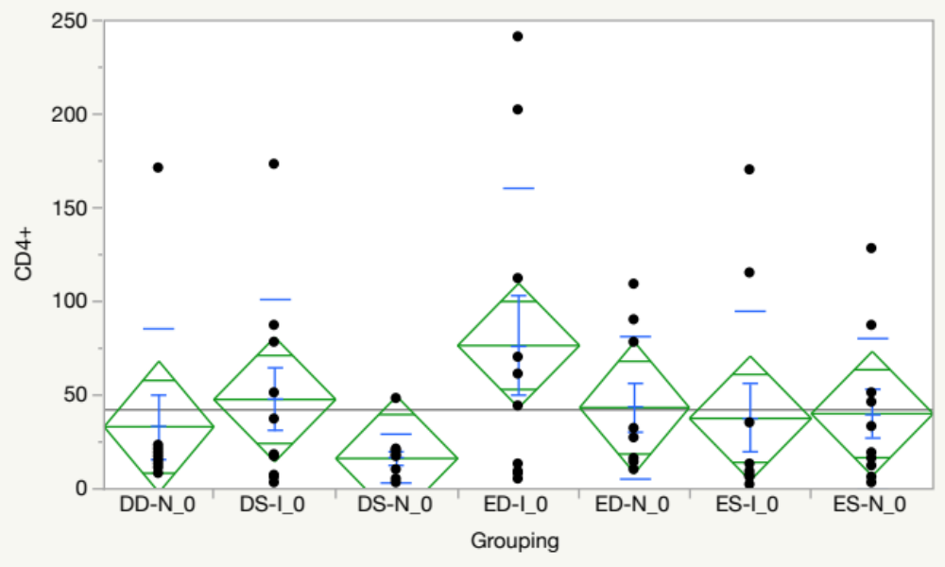
Oneway Analysis of CD4+ By Grouping
Blue line, Mean and
Standard deviations
(Wilcoxon). See tables
below.
Green, Mean
and Standard deviation
by ANOVA. See tables.
Fit Group

Slide 10
Nonparametric Comparisons For Each Pair Using Wilcoxon Method
q* | Alpha
1.95996 | 0.05
Fit Group > Oneway Analysis of CD4+ By Grouping

Slide 11
Nonparametric Comparisons For Each Pair Using Wilcoxon Method
Level | - Level | Score Mean Difference | Std Err Dif | Z | p-Value | Hodges-Lehmann | Lower CL | Upper CL | Difference Plot
ED-N_0 | DS-N_0 | 4.43333 | 2.573068 | 1.72298 | 0.0849 | 11.0000 | -3.0000 | 69.0000
ED-I_0 | DS-N_0 | 3.80000 | 2.640773 | 1.43897 | 0.1502 | 36.5000 | -4.0000 | 102.0000
ES-N_0 | DS-N_0 | 3.40000 | 2.640773 | 1.28750 | 0.1979 | 11.5000 | -4.0000 | 41.0000
ES-N_0 | ES-I_0 | 2.30000 | 2.640773 | 0.87096 | 0.3838 | 8.0000 | -19.0000 | 40.0000
ED-N_0 | DD-N_0 | 2.22222 | 2.515313 | 0.88348 | 0.3770 | 6.0000 | -7.0000 | 67.0000
ED-I_0 | DD-N_0 | 1.79444 | 2.583303 | 0.69463 | 0.4873 | 30.0000 | -10.0000 | 97.0000
ED-I_0 | DS-I_0 | 1.70000 | 2.645751 | 0.64254 | 0.5205 | 7.0000 | -32.0000 | 94.0000
ES-N_0 | DD-N_0 | 1.26667 | 2.584438 | 0.49011 | 0.6241 | 4.5000 | -11.0000 | 38.0000
DS-I_0 | DD-N_0 | 1.05556 | 2.584438 | 0.40843 | 0.6830 | 4.5000 | -12.0000 | 63.0000
ED-N_0 | DS-I_0 | 0.42222 | 2.583303 | 0.16344 | 0.8702 | 3.5000 | -51.0000 | 39.0000
ED-N_0 | ED-I_0 | -0.10556 | 2.584438 | -0.04084 | 0.9674 | -3.0000 | -98.0000 | 24.0000
ES-N_0 | DS-I_0 | -0.30000 | 2.641770 | -0.11356 | 0.9096 | -0.5000 | -45.0000 | 34.0000
ES-N_0 | ED-N_0 | -0.42222 | 2.583303 | -0.16344 | 0.8702 | -2.5000 | -45.0000 | 32.0000
ES-I_0 | DS-N_0 | -0.50000 | 2.639777 | -0.18941 | 0.8498 | -1.0000 | -11.0000 | 25.0000
ES-N_0 | ED-I_0 | -1.70000 | 2.645751 | -0.64254 | 0.5205 | -10.5000 | -96.0000 | 25.0000
ES-I_0 | DS-I_0 | -2.40000 | 2.639777 | -0.90917 | 0.3633 | -6.5000 | -58.0000 | 17.0000
DS-N_0 | DD-N_0 | -2.42778 | 2.578759 | -0.94145 | 0.3465 | -3.0000 | -13.0000 | 5.0000
DS-N_0 | DS-I_0 | -3.00000 | 2.638780 | -1.13689 | 0.2556 | -13.5000 | -67.0000 | 4.0000
ES-I_0 | DD-N_0 | -3.06111 | 2.579896 | -1.18652 | 0.2354 | -6.0000 | -14.0000 | 20.0000
ES-I_0 | ED-I_0 | -3.40000 | 2.639777 | -1.28799 | 0.1978 | -28.5000 | -99.0000 | 5.0000
ES-I_0 | ED-N_0 | -3.90556 | 2.582168 | -1.51251 | 0.1304 | -8.0000 | -69.0000 | 21.0000
Fit Group > Oneway Analysis of CD4+ By Grouping

Slide 12
Summary of Fit
Rsquare | 0.105469
Adj Rsquare | 0.017482
Root Mean Square Error | 52.51953
Mean of Response | 42.19118
Observations (or Sum Wgts) | 68
Fit Group > Oneway Analysis of CD4+ By Grouping > Oneway Anova

Slide 13
Analysis of Variance
Source | DF | Sum of Squares | Mean Square | F Ratio | Prob > F
Grouping | 6 | 19838.13 | 3306.35 | 1.1987 | 0.3193
Error | 61 | 168256.39 | 2758.30
C. Total | 67 | 188094.51
Fit Group > Oneway Analysis of CD4+ By Grouping > Oneway Anova

Slide 14
Means for Oneway Anova
Level | Number | Mean | Std Error | Lower 95% | Upper 95%
DD-N_0 | 9 | 33.1111 | 17.507 | -1.90 | 68.12
DS-I_0 | 10 | 47.7000 | 16.608 | 14.49 | 80.91
DS-N_0 | 10 | 16.2000 | 16.608 | -17.01 | 49.41
ED-I_0 | 10 | 76.5000 | 16.608 | 43.29 | 109.71
ED-N_0 | 9 | 43.3333 | 17.507 | 8.33 | 78.34
ES-I_0 | 10 | 37.6000 | 16.608 | 4.39 | 70.81
ES-N_0 | 10 | 40.1000 | 16.608 | 6.89 | 73.31
Std Error uses a pooled estimate of error variance
Fit Group > Oneway Analysis of CD4+ By Grouping > Oneway Anova

Slide 15
Means and Std Deviations
Level | Number | Mean | Std Dev | Std Err Mean | Lower 95% | Upper 95%
DD-N_0 | 9 | 33.111111 | 51.928904 | 17.309635 | -6.804978 | 73.027201
DS-I_0 | 10 | 47.7 | 53.235431 | 16.834521 | 9.6176668 | 85.782333
DS-N_0 | 10 | 16.2 | 12.769756 | 4.0381514 | 7.0650669 | 25.334933
ED-I_0 | 10 | 76.5 | 84.197189 | 26.625489 | 16.268959 | 136.73104
ED-N_0 | 9 | 43.333333 | 38.18704 | 12.729013 | 13.980176 | 72.68649
ES-I_0 | 10 | 37.6 | 57.500145 | 18.183142 | -3.533126 | 78.733126
ES-N_0 | 10 | 40.1 | 40.117743 | 12.686344 | 11.401495 | 68.798505
Fit Group > Oneway Analysis of CD4+ By Grouping

Slide 16
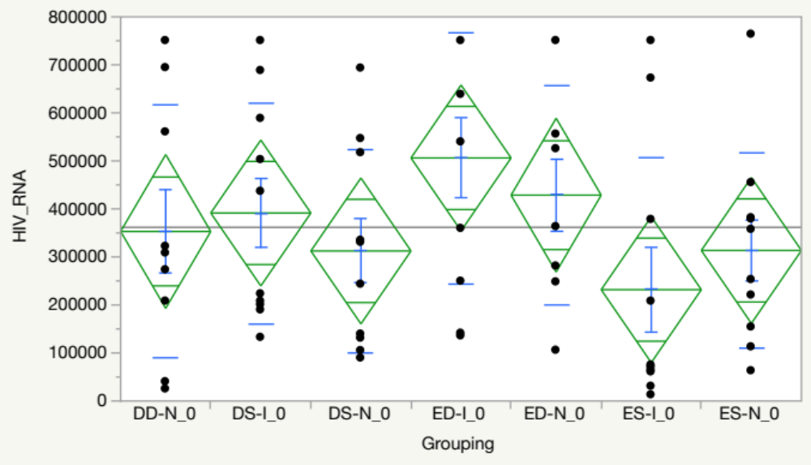
Oneway Analysis of HIV_RNA By Grouping
Blue line, Mean and
Standard deviations
(Wilcoxon). See tables
below.
Green, Mean
and Standard deviation
by ANOVA. See tables.
Fit Group

Slide 17
Nonparametric Comparisons For Each Pair Using Wilcoxon Method
q* | Alpha
1.95996 | 0.05
Fit Group > Oneway Analysis of HIV_RNA By Grouping

Slide 18
Nonparametric Comparisons For Each Pair Using Wilcoxon Method
Level | - Level | Score Mean Difference | Std Err Dif | Z | p-Value | Hodges-Lehmann | Lower CL | Upper CL | Difference Plot
ED-I_0 | DS-N_0 | 5.10000 | 2.643761 | 1.92907 | 0.0537 | 204511 | -6907 | 507278
ES-N_0 | ES-I_0 | 3.90000 | 2.645751 | 1.47406 | 0.1405 | 111630 | -144879 | 317074
ED-I_0 | DD-N_0 | 3.27222 | 2.579896 | 1.26835 | 0.2047 | 133744 | -131998 | 477334
ED-N_0 | DS-N_0 | 3.27222 | 2.585573 | 1.26557 | 0.2057 | 142257 | -137423 | 415927
ED-I_0 | DS-I_0 | 2.70000 | 2.640773 | 1.02243 | 0.3066 | 109979 | -87526 | 438161
ED-N_0 | DD-N_0 | 1.66667 | 2.515313 | 0.66261 | 0.5076 | 56326 | -202517 | 347779
ED-N_0 | DS-I_0 | 1.47778 | 2.584438 | 0.57180 | 0.5675 | 58689 | -221671 | 313856
ES-N_0 | DS-N_0 | 0.50000 | 2.645751 | 0.18898 | 0.8501 | 18769 | -217736 | 226533
DS-I_0 | DD-N_0 | 0.10556 | 2.585573 | 0.04082 | 0.9674 | 7531 | -189505 | 315219
ES-N_0 | DD-N_0 | 0.00000 | 2.585573 | 0.00000 | 1.0000 | -3864 | -312601 | 181566
DS-N_0 | DD-N_0 | -0.52778 | 2.585573 | -0.20412 | 0.8383 | -36663 | -233552 | 224504
ED-N_0 | ED-I_0 | -1.58333 | 2.576484 | -0.61453 | 0.5389 | -56349 | -387411 | 165916
ES-N_0 | DS-I_0 | -1.70000 | 2.645751 | -0.64254 | 0.5205 | -69232 | -330755 | 167735
DS-N_0 | DS-I_0 | -2.10000 | 2.645751 | -0.79373 | 0.4274 | -74147 | -347151 | 130095
ES-N_0 | ED-N_0 | -2.42778 | 2.585573 | -0.93897 | 0.3477 | -127525 | -371231 | 100535
ES-I_0 | DD-N_0 | -2.53333 | 2.584438 | -0.98023 | 0.3270 | -145489 | -485447 | 104897
ES-N_0 | ED-I_0 | -3.50000 | 2.643761 | -1.32387 | 0.1855 | -251809 | -484426 | 79436
ES-I_0 | DS-N_0 | -3.90000 | 2.645751 | -1.47406 | 0.1405 | -77692 | -315154 | 125864
ES-I_0 | DS-I_0 | -4.70000 | 2.645751 | -1.77643 | 0.0757 | -147671 | -442157 | 62367
ES-I_0 | ED-N_0 | -5.06667 | 2.584438 | -1.96045 | 0.0499* | -216933 | -491294 | 14973
ES-I_0 | ED-I_0 | -6.10000 | 2.640773 | -2.30993 | 0.0209* | -291804 | -675617 | -41613
Fit Group > Oneway Analysis of HIV_RNA By Grouping

Slide 19
Summary of Fit
Rsquare | 0.118765
Adj Rsquare | 0.032087
Root Mean Square Error | 240252.3
Mean of Response | 361573.8
Observations (or Sum Wgts) | 68
Fit Group > Oneway Analysis of HIV_RNA By Grouping > Oneway Anova

Slide 20
Analysis of Variance
Source | DF | Sum of Squares | Mean Square | F Ratio | Prob > F
Grouping | 6 | 4.7453e+11 | 7.909e+10 | 1.3702 | 0.2411
Error | 61 | 3.521e+12 | 5.772e+10
C. Total | 67 | 3.9955e+12
Fit Group > Oneway Analysis of HIV_RNA By Grouping > Oneway Anova

Slide 21
Means for Oneway Anova
Level | Number | Mean | Std Error | Lower 95% | Upper 95%
DD-N_0 | 9 | 353005 | 80084 | 192867 | 513143
DS-I_0 | 10 | 391460 | 75974 | 239540 | 543381
DS-N_0 | 10 | 312455 | 75974 | 160535 | 464375
ED-I_0 | 10 | 506068 | 75974 | 354148 | 657988
ED-N_0 | 9 | 428614 | 80084 | 268476 | 588752
ES-I_0 | 10 | 231791 | 75974 | 79871 | 383711
ES-N_0 | 10 | 313471 | 75974 | 161551 | 465391
Std Error uses a pooled estimate of error variance
Fit Group > Oneway Analysis of HIV_RNA By Grouping > Oneway Anova

Slide 22
Means and Std Deviations
Level | Number | Mean | Std Dev | Std Err Mean | Lower 95% | Upper 95%
DD-N_0 | 9 | 353004.56 | 262964.39 | 87654.795 | 150872.23 | 555136.88
DS-I_0 | 10 | 391460.4 | 230114.43 | 72768.571 | 226846.46 | 556074.34
DS-N_0 | 10 | 312454.8 | 211573.33 | 66905.361 | 161104.36 | 463805.24
ED-I_0 | 10 | 506068.1 | 261496.7 | 82692.517 | 319004.63 | 693131.57
ED-N_0 | 9 | 428614.11 | 228358.51 | 76119.504 | 253082.22 | 604146
ES-I_0 | 10 | 231791.1 | 275153.41 | 87011.147 | 34958.21 | 428623.99
ES-N_0 | 10 | 313470.8 | 203948.61 | 64494.213 | 167574.75 | 459366.85
Fit Group > Oneway Analysis of HIV_RNA By Grouping

Slide 23
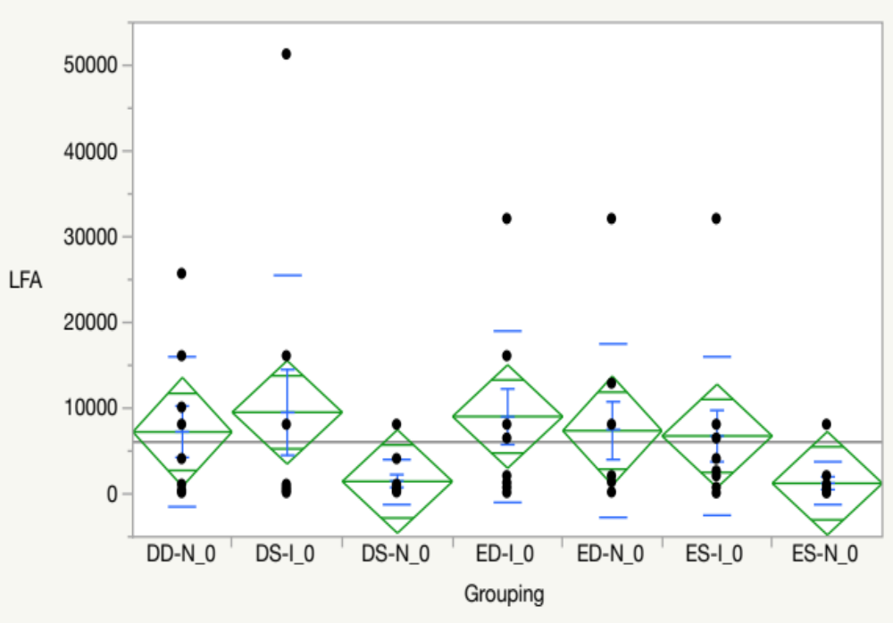
Oneway Analysis of LFA By Grouping
Blue line, Mean and
Standard deviations
(Wilcoxon). See tables
below.
Green, Mean
and Standard deviation
by ANOVA. See tables.
Fit Group

Slide 24
Nonparametric Comparisons For Each Pair Using Wilcoxon Method
q* | Alpha
1.95996 | 0.05
Fit Group > Oneway Analysis of LFA By Grouping

Slide 25
Nonparametric Comparisons For Each Pair Using Wilcoxon Method
Level | - Level | Score Mean Difference | Std Err Dif | Z | p-Value | Hodges-Lehmann | Lower CL | Upper CL | Difference Plot
ED-I_0 | DS-N_0 | 6.10000 | 2.635786 | 2.31430 | 0.0207* | 6240.00 | 320.0 | 15500.0
ES-I_0 | DS-N_0 | 5.50000 | 2.632789 | 2.08904 | 0.0367* | 3250.00 | 0.0 | 7500.0
ED-N_0 | DS-N_0 | 4.96111 | 2.570788 | 1.92980 | 0.0536 | 1840.00 | 0.0 | 7900.0
ED-I_0 | DS-I_0 | 1.70000 | 2.625783 | 0.64743 | 0.5174 | 580.00 | -8000.0 | 8000.0
ED-I_0 | DD-N_0 | 1.26667 | 2.575346 | 0.49184 | 0.6228 | 740.00 | -8000.0 | 8000.0
ES-I_0 | DS-I_0 | 0.80000 | 2.634788 | 0.30363 | 0.7614 | 1000.00 | -9600.0 | 6080.0
ED-N_0 | DS-I_0 | 0.73889 | 2.574207 | 0.28704 | 0.7741 | 280.00 | -8000.0 | 7360.0
ED-N_0 | DD-N_0 | 0.33333 | 2.508808 | 0.13287 | 0.8943 | 60.00 | -8000.0 | 7900.0
ES-I_0 | ED-N_0 | 0.21111 | 2.567364 | 0.08223 | 0.9345 | 0.00 | -6400.0 | 6000.0
DS-I_0 | DD-N_0 | 0.10556 | 2.566222 | 0.04113 | 0.9672 | 0.00 | -9000.0 | 8000.0
ES-I_0 | DD-N_0 | 0.00000 | 2.576484 | 0.00000 | 1.0000 | 0.00 | -8000.0 | 6080.0
ES-N_0 | DS-N_0 | -0.40000 | 2.605662 | -0.15351 | 0.8780 | 0.00 | -840.0 | 680.0
ED-N_0 | ED-I_0 | -0.84444 | 2.567364 | -0.32891 | 0.7422 | -490.00 | -8000.0 | 6400.0
ES-I_0 | ED-I_0 | -1.30000 | 2.629789 | -0.49434 | 0.6211 | -920.00 | -9600.0 | 3960.0
DS-N_0 | DD-N_0 | -3.48333 | 2.571928 | -1.35437 | 0.1756 | -3250.00 | -9900.0 | 120.0
ES-N_0 | DD-N_0 | -4.11667 | 2.576484 | -1.59778 | 0.1101 | -3250.00 | -10000.0 | 120.0
DS-N_0 | DS-I_0 | -4.80000 | 2.627787 | -1.82663 | 0.0678 | -840.00 | -15500.0 | 60.0
ES-N_0 | DS-I_0 | -5.10000 | 2.627787 | -1.94080 | 0.0523 | -840.00 | -15500.0 | 0.0
ES-N_0 | ED-N_0 | -5.38333 | 2.571928 | -2.09311 | 0.0363* | -1840.00 | -8000.0 | 0.0
ES-N_0 | ES-I_0 | -6.10000 | 2.634788 | -2.31518 | 0.0206* | -3500.00 | -7500.0 | -320.0
ES-N_0 | ED-I_0 | -6.50000 | 2.634788 | -2.46699 | 0.0136* | -6240.00 | -15500.0 | -320.0
Fit Group > Oneway Analysis of LFA By Grouping

Slide 26
Summary of Fit
Rsquare | 0.110145
Adj Rsquare | 0.022619
Root Mean Square Error | 9531.732
Mean of Response | 6049.412
Observations (or Sum Wgts) | 68
Fit Group > Oneway Analysis of LFA By Grouping > Oneway Anova

Slide 27
Analysis of Variance
Source | DF | Sum of Squares | Mean Square | F Ratio | Prob > F
Grouping | 6 | 685995265 | 114332544 | 1.2584 | 0.2899
Error | 61 | 5542089111 | 90853920
C. Total | 67 | 6228084376
Fit Group > Oneway Analysis of LFA By Grouping > Oneway Anova

Slide 28
Means for Oneway Anova
Level | Number | Mean | Std Error | Lower 95% | Upper 95%
DD-N_0 | 9 | 7228.89 | 3177.2 | 876 | 13582
DS-I_0 | 10 | 9520.00 | 3014.2 | 3493 | 15547
DS-N_0 | 10 | 1450.00 | 3014.2 | -4577 | 7477
ED-I_0 | 10 | 9028.00 | 3014.2 | 3001 | 15055
ED-N_0 | 9 | 7375.56 | 3177.2 | 1022 | 13729
ES-I_0 | 10 | 6760.00 | 3014.2 | 733 | 12787
ES-N_0 | 10 | 1234.00 | 3014.2 | -4793 | 7261
Std Error uses a pooled estimate of error variance
Fit Group > Oneway Analysis of LFA By Grouping > Oneway Anova

Slide 29
Means and Std Deviations
Level | Number | Mean | Std Dev | Std Err Mean | Lower 95% | Upper 95%
DD-N_0 | 9 | 7228.8889 | 8818.7477 | 2939.5826 | 450.19933 | 14007.578
DS-I_0 | 10 | 9520 | 15967.5 | 5049.367 | -1902.462 | 20942.462
DS-N_0 | 10 | 1450 | 2591.1002 | 819.37781 | -403.5614 | 3303.5614
ED-I_0 | 10 | 9028 | 9976.4353 | 3154.8259 | 1891.2881 | 16164.712
ED-N_0 | 9 | 7375.5556 | 10222.151 | 3407.3838 | -481.8855 | 15232.997
ES-I_0 | 10 | 6760 | 9303.2085 | 2941.9328 | 104.88553 | 13415.114
ES-N_0 | 10 | 1234 | 2454.095 | 776.05298 | -521.5538 | 2989.5538
Fit Group > Oneway Analysis of LFA By Grouping

