Slide 1

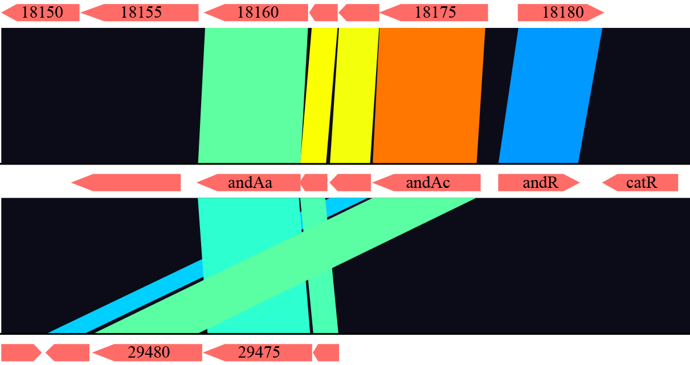
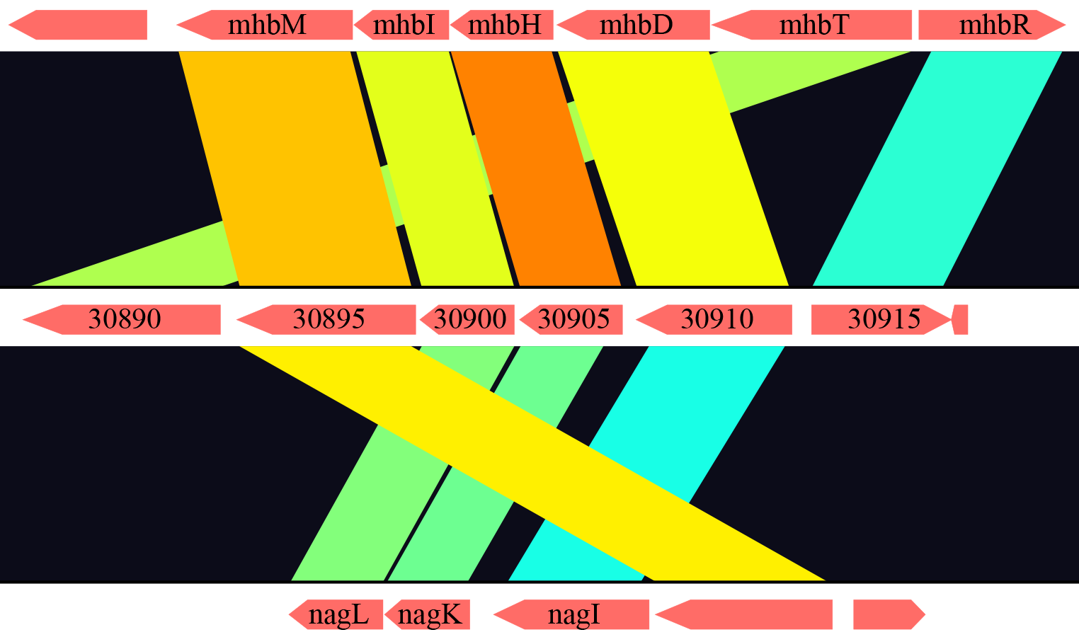
A
NH9 chromosome 1
30
40
50
60
70
80
90
100
18165
18170
DBO1
andAb
andAd
29490
29485
29470
NH9 chromosome 2
B
Klebsiella pneumoniae M5a1
NH9
nagX
Polaromonas naphthalenivorans CJ2

