Slide 1
We use older electrophoresis tanks for electrophoresis, and sometimes we add abandoned proteins on both sides due to the distortion of the bands caused by uneven current on both sides.
AP: abandoned proteins
S: sham
S+N: sham+NBP
D+N: DKK1+NBP

Slide 2
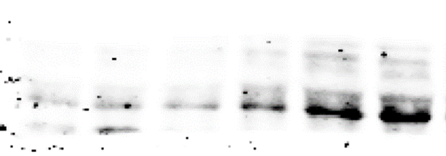
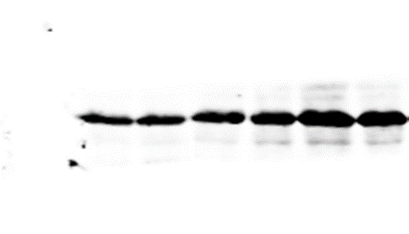
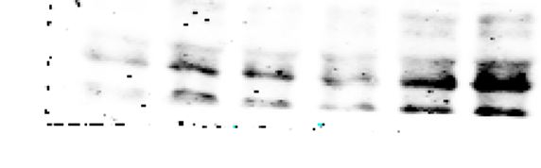
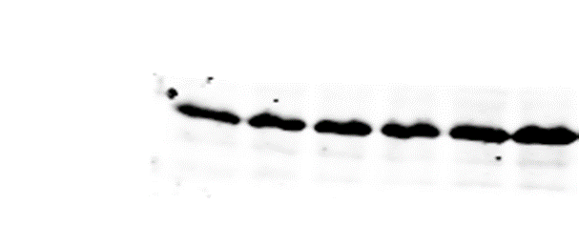
wnt3a/β-actin
AP AP Sham S+N MCAO NBP
AP AP Sham S+N MCAO NBP
Group1：
Wnt3a
Repeat1
Repeat2
Repeat3
β-actin
β-actin
β-actin
AP AP Sham S+N MCAO NBP
AP AP Sham S+N MCAO NBP
Sham S+N MCAO NBP
Sham S+N MCAO NBP

Slide 3
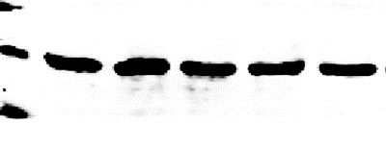
wnt3a/β-actin
AP Sham S+N MCAO NBP
AP Sham S+N MCAO NBP
Group2
Wnt3a
Repeat1
Repeat2
Repeat3
β-actin
β-actin
β-actin
Sham S+N MCAO NBP
Sham S+N MCAO NBP
Sham S+N MCAO NBP
Sham S+N MCAO NBP

Slide 4
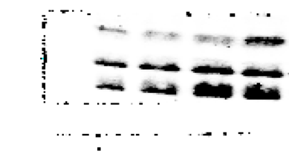
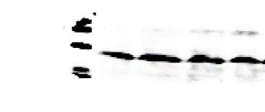
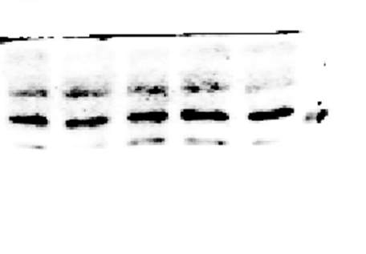
wnt3a/β-actin
Sham S+N MCAO NBP
Sham S+N MCAO NBP
Group3
Wnt3a
Repeat1
Repeat2
Repeat3
β-actin
β-actin
β-actin
Sham S+N MCAO NBP AP
Sham S+N MCAO NBP AP
Sham S+N MCAO NBP AP
Sham S+N MCAO NBP AP

Slide 5
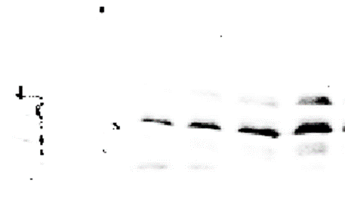
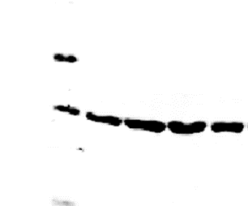
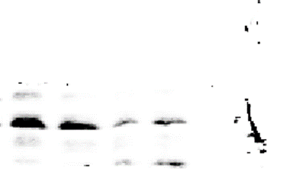
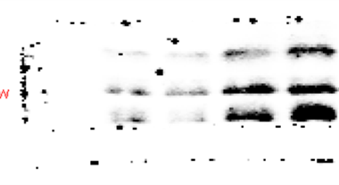
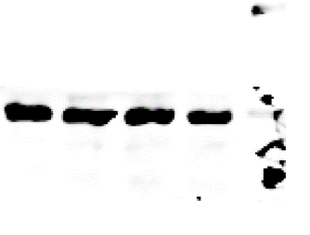
wnt3a/β-actin
Sham S+N MCAO NBP
Sham S+N MCAO NBP
Group4
Wnt3a
Repeat1
Repeat2
Repeat3
β-actin
β-actin
β-actin
Sham S+N MCAO NBP
Sham S+N MCAO NBP
Sham S+N MCAO NBP
Sham S+N MCAO NBP

Slide 6
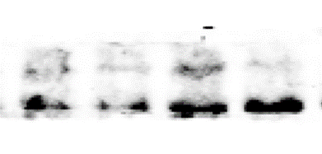
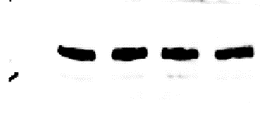
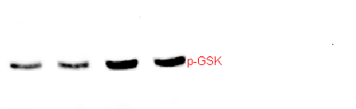
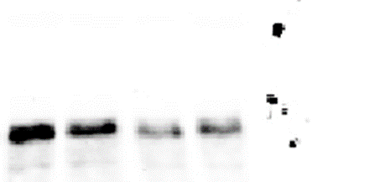
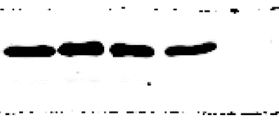
pGSK-3β/GSK-3β
Sham S+N MCAO NBP
Sham S+N MCAO NBP
Group1
pGSK-3β
Repeat1
Repeat2
Repeat3
GSK-3β
Repeat1
Repeat2
Repeat3
Sham S+N MCAO NBP
Sham S+N MCAO NBP
Sham S+N MCAO NBP
Sham S+N MCAO NBP

Slide 7
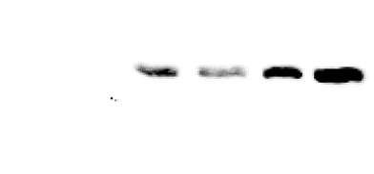
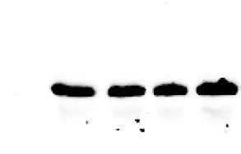
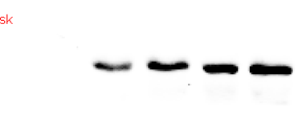
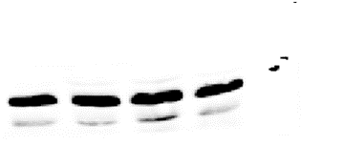
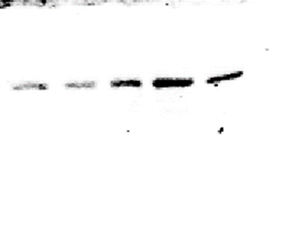
pGSK-3β/GSK-3β
Sham S+N MCAO NBP
Sham S+N MCAO NBP
Group2：
pGSK-3β
Repeat1
Repeat2
Repeat3
GSK-3β
Repeat1
Repeat2
Repeat3
Sham S+N MCAO NBP
Sham S+N MCAO NBP
Sham S+N MCAO NBP AP
Sham S+N MCAO NBP AP

Slide 8
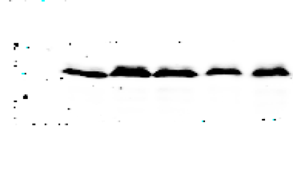

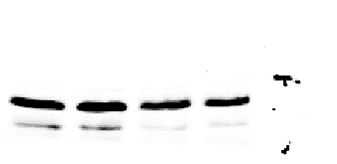
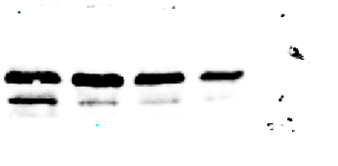
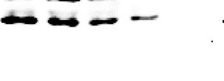
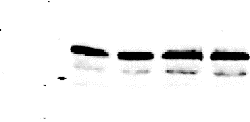
pGSK-3β/GSK-3β
Sham S+N MCAO NBP AP
Sham S+N MCAO NBP AP
Group3：
pGSK-3β
Repeat1
Repeat2
Repeat3
GSK-3β
Repeat1
Repeat2
Repeat3
Sham S+N MCAO NBP
Sham S+N MCAO NBP
Sham S+N MCAO NBP
Sham S+N MCAO NBP

Slide 9
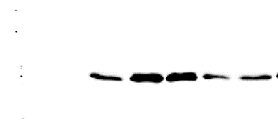
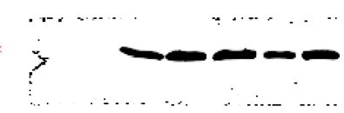
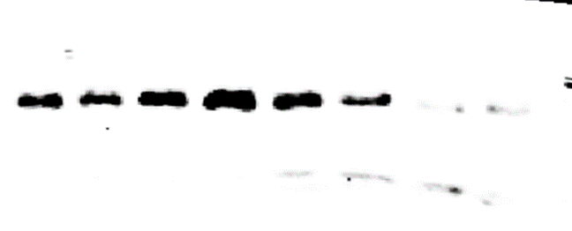
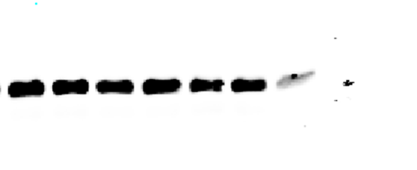
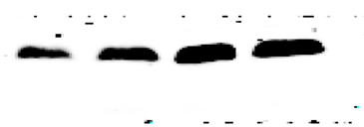
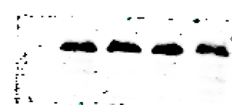
pGSK-3β/GSK-3β
Sham S+N MCAO NBP AP
Sham S+N MCAO NBP AP
Group4：
pGSK-3β
Repeat1
Repeat2
Repeat3
GSK-3β
Repeat1
Repeat2
Repeat3
Sham S+N MCAO NBP AP AP
Sham S+N MCAO NBP AP AP
Sham S+N MCAO NBP
Sham S+N MCAO NBP

Slide 10
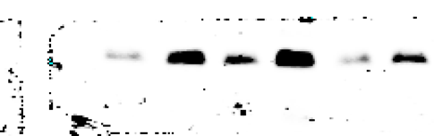
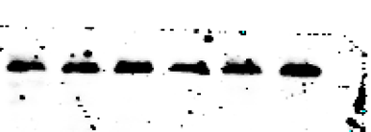
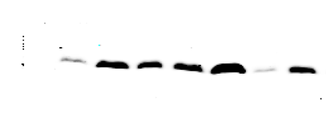
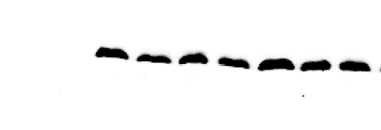
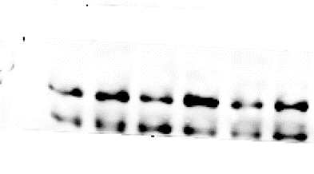
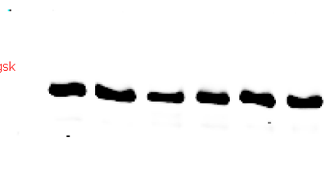
pGSK-3β/GSK-3β
Group1：
pGSK-3β
Repeat1
Repeat2
Repeat3
AP AP MCAO NBP DKK1 D+N
AP AP MCAO NBP DKK1 D+N
GSK-3β
Repeat1
Repeat2
Repeat3
AP AP AP MCAO NBP DKK1 D+N
AP AP AP MCAO NBP DKK1 D+N
AP AP MCAO NBP DKK1 D+N
AP AP MCAO NBP DKK1 D+N

Slide 11
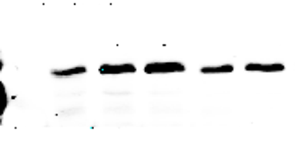
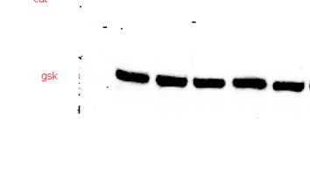
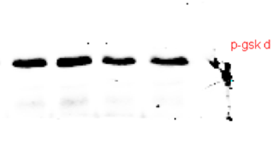
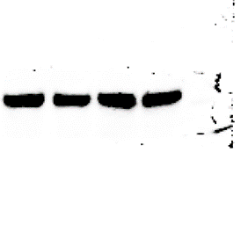
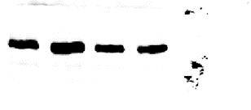
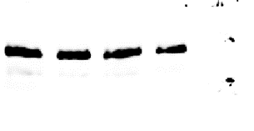
pGSK-3β/GSK-3β
Group2：
AP MCAO NBP DKK1 D+N
AP MCAO NBP DKK1 D+N
pGSK-3β
Repeat1
Repeat2
Repeat3
GSK-3β
Repeat1
Repeat2
Repeat3
MCAO NBP DKK1 D+N
MCAO NBP DKK1 D+N
MCAO NBP DKK1 D+N
MCAO NBP DKK1 D+N

Slide 12
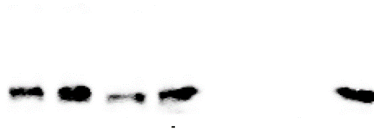
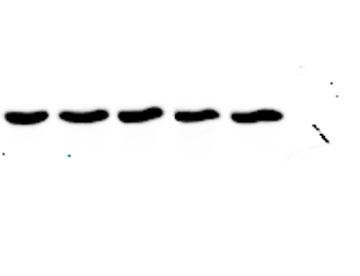
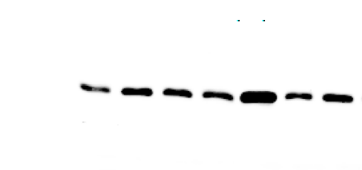
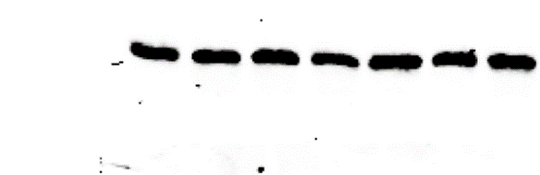
pGSK-3β/GSK-3β
Group3：
MCAO NBP DKK1 D+N
MCAO NBP DKK1 D+N
pGSK-3β
Repeat1
Repeat2
Repeat3
GSK-3β
Repeat1
Repeat2
Repeat3
MCAO NBP DKK1 D+N AP
MCAO NBP DKK1 D+N AP
AP AP AP MCAO NBP DKK1 D+N
AP AP AP MCAO NBP DKK1 D+N

Slide 13






pGSK-3β/GSK-3β
Group4：
AP AP MCAO NBP DKK1 D+N
AP AP MCAO NBP DKK1 D+N
pGSK-3β
Repeat1
Repeat2
Repeat3
GSK-3β
Repeat1
Repeat2
Repeat3
AP MCAO NBP DKK1 D+N
AP MCAO NBP DKK1 D+N
MCAO NBP DKK1 D+N
MCAO NBP DKK1 D+N

Slide 14




p-β-catenin/β-catenin
Group1：
Sham S+N MCAO NBP AP AP
Sham S+N MCAO NBP AP AP
β-catenin
Repeat1
Repeat2
Repeat3
p-β-catenin
Repeat1
Repeat2
Repeat3
Sham S+N MCAO NBP
Sham S+N MCAO NBP
Sham S+N MCAO NBP
Sham S+N MCAO NBP

Slide 15




p-β-catenin/β-catenin
Group2：
Sham S+N MCAO NBP
β-catenin
Repeat1
Repeat2
Repeat3
Sham S+N MCAO NBP
p-β-catenin
Repeat1
Repeat2
Repeat3
Sham S+N MCAO NBP
Sham S+N MCAO NBP
Sham S+N MCAO NBP AP
Sham S+N MCAO NBP AP

Slide 16





p-β-catenin/β-catenin
Group3：
Sham S+N MCAO NBP
β-catenin
Repeat1
Repeat2
Repeat3
Sham S+N MCAO NBP
p-β-catenin
Repeat1
Repeat2
Repeat3
AP AP Sham S+N MCAO NBP
AP AP Sham S+N MCAO NBP
Sham S+N MCAO NBP
Sham S+N MCAO NBP

Slide 17




p-β-catenin/β-catenin
Group4：
Sham S+N MCAO NBP
β-catenin
Repeat1
Repeat2
Repeat3
Sham S+N MCAO NBP
p-β-catenin
Repeat1
Repeat2
Repeat3
Sham S+N MCAO NBP
Sham S+N MCAO NBP
AP AP Sham S+N MCAO NBP
AP AP Sham S+N MCAO NBP

Slide 18





β-catenin/β-actin
Group1：
AP AP MCAO NBP DKK1 D+N
AP AP MCAO NBP DKK1 D+N
β-actin
Repeat1
Repeat2
Repeat3
β-catenin
Repeat1
Repeat2
Repeat3
AP AP MCAO NBP DKK1 D+N
AP AP MCAO NBP DKK1 D+N
AP AP MCAO NBP DKK1 D+N
AP AP MCAO NBP DKK1 D+N

Slide 19





β-catenin/β-actin
Group2：
AP AP MCAO NBP DKK1 D+N
AP AP MCAO NBP DKK1 D+N
β-actin
Repeat1
Repeat2
Repeat3
β-catenin
Repeat1
Repeat2
Repeat3
MCAO NBP DKK1 D+N
MCAO NBP DKK1 D+N
AP AP MCAO NBP DKK1 D+N
AP AP MCAO NBP DKK1 D+N

Slide 20






β-catenin/β-actin
Group3：
MCAO NBP DKK1 D+N AP
MCAO NBP DKK1 D+N AP
β-actin
Repeat1
Repeat2
Repeat3
β-catenin
Repeat1
Repeat2
Repeat3
MCAO NBP DKK1 D+N
MCAO NBP DKK1 D+N
MCAO NBP DKK1 D+N AP AP
MCAO NBP DKK1 D+N AP AP

Slide 21






β-catenin/β-actin
Group4：
MCAO NBP DKK1 D+N AP AP AP
β-actin
Repeat1
Repeat2
Repeat3
MCAO NBP DKK1 D+N AP AP AP
β-catenin
Repeat1
Repeat2
Repeat3
MCAO NBP DKK1 D+N AP AP
MCAO NBP DKK1 D+N AP AP
MCAO NBP DKK1 D+N AP AP
MCAO NBP DKK1 D+N AP AP

Slide 22





VEGF/β-actin
Group1：
Sham S+N MCAO NBP
Sham S+N MCAO NBP
VEGF
Repeat1
Repeat2
Repeat3
β-actin
Repeat1
Repeat2
Repeat3
Sham S+N MCAO NBP
Sham S+N MCAO NBP
Sham S+N MCAO NBP
Sham S+N MCAO NBP

Slide 23






VEGF/β-actin
Group2：
Sham S+N MCAO NBP
Sham S+N MCAO NBP
VEGF
Repeat1
Repeat2
Repeat3
β-actin
Repeat1
Repeat2
Repeat3
Sham S+N MCAO NBP
Sham S+N MCAO NBP
AP AP Sham S+N MCAO NBP
AP AP Sham S+N MCAO NBP

Slide 24





VEGF/β-actin
Group3：
Sham S+N MCAO NBP AP
Sham S+N MCAO NBP AP
VEGF
Repeat1
Repeat2
Repeat3
β-actin
Repeat1
Repeat2
Repeat3
Sham S+N MCAO NBP
Sham S+N MCAO NBP
Sham S+N MCAO NBP AP AP
Sham S+N MCAO NBP AP AP

Slide 25






VEGF/β-actin
Group4：
Sham S+N MCAO NBP
Sham S+N MCAO NBP
VEGF
Repeat1
Repeat2
Repeat3
β-actin
Repeat1
Repeat2
Repeat3
Sham S+N MCAO NBP
Sham S+N MCAO NBP
AP AP Sham S+N MCAO NBP
AP AP Sham S+N MCAO NBP

Slide 26






BDNF/β-actin
Group1：
Sham S+N MCAO NBP
Sham S+N MCAO NBP
BDNF
Repeat1
Repeat2
Repeat3
β-actin
Repeat1
Repeat2
Repeat3
Sham S+N MCAO NBP
Sham S+N MCAO NBP
Sham S+N MCAO NBP
Sham S+N MCAO NBP

Slide 27





BDNF/β-actin
Group2：
Sham S+N MCAO NBP
Sham S+N MCAO NBP
BDNF
Repeat1
Repeat2
Repeat3
β-actin
Repeat1
Repeat2
Repeat3
Sham S+N MCAO NBP
Sham S+N MCAO NBP
Sham S+N MCAO NBP
Sham S+N MCAO NBP

Slide 28






BDNF/β-actin
Group3：
Sham S+N MCAO NBP
Sham S+N MCAO NBP
BDNF
Repeat1
Repeat2
Repeat3
β-actin
Repeat1
Repeat2
Repeat3
Sham S+N MCAO NBP
Sham S+N MCAO NBP
Sham S+N MCAO NBP
Sham S+N MCAO NBP

Slide 29




BDNF/β-actin
Group4：
Sham S+N MCAO NBP
Sham S+N MCAO NBP
BDNF
Repeat1
Repeat2
Repeat3
β-actin
Repeat1
Repeat2
Repeat3
AP AP Sham S+N MCAO NBP
AP AP Sham S+N MCAO NBP
AP Sham S+N MCAO NBP
AP Sham S+N MCAO NBP

