Slide 1
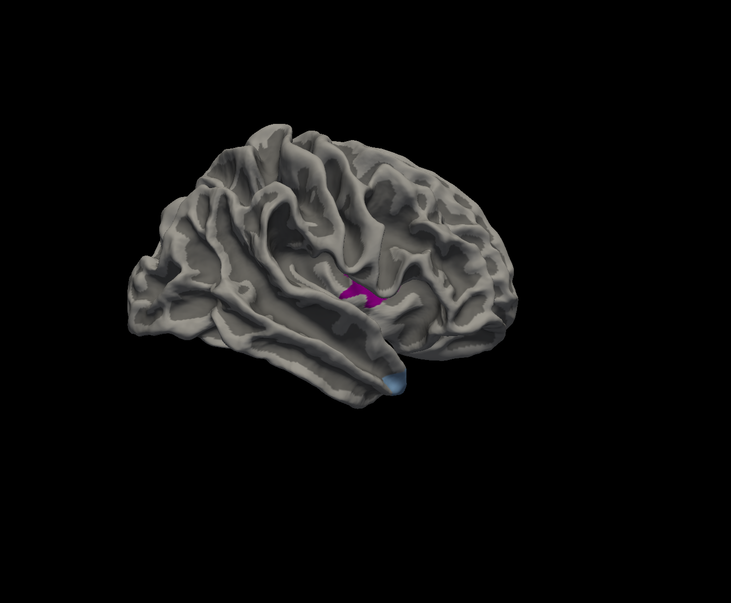
Figure S3. Surface-based morphometry analysis of the 97 only right-handed dominant PD patients revealed that the Visual Hallucination was associated with cortical volume in right insula (purple) and right temporal pole (light blue). (p < 0.01 corrected by Monte Carlo simulation).

