Slide 1
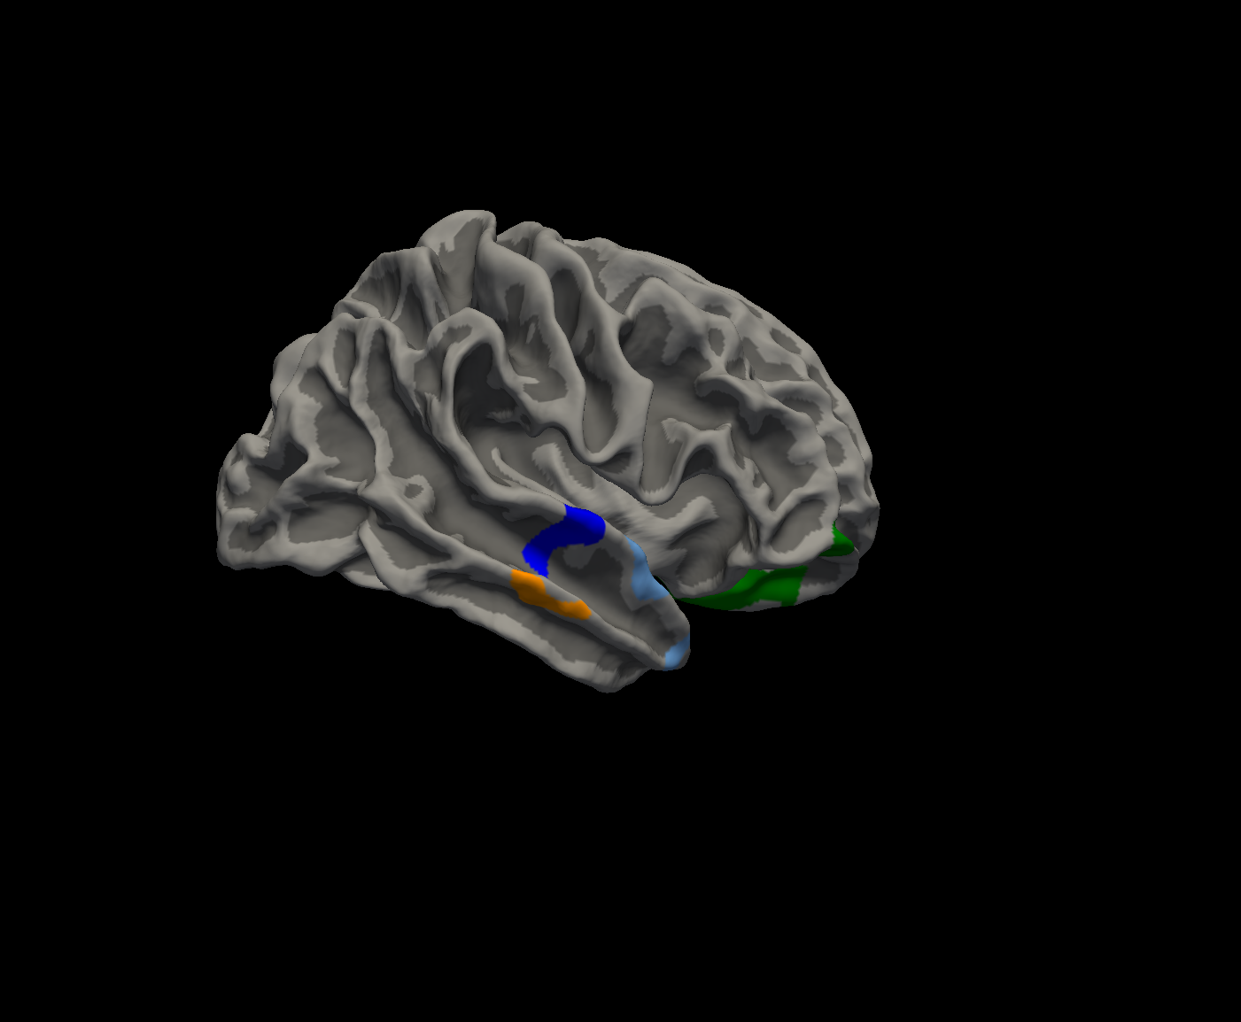
Figure S2. Surface-based morphometry analysis of the 97 only right-handed dominant PD patients revealed that the score of Noise Pareidolia Test was associated with cortical volume in right medial orbitofrontal cortex (green), right lateral orbitofrontal cortex (green), right superior temporal cortex (blue), right middle temporal cortex (orange), and right temporal pole (light blue). (p < 0.01 corrected by Monte Carlo simulation).

