Slide 1
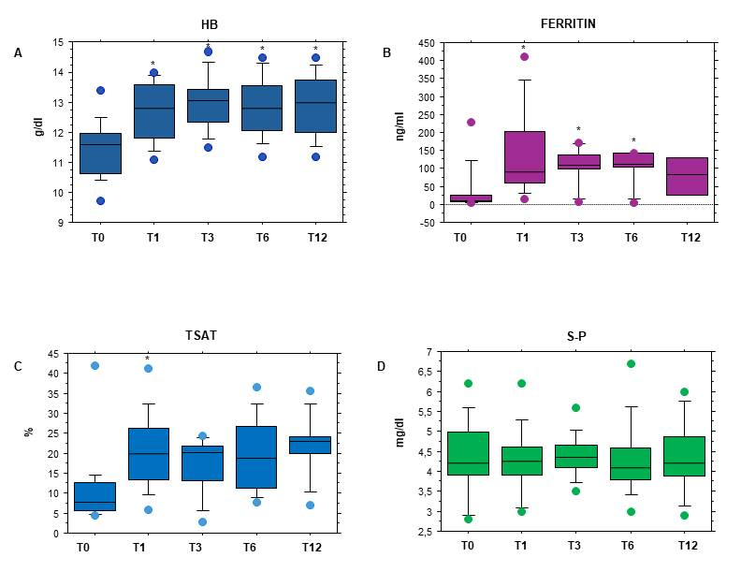
USE OF FERRIC CARBOXYMALTOSE THERAPY IN PEDIATRIC KIDNEY TRANSPLANT PATIENTS
AIM: To demonstrate that FCM is safe and effective in the therapy of iron deficiency anemia in pediatric KT patients
DESIGN & OUTCOMES:
Retrospective Single Centre Cohort Study
15
Iron deficiency (ID)
Hb
Ferritin
15 KT patients
i.v. FCM
Tsat
10
Iron deficiency anaemia (IDA)
S-Phosphorus
SAFETY AND EFFECTIVENESS OF FERRIC CARBOXYMALTOSE INTRAVENOUS THERAPY IN PEDIATRIC PATIENTS WITH KIDNEY TRANSPLANT
CONCLUSION: FCM i.v. therapy is effective and safe in the correction of ID and IDA in KT pediatric patients during stable post-transplant follow up.
[Torres] et al. 2024

