Slide 1
12-hour phenotypic drug susceptibility testing for Mycobacterium tuberculosis variant bovis BCG
Supplementary Information
Buu Minh Tran, Jimmy Larsson, Anastasia Grip, Praneeth Karempudi, Johan Elf*
Department of Cell and Molecular Biology, Uppsala University, Sweden
E-mail: johan.elf@icm.uu.se

Slide 2
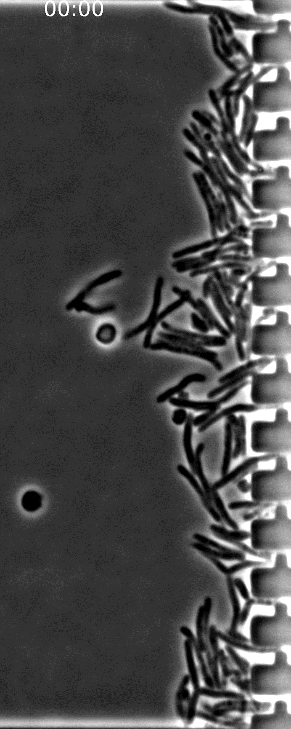
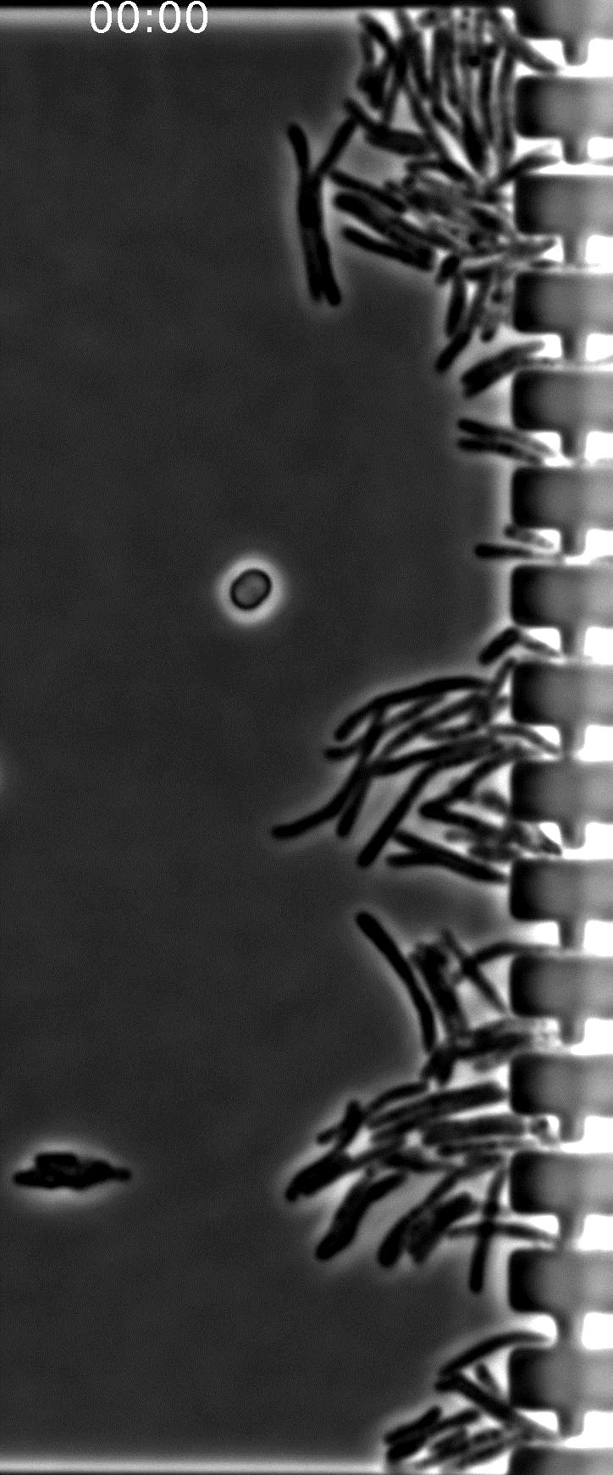
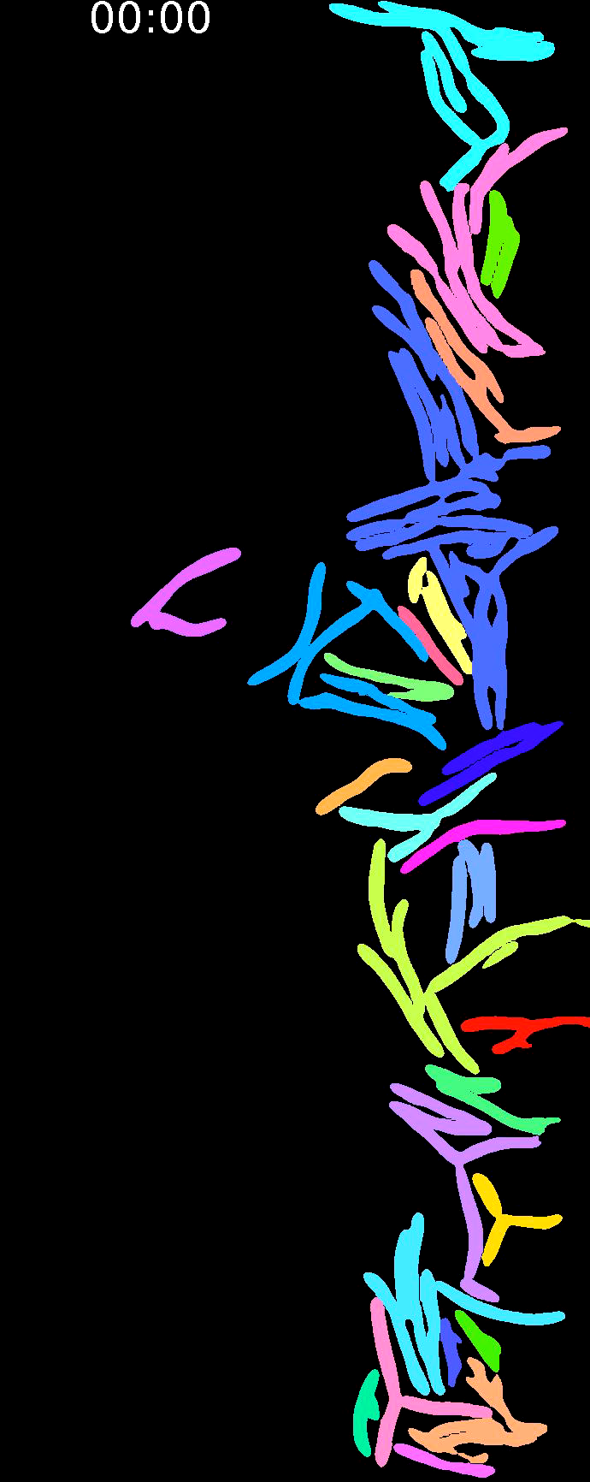
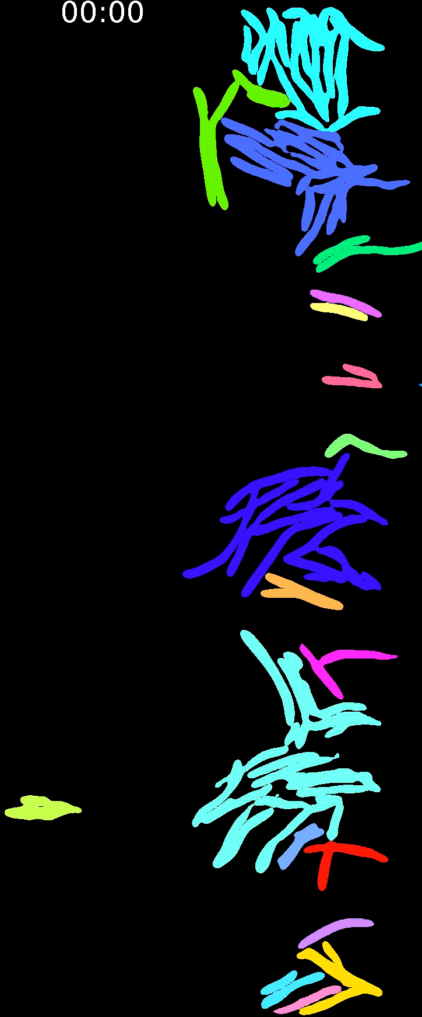
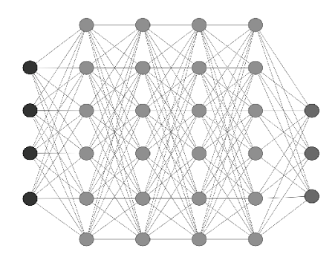
Deep neural network image-segmentation
Phase contrast of M. bovis BCG
Segmented mask
Reference
INH 0.5 mg/L
Reference
INH 0.5 mg/L

Slide 3
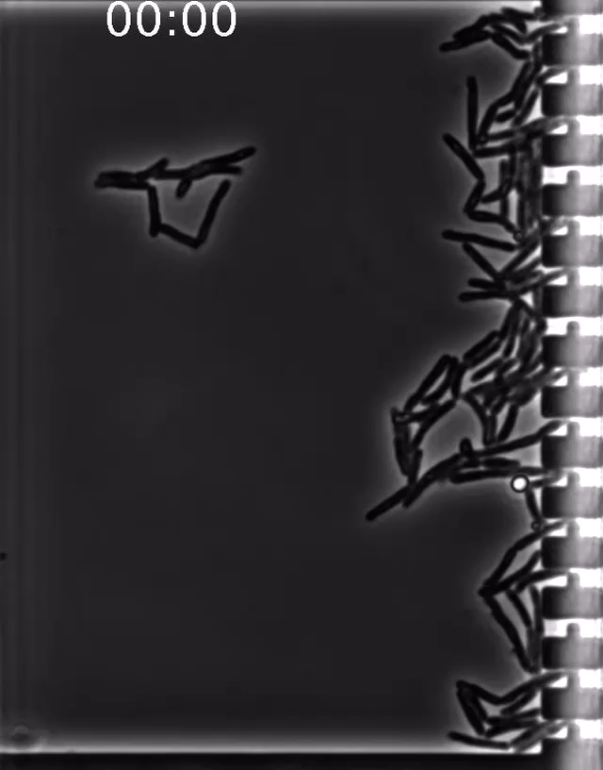
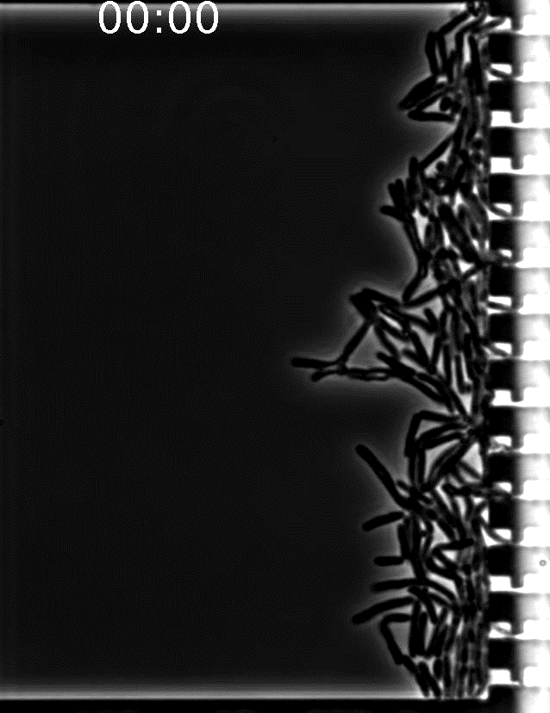
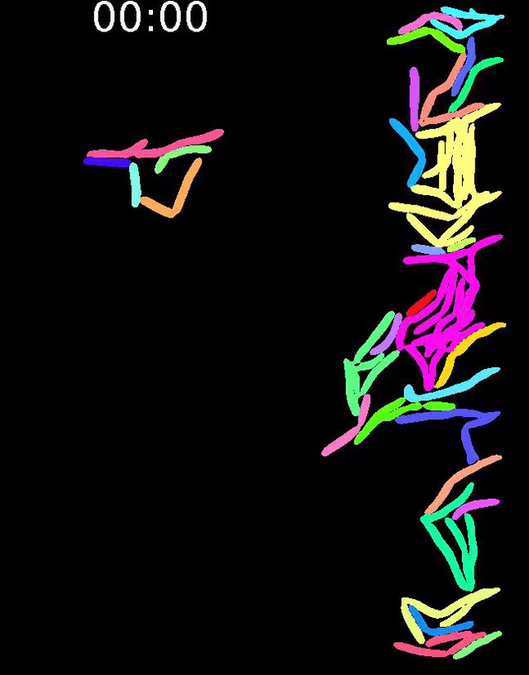
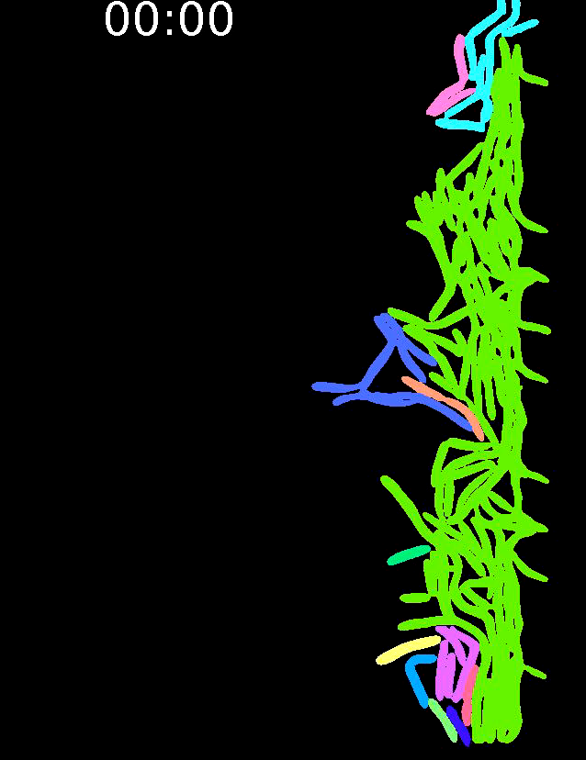
Deep neural network image-segmentation
Phase contrast of M. smegmatis NCTC 8159
Segmented mask
Reference
RIF 50 mg/L
Reference
RIF 50 mg/L

