Slide 1
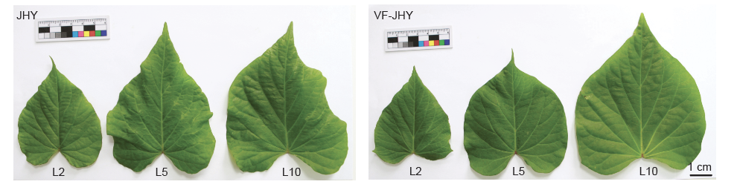
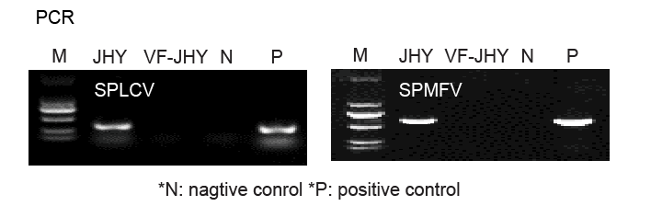
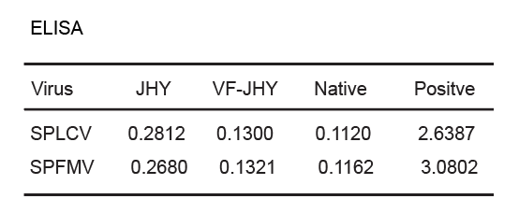
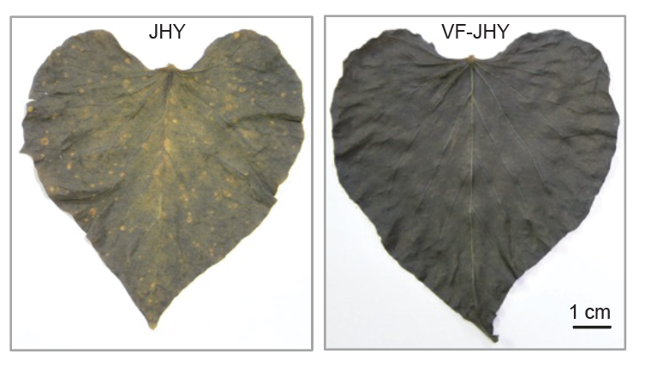
Supplemental figure 1
A
B
C
D
Figure S1 Sweet potato virus disease leads to the significant yield loss
(A) Phenotype of the leaves from sweet potato virus disease (SPVD) plant (JHY) and the virus-free plant (VF-JHY) grown in the greenhouse.
(B) (C) Detection of viruses in JHY and VF-JHY plants using PCR and ELISA, no viruses were detected in the VF-JHY plants.
(D) Effect of SPVD in starch biosynthesis by the Iodine staining. JHY has less starch content.

Slide 2
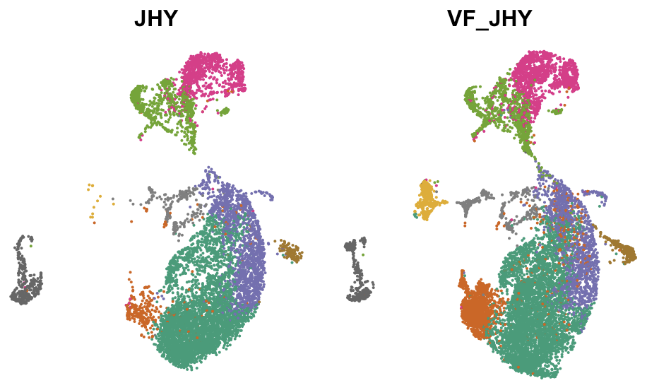
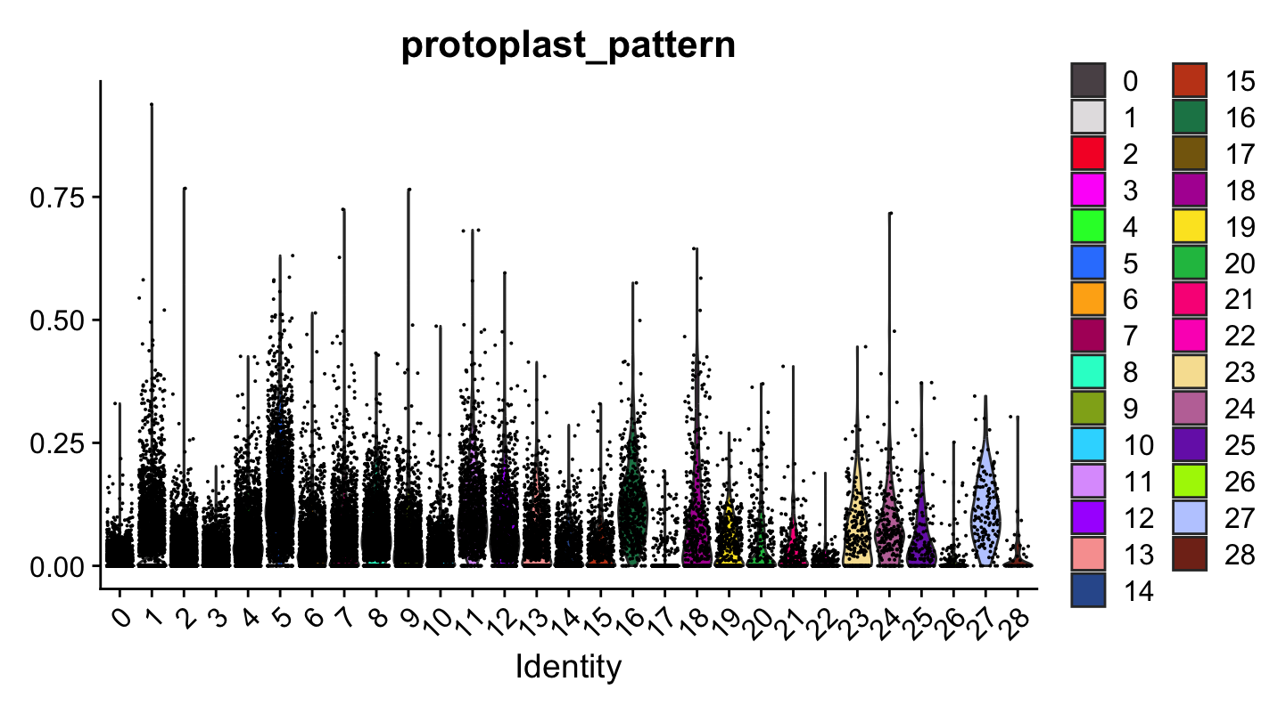
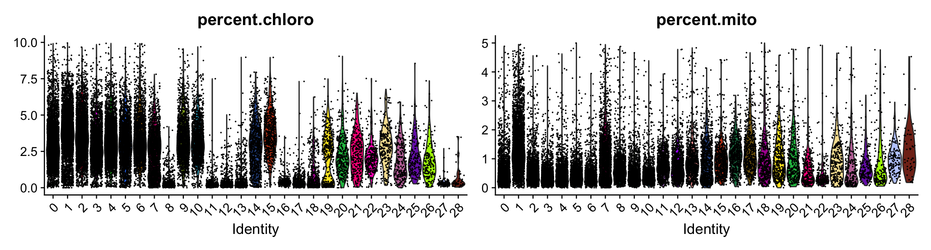
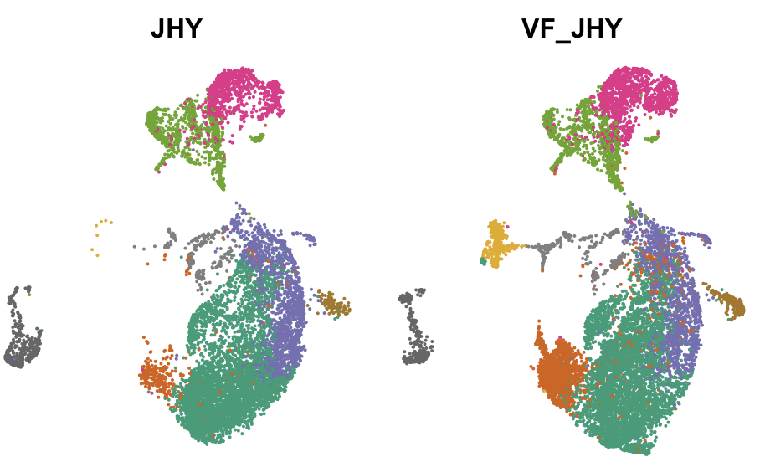
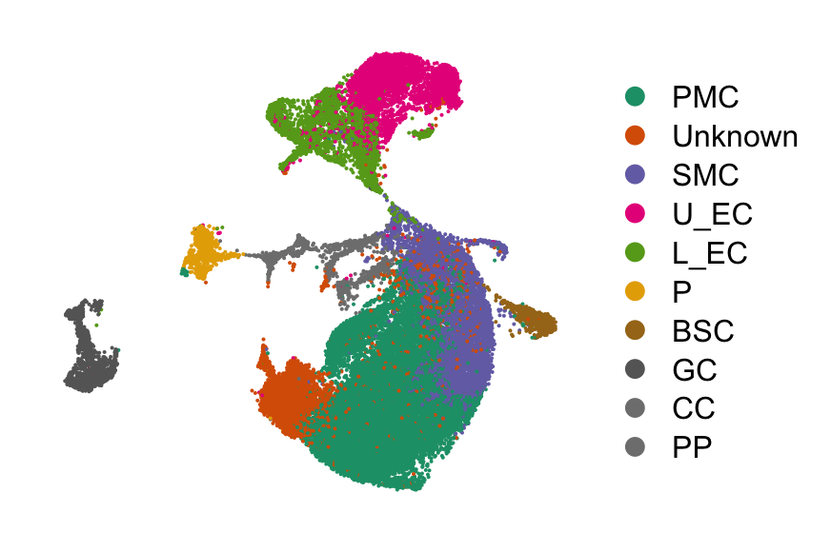
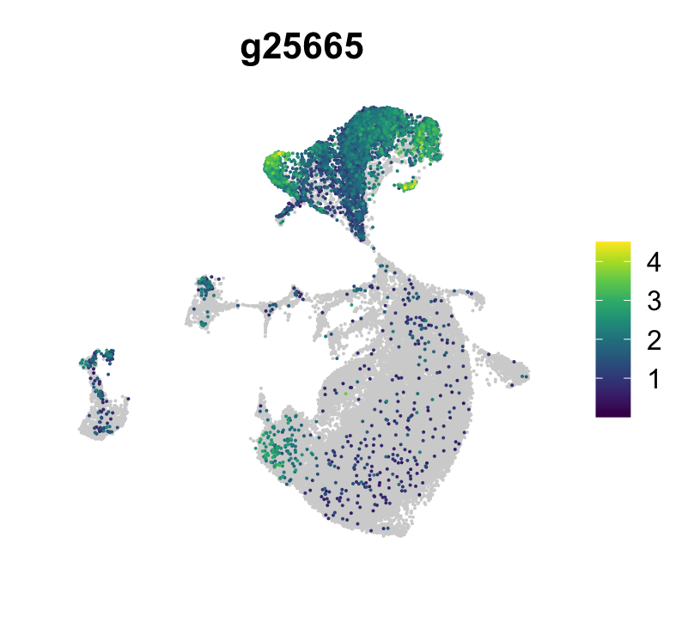
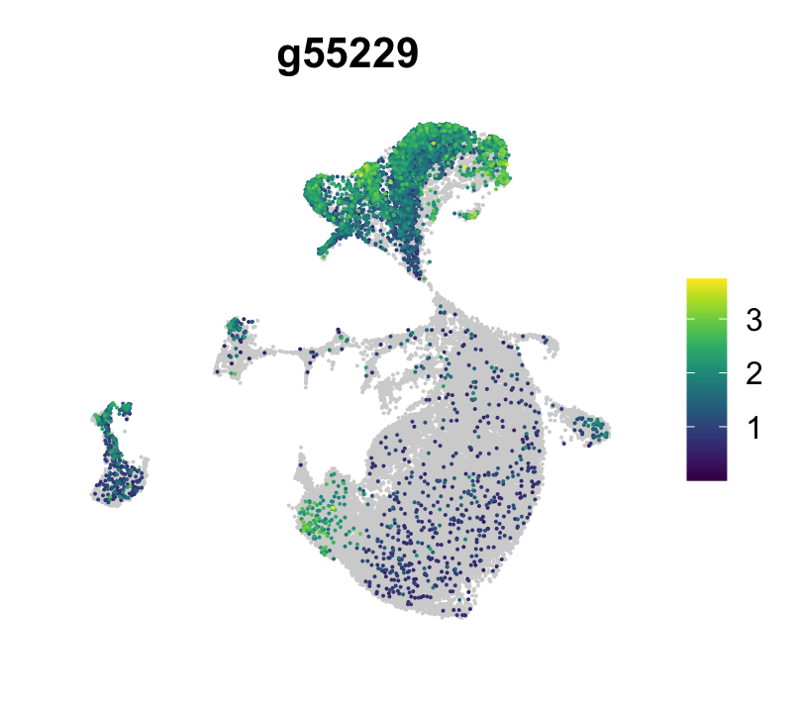
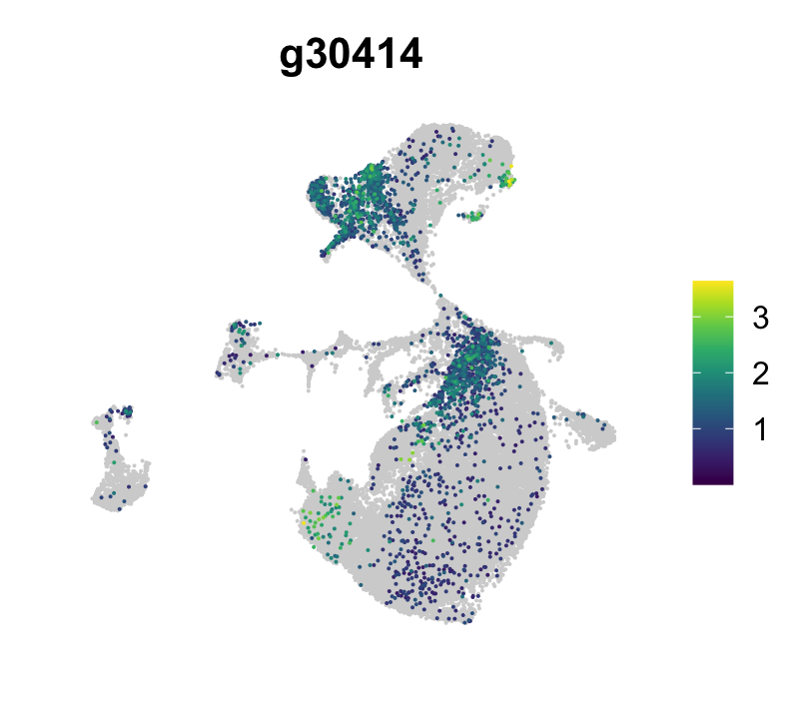
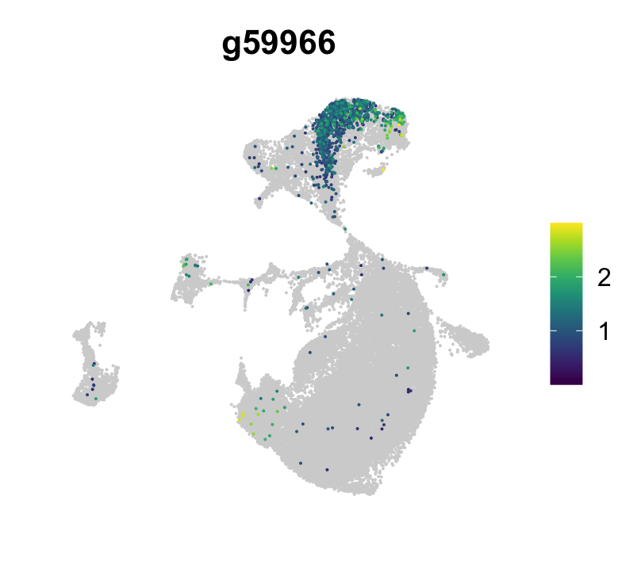
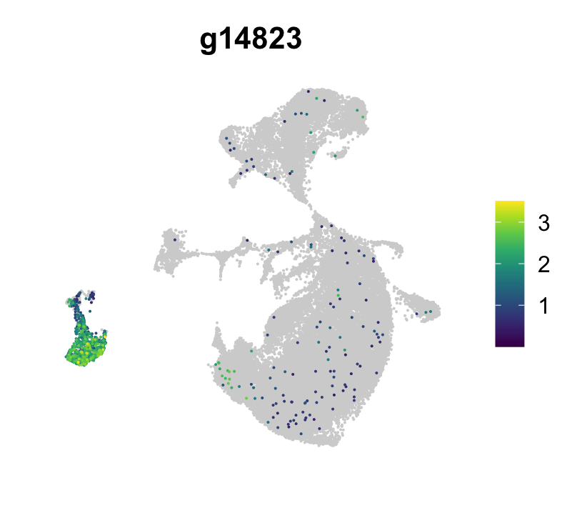
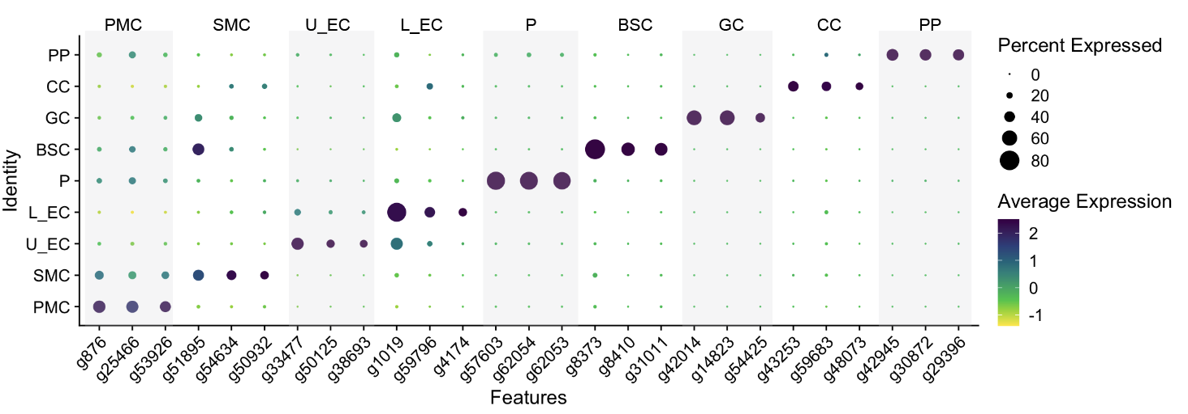
Supplemental figure 2
A
Replicate 1
D
%
Replicate 2
%
%
VC
B
Epidermis marker genes
Abaxial marker
Adaxial marker
Guard cell marker
C
Figure S2 Construction of scRNA-seq atlas.
(A) Two replicates were used for collecting scRNA-seq data.
(B) Proportion of chloroplast, mitochondria, and protoplast-induced genes.
(C) Expression of cell type markers.
(D) Cell type-specific markers identified by scRNA-seq.
(E) Effect of SPVD on the stomata cell development.

Slide 3
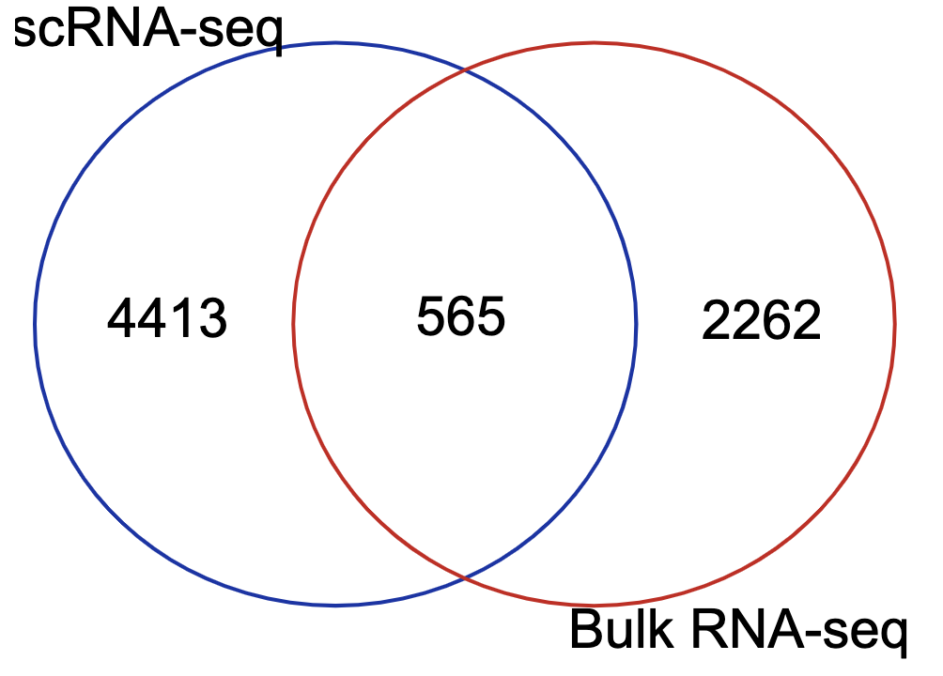
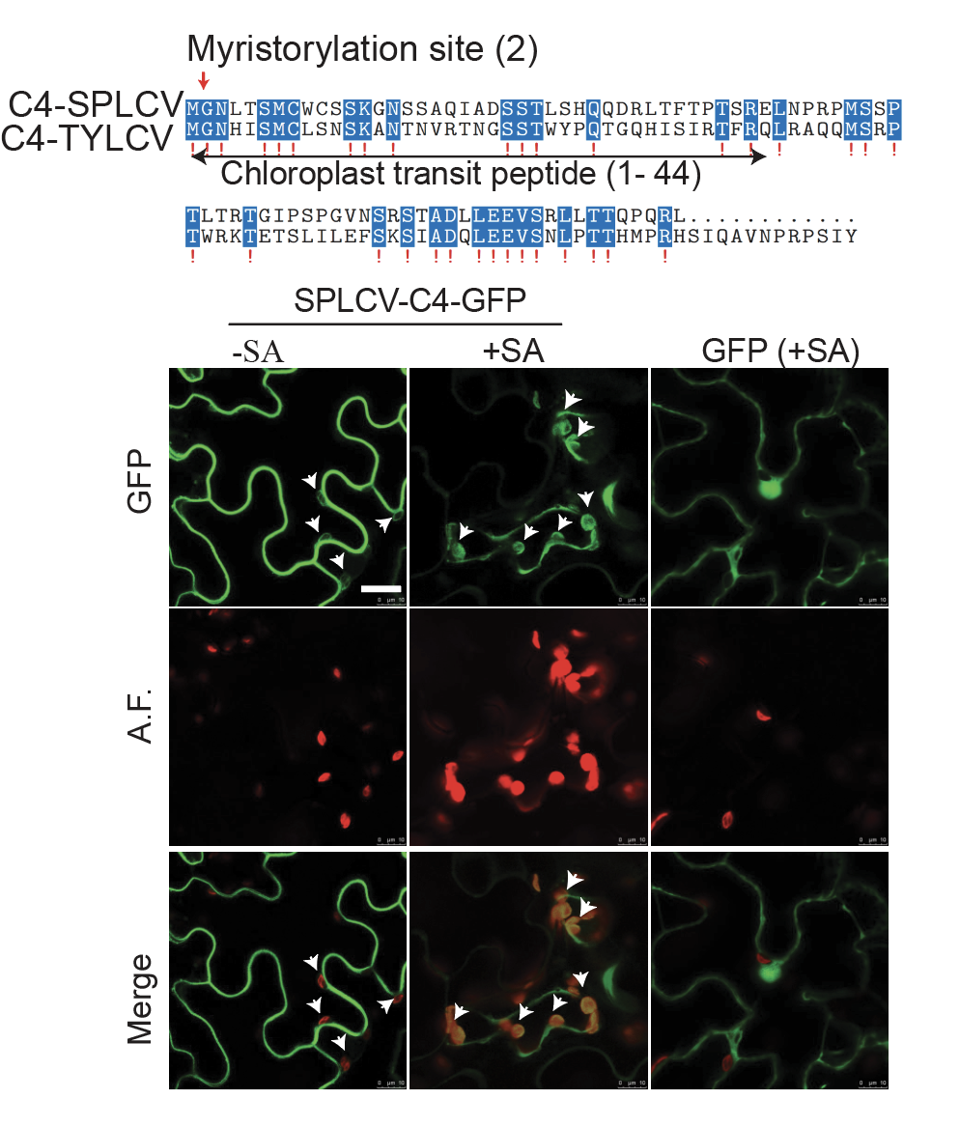
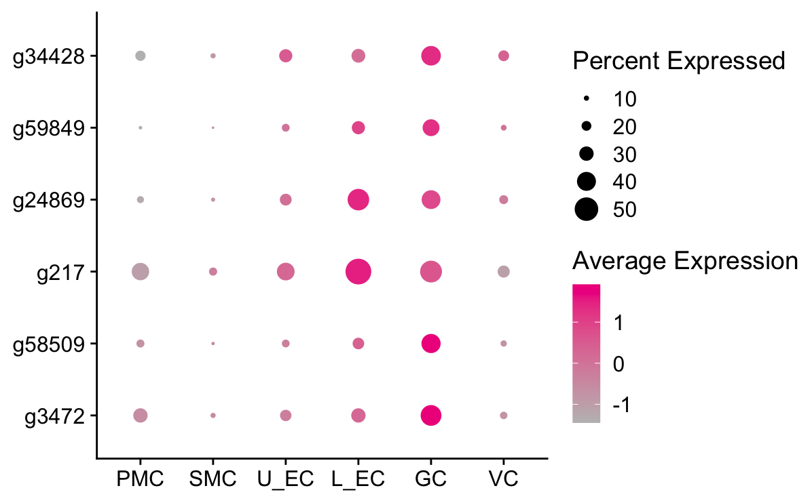
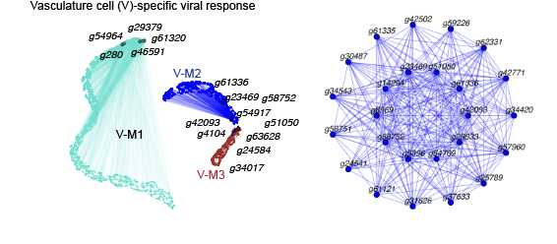
Supplemental figure 3
A
B
C
CPKs
D
Figure S3 Comparison of bulk mRNA-seq and scRNA-seq data.
(A) Comparison of differentially expressed genes identified in the bulk mRNA-seq and scRNA-seq.
(B) Translocation of SPLCV C4 protein from the plasma membrane to the chloroplast.
(C) Expression of CPKs, the positive regulators of SA biosynthesis.
(D) Vasculature cell-type immune coexpression network built by hdWGCNA.

Slide 4
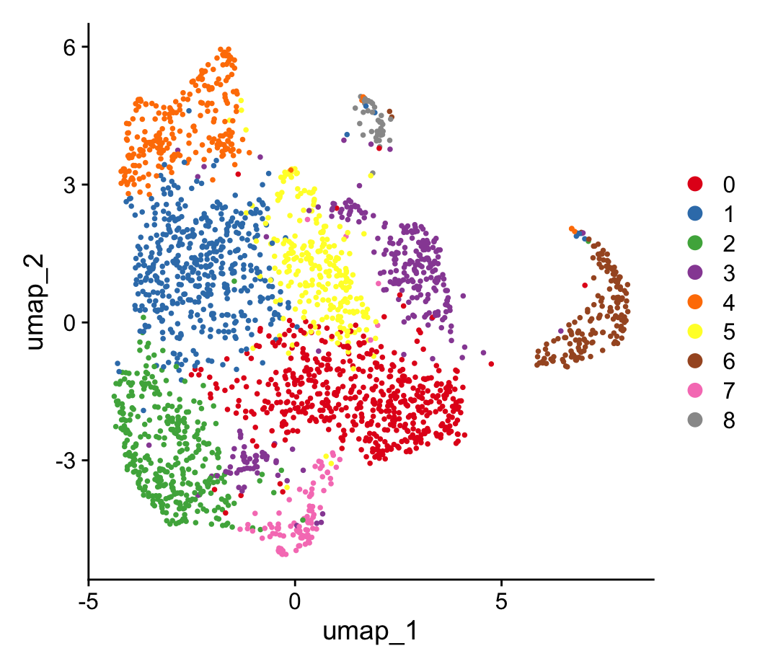
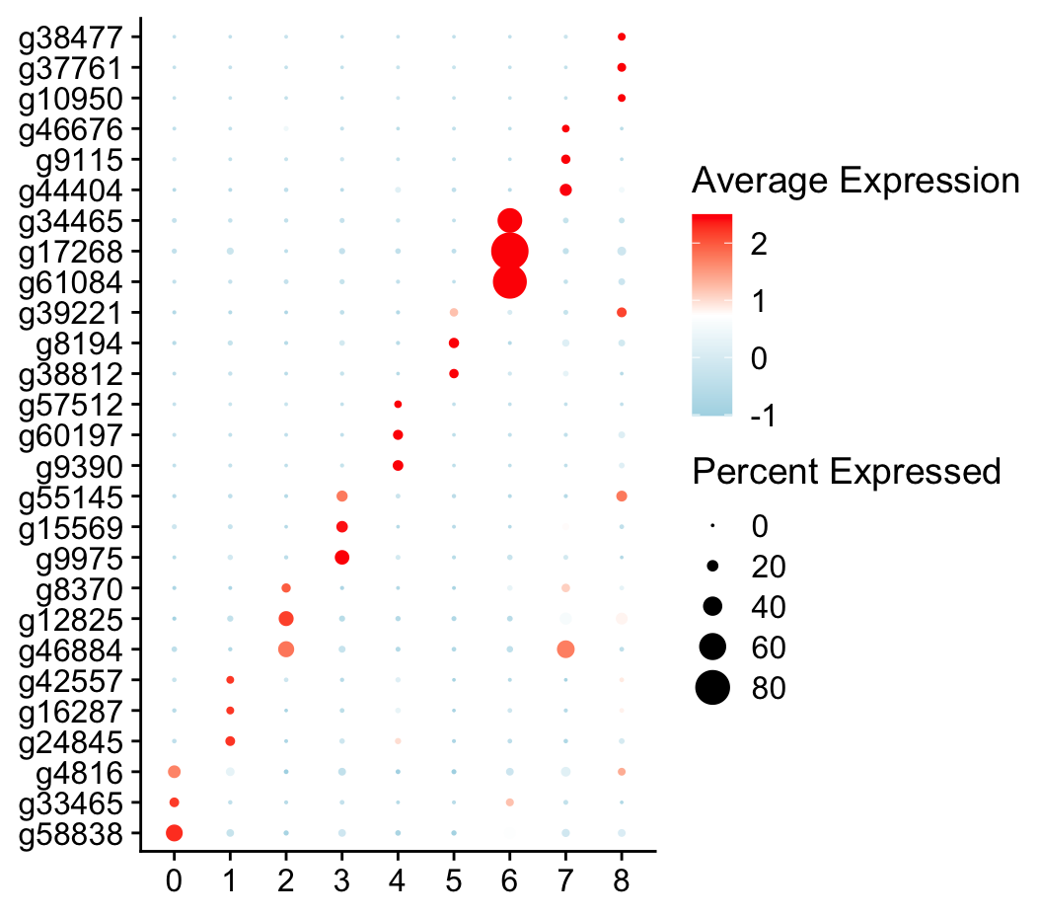
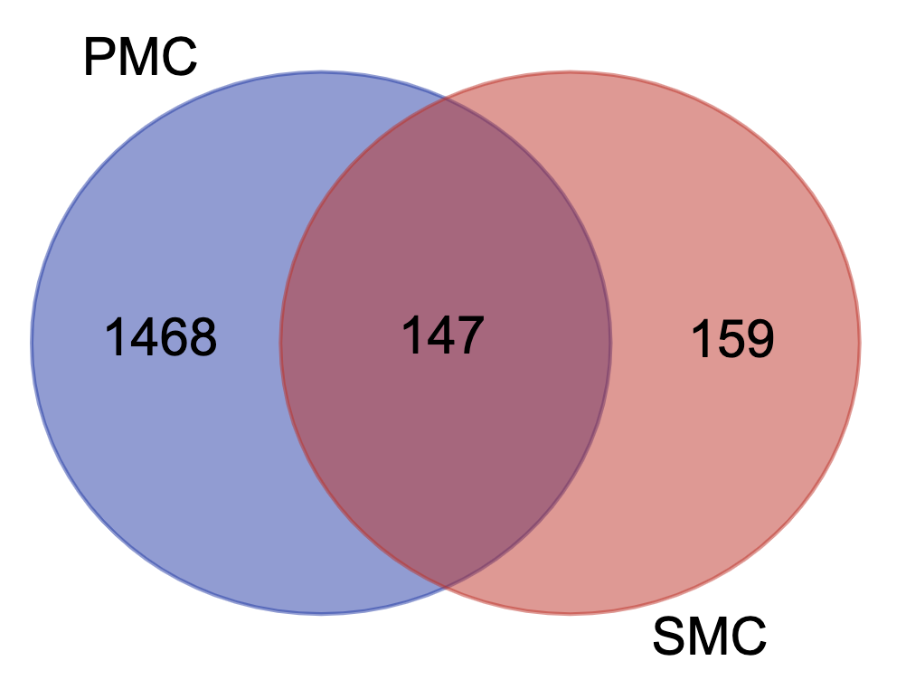
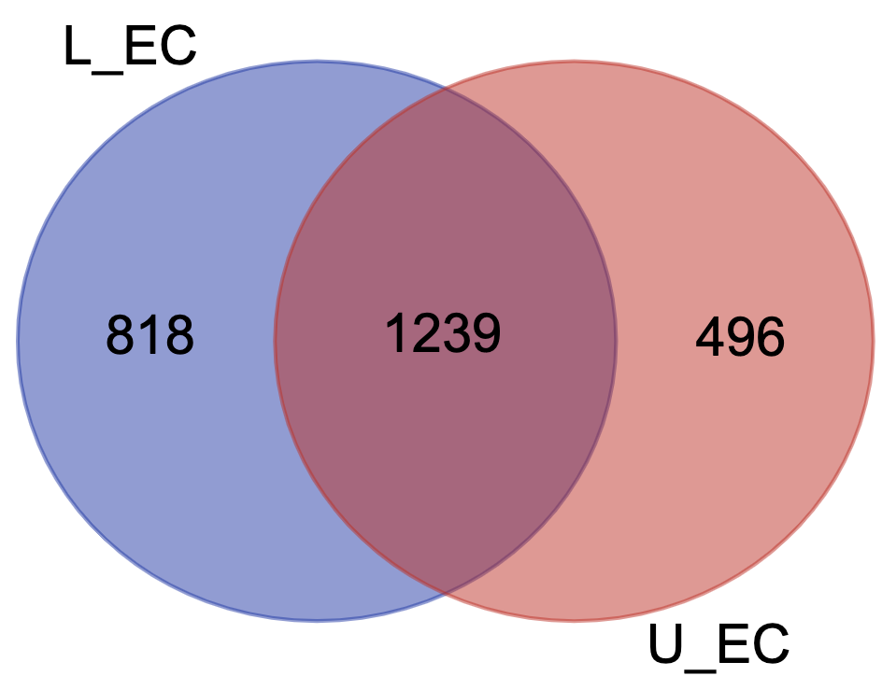
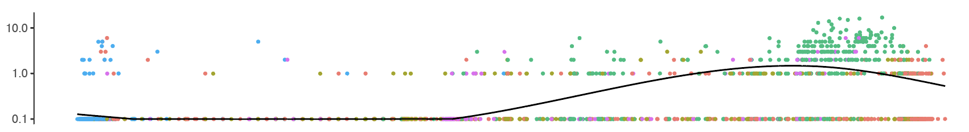
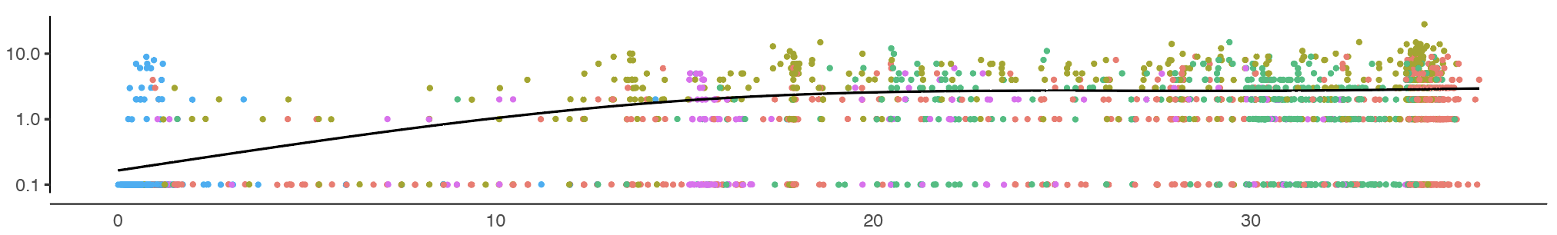
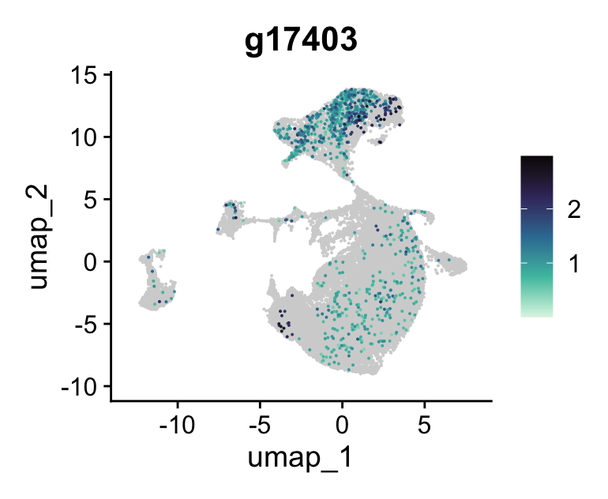
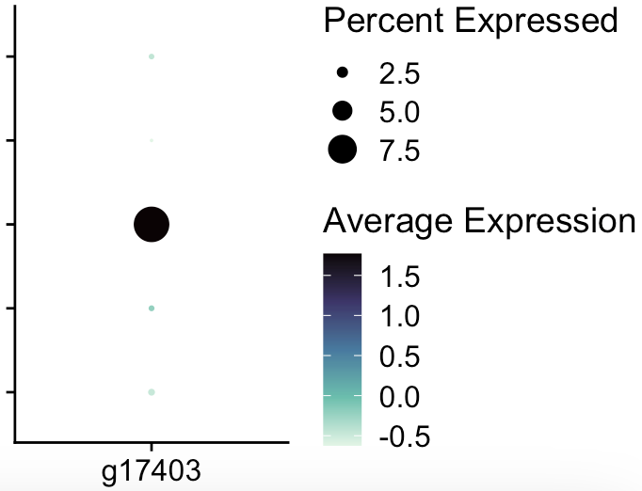
Supplemental figure 4
A
B
Palisade Mesophyll cells:3, 5, 7
Spongy Mesophyll cells: 0, 2,6
Epidermis: 1, 4
Vasculature: 8
C
D
g13640 (JAZ10)
g17403 (MYB16)
GC
VC
EC
SMC
PMC

Slide 5
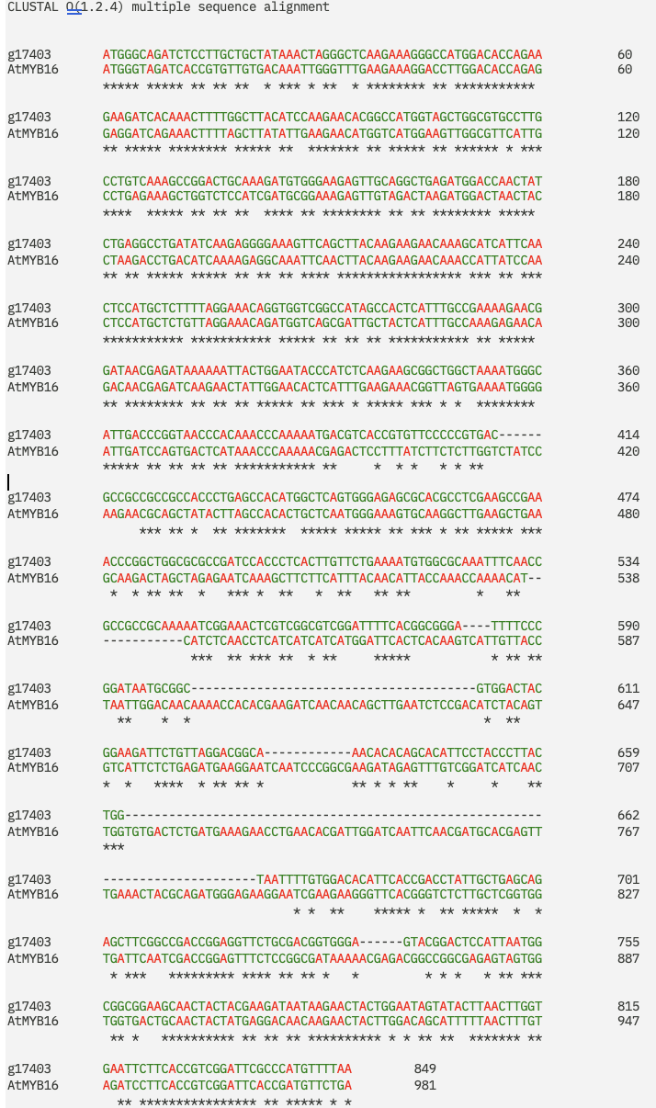
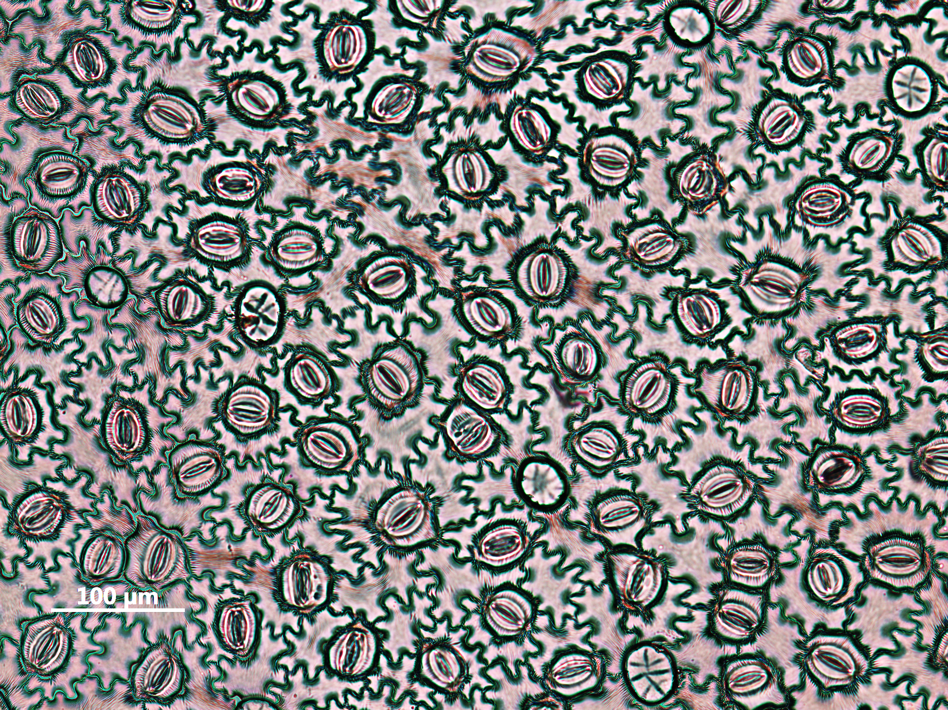
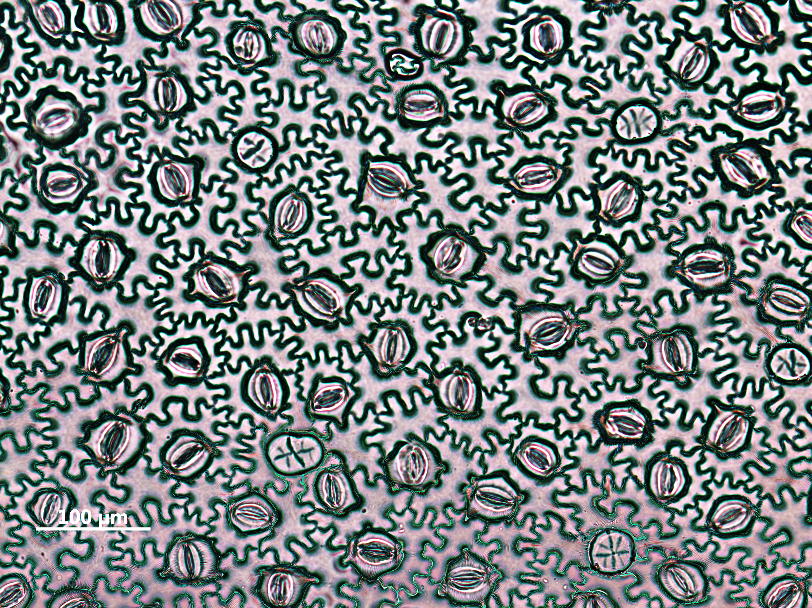
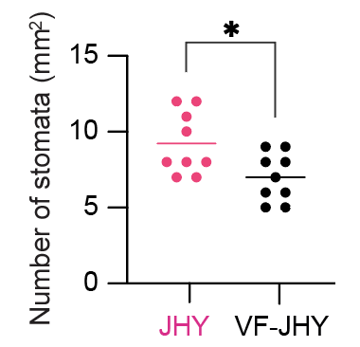
E
F
JHY
VF-JHY
Figure S4 Cell type-specific immune response induced by the virus infection
(A) Subclustering of the cluster 1 and 26.
(B) Cluster-specific markers in the subclusters of cluster 1 and 26.
(C) Comparison of differentially expressed genes in the mesophyll, epidermal, the the four major cell types.
(D) Expression of JAZ10 and MYB16 alongside the pseudotime (upper panel), and the epidermis-specific expression of MYB10.
(E) Sequence alignment of AtMYB16 and g17403(IbMYB16)
(F) Morphology of JHY and VF-JHY lower epidermis (upper panel), and stomata density (lower panel).

Slide 6
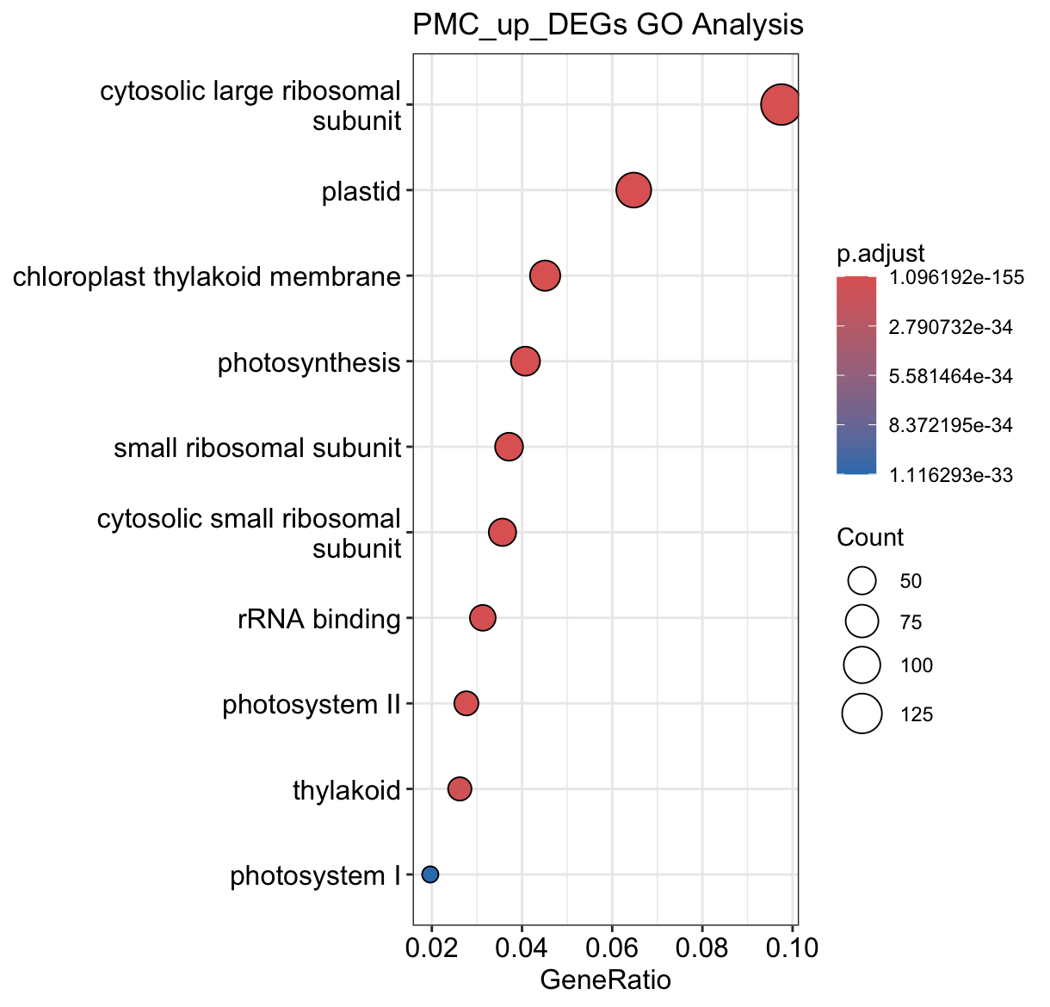
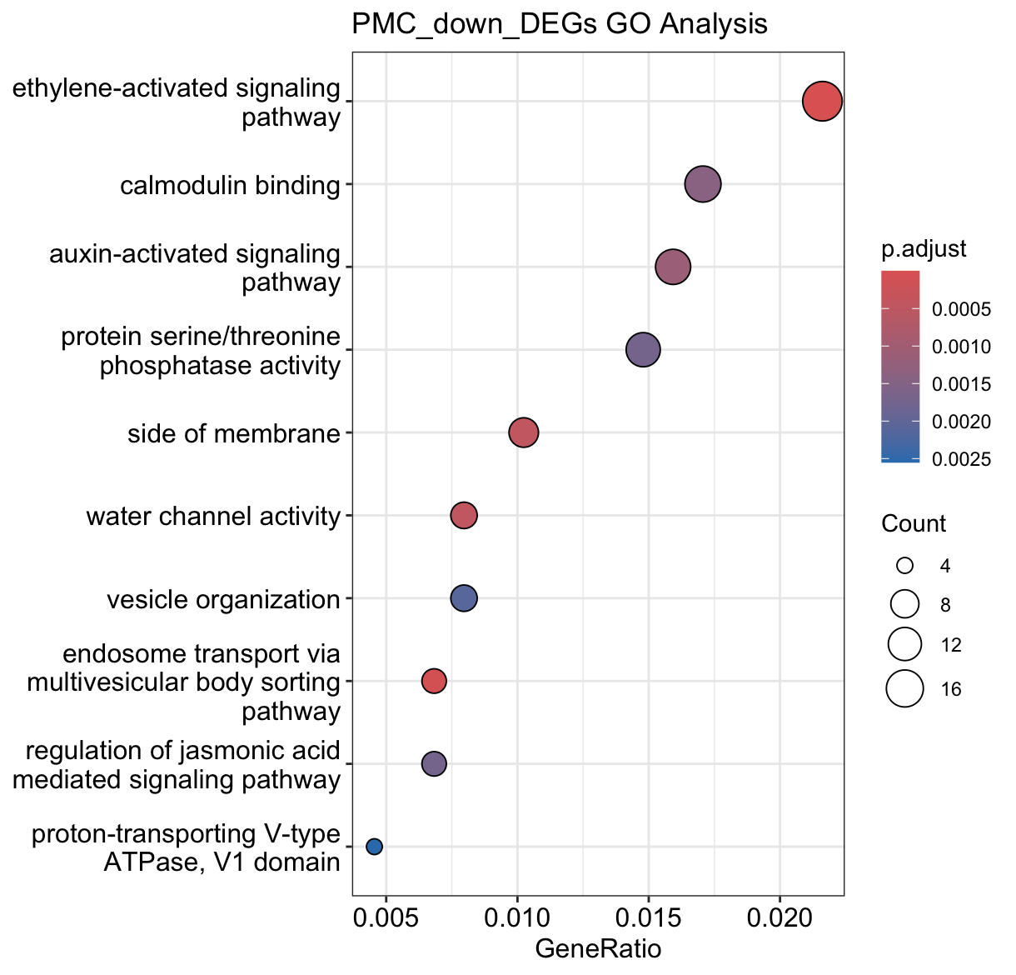
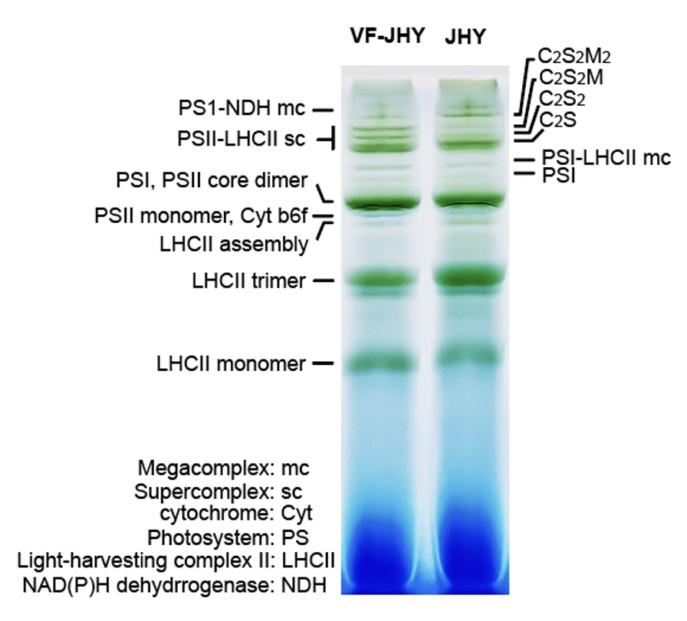
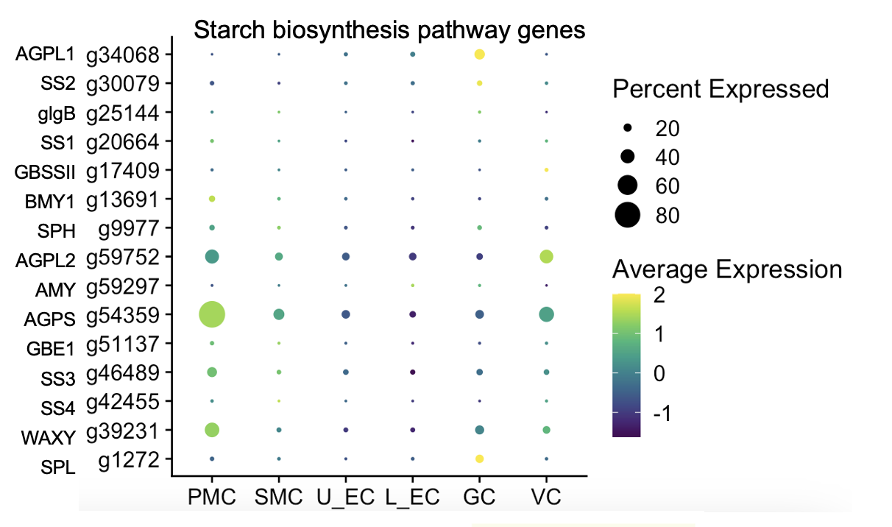
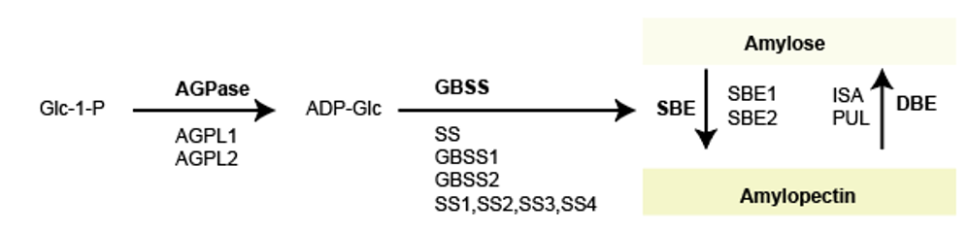
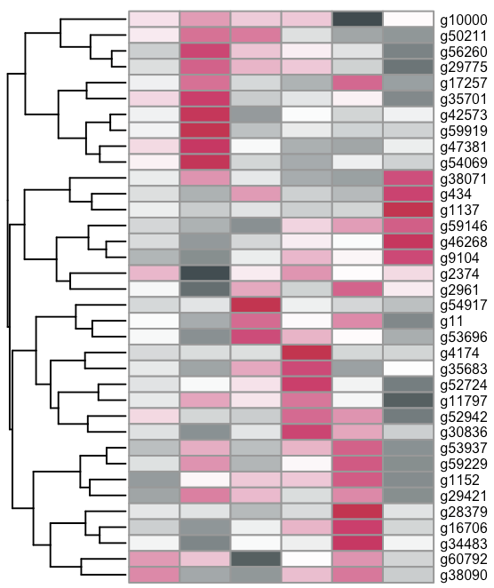
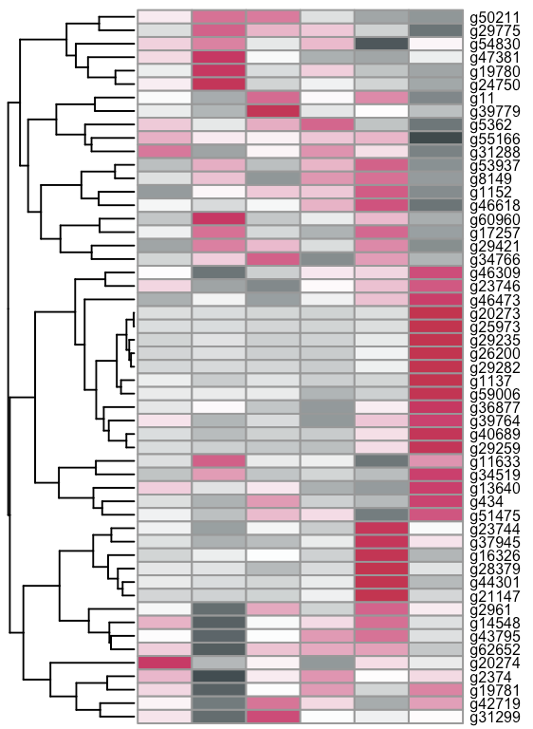
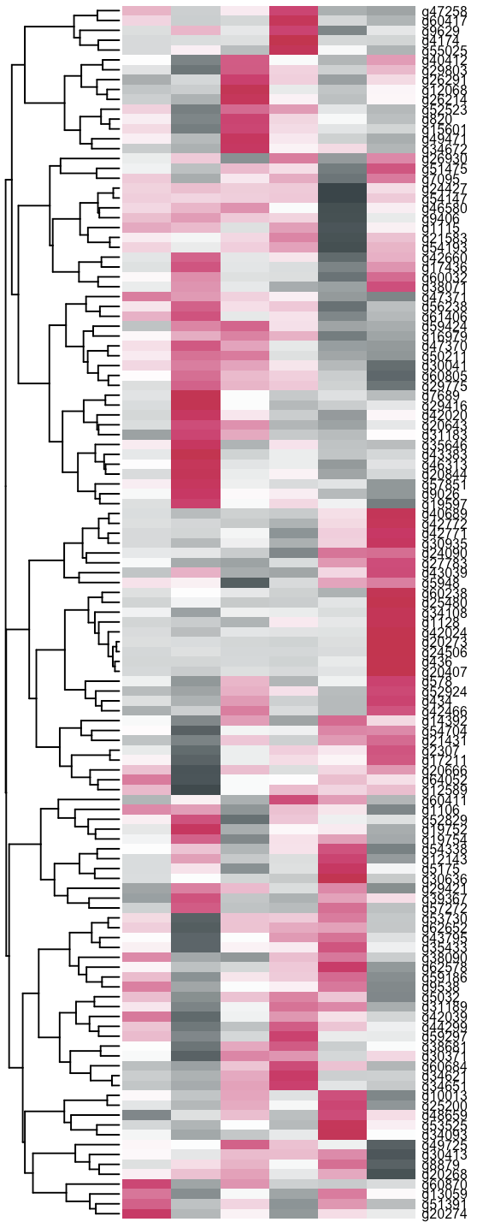
Supplemental figure 5
A
B
C
D
SA responsive
JA responsive
ABA responsive
PM SM L_E U_E V G
PM SM L_E U_E V G
PM SM L_E U_E V G
Figure S5 Palisade mesophyll cell-specific immune response induced by the virus infection
(A) GO enrichment assay of PMC-specific up- and down-regulated genes.
(B) Native blue gel of isolated thylakoid membrane from JHY and VF-JHY leaves.
(C) Expression of starch biosynthesis pathway genes across the cell types.
(D) Expression of SA, JA, and ABA responsive genes across the cell types.

Slide 7
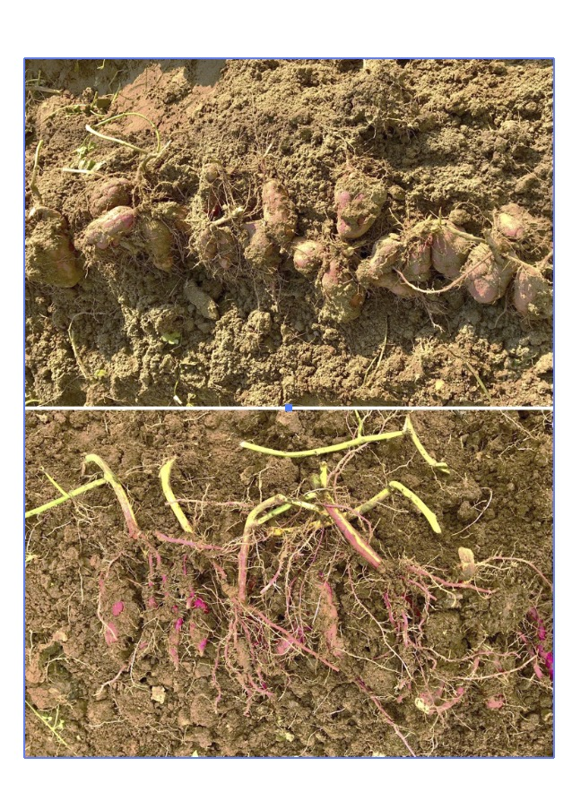
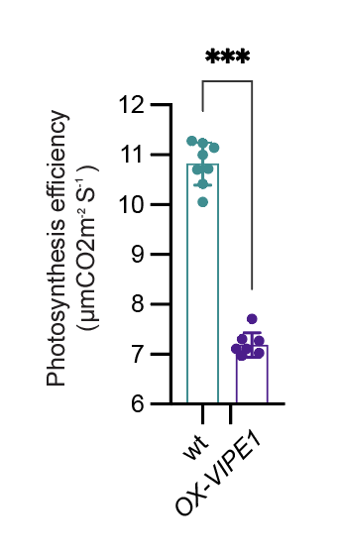
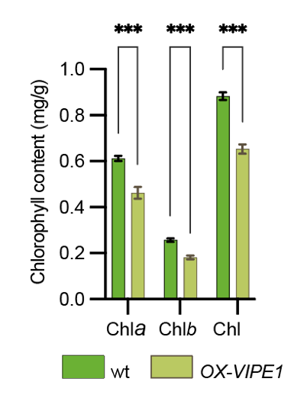
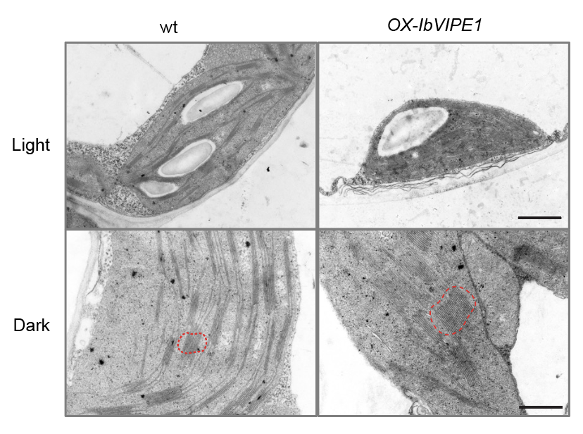
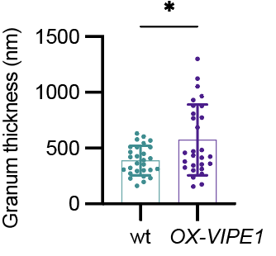
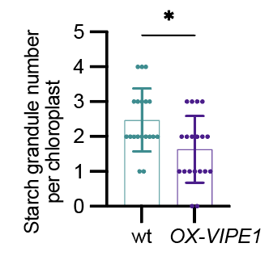
Supplemental figure 6
A
Wild type
OX_VIPE1
B
C
Figure S6 Overexpression of VIPE1 affects the yield of sweet potato.
(A) Overexpression of VIPE1 reduced the yield in the field.
(B) Overexpression of VIPE1 reduced the photosynthesis efficiency.
(C) Overexpression of VIPE1 disrupts the chloroplast ultrastructure.

