Slide 1
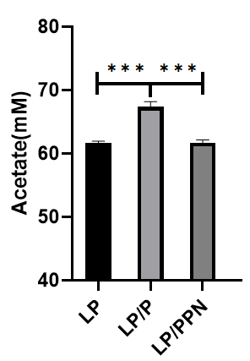
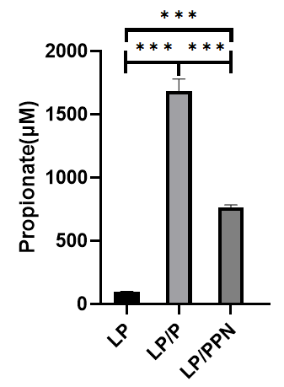
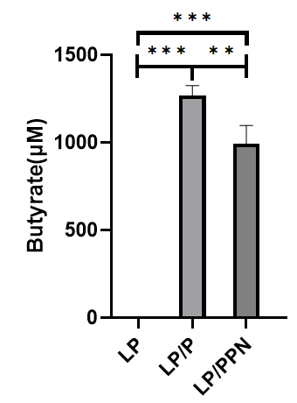
Supplement DATA 1
A
B
C
Supplementary figure 1. Changes in in vitro SCFA fermentation profile of probiotics LP upon treating prebiotics pullulan or nanoprebiotics PPNs. The contents of acetate (A), propionate (B) and butyrate (C) in the culture medium of LP.

Slide 2
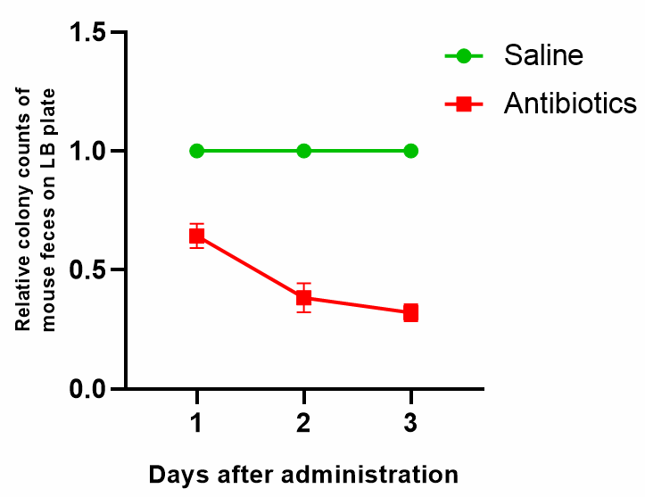
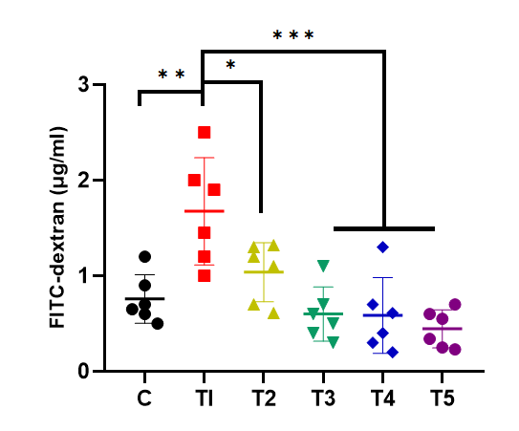
Supplement DATA 2
Supplementary figure 2. Colony counts on LB agar after mice treated with antibiotics (ampicillin: gentamicin: neomycin: vancomycin = 2:2:2:1, total 20mg/mice) compared to that of saline-treated group.
Supplement DATA 3
Supplementary figure 3. The level of FITC-dextran detected in serum by groups after the trial.

Slide 3
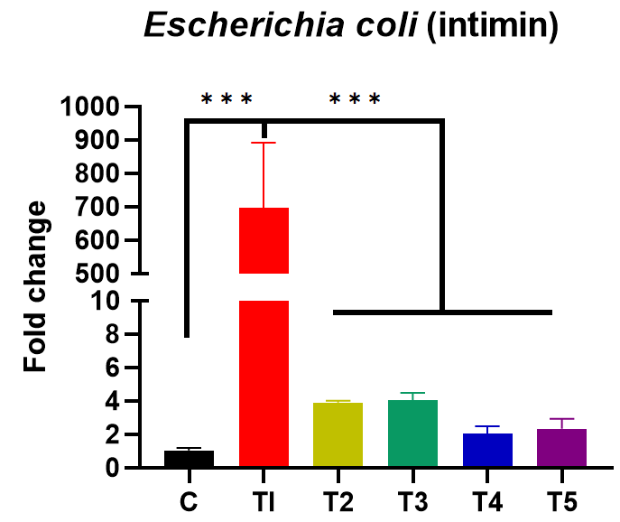
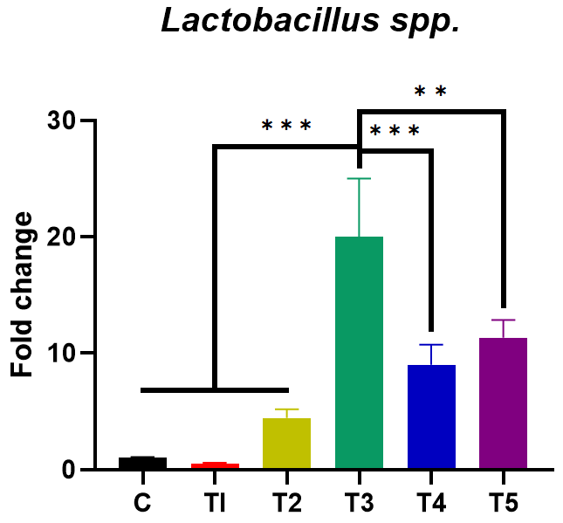
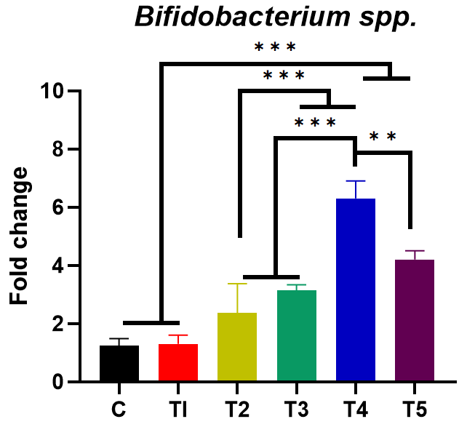
Supplement DATA 4
A
B
C
Supplementary figure 4. Fold changes in the gene expression of markers detecting the enteropathogenic E. coli (intimin) (A), Lactobacillus spp. (B) and Bifidobacterium spp. (C) in intestinal content samples by groups.

Slide 4
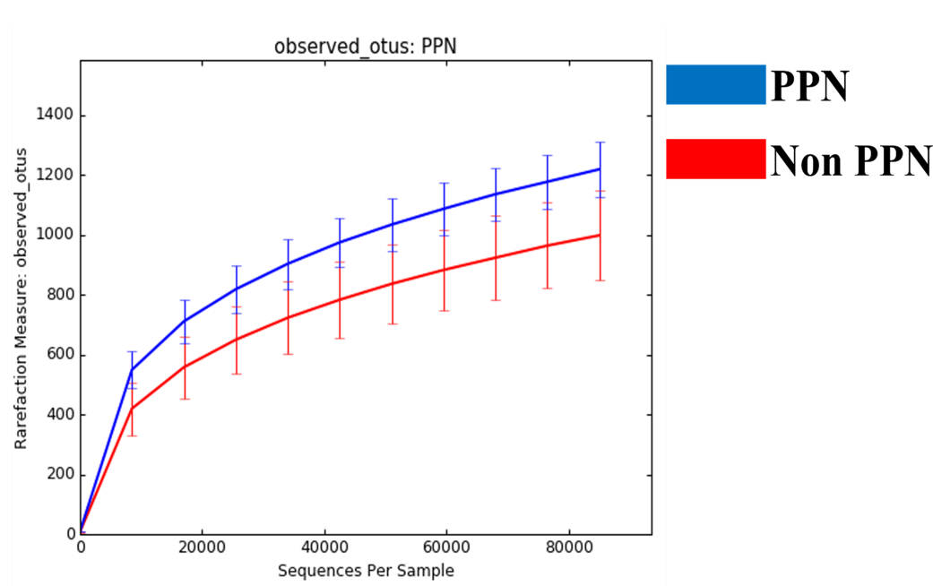
Supplement DATA 5
A
B
C
Supplementary figure 5. Differences in the gut microbial diversity among groups upon pro-/synbiotics treatment. Alpha diversity indices (A: Shannon Index; B: Simpson Index) of gut microbiota by groups. Effects of PPN treatment on observed OTUs (C).

Slide 5
Supplement DATA 6
A
Proteobacteria
Supplementary figure 6. Relative abundance of Proteobacteria by groups. One-way ANOVA with Tukey’s post hoc test was used to determine significant differences among groups, and different superscript letters indicate significant difference (P < 0.05).

Slide 6
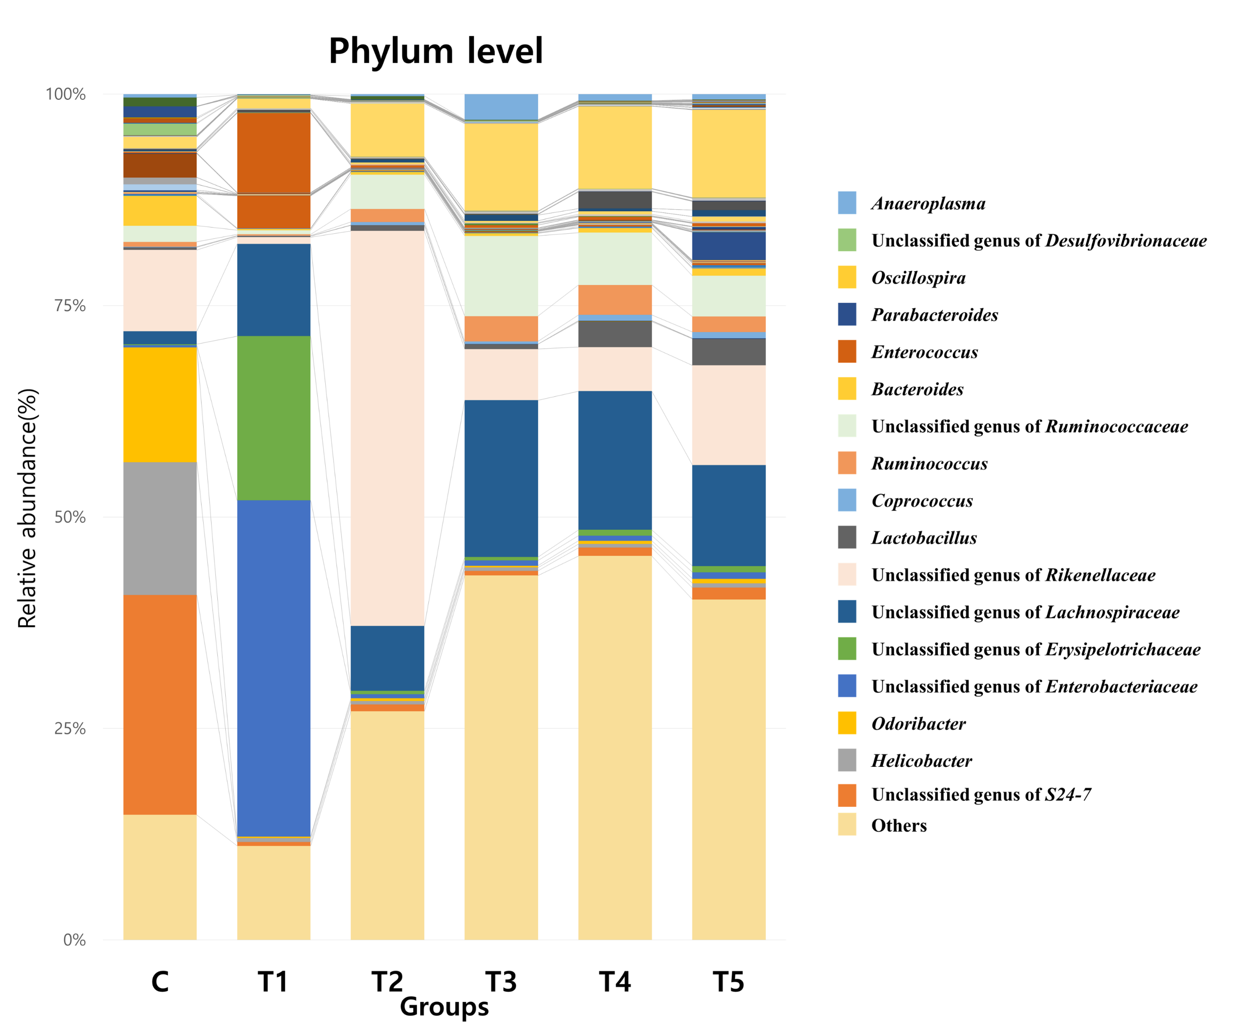
Supplement DATA 7
A
B
Lactobacillus
C
Bifidobacterium
D
E
Faecalibacterium
Unclassified genus of Veillonellaceae
Supplementary figure 7. Overall compositions of the gut microbiota at genus level (A) and relative abundance of genera significantly differed by groups. (B) One-way ANOVA with Tukey’s post hoc test was used to each genera to determine significant differences among groups, and different superscript letters indicate significant difference (P < 0.05).

Slide 7
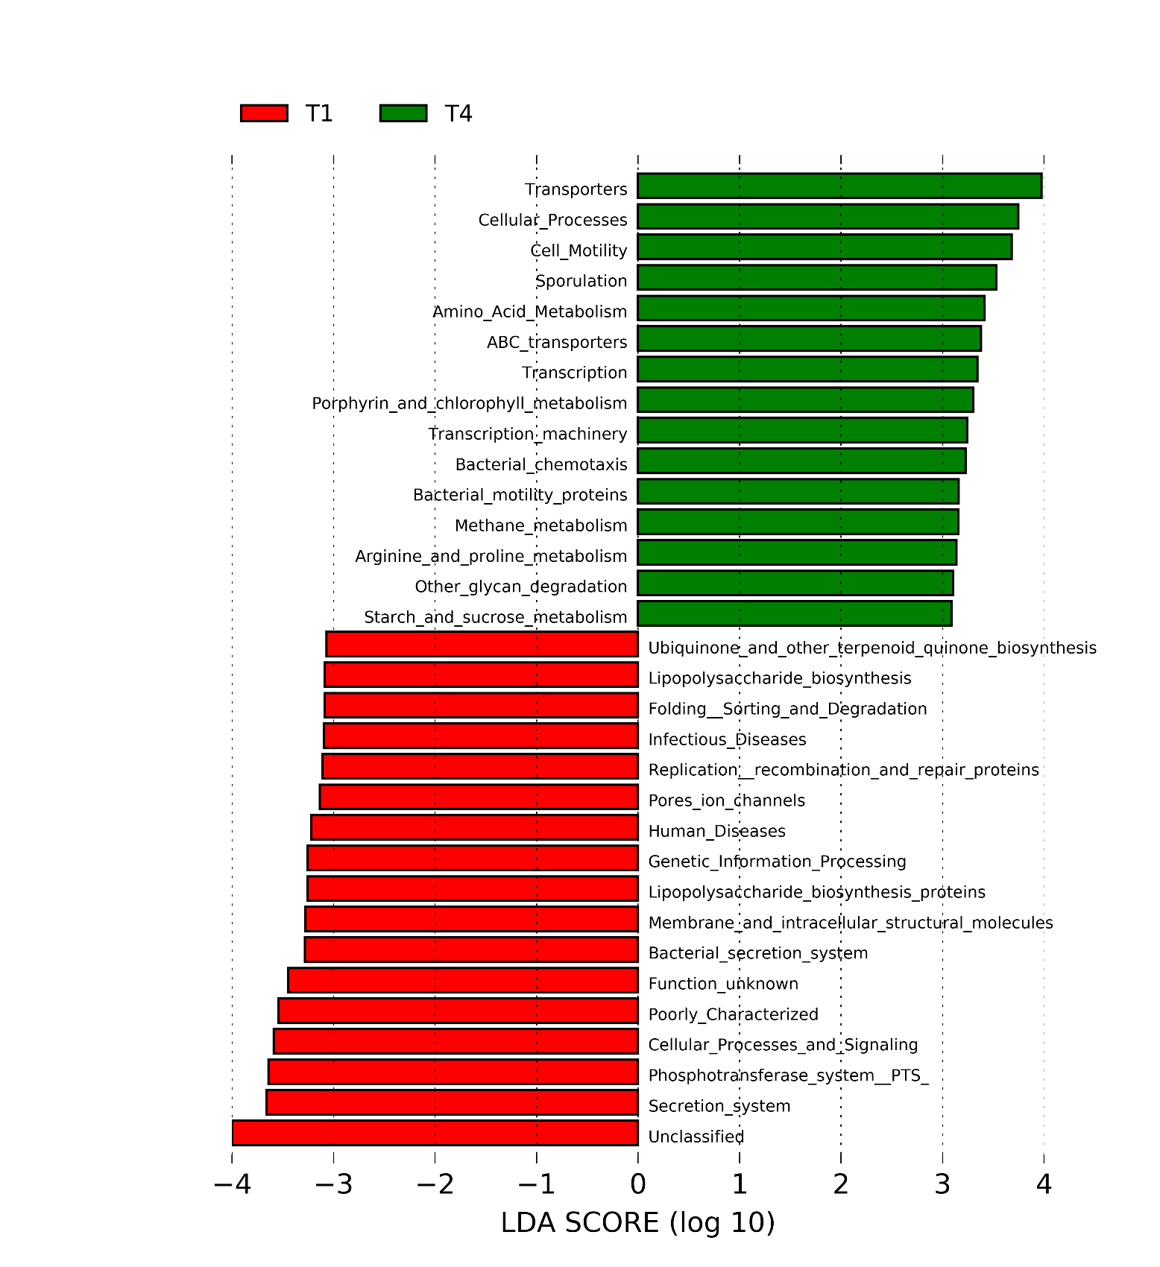
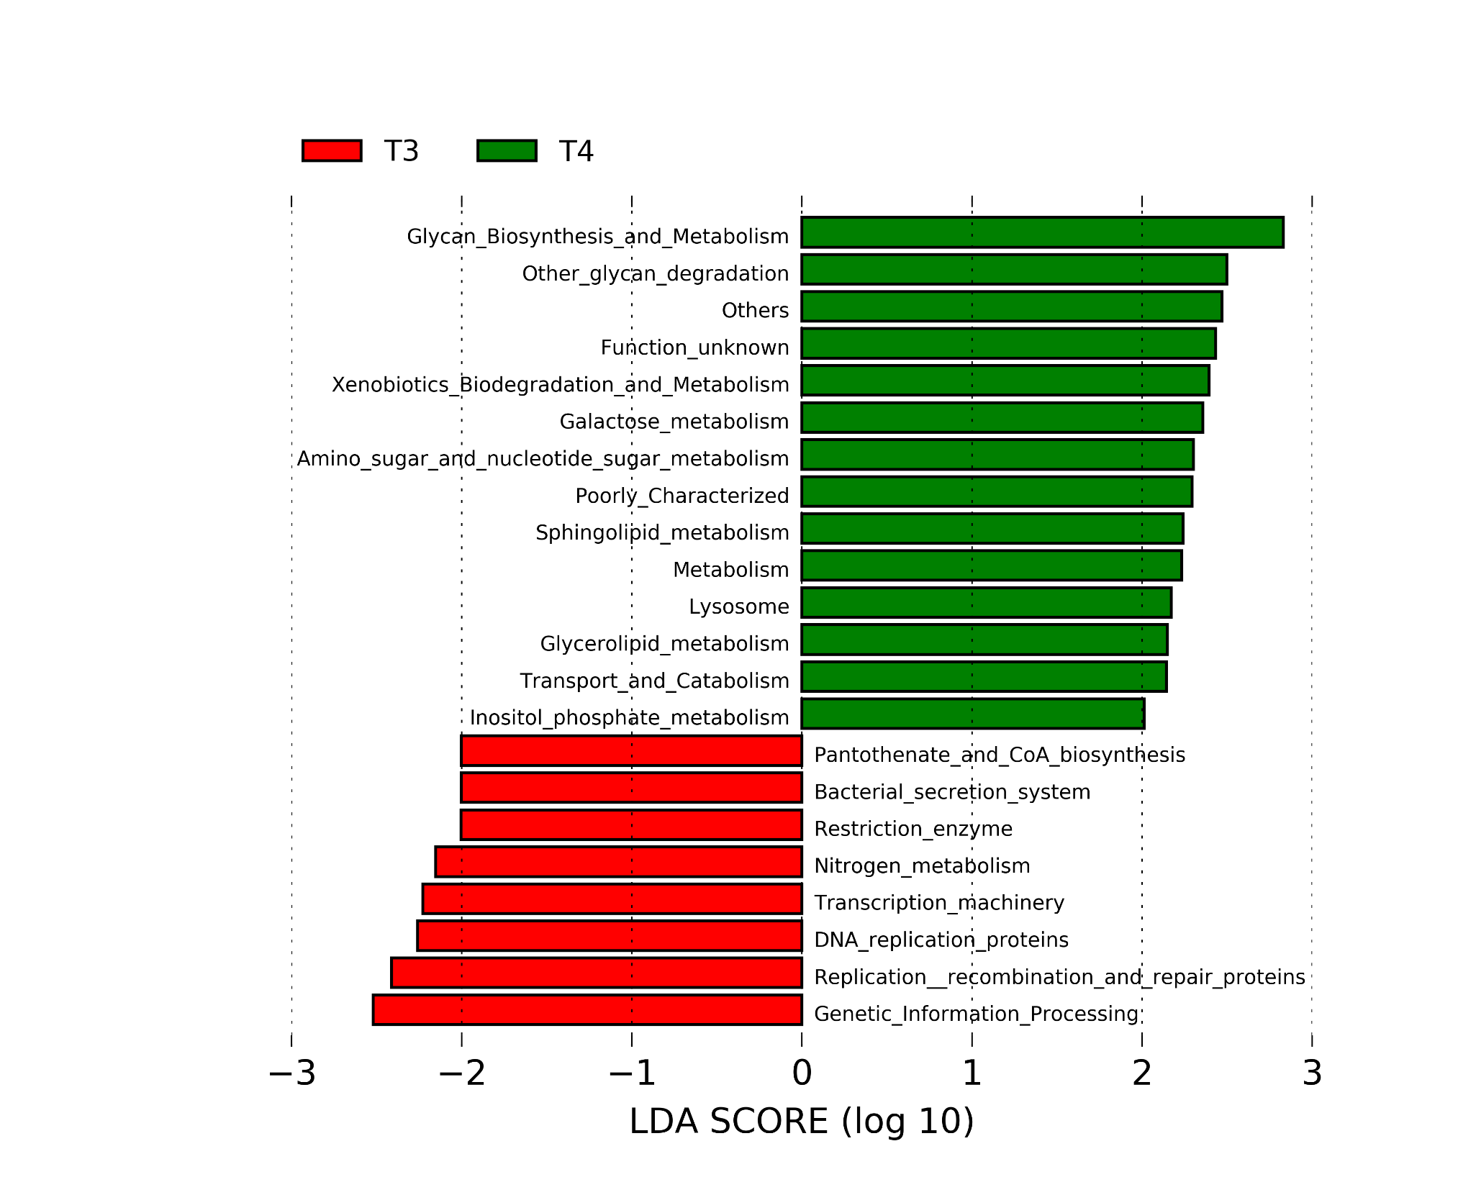
Supplement DATA 8
A
B
Supplementary figure 8. Metagenomic prediction of gut microbiota of dysbiosis-induced mice after the trial to determine effects of synbiotics LP/PPN (A; T1 vs. T4) or prebiotics nanoparticulation (B; T3 vs. T4). Microbial functions were predicted using PICRUSt at the third level of the KEGG pathway and LEfSe analysis were represented as histograms.

Slide 8
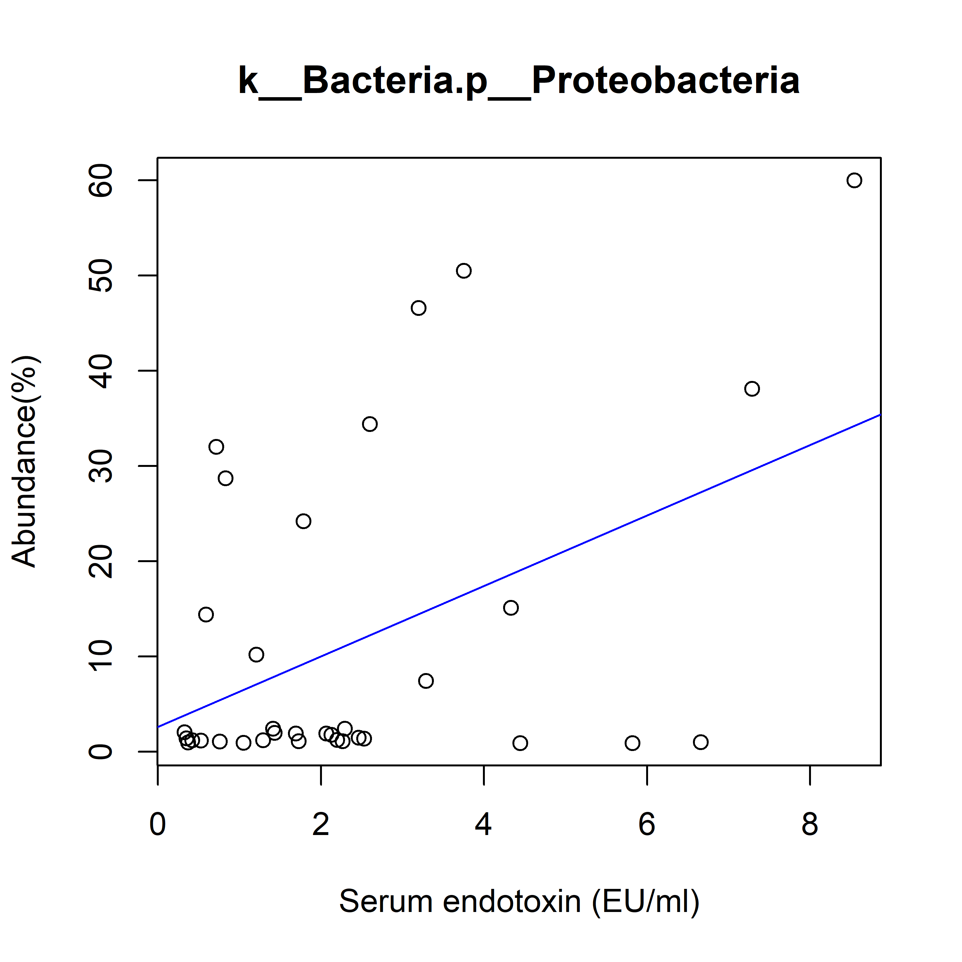
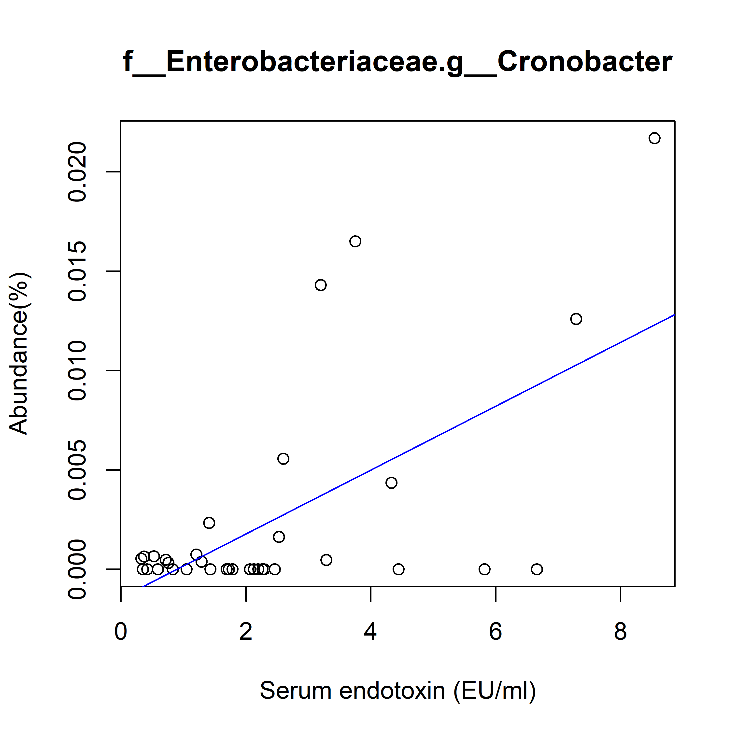
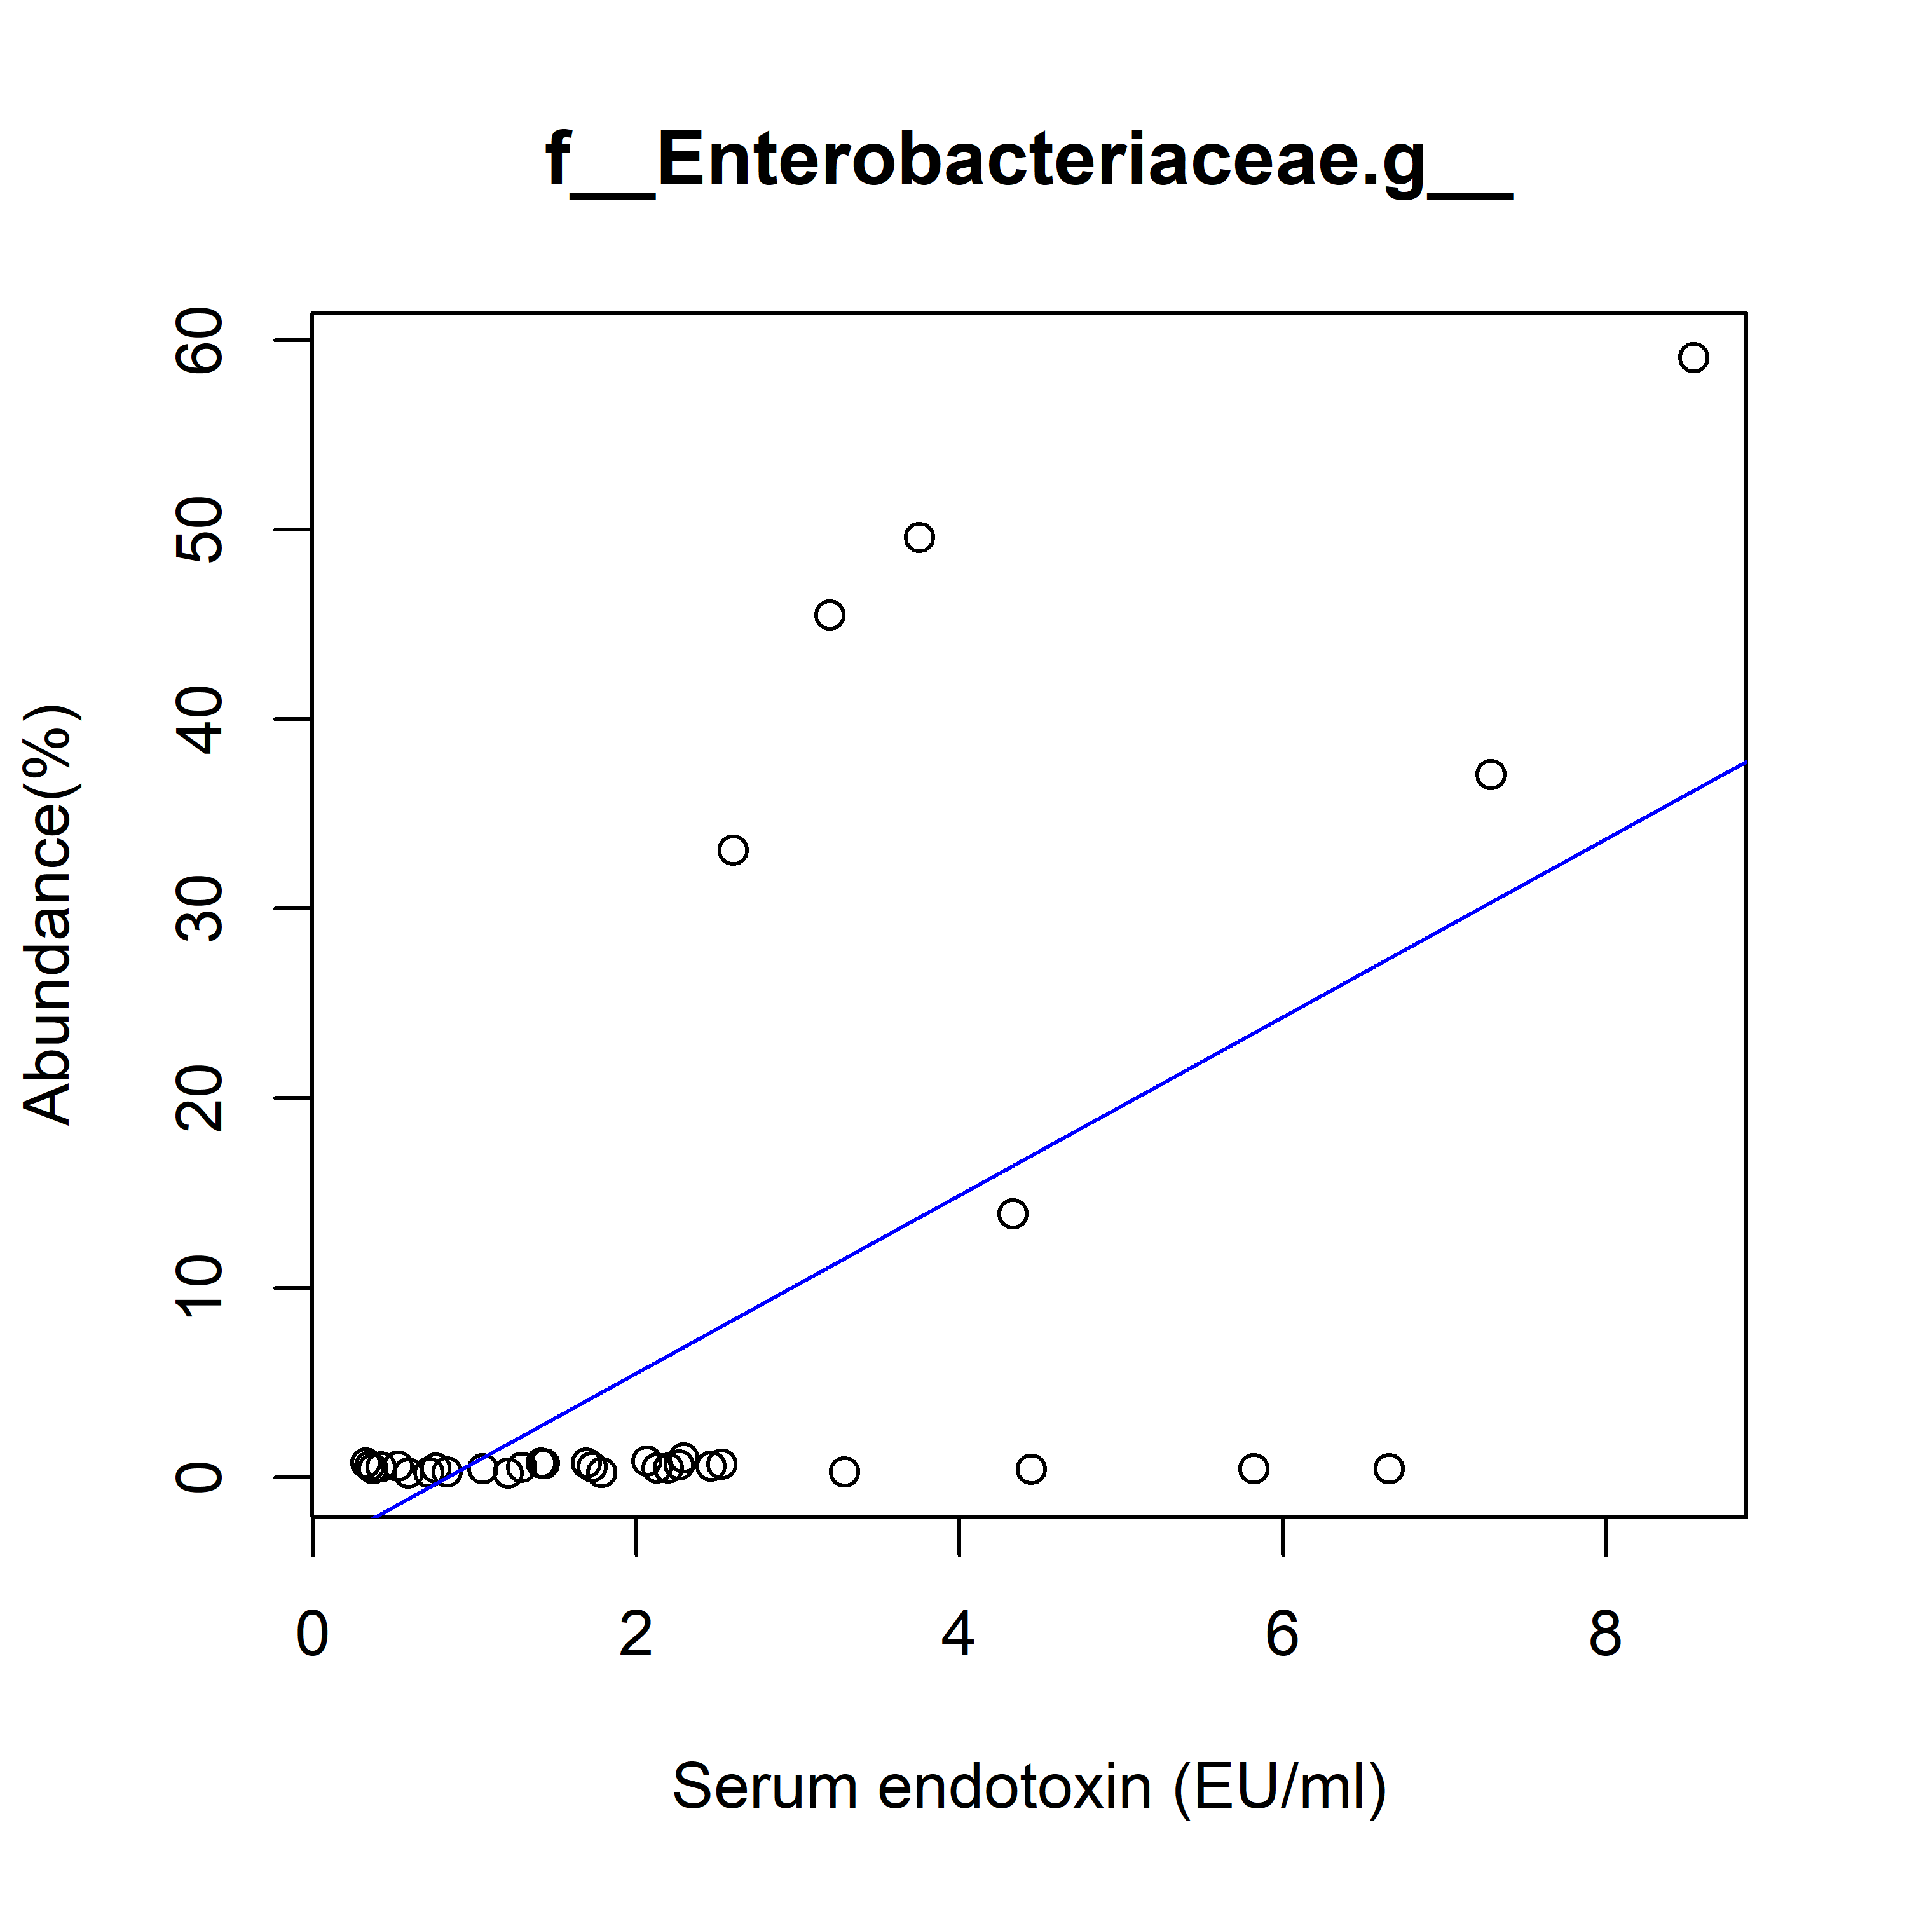
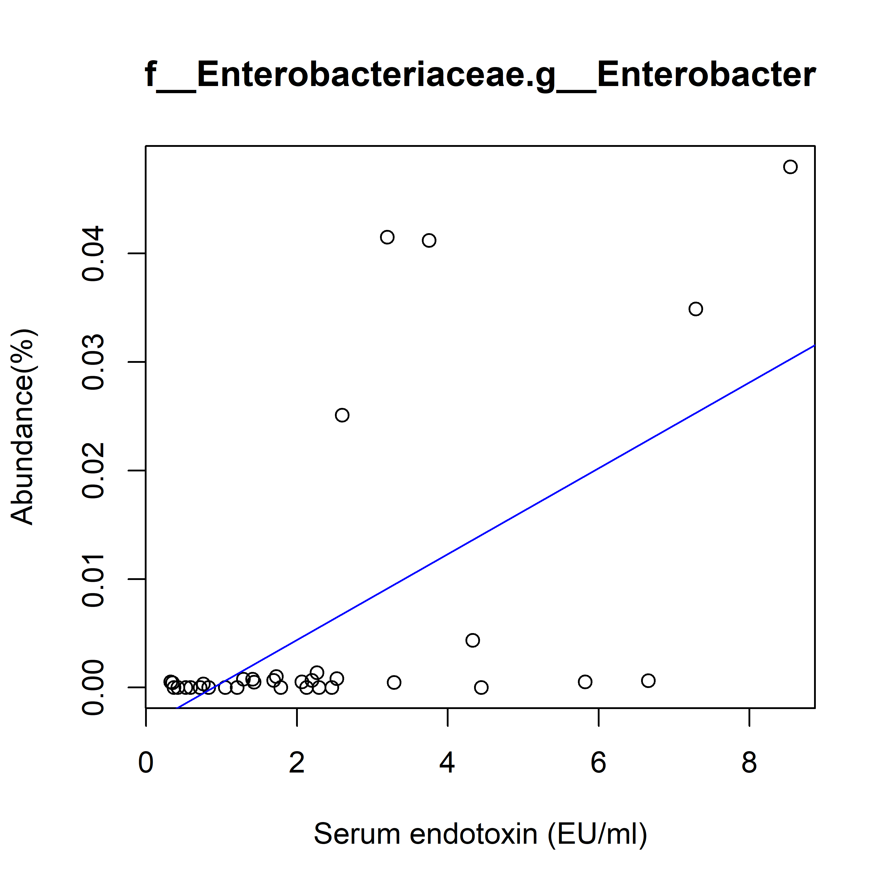
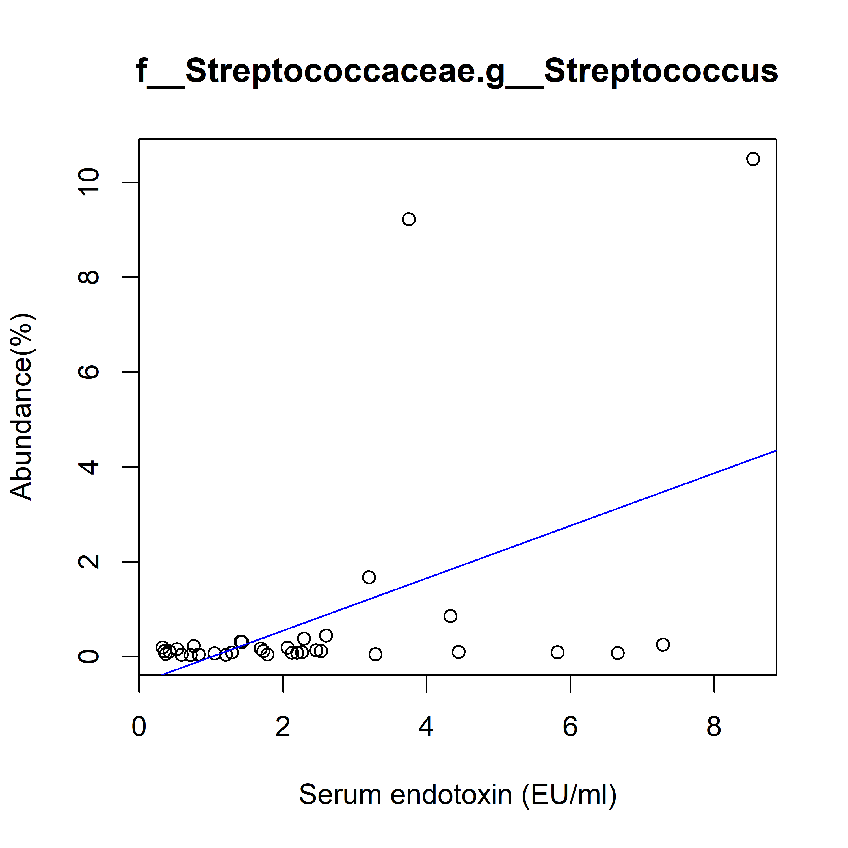
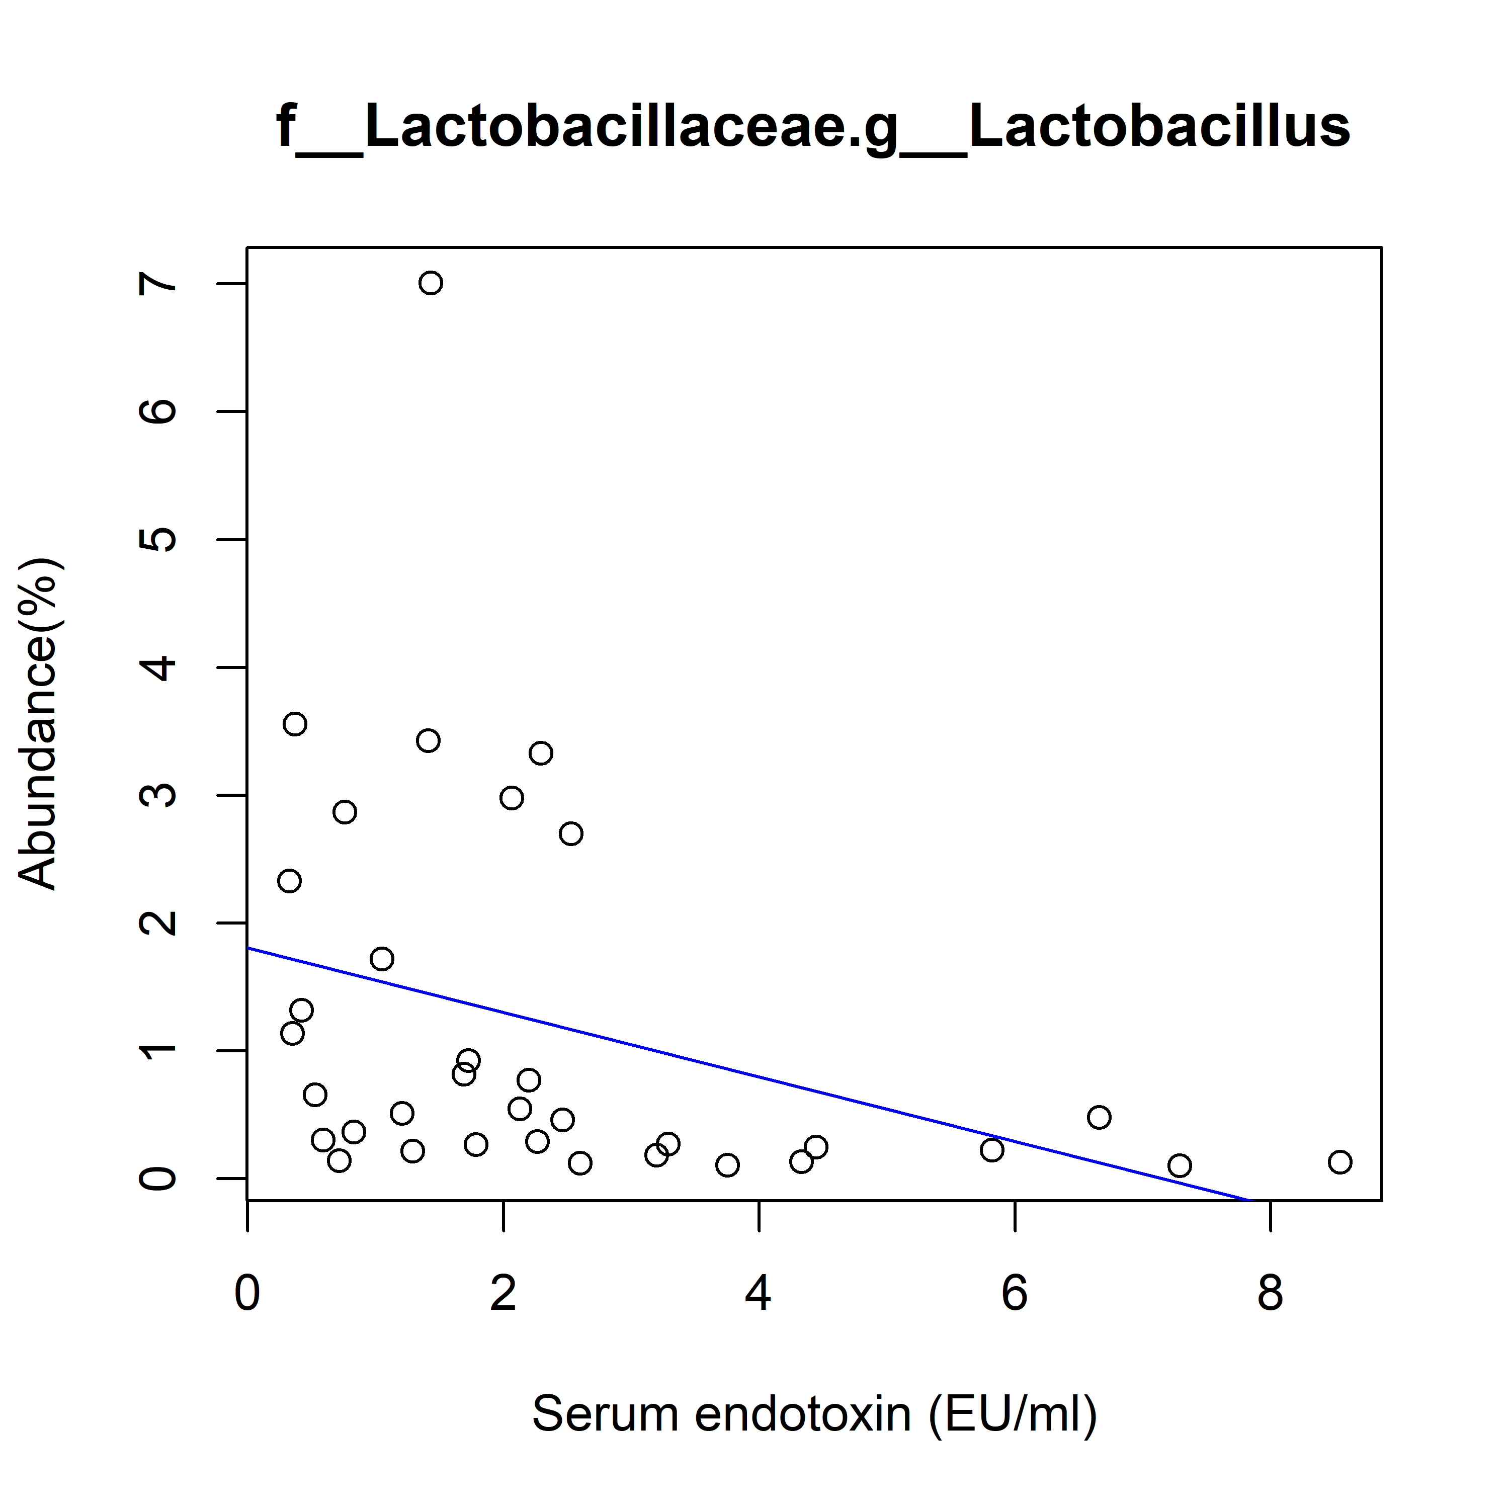
Supplement DATA 9
A
B
C
r = 0.45 (P = 0.007)
y = 3.6996x + 2.6107
r = 0.62 (P < 0.001)
y = 0.0016x – 0.0014
r = 0.60 (P < 0.001)
y = 4.7012x – 3.9303
D
E
F
r = 0.59 (P < 0.001)
y = 0.0040x – 0.0035
r = 0.49 (P = 0.0003)
y = 0.5535x – 0.5632
r = -0.34 (P = 0.046)
y = -0.2522x + 1.8076
Supplementary figure 9. Correlation analysis between the level of serum endotoxin and relative abundances of bacteria. Proteobacteria (A) was the only phylum showed correlation with serum endotoxin. Several genera including Cronobacter (B), Unclassified genus of Enterobacteriaceae family (C), Enterobacter (D), and Streptococcus (E) were significantly positive correlated whereas Lactobacillus (F) was significantly negative correlated with the level of serum endotoxin. The relationship was assessed by Pearson’s correlation coefficient (r) and P values from simple linear regression.

