Slide 1
Supplementary materials:
Personalized bioconversion of Panax notoginseng saponins mediated by gut microbiota between Chinese-diet and Western-diet healthy subjects

Slide 2
Figure Legends
Fig.S1.Typical MRM chromatograms of blank substrate (a) and blank substrate spiked with IS or with analytes (b) in positive ion mode. b1, b2, b3, b4, b5 and b6 were typical MRM chromatograms of blank substrate spiked with GF1, PPT, GRh2, GC-K, PPD or IS Digoxin, and a1, a2, a3, a4, a5and a6 were the corresponding chromatograms of blank substrate. Time marked on the peak was the retention time of corresponding analytes.
Fig. S2 Mass scan spectra and fragmentation pathways of GF1(a), PPT(b), GRh2(c), GC-K(d) , PPD(e) and Digoxin(f) in positive ion mode.
Fig. S3: Typical TICs of mixed standards(including GF1, PPT, GRh2, GC-K ,PPD and Digoxin ) (a) and samples transformed PNS by gut microbita collected from LF-PF(b) and HF-HP(c) diet groups at 37 ◦C for 0h and 48 h in positive ion mode.
Fig. S4. Rarefaction curve based on Shannon index (a) and observed OTU numbers(b).

Slide 3
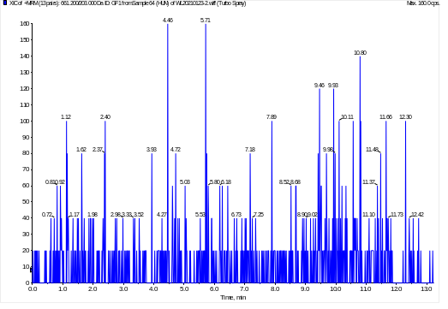
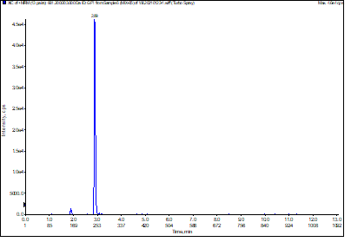
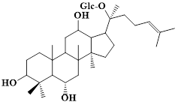
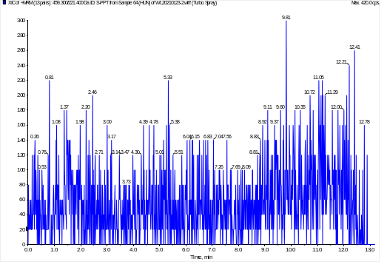
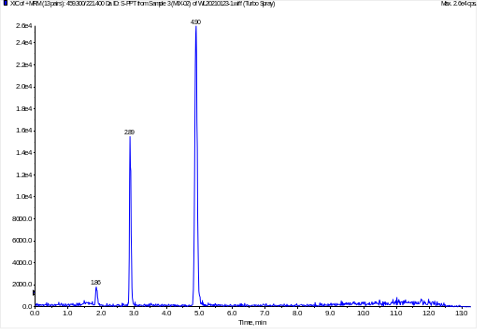
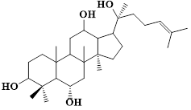
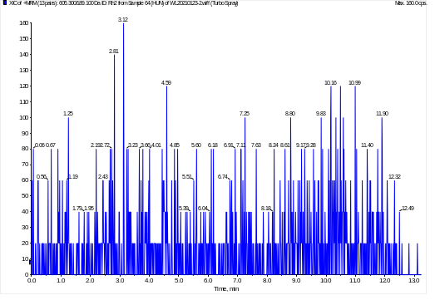
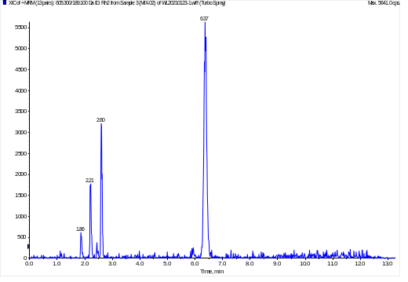
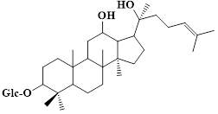
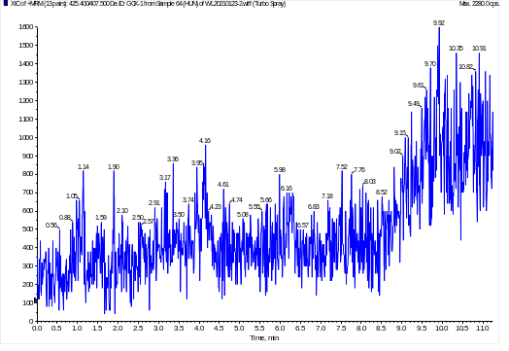
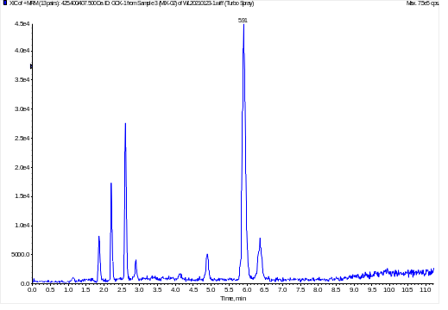
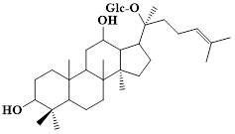
a1
b1
GF1
a2
b2
PPT
a3
b3
GRh2
a4
b4
GC-K
Fig. S1

Slide 4
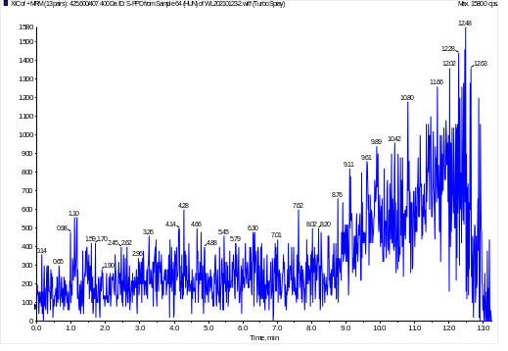
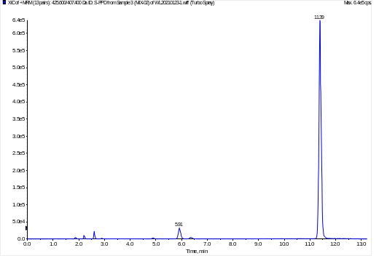
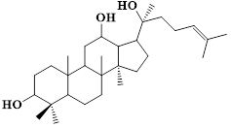
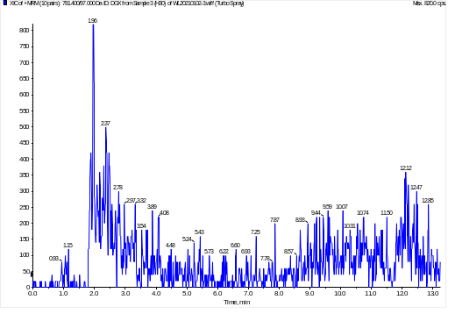
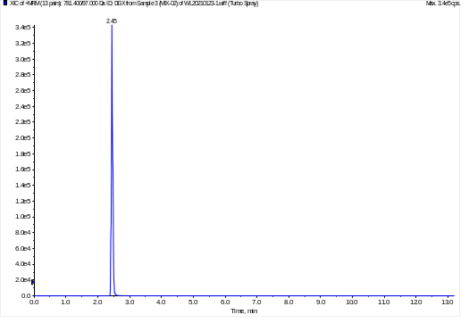
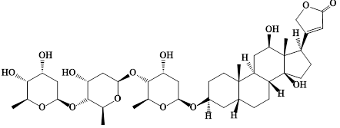
a5
b5
PPD
a6
b6
Digoxin
Fig. S1

Slide 5
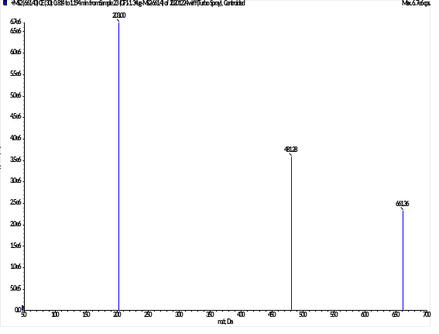
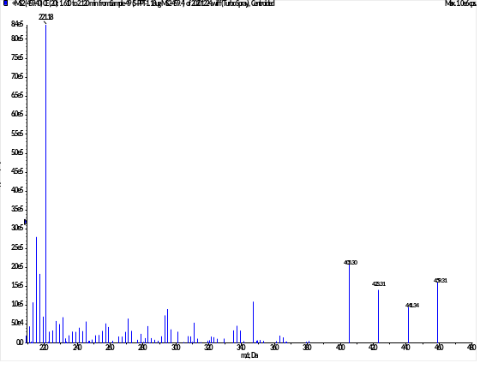
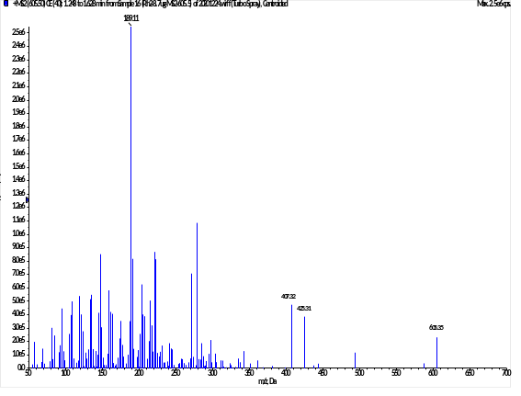
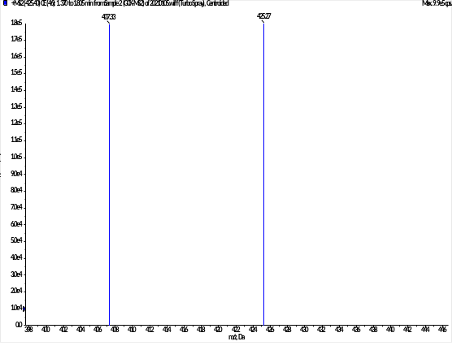
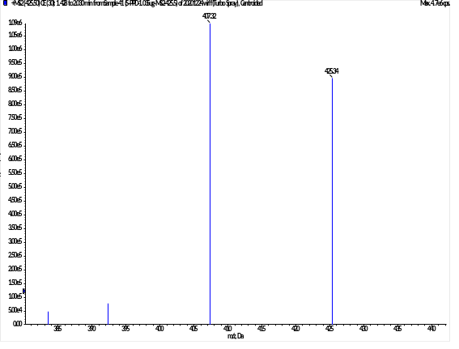
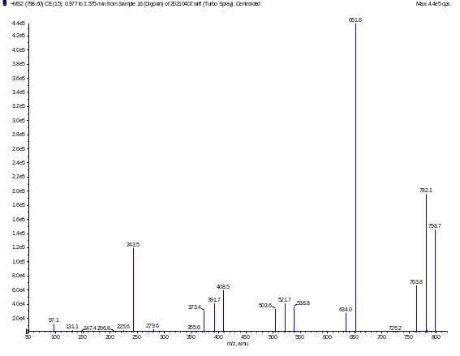
a
b
c
d
e
f
Fig. S2

Slide 6
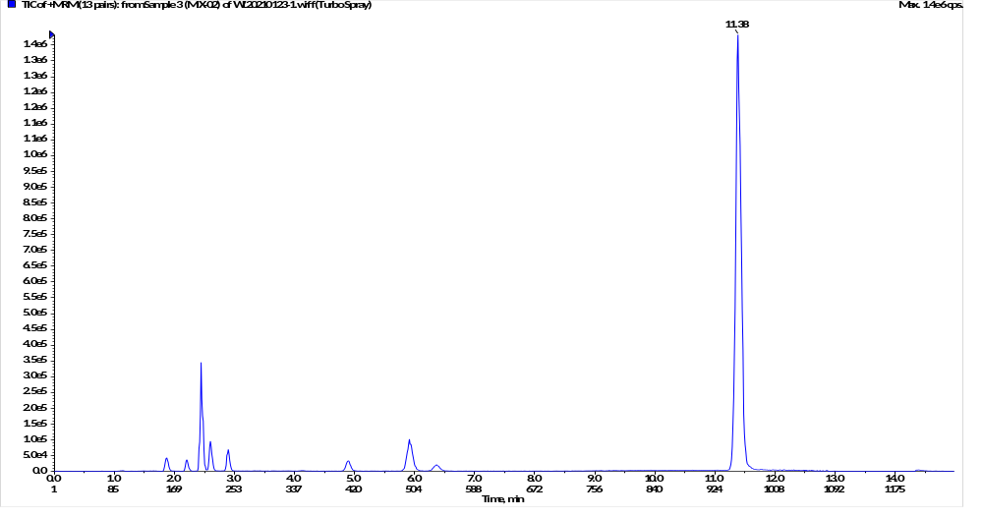
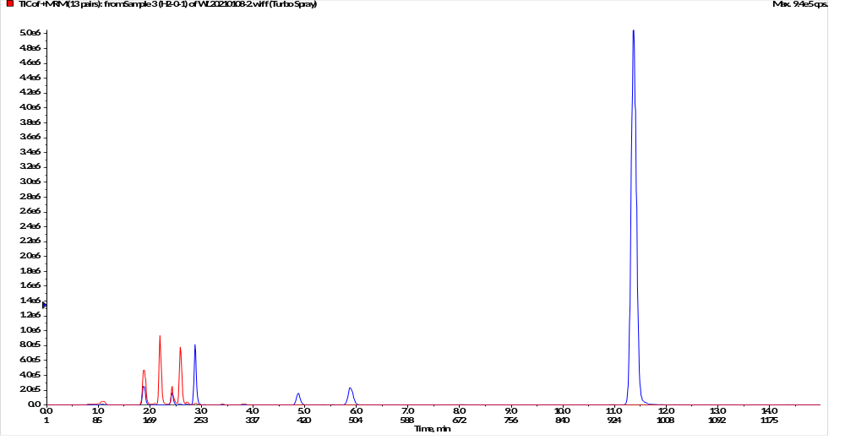
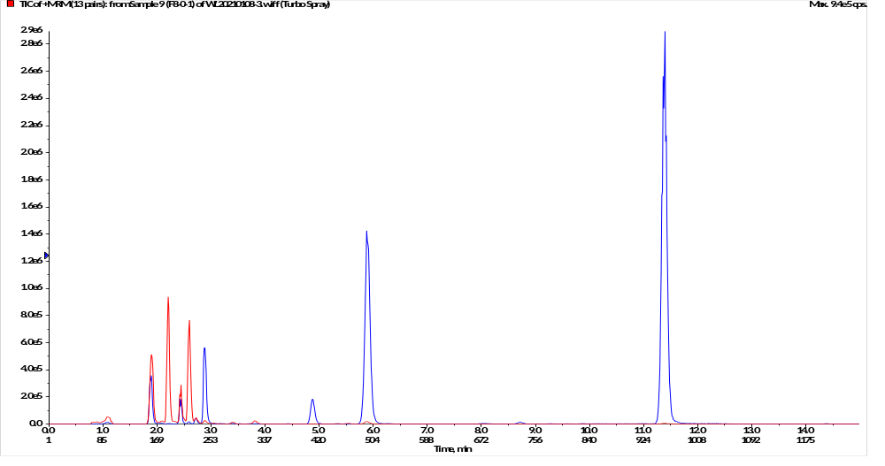
a
PPD
Digoxin
GF1
GC-K
PPT
Rh2
b
0 h
48 h
c
0 h
48 h
Fig. S3

Slide 7
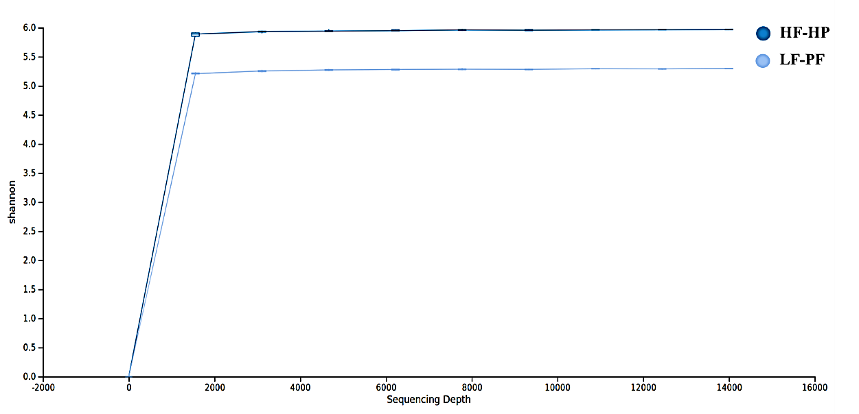
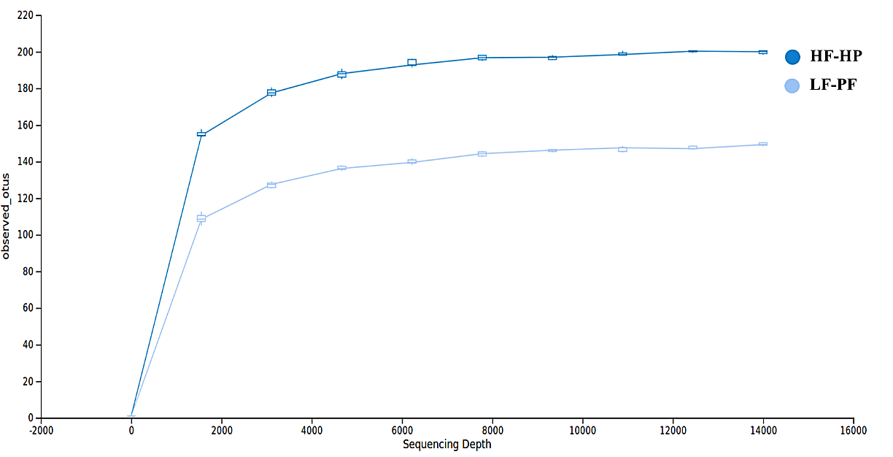
a
b
Fig. S4

