Slide 1
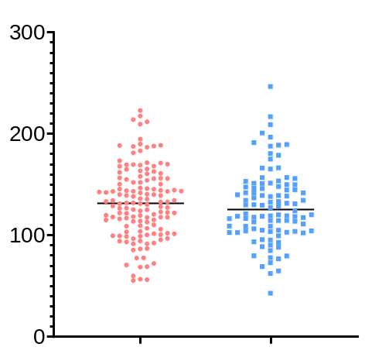
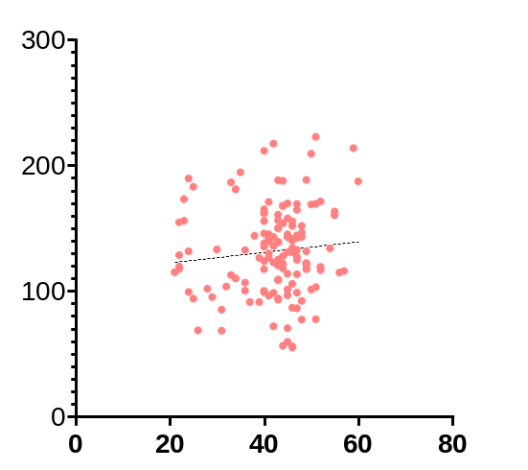
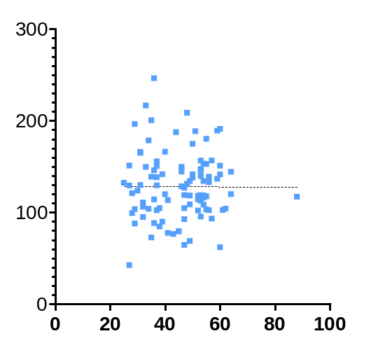
Supplementary Figure 1
A
B
C
P=0.440
Female (N=139)
Male (N=102)
Serum TFPI2 level
(pg/mL)
Spearman's rank correlation coefficient: 0.074 (P=0.389)
Spearman's rank correlation coefficient: 0.036 (P=0.717)
Female
(N=139)
Male
(N=102)
Age
Age

