Slide 1
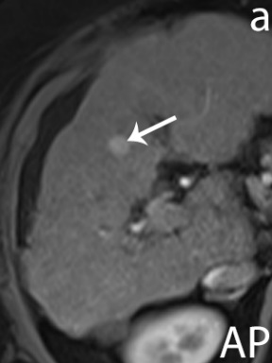
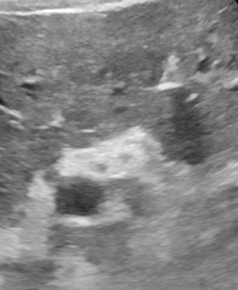
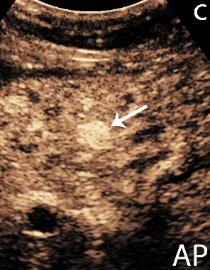
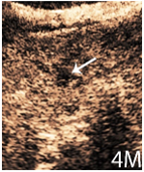
Occult Liver Nodules: their Detection and Characterization with CEUS
100 at-risk patients: occult lesions on CEUS
114 occult lesions:
78 from MR/CT, 36 from CEUS exam
KEY CEUS TECHNIQUES:
Blindshot Injection
Portal Venous Phase Sweep of Liver
On-top Injection
Greyscale
Occult
Biopsy proven HCC: cirrhotic liver
APHE only on MR, no greyscale US correlate
CEUS BLINDSHOT INJECTION
shows APHE and late washout
Qiao A, Wilson SR et al; 2024

