Slide 1
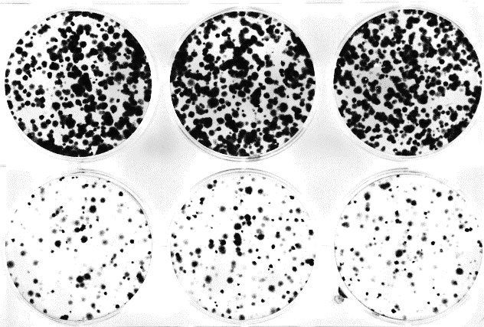


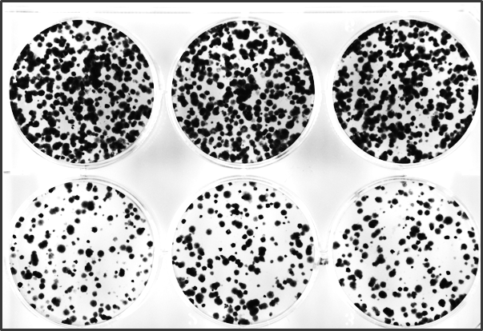
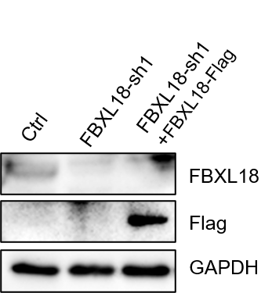
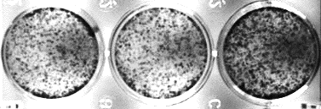
Supplementary Fig.1
A
shCtrl
B
FBXL18-sh1
FBXL18-sh2
FBXL18
shCtrl
GAPDH
sh1
SPC-A1
C
shCtrl
sh2
SPC-A1
D
F
A549
Ctrl
FBXL18-sh1
FBXL18-sh1
+
FBXL18-Flag
E

