Slide 1
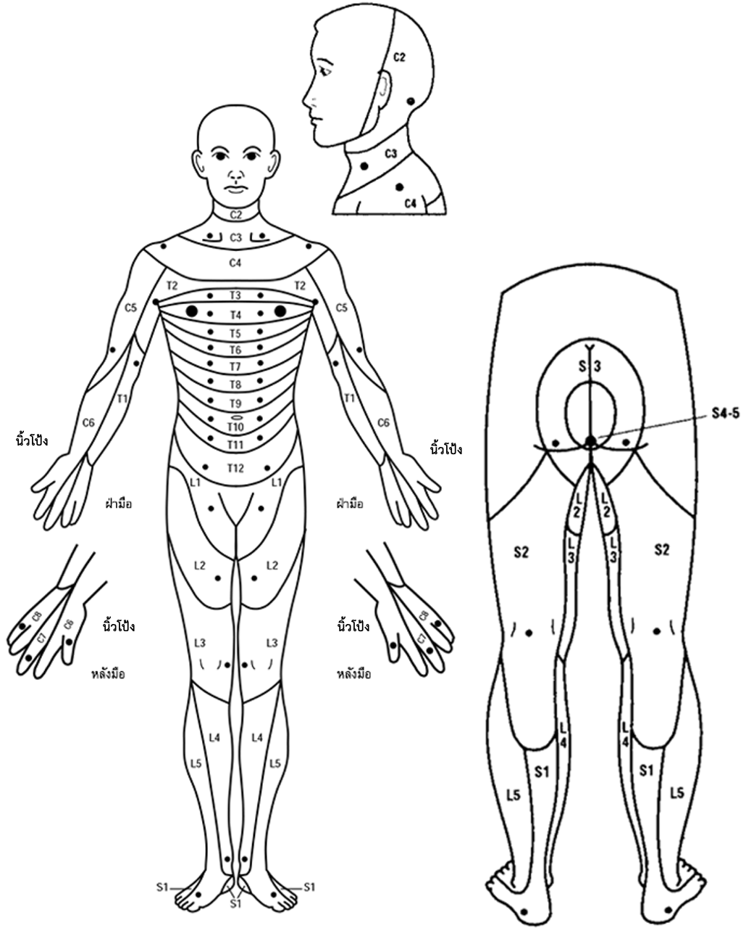
Identify and indicate the transition points where sensation changes from "normal" to "abnormal" or "absent" across different areas of your skin.
Thumb
Thumb
Palm
Palm
Thumb
Thumb
Dorsal
Dorsal
Sensory function | Description
Normal | The sensation should feel similar to what you normally experience on both sides of your cheeks. You should also be able to distinguish between sharp and dull stimuli or light touch when your skin is touched.
Abnormal | The sensation may feel stronger or weaker than what you would normally experience on both sides of your cheeks, or you might be unable to distinguish between sharp and dull stimuli or light touch.
Absent | No sensation is felt at all when touched.

Slide 2
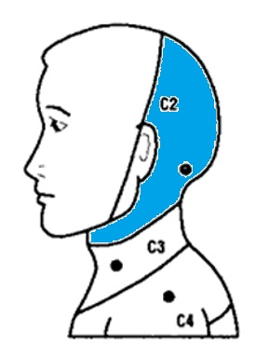
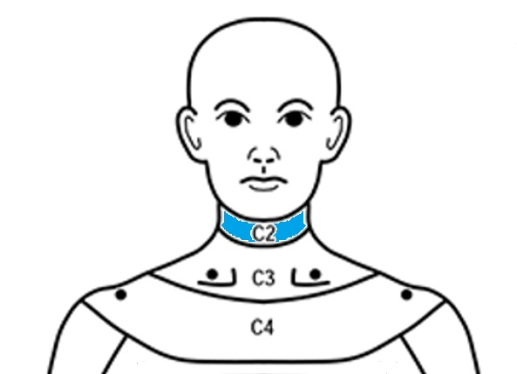
C2
The skin behind the ear (approximately 1 inch behind)
Normal | Abnormal | Absent

Slide 3
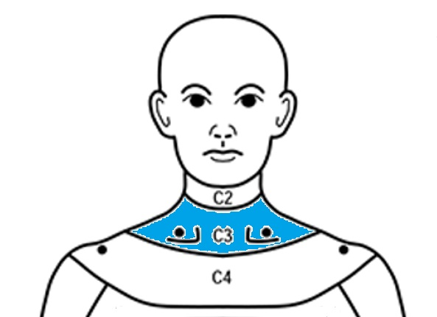
C3
The skin above the collar bone (mid line of each side)
Normal | Abnormal | Absent

Slide 4
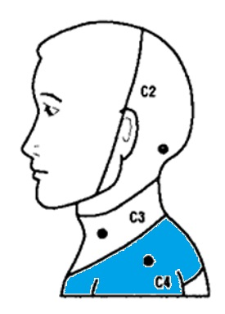
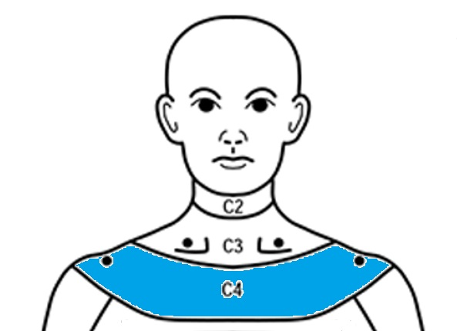
C4
The skin on the upper-front part of the shoulder
Normal | Abnormal | Absent

Slide 5
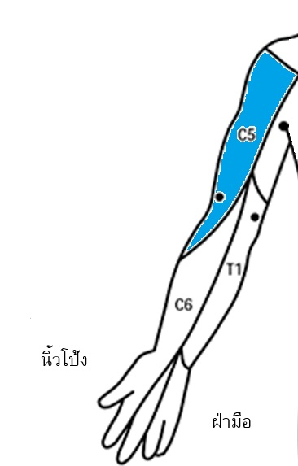
C5
The skin on the outer part of the elbow crease
ข้อพับ
Crease
Thumb
Palm
Normal | Abnormal | Absent

Slide 6
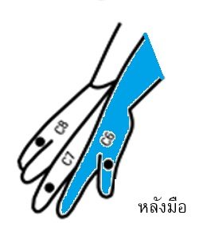
C6
The skin on the back of the thumb
Thumb
Dorsal
Normal | Abnormal | Absent

Slide 7
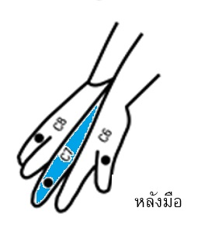
C7
The skin on the back of your middle finger
Thumb
Dorsal
Normal | Abnormal | Absent

Slide 8
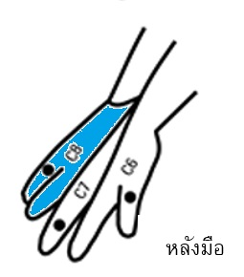
C8
The skin on the back of your little finger
Thumb
Dorsal
Normal | Abnormal | Absent

Slide 9
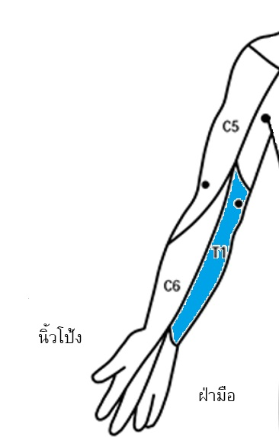
T1
The skin of the elbow
Crease
Thumb
Palm
Normal | Abnormal | Absent

Slide 10
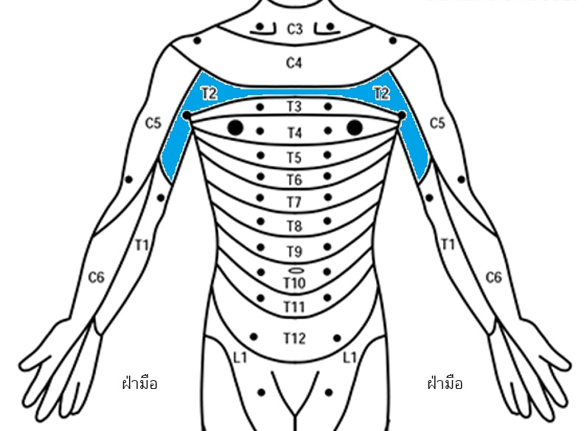
T2
The skin at your armpit
Palm
Palm
Normal | Abnormal | Absent

Slide 11
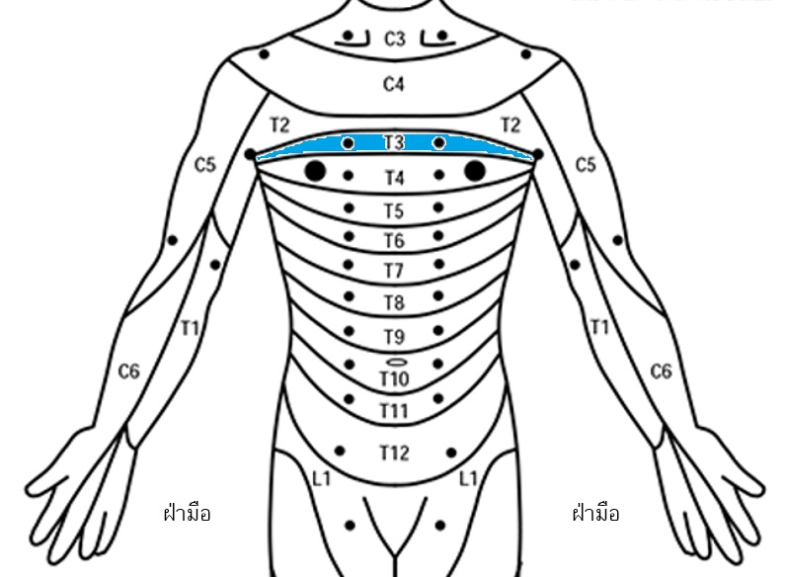
T3
The skin 2 inches above the nipple
Palm
Palm
Normal | Abnormal | Absent

Slide 12
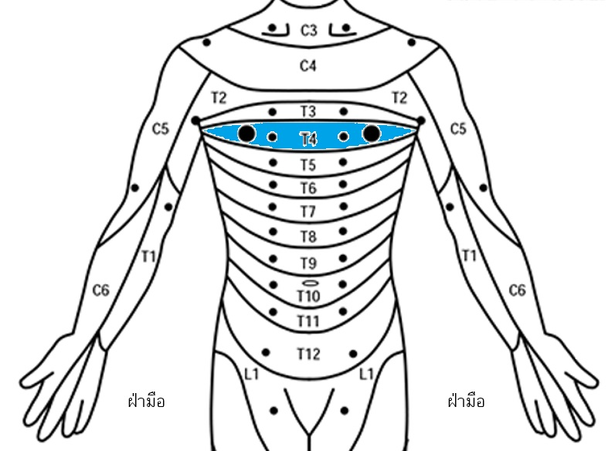
T4
The skin next to the nipple (inner part)
Palm
Palm
Normal | Abnormal | Absent

Slide 13
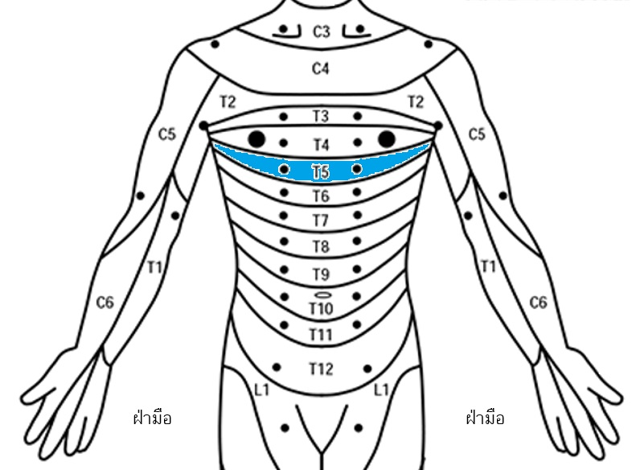
T5
The skin between the nipple and the xiphisternum
Palm
Palm
Normal | Abnormal | Absent

Slide 14
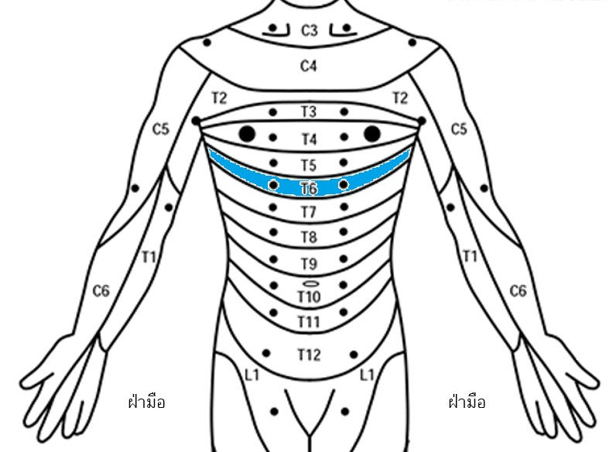
T6
The skin next to the xiphisternum
Palm
Palm
Normal | Abnormal | Absent

Slide 15
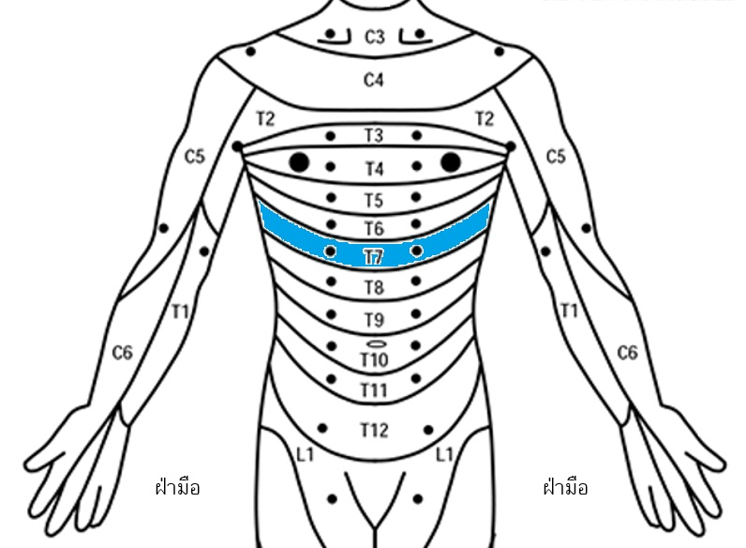
T7
The slightly under the xiphisternum
Palm
Palm
Normal | Abnormal | Absent

Slide 16
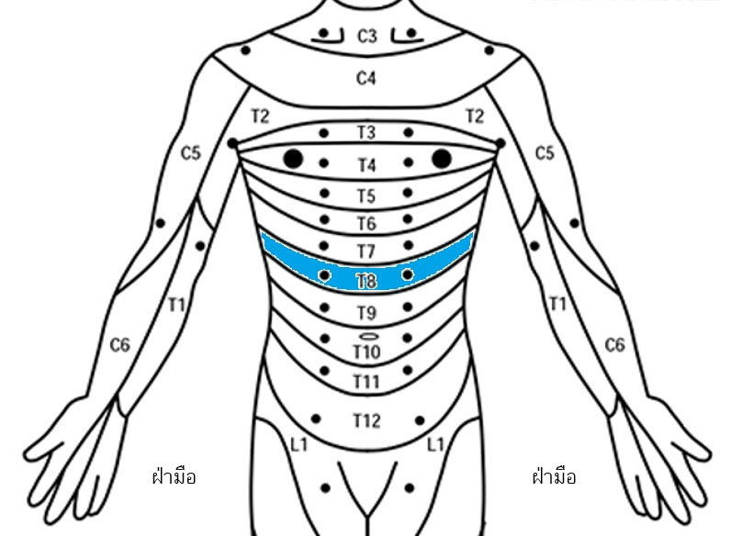
T8
The skin between the xiphisternum and the belly button
Palm
Palm
Normal | Abnormal | Absent

Slide 17
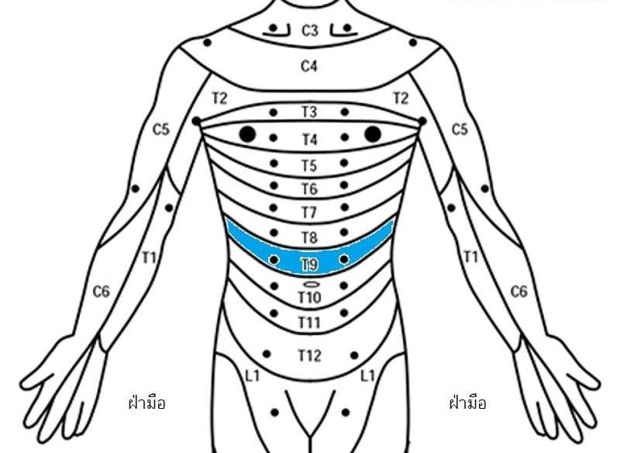
T9
The skin slightly above the belly button
Palm
Palm
Normal | Abnormal | Absent

Slide 18
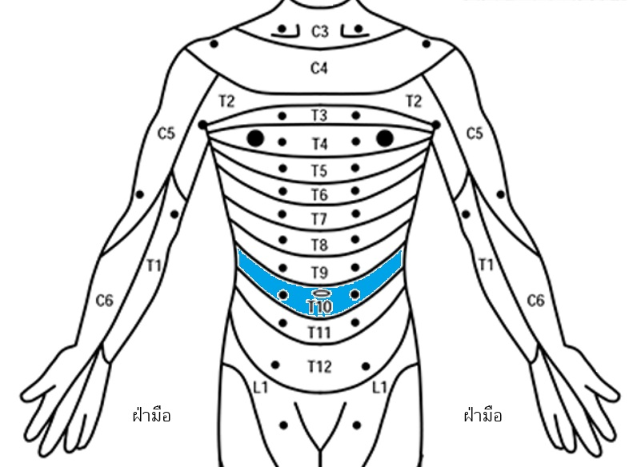
T10
The skin next to the belly button
Palm
Palm
Normal | Abnormal | Absent

Slide 19
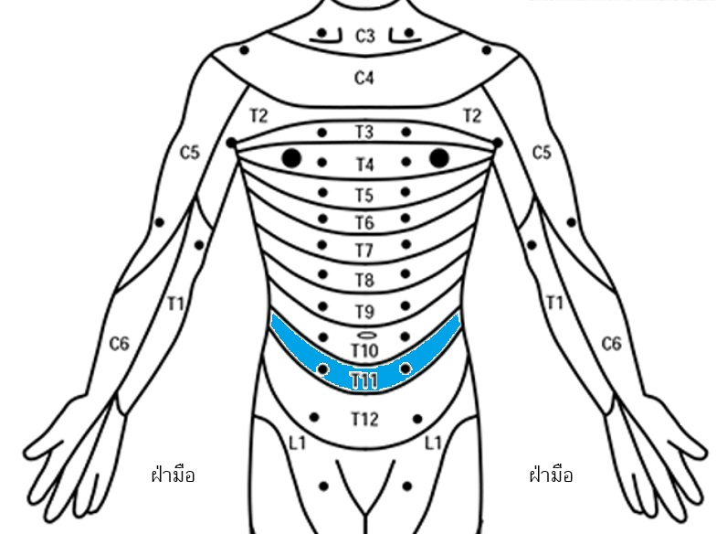
T11
The skin slightly under the belly button
Palm
Palm
Normal | Abnormal | Absent

Slide 20
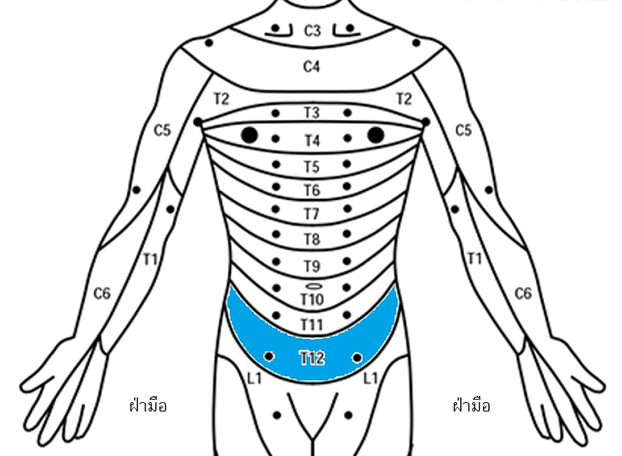
T12
The skin on groin crease
Palm
Palm
Normal | Abnormal | Absent

Slide 21
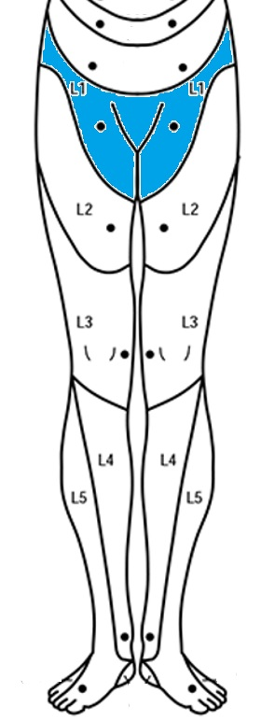
L1
The skin over the top of upper-thigh
Normal | Abnormal | Absent

Slide 22
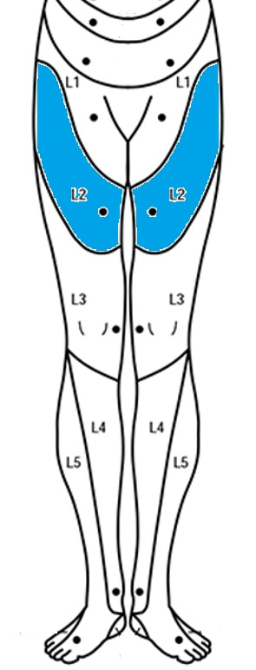
L2
The skin over the top of mid-thigh
Normal | Abnormal | Absent

Slide 23
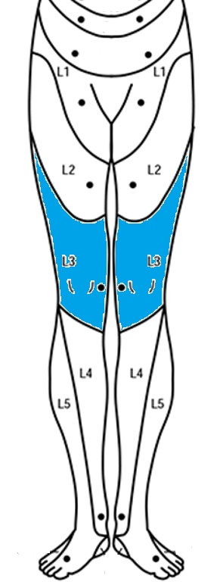
L3
The skin inside thigh near the knee
Normal | Abnormal | Absent

Slide 24
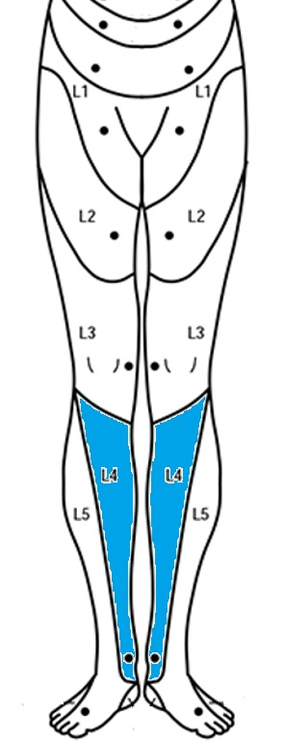
L4
The skin over inside of the ankle
Normal | Abnormal | Absent

Slide 25
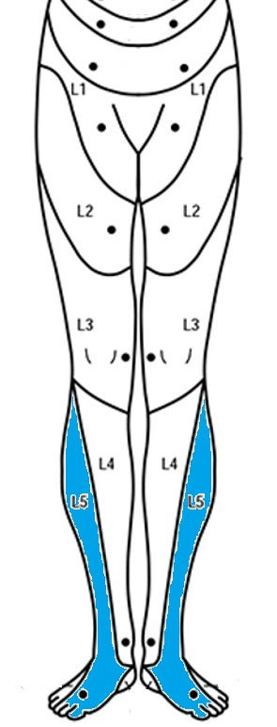
L5
The skin on top of the foot around the middle toe area
Normal | Abnormal | Absent

Slide 26
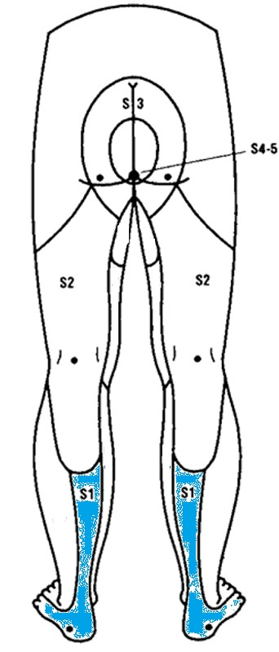
S1
The skin under the sole of foot
Normal | Abnormal | Absent

Slide 27
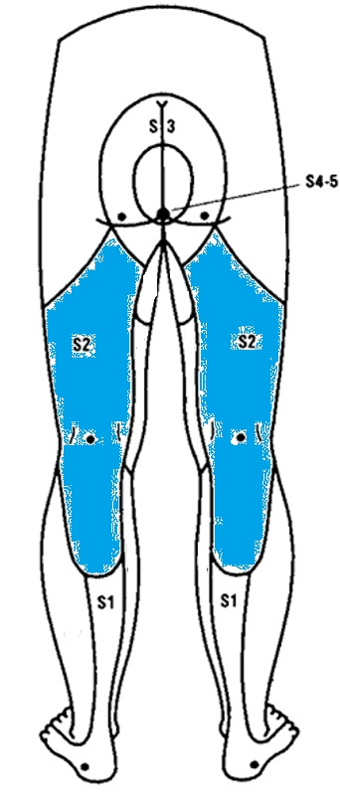
S2
The skin behind the knee
Normal | Abnormal | Absent

Slide 28
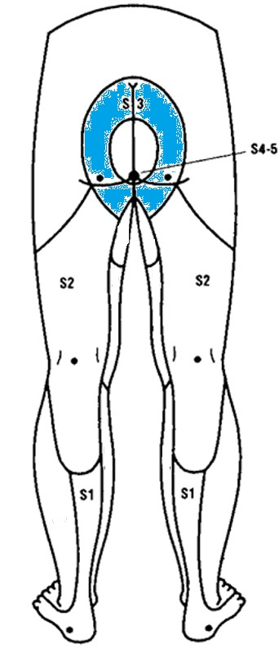
S3
The skin under the buttocks
Normal | Abnormal | Absent

Slide 29
Grade | Description
0 | No movement with no muscle twitch.
1 | No movement but witness some muscle twitch.
2 | Full active range of motion when perform in horizontal plane.
3 | Full active range of motion when perform in vertical plane. (as show in the pictures)
4 | Full active range of motion when perform against some resistance.
5 | Full active range of motion when perform against full resistance.

Slide 30
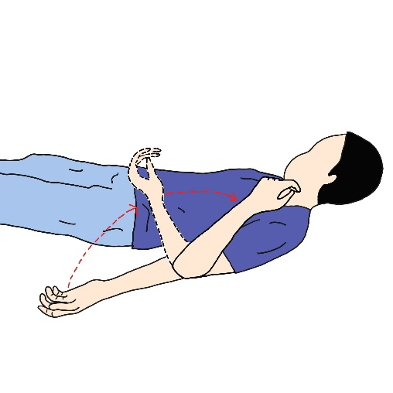
C5
Starting position: straighten your arm and face your palm upward.
Action: bend your elbow.
Grade | Description
0 | No movement with no muscle twitch.
1 | Touch the front of your upper arm, you will notice muscle twitching when attempting to bend your elbow.
2 | Lying on your side, bend your elbow. You can move it until it reaches its limit when done horizontally.
3 | Full active range of motion when perform in vertical plane. (as show in the pictures)
4 | Full active range of motion when perform against some resistance.
5 | Full active range of motion when perform against full resistance.

Slide 31
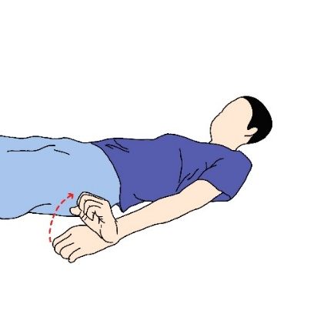
C6
Starting position: face your palm downward.
Action: bend the wrist backward.
Grade | Description
0 | No movement with no muscle twitch.
1 | Touch the back of your forearm, you will notice muscle twitching when attempting to flick your wrist.
2 | Rotate your palm perpendicular to the floor, lift your wrist, and you can move it until it reaches its limit when done horizontally.
3 | Full active range of motion when perform in vertical plane. (as show in the pictures)
4 | Full active range of motion when perform against some resistance.
5 | Full active range of motion when perform against full resistance.

Slide 32
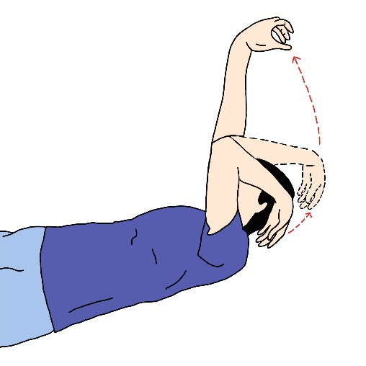
C7
Starting position: lift your shoulder, bend your elbow, and put your palm on your shoulder.
Action: straighten your arm up to the ceiling.
Grade | Description
0 | No movement with no muscle twitch.
1 | Touch the back of your upper arm, you will notice muscle twitching when attempting to straighten your arm.
2 | Lying on your side, extend your arm forward. You can move it until it reaches its limit when done horizontally.
3 | Full active range of motion when perform in vertical plane. (as show in the pictures)
4 | Full active range of motion when perform against some resistance.
5 | Full active range of motion when perform against full resistance.

Slide 33
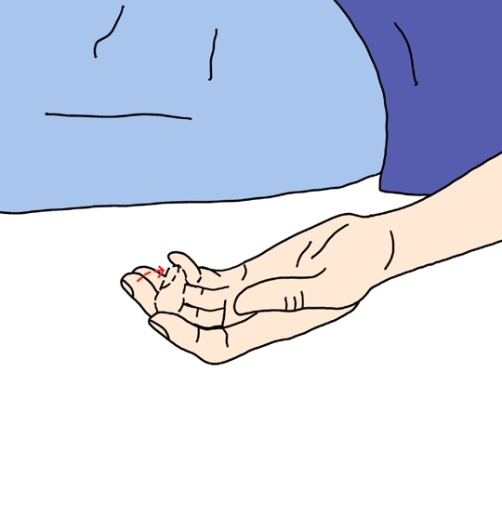
C8
Starting position: open your hand.
Action: bend your middle finger.
Grade | Description
0 | No movement with no muscle twitch.
1 | Touch the front of your forearm, you will notice muscle twitching when attempting to bend your middle finger or observing twitching of the tip of the middle finger.
2 | Rotate your palm perpendicular to the floor, bend your middle finger at the tip, and you can move it by yourself until it reaches its limit if done horizontally.
3 | Full active range of motion when perform in vertical plane. (as show in the pictures)
4 | Full active range of motion when perform against some resistance.
5 | Full active range of motion when perform against full resistance.

Slide 34
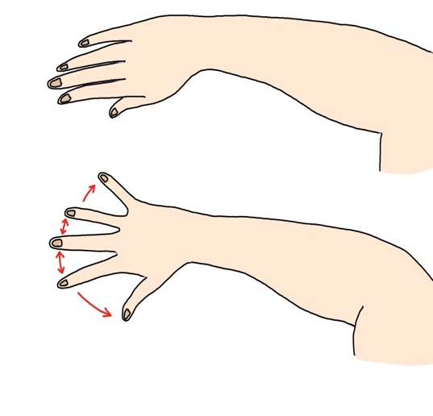
T1
Starting position: open and straight hand with closed fingers.
Action: spread the fingers apart.
Grade | Description
0 | No movement with no muscle twitch.
1 | Touch the side of the palm near the base of the little finger, you will notice muscle twitching when attempting to spread the little finger.
2 | Place your hand flat on the floor, spread your little finger out, and you can move it by yourself until it reaches its limit if done horizontally.
3 | Full active range of motion when perform in vertical plane. (as show in the pictures)
4 | Full active range of motion when perform against some resistance.
5 | Full active range of motion when perform against full resistance.

Slide 35
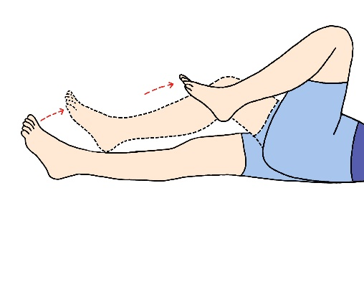
L2
Starting position: lie on your back and straighten your hip.
Action: bend the hip to your torso.
Grade | Description
0 | No movement with no muscle twitch.
1 | Touch the top/side of the thigh, you will notice muscle twitching when attempting to bend the hip.
2 | Lying on your side, bend your knee towards your chest, and you can move it by yourself until it reaches its limit if done horizontally.
3 | Full active range of motion when perform in vertical plane. (as show in the pictures)
4 | Full active range of motion when perform against some resistance.
5 | Full active range of motion when perform against full resistance.

Slide 36
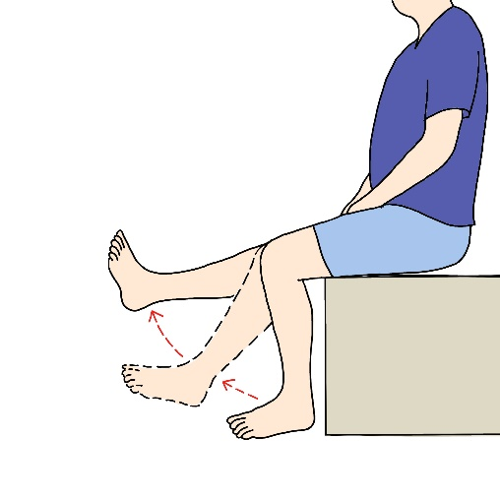
L3
Starting position: bend the knee.
Action: straighten out the knee.
Grade | Description
0 | No movement with no muscle twitch.
1 | Touch above the knee, you will notice muscle twitching when attempting to straighten the leg out.
2 | Lying on your side, extend your knee forward, and you can move it by yourself until it reaches its limit if done horizontally.
3 | Full active range of motion when perform in vertical plane. (as show in the pictures)
4 | Full active range of motion when perform against some resistance.
5 | Full active range of motion when perform against full resistance.

Slide 37
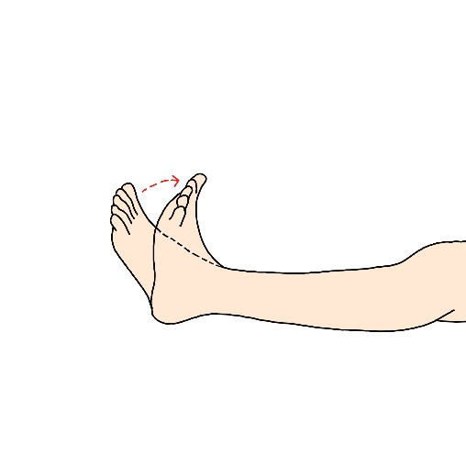
L4
Starting position: natural position.
Action: bend the ankle upward.
Grade | Description
0 | No movement with no muscle twitch.
1 | Touch the front side of the shin, you will notice muscle twitching when attempting to lift the foot.
2 | Lying on your side, lift your foot up, and you can move it by yourself until it reaches its limit if done horizontally.
3 | Full active range of motion when perform in vertical plane. (as show in the pictures)
4 | Full active range of motion when perform against some resistance.
5 | Full active range of motion when perform against full resistance.

Slide 38
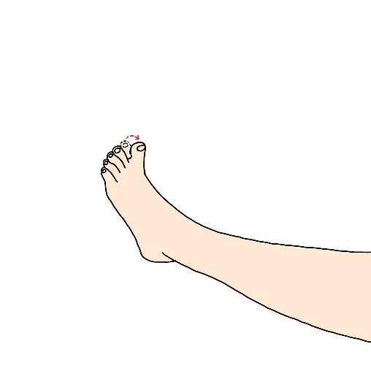
L5
Starting position: natural position.
Action: pulling big toe up.
Grade | Description
0 | No movement with no muscle twitch.
1 | Touch the back of the foot near the big toe, you will notice muscle twitching when attempting to lift the big toe.
2 | Lying on your side, lift your big toe up, and you can move it by yourself until it reaches its limit if done horizontally.
3 | Full active range of motion when perform in vertical plane. (as show in the pictures)
4 | Full active range of motion when perform against some resistance.
5 | Full active range of motion when perform against full resistance.

Slide 39
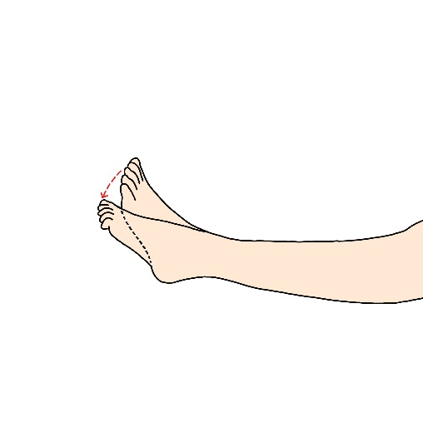
S1
Starting position: natural position.
Action: pressing foot down.
Grade | Description
0 | No movement with no muscle twitch.
1 | Touch the calf, you will notice muscle twitching when attempting to push the tip of the foot down.
2 | Lying on your side, push the tip of your foot down, and you can move it by yourself until it reaches its limit if done horizontally.
3 | Full active range of motion when perform in vertical plane. (as show in the pictures)
4 | Full active range of motion when perform against some resistance.
5 | Full active range of motion when perform against full resistance.

Slide 40
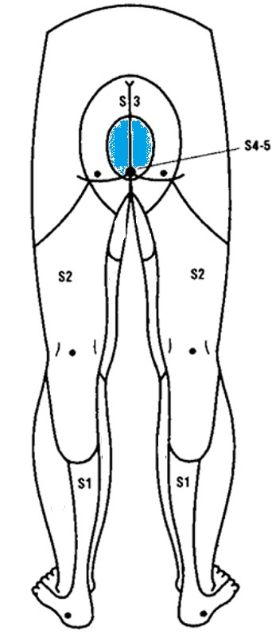
S4-5
The skin around the anus
Normal | Abnormal | Absent

Slide 41
When inserting a finger or performing anal care, do you feel any pressure inside your rectum?
 Yes
 No
 Unsure

Slide 42
Can you consciously tighten the muscles around your anus to control passing gas or prevent stool leakage?
 Yes
 No
 Unsure

