Slide 1
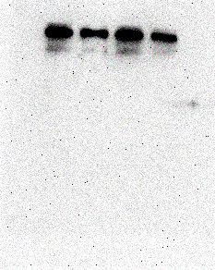
E-CAD
N-CAD
vimentin
snail
slug
GAPDH
TUBB2B
150
100
70
50
35
25
20
NC OE NC OE
LN229 T98
E-CAD
N-CAD
vimentin
snail
slug
GAPDH
TUBB2B
150
100
70
50
35
25
20
NC SH NC SH
LN229 T98

Slide 2
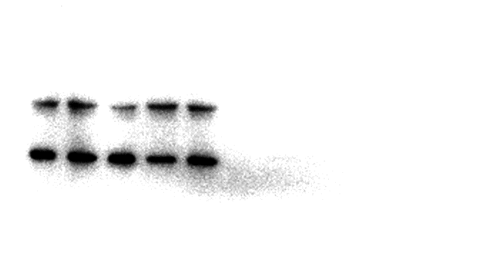
HEK293T
Vimentin-Input
Vimentin-IP
TUBB2B-Input
TUBB2B-IP
150
100
70
50
35
25
20
GAPDH-Input
GAPDH-IP
150
100
70
50
35
25
20

Slide 3
T98
GAPDH
TUBB2B
vinmentin
150
100
70
50
35
25
20
Input lgG IP
LN229
GAPDH
TUBB2B
vinmentin
150
100
70
50
35
25
20
Input lgG IP

