Slide 1
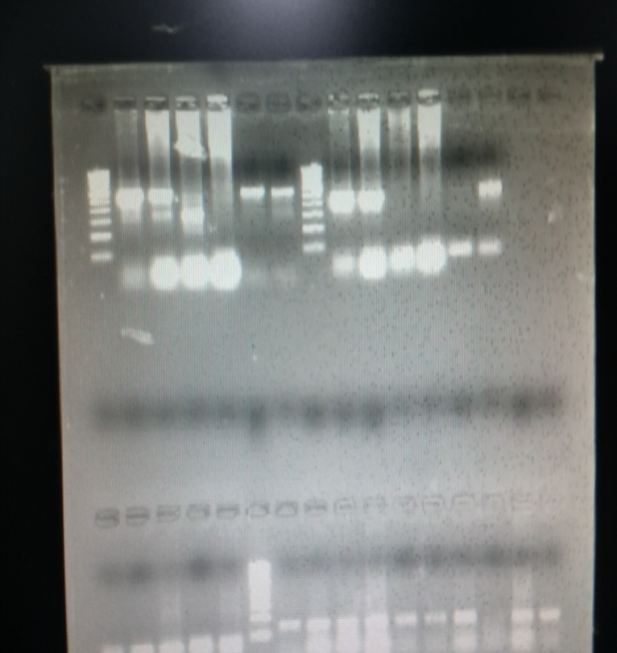
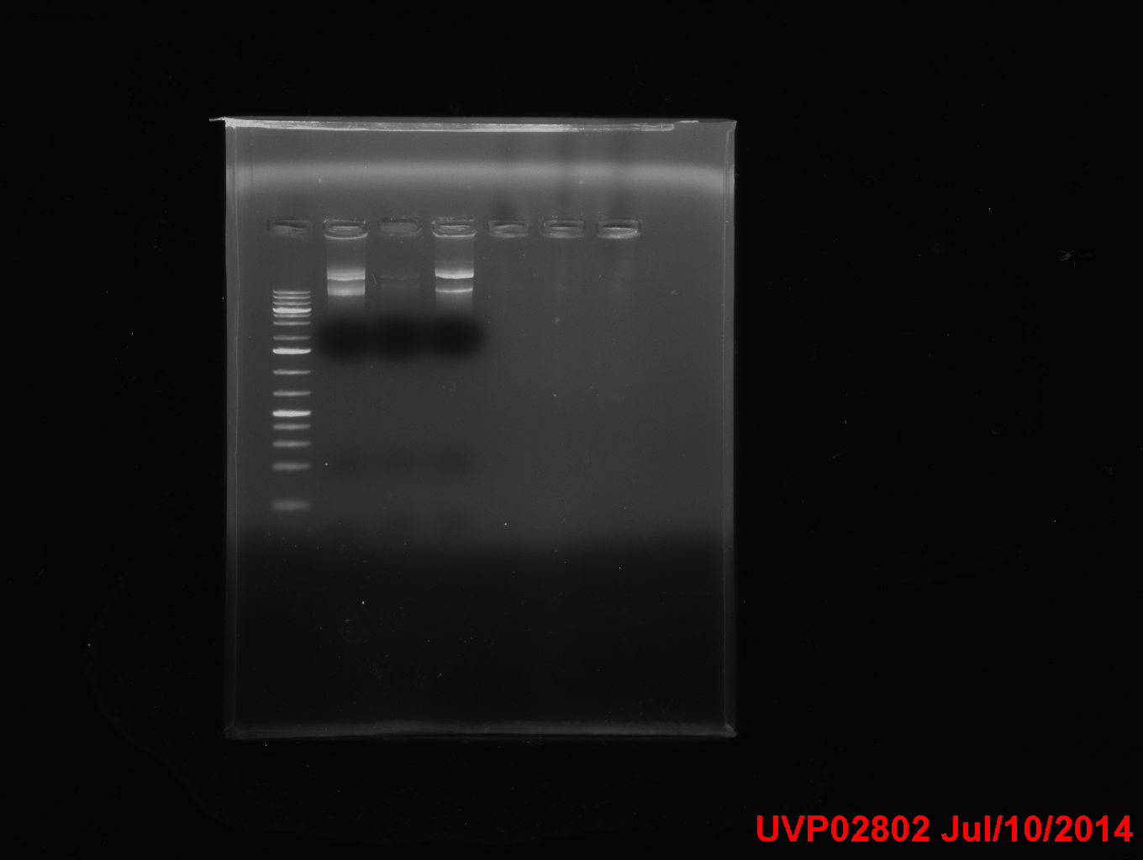
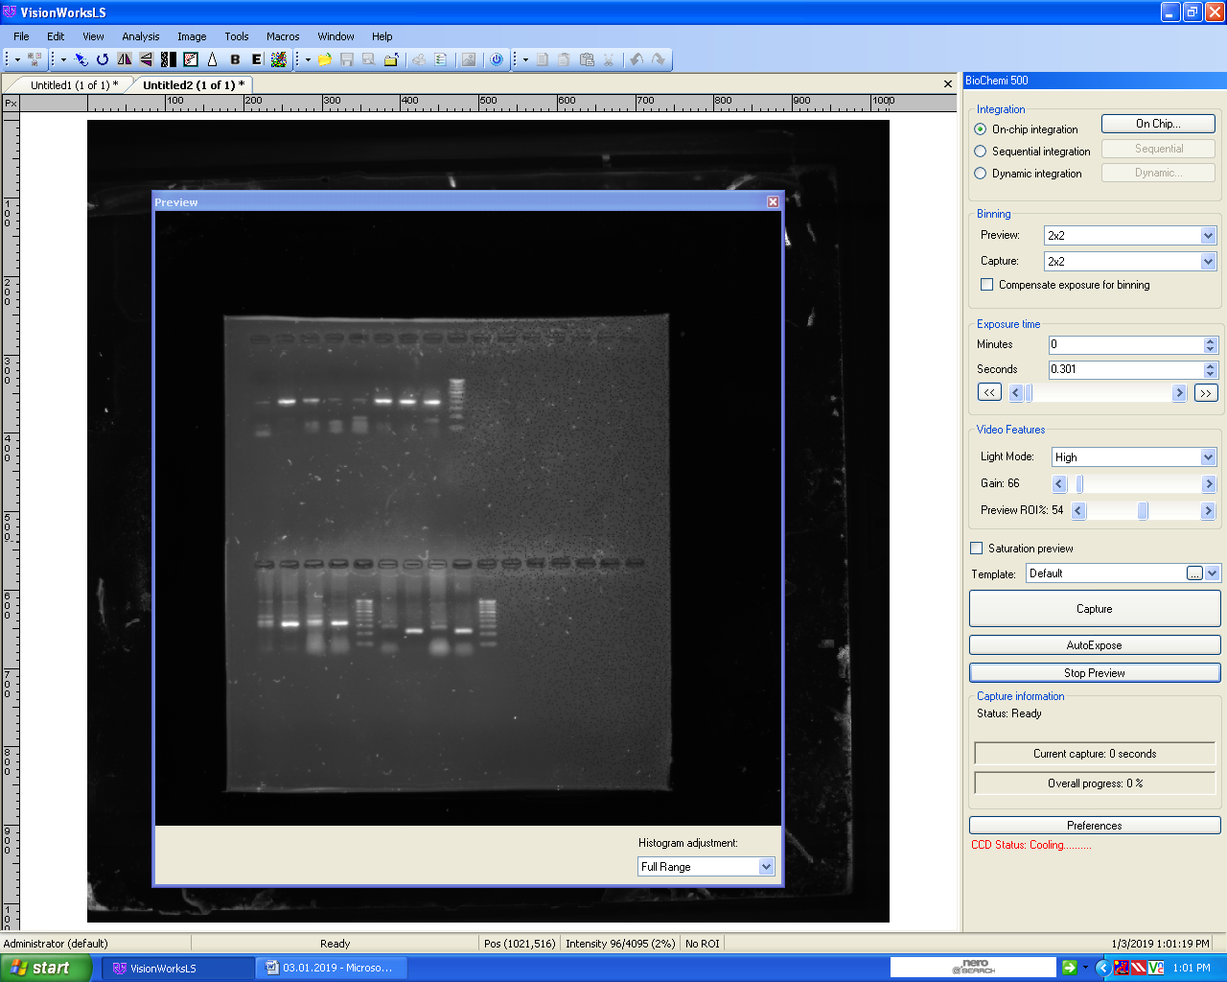
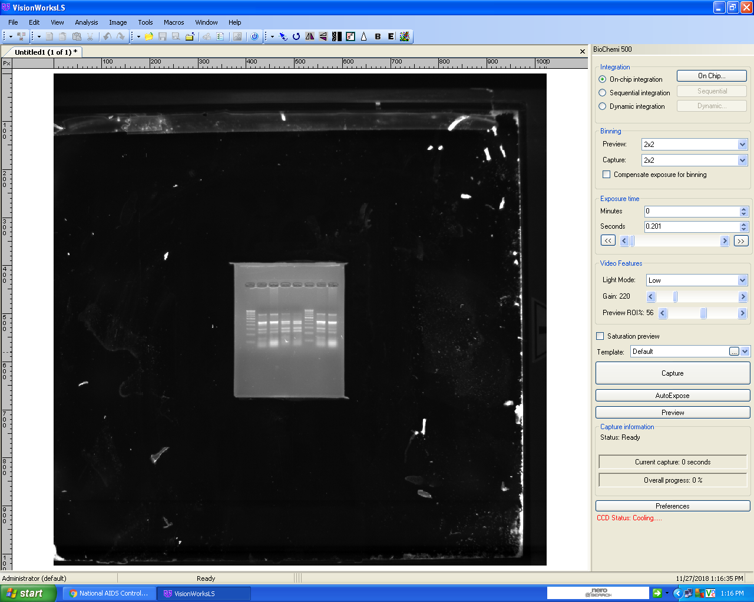
PCR to assess presence of endogenous HPV16 E6, E7 genes in DNA from CaSki & C33A cells
SUPPLEMENTARY DATA
Post Transfection Assessment of HIV-gag and Tat signatures
MW
MW
MW
6
7
9
NC
MigR1
HA-Tat
pNL_{4.3}
8
10
11
3
4
5
12
1
3
8
1
2
13 14
1
7
8
14
10
PC
MW
E6
PC
E7
HIV-Gag
MW
HIV-Tat
Lane 1,8 Molecular weight marker
Lane 2,3 DNA from CaSki cells for E6
Lane 4,5 DNA from C33A cells for E6
Lane 6,7-Positive Control for E6
Lane 9,10 DNA from CaSki cells for E7
Lane 11,12 DNA from C33A cells for E7
Lane 13,14-Negative, Positive Control for E7
Purified Plasmid DNA
(2nd Elute)
Sample1 : CaSki cell line untransfected
Sample 3 : CaSki + 3µg Tat
Sample 8 : C33A cell line untransfected
Sample 10 : Caski + 3µg Tat
8
10
Sample1 : CaSki cell line untransfected
Sample 7 : CaSki + 3µg HIV-1
Sample 8 : C33A cell line untransfected
Sample 14 : Caski + 3µg HIV-1
PCR FOR NOTCH-1 USING DNA FROM HIV-HPV TRANSFECTED CASKI AND C33A CELLS
HIV-Tat
HIV-Tat
The PCR amplicons were purified and sequenced using PCR Ref sequence NG_007458 to reconfirm the presence of Notch-1 using the same forward and reverse primers.
1
2
3
4
1. DNA from untreated Caski cell s
2. DNA from C33A cell s
3. DNA from HIV+HPV positive woman
4. DNA from HIV+HPV positive woman
Notch1

Slide 2
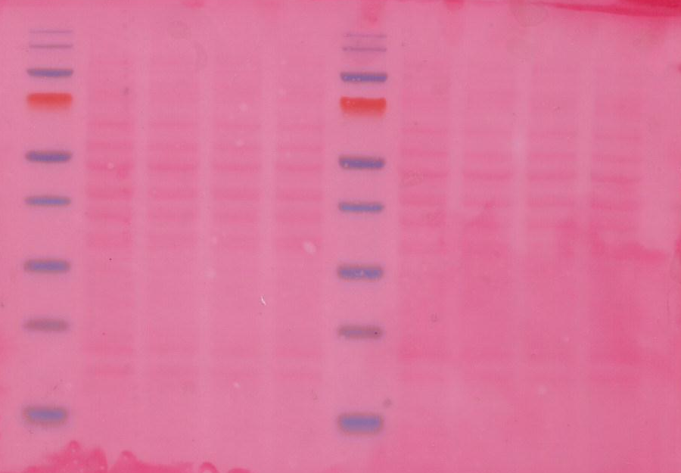
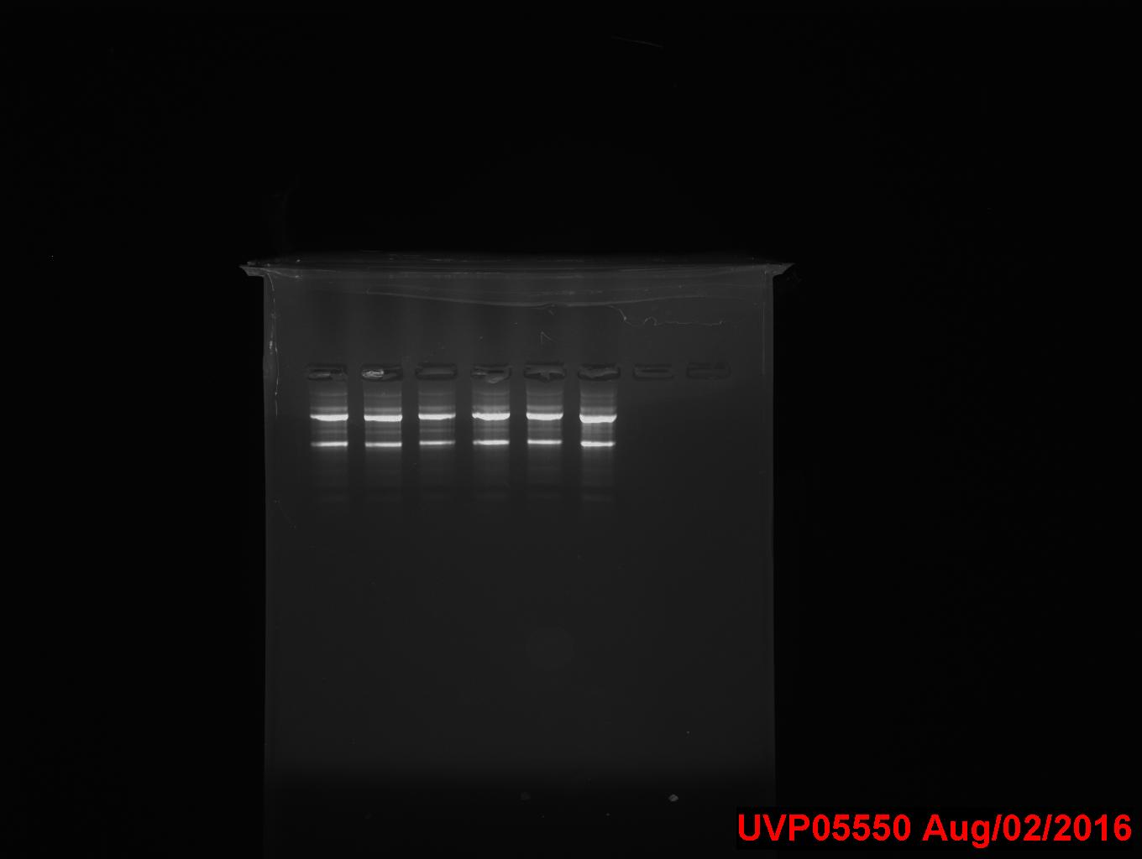
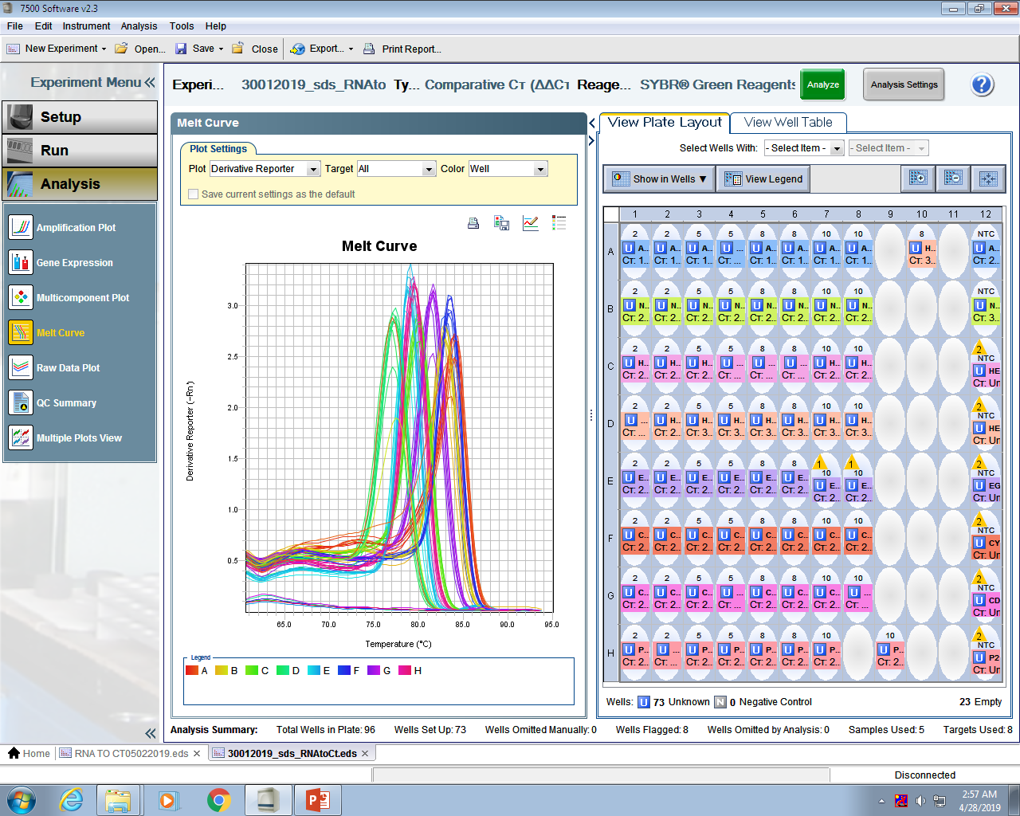
Protein Estimation and Ponceau S Staining
MW
5
7
1
1
3
3
5
7
Assessment of RNA Integrity
1.CaSki + mock transfected
3. CaSki + Tat (3.0µg)
5. CaSki +migR1(3.0µg)
7. CaSki + pNL_{4.3}(3.0µg)
1
2
3
4
5
6
1,4 :Control CaSki (24 hrs post transfection)
2,5 :Caski+ HA _{tat}
3,6 :CaSki+ HIV
4-6 CaSki (48 hrs post transfection)

