Slide 1
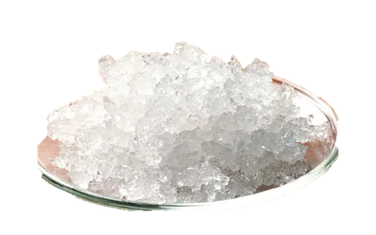
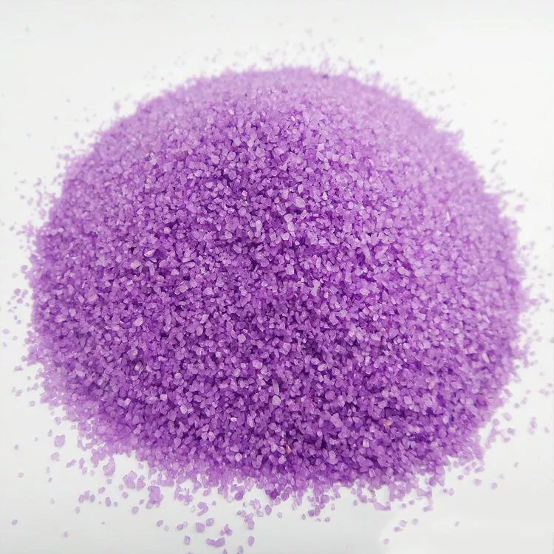
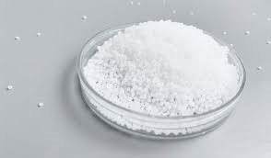
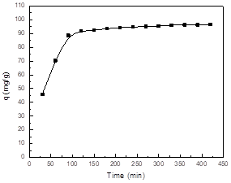
Zn(NO₃)₂.6H₂O
Fe(NO₃)₃.9H₂O
PVA
AC
PVA
CH₄N₂O
Stirring for 30 mint at 70C°
14

