Slide 1
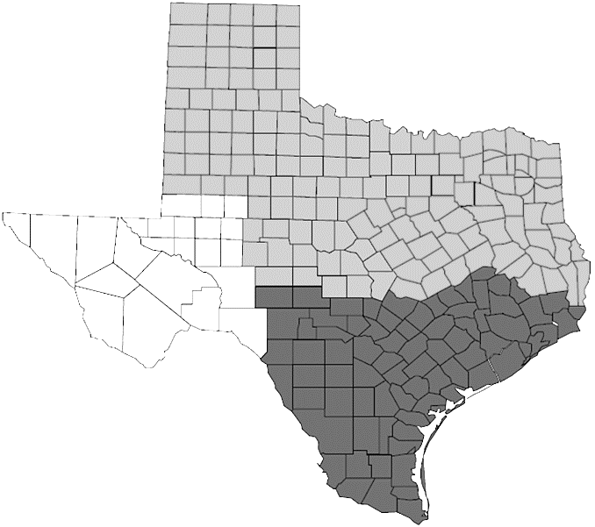
Fig. S1
TXE lines Yield trial location (abbreviation)
In High Plains:
Bushland (Irrigated) (BI)
Bushland (Dry) (BD)
Etter (Irrigated) (EI)
Etter (Dry) (ED)
Claude (CL)
Clovise (Irrigated) (CVI)
High Plains
Rolling Plains
In Rolling Plains:
Blacklands
Abilene (Irrigated) (ABI)
Chillicothe (CH)
Munday (MU)
Crooke County (CKE)
In Blacklands:
McGregor (MCG)
Prosper (PRO)
Ellis County (ELS)
Lamar County (LAM)
South Texas
In South Texas:
Brady (BRD)
Castroville (CAS)
College Station (CS)
Uvalde (UVL)

Slide 2
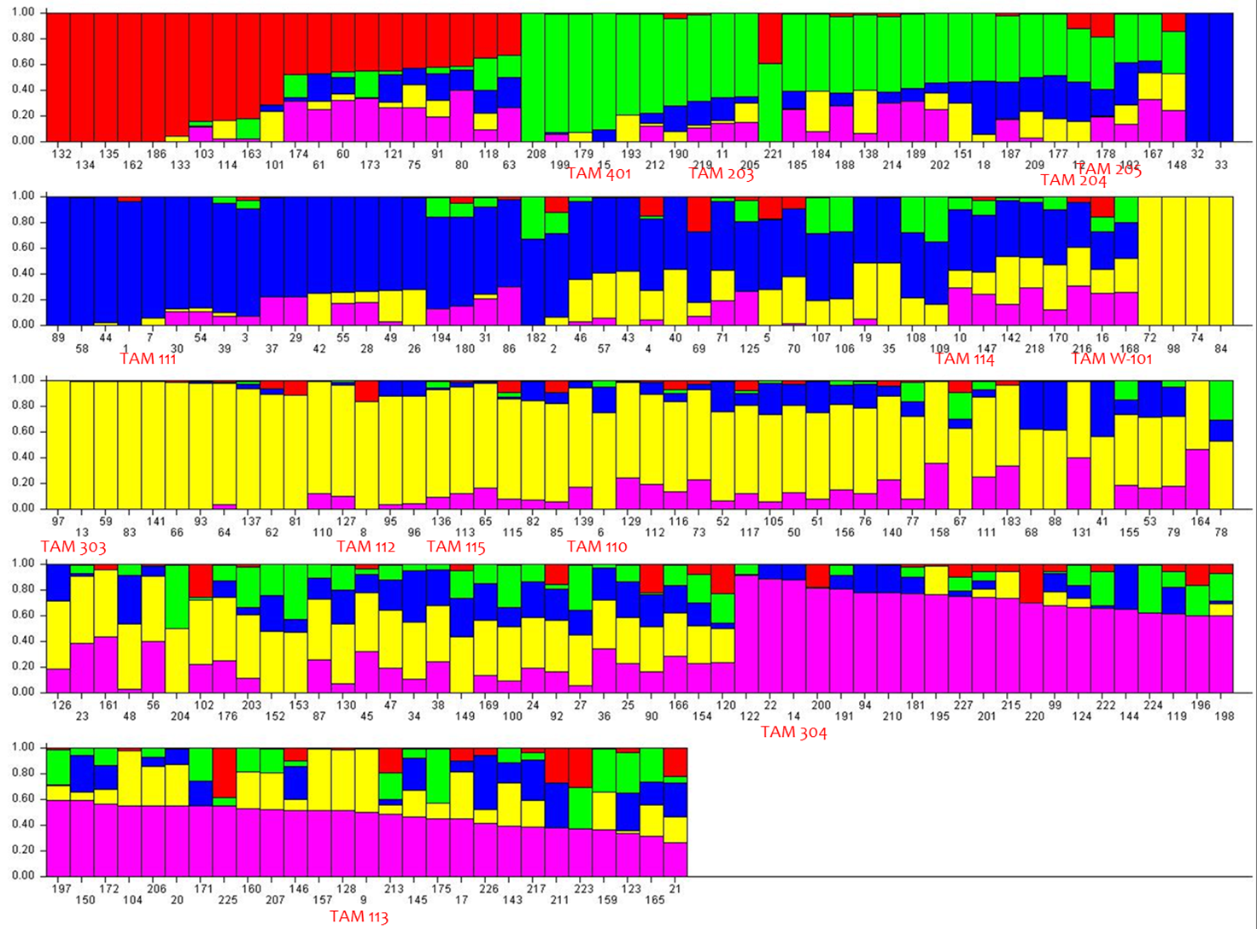
Fig. S2

