Slide 1
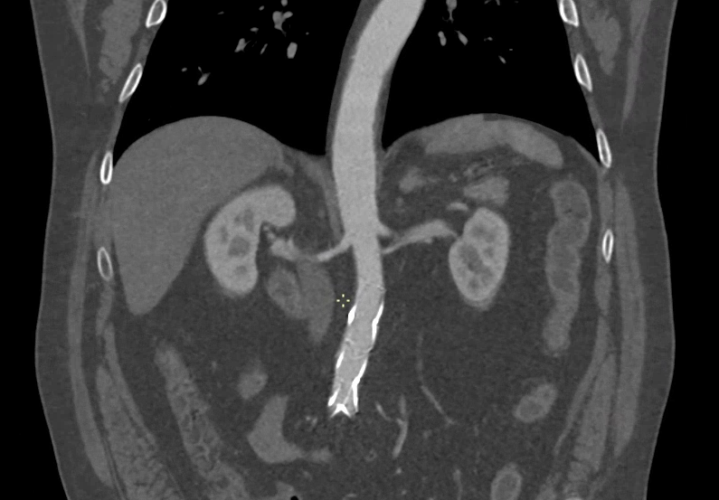
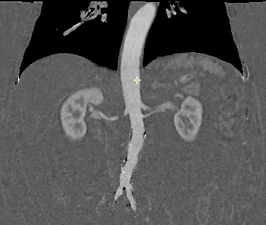
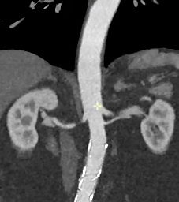
NEW VIRTUAL CONTRAST ENHANCEMENT BOOST TECHNIQUE CAN REDUCE THE DOSE OF INTRAVENOUS CONTRAST MEDIUM USED IN ANGIOTOMOGRAPHY OF THE ABDOMINAL AORTA
Original Contrast Enhancement CT image
Subtraction Iodine
Map
Virtual Contrast Enhancement Boost Technique
Original Arterial
Subtraction Iodine map
The iodine map is added to the original contrast enhancement CT image. Thus increasing the degree of contrast enhancement.
Noschang J et al; 2023
Notes:
Figure 1

