Slide 1
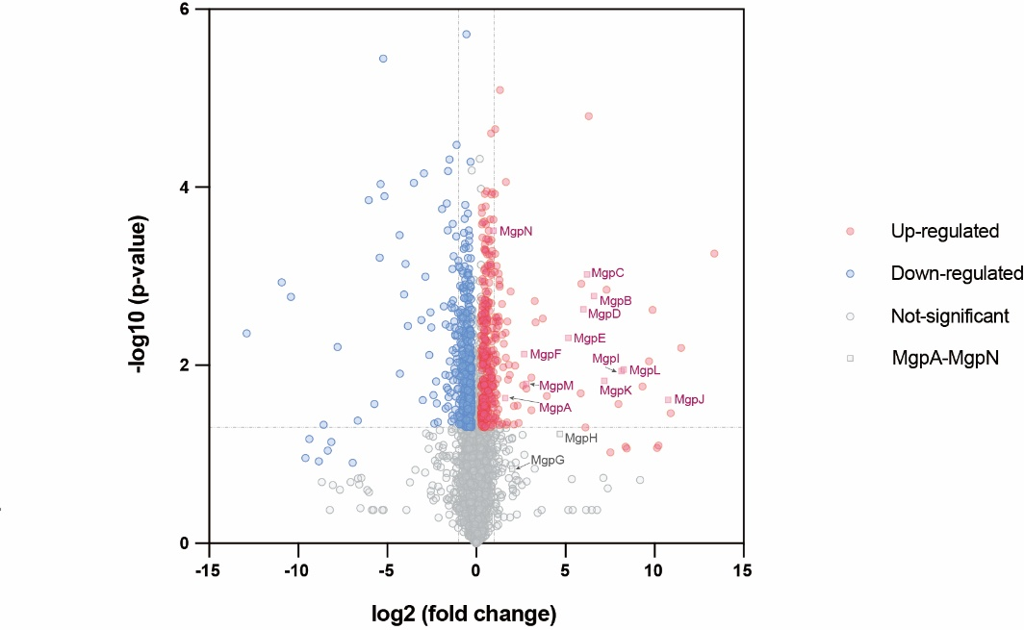
a
mgpA
mgpB
mgpC
mgpD
mgpE
mgpF
G H I J K L M N
DSM 23488 WT
P_{Rha}
apra
redγ-redβα7029
Red/ET recombineering
km
mgpA
mgpB
mgpC
pBBR1
DSM 23488::P_{apra}
mgpD
mgpE
mgpF
G H I J K L M N
CYMG Medium
1
*
Intens.
*
x10⁵
4
*
2.0
5
1.5
1.0
iiiii
i
0.5
0.0
7.5
10.0
12.5
15.0
17.5
20.0
22.5
Time [min]
Intens.
M9 Medium
2
3
x10⁵
*
3
*
2
1
iiiii
i
0
8
10
12
14
16
18
20
22
Time [min]
b
Extended Figure 1.

Slide 2
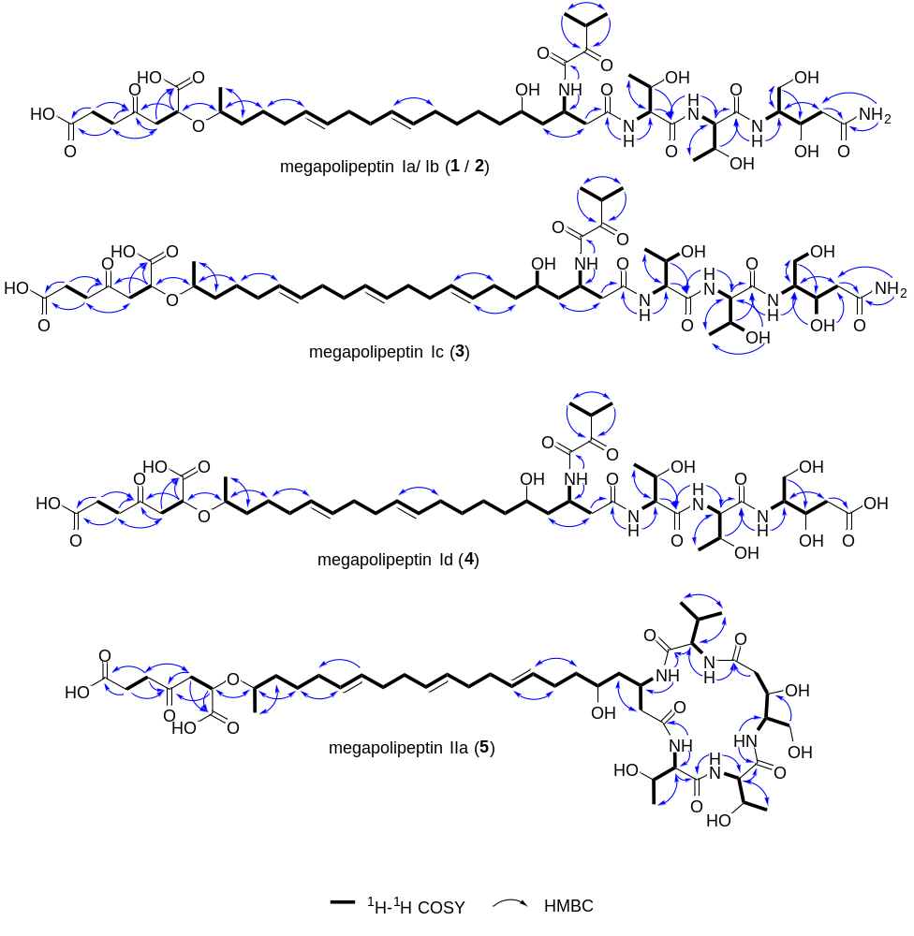
Extended Figure 2.

Slide 3
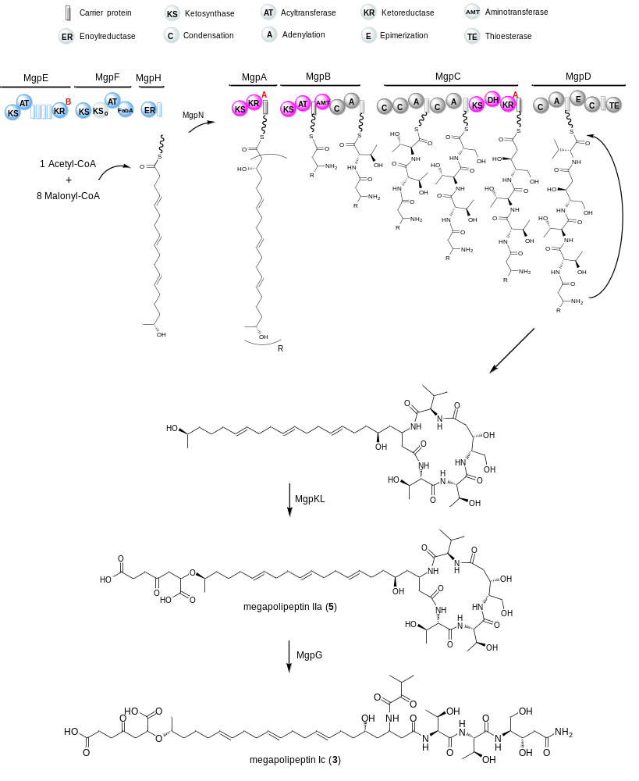
Extended Figure 3.

Slide 4
chpA
chpB
chpC
chpD
chpE
ATCC 31532 WT
F G H I
HA1 apra HA2
double crossover
cm
R6K
chpB
chpC
chpD
chpE
ATCC 31532 ∆chpA
F G H I
PDB Medium
8
Intens.
10
x10⁵
9
7
6
6
*
4
*
2
*
0
ii
6
8
10
12
14
16
18
20
Time [min]
i
Extended Figure 4.

Slide 5
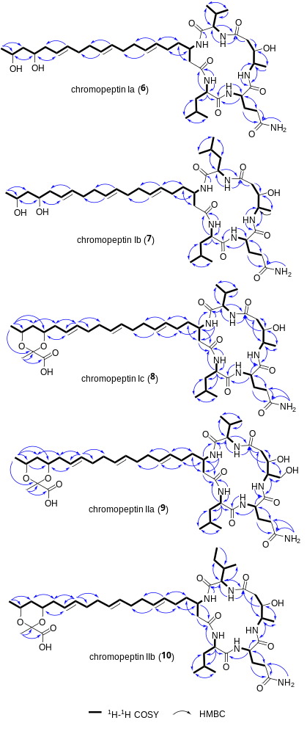
Extended Figure 5.

Slide 6
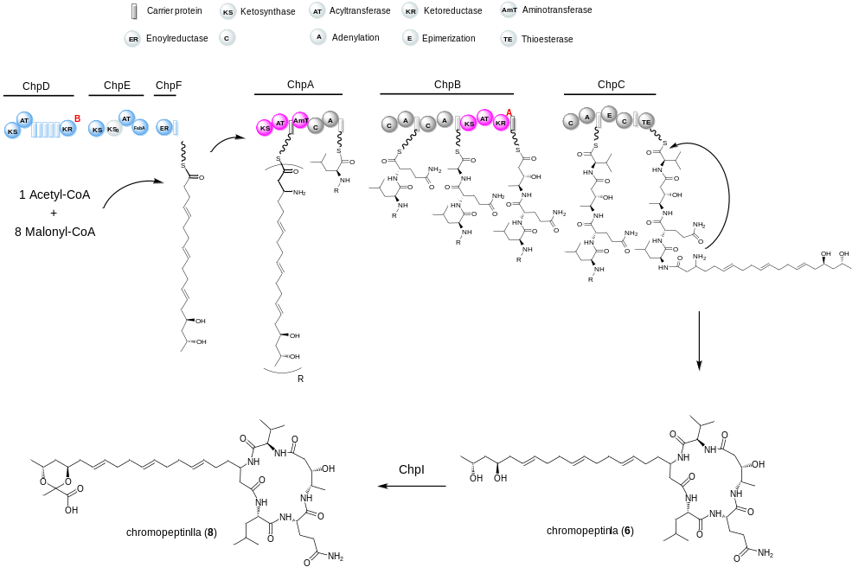
Extended Figure 6.

Slide 7
Digested genomic DNA of C. koreensis
cm
p15A
p15A-cm-ctp
P₁₃
p15A-cm-P₁₃-genta-ctp
Linear vector
cm
p15A
PCR product
PCR product
oriT
apra
genta
P₁₃
IR
PhiC31
IR
LLHR
LCHR
LCHR
cm
p15A
p15A
p15A-cm-ctp
p15A-cm-P₁₃-genta-ctp
P₁₃
p15A-phiC31-apra-P₁₃-genta-ctp
P₁₃
p15A
PhiC31
Intens.
Landy1 Medium
12
x10⁵
11
1.0
0.8
13
0.6
*
*
0.4
ii
0.2
i
0.0
6
8
10
12
14
16
18
20
Time [min]
Extended Figure 7.

Slide 8
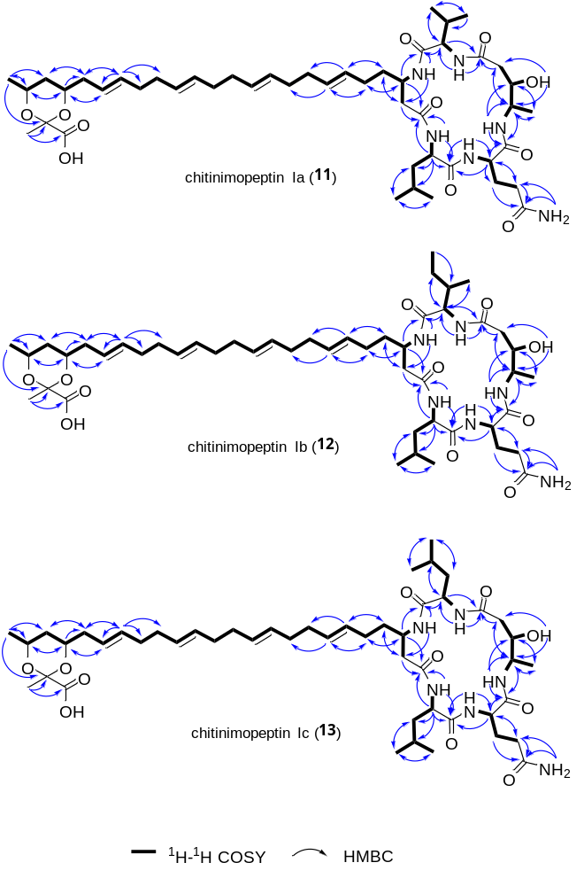
Extended Figure 8.

Slide 9
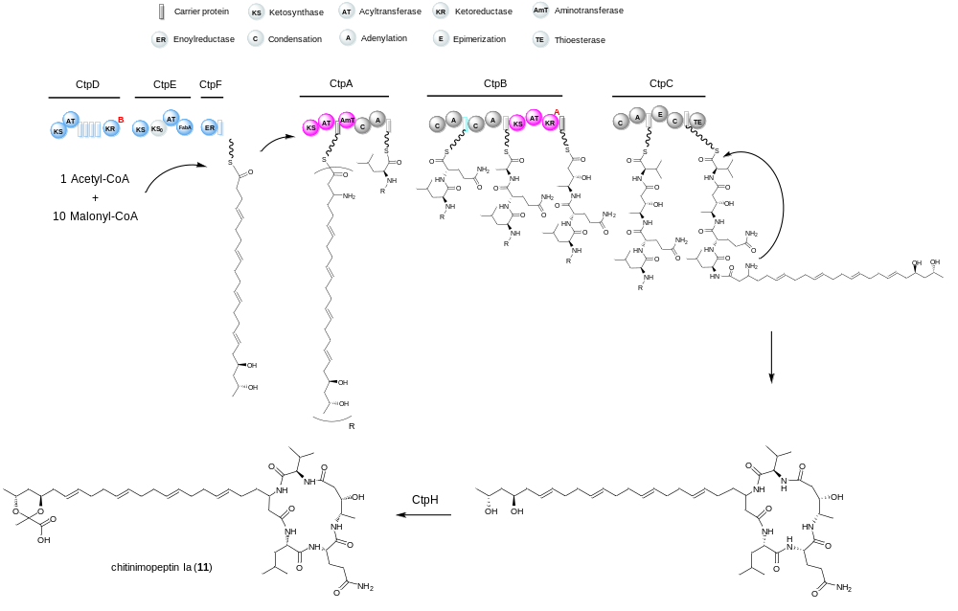
Extended Figure 9.

Slide 10
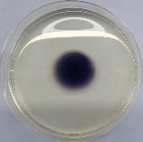
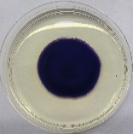
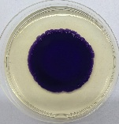
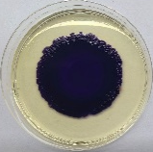
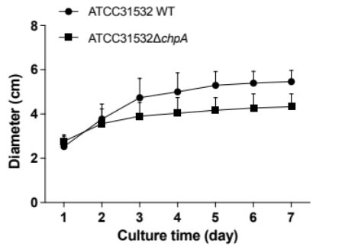
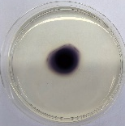
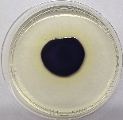
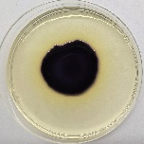
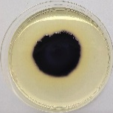
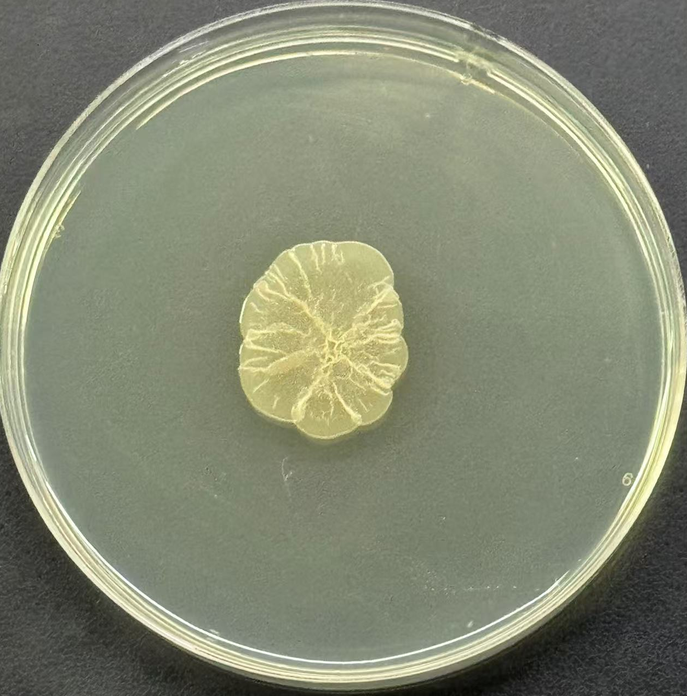
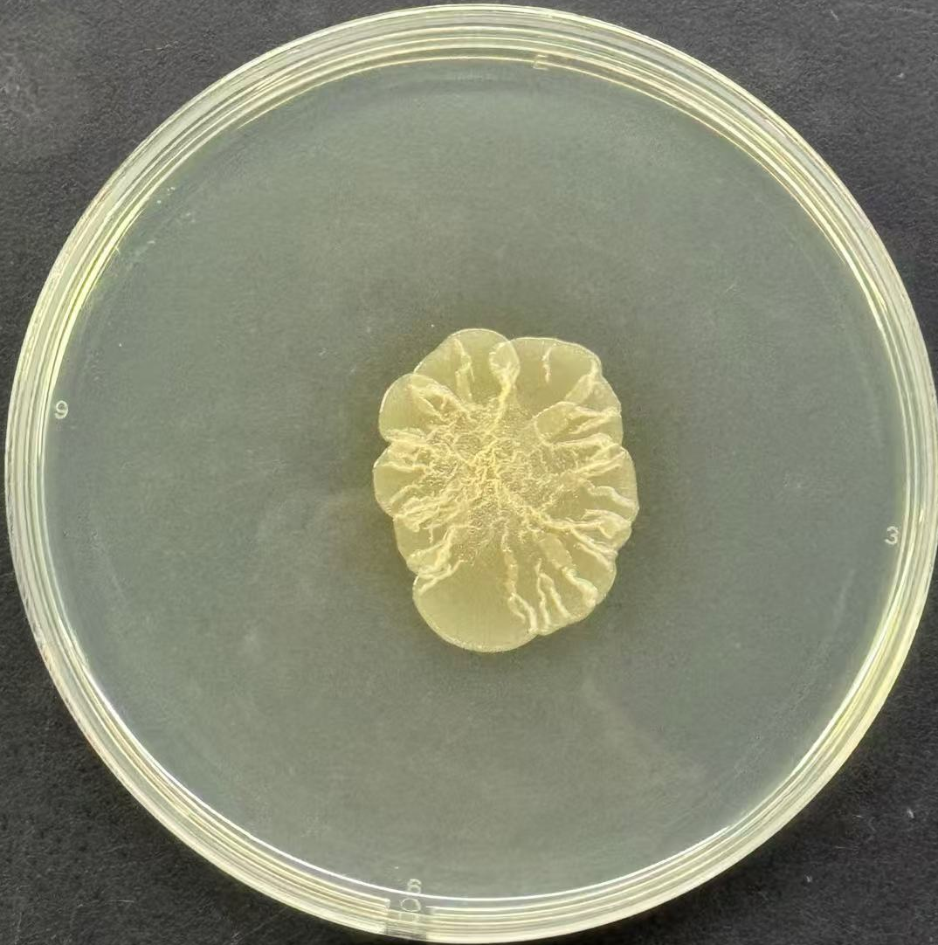
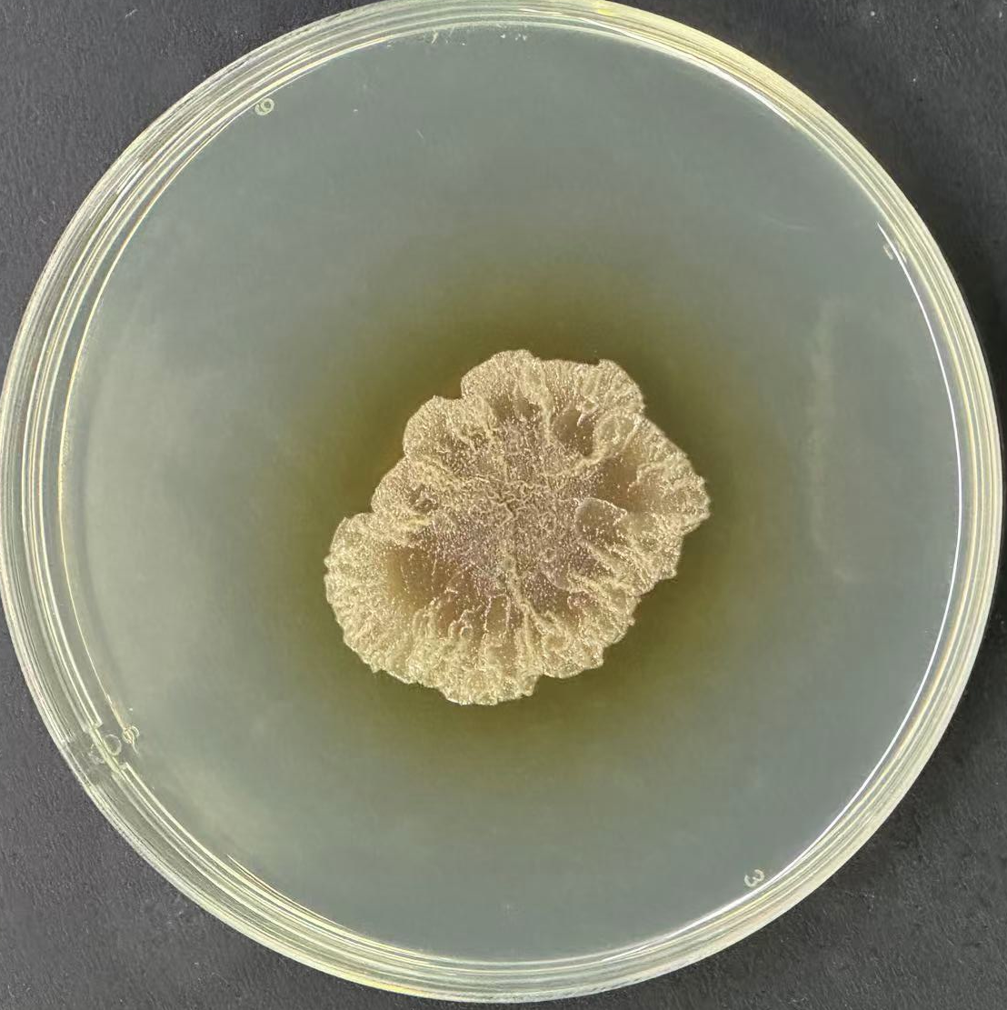
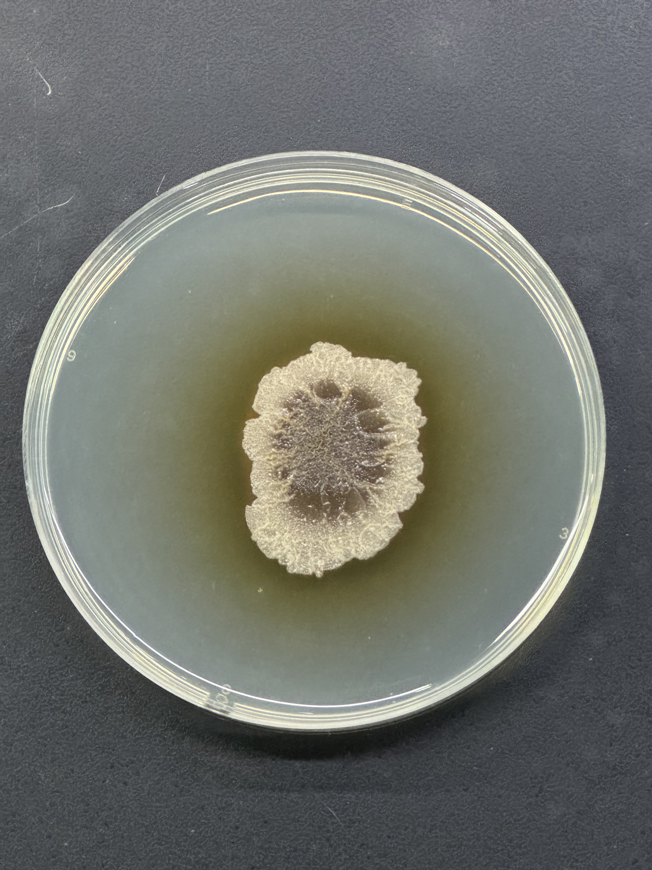
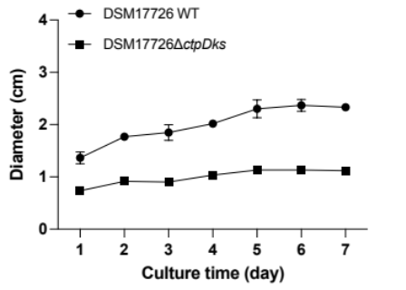
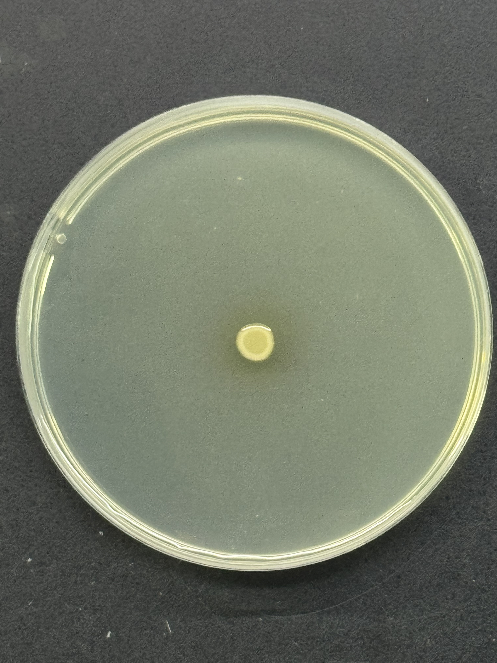
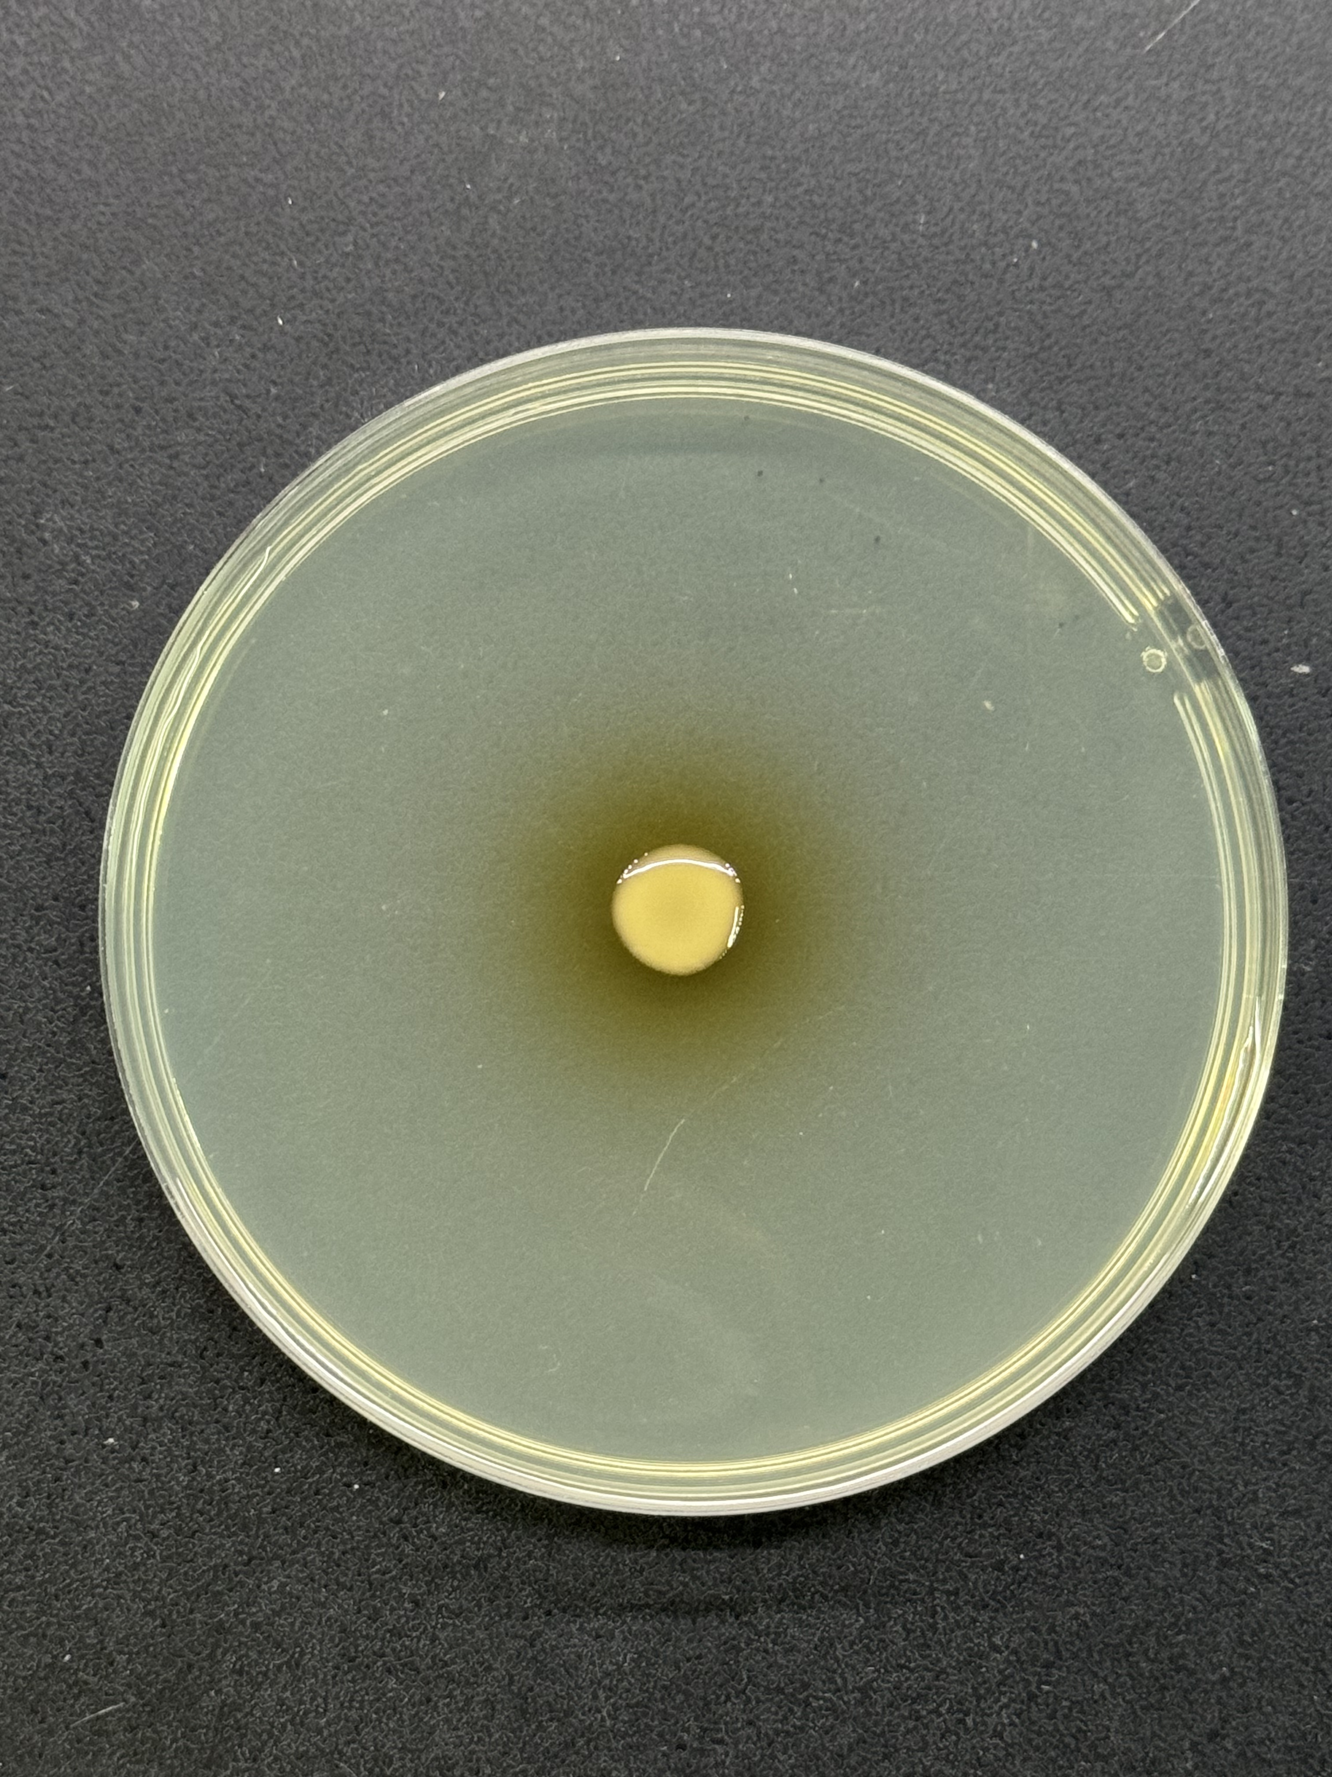
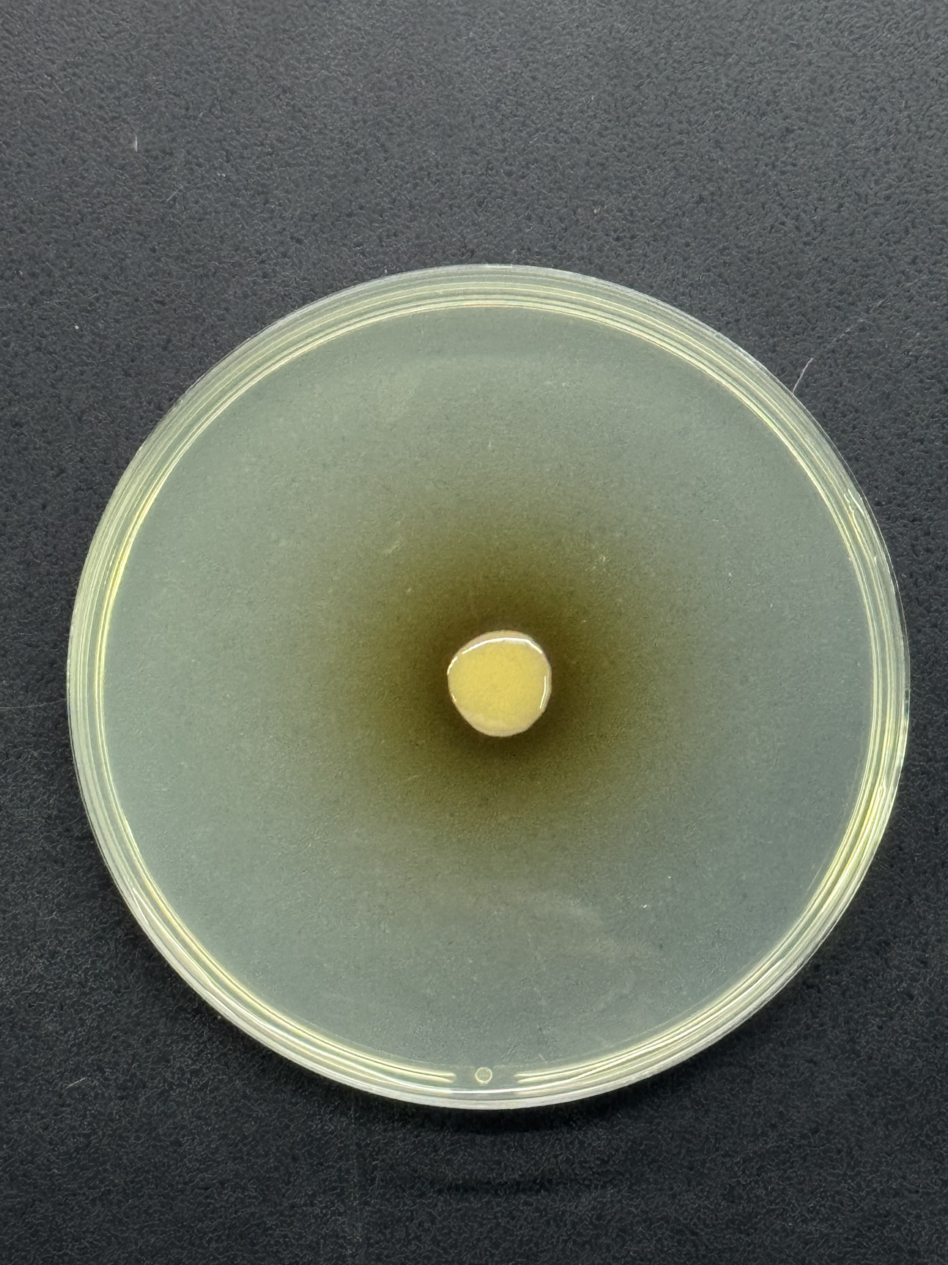
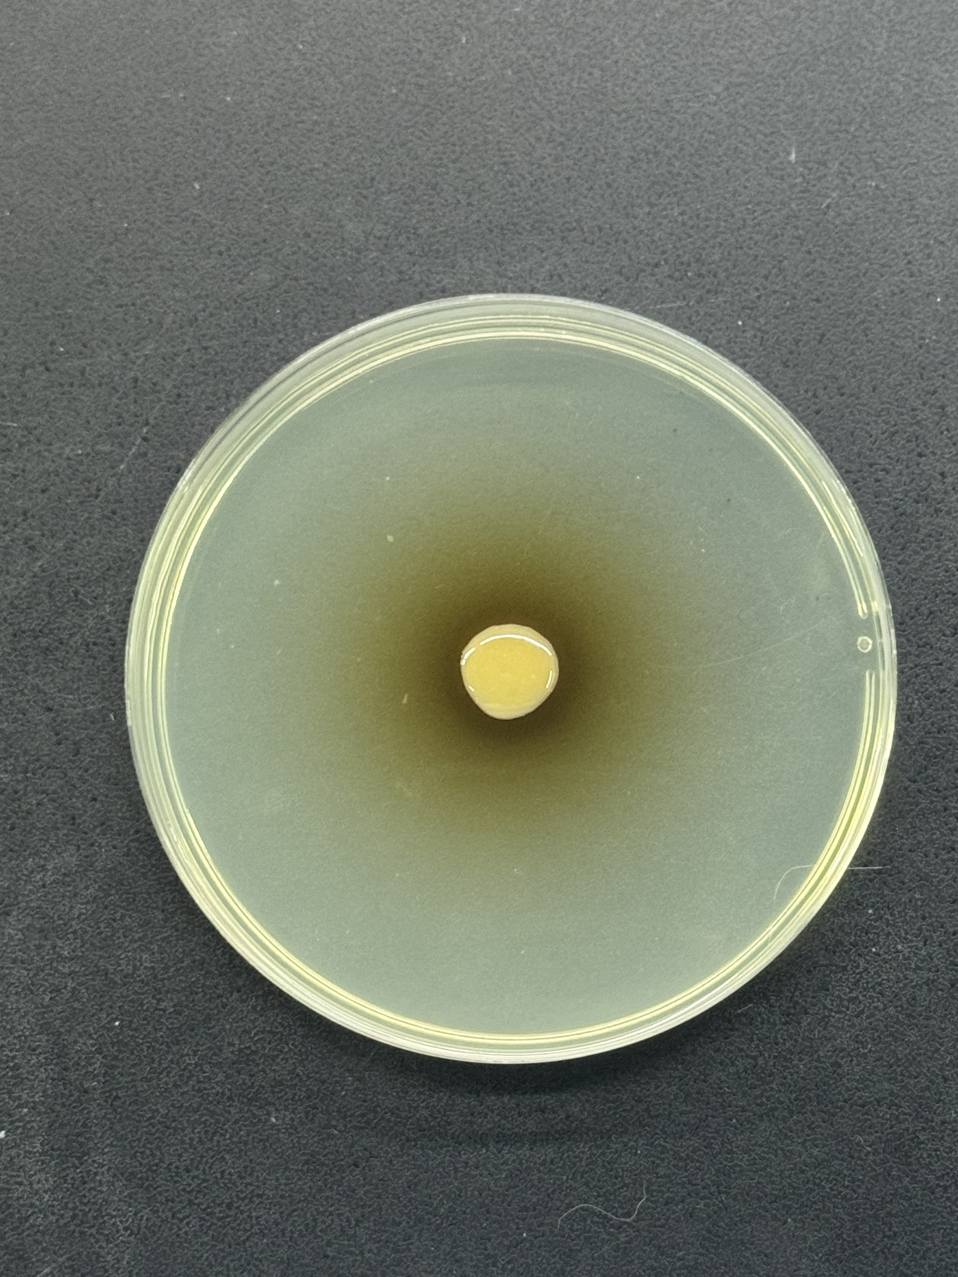
a
Day1
Day3
Day5
Day7
Chr. subtsugae
ATCC 31532 WT
Chr. subtsugae
ATCC 31532ΔchpA
Day1
Day3
Day5
Day7
Chi. koreensis
DSM 17726 WT
Chi. koreensis
DSM 17726ΔctpDks
b
Compound | IC50±SD (μM）
 | 5637 cells (Human Bladder Carcinoma Cells)
chromopeptin Ia (6) | >50
chromopeptin Ib (7) | >50
chromopeptin IIa (8) | 9.4727±0.0768
chromopeptin IIc (10) | 4.1893±0.3298
doxorubicin | <0.1
c
Compound | Minimum inhibition concentration (MIC) of Valsa mali (μM）
chitinimopeptin Ia (11) | 3.13
chitinimopeptin Ib/Ic (12/13) | 12.50
carbendazim | 0.78
Extended Figure 10.
Notes:
b图曲线

