Slide 1
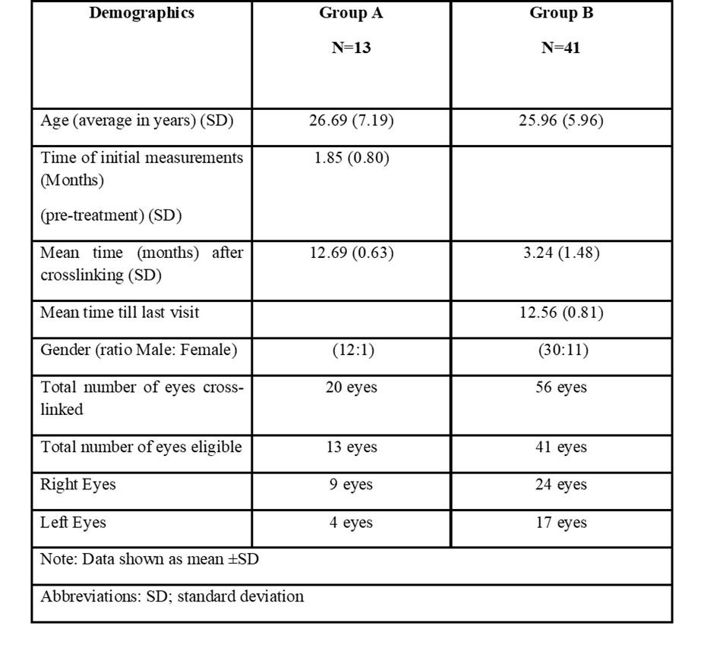
Table I -Summary of demographic and baseline characteristics

Slide 2
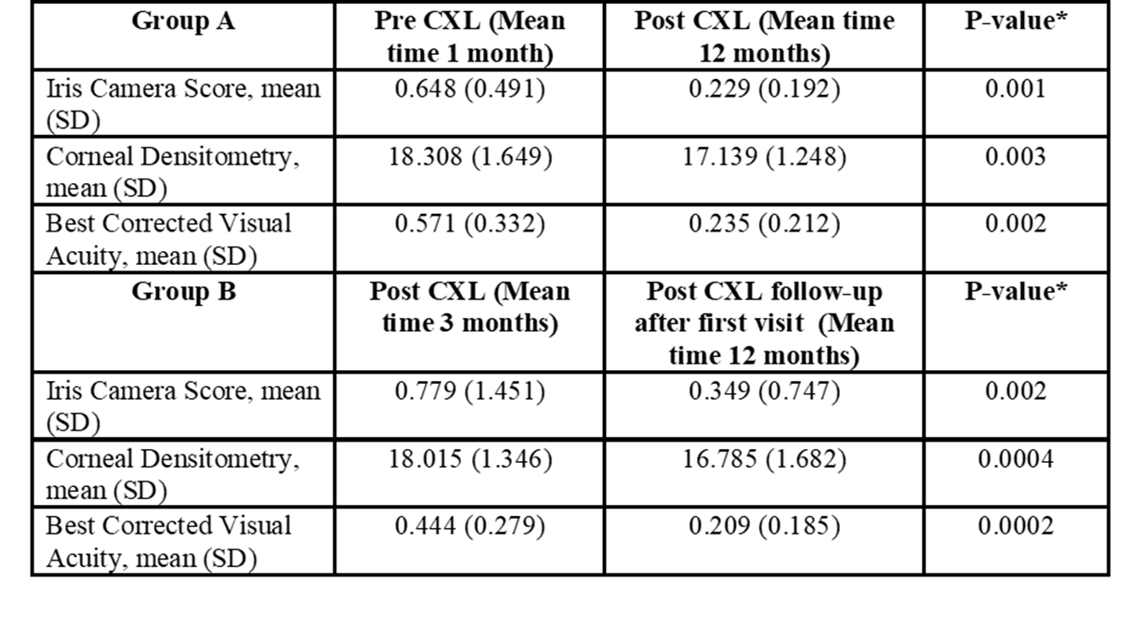
Table II Summary of means and standard deviations of the COM score, densitometry and BCVA for both groups

