Slide 1
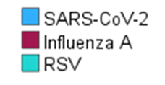
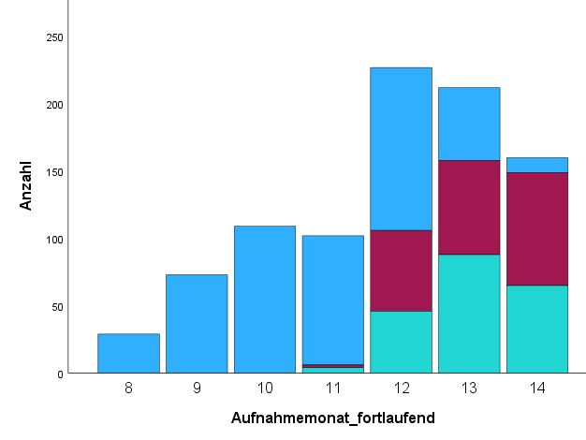
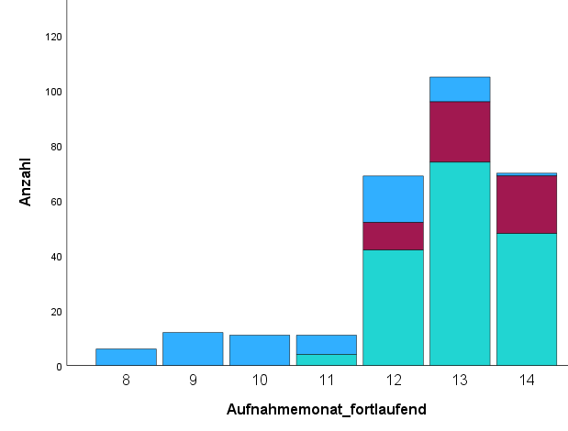
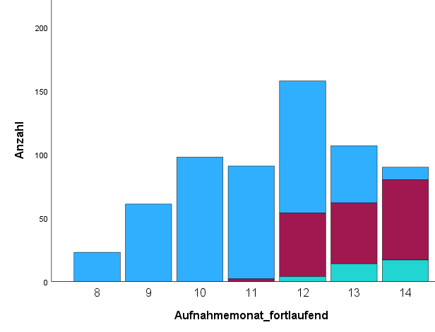
Time course of infections
All
< 18 years of age
≥ 18 years of age
Number
Number
Number
Month of admission
Month of admission
Month of admission
Supplemental Figure 1: Numbers of patients stratified according to type of infections versus month of admission. Absolute numbers are shown. On the horizontal axes, „8“ refers to August 2023, „12“ to December 2023, and „13“ and „14“ to January and February 2024, respectively.

