Slide 1
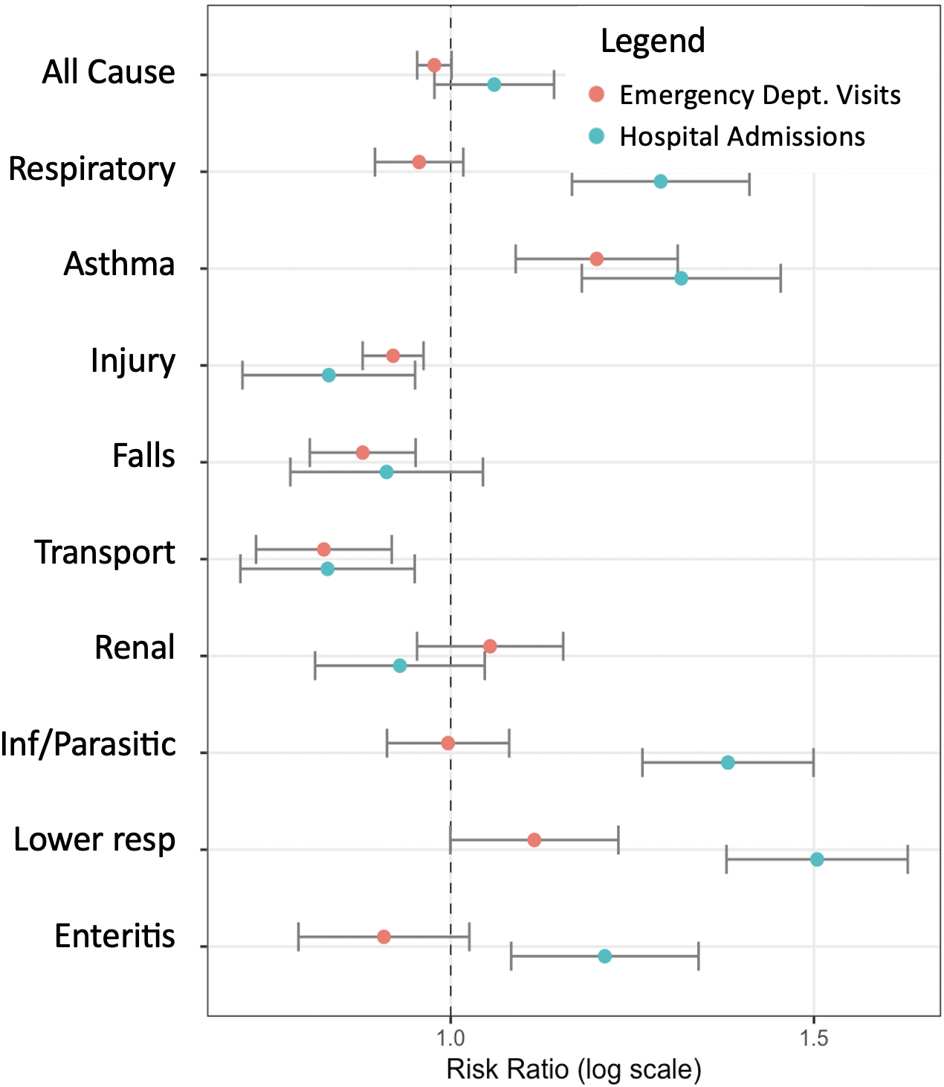
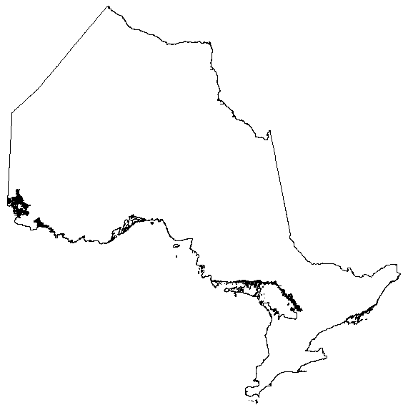













Extreme heat and pediatric health in a warming world: a space-time stratified case-crossover investigation in Ontario
Hallah Kassemª, Dr. Eric Lavigne^{b,c}, Dr. Kate Weinberger^{a1}, Dr. Michael Brauerª
Population
Children in Ontario (May-Sep; 2005-2015) seeking emergency healthcare
Methods
Space-time-stratified case crossover with
conditional quasi-Poisson regression
Results
MAY 2005
S M T W T F S
May-Sep
May-Sep
1
2005
2015
K0A
1
3
5
Strata: 1 2 3
Strata 3*
Incidence_{E}
Incidence_{U}
RR = 2
*Example uses synthetic Strata 3 data
ªSchool of Population and Public Health, University of British Columbia, Vancouver, BC
^{b}School of Epidemiology and Public Health, University of Ottawa, Ottawa, ON
^{c}Environmental Health Science and Research Bureau, Health Canada, Ottawa, ON
¹Present address: ICF, Seattle, WA

