Slide 1
Activities for Wellbeing System Maps
Big Circle Meeting
19.01.2024

Slide 2
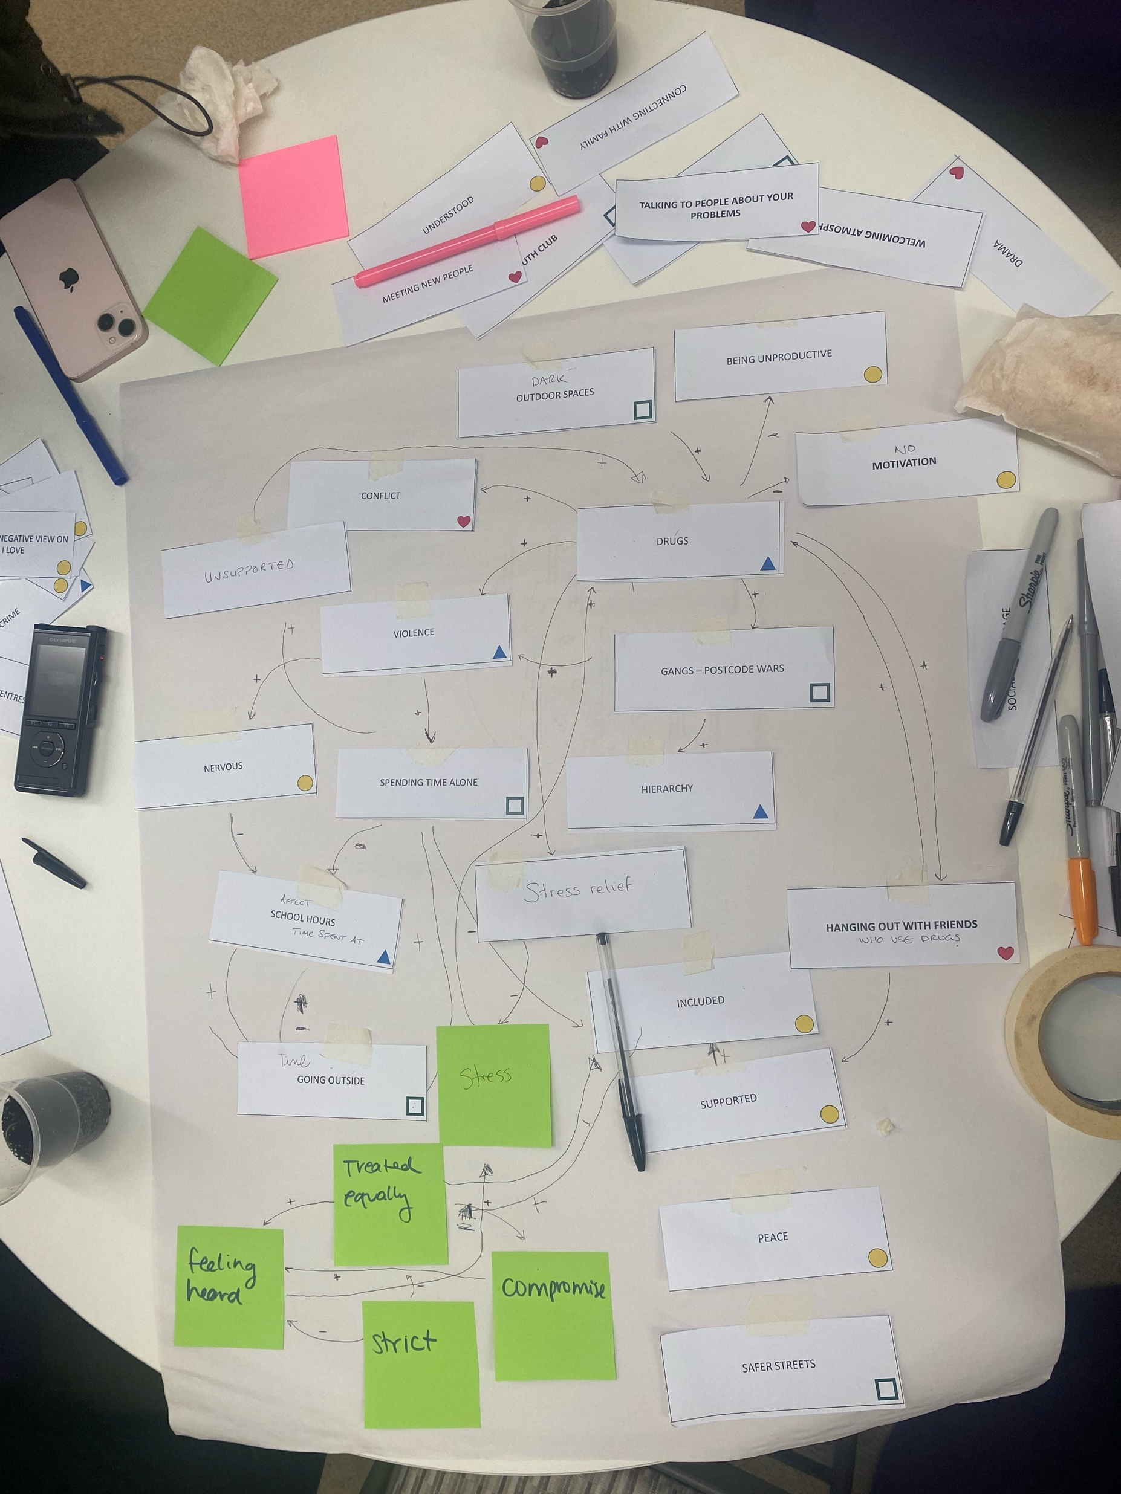
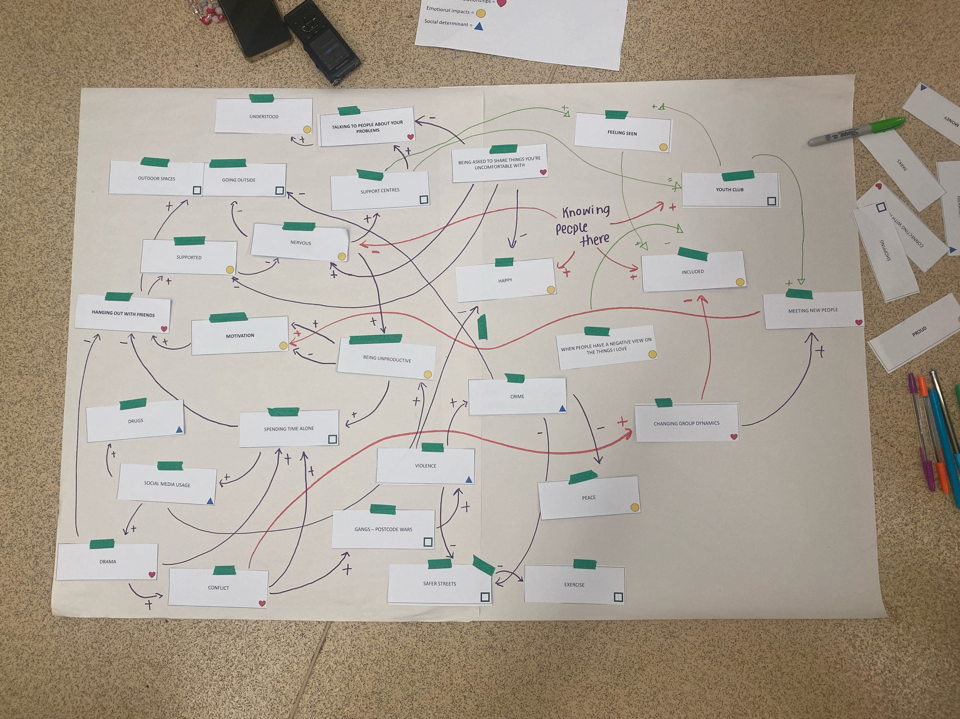
Group Model Building

Slide 3
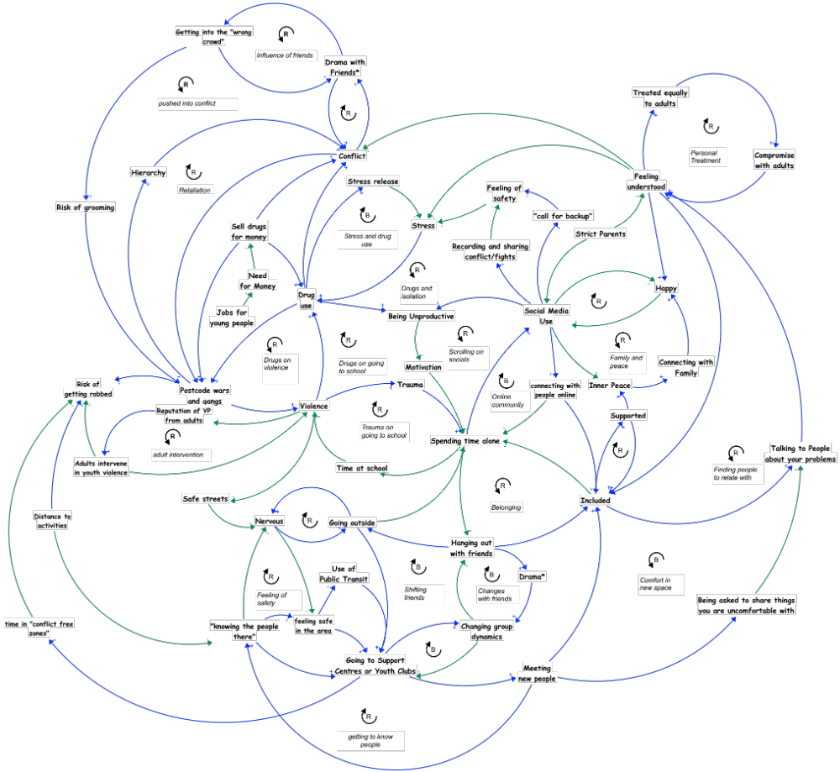
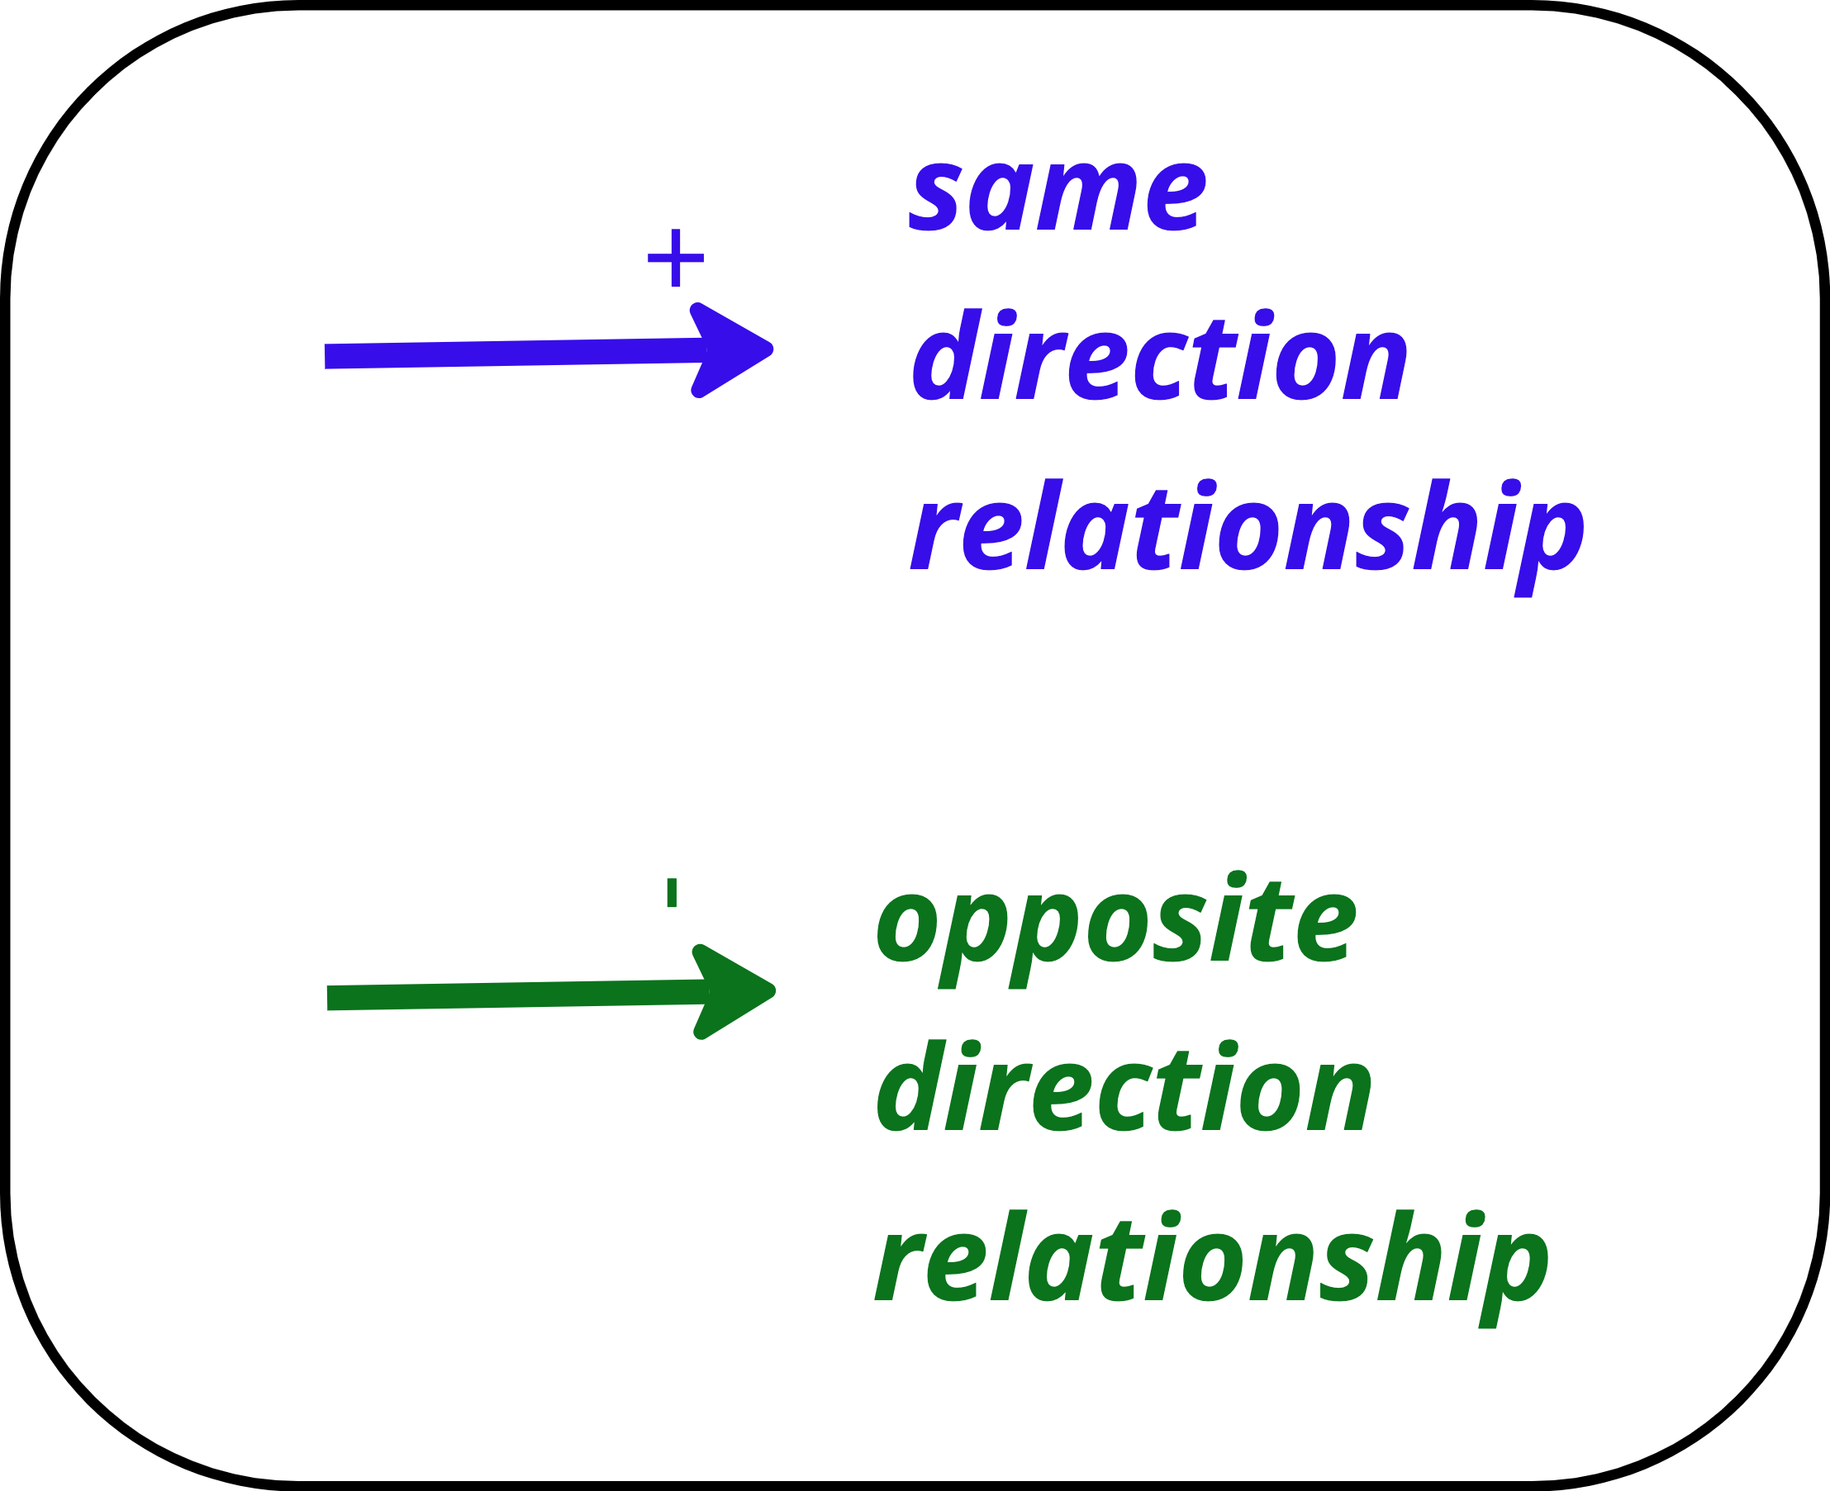

Slide 4
Key Dynamics of the System Map
1

Slide 5
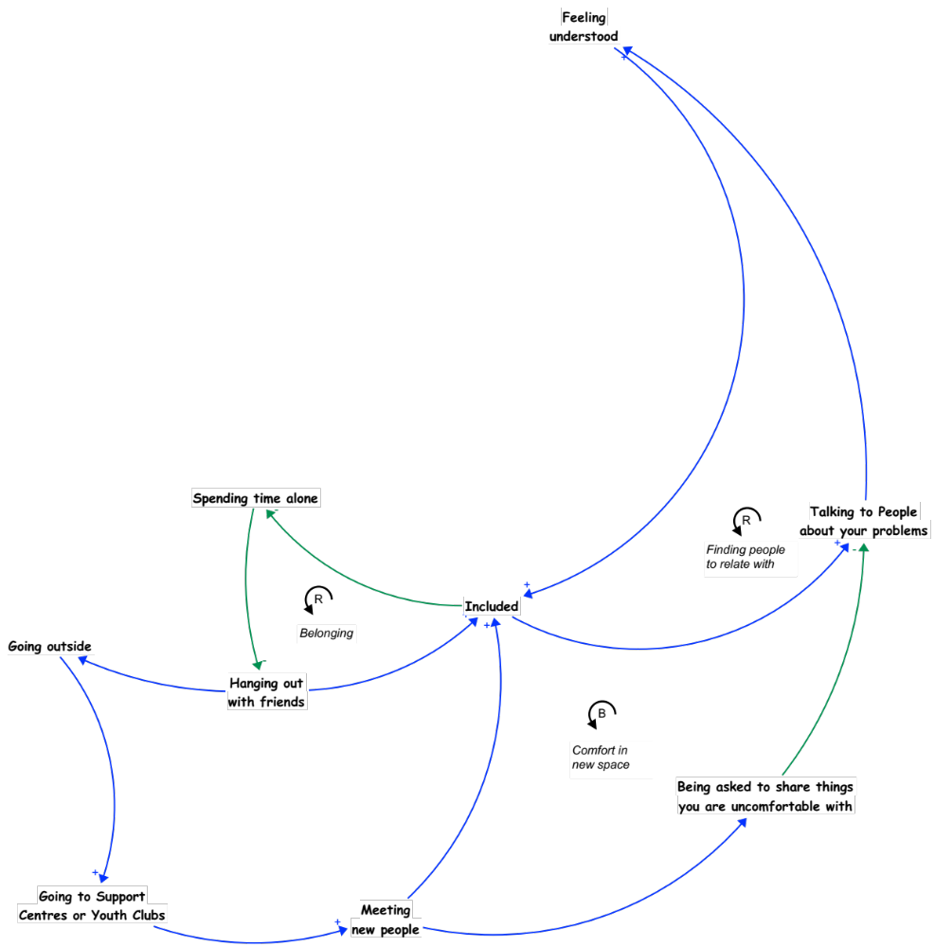
01.
Comfort in New Spaces
As more young people attend support centres and youth clubs, they have greater opportunity to meet new people. While allows for them to feel more included, it also increases the risk of ”being asked to share things [they] are uncomfortable with”. When they feel more included it provides them greater opportunity to talk to people about their problems. However, if they are asked to share things they may feel more uncomfortable with it can lead to them being less willing to talk to people about their problems.
Talking to people about their problems is central to feeling understood and included. When young people feel this way they spend less time alone, more time with friends, and are more likely to engage in support centres of youth clubs.

Slide 6
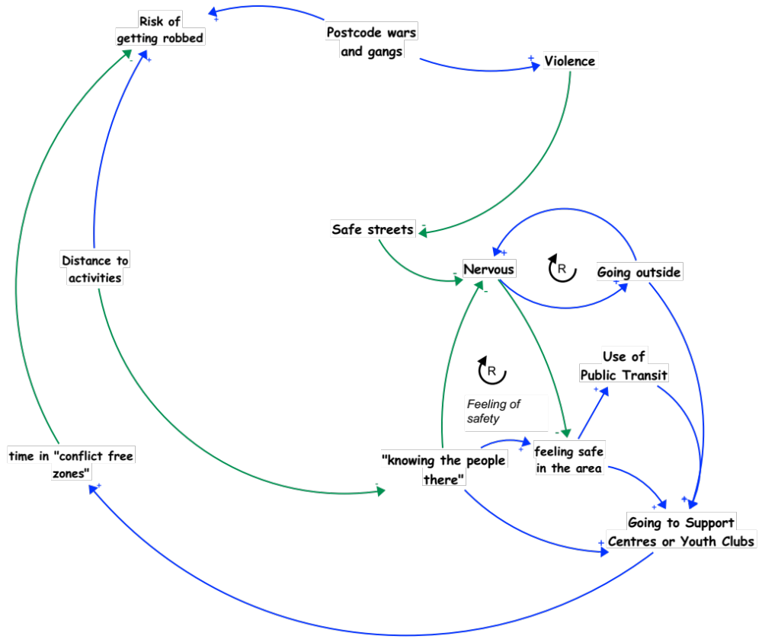
02.
Safety Engaging in Activities
The safety of the area around activities for wellbeing is a key determinant for young peoples’ positive experience and engagement in activities and spaces.
Increased violence-–influenced by factors such as postcode wars—makes for less safe streets. This increases young peoples’ nervousness and decreases their sense of safety, making them less likely to go to support centres and youth clubs. They may also engage less in public transit if they feel unsafe thereby making it more challenging for them to go to activities for wellbeing.
Distance also has a major impact on young peoples’ sense of safety. The further away young people are from their home, the more they are at risk of being robbed and the less likely they are to “know people”. This is a barrier to them feeling safe and wanting to engage with activities and supports outside of their hyperlocal area.

Slide 7
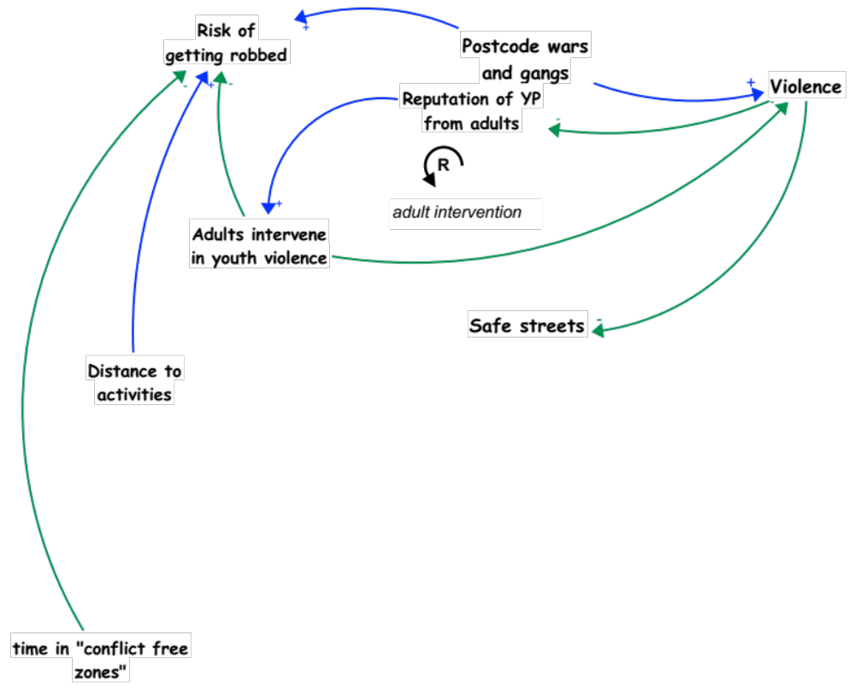
03.
Reputation of Young People and Violence
Young people described how the more young people are perceived as violent, the less adults are willing to intervene. This leaves young people more vulnerable things like to violence and being robbed.
This is further complicated by the prevalence of postcode wars and gangs. When there is higher involvement or activity of gangs and postcode wars, there tends to be more violence in the area. This influences the reputation of how young people are viewed by adults and makes them more fearful or less willing to intervene when they see a young person who may be experiencing violence.
As previously described, distance to activities also influences how much young people are at risk of violence in Newham. However, time in “conflict free zones” (such as safe spaces and activities), reduces their risk of being robbed or involved in violence.

Slide 8
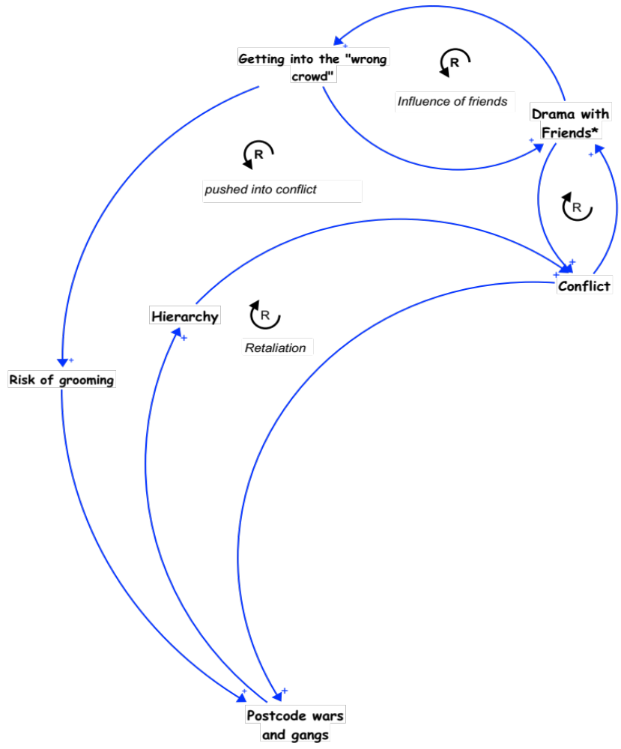
04.
Influences on Engaging in Conflict
Friends, peers, and “getting into the wrong crowd” were described to have an influence on young people getting involved in conflict and violence. When young people are surrounded by the “wrong crowd” they become more at risk for grooming-–which can lead to them becoming involved in postcode wars or gangs. Conflict and drama with friends is one way that young people may be influenced to get into ”the wrong crowd”.
When involved with certain groups, young people can become influenced by power dynamics and hierarchy which can lead to more conflict. This can become a cyclical pattern with conflict leading to retaliation and more conflict.

Slide 9
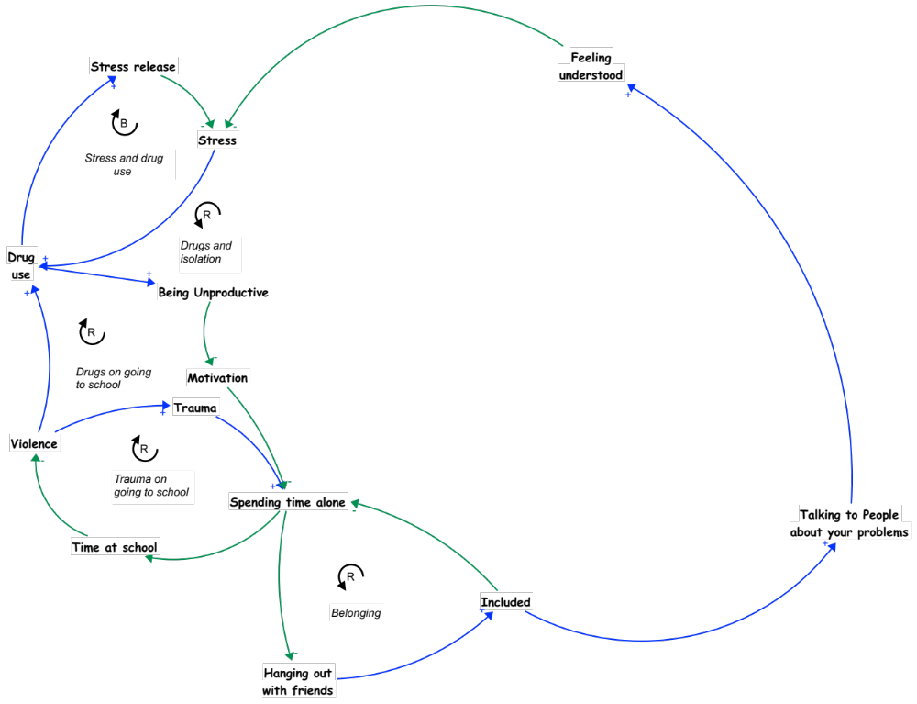
05.
Stress, Isolation, and Belonging
A sense of belonging—feeling included, having people to talk about your problems with, and feeling understood—is critical for promoting the wellbeing of young people.
When young people don’t have that sense of belonging, or places and people where they feel understood, they tend to be more stressed, less motivated, and more likely to self isolate. This can lead them to withdraw from friends and school and lean towards things like drug use to release their sense of stress.
Experiences of violence can also perpetuate self isolation, as trauma may lead them to want to spend more time alone. When young people self-isolate they lose out on spaces for connection and inclusion which can may it demotivating to engage and connect with others.

Slide 10
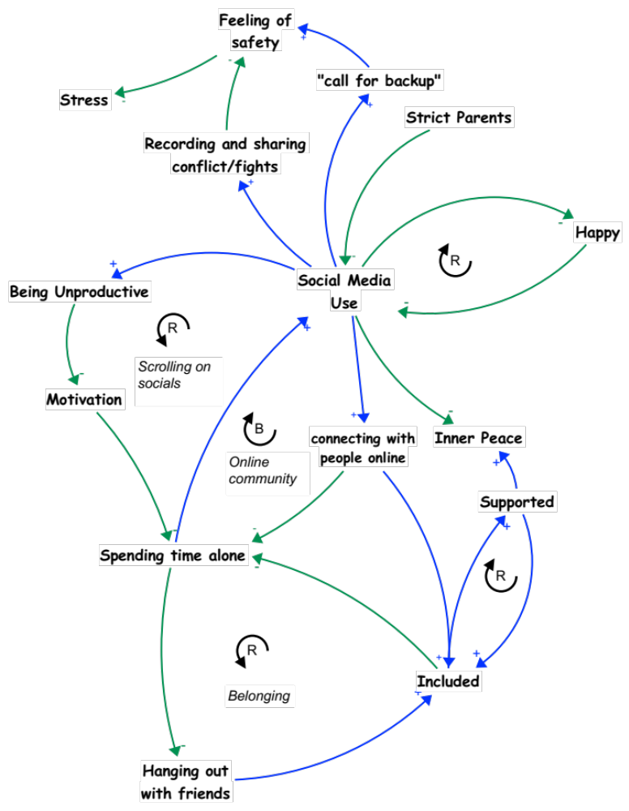
06.
Social Media and Connection
Self-isolation and spending time alone can lead to more time using social media. Young people in the small circle saw the use of social media to have varying influences on a sense of connection. In some ways social media can lead young people to be less productive and lose motivation—leading them to spend more time alone and feel less included and supported by friends.
However, social media can also give young people a space to connect with people online and build online spaces where they can feel supported and included.
Spending more time on social media, however, was also described to make young people feel less happy and lose a sense of inner peace. And the less happy they felt, the more likely they were to engage more with social media.
Finally, social media can also be a tool around experiences of violence. As young people described using snapchat to “call for backup” and also record or share conflict or fights. This impacts upon their feelings of safety and stress levels.

Slide 11
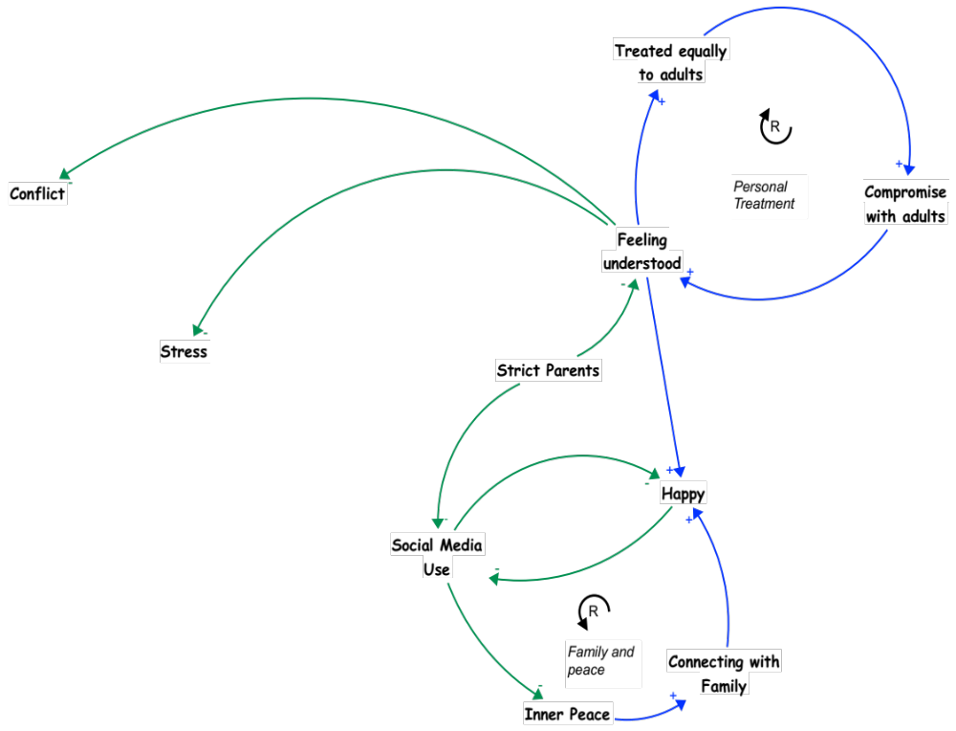
07.
Connection with Parents and Adults
Feeling understood is a central factor shaping young peoples’ wellbeing in Newham. When young people are treated equally to adults (and feel respected) then they are more likely to feel that their voice matters and can compromise and feel understood by adults. This supports their sense of happiness and reduces stress and conflict.
When young people feel understood and happy, it supports their sense of inner peace and can increase their sense of connection with their family. Feeling connected to their family is also central to supporting their mental wellbeing.
However, influences like strict parents may make young people feel less understood and may influence for them to engage less in spaces and social media platforms (which can have both supportive and unsupportive impacts on their wellbeing).

Slide 12
02
Key Insights
2

Slide 13
Key Insights from the System Map
Feeling understood is central to supporting young peoples’ wellbeing in Newham.
Experiences and fear of violence often drives young peoples’ ability and willingness to engage in activities in the local area.
    It is harder and riskier to travel to activities and spaces further away from home or the area where you are known
  It is important to know the people you will see in the spaces you are engaging
  Perceptions of young people by adults can influence young peoples’ sense of security
Supporting a sense of belonging is essential for both young peoples’ wellbeing and physical safety.

Slide 14
Violence and Crime System Maps
Big Circle Meeting
18.1.2024

Slide 15
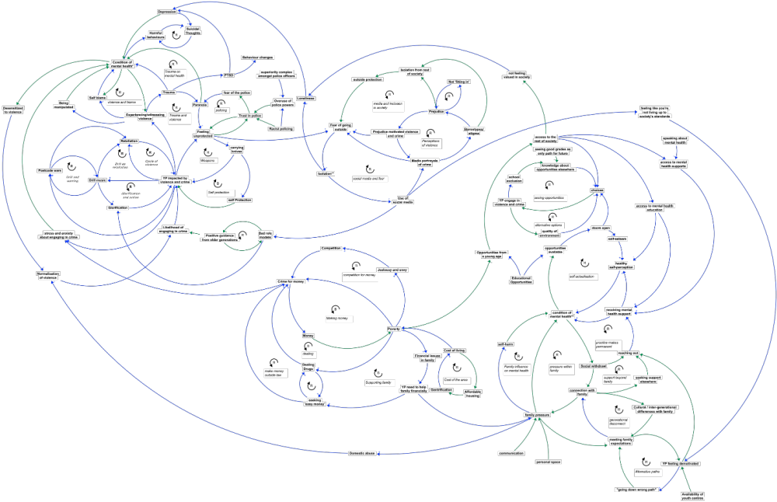

Slide 16
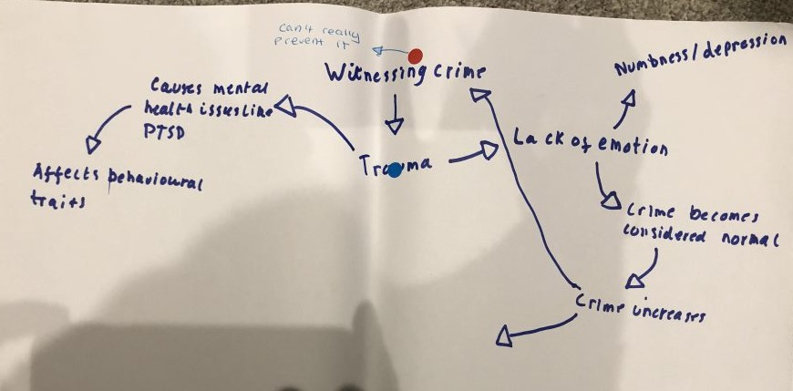
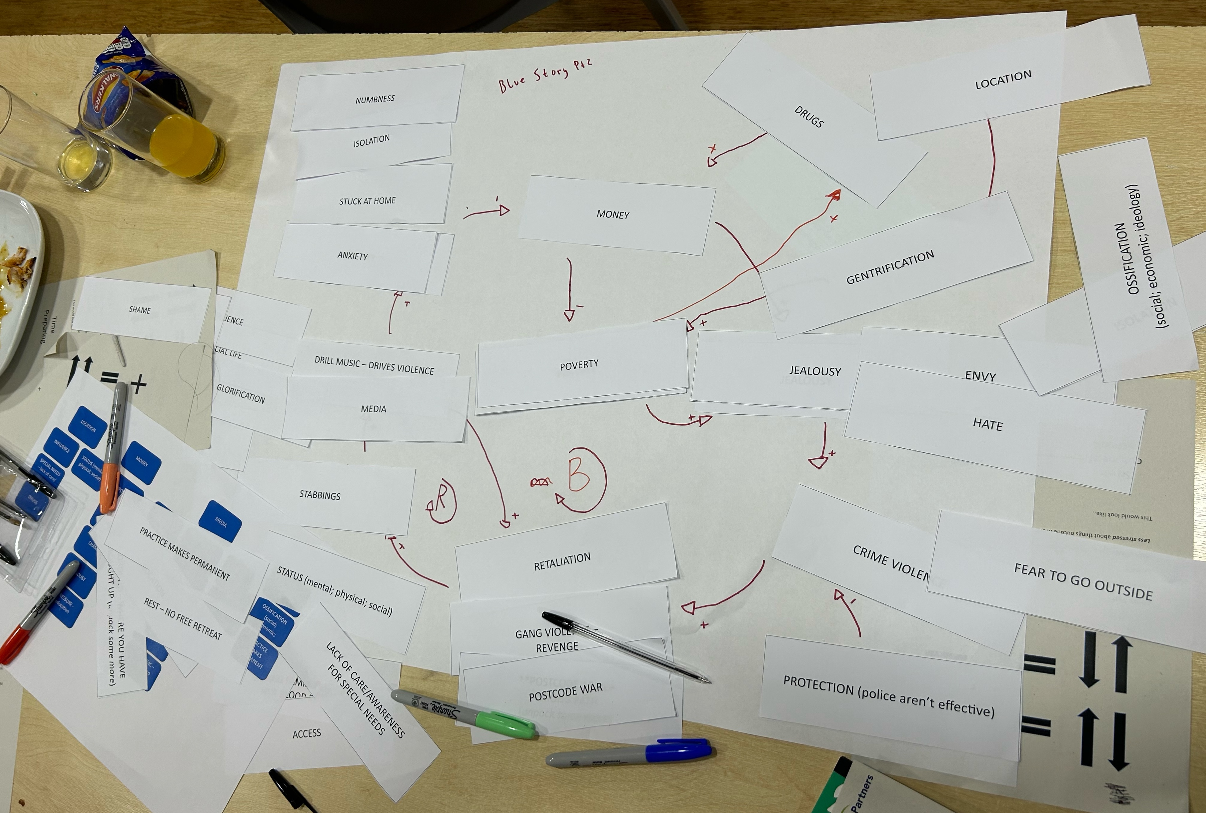
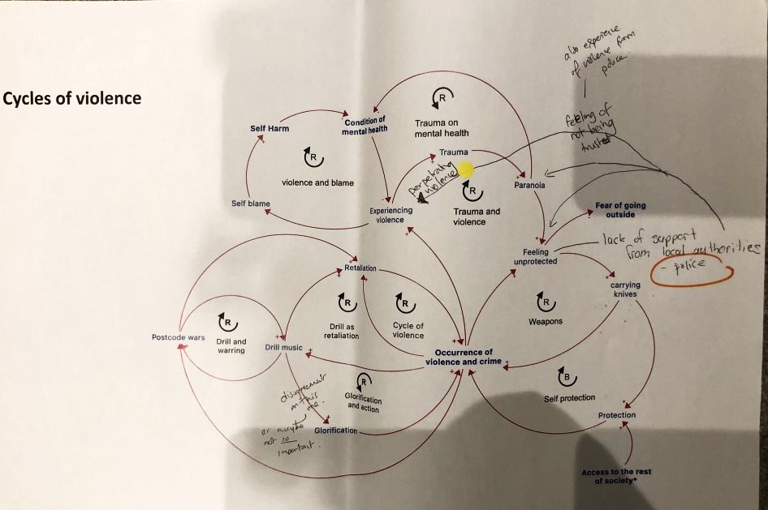
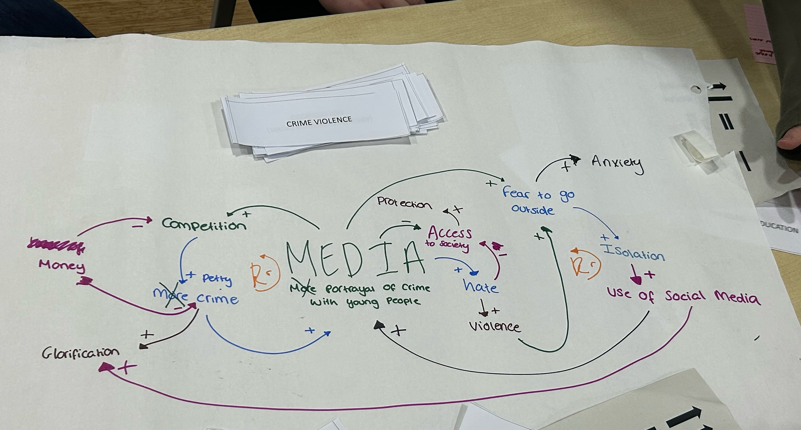
Group Model Building

Slide 17
Key Dynamics of the System Map
1

Slide 18
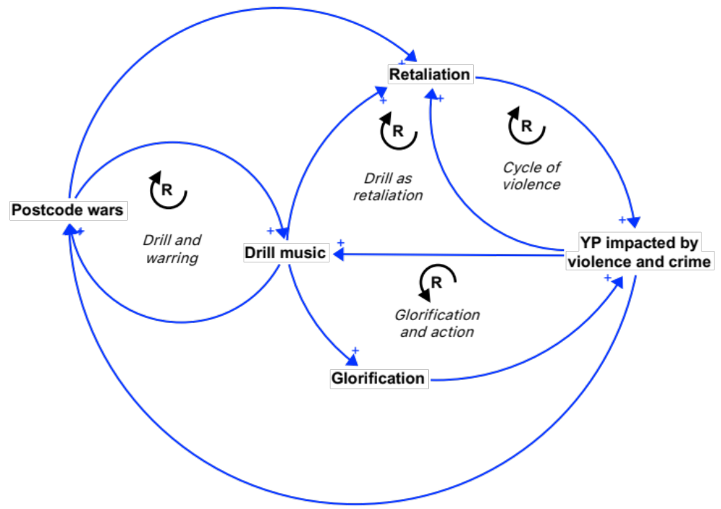
01.
Cycles of Violence
Young people in the small circles described how being impacted or involved in violence and crime can lead to retaliation and cycles of violence.
This is further implicated by drill music and the glorification of violence, which also encourages postcode wars.
Together these factors create repeating cycles of violence. However, it is not the full picture.
The wider context around some of the root drivers of violence—and their connection to young peoples' wellbeing—will be explore in the next slides.

Slide 19
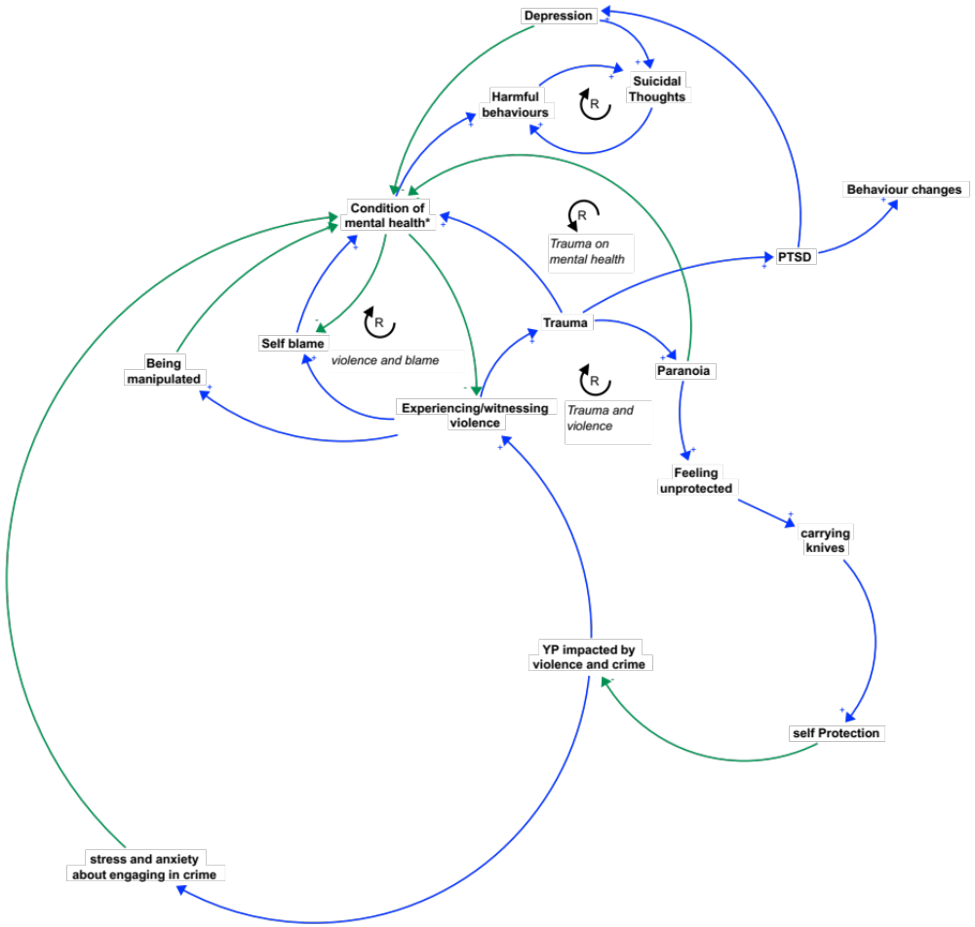
02.
Violence on Mental Health
Experiences and witnessing violence can have many negative impacts on young peoples' mental wellbeing. This includes increased self-blame, trauma, PTSD, depression, paranoia and risk of being manipulated by others. All of which contribute to a worse condition of mental health.
The relationship between these consequences of experiencing and witnessing violence also create patterns and cycles of violence, blame, and trauma. For example, if a young person experiences or witnesses violence they are at higher risk for trauma and paranoia. This may make them feel more unprotected and therefore more likely to carry a knife for protection. This could lead them to become more involved in violence and crime and thereby repeat this cycle.
Importantly, young people also shared the relationship between being involved or impacted by violence and crime and the stress associated with engaging in criminal activity. This also has a negative toll on young peoples' mental wellbeing.

Slide 20
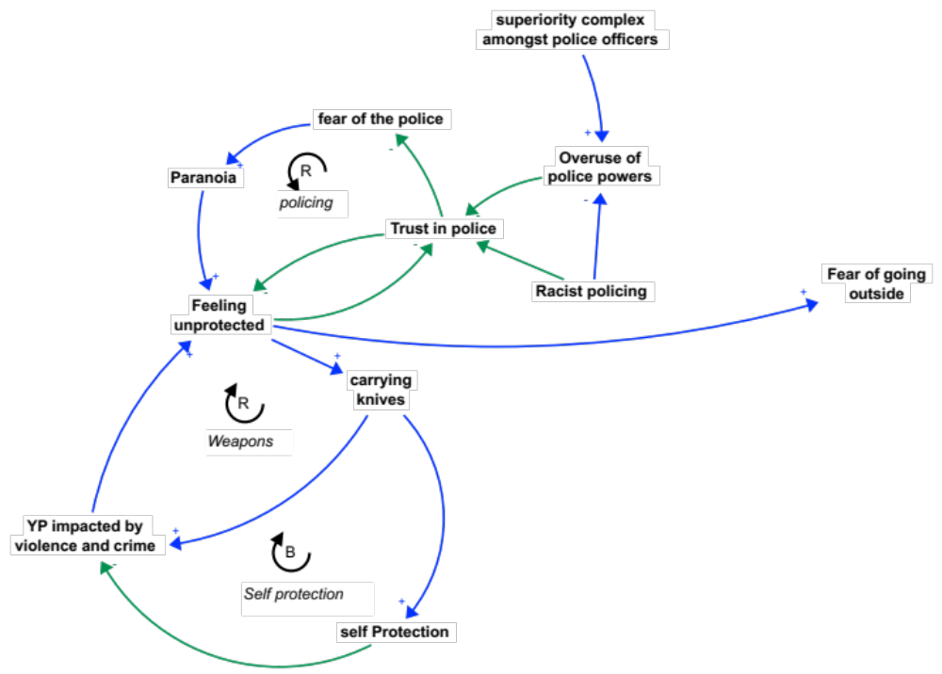
03.
Policing and Protection
Feelings of protection are also implicated by outside institutions and structures, such as policing.
Trust in police is something that young people said had a strong influence on their sense of safety and fear of violence in Newham. The less young people trust the police, the more likely they are to feel unprotected and take matters of protection into their own hands. Mistrust in the police can also lead to fear and paranoia.
Young people articulated that this sense of trust or mistrust comes from experiences of racist policing and the overuse of police powers, which relates back to power and superiority of police officers in Newham.

Slide 21
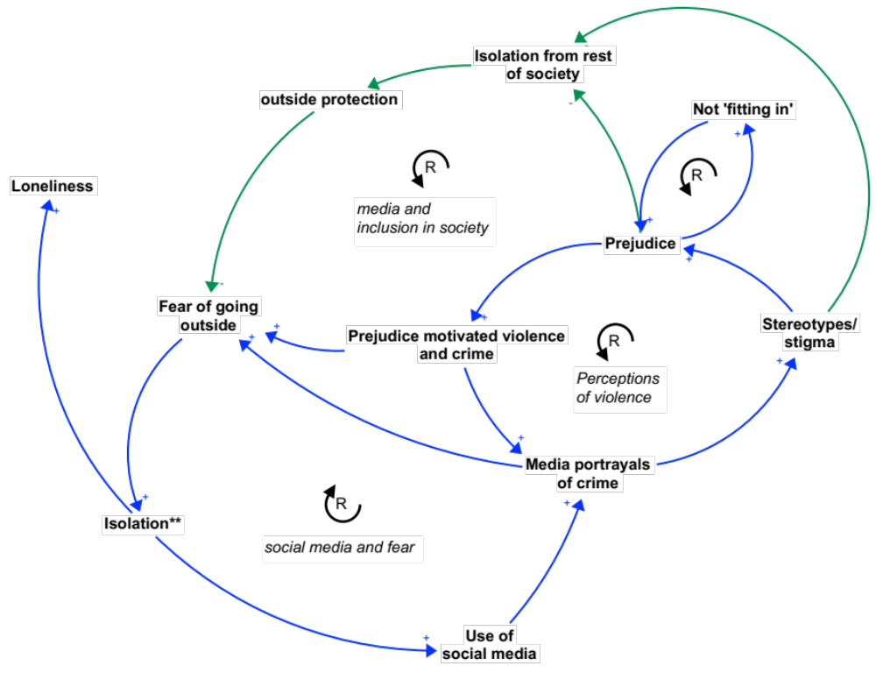
04.
Media and Perceptions of Violence
Media also has a strong role to play within the dynamics of this system modelled by young people in the small circles. The more young people fear going outside the more they tend to isolate or stay at home and experiences higher levels of loneliness. This often leads them to use more social media and witness media portrayals of crime that may add to this fear of going outside.
Young people shared how stereotypes and stigma (around this like race, age, class, etc) often shape perceptions and portrayals of violence by the media. This can have a larger impact on a community level—isolating groups of people from the "rest of society" and "outside protection". This dynamic is similar to what is known as 'spatial stigma', which perpetuates inequalities between communities.

Slide 22
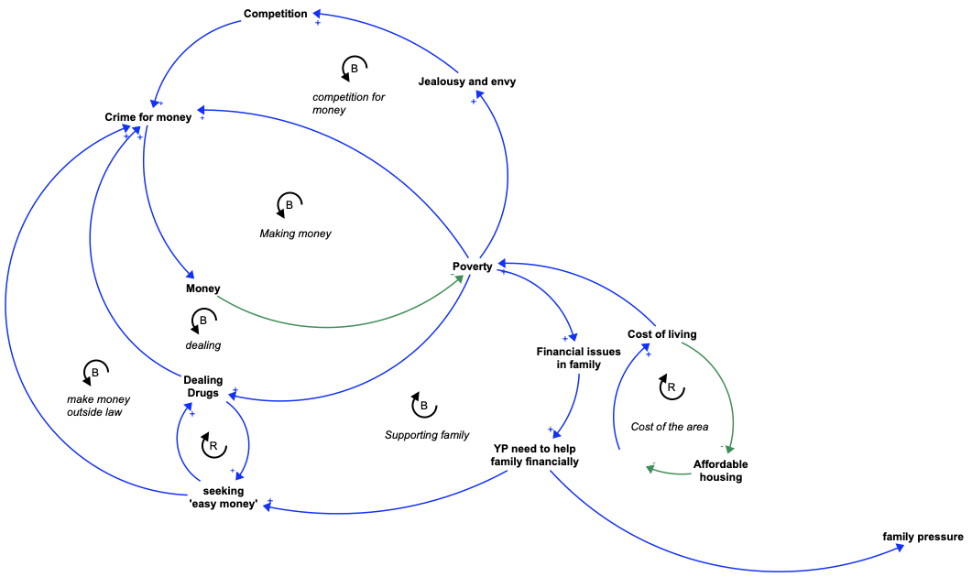
05.
Poverty and Crime
Poverty underpins many of the dynamics related to experiences and involvement in violence and crime. This dynamic is particularly prevalent for young people whose families are struggling financially.
The pressures of poverty can lead young people to seek out more 'easy money' which may involve things like dealing drugs or other non-legal ways of making money. This is done to alleviate themselves and their family from the pressure of poverty. These dynamics can be further complicated by jealousy, envy, and competition.
Young people also spoke about the high levels of gentrification in Newham and how the cost of living rising makes for less affordable housing and is putting more pressure on families in the area. This dynamic is also experienced by young people from both experiences of poverty themselves and additional pressure from their families.

Slide 23
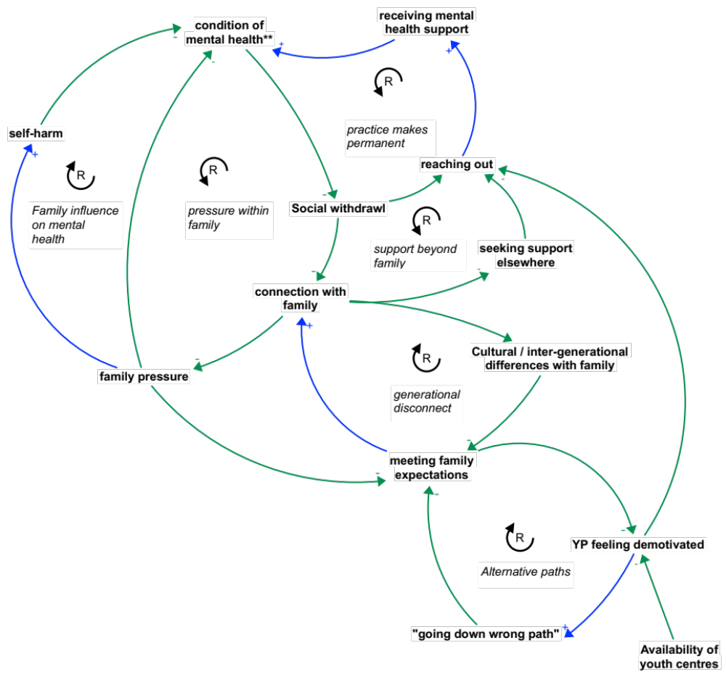
06.
Family Dynamics and Support
The relationship that young people have with their families is critical to supporting their mental wellbeing. As described previously, pressures from families because of outside dynamics like poverty can lead to young people feeling as though they are not meeting their family's expectations and can cause for poor mental health and, in some cases, self-harm.
Family pressure may also lead to young people becoming socially withdrawn and less likely to reach out for mental health support or support within their family.
Young people in the small circle also described how cultural or inter-generational differences within families can make them feel more like they are not living up to their families' expectations. This can contribute to a sense of demotivation and "going down the wrong path". One way to help mitigate this experience young people shared was the availability of youth centres and outside spaces of support.

Slide 24
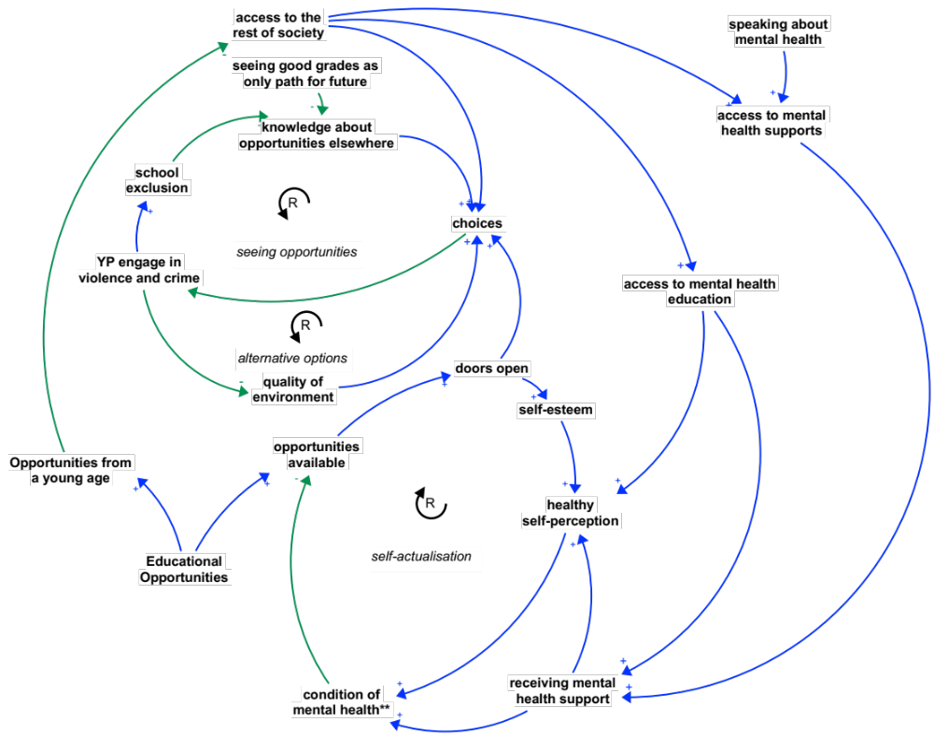
07.
Mental Health Support
Opportunities for mental health support are closely related to young peoples 'access to the rest of society'--including educational opportunities, choices and experiences from a young age, the money to be able to access resources, and psychological and physical safety.
When young people have less access to opportunities, it leads to less choices. This can lead to young people becoming more engaged in violence and crime. Engaging in violence and crime can further reduce choices and knowledge about opportunities as it can lead to young people becoming excluded from school. When these dynamics are at play, it can also reduce the quality of the environment around young people—once again leading to less choice.
When opportunities are available, however, it can lead to doors opening for young people—supporting a healthy self-perception and bettering their condition of mental health.

Slide 25
02
Key Insights
2

Slide 26
Key Insights from the System Map
Importance of choices and access to opportunities for young people to support their mental wellbeing.
Pressures from poverty and the cost of living have a big impact on the choices that young people make—including experiences of crime and violence.
Perceptions of the area and the community contribute to young peoples' experiences of safety and wellbeing. This includes perceptions from sources of outside protection, such as policing.
Role of family as a source of pressure and support for young people.

