Slide 1
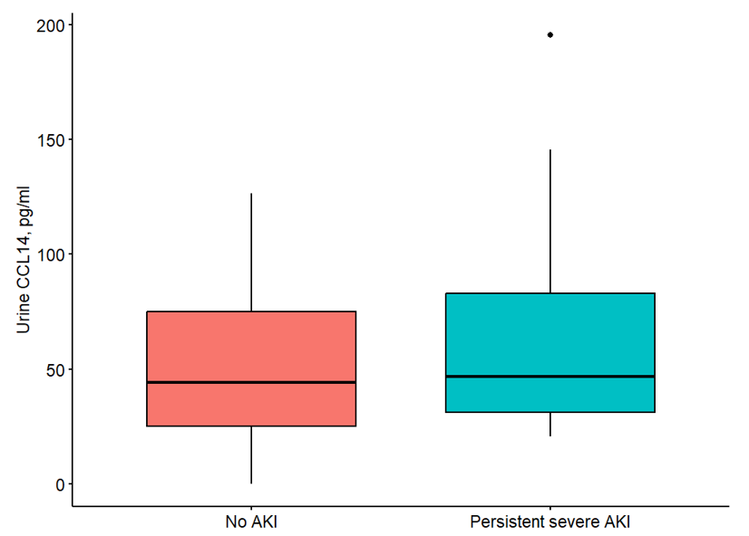
[ENTER SHORT TITLE IN THIS BOX – no more than 2 lines,
minimum font size 24pt]
AIM: Evaluate association of early postoperative urinary c-c motif chemokine ligand 14 (CCL14) and persistent severe acute kidney injury (AKI) in pediatric post-cardiac surgery patients.
DESIGN & OUTCOMES:
14 patients with persistent severe AKI
Longer CICU and hospital length of stay
257 post-bypass patients < 18 years old
No difference in CCL14 levels
27 patients without AKI
Box and whiskers plot demonstrating the distribution of urine CCL14 between persistent severe AKI and no AKI patients.
CONCLUSION: In post cardiac surgery pediatric patients, persistent severe AKI was associated with prolonged CICU and hospital length of stay but there was no difference in CCL14 levels compared to those without AKI. Future studies are needed to evaluate use of CCL14 for predicting persistent severe AKI.
Brandewie et al. 2024

