Slide 1
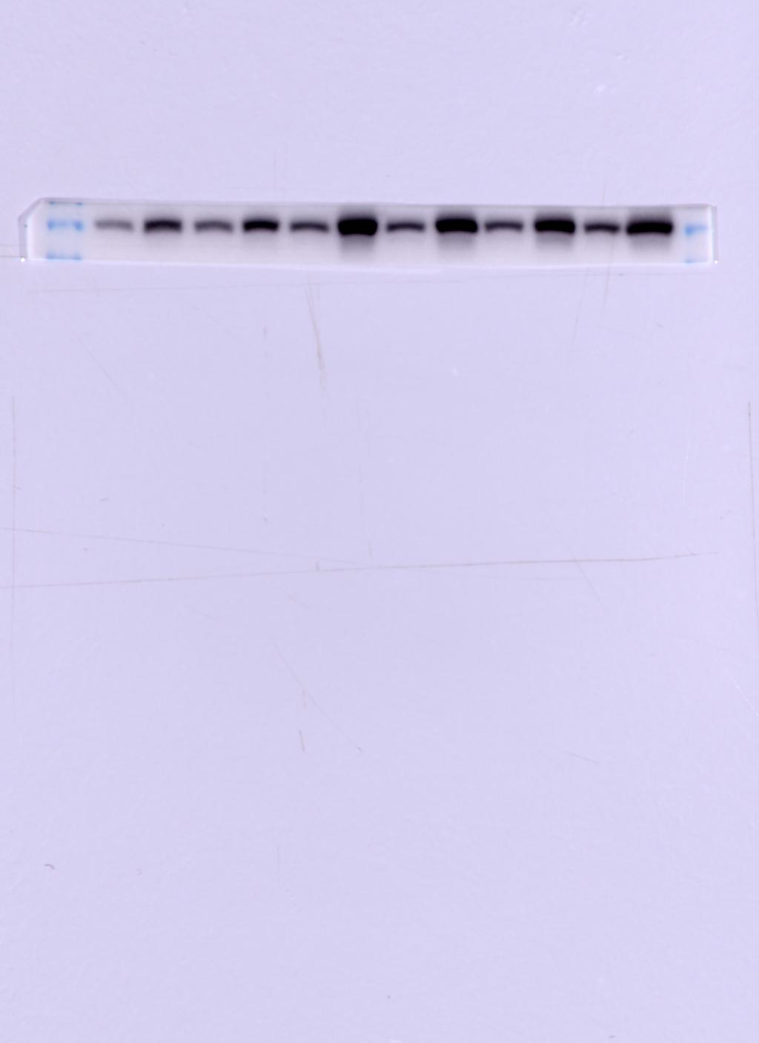
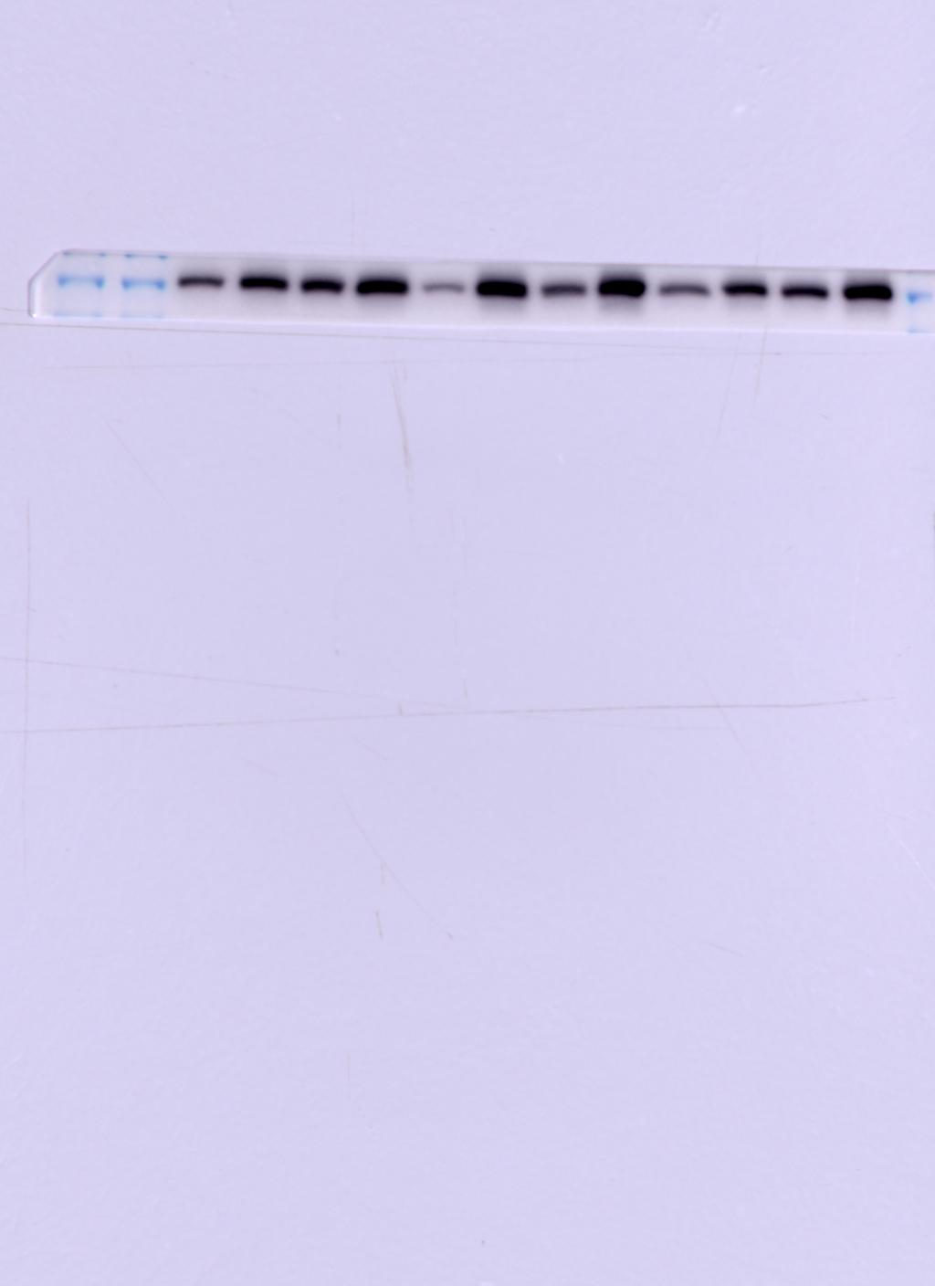
Mφ+LPS+TM
Mφ+LPS+TM
Mφ+LPS+TM
Mφ+LPS+TM
Mφ+LPS+TM
Mφ+LPS+TM
Mφ+LPS+TM
Mφ+LPS+TM
Mφ+LPS+TM
Mφ+LPS+TM
Mφ+LPS+TM
Mφ+TM
Mφ+LPS+TM
Mφ+TM
Mφ+TM
Mφ+TM
Mφ+TM
Mφ+TM
Mφ+TM
Mφ+TM
Mφ+LPS
Mφ+TM
Mφ+LPS
Mφ+LPS
Mφ+LPS
Mφ+LPS
Mφ+LPS
Mφ+LPS
Mφ+LPS
Mφ+LPS+TM
Mφ+LPS
Mφ+LPS+TM
Mφ+LPS+TM
Mφ+LPS+TM
Mφ+LPS+TM
Mφ+LPS+TM
Mφ+LPS+TM
Mφ+LPS
Mφ+LPS+TM
Mφ+LPS
Mφ+LPS
Mφ+LPS
Mφ+LPS
Mφ+LPS
Mφ+LPS
Mφ+LPS
Mφ+LPS
Mφ+LPS
Mφ+LPS
Mφ+LPS
Mφ+LPS
Mφ+LPS
Mφ+LPS
Mφ+LPS
Mφ+LPS
Mφ+LPS
Mφ+LPS
Mφ+LPS
Mφ+TM
Mφ+LPS
Mφ+TM
Mφ+TM
Mφ+TM
Mφ+TM
Mφ+TM
Mφ+TM
Mφ+TM
Mφ+TM
Mφ+TM
Mφ+TM
Mφ+TM
Mφ+TM
Mφ+TM
Mφ+TM
Mφ+TM
Mφ+LPS
Mφ+LPS
Mφ+LPS
Mφ+LPS
Mφ+LPS
Mφ+LPS
Mφ+LPS
Mφ+LPS
Mφ+LPS
Mφ+LPS
Mφ+LPS
Mφ+LPS
Mφ+LPS
Mφ+LPS
Mφ+LPS
Mφ+LPS
Mφ
Mφ
Mφ
Mφ
Mφ
Mφ
Mφ
Mφ
Mφ
Mφ
Mφ
Mφ
Mφ
Mφ
Mφ
Mφ
Mφ+TM
Mφ+TM
Mφ+TM
Mφ+TM
Mφ+TM
Mφ+TM
Mφ+TM
Mφ+TM
Mφ+TM
Mφ+TM
Mφ+TM
Mφ+TM
Mφ+TM
Mφ+TM
Mφ+TM
Mφ+TM
Mφ+TM
Mφ+TM
Mφ+TM
Mφ+TM
Mφ+TM
Mφ+LPS
Mφ+LPS
Mφ+LPS
Mφ+LPS
Mφ+LPS
Mφ
Mφ
Mφ
Mφ
Mφ
Mφ+TM
Mφ+TM
Mφ+TM
Mφ+TM
Mφ+TM
Mφ
Mφ
Mφ
Mφ
Mφ
Mφ
Mφ
Mφ
Mφ
Mφ
Mφ
Mφ
Mφ
Mφ
Mφ
Mφ
Mφ
Mφ
Mφ
Mφ
Mφ
Mφ
Mφ
Mφ
Mφ
Mφ
Mφ
Mφ
Mφ
Mφ
Mφ
Mφ
Mφ
Mφ
24h
48h
72h
24h
48h
72h
Protein expression of iNOS in macrophages.
Macrophages/LPS-activated macrophages co-cultured with TM conidia for 24h,48h and 72h.

Slide 2
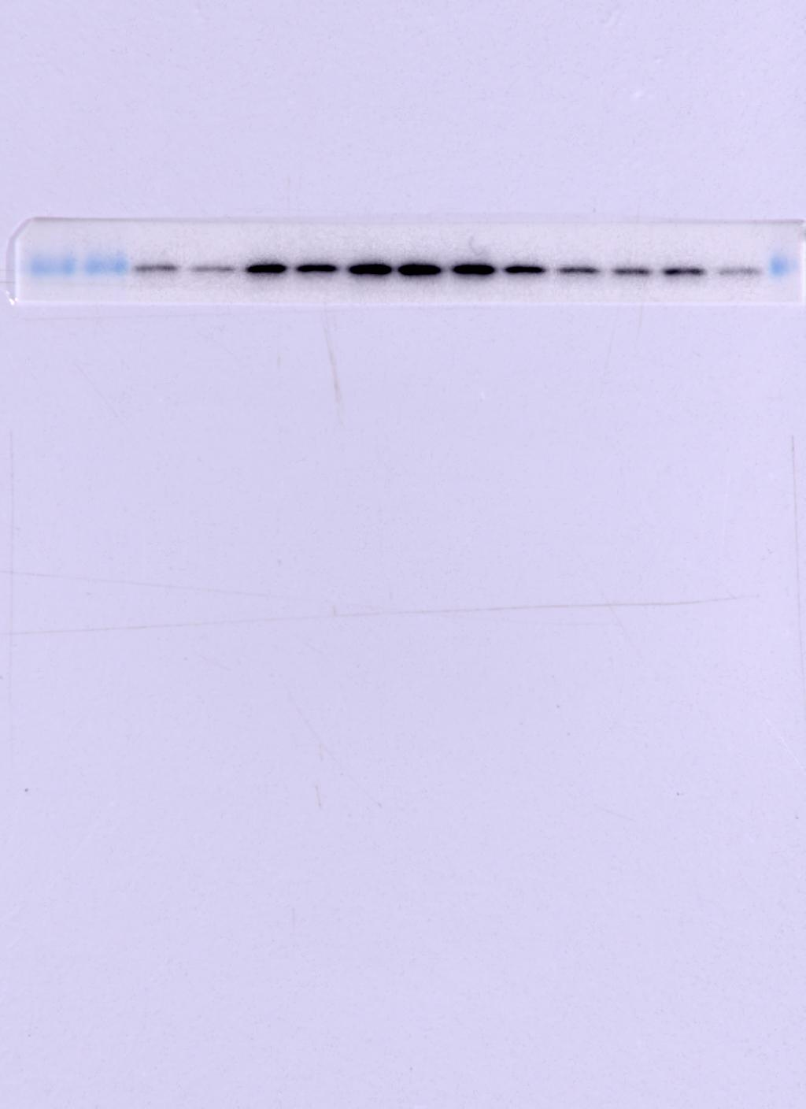
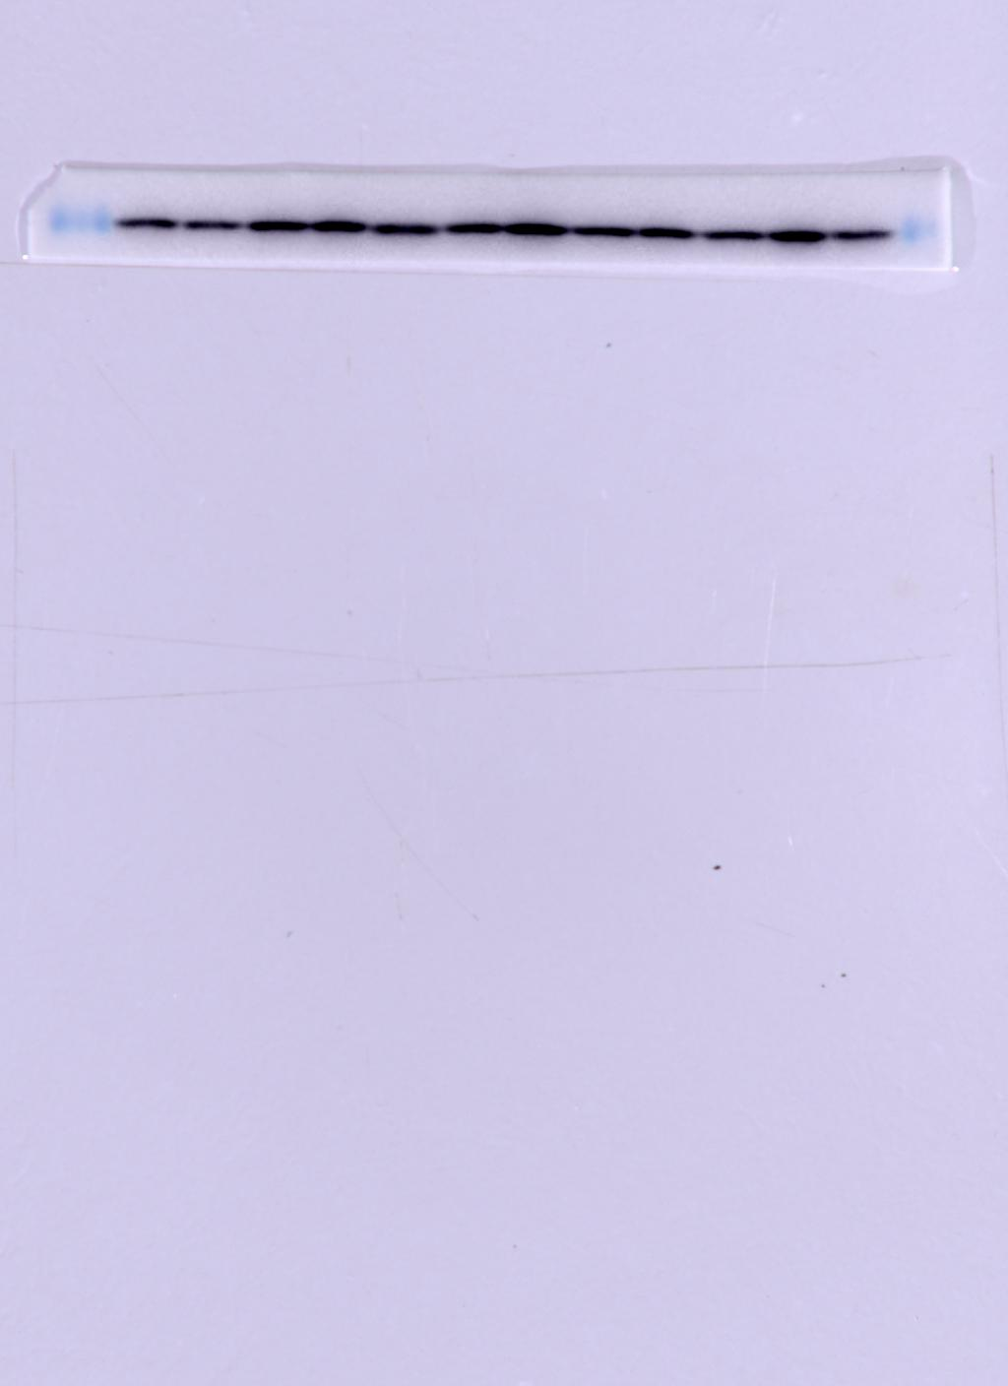
Mφ+LPS+TM
Mφ+LPS+TM
Mφ+TM
Mφ+TM
Mφ+LPS
Mφ+LPS+TM
Mφ+LPS
Mφ+LPS+TM
Mφ+LPS+TM
Mφ+LPS+TM
Mφ+LPS
Mφ+LPS
Mφ+LPS
Mφ+LPS
Mφ+TM
Mφ+LPS
Mφ+TM
Mφ+TM
Mφ+TM
Mφ+TM
Mφ+TM
Mφ+TM
Mφ+LPS
Mφ+LPS
Mφ+LPS
Mφ+LPS
Mφ+LPS
Mφ
Mφ
Mφ
Mφ
Mφ
Mφ+TM
Mφ+TM
Mφ+TM
Mφ+TM
Mφ+LPS
Mφ+TM
Mφ+LPS+TM
Mφ+LPS
Mφ+LPS+TM
Mφ
Mφ
Mφ
Mφ
Mφ
Mφ
Mφ
Mφ+LPS
Mφ
Mφ+LPS
Mφ+LPS
Mφ+LPS
Mφ+TM
Mφ+LPS
Mφ+TM
Mφ+TM
Mφ+TM
Mφ+TM
Mφ+LPS
Mφ+LPS
Mφ+LPS
Mφ+LPS
Mφ+LPS
Mφ
Mφ
Mφ
Mφ
Mφ
Mφ+TM
Mφ+TM
Mφ+TM
Mφ+TM
Mφ+TM
Mφ
Mφ
Mφ
Mφ
Mφ
Mφ
Mφ
Mφ
24h
48h
72h
24h
48h
72h
Protein expression of Arg1 in macrophages.
Macrophages/LPS-activated macrophages co-cultured with TM conidia for 24h,48h and 72h.

Slide 3
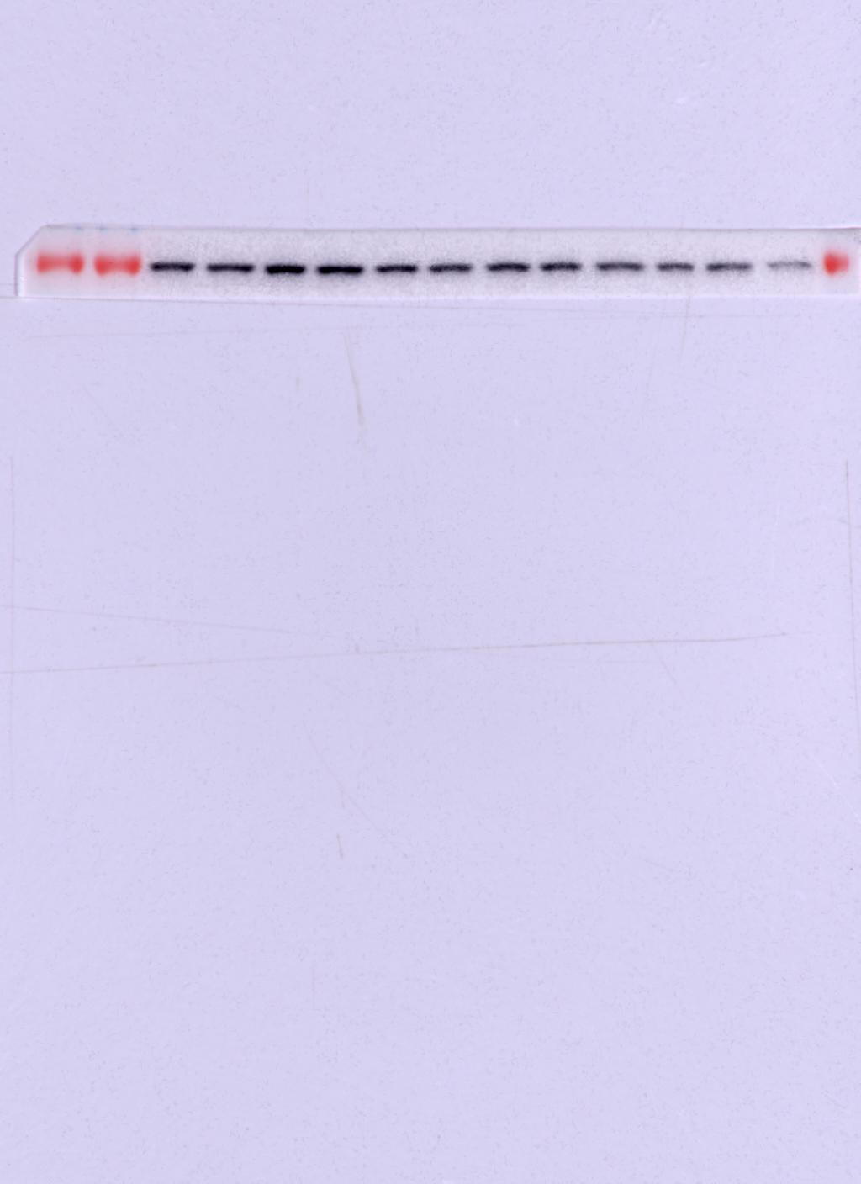
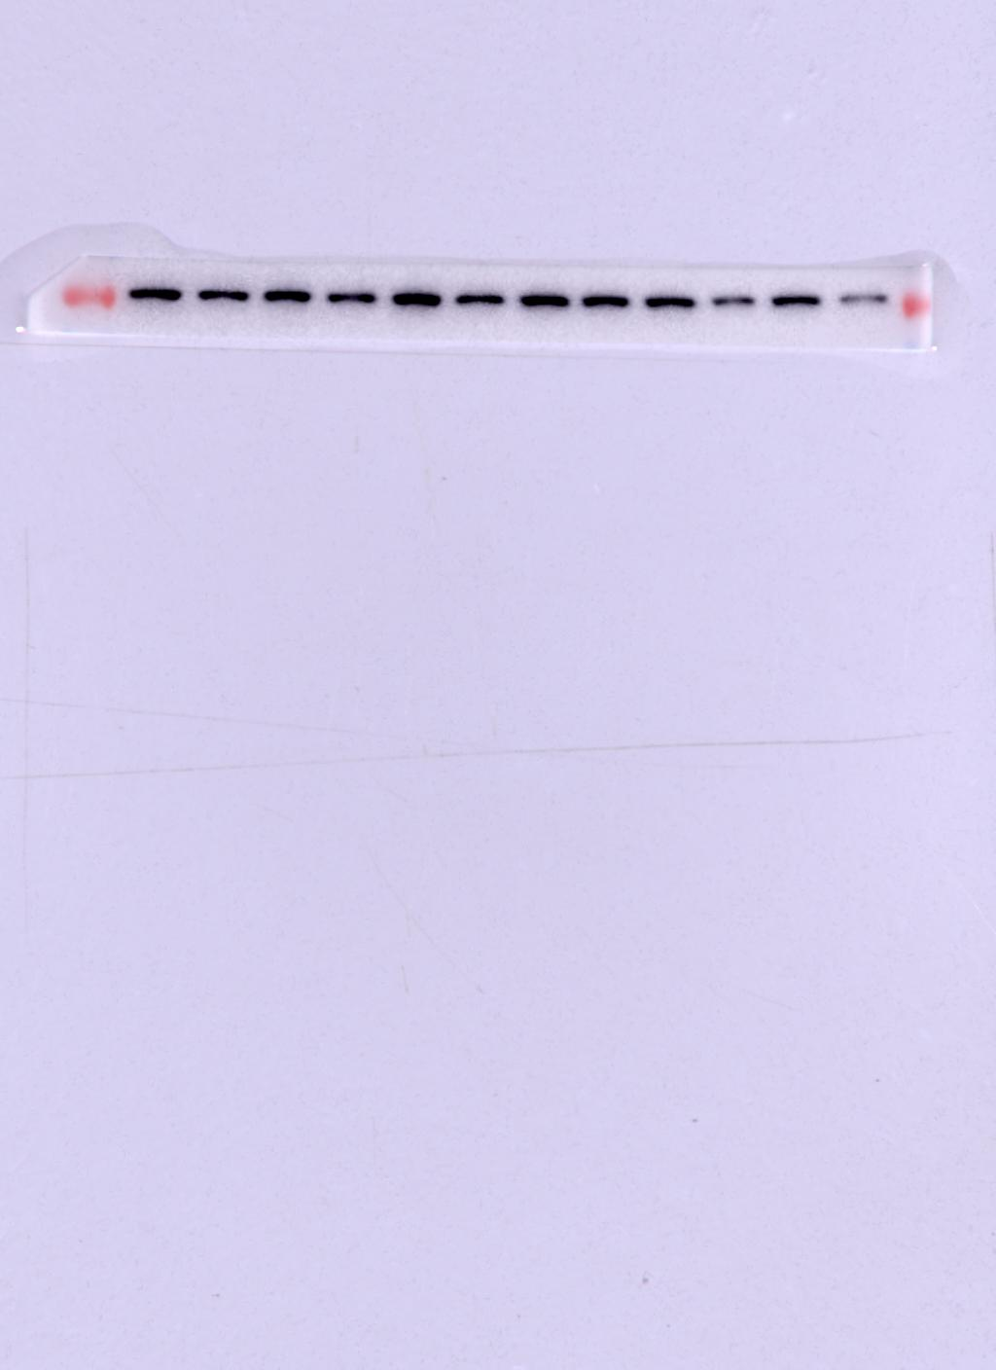
Mφ+LPS+TM
Mφ+LPS+TM
Mφ+LPS+TM
Mφ+LPS+TM
Mφ+TM
Mφ+TM
Mφ+TM
Mφ+TM
Mφ+LPS
Mφ+LPS
Mφ+LPS
Mφ+LPS
Mφ+LPS+TM
Mφ+LPS+TM
Mφ+LPS+TM
Mφ+LPS+TM
Mφ+LPS
Mφ+LPS
Mφ+LPS
Mφ+LPS
Mφ+TM
Mφ+LPS
Mφ+TM
Mφ+TM
Mφ+TM
Mφ+TM
Mφ+LPS
Mφ+LPS
Mφ+LPS
Mφ+LPS
Mφ+LPS
Mφ+LPS
Mφ+LPS
Mφ+LPS
Mφ+LPS
Mφ+LPS
Mφ
Mφ
Mφ
Mφ
Mφ
Mφ+TM
Mφ+TM
Mφ+TM
Mφ+TM
Mφ+TM
Mφ+TM
Mφ+TM
Mφ+TM
Mφ+TM
Mφ+TM
Mφ+LPS
Mφ+LPS
Mφ+LPS
Mφ+LPS
Mφ+LPS
Mφ
Mφ
Mφ
Mφ
Mφ
Mφ+TM
Mφ+TM
Mφ+TM
Mφ+TM
Mφ+TM
Mφ
Mφ
Mφ
Mφ
Mφ
Mφ
Mφ
Mφ
Mφ
Mφ
Mφ
Mφ
Mφ
Mφ
Mφ
Mφ
24h
48h
72h
24h
48h
72h
Protein expression of CD86 in macrophages.
Macrophages/LPS-activated macrophages co-cultured with TM conidia for 24h,48h and 72h.

Slide 4
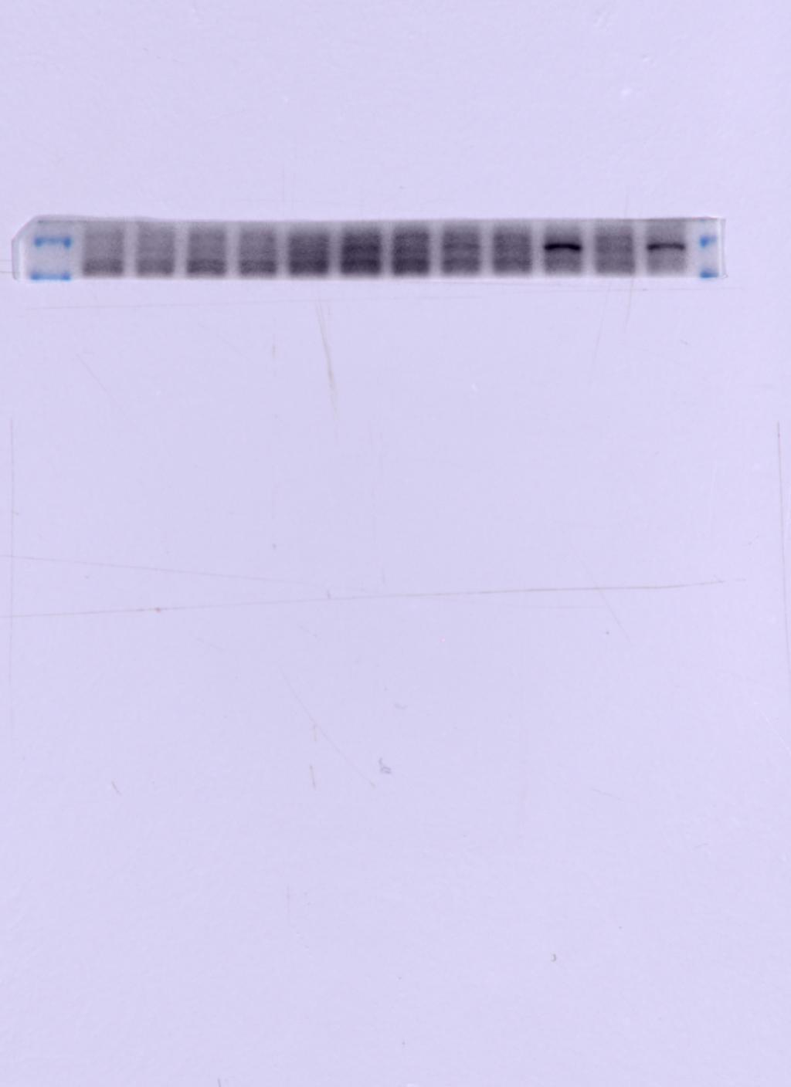
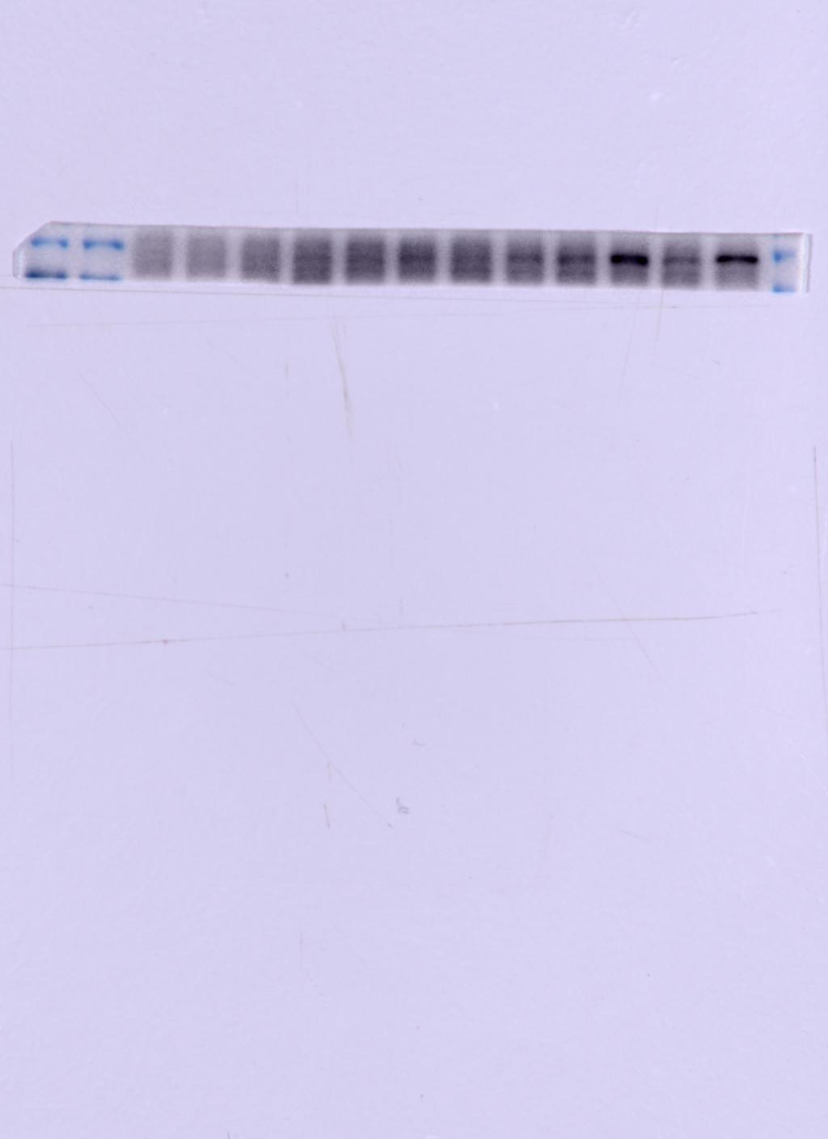
Mφ+LPS+TM
Mφ+LPS+TM
Mφ+LPS+TM
Mφ+LPS+TM
Mφ+TM
Mφ+TM
Mφ+TM
Mφ+TM
Mφ+LPS
Mφ+LPS
Mφ+LPS
Mφ+LPS
Mφ+LPS+TM
Mφ+LPS+TM
Mφ+LPS+TM
Mφ+LPS+TM
Mφ+LPS
Mφ+LPS
Mφ+LPS
Mφ+LPS
Mφ+LPS
Mφ+LPS
Mφ+LPS
Mφ+LPS
Mφ+LPS
Mφ+LPS
Mφ+TM
Mφ+TM
Mφ+TM
Mφ+TM
Mφ+TM
Mφ+LPS
Mφ+LPS
Mφ+LPS
Mφ+LPS
Mφ+TM
Mφ+LPS
Mφ+TM
Mφ+TM
Mφ+TM
Mφ+TM
Mφ
Mφ
Mφ
Mφ
Mφ
Mφ+TM
Mφ+TM
Mφ+TM
Mφ+TM
Mφ+LPS
Mφ+TM
Mφ+LPS
Mφ+LPS
Mφ+LPS
Mφ+LPS
Mφ
Mφ
Mφ
Mφ
Mφ
Mφ+TM
Mφ+TM
Mφ+TM
Mφ+TM
Mφ+TM
Mφ
Mφ
Mφ
Mφ
Mφ
Mφ
Mφ
Mφ
Mφ
Mφ
Mφ
Mφ
Mφ
Mφ
Mφ
Mφ
24h
48h
72h
24h
48h
72h
Protein expression of IL-4R in macrophages.
Macrophages/LPS-activated macrophages co-cultured with TM conidia for 24h,48h and 72h.

Slide 5
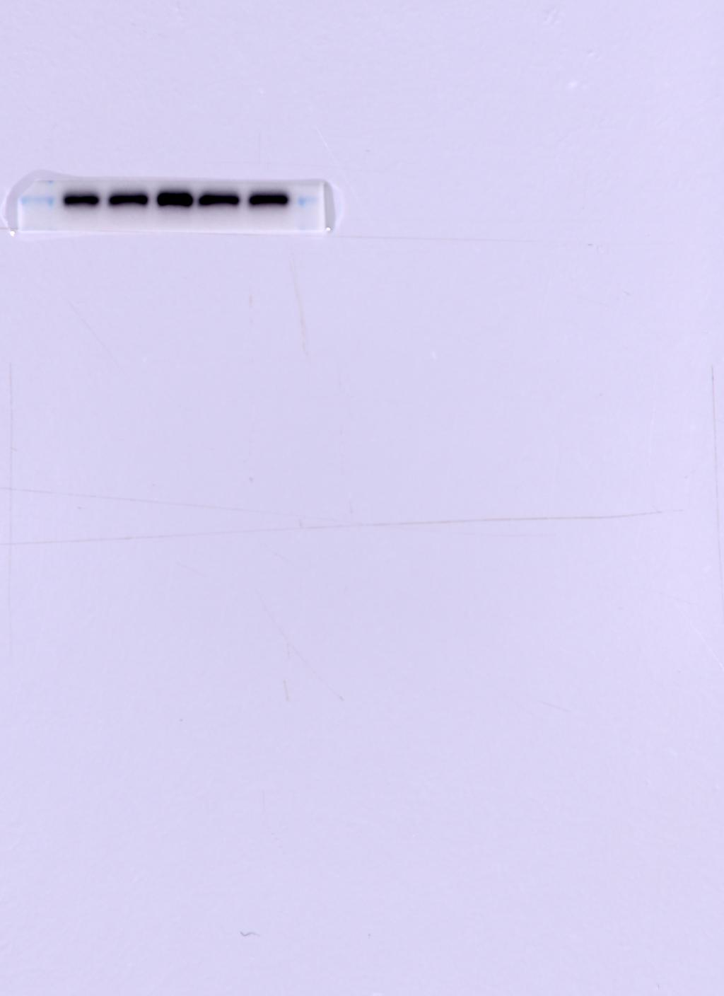
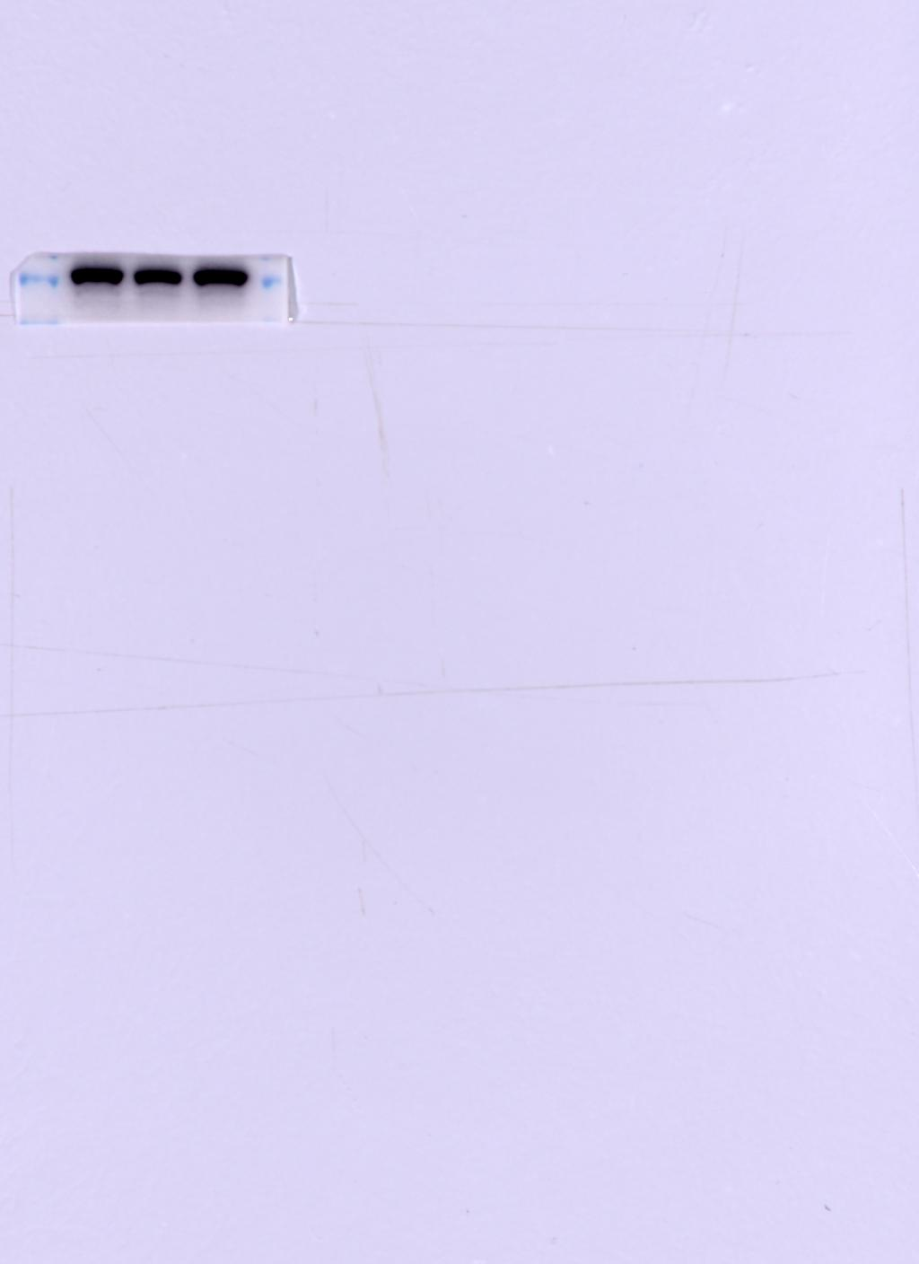
nor-Neg
nor-Posi
Ctrl
nor-Neg
nor-Posi
Ctrl
Protein expression of iNOS in macrophages. LPS-activated macrophages pretreated with /without 20μM nor-NOHA before being co-cultured with TM conidia for 24h (MOI=10)
Nor-Neg: LPS-activated macrophages pretreated without 20μM nor-NOHA for 2h
Nor-Posi: LPS-activated macrophages pretreated with20μM nor-NOHA for 2h

Slide 6
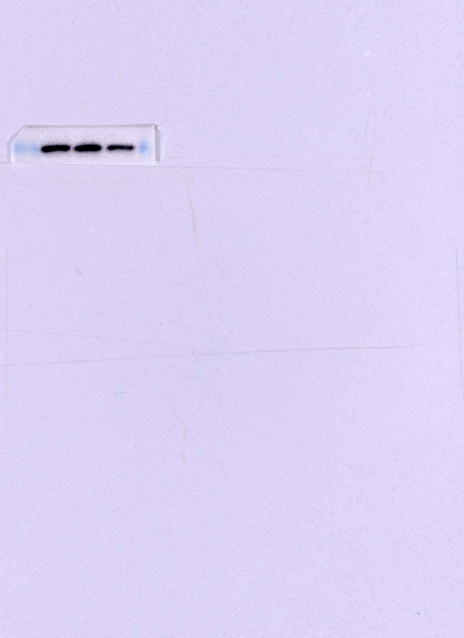
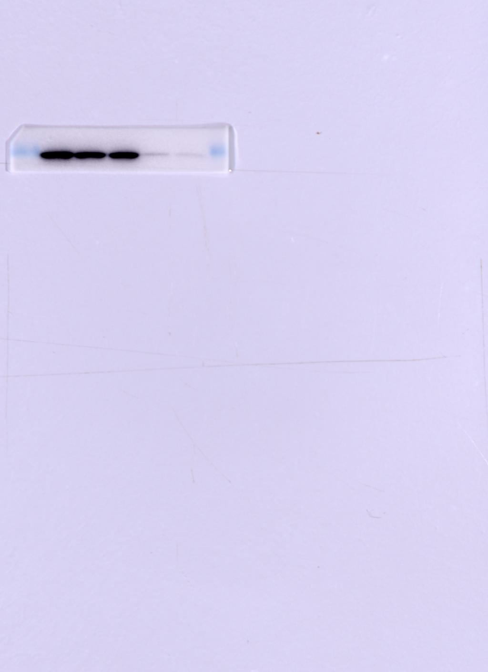
nor-Posi
nor-Neg
nor-Posi
nor-Neg
Ctrl
Ctrl
Protein expression of Arg1 in macrophages. LPS-activated macrophages pretreated with /without 20μM nor-NOHA before being co-cultured with TM conidia for 24h (MOI=10)
Nor-Neg: LPS-activated macrophages pretreated without 20μM nor-NOHA for 2h
Nor-Posi: LPS-activated macrophages pretreated with20μM nor-NOHA for 2h

