Slide 1
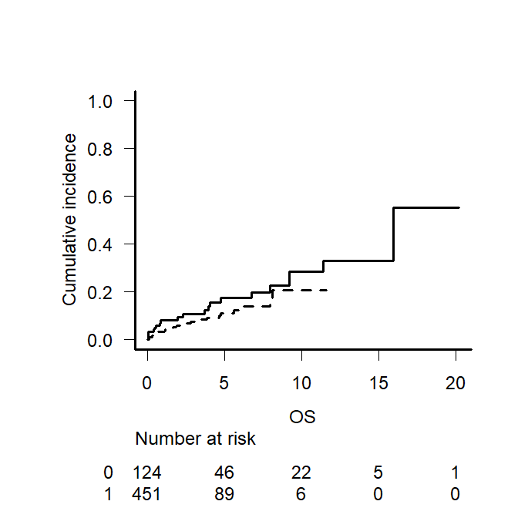
sFig.1A
p = 0.160
Cumulative incidence of non-relapse mortality
(probability)
Year 2000-2010
Year 2011-2022
Time after ASCT (years)
Year 2000-2010
Year 2011-2021

Slide 2
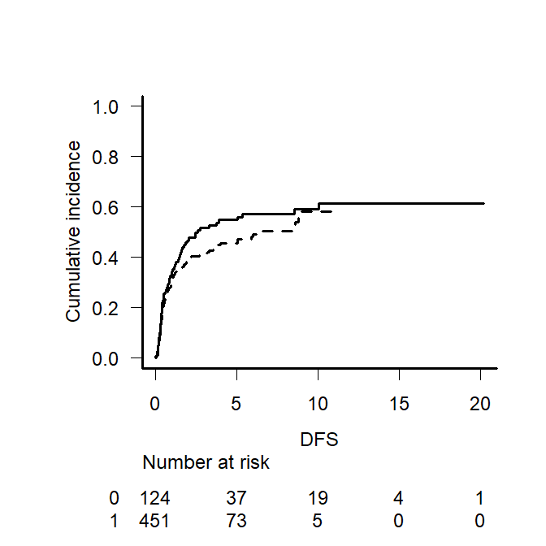
sFig.1B
p = 0.202
Year 2000-2010
Cumulative incidence of relapse/progression
(probability)
Year 2011-2022
Time after ASCT (years)
Year 2000-2010
Year 2011-2021

Slide 3
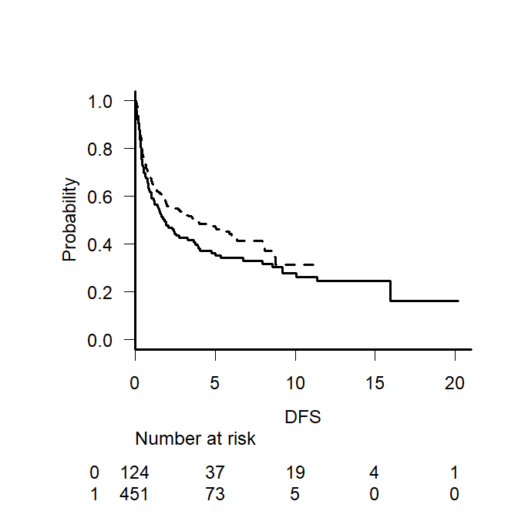
sFig.1C
p = 0.083
Year 2011-2022
Progression-free Survival
(probability)
Year 2000-2010
Time after ASCT (years)
Year 2000-2010
Year 2011-2022

