Slide 1
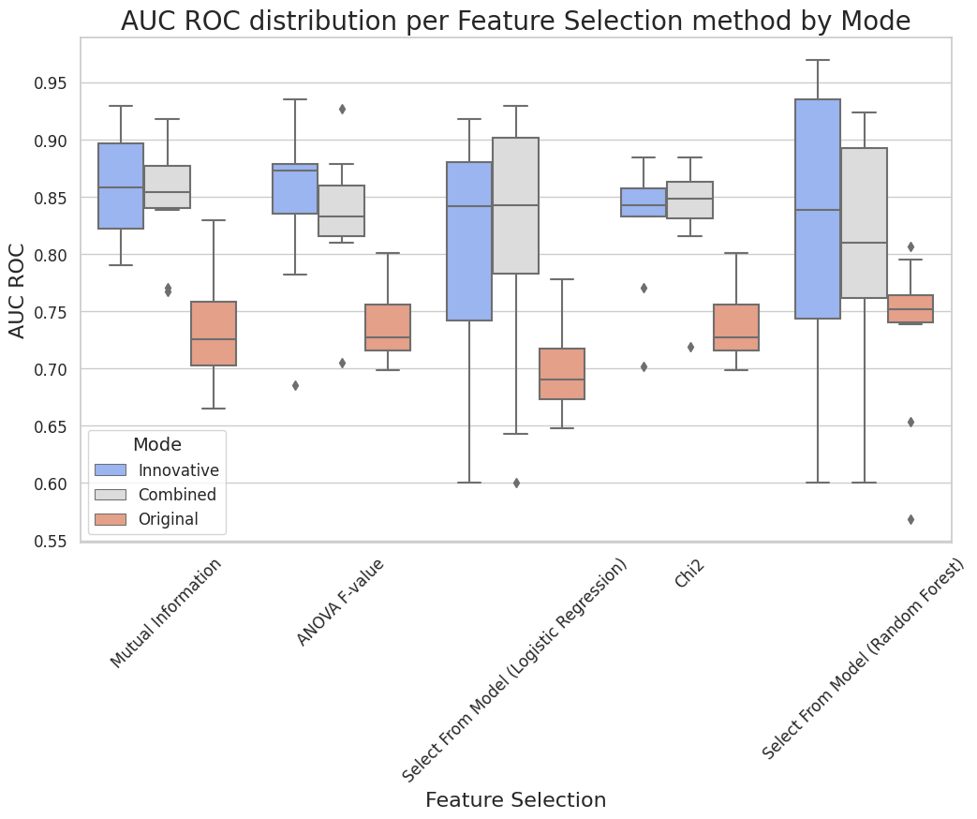
Notes:
Supplementary Figure 1. Area under the ROC curve distribution per feature selection method by mode.

Slide 2
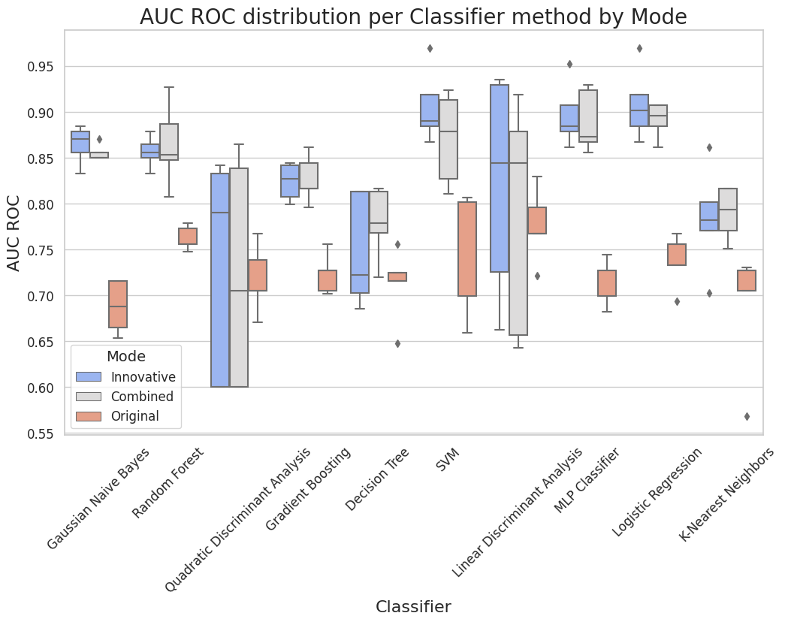
Notes:
Supplementary Figure 2. Area under the ROC curve distribution per machine learning based classifier by mode.

