Slide 1
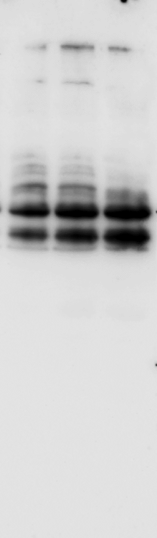
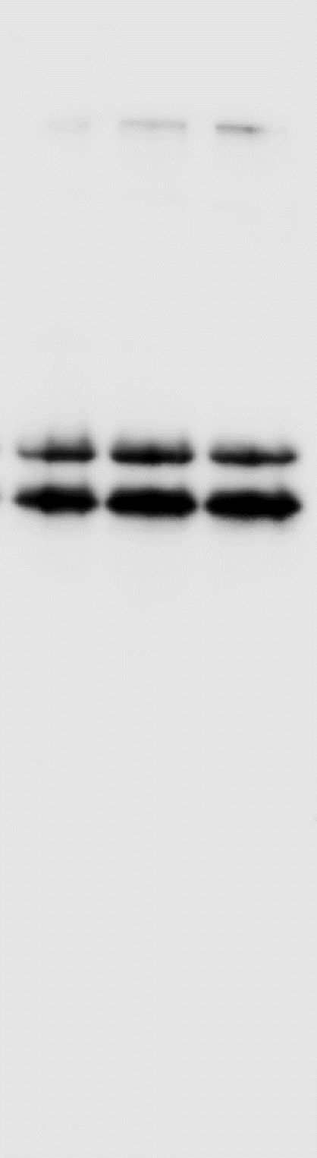
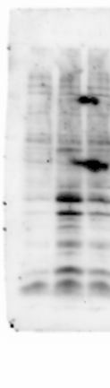
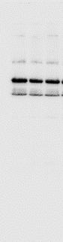
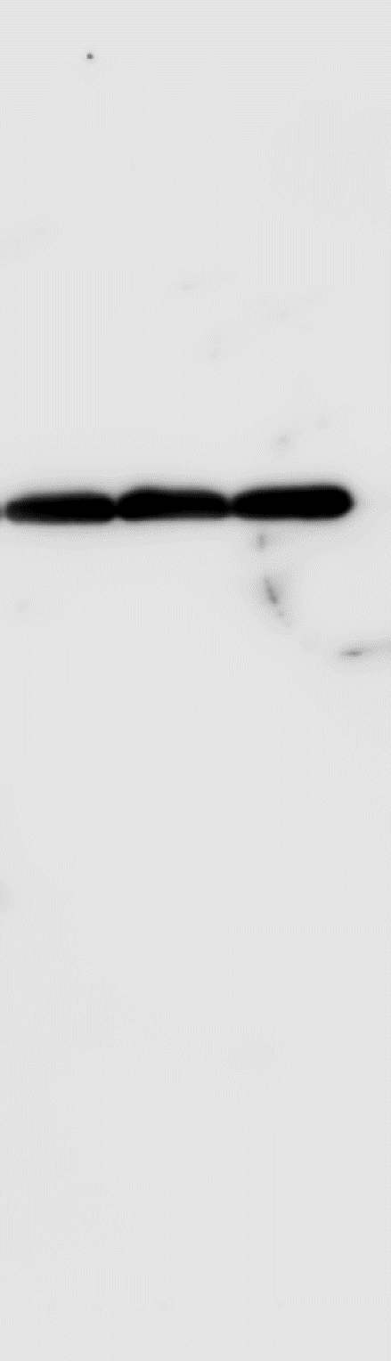
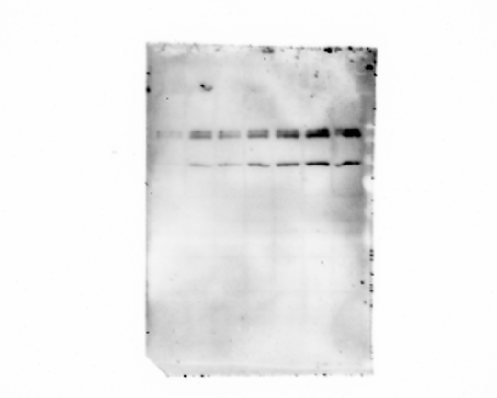
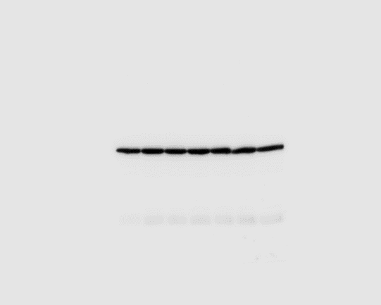
2*10⁹ sEVs
2*10⁹ sEVs
10⁹ sEVs
10⁹ sEVs
Control
Control
- phospho-GSK3α
55 -
- GSK3α
- phospho-GSK3β
40 -
- GSK3β
2*10⁹ sEVs
2*10⁹ sEVs
2*10⁹ sEVs
10⁹ sEVs
10⁹ sEVs
10⁹ sEVs
Control
Control
Control
- phospho-p54
JNK
- JNK
- TUB
Figure 6D. WB analysis of the increased expression of GSK3 inactive and JNK active form
100 -
- Non-phospho (Active)
β-catenin
50 -
- TUB
Figure 6F 𝛽-catenin active form in C2C12 myotubes treated with increasing NSC-34 sEVs

