Slide 1
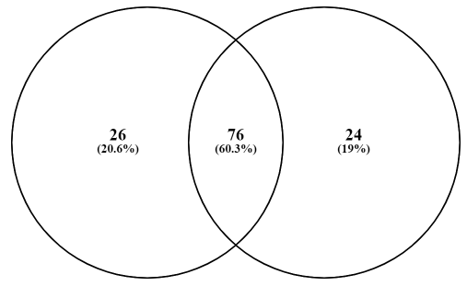
Figure S2 – Venn diagram of the miRNAs identified in NSC-34-derived sEVs at Diff-T2 and Diff-T5. The miRNAs detected in at least two independent reads were considered for the analysis; significantly down- and up-regulated miRNAs were reported in red and green, respectively.
Diff-T2 sEVs
Diff-T5 sEVs
mmu-miR-1224-5p
mmu-miR-128-1-5p
mmu-miR-129-2-3p
mmu-miR-1895
mmu-miR-1933-3p
mmu-miR-218-2-3p
mmu-miR-21a-3p
mmu-miR-300-3p
mmu-miR-3071-3p
mmu-miR-322-3p
mmu-miR-486a-5p
mmu-miR-504-3p
mmu-miR-574-3p
mmu-miR-652-5p
mmu-miR-669b-3p
mmu-miR-669c-3p
mmu-miR-669p-3p
mmu-miR-6715-3p
mmu-miR-674-3p
mmu-miR-690
mmu-miR-6944-5p
mmu-miR-7070-5p
mmu-miR-7653-5p
mmu-miR-7654-3p
mmu-miR-8094
mmu-miR-92b-5p
mmu-miR-10b-5p
mmu-miR-1199-5p
mmu-miR-124-3p
mmu-miR-126b-3p
mmu-miR-129b-3p
mmu-miR-130a-3p
mmu-miR-130b-3p
mmu-miR-138-1-3p
mmu-miR-140-3p
mmu-miR-149-3p
mmu-miR-16-5p
mmu-miR-181c-3p
mmu-miR-182-5p
mmu-miR-185-5p
mmu-miR-191-5p
mmu-miR-194-5p
mmu-miR-1947-5p
mmu-miR-195a-5p
mmu-miR-196a-2-3p
mmu-miR-203-3p
mmu-miR-210-3p
mmu-miR-212-3p
mmu-miR-2137
mmu-miR-214-3p
mmu-miR-24-3p
mmu-miR-25-5p
mmu-miR-296-5p
mmu-miR-298-5p
mmu-miR-3065-5p
mmu-miR-3076-5p
mmu-miR-3099-3p
mmu-miR-31-5p
mmu-miR-320-3p
mmu-miR-330-3p
mmu-miR-335-5p
mmu-miR-339-3p
mmu-miR-342-3p
mmu-miR-344-3p
mmu-miR-344b-3p
mmu-miR-34c-3p
mmu-miR-350-3p
mmu-miR-351-5p
mmu-miR-3620-3p
mmu-miR-381-3p
mmu-miR-3960
mmu-miR-421-3p
mmu-miR-423-3p
mmu-miR-423-5p
mmu-miR-425-5p
mmu-miR-466g
mmu-miR-466m-3p
mmu-miR-467d-5p
mmu-miR-497a-5p
mmu-miR-501-3p
mmu-miR-5114
mmu-miR-5126
mmu-miR-6236
mmu-miR-6240
mmu-miR-652-3p
mmu-miR-6538
mmu-miR-6540-5p
mmu-miR-669a-3p
mmu-miR-671-5p
mmu-miR-677-3p
mmu-miR-6929-5p
mmu-miR-6968-5p
mmu-miR-6977-5p
mmu-miR-7036a-5p
mmu-miR-706
mmu-miR-709
mmu-miR-712-5p
mmu-miR-714
mmu-miR-7224-3p
mmu-miR-877-5p
mmu-miR-9-3p
mmu-miR-99b-5p
mmu-miR-139-3p
mmu-miR-17-3p
mmu-miR-196b-3p
mmu-miR-218-1-3p
mmu-miR-2861
mmu-miR-409-3p
mmu-miR-467b-3p
mmu-miR-5113
mmu-miR-5128
mmu-miR-5131
mmu-miR-598-5p
mmu-miR-664-5p
mmu-miR-668-3p
mmu-miR-6936-3p
mmu-miR-6981-5p
mmu-miR-700-3p
mmu-miR-702-3p
mmu-miR-7032-5p
mmu-miR-7040-5p
mmu-miR-7118-5p
mmu-miR-7672-5p
mmu-miR-7687-5p
mmu-miR-8109
mmu-miR-8112

