Slide 1
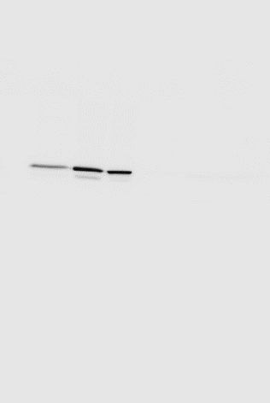
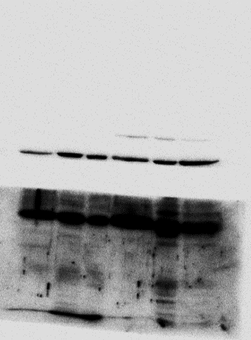
Diff-T4 lEVs
Diff-T6 lEVs
Diff-T2 sEVs
Diff-T2l EVs
Diff-T6 sEVs
Diff-T4 sEVs
100
A
70
CALNEXIN
Diff-T4 lEVs
Diff-T6 lEVs
Diff-T2 sEVs
Diff-T2 lEVs
Diff-T6 sEVs
Diff-T4 sEVs
100
70
HSP70
A
50
Cut
45
TSG101
B
35
25
15
Diff-T4 lEVs
Diff-T6 lEVs
Diff-T2 sEVs
Diff-T2l EVs
Diff-T6 sEVs
Diff-T4 sEVs
100
A
70
ALIX
Cut
B
Tsg101
Figure 1G The WBs were cut at about 50 kDa and the two parts (A and B) developed simultaneously with two different antibodies

