Slide 1
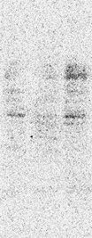
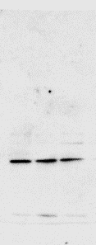
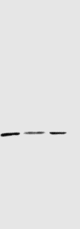
Diff-T2
Diff-T2
Diff-T5
Diff-T0
Diff-T5
Diff-T0
180
- Agrin
130
35 -
- Wnt3a
25 -
Diff-T2
Diff-T0
Diff-T5
Diff-T2
Diff-T0
Diff-T5
55
- Actin
40
- Wnt11
40
35
Figure 4B. WB of the NSC-34 cell bodies during differentiation

Slide 2
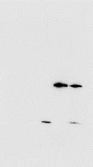
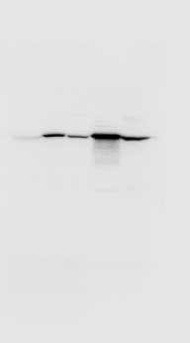
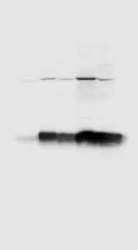
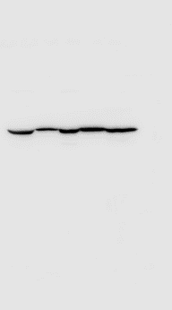
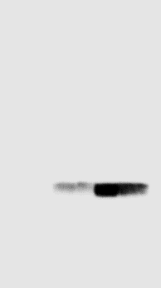
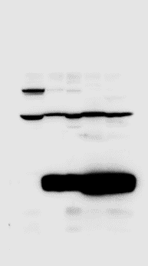
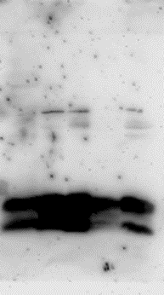
lEVs
sEVs
lEVs
sEVs
lEVs
sEVs
CB-Diff-T0
CB-Diff-T0
CB-Diff-T0
Diff-T5
Diff-T5
Diff-T5
Diff-T5
Diff-T5
Diff-T2
Diff-T5
Diff-T2
Diff-T2
Diff-T2
Diff-T2
Diff-T2
55
- Tsg101
35
- Wnt3A
40
25
- CD9
25
15
lEVs
sEVs
lEVs
sEVs
lEVs
sEVs
CB-Diff-T0
CB-Diff-T0
Diff-T5
Diff-T5
Diff-T5
Diff-T5
Diff-T2
Diff-T2
Diff-T2
Diff-T2
CB-Diff-T0
Diff-T5
Diff-T5
Diff-T2
Diff-T2
100
- Calnexin
40
- Wnt11
70
35
25
- CD81
15
lEVs
sEVs
CB-Diff-T0
Diff-T5
Diff-T5
Diff-T2
Diff-T2
55
- Wnt4
40
Figure 4C. WB of lEVs and sEVs isolated during NSC-34 differentiation

