Slide 1
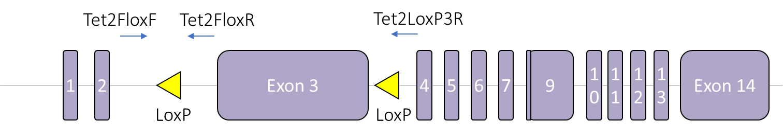
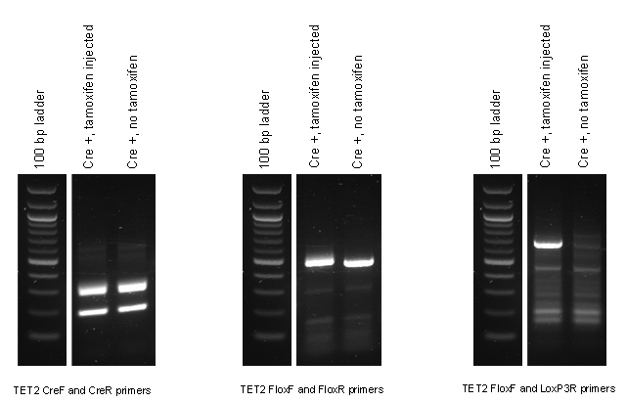
Supplementary Figure 1
A
Primer name | Primer sequence
Tet2FloxF | AAGAATTGCTACAGGCCTGC
Tet2FloxR | TTCTTTAGCCCTTGCTGAGC
Tet2LoxP3R | TAGAGGGAGGGGGCATAAGT
B
C
TET2FloxF and TET2FloxR primers
TET2FloxF and TET2LoxP3R primers

