Slide 1
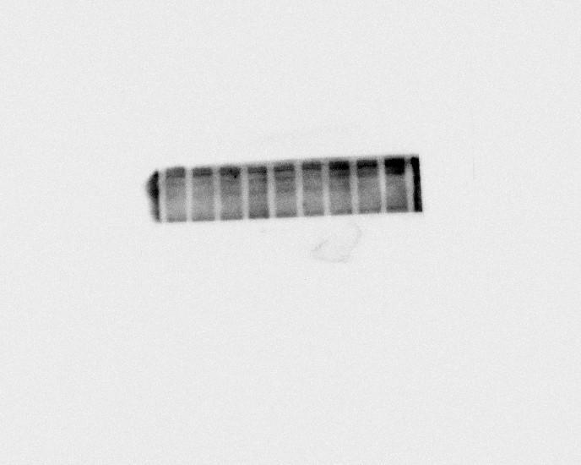
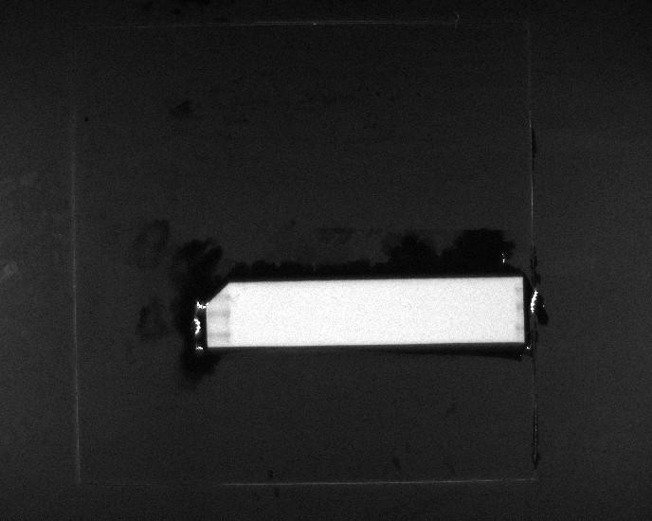
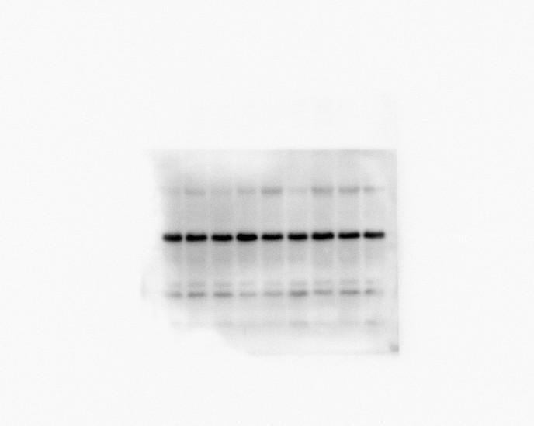
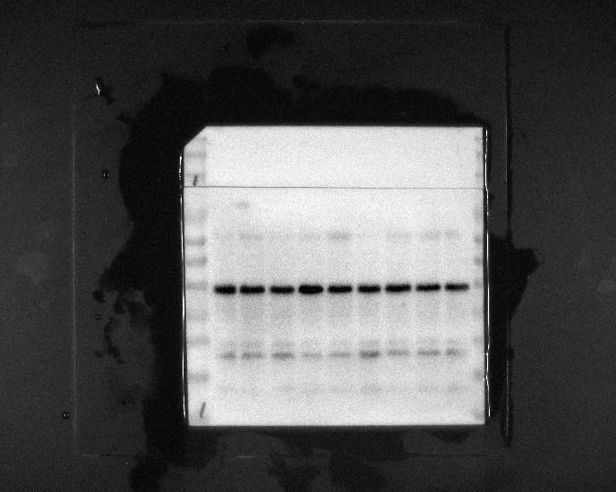
Figure3D
HIF-1α
120KD
HIF-1α
150KD
100KD
70KD
HIF-1α
150KD
100KD
70KD
50KD
GAPDH
36KD
40KD
GAPDH
35KD
25KD
20KD
15KD
10KD

Slide 2
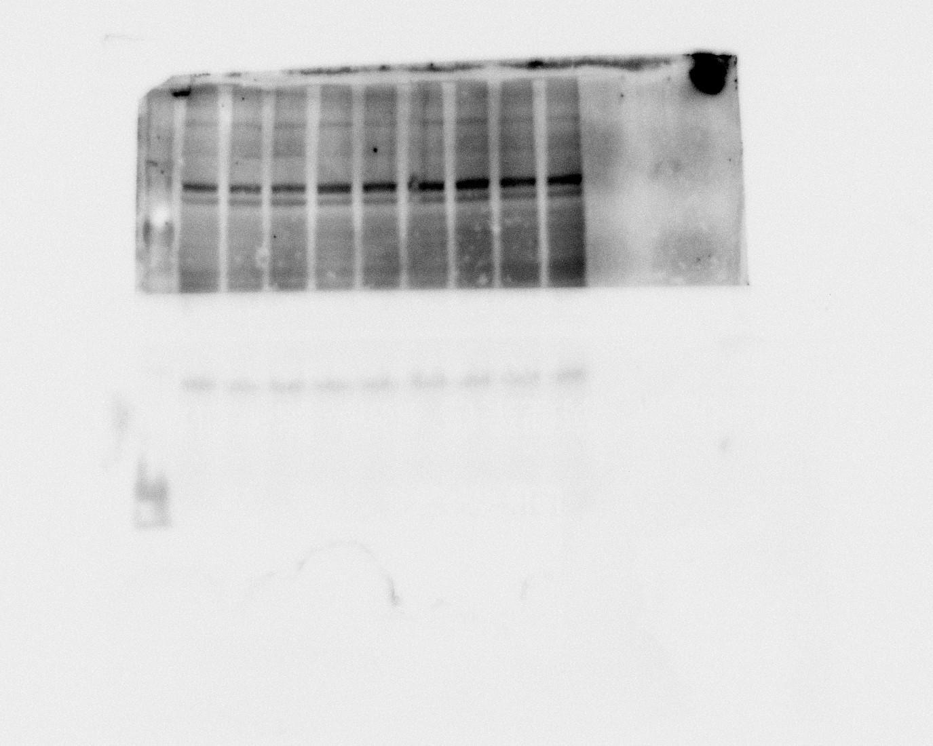
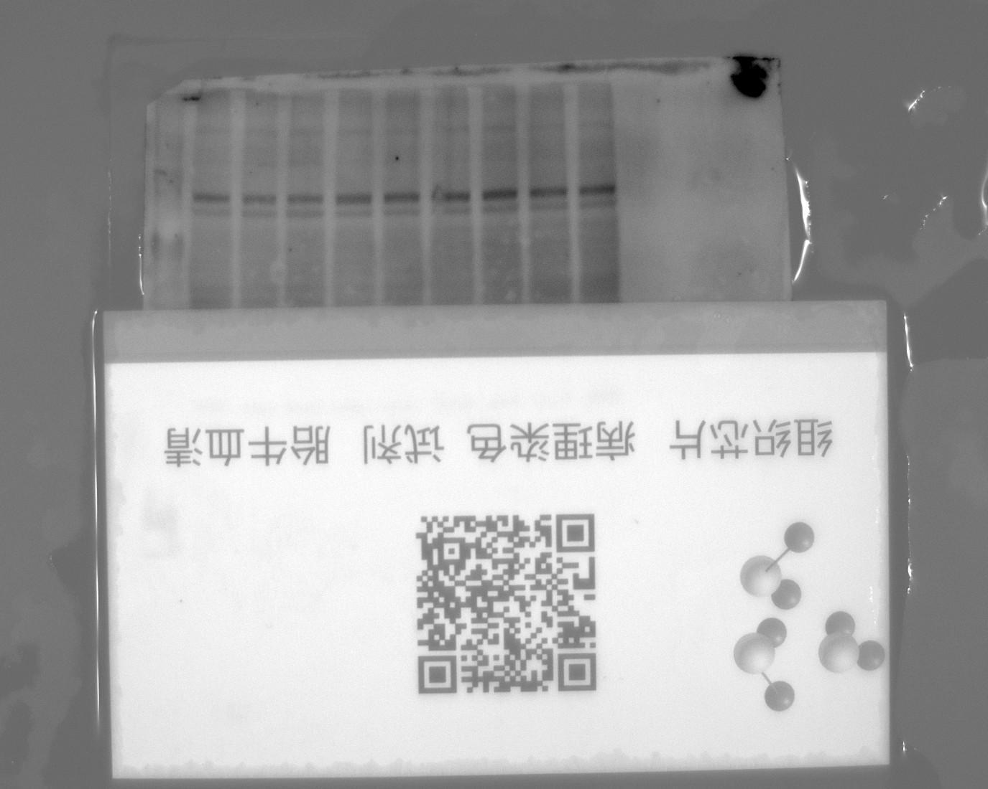
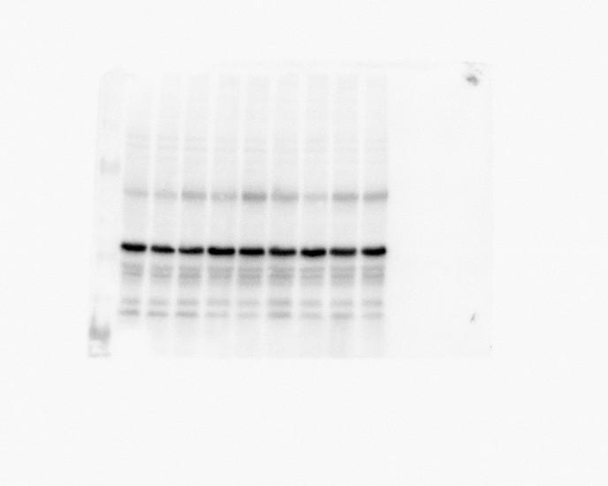
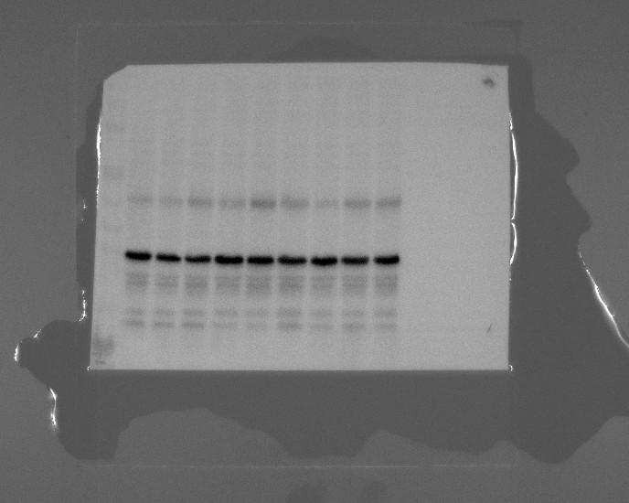
Figure3D
MMP9
67KD
70KD
MMP9
50KD
GAPDH
36KD
40KD
GAPDH
35KD

Slide 3
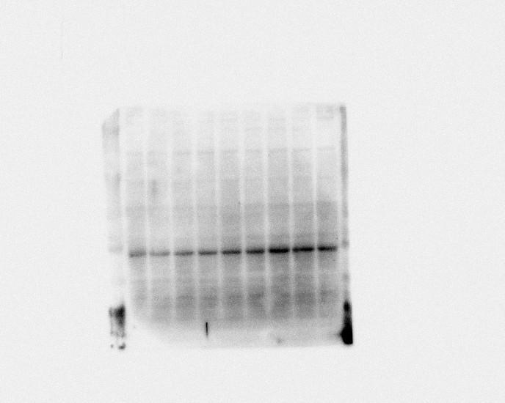
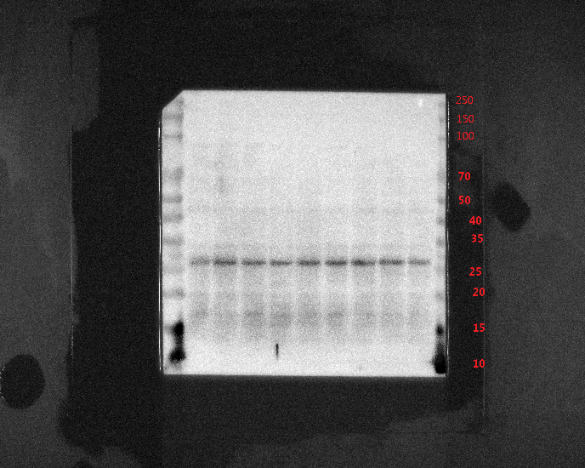
Figure3D
26KD
TNF-α
TNF-α
250KD
150KD
100KD
70KD
GAPDH
36KD
50KD
40KD
GAPDH
35KD
25KD
20KD
15KD
10KD

Slide 4
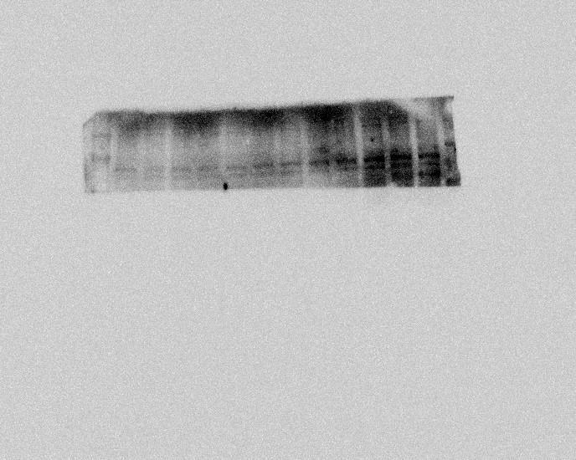
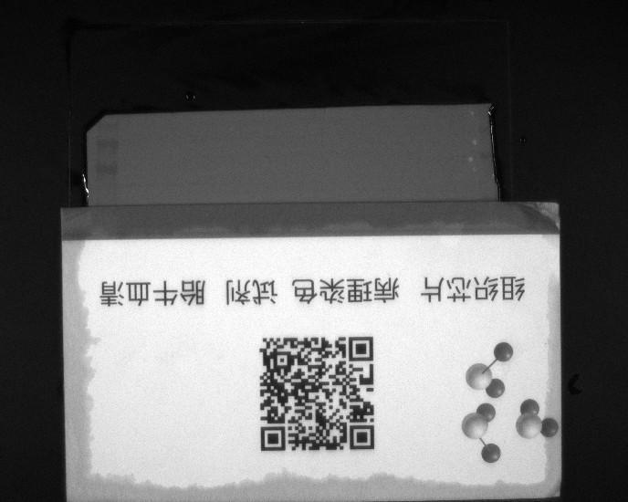
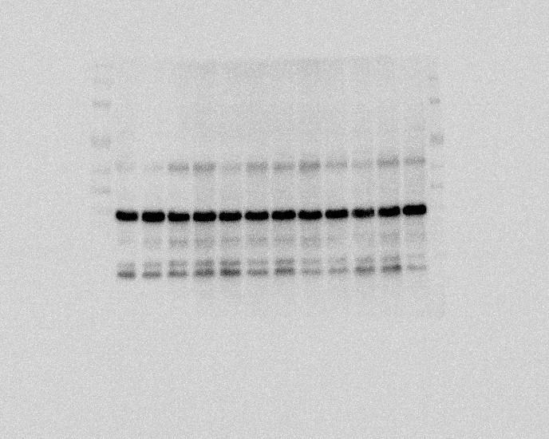
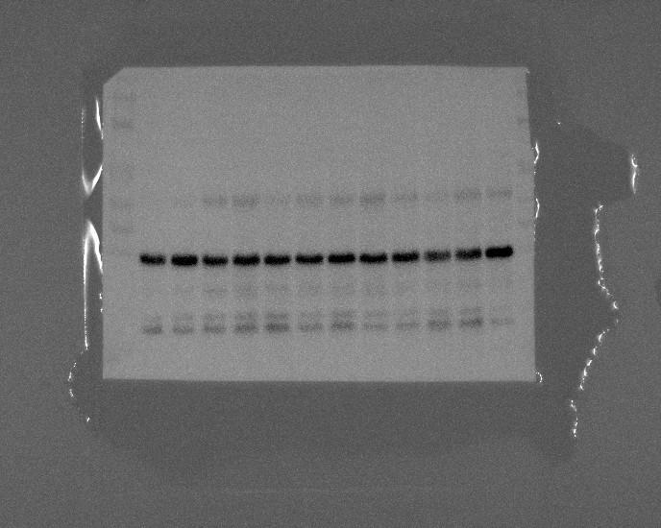
Figure3F
120KD
150KD
HIF-1α
HIF-1α
100KD
150KD
100KD
70KD
50KD
40KD
GAPDH
GAPDH
36KD
35KD

Slide 5
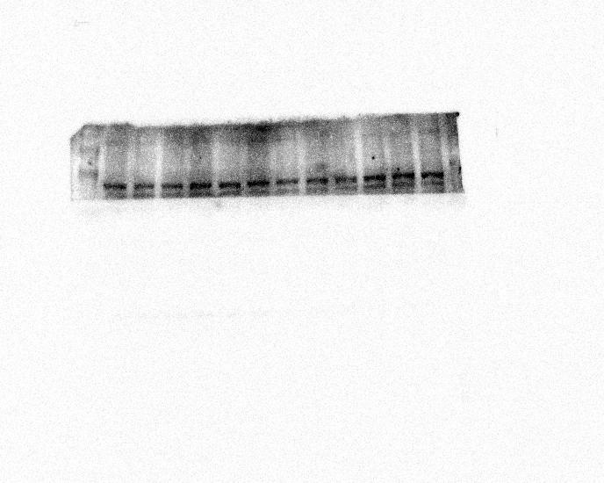
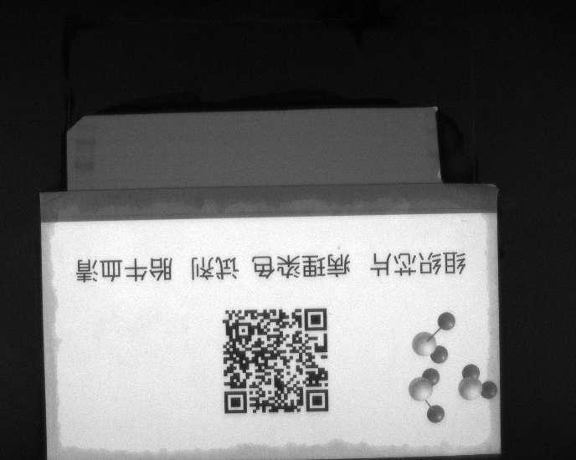


Figure3F
67KD
70KD
MMP9
MMP9
50KD
150KD
100KD
70KD
50KD
GAPDH
36KD
40KD
GAPDH
35KD

Slide 6
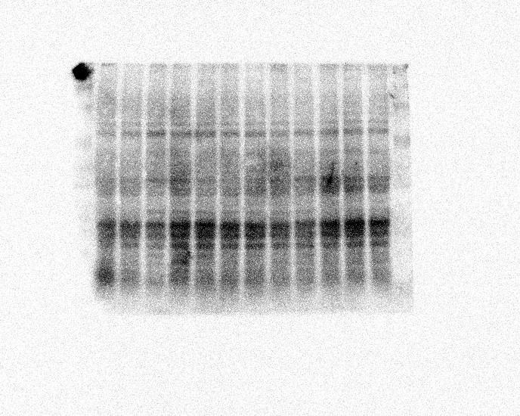
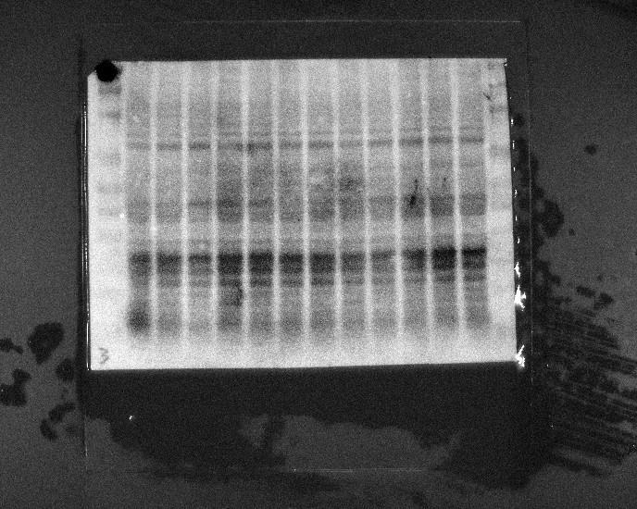
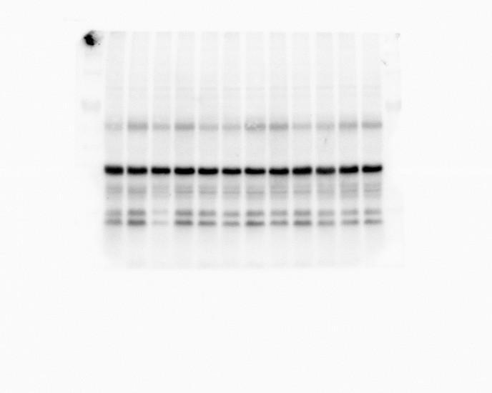
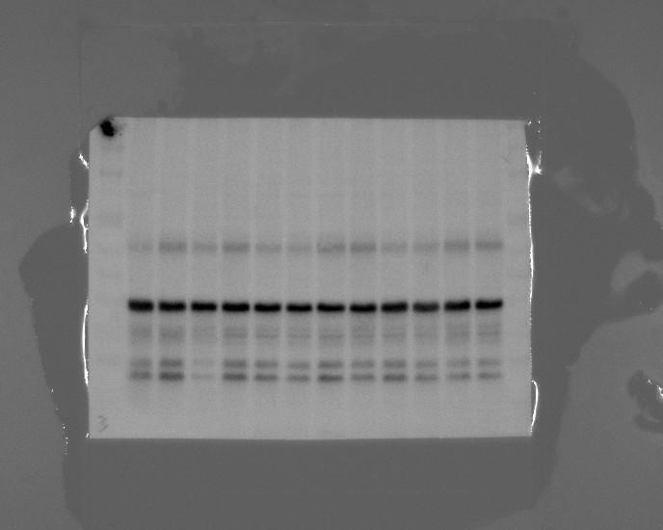
Figure3F
150KD
100KD
70KD
50KD
40KD
TNF-α
35KD
TNF-α
26KD
25KD
20KD
15KD
150KD
100KD
GAPDH
36KD
70KD
50KD
GAPDH
40KD
35KD
25KD
15KD

Slide 7
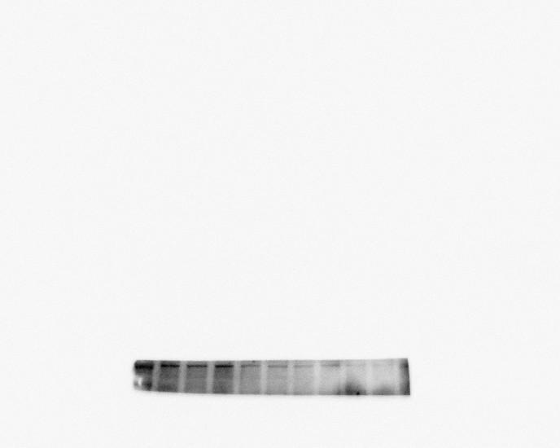
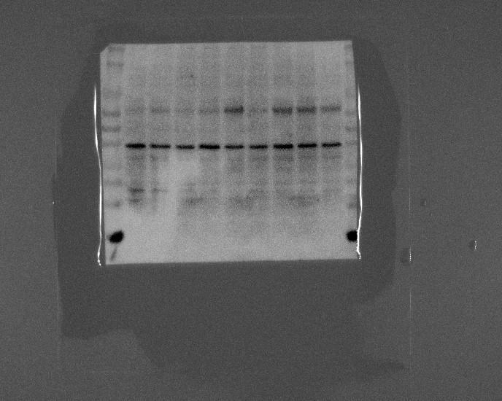
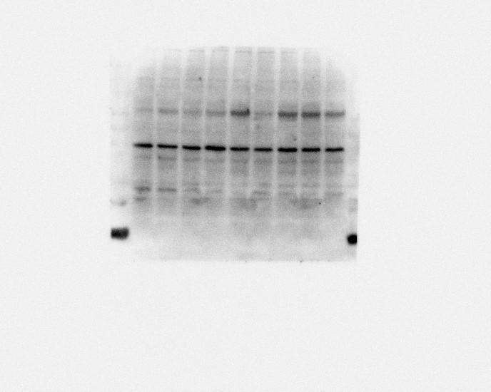
Figure4D
FN1
150KD
100KD
70KD
50KD
40KD
35KD
25KD
15KD
FN1
275KD
150KD
100KD
70KD
50KD
GAPDH
40KD
GAPDH
36KD
35KD
25KD
15KD

Slide 8
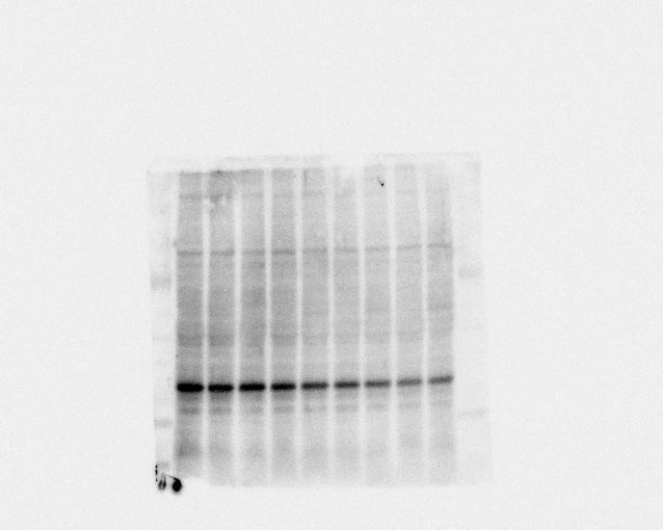
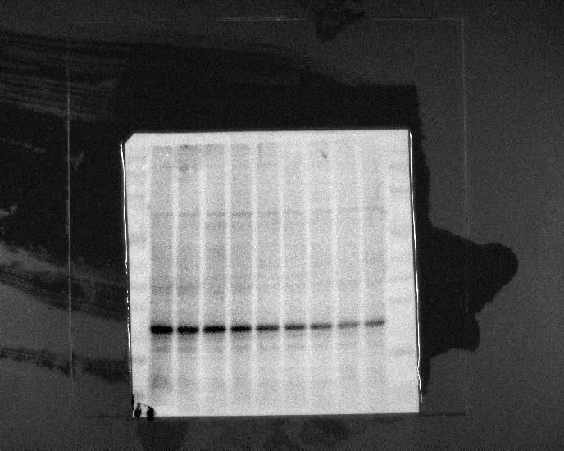
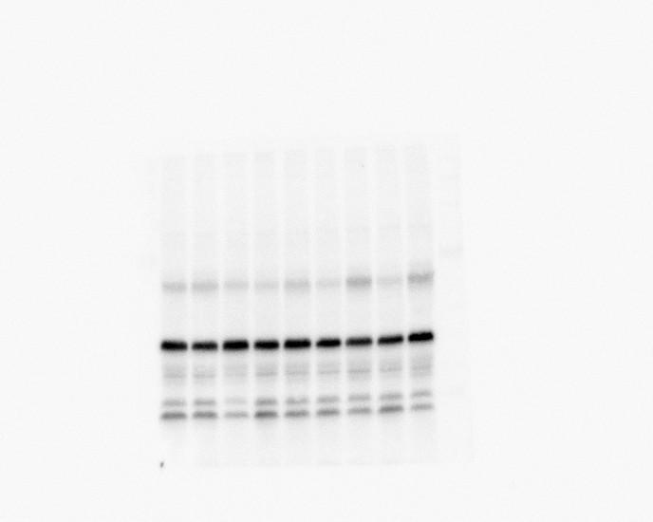
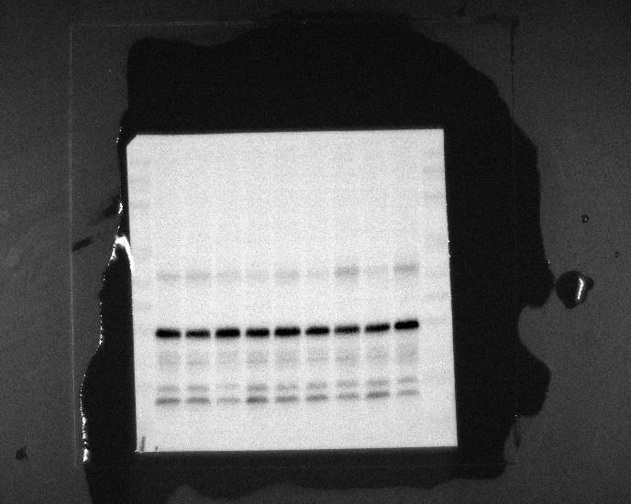
Figure4D
250KD
150KD
100KD
70KD
50KD
45KD
40KD
VEGF
VEGF
35KD
25KD
15KD
250KD
150KD
100KD
70KD
50KD
36KD
GAPDH
40KD
GAPDH
35KD
25KD
15KD

Slide 9
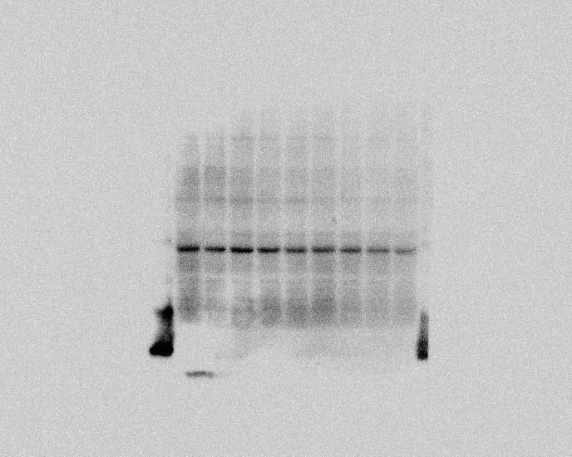
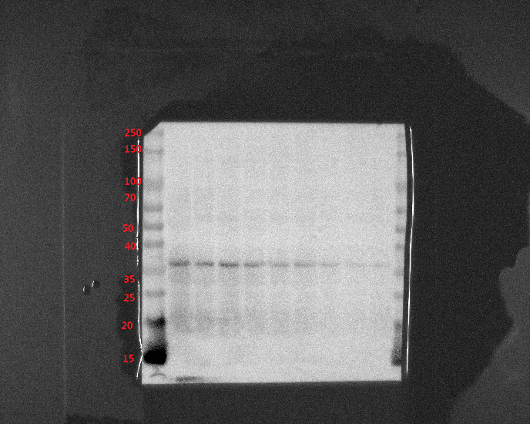
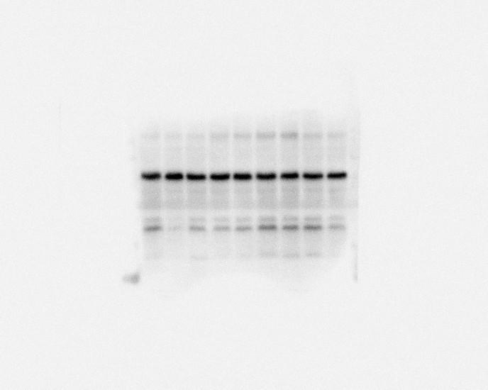
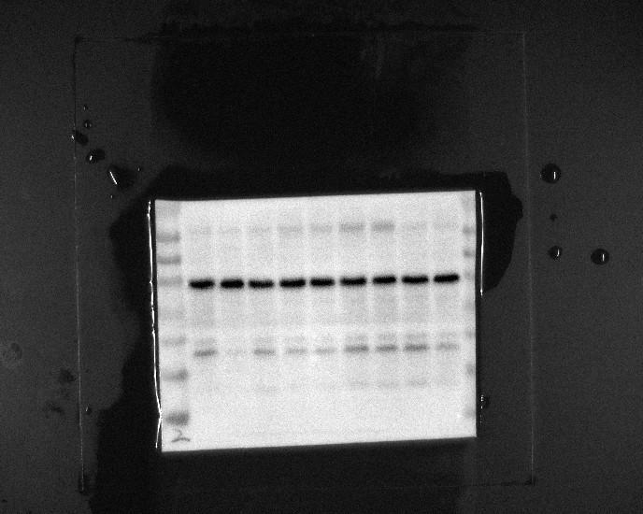
Figure4D
α-SMA
42KD
GAPDH
36KD
100KD
70KD
50KD
40KD
35KD
25KD
15KD

Slide 10
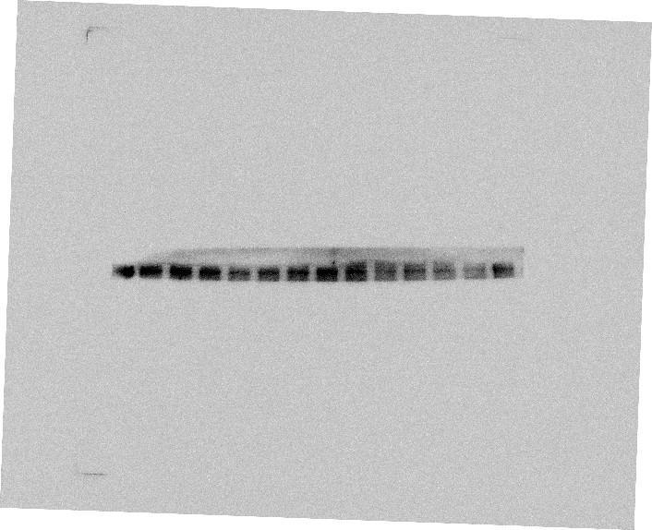
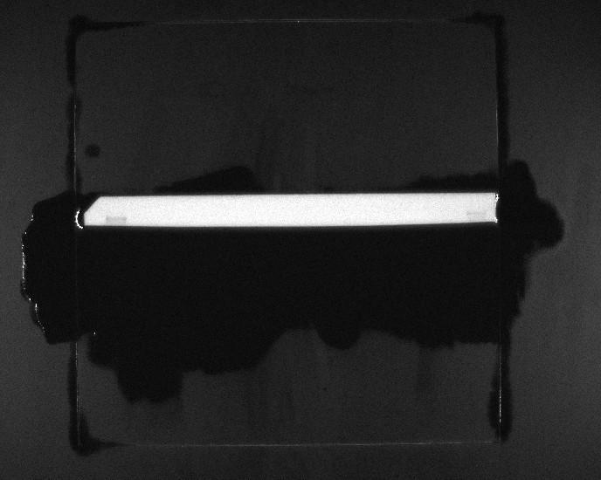
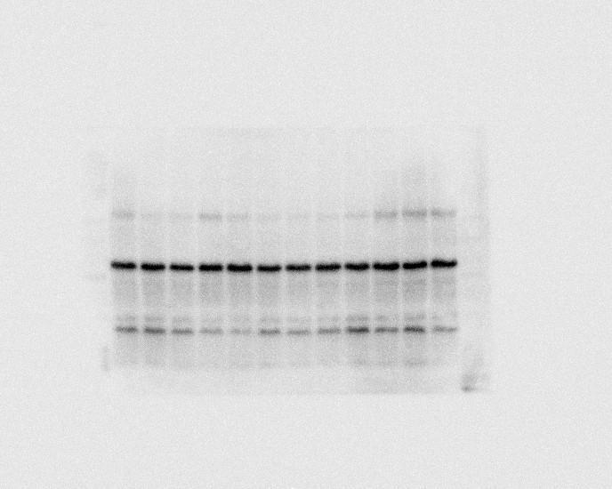
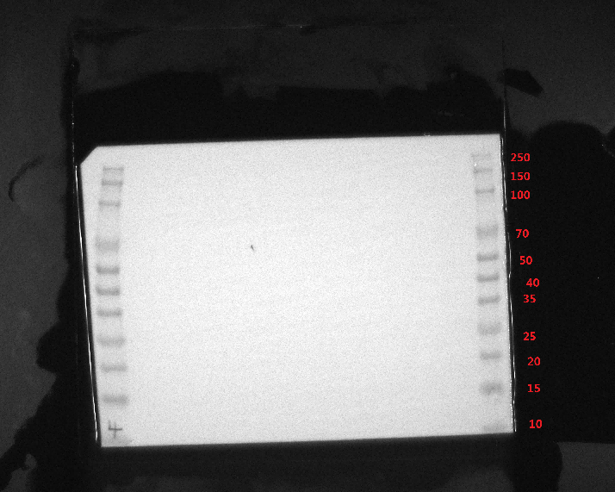
Figure4F
FN1
250KD
FN1
275KD
FN1
36KD
GAPDH

Slide 11
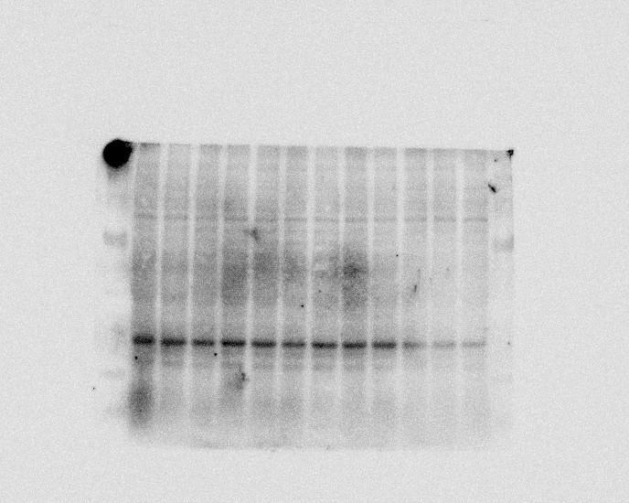
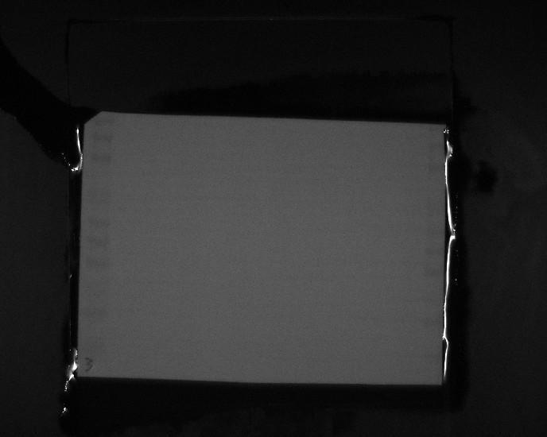
Figure4F
250KD
150KD
100KD
70KD
50KD
40KD
35KD
VEGF
45KD
25KD
15KD
10KD
250KD
150KD
100KD
GAPDH
36KD
70KD
50KD
40KD
GAPDH
35KD
25KD
15KD
10KD

Slide 12
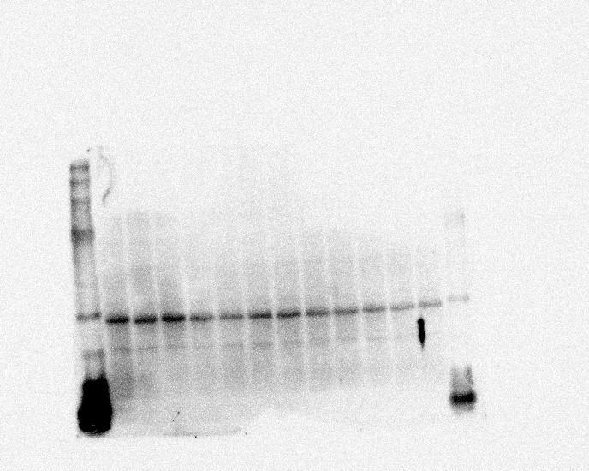
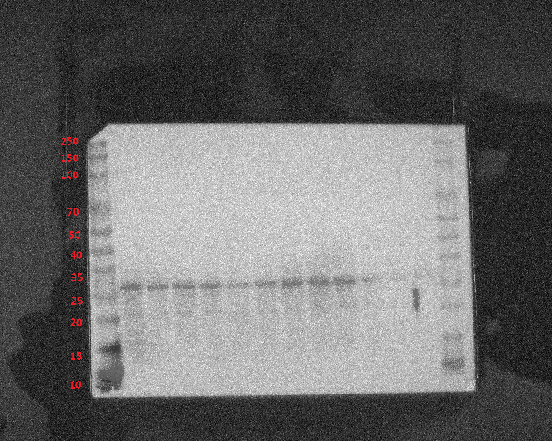
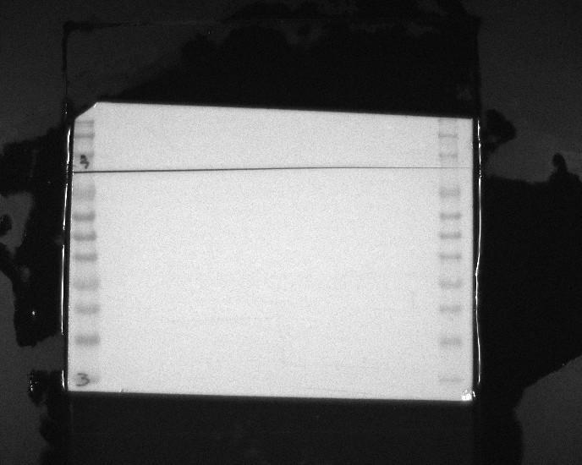
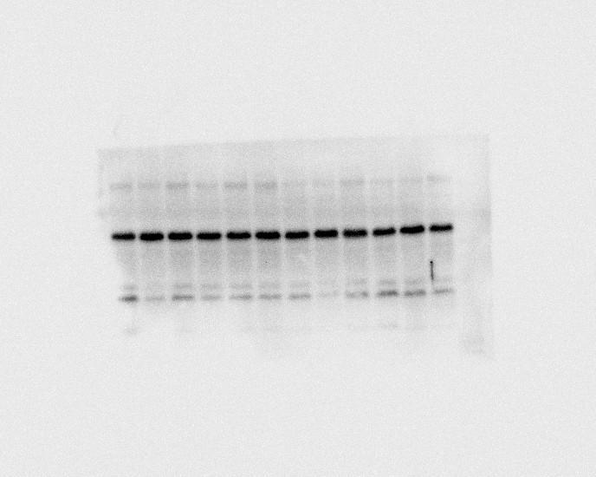
Figure4F
42KD
α-SMA
α-SMA
250KD
150KD
100KD
70KD
36KD
50KD
GAPDH
40KD
35KD
25KD
20KD
15KD
10KD

