Slide 1
Table S1. Validation summary of CD151 selective Ab clones derived from NGS enrichment ranking analysis. The antibody sequences were synthesized as Fab protein and assayed for cellular binding on HEK293T-CD151+ cells via flow-cytometry. In-situ validation result “Pass” = fluorescence signal 3-fold or greater than background (HEK293T-CD151- cells).
Selection | ID | Counts | %Total | Log2 P/N | L3 |  |  |  |  |  |  |  | H1 |  |  |  |  |  | H2 |  |  |  |  |  |  |  |  |  | H3 |  |  |  |  |  |  |  |  |  |  |  |  |  |  |  |  |  |  | Pvalue | In situ valid
 |  |  |  |  | 107 | 108 | 109 | 110 | 111 | 113 | 114 | 115 | 30 | 35 | 36 | 37 | 38 | 39 | 55 | 56 | 57 | 58 | 59 | 62 | 63 | 64 | 65 | 66 | 107 | 108 | 109 | 110 | 111 | 111.1 | 111.2 | 111.3 | 111.4 | 111.5 | 112.5 | 112.4 | 112.3 | 112.2 | 112.1 | 112 | 113 | 114 | 115
After filtering | CD151-1 | 2260484 | 3E+01 | 7.2 | S | F | F | - | - | - | P | I | L | S | Y | Y | S | M | S | I | Y | P | S | Y | G | Y | T | Y | S | H | Y | G | V | - | - | - | - | - | - | - | - | - | W | Y | G | A | M | < 1E-200 | PASS
 | CD151-2 | 137 | 2E-03 | 4.2 | S | W | V | Y | - | S | L | I | I | Y | Y | Y | S | M | S | I | S | P | Y | S | G | Y | T | Y | S | P | Y | A | V | - | - | - | - | - | - | - | - | - | - | F | Y | G | M | < 1E-035 | PASS
 | CD151-3 | 74 | 1E-03 | 5.7 | S | G | W | P | - | F | L | I | I | S | Y | S | Y | M | S | I | Y | P | Y | Y | G | Y | T | Y | S | H | Y | G | V | - | - | - | - | - | - | - | - | - | W | Y | G | A | M | < 1E-142 | PASS
 | CD151-4 | 7 | 9E-05 | 1.8 | S | S | Y | - | - | S | L | I | L | S | Y | S | Y | M | S | I | S | S | S | Y | G | Y | T | S | S | Y | S | G | G | - | - | - | - | - | - | - | - | - | - | - | - | A | L | < 1E-027 | PASS
Before filtering | CD151-5 | 361 | 4E-05 | 3.6 | S | F | F | - | - | - | P | I | I | S | Y | S | S | M | S | I | S | P | Y | S | G | S | T | Y | S | Y | - | - | - | - | - | - | - | - | - | - | - | - | - | - | - | A | L | <1E-200 | FAIL
 | CD151-6 | 2869 | 3E-04 | 4.9 | S | F | F | - | - | - | P | I | I | Y | S | S | S | I | S | I | S | P | S | S | G | Y | T | Y | A | W | G | H | - | - | - | - | - | - | - | - | - | - | - | W | Y | G | F | <1E-200 | FAIL
 | CD151-7 | 38498 | 5E-03 | 5.0 | S | F | F | - | - | - | P | I | L | Y | Y | Y | Y | M | S | I | S | P | S | Y | G | S | T | Y | S | Y | G | P | - | - | - | - | - | - | - | - | - | - | G | Y | W | G | F | <1E-200 | FAIL
 | CD151-8 | 682 | 9E-05 | 6.7 | S | F | F | - | - | - | P | I | I | Y | S | S | S | M | S | I | Y | P | S | Y | S | Y | T | S | G | S | G | - | - | - | - | - | - | - | - | - | - | - | - | - | Y | A | M | <1E-200 | FAIL
 | CD151-9 | 401 | 5E-05 | 4.1 | S | F | F | - | - | - | P | I | L | Y | Y | S | S | M | S | I | S | P | S | Y | G | Y | T | S | A | A | G | Y | P | H | Y | S | - | - | - | W | S | Y | Y | Y | G | A | L | <1E-200 | FAIL
 | CD151-10 | 9760 | 1E-03 | 5.7 | S | F | F | - | - | - | P | I | I | Y | S | S | S | I | S | I | Y | S | Y | Y | G | S | T | Y | G | P | W | - | - | - | - | - | - | - | - | - | - | - | - | - | W | A | F | <1E-200 | FAIL
 | CD151-11 | 400 | 5E-05 | 5.3 | S | F | F | - | - | - | P | I | I | S | Y | Y | S | M | S | I | S | S | Y | Y | S | Y | T | Y | A | A | Y | P | Y | G | - | - | - | - | - | - | W | Y | S | G | G | A | F | <1E-200 | FAIL
 | CD151-12 | 127 | 1E-05 | 6.2 | V | G | W | P | P | I | P | P | L | S | Y | Y | S | M | S | I | Y | P | S | Y | G | Y | T | Y | S | H | Y | G | V | - | - | - | - | - | - | - | - | - | W | Y | G | A | M | <1E-200 | FAIL
 | CD151-13 | 10626 | 1E-03 | 5.5 | S | F | F | - | - | - | P | I | I | Y | S | Y | Y | I | S | I | S | S | Y | Y | S | S | T | Y | G | P | F | S | - | - | - | - | - | - | - | - | - | - | H | P | Y | G | F | <1E-200 | FAIL
 | CD151-14 | 111 | 1E-05 | 7.1 | S | F | F | - | - | - | P | I | L | S | Y | Y | S | M | S | I | Y | P | S | Y | G | Y | T | Y | S | H | Y | G | V | W | - | - | - | - | - | - | - | Y | G | A | Y | G | L | <1E-200 | FAIL
 | CD151-15 | 306 | 4E-05 | 5.7 | S | F | F | - | - | - | P | I | I | S | Y | S | S | I | S | I | Y | P | Y | Y | G | Y | T | S | S | P | Y | - | - | - | - | - | - | - | - | - | - | - | - | Y | H | A | M | <1E-200 | FAIL
 | CD151-16 | 338 | 4E-05 | 5.9 | Y | Y | Y | P | A | V | P | I | L | S | Y | Y | S | M | S | I | Y | P | S | Y | G | Y | T | Y | S | H | Y | G | V | - | - | - | - | - | - | - | - | - | W | Y | G | A | M | <2E-038 | FAIL
 | CD151-17 | 1714 | 2E-04 | 5.6 | S | F | F | - | - | - | P | I | I | S | Y | Y | S | M | S | I | Y | P | Y | Y | G | Y | T | S | S | S | Y | - | - | - | - | - | - | - | - | - | - | - | - | Y | H | A | M | <1E-200 | FAIL
 | CD151-18 | 92 | 1E-05 | 5.8 | S | F | F | - | - | - | P | I | I | Y | S | S | S | I | Y | I | Y | S | Y | Y | G | S | T | Y | G | P | W | - | - | - | - | - | - | - | - | - | - | - | - | - | W | A | F | <1E-200 | FAIL
 | CD151-19 | 267 | 3E-05 | 4.6 | S | F | F | - | - | - | P | I | I | S | Y | Y | S | M | S | I | S | S | Y | Y | G | S | T | S | S | W | S | F | S | W | G | - | - | - | - | - | P | G | G | G | Y | A | M | <1E-200 | FAIL
 | CD151-20 | 2620 | 3E-04 | 5.2 | S | F | F | - | - | - | P | I | I | S | Y | Y | Y | I | S | I | Y | P | S | S | G | Y | T | Y | Y | S | S | - | - | - | - | - | - | - | - | - | - | - | - | - | H | G | L | <1E-200 | FAIL
 | CD151-21 | 3450 | 4E-04 | 5.5 | S | F | F | - | - | - | P | I | F | S | S | S | S | I | S | I | Y | P | Y | S | G | Y | T | S | G | A | V | V | H | S | Y | G | G | Y | A | Y | H | H | S | Y | Y | G | L | <1E-200 | FAIL
 | CD151-22 | 862 | 1E-04 | 5.4 | S | F | F | - | - | - | P | I | I | S | Y | Y | S | M | S | I | Y | P | Y | S | G | Y | T | Y | V | G | Y | W | - | - | - | - | - | - | - | - | - | - | - | G | Y | G | M | <1E-200 | FAIL
 | CD151-23 | 450 | 5E-05 | 7.2 | S | F | F | - | - | - | P | I | L | S | Y | Y | S | M | S | I | Y | P | S | Y | G | Y | T | Y | F | H | Y | G | V | - | - | - | - | - | - | - | - | - | W | Y | G | A | M | <1E-200 | FAIL
 | CD151-24 | 1475 | 1E-04 | 4.0 | S | F | F | - | - | - | P | I | L | S | Y | Y | S | M | S | I | Y | P | S | Y | G | Y | T | Y | G | P | W | H | G | - | - | - | - | - | - | - | - | - | - | S | Y | G | L | <1E-200 | FAIL
 | CD151-25 | 1313 | 1E-04 | 7.2 | S | F | F | - | - | - | P | I | L | S | Y | Y | S | M | S | I | Y | P | S | Y | G | Y | T | Y | P | H | Y | G | V | - | - | - | - | - | - | - | - | - | W | Y | G | A | M | <1E-200 | FAIL
 | CD151-26 | 4820 | 6E-04 | 5.0 | S | F | F | - | - | - | P | I | L | S | Y | Y | S | M | S | I | Y | P | S | Y | G | Y | T | Y | S | F | A | G | W | - | - | - | - | - | - | - | - | - | A | S | Y | A | F | <1E-200 | FAIL
 | CD151-27 | 46985 | 6E-03 | 5.2 | S | F | F | - | - | - | P | I | L | S | Y | S | Y | M | S | I | Y | P | Y | S | G | S | T | Y | S | G | Y | W | G | - | - | - | - | - | - | - | - | - | - | A | Y | G | M | <1E-200 | FAIL
Notes:
Table S2. In situ validation of CD151 antigen from NGS selected sequences. Antibody sequences were synthesized as Fab protein and assayed for cellular binding on CD151 positive cells via flow-cytometry. In-situ validation result “Pass” = fluorescence signal 3-fold or greater than background.

Slide 2
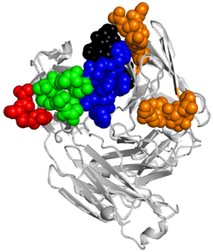
A
B
Name | Library-F Parental CDR NA Sequences | Length
L3 | 5′- TCTTCTTATTCTCTGATC -3′ | 18
H1 | 5′- TTTTCTTCTTCTTCTATA -3′ | 18
H2 | 5′- TCTATTTCTTCTTCTTATGGCTATACTTAT -3′ | 30
H3 | 5′- ACTGTTCGTGGATCCAAAAAACCGTACTTCTCTGGTTGGGCTATG -3′ | 45
Name | Library-F Variable CDR NA Sequences | Length
L3 | 5′- X(3-7)CYGWTC -3′ | 15 - 27
H1 | 5′- MTCTMTTMTTMTTMTATS -3′ | 18
H2 | 5′- TMTATTTMTYCTTMTTMTRGCTMTACTTMT -3′ | 30
H3 | 5′- X(1-17)GSTWTK -3′ | 9 - 57
C
L1
D
L3
CDR-L3
107 | 108 | 109 | 114 | 115 | 116
X | X | X | X | PL | FI
H1
L2
CDR-H1
30 | 35 | 36 | 37 | 38 | 39
IL | YS | YS | YS | YS | IM
H2
H3
CDR-H2
55 | 56 | 57 | 58 | 59 | 62 | 63 | 64 | 65 | 66
YS | I | YS | PS | YS | YS | GS | YS | T | YS
CDR-H3
107 | 108 | 109 | 110 | 111 | 112 | 113 | 114 | 115
X | X | X | X | X | X | X | AG | FILM
Figure S1. Library F CDR sequences. (A) Nucleotide sequences are formatted according to IUPAC code, and showing the nucleotide composition of template (parental) CDR sequences utilized to construct library F. Among 3x1010 unique clones in Library F, diversity was incorporated in approximately 80% of the population in each CDR and the retention of template sequences in the remainders. (B) Composition of pattern (variable) nucleotide sequences in library F, where the pattern CDR sequences describe the composition and length diversity introduced to CDRs-H1, H2, H3 and L3 by allowing loop lengths that are found within these regions of natural antibodies. X(3-7) and X(1-17) indicates the insertion of 3 to 7 and 1 to 17 tri-nucleotides from a mixture designed to contain nine different amino acids of the following composition; 25% Tyr, 20% Ser, 20% Gly, 10% Ala, and 5% each of Phe, Trp, His, Pro and Val, all respectively. (C) Framework Structure of Fab region showing the CDR loops L1 and L2 (orange), L3 (black), H1 (green), H2 (red), and H3 (blue) as spheres. The figure was generated using PyMOL (http://www.pymol.org/) with crystal structure coordinates (Protein Data Bank entry 1MIM). (D) Description of the synthetic antibody library F CDR amino acid sequences, highlighting the CDR diversity by position (shaded in gray are fixed positions). Allowed amino acids are denoted by the single-letter code, where X denotes a mixture of nine amino acids (Y, S, G, A, F, W, H, P or V). The lengths of CDR-L3 and CDR-H3 may vary from 3–9 and 1–19 respectively and the residue numbering is according to the IMGT scheme.
Notes:
Figure S5. Library-F synthetic variable CDR regions. (A) Nucleotide sequences are formatted using IUPAC code. Composition of template (parental) nucleotide CDR sequences utilized to construct library F. Nucleotide sequences of the anti-maltose-binding protein Fab utilized as template in the construction of Library F. Among 3x1010 unique clones in Library F, diversity was incorporated in approximately 80% of the population in each CDR and the retention of template sequences in the remainders. (B) Composition of pattern (variable) nucleotide sequences in library F. The pattern CDR sequences describe how the composition of the three heavy-chain CDRs and CDR-L3 was diversified, and how length diversity was introduced to CDR-H3 and CDR-L3 by allowing loop lengths that are found within these regions of natural antibodies. X(3-7) and X(1-17) indicates the insertion of 3 to 7 and 1 to 17 tri-nucleotides from a mixture designed to contain nine different amino acids of the following composition; 25% Tyr, 20% Ser, 20% Gly, 10% Ala, and 5% each of Phe, Trp, His, Pro and Val, all respectively.

Slide 3
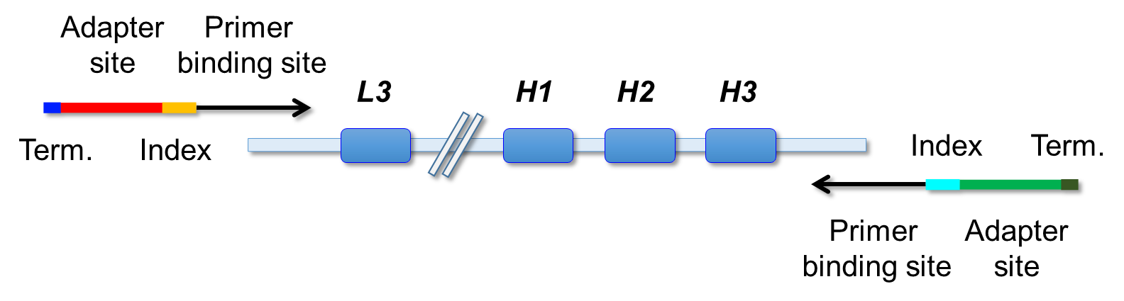

Template
Region
PCR
Amplification
NGS
Read-Out
Figure S2. Description of NGS strategy for Illumina read-out of the diversified CDRs. The template DNA Fab region includes a PhoA promoter followed by a ribosome binding site (RBS) and two gene cassettes with signal peptide (SP) sequences and light or heavy antibody regions followed by the M13 gene-3 for display on phage particles. The phagemid template Fab region is PCR amplified utilizing two distinct primers that contain barcoded indexes and Illumina adapter sites. The amplicons are sequenced with three distinct read out primers that cover the sequences of the diversified regions L3, H1, H2, and H3.
Notes:
Figure S3. Description of NGS strategy for Illumina read-out of Ab diversified regions. Schematic of output phage sample preparation for NGS identification. The template Fab region includes a PhoA promoter followed by a ribosome binding site (RBS) and two gene cassetes with signal peptide (SP) sequences and light or heavy antibody regions followed by the M13 gene-3 for display on phage particles. The phagemid template Fab region is PCR amplified utilizing two distinct primers that contain barcoded indexes and Illumina adapter sites. The amplicons are sequenced with three distinct read out primers that cover the sequences of the diversified regions L3, H1, H2, and H3.

Slide 4
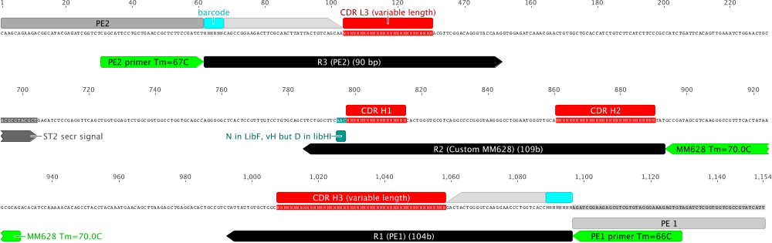
Figure S3. Library F NGS three-read diagram showing annealing regions of primers on Ab framework.
Notes:
Figure S4. Library-F NGS three-read diagram showing annealing regions of primers.

Slide 5
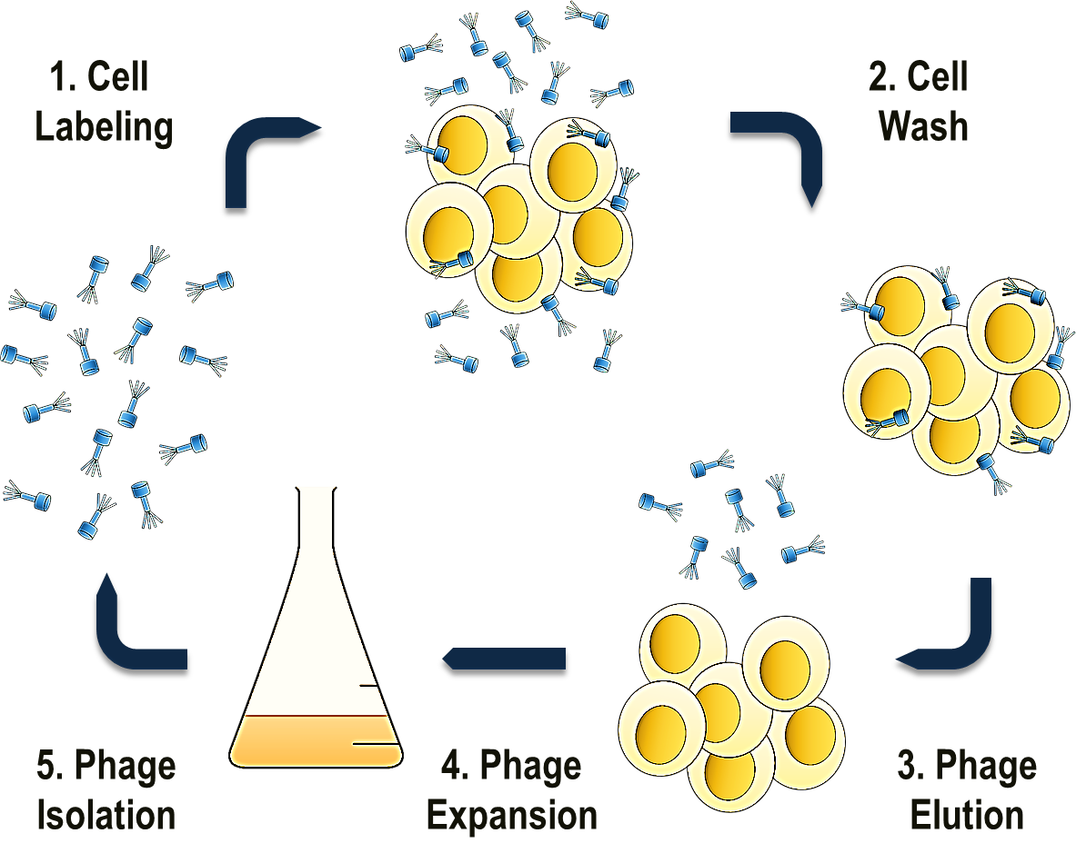
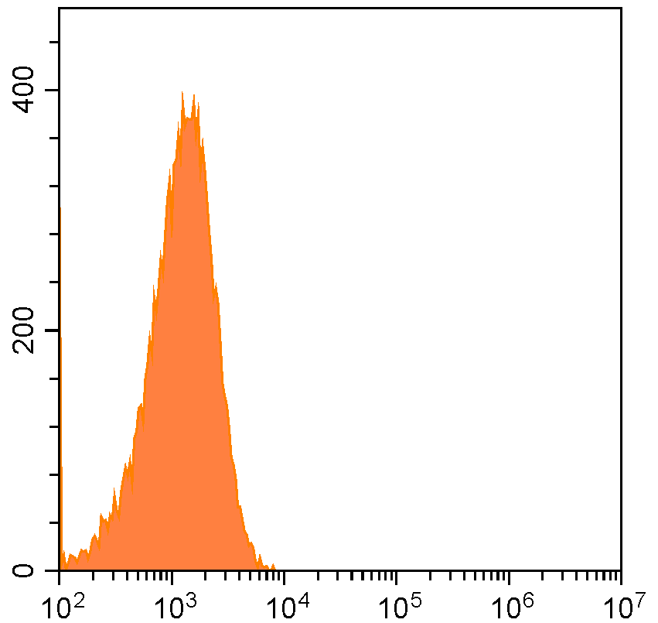
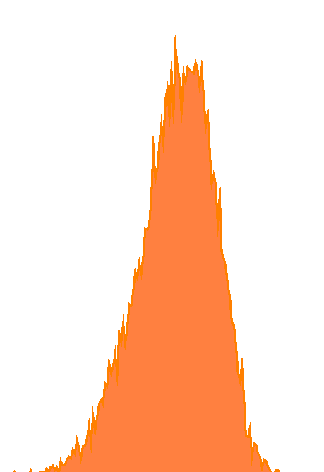
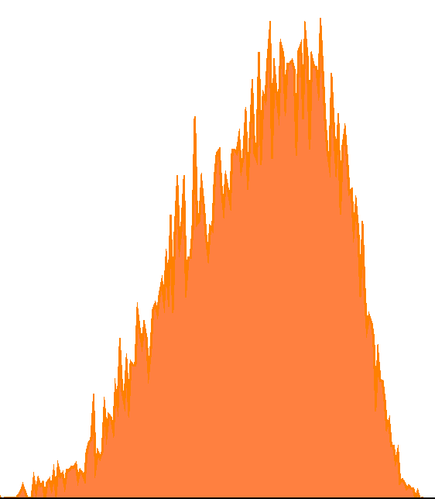
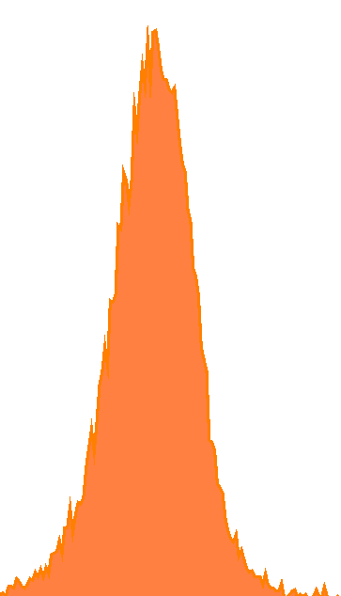
A
B
HEK293 Cells
Control
(Unlabeled)
Counts
sh-RNA CD151
Parental
CD151(+)
(overexpressing)
Fluorescence (a.u.)
Figure S4. Validation of CD151 transgenic and knock-down cell lines used in this report. (A) Flow-cytometry histograms showing the CD151 surface expression of different HEK293T cell lines. Measurements were performed using an overexpressing CD151 cell line (HEK293T-CD151+), a short hair-pin RNA CD151 knockdown cell line(HEK293T-CD151-) cell line, and the parental HEK293T cell line, and CD151 surface expression measured utilizing a mouse anti-human CD151 PE conjugated IgG (Biolegend; cat. 350408). (B) Schematic of a round of selection where amplified Fab-phage is utilized to label antigens at the surface of live mammalian cells. After cellular wash and elution, the Fab-phage are amplified in E. coli and isolated for the next round of selection.
Notes:
Figure S1. Validation of CD151 transgenic and knock-down cell lines used in this report. (A) Flow-cytometry histograms showing CD151 expression on different HEK293 cell lines utilizing mouse anti-human CD151 IgG (Biolegend; cat. 350408). (B) Schematic of a round of selection where amplified Fab-phage is utilized to label antigens at the surface of live mammalian cells. After cellular wash and elution the Fab-phage are amplified in E.coli and isolated for the next round of selection. (C) Diagram of all rounds of selection where after round 1 the Fab-phage are alternated between cell surface antigen negative cells and antigen positive cells. After round 4 the enriched Fab-phage are eluted from both negative and positive selection lines and subjected to next-generation sequencing analysis for identification of potential antibody candidates.

Slide 6
Fold Change Absorbance (450 nm)
Fab-phage Well ID
Figure S5. Binding measurements of Fab-phage to CD151 expressing cells (HEK293T-CD151+) by single-point cellular ELISA measurements. The fold change signal is measured by taking the ratio of signal from HEK293T-CD151+ cells over HEK293T-CD151- cells. A fold change signal of 5 or greater is deemed as a potential positive CD151 Fab-phage binder.
Notes:
Figure S2. Binding measurements of Fab-phage to CD151 expressing cells by single-point cellular ELISA. Fold change signal measured by taking the ratio of signal from CD151 expressing HEK cells over CD151 negative HEK293 cells. Fold change signal of 5 or greater deemed as positive CD151 Fab-phage binder.

Slide 7
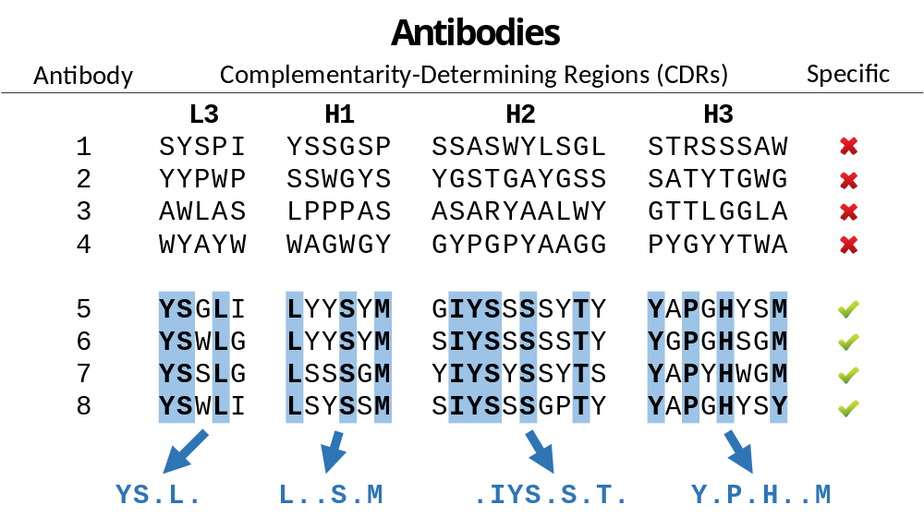
Figure S6. Linear information of paratope motifs as predictor for binding specificity of antibodies. Representation of the premise stating that highly selective Abs are enriched with paratope motifs that enable specific recognition of target epitopes, whereas non-specific Abs lack such enrichment.
Notes:
Figure S6. Linear information as predictor for binding specificity of antibodies. Representation of the premise stating that highly selective Abs are enriched with paratope motifs that enable specific recognition of target epitopes, whereas non-specific Abs lack such enrichment.

Slide 8
CellectSeq
in Situ Ab Selection
Synthetic Ab
Phage Library
Cellular Antigen
Ab Selection
Workflow
NGS
Ab Selection
In Silico
Ab Selection
Validation on
CD151
antigen
Figure S7. Description of CellectSeq Methodology. Flow-chart of workflow for the CellectSeq Methodology.
Notes:
Figure S7. Description of CellectSeq Methodology. Flow-chart of workflow for the CellectSeq Methodology.

Slide 9
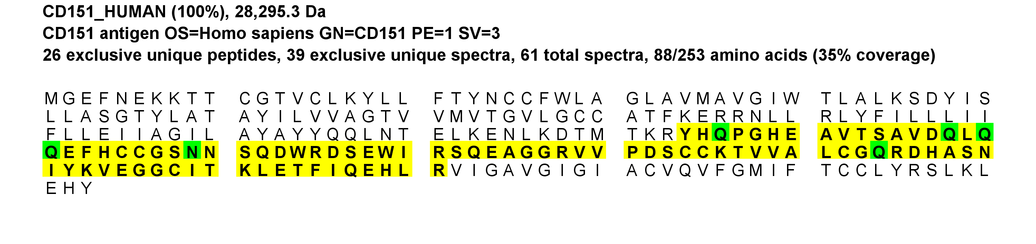
A
Peptide Sequence | Prob | NTT | Observed | Actual Mass | Charge | Delta Da | Delta PPM | Retention Time | TIC | Start | Stop
(R)YHQPGHEAVTSAVD(Q) | 100% | 1 | 755.8512 | 1,509.69 | 2 | 0.002978 | 1.971 | 1,199.02 | 28,219.70 | 134 | 147
(R)YHQPGHEAVTSAVDqLQQEFHccGSNNSQDWR(D) | 100% | 2 | 1,262.88 | 3,785.62 | 3 | 0.02026 | 5.349 | 2,083.31 | 349181 | 134 | 165
(R)YHQPGHEAVTSAVDQLQQEFHccGSNNSQDWR(D) | 100% | 2 | 947.162 | 3,784.62 | 4 | 0.005595 | 1.478 | 2,091.73 | 679396 | 134 | 165
(R)YHQPGHEAVTSAVDQLQQEFHccGSNNSQDWR(D) | 100% | 2 | 757.9313 | 3,784.62 | 5 | 0.007019 | 1.854 | 2,044.05 | 2404360 | 134 | 165
(R)YHQPGHEAVTSAVDQLQQEFHccGSNNSQDWR(D) | 100% | 2 | 1,262.55 | 3,784.62 | 3 | 0.007071 | 1.868 | 2,084.86 | 242073 | 134 | 165
(R)YHQPGHEAVTSAVDqLQQEFHccGSNNSQDWR(D) | 100% | 2 | 947.4098 | 3,785.61 | 4 | 0.01278 | 3.375 | 2,110.59 | 749697 | 134 | 165
(R)YHQPGHEAVTSAVDQLQQEFHccGSNNSQDWR(D) | 100% | 2 | 947.1612 | 3,784.62 | 4 | 0.002595 | 0.6856 | 2,116.30 | 716182 | 134 | 165
(R)YHQPGHEAVTSAVDQLQQEFHccGSNNSQDWR(D) | 100% | 2 | 757.9298 | 3,784.61 | 5 | -0.0006806 | -0.1798 | 2,076.86 | 3128270 | 134 | 165
(R)YHQPGHEAVTSAVDQLQQEFHccGSNNSQDWR(D) | 100% | 2 | 947.1624 | 3,784.62 | 4 | 0.007195 | 1.901 | 2,061.91 | 2842120 | 134 | 165
(R)YHQPGHEAVTSAVDQLQQEFHccGSNNSQDWR(D) | 100% | 2 | 757.9311 | 3,784.62 | 5 | 0.005819 | 1.537 | 2,060.00 | 4550050 | 134 | 165
(R)YHQPGHEAVTSAVDQLqqEFHccGSNNSQDWR(D) | 100% | 2 | 758.3284 | 3,786.61 | 5 | 0.02414 | 6.373 | 2,131.28 | 692289 | 134 | 165
(R)YHQPGHEAVTSAVDQLQQEFHccGSNNSQDWR(D) | 100% | 2 | 947.1622 | 3,784.62 | 4 | 0.006515 | 1.721 | 2,045.04 | 1510660 | 134 | 165
(R)YHQPGHEAVTSAVDQLQQEFHccGSNNSQDWR(D) | 100% | 2 | 947.1636 | 3,784.63 | 4 | 0.012 | 3.169 | 2,078.74 | 1955760 | 134 | 165
(R)YHQPGHEAVTSAVDQLQQEFHccGSnNSQDWR(D) | 100% | 2 | 947.4146 | 3,785.63 | 4 | 0.03198 | 8.445 | 2,128.90 | 576662 | 134 | 165
(R)YHQPGHEAVTSAVDQLQqEFHccGSNNSQDWR(D) | 100% | 2 | 947.415 | 3,785.63 | 4 | 0.03374 | 8.91 | 2,108.86 | 657494 | 134 | 165
(R)YHqPGHEAVTSAVDQLQQEFHccGSNNSQDWR(D) | 100% | 2 | 758.1332 | 3,785.63 | 5 | 0.0323 | 8.531 | 2,110.18 | 1119500 | 134 | 165
(R)YHQPGHEAVTSAVDQLQQEFHccGSNNSQDWRDSEWIR(S) | 100% | 2 | 1,143.75 | 4,570.97 | 4 | -0.009305 | -2.035 | 2,216.99 | 498966 | 134 | 171
(R)YHQPGHEAVTSAVDQLQQEFHccGSNNSQDWRDSEWIR(S) | 100% | 2 | 1,143.75 | 4,570.98 | 4 | 0.003095 | 0.677 | 2,242.54 | 578642 | 134 | 171
(R)YHQPGHEAVTSAVDQLQQEFHccGSNNSQDWRDSEWIR(S) | 100% | 2 | 1,143.76 | 4,571.00 | 4 | 0.0255 | 5.576 | 2,220.05 | 369365 | 134 | 171
(R)YHQPGHEAVTSAVDQLQQEFHccGSNNSQDWRDSEWIR(S) | 99% | 2 | 1,143.75 | 4,570.99 | 4 | 0.008695 | 1.902 | 2,251.29 | 381205 | 134 | 171
(N)SQDWRDSEWIR(S) | 100% | 1 | 493.2322 | 1,476.67 | 3 | 0.000222 | 0.1502 | 1,798.72 | 549618 | 161 | 171
(R)DSEWIRSQEAGGR(V) | 100% | 2 | 497.5716 | 1,489.69 | 3 | 0.001902 | 1.276 | 1,376.11 | 329755 | 166 | 178
(R)DSEWIRSQEAGGR(V) | 100% | 2 | 745.8527 | 1,489.69 | 2 | -0.000222 | -0.1489 | 1,375.76 | 126385 | 166 | 178
(R)DSEWIRSQEAGGR(V) | 100% | 2 | 745.8544 | 1,489.69 | 2 | 0.003178 | 2.132 | 1,391.74 | 96,599.50 | 166 | 178
(R)DSEWIRSQEAGGR(V) | 100% | 2 | 497.5712 | 1,489.69 | 3 | 0.000612 | 0.4105 | 1,391.58 | 209671 | 166 | 178
(S)EWIRSQEAGGR(V) | 100% | 1 | 644.8229 | 1,287.63 | 2 | -0.000822 | -0.6379 | 1,380.40 | 184578 | 168 | 178
(E)WIRSQEAGGR(V) | 100% | 1 | 580.3019 | 1,158.59 | 2 | -0.000142 | -0.1225 | 1,378.08 | 102108 | 169 | 178
(W)IRSQEAGGR(V) | 100% | 1 | 487.2625 | 972.5103 | 2 | 0.000178 | 0.1828 | 1,378.79 | 83,011.00 | 170 | 178
(I)RSQEAGGR(V) | 99% | 1 | 430.7202 | 859.4258 | 2 | -0.000262 | -0.3045 | 1,383.36 | 97,702.20 | 171 | 178
(R)SQEAGGRVVPDSccK(T) | 100% | 2 | 825.3724 | 1,648.73 | 2 | 0.0004274 | 0.2591 | 1,056.88 | 99,868.40 | 172 | 186
(R)SQEAGGRVVPDSccK(T) | 100% | 2 | 550.5834 | 1,648.73 | 3 | -0.001409 | -0.8538 | 1,056.50 | 173209 | 172 | 186
(Q)EAGGRVVPDSccK(T) | 100% | 1 | 717.8268 | 1,433.64 | 2 | -0.0002526 | -0.1761 | 1,057.10 | 28,007.50 | 174 | 186
(E)AGGRVVPDSccK(T) | 100% | 1 | 653.3046 | 1,304.59 | 2 | -0.002113 | -1.618 | 1,059.11 | 25,656.50 | 175 | 186
(A)GGRVVPDSccK(T) | 100% | 1 | 617.7861 | 1,233.56 | 2 | -0.001893 | -1.533 | 1,060.63 | 21,933.20 | 176 | 186
(R)VVPDSccK(T) | 99% | 2 | 482.7147 | 963.4149 | 2 | -0.0005526 | -0.573 | 952.392 | 18,906.60 | 179 | 186
(R)VVPDSccKTVVAL(C) | 100% | 1 | 724.3693 | 1,446.72 | 2 | 0.002767 | 1.912 | 1,840.22 | 1079580 | 179 | 191
(R)VVPDSccKTVVALcGQR(D) | 100% | 2 | 974.9749 | 1,947.94 | 2 | 0.002182 | 1.12 | 1,550.36 | 186627 | 179 | 195
(R)VVPDSccKTVVALcGQR(D) | 100% | 2 | 650.318 | 1,947.93 | 3 | -0.0007439 | -0.3817 | 1,549.32 | 888369 | 179 | 195
(V)PDSccKTVVALcGQR(D) | 100% | 1 | 875.9058 | 1,749.80 | 2 | 0.0007821 | 0.4467 | 1,549.87 | 156243 | 181 | 195
(V)PDSccKTVVALcGQR(D) | 100% | 1 | 584.2719 | 1,749.79 | 3 | -0.002394 | -1.367 | 1,550.19 | 243015 | 181 | 195
(K)TVVALcGQR(D) | 100% | 2 | 502.2718 | 1,002.53 | 2 | 0.0009527 | 0.9493 | 1,386.86 | 1772130 | 187 | 195
(K)TVVALcGQR(D) | 100% | 2 | 502.2715 | 1,002.53 | 2 | 0.0002127 | 0.2119 | 1,419.50 | 136818 | 187 | 195
(K)TVVALcGQR(D) | 100% | 2 | 502.2712 | 1,002.53 | 2 | -0.0002873 | -0.2863 | 1,370.84 | 2156330 | 187 | 195
(K)TVVALcGQR(D) | 100% | 2 | 502.2717 | 1,002.53 | 2 | 0.0007727 | 0.77 | 1,403.70 | 221122 | 187 | 195
(K)TVVALcGQR(D) | 100% | 2 | 502.2717 | 1,002.53 | 2 | 0.0007127 | 0.7102 | 1,436.99 | 100389 | 187 | 195
(K)TVVALcGqR(D) | 100% | 2 | 502.7637 | 1,003.51 | 2 | 0.0006967 | 0.6936 | 1,541.87 | 125093 | 187 | 195
(K)TVVALcGQRDHASNIYK(V) | 100% | 2 | 966.4936 | 1,930.97 | 2 | 0.004213 | 2.181 | 1,352.36 | 43,553.40 | 187 | 203
(K)TVVALcGQRDHASNIYK(V) | 100% | 2 | 644.6626 | 1,930.97 | 3 | -0.002463 | -1.275 | 1,346.18 | 304195 | 187 | 203
(K)TVVALcGQRDHASNIYK(V) | 99% | 2 | 644.6635 | 1,930.97 | 3 | 0.0000867 | 0.04488 | 1,363.61 | 132470 | 187 | 203
(T)VVALcGQR(D) | 99% | 1 | 451.7477 | 901.4809 | 2 | 0.0004927 | 0.5459 | 1,374.79 | 100389 | 188 | 195
(R)DHASNIYK(V) | 99% | 2 | 474.2326 | 946.4506 | 2 | -0.000222 | -0.2343 | 932.124 | 9,219.32 | 196 | 203
(R)DHASNIYKVEGG(C) | 100% | 1 | 645.3095 | 1,288.60 | 2 | -0.000422 | -0.3272 | 1,251.10 | 56,776.00 | 196 | 207
(R)DHASNIYKVEGGcITK(L) | 100% | 2 | 896.4385 | 1,790.86 | 2 | 0.0001127 | 0.06289 | 1,346.51 | 68,887.70 | 196 | 211
(R)DHASNIYKVEGGcITK(L) | 100% | 2 | 896.4393 | 1,790.86 | 2 | 0.001773 | 0.9893 | 1,363.78 | 61,355.90 | 196 | 211
(R)DHASNIYKVEGGcITK(L) | 100% | 2 | 597.9607 | 1,790.86 | 3 | -0.002063 | -1.151 | 1,343.67 | 162827 | 196 | 211
(R)DHASNIYKVEGGcITK(L) | 100% | 2 | 597.9618 | 1,790.86 | 3 | 0.001237 | 0.6902 | 1,360.94 | 458754 | 196 | 211
(R)DHASNIYKVEGGcITK(L) | 100% | 2 | 448.7228 | 1,790.86 | 4 | -0.0000793 | -0.04426 | 1,357.48 | 104237 | 196 | 211
(K)LETFIQEHLR(V) | 100% | 2 | 429.234 | 1,284.68 | 3 | -0.002598 | -2.021 | 1,756.47 | 472965 | 212 | 221
(K)LETFIQEHLR(V) | 100% | 2 | 429.2353 | 1,284.68 | 3 | 0.001452 | 1.129 | 1,772.35 | 561276 | 212 | 221
(L)ETFIQEHLR(V) | 100% | 1 | 586.8072 | 1,171.60 | 2 | 0.001178 | 1.005 | 1,764.66 | 293604 | 213 | 221
(E)TFIQEHLR(V) | 99% | 1 | 522.2858 | 1,042.56 | 2 | 0.000978 | 0.9372 | 1,762.75 | 272648 | 214 | 221
Notes:
Figure S8. IP-MS peptide coverage results of CD151 protein: (A) Fab CD151-1 assayed utilizing HEK293-CD151(+) cells; (B) Fab CD151-1 assayed utilizing HT-1080 cells; (C) Fab CD151-2 assayed utilizing HEK293-CD151(+); (D) Fab CD151-2 assayed utilizing HT-1080 cells; (E) Fab CD151-3 assayed utilizing HEK293-CD151(+) cells; (F) Fab CD151-3 assayed utilizing HT-1080 cells (G) Fab CD151-4 assayed utilizing HEK293-CD151(+) cells; and (H) Fab CD151-4 assayed utilizing HT-1080 cells. NTT - Number of termini consistent with the enzymatic cleavage or tryptic termini; Observed - Mass over charge (M/Z) of the parent or precursor ion measured by the mass spectrometer.; Actual Mass - Peptide mass in Dalton obtained by multiplying the charge to the subtraction of one proton from the observed M/Z; Charge - Peptide charge; Delta Da - (Actual Mass - Theoretical Peptide Mass) in Dalton, where the Theoretical Peptide Mass or Calculated peptide mass, is given by the sum of amino acid residue masses included in the peptide plus a water molecule; Delta PPM - (Actual Mass - Theoretical Peptide Mass) in PPM also referred to in the spectrum as the Parent error. It is calculated by dividing the delta mass expressed in Dalton by the Actual Mass and then multiplied by one million.; Retention Time - Measured in seconds, it is included in the table only if the information is listed in the peak list of the loaded data; TIC - MS/MS Total Ion Current; Start - Peptide start index; and Stop - Peptide stop index.

Slide 10
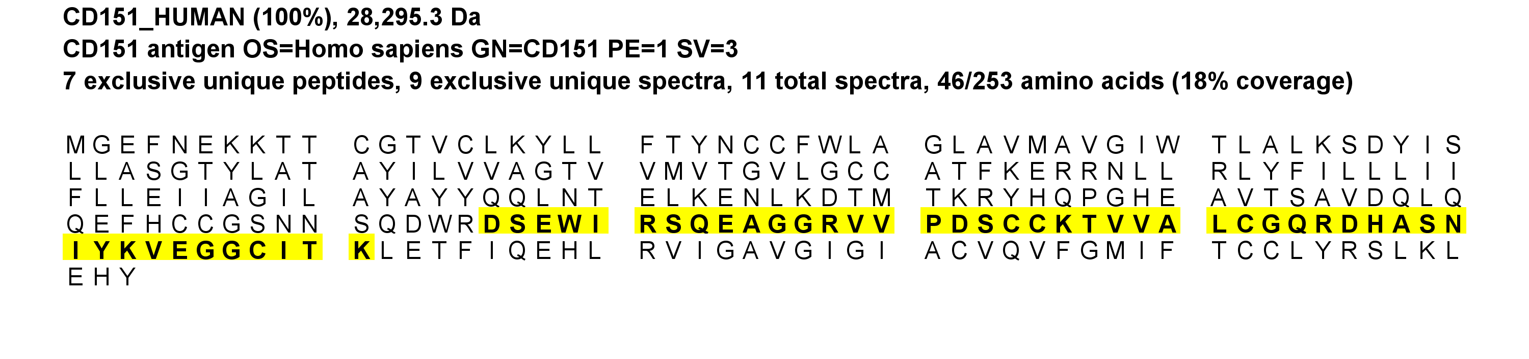
B
Peptide Sequence | Prob | NTT | Observed | Actual Mass | Charge | Delta Da | Delta PPM | Retention Time | TIC | Start | Stop
(R)DSEWIRSQEAGGR(V) | 100% | 2 | 497.5722 | 1,489.69 | 3 | 0.003702 | 2.483 | 1,400.59 | 177088 | 166 | 178
(R)DSEWIRSQEAGGR(V) | 99% | 2 | 745.8537 | 1,489.69 | 2 | 0.001778 | 1.193 | 1,398.42 | 61,353.10 | 166 | 178
(R)SQEAGGRVVPDSccK(T) | 100% | 2 | 825.3735 | 1,648.73 | 2 | 0.002547 | 1.544 | 1,058.33 | 40,111.70 | 172 | 186
(R)SQEAGGRVVPDSccK(T) | 100% | 2 | 550.5833 | 1,648.73 | 3 | -0.001979 | -1.199 | 1,057.88 | 69,459.50 | 172 | 186
(Q)EAGGRVVPDSccK(T) | 100% | 1 | 717.8262 | 1,433.64 | 2 | -0.001453 | -1.013 | 1,059.00 | 15,537.70 | 174 | 186
(E)AGGRVVPDSccK(T) | 100% | 1 | 653.305 | 1,304.60 | 2 | -0.001253 | -0.9594 | 1,060.56 | 8,986.21 | 175 | 186
(V)PDSccKTVVALcGQR(D) | 100% | 1 | 875.9066 | 1,749.80 | 2 | 0.002382 | 1.361 | 1,557.96 | 57,952.40 | 181 | 195
(K)TVVALcGQR(D) | 100% | 2 | 502.2715 | 1,002.53 | 2 | 0.0004127 | 0.4112 | 1,409.23 | 234913 | 187 | 195
(K)TVVALcGQR(D) | 100% | 2 | 502.2712 | 1,002.53 | 2 | -0.0002873 | -0.2863 | 1,392.37 | 359208 | 187 | 195
(R)DHASNIYKVEGGcITK(L) | 100% | 2 | 597.9618 | 1,790.86 | 3 | 0.001237 | 0.6902 | 1,364.27 | 72,486.00 | 196 | 211
(R)DHASNIYKVEGGcITK(L) | 100% | 2 | 597.9621 | 1,790.86 | 3 | 0.002137 | 1.192 | 1,375.54 | 93,607.90 | 196 | 211
Notes:
Figure S8. (Continued)

Slide 11
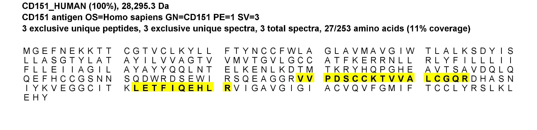
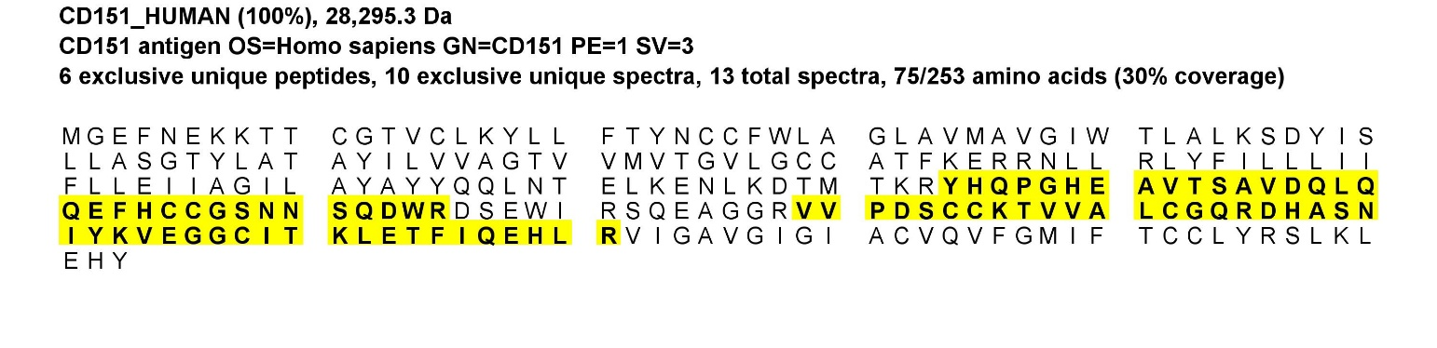
C
Peptide Sequence | Prob | NTT | Observed | Actual Mass | Charge | Delta Da | Delta PPM | Retention Time | TIC | Start | Stop
(R)VVPDSccK(T) | 100% | 2 | 482.7129 | 963.4112 | 2 | -0.00427 | -4.43 | 901.061 | 1125540 | 179 | 186
(K)TVVALcGQR(D) | 100% | 2 | 502.2692 | 1,002.52 | 2 | -0.00424 | -4.221 | 1,358.82 | 1.84E+07 | 187 | 195
(K)LETFIQEHLR(V) | 100% | 2 | 429.234 | 1,284.68 | 3 | -0.00257 | -2.001 | 1,787.19 | 2656250 | 212 | 221
D
Peptide Sequence | Prob | NTT | Observed | Actual Mass | Charge | Delta Da | Delta PPM | Retention Time | TIC | Start | Stop
(R)YHQPGHEAVTSAVDQLQQEFHccGSNNSQDWR(D) | 100% | 2 | 1,262.55 | 3,784.62 | 3 | 0.003983 | 1.052 | 1,970.22 | 2351090 | 134 | 165
(R)YHQPGHEAVTSAVDQLQQEFHccGSNNSQDWR(D) | 100% | 2 | 757.9265 | 3,784.60 | 5 | -0.01718 | -4.537 | 1,974.62 | 1.51E+07 | 134 | 165
(R)YHQPGHEAVTSAVDQLQQEFHccGSNNSQDWR(D) | 100% | 2 | 947.1572 | 3,784.60 | 4 | -0.01379 | -3.643 | 1,970.06 | 1.05E+07 | 134 | 165
(R)VVPDSccK(T) | 100% | 2 | 482.7151 | 963.4156 | 2 | 0.0001357 | 0.1407 | 978.921 | 299514 | 179 | 186
(K)TVVALcGQR(D) | 100% | 2 | 502.2713 | 1,002.53 | 2 | -0.00009215 | -0.09183 | 1,443.89 | 3.88E+07 | 187 | 195
(K)TVVALcGQR(D) | 100% | 2 | 502.2716 | 1,002.53 | 2 | 0.000542 | 0.5401 | 1,452.82 | 5224880 | 187 | 195
(K)TVVALcGQR(D) | 100% | 2 | 502.2712 | 1,002.53 | 2 | -0.0002976 | -0.2965 | 1,435.48 | 4.90E+07 | 187 | 195
(K)TVVALcGQR(D) | 100% | 2 | 502.2713 | 1,002.53 | 2 | -0.0001389 | -0.1384 | 1,471.77 | 2816750 | 187 | 195
(R)DHASNIYKVEGGcITK(L) | 100% | 2 | 896.4397 | 1,790.86 | 2 | 0.002476 | 1.382 | 1,357.90 | 1745420 | 196 | 211
(R)DHASNIYKVEGGcITK(L) | 100% | 2 | 597.9615 | 1,790.86 | 3 | 0.0003224 | 0.1799 | 1,356.12 | 5879890 | 196 | 211
(R)DHASNIYKVEGGcITK(L) | 100% | 2 | 448.7231 | 1,790.86 | 4 | 0.0008654 | 0.4829 | 1,359.21 | 5140110 | 196 | 211
(K)VEGGcITKLETFIQEHLR(V) | 100% | 2 | 710.7118 | 2,129.11 | 3 | 0.01933 | 9.073 | 2,351.10 | 5209280 | 204 | 221
(K)LETFIQEHLR(V) | 100% | 2 | 429.2356 | 1,284.68 | 3 | 0.002075 | 1.614 | 1,744.21 | 3.12E+07 | 212 | 221
Notes:
Figure S8. (Continued)

Slide 12
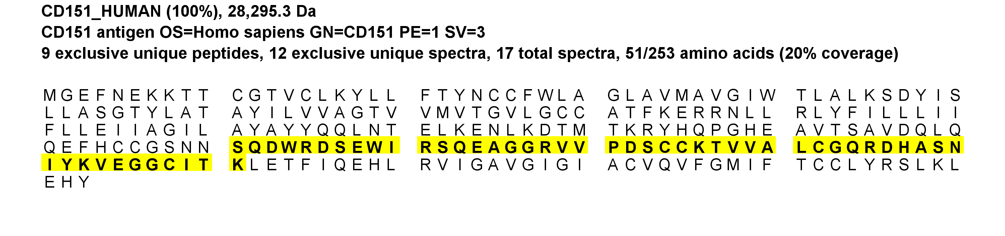
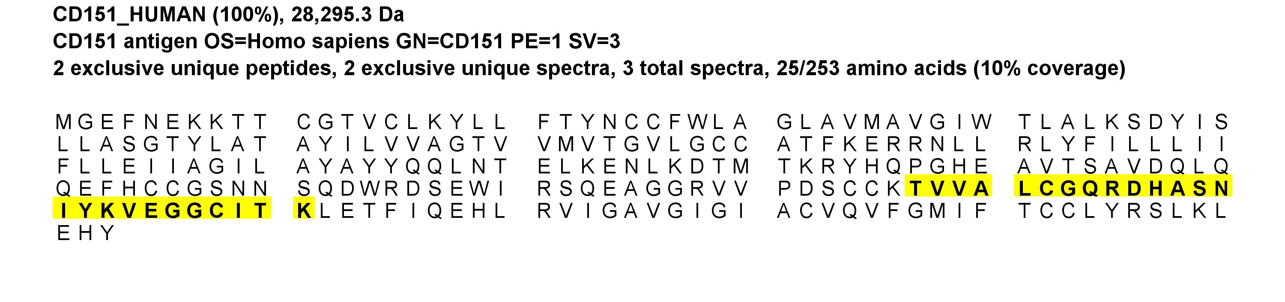
E
Peptide Sequence | Prob | NTT | Observed | Actual Mass | Charge | Delta Da | Delta PPM | Retention Time | TIC | Start | Stop
(T)VVALcGQR(D) | 100% | 1 | 451.748 | 901.4815 | 2 | 0.001113 | 1.233 | 1,374.44 | 210971 | 188 | 195
(V)VALcGQR(D) | 99% | 1 | 402.2133 | 802.4121 | 2 | 0.0000527 | 0.06559 | 1,372.28 | 279206 | 189 | 195
(K)TVVALcGQRDHASNIYK(V) | 100% | 2 | 644.6629 | 1,930.97 | 3 | -0.001563 | -0.8092 | 1,341.91 | 186621 | 187 | 203
(K)TVVALcGQR(D) | 100% | 2 | 502.2721 | 1,002.53 | 2 | 0.001513 | 1.507 | 1,385.63 | 2584590 | 187 | 195
(K)TVVALcGQR(D) | 100% | 2 | 502.2711 | 1,002.53 | 2 | -0.0004873 | -0.4856 | 1,434.37 | 233961 | 187 | 195
(K)TVVALcGQR(D) | 100% | 2 | 502.2718 | 1,002.53 | 2 | 0.0009527 | 0.9493 | 1,369.27 | 2019500 | 187 | 195
(K)TVVALcGQR(D) | 100% | 2 | 502.2719 | 1,002.53 | 2 | 0.001073 | 1.069 | 1,416.82 | 255403 | 187 | 195
(K)TVVALcGQR(D) | 100% | 2 | 502.2714 | 1,002.53 | 2 | 0.0001127 | 0.1123 | 1,401.00 | 458732 | 187 | 195
(K)TVVALcGQR(D) | 100% | 2 | 502.2706 | 1,002.53 | 2 | -0.001487 | -1.482 | 1,467.31 | 128380 | 187 | 195
(R)SQEAGGRVVPDSccK(T) | 100% | 2 | 825.3726 | 1,648.73 | 2 | 0.0006674 | 0.4045 | 1,046.54 | 44,605.30 | 172 | 186
(R)SQEAGGRVVPDSccK(T) | 100% | 2 | 550.5833 | 1,648.73 | 3 | -0.001829 | -1.108 | 1,045.69 | 125102 | 172 | 186
(N)SQDWRDSEWIR(S) | 100% | 1 | 493.2327 | 1,476.68 | 3 | 0.001692 | 1.145 | 1,802.62 | 468069 | 161 | 171
(R)DSEWIRSQEAGGR(V) | 100% | 2 | 497.5711 | 1,489.69 | 3 | 0.000522 | 0.3502 | 1,376.61 | 259835 | 166 | 178
(R)DSEWIRSQEAGGR(V) | 100% | 2 | 745.8538 | 1,489.69 | 2 | 0.001978 | 1.327 | 1,374.75 | 133783 | 166 | 178
(R)DHASNIYKVEGGcITK(L) | 100% | 2 | 896.4396 | 1,790.86 | 2 | 0.002313 | 1.291 | 1,346.39 | 120239 | 196 | 211
(R)DHASNIYKVEGGcITK(L) | 100% | 2 | 597.9612 | 1,790.86 | 3 | -0.0005633 | -0.3144 | 1,343.34 | 267701 | 196 | 211
(R)DHASNIYK(V) | 100% | 2 | 474.2322 | 946.4499 | 2 | -0.000942 | -0.9942 | 920.784 | 18,269.90 | 196 | 203
F
Peptide Sequence | Prob | NTT | Observed | Actual Mass | Charge | Delta Da | Delta PPM | Retention Time | TIC | Start | Stop
(K)TVVALcGQR(D) | 100% | 2 | 502.2718 | 1,002.53 | 2 | 0.001013 | 1.009 | 1,370.38 | 302005 | 187 | 195
(K)TVVALcGQR(D) | 100% | 2 | 502.2702 | 1,002.53 | 2 | -0.002227 | -2.219 | 1,385.96 | 168863 | 187 | 195
(R)DHASNIYKVEGGcITK(L) | 100% | 2 | 597.961 | 1,790.86 | 3 | -0.001163 | -0.6492 | 1,341.86 | 192378 | 196 | 211
Notes:
Figure S8. (Continued)

Slide 13
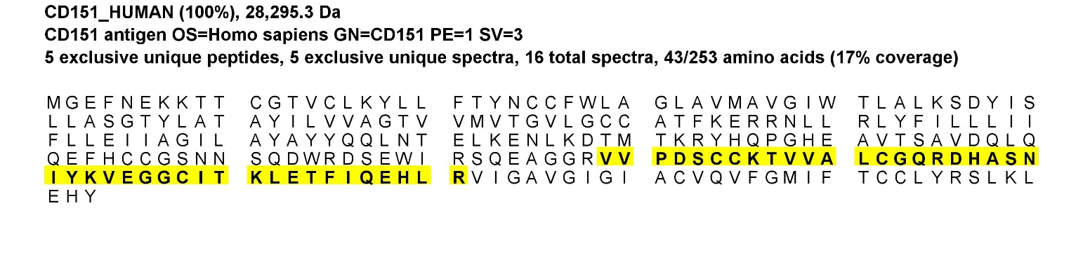
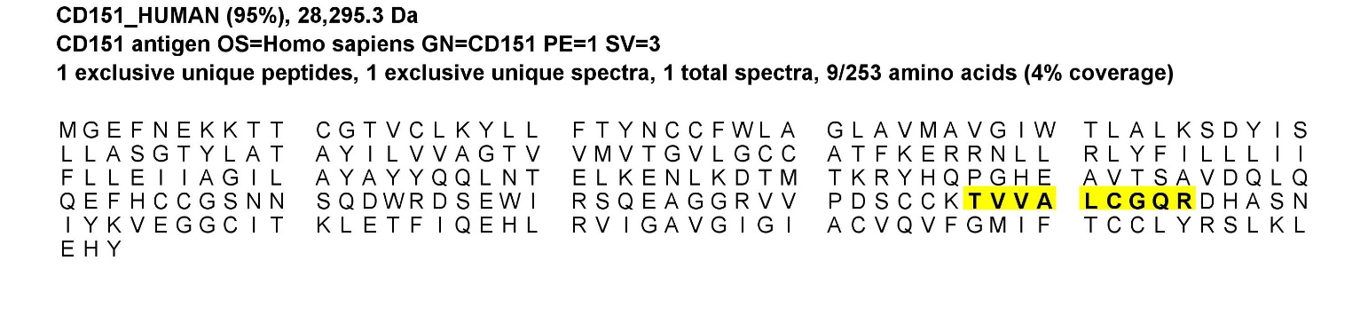
G
Peptide Sequence | Prob | NTT | Observed | Actual Mass | Charge | Delta Da | Delta PPM | Retention Time | TIC | Start | Stop
(R)VVPDSccK(T) | 100% | 2 | 482.7137 | 963.4129 | 2 | -0.002563 | -2.658 | 722.625 | 398406 | 179 | 186
(R)VVPDSccK(T) | 100% | 2 | 482.714 | 963.4134 | 2 | -0.002075 | -2.151 | 727.597 | 1345210 | 179 | 186
(R)VVPDSccK(T) | 99% | 2 | 482.7141 | 963.4136 | 2 | -0.001892 | -1.961 | 732.873 | 715476 | 179 | 186
(K)TVVALcGQR(D) | 100% | 2 | 502.2703 | 1,002.53 | 2 | -0.002161 | -2.153 | 1,435.08 | 3872810 | 187 | 195
(K)TVVALcGQR(D) | 100% | 2 | 502.2703 | 1,002.53 | 2 | -0.002161 | -2.153 | 1,414.72 | 5.56E+07 | 187 | 195
(K)TVVALcGQR(D) | 99% | 2 | 502.2703 | 1,002.53 | 2 | -0.002039 | -2.031 | 1,420.11 | 1.47E+07 | 187 | 195
(K)TVVALcGQR(D) | 99% | 2 | 502.2704 | 1,002.53 | 2 | -0.001794 | -1.788 | 1,409.30 | 6.29E+07 | 187 | 195
(K)TVVALcGQR(D) | 99% | 2 | 502.2705 | 1,002.53 | 2 | -0.001611 | -1.606 | 1,426.83 | 5096410 | 187 | 195
(K)TVVALcGQR(D) | 96% | 2 | 502.2702 | 1,002.53 | 2 | -0.002344 | -2.335 | 1,403.95 | 9753460 | 187 | 195
(R)DHASNIYK(V) | 100% | 2 | 474.2318 | 946.4489 | 2 | -0.001922 | -2.028 | 643.867 | 537703 | 196 | 203
(R)DHASNIYK(V) | 99% | 2 | 474.2317 | 946.4489 | 2 | -0.001983 | -2.093 | 649.119 | 893082 | 196 | 203
(R)DHASNIYKVEGGcITK(L) | 100% | 2 | 597.9601 | 1,790.86 | 3 | -0.003732 | -2.083 | 1,286.70 | 327999 | 196 | 211
(R)DHASNIYKVEGGcITK(L) | 100% | 2 | 597.9612 | 1,790.86 | 3 | -0.0006196 | -0.3458 | 1,292.41 | 222183 | 196 | 211
(R)DHASNIYKVEGGcITK(L) | 100% | 2 | 597.9598 | 1,790.86 | 3 | -0.004648 | -2.594 | 1,280.14 | 179594 | 196 | 211
(K)LETFIQEHLR(V) | 100% | 2 | 429.234 | 1,284.68 | 3 | -0.002481 | -1.93 | 1,762.13 | 3698930 | 212 | 221
(K)LETFIQEHLR(V) | 99% | 2 | 429.234 | 1,284.68 | 3 | -0.002573 | -2.001 | 1,768.77 | 2047600 | 212 | 221
H
Peptide Sequence | Prob | NTT | Observed | Actual Mass | Charge | Delta Da | Delta PPM | Retention Time | TIC | Start | Stop
(K)TVVALcGQR(D) | 98% | 2 | 502.2704 | 1,002.53 | 2 | -0.001855 | -1.849 | 1,372.09 | 4044640 | 187 | 195
Notes:
Figure S8. (Continued)

Slide 14
Figure S8. IP-MS peptide coverage results of CD151 protein: (A) Fab CD151-1 assayed utilizing HEK293T-CD151+ cells; (B) Fab CD151-1 assayed utilizing HT-1080 cells; (C) Fab CD151-2 assayed utilizing HEK293T-CD151+; (D) Fab CD151-2 assayed utilizing HT-1080 cells; (E) Fab CD151-3 assayed utilizing HEK293T-CD151+ cells; (F) Fab CD151-3 assayed utilizing HT-1080 cells (G) Fab CD151-4 assayed utilizing HEK293T-CD151+ cells; and (H) Fab CD151-4 assayed utilizing HT-1080 cells. NTT - Number of termini consistent with the enzymatic cleavage or tryptic termini; Observed - Mass over charge (M/Z) of the parent or precursor ion measured by the mass spectrometer.; Actual Mass - Peptide mass in Dalton obtained by multiplying the charge to the subtraction of one proton from the observed M/Z; Charge - Peptide charge; Delta Da - (Actual Mass - Theoretical Peptide Mass) in Dalton, where the Theoretical Peptide Mass or Calculated peptide mass, is given by the sum of amino acid residue masses included in the peptide plus a water molecule; Delta PPM - (Actual Mass - Theoretical Peptide Mass) in PPM also referred to in the spectrum as the Parent error. It is calculated by dividing the delta mass expressed in Dalton by the Actual Mass and then multiplied by one million.; Retention Time - Measured in seconds, it is included in the table only if the information is listed in the peak list of the loaded data; TIC - MS/MS Total Ion Current; Start - Peptide start index; and Stop - Peptide stop index.

