Slide 1
Fig. S1. Bacteriostatic ability of LAB. Blue indicates no bacteriostatic ability, red indicates bacteriostatic ability.

Slide 2
Fig. S2. Inhibitory activity of four LAB strains against Yersinia enterocolitica Y₁ and 52203. (A) Double AGAR assay for bacteriostasis and (B) Oxford cup assay for bacteriostasis. Position 1 of each plate is the control.

Slide 3
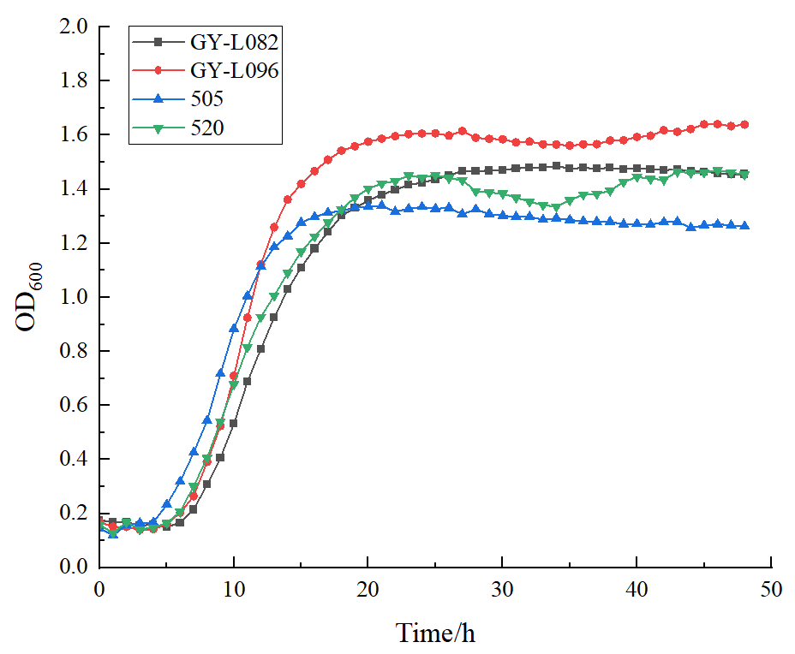
Fig. 3. Growth of four LAB.

Slide 4
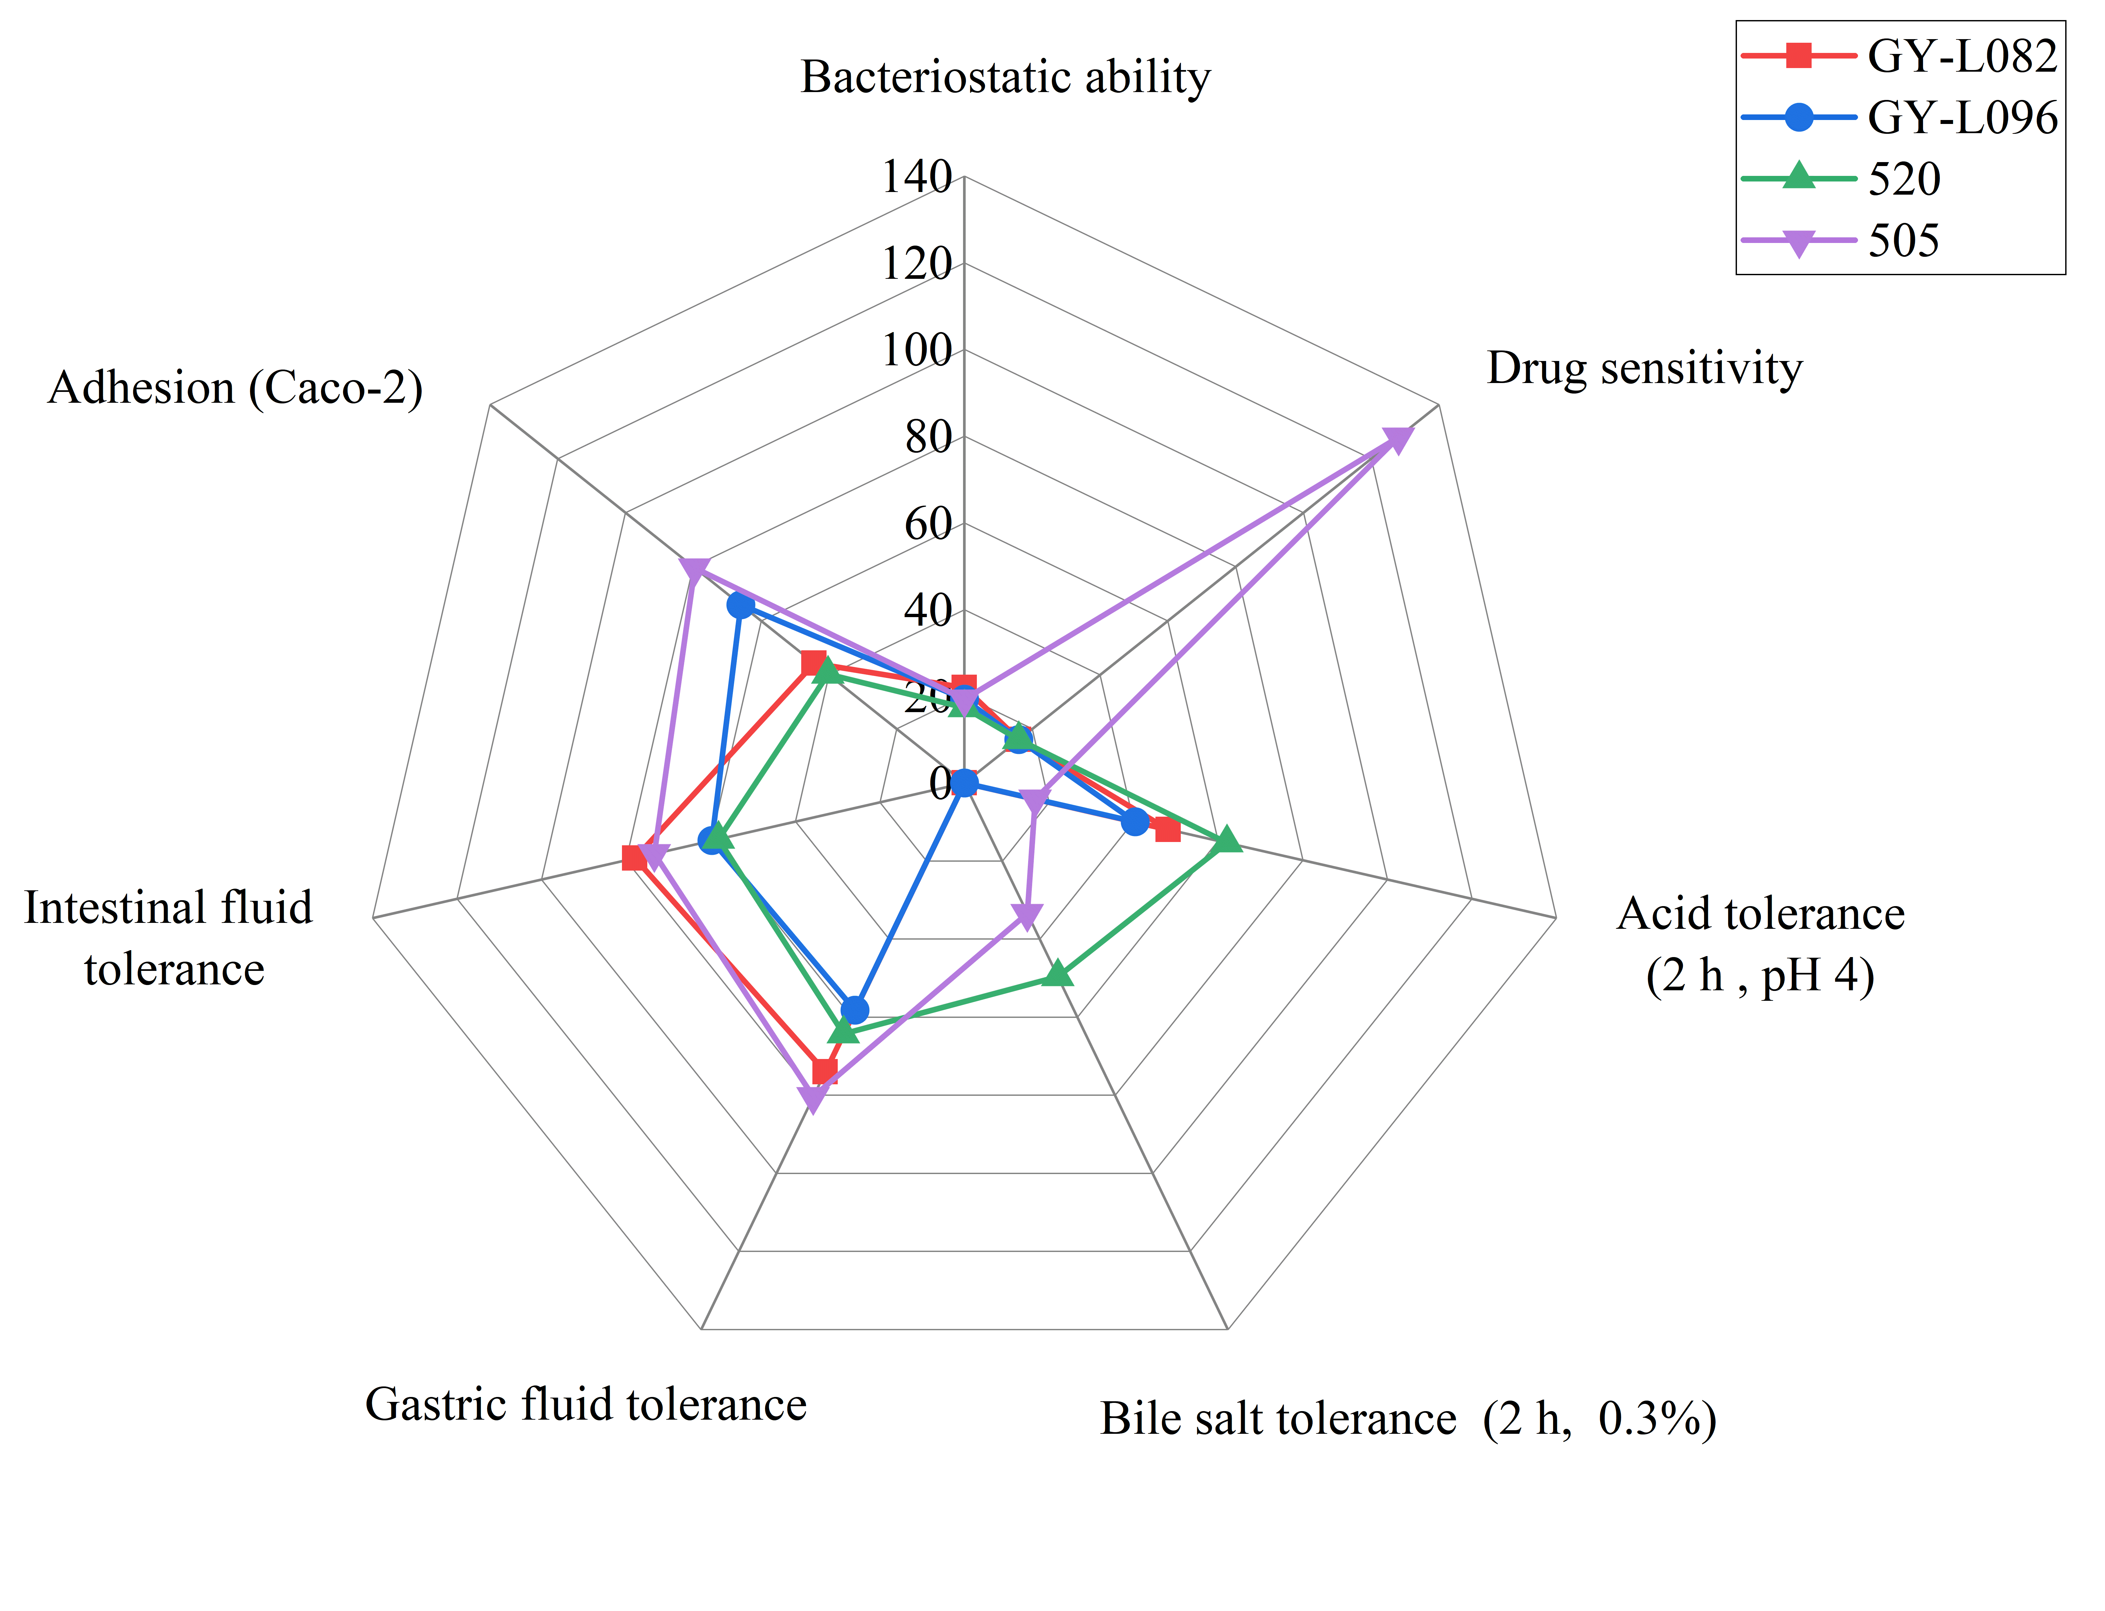
Fig. 4. Radar map of fine characteristics of four LAB.

Slide 5
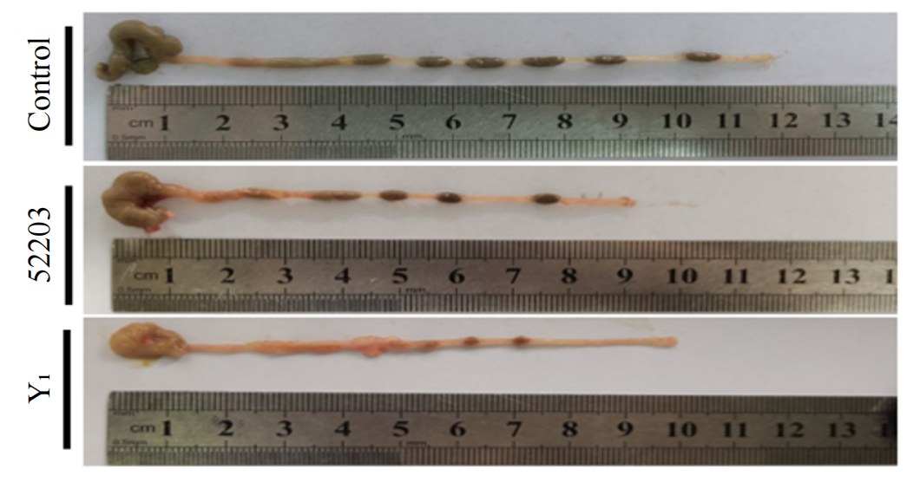
Fig. 5. Effect of two Yersinia enterocolitica strains on cecal colon length.

Slide 6
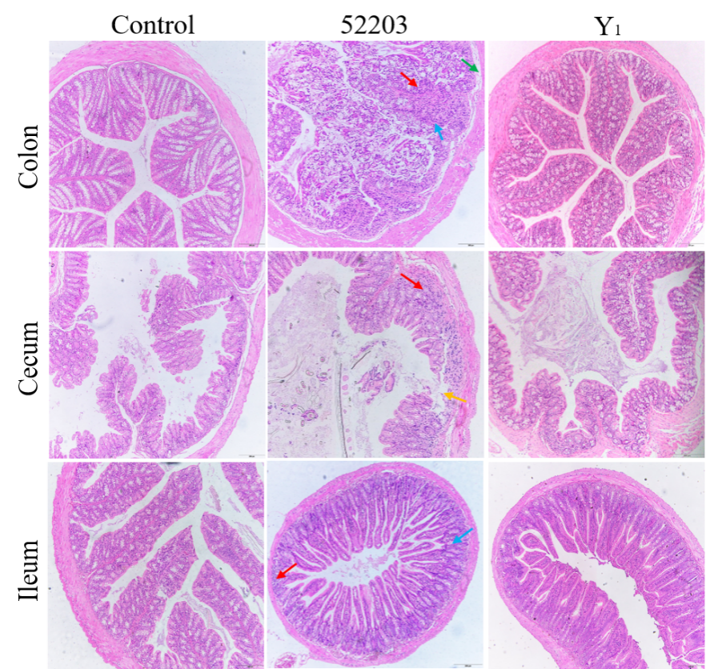
Fig. 6. Effect of Yersinia enterocolitis infection on mice tissue.

Slide 7
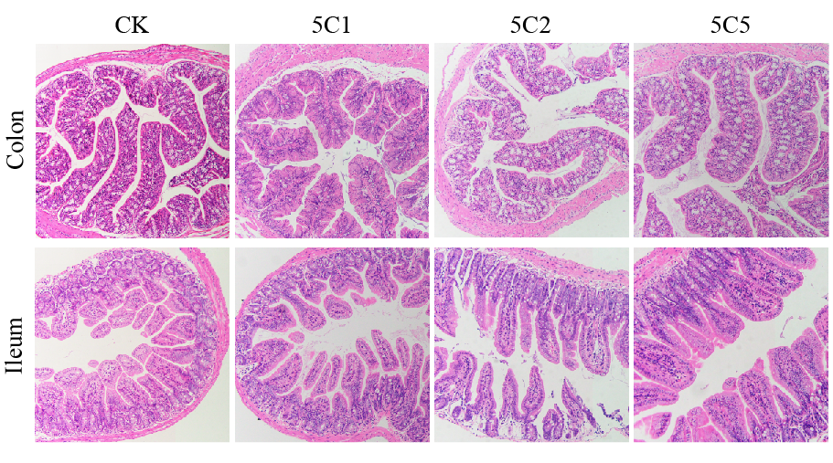
Fig. 7. Recovery effect of Lactobacillus brevis 505 on intestinal injury caused by ciprofloxacin.

Slide 8
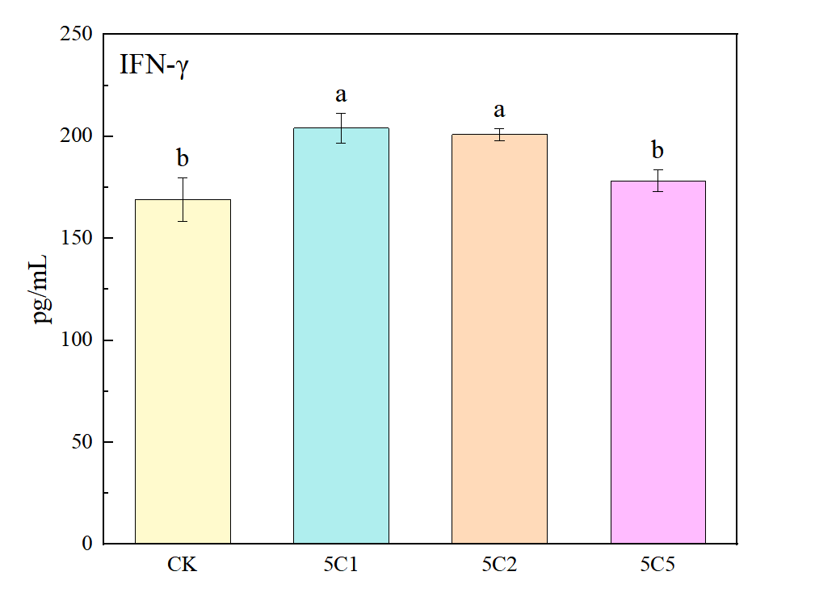
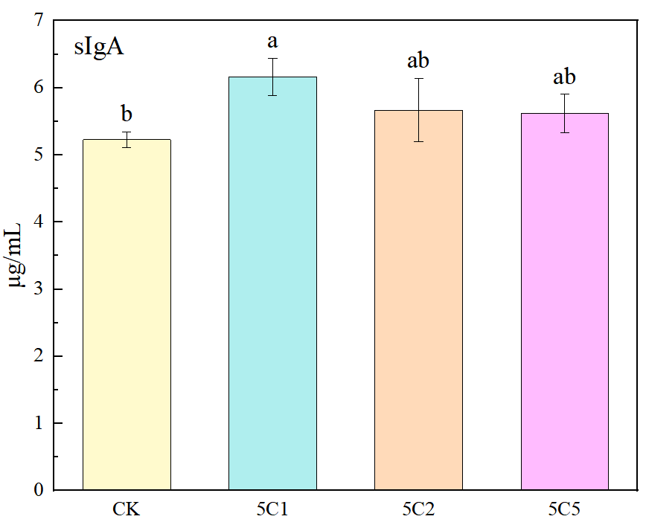
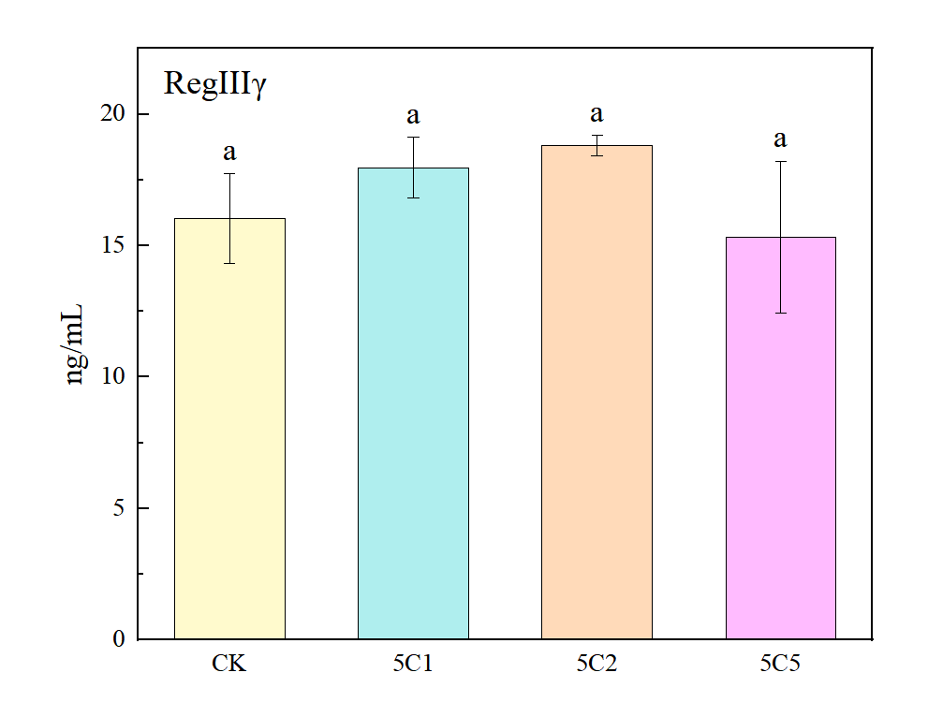
Fig. 8. Effect of ciprofloxacin exposure and Lactobacillus brevis 505 treatment on intestinal immune factors.

Slide 9
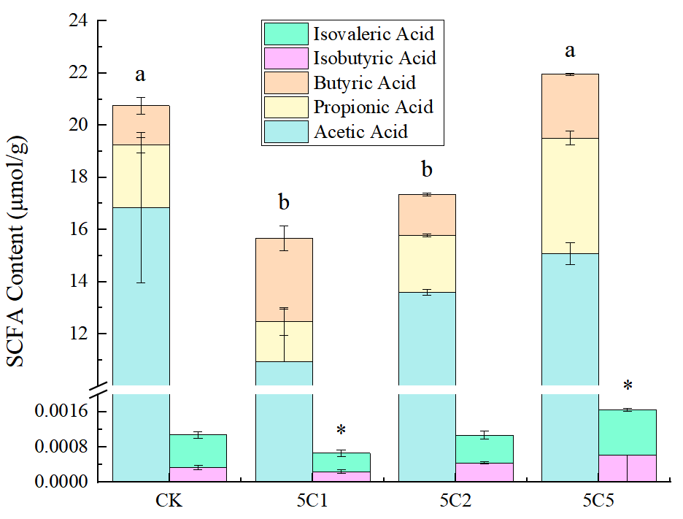
Fig. 9. Effects of Lactobacillus brevis 505 on ciprofloxacin-induced short-chain fatty acid content in mice feces.

Slide 10
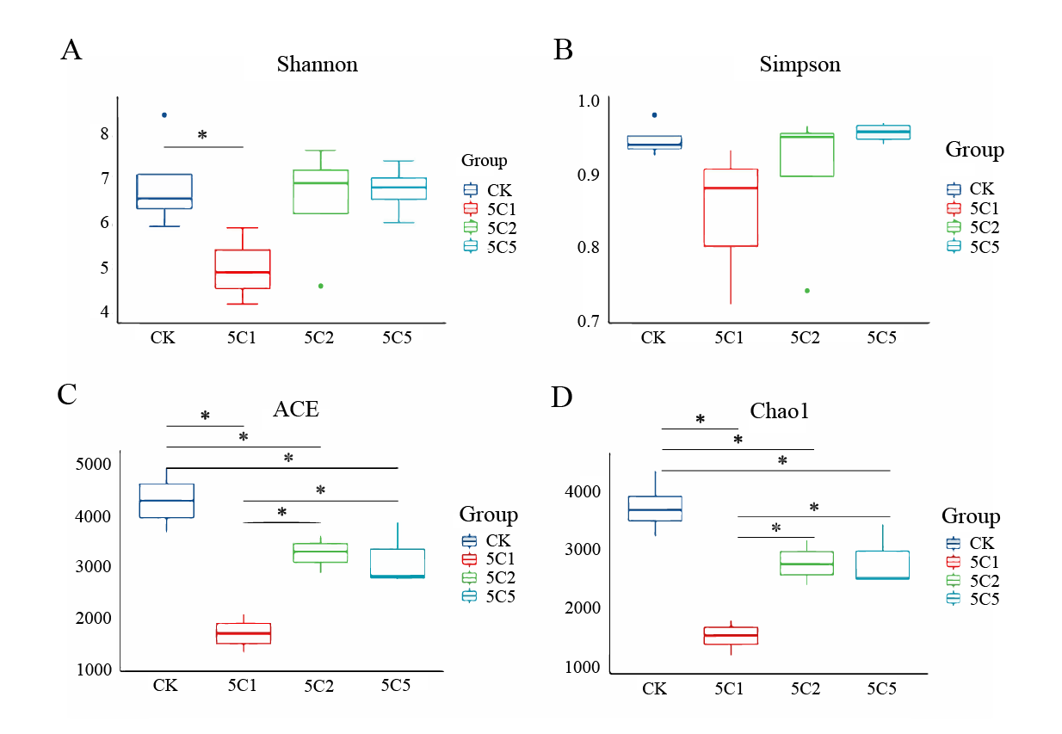
Fig. 10. Improvement of intestinal flora disturbance induced by ciprofloxacin by Lactobacillus brevis 505 on flora diversity. * P < 0.05.

Slide 11
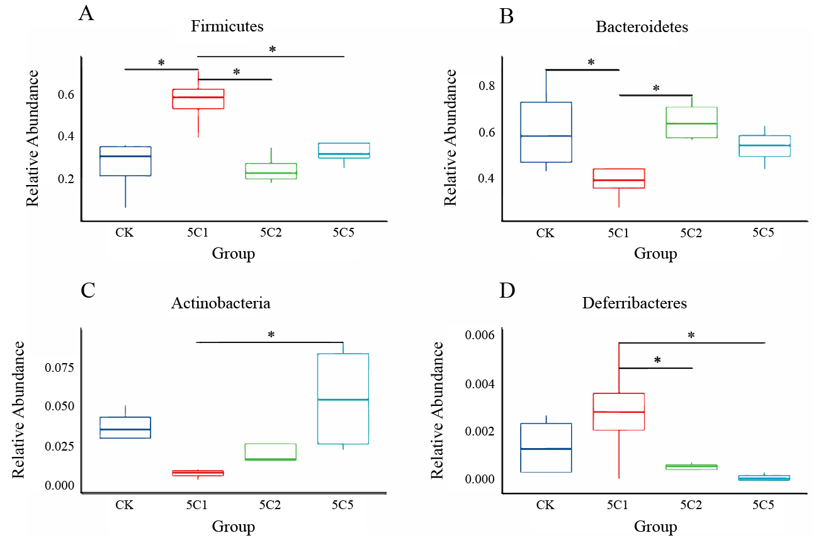
Fig. 11. Effect of ciprofloxacin on relative abundance of specific bacteria at phylum level and improvement of Lactobacillus brevis 505.

Slide 12
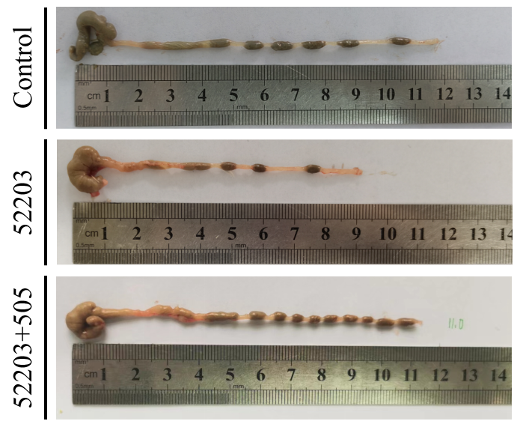
Fig. 12. Restoring effect of Lactobacillus brevis 505 on colon shortening caused by Yersinia enterocolitica 52203.

Slide 13
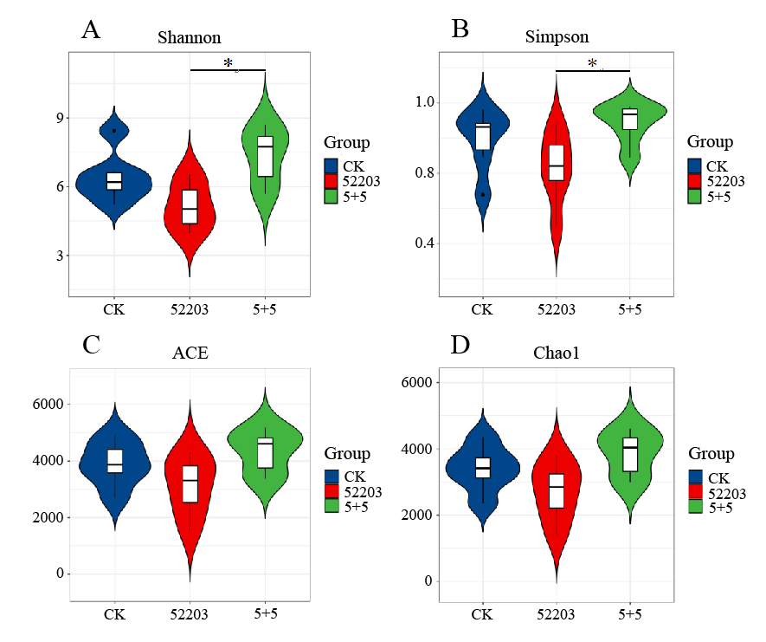
Fig. 13. Improvement of intestinal flora diversity by infection to Yersinia enterocolitica 52203 and Lactobacillus brevis 505. (A and B) Shannon and Simpson indices. (C and D) ACE and Chao1 indices, respectively, calculated after rarefying to an equal number of sequence reads for all samples. * P < 0.05.

