Slide 1
Figure S1
T-47D
A3B-GFP inducible cells
SK-OV-3
A3B-GFP inducible cells
Expression level, relative to TBP
Expression level, relative to TBP
DMSO
100 ng/μl Doxycycline, 72 hours
Figure S1. Gene expression profiles for cytidine deaminases in A3B-inducible T-47D and SK-OV-3 cells. RNA-seq data were normalised using transcript per million method and then adjusted by the expression of TBP gene. Data represent mean value of four replicates and error bars standard deviation.

Slide 2
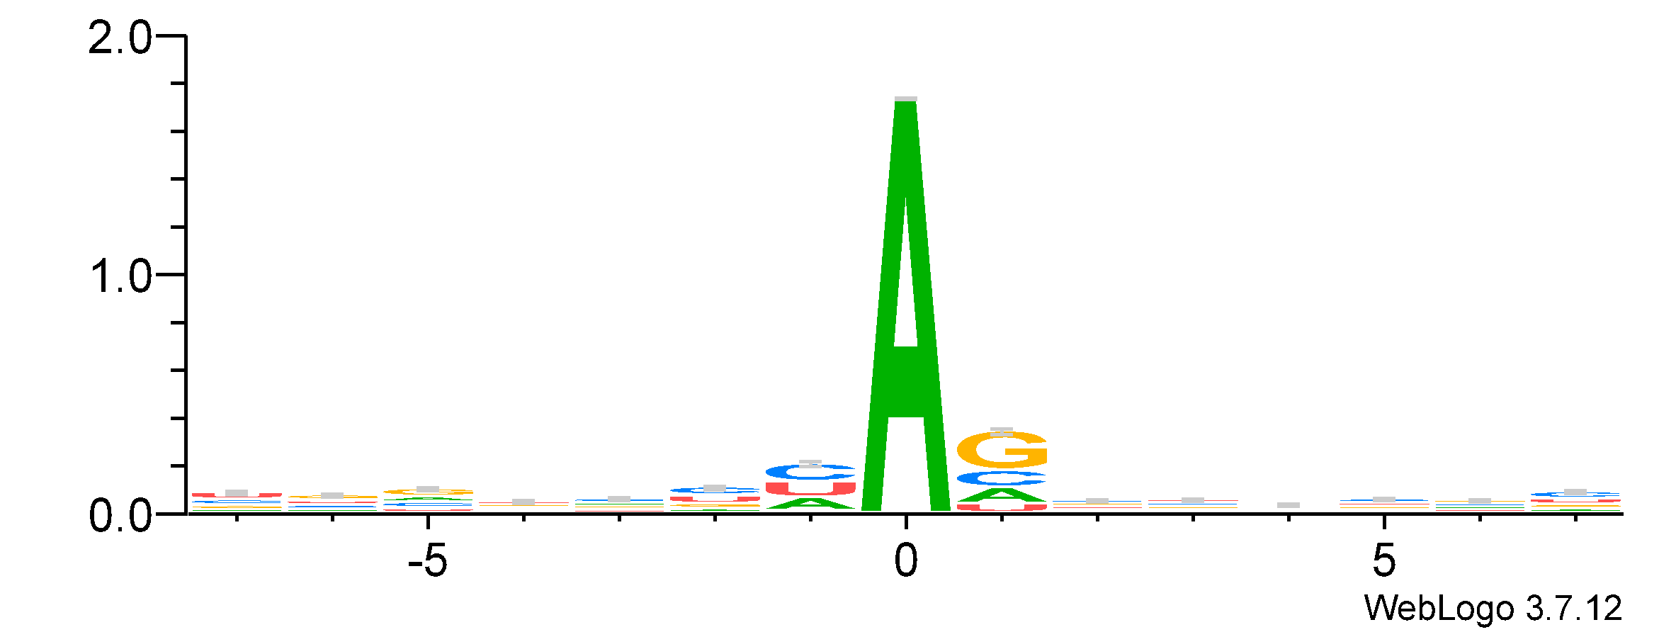
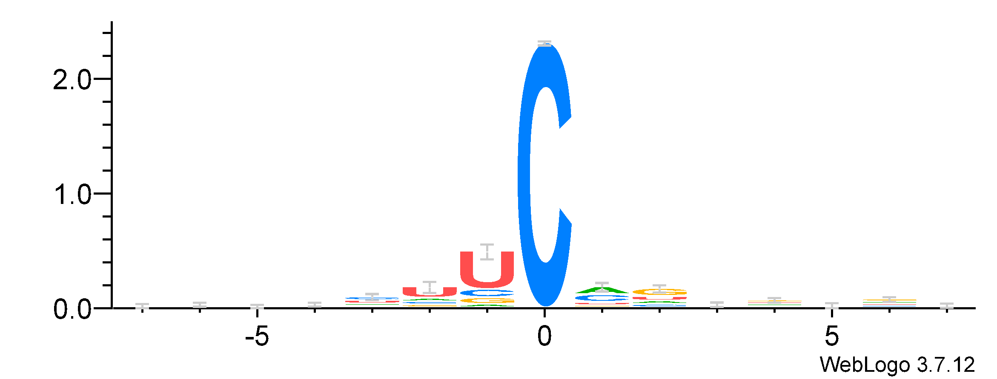

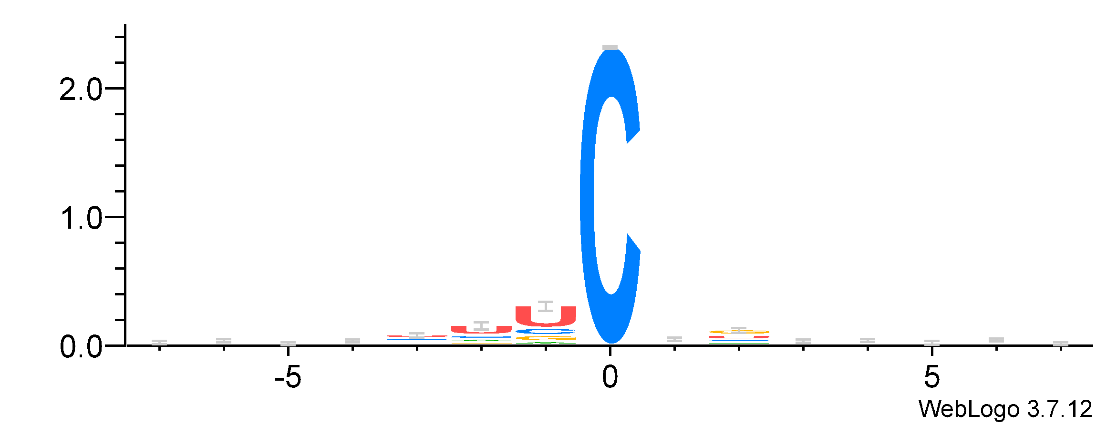
Figure S2
(b)
A>G(I) DVRs
CADRES
JACUSA2
RDD mode
2534
66990
571
(a)
566
JACUSA RRD mode
A>I DVRs
JACUSA RRD mode
C>U DVRs
93
14354
2
2
2740
1
1
JACUSA2
RRD mode
0
-5
0
5
0
-5
0
5
nucleotide frequency (bits)
JACUSA RDD mode
A>I DVRs
JACUSA RDD mode
C>U DVRs
C>U DVRs
2
2
CADRES
JACUSA2
RDD mode
189
231
2120
1
1
31
365
683
0
-5
0
5
0
-5
0
5
position relative to DVRs (bp)
343
JACUSA2
RRD mode
Figure S2. DVR detection in A3B-inducible T-47D cells with JACUSA2 RDD or RRD mode. (a) Sequence motif of nucleotides flanking DVRs. (b) Venn diagram showing the overlap between DVRs called by CADRES and JACUSA2.

Slide 3
Figure S3
CADRES C->U DVRS
CADRES C->U DVRS
15
15
10
10
-log(FDR)
5
5
FDR = 0.05
FDR = 0.05
0
0
-0.6
-0.3
0
0.3
0.6
-0.6
-0.3
0
0.3
0.6
ΔAF
ΔAF
rMATs C->U DVRs
rMATs-DVR A->G(I) DVRs
15
15
10
10
-log(FDR)
5
5
FDR = 0.05
FDR = 0.05
0
0
-0.6
-0.3
0
0.3
0.6
-0.6
-0.3
0
0.3
0.6
ΔAF
ΔAF
Figure S3. Volcano plots showing results of rMATS GLMM analysis for DVRs identified by CADRES and rMATS-DVR . FDR, false positive rate, AF, alternative allele frequency, where ΔAF
ΔAF=AF_{dox-treated}-AF_{dox-untreated}.

